Slide 1
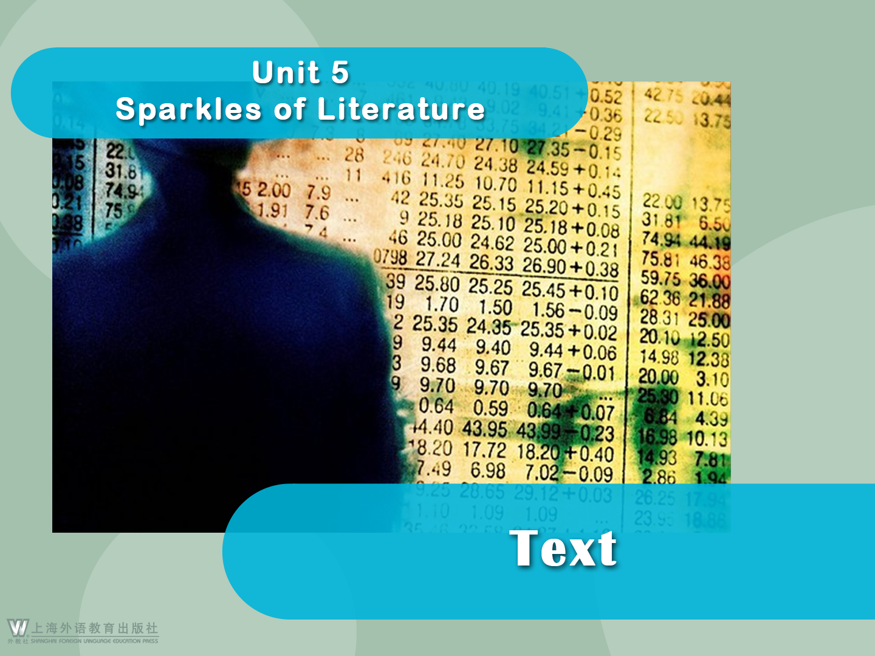

Slide 2





The Romance of a Busy Broker
The Romance of a Busy Broker
O. Henry
1 Pitcher, confidential clerk in the office of Harvey Maxwell, allowed a look of mild interest and surprise to visit his usually expressionless face when his employer briskly entered at half past nine in company with his young lady stenographer. With a short and quick “Good-morning, Pitcher,” Maxwell dashed at his desk as though he were intending to leap over it, and then plunged into
the great heap of letters and telegrams waiting there for him.

Slide 3

The Romance of a Busy Broker
2 The young lady had been Maxwell’s stenographer for a year. She was beautiful in a way that was decidedly unstenographic. Her dress was grey and plain, but it fitted her figure with fidelity and discretion. On this morning she was softly and shyly radiant. Her eyes were dreamily bright, her cheeks genuine peach-blow, her expression a happy one, tinged with reminiscence.

Slide 4


The Romance of a Busy Broker
3 Pitcher, still mildly curious, noticed a difference in her ways this morning. Instead of going straight into the adjoining room, where her desk was, she lingered, slightly hesitating, in the outer office. Once she moved over by Maxwell’s desk, near enough for him to be aware of her presence.

Slide 5

The Romance of a Busy Broker
4 The machine sitting at that desk was no longer a man; it was a busy New York broker, moved by buzzing wheels and uncoiling springs.
5 “Well — what is it? Anything?” asked Maxwell sharply. His opened mail lay like a bank of stage snow on his crowded desk. His keen grey eyes, impersonal and harsh, flashed upon her half impatiently.
6 “Nothing,” answered the stenographer, moving away with a little smile.
7 “Mr. Pitcher,” she said to the confidential clerk, “did Mr. Maxwell say anything yesterday about engaging another stenographer?”

Slide 6

The Romance of a Busy Broker
8 “He did,” answered Pitcher. “He told me to get another one. I notified the agency yesterday afternoon to send over a few samples this morning. It’s 9:45, and not a single picture hat or piece of pineapple chewing gum has showed up yet.”
9 “I will do the work as usual, then,” said the young lady, “until someone comes to fill the place.” And she went to her desk at once.

Slide 7

The Romance of a Busy Broker
10 This day was Harvey Maxwell’s busy day. The desk telephone had a chronic attack of buzzing. Men began to throng into the office and call at him, joyfully, sharply, viciously, excitedly. Messenger boys ran in and out with messages and telegrams. The clerks in the office jumped about like sailors during a storm.

Slide 8


The Romance of a Busy Broker
11 On the Exchange there were hurricanes and landslides and snowstorms and glaciers and volcanoes, and those elemental disturbances were reproduced in miniature in the broker’s offices. Maxwell shoved his chair against the wall and transacted business after the manner of a toe dancer. He jumped from ticker to phone, from desk to door.

Slide 9

The Romance of a Busy Broker
12 In the midst of this growing and important stress the broker became suddenly aware of a high-rolled fringe of golden hair. There was a self-possessed young lady.
13 “Lady from the Stenographer’s Agency to see about the position,” said Pitcher.
14 Maxwell turned half around, with his hands full of papers and ticker tape.
15 “What position?” he asked, with a frown.

Slide 10

The Romance of a Busy Broker
16 “Position of stenographer,” said Pitcher. “You told me yesterday to call them up and have one sent over this morning.”
17 “You are losing your mind, Pitcher,” said Maxwell. “Why should I have given you any such instructions? Miss Leslie has given perfect satisfaction during the year she has been here. The place is hers as long as she chooses to retain it. There’s no place open here, madam. Countermand that order with the agency, Pitcher, and don’t bring any more of ’em in here.”

Slide 11

The Romance of a Busy Broker
18 Pitcher seized a moment to remark to the bookkeeper that the “old man” seemed to get more absent-minded and forgetful every day of the world.
19 The rush and pace of business grew fiercer and faster. Orders to buy and sell were coming and going as swift as the flight of swallows. Some of his own holdings were endangered, and the man was working like some high-geared, delicate, strong machine — strung to full tension, going at full speed, accurate, never hesitating, with the proper word and decision and act ready and prompt as clockwork. Stocks and bonds, loans and mortgages, margins and securities — here was a world of finance, and there was no room in it for the human world or the world of nature.

Slide 12

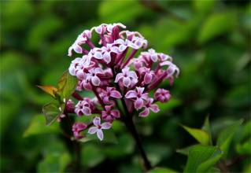
The Romance of a Busy Broker
20 When the luncheon hour drew near there came a slight lull in the uproar.
21 Maxwell stood by his desk with his hands full of telegrams and memoranda, with a fountain pen over his right ear and his hair hanging in disorderly strings over his forehead. His window was open, and through the window came a wandering — perhaps a lost —
odor — a delicate, sweet odor of lilac that fixed the broker for a moment immovable. For this odor belonged to Miss Leslie: it was her own, and hers only.

Slide 13

The Romance of a Busy Broker
22 The odor brought her vividly, almost tangibly before him. The world of finance shrank suddenly to a particle. And she was in the next room — twenty steps away.
23 “I’ll do it now,” said Maxwell, half aloud. “I’ll ask her now. I wonder I didn’t do it long ago.”
24 He dashed into the inner office and charged upon the desk of the stenographer.
25 She looked up at him with a smile. A soft pink crept over her cheek, and her eyes were kind and frank. Maxwell leaned one elbow on her desk. He still clutched fluttering papers with both hands and the pen was above his ear.

Slide 14

The Romance of a Busy Broker
26 “Miss Leslie,” he began hurriedly, “I have but a moment to spare. I want to say something in that moment. Will you be my wife? I haven’t had time to make love to you in the ordinary way, but I really do love you. Talk quick, please.”
27 “Oh, what are you talking about?” exclaimed the young lady. She rose to her feet and gazed upon him, round-eyed.
28 “Don’t you understand?” said Maxwell, firmly. “I want you to marry me. I love you, Miss Leslie. I wanted to tell you, and I snatched a minute when things had slackened up a bit. They’re calling me for the phone now. Tell ’em to
wait a minute, Pitcher. Won’t you, Miss Leslie?”

Slide 15

The Romance of a Busy Broker
29 The stenographer acted very queerly. At first she seemed overcome with amazement; then tears flowed from her wondering eyes; and then she smiled sunnily through them, and one of her arms slid tenderly about the broker’s neck.
30 “I know now,” she said, softly. “It’s this old business that has driven everything else out of your head for the time. I was frightened at first. Don’t you remember, Harvey? We were married last evening at 8 o’clock in the Little Church Around the Corner.”

Slide 16

Language Points
1. in company with (Para. 1): together with
My friend Bill is coming to see me in company with his girlfriend.
只有当劳逸结合的时候，工作的效率才会更高。
Only when work is in company with relaxation will it be more productive.
keep company with: associate with
Never keep company with dishonest people.

Slide 17
Language Points
2. dash (Para. 1): v. to run or move very quickly or hastily
The bush was a good hiding place, so we dashed behind it.
下雨了，我们冲过去躲雨。
When the rain started, we dashed for cover.
n. a ~ (for sth.)
an act of going somewhere suddenly and/or quickly
He made a dash for the door.
他向门猛冲过去。

Slide 18
Language Points
Synonym:
rush (into sth./into doing sth.): v. to do sth. or to make sb. do sth. without thinking about it carefully
Try not to rush into a decision you may later regret.
n. a situation in which you are in a hurry and need to do things quickly
两小时内完成这项任务是有点匆忙。
It was a bit of a rush to get the job done in two hours.

Slide 19
Language Points
3. plunge into (Para. 1): to jump or dive quickly and energetically into
The young man plunged his head into a basin of water to thoroughly wake himself.
但到底是什么原因导致飞机冲向大海依然是一个未解之谜。
But exactly what caused the plane to plunge into the sea remains a mystery.

Slide 20
Language Points
4. She was beautiful in a way that was decidedly unstenographic. (Para. 2)
[Paraphrase]:
Her beauty, undoubtedly, could not be described in shorthand. In other words, she was so beautiful that it was impossible to describe her in a few simple words.
[Translation]:
她的美丽却绝不是草草几笔速记所能简单描述的。

Slide 21
Language Points
5. Her dress was grey and plain, but it fitted her figure with fidelity and discretion. (Para. 2)
[Paraphrase]:
Her dress was grey and simple in style, but it suited her fine figure perfectly and revealed her shapeliness in a modest manner.
[Translation]:
她的灰色裙子很素净，但相当合身，显身材又
不失大方庄重。

Slide 22
Language Points
6. On this morning she was softly and shyly radiant. (Para. 2)
[Paraphrase]:
On this morning, although she felt very happy, she only showed it in a gentle and shy manner.
[Translation]:
这个上午，她身上焕发出一种温柔而羞怯的光彩。

Slide 23
Language Points
7. radiant (Para. 2): adj. showing great happiness, love or health
On the wedding day, the bride looked truly radiant.
她微笑着，脸上容光焕发，像个天使。
She smiled and her face was as radiant as an angel’s.
adj. sent out in rays from a central point
By means of photosynthesis (光合作用), plants convert the radiant energy of the sun into chemical energy.
通过光合作用，植物将太阳的辐射能转为化学能。

Slide 24
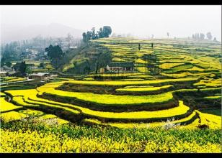
Language Points
8. reminiscence (Para. 2): n. a mental impression retained and recalled from the past
If reminiscence is a sign of aging, then I must be really old.
家乡的景物处处使人想起往事，许多往事可追溯到幼年时代。
The hometown was full of reminiscence, many going back to early childhood.

Slide 25
Language Points
9. linger (Para. 3): v. to stay in a place longer than necessary because of a reluctance to leave
The children lingered in the garden, fascinated by the beautiful roses.
女孩在门口徘徊了一会，但不敢进去。
The girl lingered for a moment at the door, but didn’t dare to come in.

Slide 26
Language Points
10. The machine sitting at that desk was no longer a man; it was a busy New York broker, moved by buzzing wheels and uncoiling springs. (Para. 4)
[Analysis]:
This is a metaphor. The machine refers to the broker, who was busy and took no rest, like a machine.
[Translation]:
坐在那办公桌前的可不再是个常人，而是一名忙碌的纽约股票交易“机器人”，轮子吱吱作响，弹簧绷得紧紧的。

Slide 27
Language Points
11. His opened mail lay like a bank of stage snow on his crowded desk. (Para. 5)
[Paraphrase]:
His desk was piled up with files, and the opened mail was scattered over it like a slope of imitation snow on the stage.
[Translation]:
拆开的信件躺在堆满东西的办公桌上，就像一片堆积起来的雪坡。

Slide 28
Language Points
12. … not a single picture hat or piece of pineapple chewing gum has showed up yet. (Para. 8)
[Paraphrase]:
No one, either man or woman, serious or not, has showed up (for the position of stenographer).
[Analysis]:
This is a metonymy. A picture hat is a woman’s dressy hat with a wide brim, which is used here to refer to a lady. A piece of pineapple chewing gum refers to a man.
[Translation]:
一个人都没来，既没有戴阔边帽的女士，也没有嚼菠萝口香糖的男人。

Slide 29

Language Points
13. The desk telephone had a chronic attack of buzzing. (Para. 10)
[Paraphrase]:
The noise that the desk telephone made was long and continuous, just like the chronic disease a patient suffered from.
[Translation]:
桌上的电话像害了病好不了似地响个不停。

Slide 30
Language Points
14. chronic (Para. 10): adj. being long-lasting and recurrent or characterized by long suffering
He has a chronic cough.
He suffered from a chronic back pain.
对岁数较大和患有一些慢性病的人来说，应该每年甚至更短时间体检一次。
For older people and those with some sort of chronic disease, a yearly visit or even more frequent appointments make sense/physical examination should be held every year or even more frequently.

Slide 31
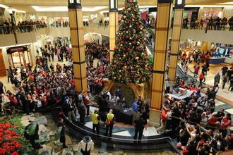
Language Points
15. throng (Para. 10): v. to press tightly together or cram
The crowd thronged into the stadium.
圣诞季节时商场里挤满了顾客。
The department store was thronged with customers during the Christmas season.

Slide 32
Language Points
16. On the Exchange there were hurricanes and landslides and snowstorms and glaciers and volcanoes, and those elemental disturbances were reproduced in miniature in the broker’s offices. (Para. 11)
[Paraphrase]:
On the Exchange the shares’ prices often went through breath-taking plunges and soars like hurricanes and landslides and snowstorms and glaciers and volcanoes, and all these dramatic changes were reflected in the broker’s work in his offices.

Slide 33
Language Points
16. On the Exchange there were hurricanes and landslides and snowstorms and glaciers and volcanoes, and those elemental disturbances were reproduced in miniature in the broker’s offices. (Para. 11)
[Translation]:
证券交易所里行情涨跌，像飓风，像山崩，像雪暴，像冰川和火山，而经纪人办公室里所发生的一切就是这些自然力量的缩影。

Slide 34
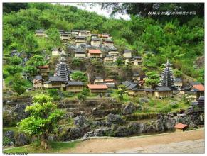
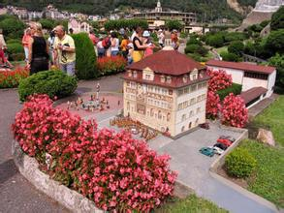
Language Points
17. in miniature (Para. 11): on a small scale
He’s giving a party in miniature on his birthday.
50个国家的约100处历史名胜和自然景观均以微缩模型展出。
About 100 famous historical and natural sights from 50 countries are on display in miniature.

Slide 35
Language Points
miniature: adj. very small; much smaller than usual
The little girl has miniature furniture for her dolls.
n. a very small copy or model of sth.; a very small version of sth.
To my mind, the doctor mentioned above is just a miniature of our society.

Slide 36
Language Points
18. Maxwell shoved his chair against the wall and transacted business after the manner of a toe dancer. (Para. 11)
[Paraphrase]:
Maxwell pushed his chair against the wall with a quick, violent movement and transacted business swiftly and skillfully like a toe dancer’s dancing.
[Analysis]:
This is a simile. This sentence depicts vividly a busy broker.
[Translation]:
麦克斯韦尔把椅子猛推到墙边，像芭蕾舞者踮着脚尖跳舞般敏捷地处理业务。

Slide 37
Language Points
19. after the manner of (Para. 11): in the wake of
This fable was written after the manner of Aesop.
当他死的时候，所有的人一致哀悼他，并按传统的方式安葬了他。
When he died all his people mourned and they buried him after the manner of tradition.
in the manner of/in ... manner: in the style of a particular person or thing
She looked at him in an adoring manner.
她以崇拜的眼神看着他。

Slide 38
Language Points
20. … a high-rolled fringe of golden hair.
(Para. 12)
[Analysis]:
This is a synecdoche. It refers to a person with a high-rolled fringe of golden hair.
[Translation]:
一缕高高卷起的金发刘海。

Slide 39
Language Points
21. Orders to buy and sell were coming and going as swift as the flight of swallows. (Para. 19)
[Paraphrase]:
Orders to buy and sell were taking place at a very high speed, like the flight of swallows.
[Analysis]:
This is a simile.
[Translation]:
下单买进卖出，来去疾如飞燕。

Slide 40
Language Points
22. … the man was working like some high-geared, delicate, strong machine — strung to full tension, going at full speed, accurate, never hesitating, with the proper word and decision and act ready and prompt as clockwork. (Para. 19)
[Analysis]:
This is simile and parallelism. Here the author successfully depicts a busy machine-like broker by applying a string of short adjectives such as “high-geared”, “delicate”, “strong”, and a string of phrases such as “strung to full tension” and “going at full speed”. These paralleled words and phrases work together to create a fast rhythm, which conveys to the reader the tension the broker faced every day.

Slide 41
Language Points
22. … the man was working like some high-geared, delicate, strong machine — strung to full tension, going at full speed, accurate, never hesitating, with the proper word and decision and act ready and prompt as clockwork. (Para. 19)
[Translation]:
他就像一台高速运转、精密而强大的机器那样工作着——精神绷紧到最大限度，开足马力，准确精密，从不犹豫，言语、决策和行动都像机械装置那般，正确无误，准备充分，反应迅速。

Slide 42
Language Points
23. string (Para. 19): v. to stretch out or extend
He strung his bow.
不要把网球拍的弦绷太紧了。
Don’t string your tennis racquet too tightly.
n. a set or series of things that are joined together, for example on a string
There have been a string of airplane crashes lately.

Slide 43
Language Points
24. … here was a world of finance, and there was no room in it for the human world or the world of nature. (Para. 19)
[Paraphrase]:
All that the broker cared about was just finance, and he had no time and energy to care about people or nature.
[Translation]:
这是一个只有金融业务的世界，容不下丝毫人情世故、自然山水。

Slide 44
Language Points
25. … a wandering — perhaps a lost — odor …
(Para. 21)
[Paraphrase]:
an odor which kept moving about in the room and seemed to remind the broker of the past or something else
[Translation]:
窗口飘进了一缕气息——或许是一种久违的气息
——一股优雅的丁香花香气

Slide 45
Language Points
26. The world of finance shrank suddenly to a particle. (Para. 22)
[Paraphrase]:
Suddenly his business seemed nothing to him, and he did not care a bit about it now.
[Translation]:
金融世界转瞬间缩成了一粒尘埃。

Slide 46
Language Points
27. make love to (Para. 26): to express love to
She never expected him to make love to her there.
当托马斯突然表白时，这位年轻女士非常尴尬。
The young lady was rather embarrassed when Thomas made love to her abruptly.

