Slide 1
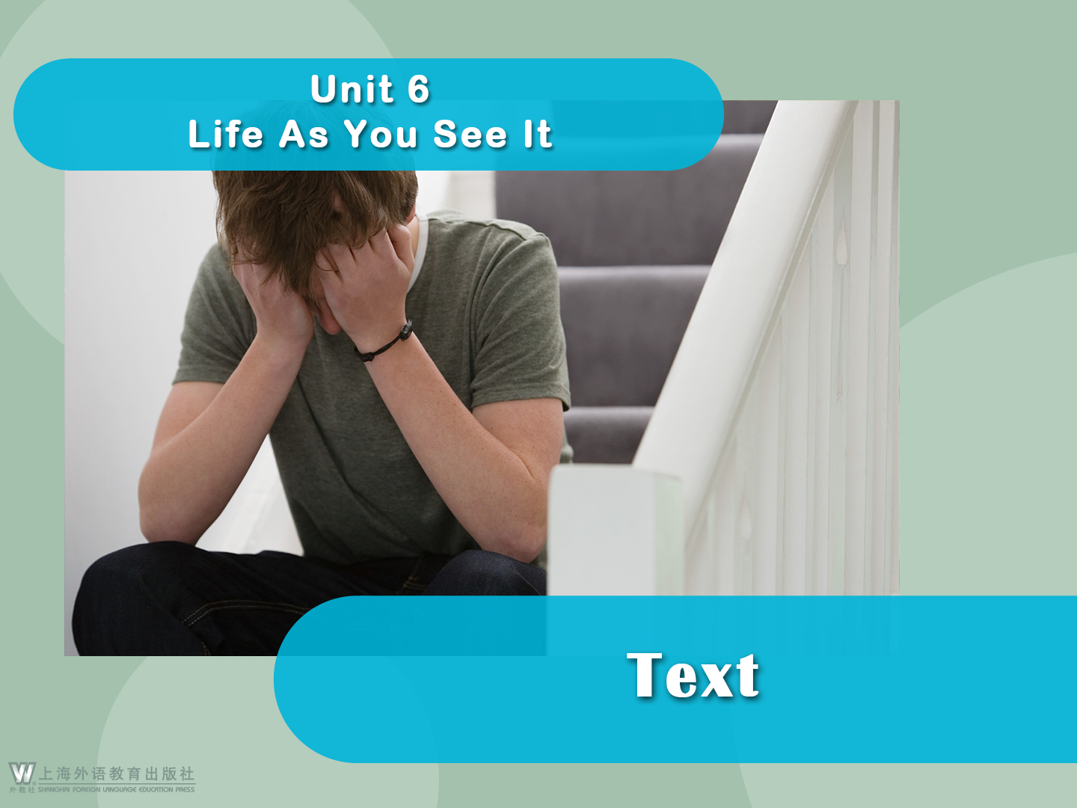

Slide 2





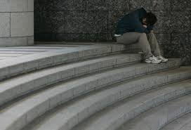
Battling Depression as a College Student
Battling Depression as a College Student
Braulio Campos
1 For Vaheh Hartoonian, life was not something to be happy about. Thoughts of self-contempt and guilt were ever-present companions in his daily life. Though he managed to get up every morning and face the day ahead, a repeated discontentment with his life took a toll, and his depression became integral to his being: the norm. The chance of overcoming it seemed more unlikely every day.
2 Hartoonian, a 22-year-old former CSUN student, battled with depression and thought there was no way out.

Slide 3

Battling Depression as a College Student
3 “Typically, depression involves feelings of helplessness, hopelessness, worthlessness and guilt,” Hartoonian said. “The last two — feeling worthless and guilty — are the feelings I battled most.” He viewed his depression as being stuck in a negative circle. The feelings were so intense that he just figured it was part of his personality. “It wasn’t often that I was so depressed that I couldn’t get out of bed. I just wasn’t happy with my life, and couldn’t find my way out of the rut that I was in,” Hartoonian said.

Slide 4

Battling Depression as a College Student
4 The fear of being labeled and perceived differently kept him from talking about it and from seeking help and treatment. Entrapped with his depression and having no means of managing it, he came to be invaded by thoughts of suicide. “I have contemplated suicide and have even gone so far as to have planned it out,” Hartoonian said. “Not being afraid to talk about it is a big step for me.”

Slide 5


Battling Depression as a College Student
5 Studies have shown that Hartoonian is far from alone. The battle against depression is a struggle. A struggle an estimated 1-in-10 Americans deal with, according to the Center for Disease Control and Prevention. An American Psychological Association (APA) study shows that 53 percent of college students have experienced some form of depression. But many suffer in silence. Over two-thirds of young people do not talk about or seek help for mental
health problems, according to
Psych Central.

Slide 6

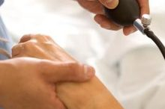
Battling Depression as a College Student
6 Hartoonian never viewed his condition as an illness until his sophomore year in college, when he saw a Blues Project presentation. Not until then did he realize that his depression could be overcome, and that help was available.
7 Seeking help is crucial, as depression can lead to thoughts of suicide. Nine percent of those participating in the APA’s study revealed that they contemplated suicide at least once since beginning college. An American College
Health Association report found that 1.5 percent of 16,000 students have attempted suicide.

Slide 7

Battling Depression as a College Student
8 Marshall Bloom, University Counseling Services (UCS) psychologist and head of the Blues Project, a group that conducts presentations on depression to classes on campus, is concerned for the lack of discussion about the subject.
9 “I’m surprised with how accurate the numbers are,” Bloom said. “Fifteen to 20 percent of students suffer from depression, and one percent will attempt suicide.”

Slide 8

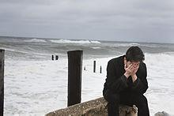
Battling Depression as a College Student
10 In 2008, suicide accounted for about 36,000 deaths, making it the 10th-leading cause of death in the U.S., according to the National Center for Injury Prevention and Control. It was ranked third among those aged 15 to 24. “Over the years, I have seen anxiety and depression rise in prominence, as well as the levels of psychological
distress,” Bloom said. “Depression is treatable, and suicide is preventable.”

Slide 9

Battling Depression as a College Student
11 The counseling service is free and confidential; the UCS website notes that its records are kept separate from academic records. Currently enrolled students can take up to eight free counseling sessions at the UCS per academic year, with a one-to-two week wait for the first appointment, according to the UCS website.

Slide 10


Battling Depression as a College Student
12 If students need additional counseling the UCS then makes referrals to nearby counselors and clinics, said Mark Stevens, director and psychologist of UCS. “We see about 50 new students per week for the free service,” said Stevens in an e-mail interview.

Slide 11

Battling Depression as a College Student
13 Hartoonian said he understands that the leap to seek help can be daunting, as many factors contribute to depression. Culture has a lot to do with it, he said, as many Latino, white and black cultures see counseling as negative. He said regardless of culture, students’ lack of understanding of what counseling is keeps them from going.

Slide 12

Battling Depression as a College Student
14 After abandoning his fears and apprehensions, he made an appointment for his first session. “I was really surprised by the sessions I went to. I did most of the talking in those first few sessions,” he said. “There was hardly any mention of the term depression. The sessions were more about my problems, and what practical solutions we could come up with to solve those problems.”

Slide 13

Battling Depression as a College Student
15 Hartoonian remembers the sense of relief by venting during his first sessions. There were hardly any questions at first, and the questions asked were general. He could answer as freely as he wanted to, no longer nervous after being told everything was confidential.

Slide 14

Battling Depression as a College Student
16 “We eventually got to a point where the psychologist was helping me notice certain patterns in my life that really contributed to depression,” Hartoonian said. “I got to address those problems in my life, and I would go back to my counselor every so often to check in what worked and what didn’t. It was all surprisingly straightforward.”

Slide 15

Battling Depression as a College Student
17 The fear of being labeled prevents people from seeking help, he said. He suggested students not ready to seek professional counseling should talk to someone they trust.
18 “I don’t want to make it seem like counselors and therapists have all the answers. In fact, my counselor and I would often joke about that, because they really don’t have the answers,” Hartoonian said. “What matters most is that they talk to someone.”

Slide 16
Language Points
1. Thoughts of self-contempt and guilt were ever-present companions in his daily life. (Para. 1)
[Paraphrase]:
Each day in his life, he was preoccupied with self-contempt and guilt.
[Analysis]:
This is a sentence with an inanimate subject, conveying a sense of objectivity in description.
[Translation]:
自轻和自责的念头总是如影随形。

Slide 17


Language Points
2. contempt (Para. 1): n. the feeling that sb./sth. is without value and deserves no respect at all
Familiarity breeds contempt.
近之则不逊。
He was fined for contempt of court.
他因藐视法庭罪而被罚款。
他把这沉默理解为轻视。
He interpreted the silence as contempt.

Slide 18
Language Points
Collocations:
have/show/feel/express contempt for
bring contempt upon oneself
bring into contempt
hold/have sb. in contempt
in contempt of: in disregard of; in spite of
蔑视，鄙视
自取其辱，自讨没趣
使…受辱，使丢脸
鄙视某人，看不起某人
不顾

Slide 19
Language Points
Word-formation:
contemptible: adj. not deserving any respect at all 可鄙的，卑劣的
He is contemptible for his betrayal of his motherland and his family.
contemptuous: adj. feeling or showing no respect for 蔑视的，轻视的
We are contemptuous of his flattering manner.

Slide 20

Language Points
3. guilt (Para. 1): n. 1) the unhappy feelings caused by knowing or thinking that you have done sth. wrong
The differences in the feelings of guilt between men and women are not cultural.
他脸上露出了内疚的神色，尽管他说他毫无过错。
His face showed guilt though he said he had done nothing wrong.

Slide 21

Language Points
2) the fact that sb. has done sth. wrong or illegal 罪行
Many supporters of Michael Peterson have been attracted by his intelligence and charisma, who continue to battle for a new trial despite the overwhelming evidence of his guilt.
法庭裁决有罪和无罪的问题。
The courts determine questions of guilt and innocence.

Slide 22
Language Points
Collocations:
erase one’s guilt
admit one’s guilt
aggravate one’s guilt
conceal/hide one’s guilt
confess one’s guilt
deny one’s guilt
expose one’s guilt
lay the guilt upon sb.
消除内疚
认罪
加重罪行
隐瞒罪行
坦白认罪
否认罪行
揭露罪行
把罪责归于某人

Slide 23

Language Points
4. companion (Para. 1): n. a person or an animal that spends a lot of time with you, or sth. being together with you
It will be advisable for you to drop such an acquaintance as John; he is not a good companion for you.
尽管她无人陪伴独自完成了航程，却并不觉孤独。
Although she finished her voyage without a companion, she did not feel lonely.

Slide 24
Language Points
5. Though he managed to get up every morning and face the day ahead, a repeated discontentment with his life took a toll, and his depression became integral to his being: the norm. (Para. 1)
[Paraphrase]:
Though he seemed able to lead a normal life every day, he repeatedly felt discontent with his life, and the distress became such a routine in his life that he felt unable to get rid of it.

Slide 25
Language Points
5. Though he managed to get up every morning and face the day ahead, a repeated discontentment with his life took a toll, and his depression became integral to his being: the norm. (Para. 1)
[Analysis]:
The author uses some different expressions, including noun, verb and adjective phrases to demonstrate Hartoonian’s problem. For example, “took a toll” and “became integral to” in this sentence and “ever-present companions” in the previous sentence. Call students’ attention to such expressions in the following paragraphs.

Slide 26
Language Points
5. Though he managed to get up every morning and face the day ahead, a repeated discontentment with his life took a toll, and his depression became integral to his being: the norm. (Para. 1)
[Translation]:
尽管他每天早晨尽力起床面对新的一天，但萦绕心头的对人生的不满已经严重影响了他的生活，以至于抑郁已成为他生活中挥之不去的一部分，成为一种常态。

Slide 27

Language Points
6. take a toll (on) (Para. 1): to have a bad effect
on sb./sth.
Being the boss might mean more money and challenging work, but it can also take a toll on physical and mental well-being.
尚不明确的是香烟烟雾是否确实对儿童的大脑造成严重影响，或是其他因素在起作用。
It’s still unclear if tobacco fumes actually take a toll on children’s brains, or if something else is at play.

Slide 28

Language Points
7. norm (Para. 1): n. a situation or a pattern of behavior that is usual or expected
Snow in the Rocky Mountain states and Northeast is the norm in winter.
我们很容易想象到，在不久的将来，纸质书将成为例外，而非常态。
It’s easy to imagine a near future in which paper books are the exception, not the norm.

Slide 29
Language Points
8. “Typically, depression involves feelings of helplessness, hopelessness, worthlessness and guilt,” Hartoonian said. “The last two — feeling worthless and guilty — are the feelings I battled most.” (Para. 3)
[Paraphrase]:
Generally depressed people tend to feel helpless, hopeless, worthless and guilty, in other words, they feel there is no hope in life, no one to help them, and what they do might be of no significance and might be wrong. The last two feelings depressed him most.

Slide 30
Language Points
8. “Typically, depression involves feelings of helplessness, hopelessness, worthlessness and guilt,” Hartoonian said. “The last two — feeling worthless and guilty — are the feelings I battled most.” (Para. 3)
[Analysis]:
The author uses three parallel words with the same word-building features to emphasize rhetorically the despair from depression.

Slide 31
Language Points
8. “Typically, depression involves feelings of helplessness, hopelessness, worthlessness and guilt,” Hartoonian said. “The last two — feeling worthless and guilty — are the feelings I battled most.” (Para. 3)
[Translation]:
“一般说来，抑郁让人感到无助、无望、无用和自责，”哈图年说，“无用和自责这后两种感觉最困扰我。”

Slide 32
Language Points
9. be stuck in (Para. 3): to be trapped in; to be tied to
The reason you may be stuck in a negative thought pattern right now is that at some point, you chose it.
他也许陷入了对幸福的追求过程，而不是真的幸福。
He may be stuck in the pursuit of happiness and not truly happy.

Slide 33
Language Points
10. The fear of being labeled and perceived differently kept him from talking about it and from seeking help and treatment. (Para. 4)
[Paraphrase]:
Just because he was afraid of being considered weird and recognized as such, he didn’t dare to talk to anyone about his problem, find help from others, or see a therapist.
[Translation]:
因为害怕自己被别人归入异类、另眼对待，哈图年不敢谈论他的抑郁，也不敢寻求帮助和治疗。

Slide 34
Language Points
11. perceive (Para. 4): v. to understand or think of sb./sth. in a particular way
Experts believe that this dream reflects your anxieties about your appearance or how others perceive you.
你如何面对并理解这些挑战将决定你整个过程的压力与焦虑。
How you face and perceive these challenges will determine your stress and anxiety levels throughout this process.

Slide 35
Language Points
Collocations:
dimly/vaguely perceive
distinctly/plainly perceive
easily perceive
gradually perceive
instinctively perceive
隐约感觉到
清楚地感觉到
轻易地看出
逐渐领悟到
凭直觉感到

Slide 36
Language Points
12. Entrapped with his depression and having no means of managing it, he came to be invaded by thoughts of suicide. (Para. 4)
[Paraphrase]:
Because he was caught with a strong sense of distress and couldn’t find ways to overcome it, he began to think about suicide.

Slide 37
Language Points
12. Entrapped with his depression and having no means of managing it, he came to be invaded by thoughts of suicide. (Para. 4)
[Analysis]:
Remind students that participial adverbials should share the same logical subject with the main clause.
[Translation]:
困在抑郁中又没有办法克服，自杀的念头开始在他的心中冒起。

Slide 38
Language Points
13. entrap (Para. 4): v. to put or catch sb./sth. in a place or situation from which they cannot escape
Some young adults grab the highest-paying jobs that they can get right out of college — jobs that entrap them on a path leading away from their career dreams.
律师使证人陷入自相矛盾中。
The lawyer entrapped the witness into contradicting himself.

Slide 39
Language Points
14. invade (Para. 4): v. to affect sth. in an unpleasant or annoying way
In the summer, a swarm of tourists invade this scenic valley, disturbing its tranquility.
对于侵犯我们隐私的人我们要学会说不。
We should learn to say no to people that invade our privacy.

Slide 40
Language Points
Word-formation:
invasion: n. an act or a process that affects sb./sth. in a way that is not welcome
Forcing people to take a genetic test against their will is clearly a serious invasion of privacy.
invasive: adj. spreading very quickly and difficult to stop
They found invasive cancer during a routine examination.

Slide 41
Language Points
15. The battle against depression is a struggle. A struggle an estimated 1-in-10 Americans deal with, according to the Center for Disease Control and Prevention. (Para. 5)
[Analysis]:
The second sentence is just a noun phrase, giving additional information to the “struggle”, showing that it is quite common among Americans.
[Translation]:
抗击抑郁是一场艰难的奋战，而疾病控制与预防中心的数据表明，约十分之一的美国人有此经历。

Slide 42
Language Points
16. estimate (Para. 5): v. to form an idea of the cost, size, value, etc. of sth., but without calculating it exactly
Media reports estimate at least 150 taxi strikes have broken out across the country since 2002.
据估计，由于高失业率，这个国家接近半数生活在贫困线或是贫困线以下。
It’s estimated that close to half the nation lives at or below the poverty level due to high unemployment rate.

Slide 43
Language Points
17. Marshall Bloom, University Counseling Services (UCS) psychologist and head of the Blues Project, a group that conducts presentations on depression to classes on campus, is concerned for the lack of discussion about the subject. (Para. 8)
[Paraphrase]:
Marshall Bloom, psychologist of UCS, is responsible for the Blues Project which gives lectures to classes on campus on battling depression. As there are few discussions on the topic of depression, Marshall Bloom is quite worried about it.

Slide 44
Language Points
17. Marshall Bloom, University Counseling Services (UCS) psychologist and head of the Blues Project, a group that conducts presentations on depression to classes on campus, is concerned for the lack of discussion about the subject. (Para. 8)
[Analysis]:
There are two appositives in this sentence, modifying
and explaining Marshall Bloom and the Blues Project respectively.

Slide 45
Language Points
17. Marshall Bloom, University Counseling Services (UCS) psychologist and head of the Blues Project, a group that conducts presentations on depression to classes on campus, is concerned for the lack of discussion about the subject. (Para. 8)
[Translation]:
马歇尔·布鲁姆是大学心理辅导服务机构的心理医生，也是抗抑郁工程的负责人。该辅导团队的工作是到学校各班级开展抗抑郁讲座。抑郁症这一话题鲜有讨论，为此他很担忧。

Slide 46

Language Points
18. be concerned for (Para. 8): to be worried and
feel concerned about
There is a lot of emphasis these days on staying physically healthy, but we should also be concerned for our mental well-being.
我们应该关心环境，为下一代创造更美好的未来。
We should be concerned for our environment and create a better future for the next generation.

Slide 47
Language Points
19. In 2008, suicide accounted for about 36,000 deaths, making it the 10th-leading cause of death in the U.S., according to the National Center for Injury Prevention and Control. (Para. 10)
[Paraphrase]:
The total number of deaths from suicide amounted to 36,000 in 2008, which ranked the 10th on the list of main causes for death, as is released by the National Center for Injury Prevention and Control.

Slide 48
Language Points
19. In 2008, suicide accounted for about 36,000 deaths, making it the 10th-leading cause of death in the U.S., according to the National Center for Injury Prevention and Control. (Para. 10)
[Analysis]:
A present participle is used here as an adverbial indicating result. The sentence is complex in idea, but simple in structure.

Slide 49
Language Points
19. In 2008, suicide accounted for about 36,000 deaths, making it the 10th-leading cause of death in the U.S., according to the National Center for Injury Prevention and Control. (Para. 10)
[Translation]:
美国国家伤害预防与控制中心的统计数据表明，美国2008年有3.6万人自杀身亡，在死因排名中位列第十。

Slide 50
Language Points
20. Over the years, I have seen anxiety and depression rise in prominence, as well as the levels of psychological distress … (Para. 10)
[Paraphrase]:
During the past years, both the seriousness of anxiety and depression and the levels of psychological distress have risen noticeably.

Slide 51
Language Points
20. Over the years, I have seen anxiety and depression rise in prominence, as well as the levels of psychological distress … (Para. 10)
[Analysis]:
The expression “as well as” connects the two phrases “anxiety and depression” and “the levels of psychological distress”, making the whole sentence concise. Another structure “see … rise in prominence” emphasizes the seriousness of the problem and indicates the speaker’s concern for it.

Slide 52
Language Points
20. Over the years, I have seen anxiety and depression rise in prominence, as well as the levels of psychological distress … (Para. 10)
[Translation]:
据我所知，近年来焦虑、抑郁者数量大幅上升，各类心理疾病的程度也在日渐加剧……

Slide 53

Language Points
21. prominence (Para. 10): n. the state of being important, well known or noticeable
His report gave prominence to the advantage of network media.
这位律师在她职业生涯的早期成名。
The lawyer reached a position of prominence in her profession at an early age.

Slide 54
Language Points
22. distress (Para. 10): n. a feeling of great worry or unhappiness; great suffering
His wild behavior was a great distress to his mother.
有些人非常关注自己的利益，而对于朋友的不幸置若罔闻。
Some people are awake enough to their own interests, who turn a deaf ear to their friends’ distress.

Slide 55
Language Points
23. Currently enrolled students can take up to eight free counseling sessions at the UCS per academic year, with a one-to-two week wait for the first appointment, according to the UCS website. (Para. 11)
[Paraphrase]:
According to the information from the UCS website, all the students of the university can take as many as eight free counseling sessions at the UCS each academic year, and they don’t have to wait long, even the first appointment is only one or two weeks away.

Slide 56
Language Points
23. Currently enrolled students can take up to eight free counseling sessions at the UCS per academic year, with a one-to-two week wait for the first appointment, according to the UCS website. (Para. 11)
[Analysis]:
The structure “with + noun phrase” serves as an adverbial providing further information. The word “wait” here is used as a noun though it usually functions as a verb.

Slide 57
Language Points
23. Currently enrolled students can take up to eight free counseling sessions at the UCS per academic year, with a one-to-two week wait for the first appointment, according to the UCS website. (Para. 11)
[Translation]:
目前在籍的学生每学年可以免费接受多达8次机构的咨询，初次预约也只要等待1至2周。

Slide 58
Language Points
24. Hartoonian said he understands that the leap to seek help can be daunting, as many factors contribute to depression. (Para. 13)
[Paraphrase]:
Hartoonian said he understands that there are many causes leading to depression, so to make the decision to seek help from others is really a very difficult big step and you might be held back from doing so.

Slide 59
Language Points
24. Hartoonian said he understands that the leap to seek help can be daunting, as many factors contribute to depression. (Para. 13)
[Analysis]:
The word “leap”, mostly used as a verb, is here a noun to indicate vividly the difficulties for those who dare not seek help.

Slide 60
Language Points
24. Hartoonian said he understands that the leap to seek help can be daunting, as many factors contribute to depression. (Para. 13)
[Translation]:
哈图年说，他知道迈过寻求帮助这道坎有可能令人望而却步，因为抑郁症的诱因很多。

Slide 61
Language Points
25. leap (Para. 13): n. a sudden large change or
increase in sth.
The party does not need a huge leap in parliamentary seats to win the next election.
熟能生巧！发现困难不要退缩，你会取得飞跃。
Practice makes perfect! Don’t withdraw after discovering difficulties. You’ll take a leap.

Slide 62
Language Points
26. daunting (Para. 13): adj. making sb. feel nervous and less confident about doing sth.
The new job was a bit daunting at first but it was all right once I’d got my eye in.
她是勇敢的女士，从不躲避让人生畏的任务。
She was a brave woman and never shunned daunting tasks.

Slide 63
Language Points
27. After abandoning his fears and apprehensions, he made an appointment for his first session. (Para. 14)
[Analysis]:
The synonyms “fears” and “apprehensions” are used together for emphasis, denoting all kinds of fears.

Slide 64

Language Points
28. apprehension (Para. 14): n. worry or fear that sth. unpleasant may happen; anxiety
We waited for their decision with a great deal of apprehension.
她害怕会重归贫困。
She was under the apprehension that she would fall back in poverty.

Slide 65
Language Points
29. Hartoonian remembers the sense of relief by venting during his first sessions. (Para. 15)
[Paraphrase]:
Hartoonian remembers how relieved he felt after speaking out his feelings and thoughts during his first sessions.

Slide 66
Language Points
30. relief (Para. 15): n. the feeling of happiness that you have when sth. unpleasant stops or does not happen
Much to my relief, the car was not damaged.
他离开的时候，我们都松了一口气。
We all breathed a sigh of relief when he left.

Slide 67
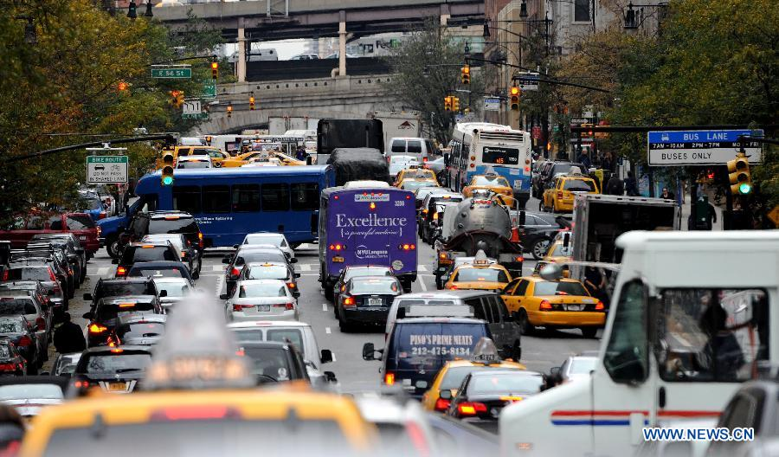
Language Points
relieve: v.
1) to remove or reduce an unpleasant feeling or pain
Treatment may allow you to live longer and can help relieve symptoms the cancer is causing.
2) to make a problem less serious
Effective and immediate measures should be taken so as to relieve the traffic congestion in this metropolitan city.

Slide 68
Language Points
31. We eventually got to a point where the psychologist was helping me notice certain patterns in my life that really contributed to depression … (Para. 16)
[Paraphrase]:
After we talked for quite some while (probably on several occasions), the psychologist helped me realize that it was some of my habits in life that had led to my depression.
[Translation]:
谈到后来，心理医生开始帮我找出是哪些生活习惯导致我患上了抑郁症。

Slide 69
Language Points
32. It was all surprisingly straightforward. (Para. 16)
[Analysis]:
Very simple words and structure are used in this sentence to indicate how relieved Hartoonian was after talking with the therapist about his problem and how overjoyed he was to find the process so simple and direct.
[Translation]:
所有的谈话都坦诚得出奇。

Slide 70
Language Points
33. I don’t want to make it seem like counselors and
therapists have all the answers. (Para. 18)
[Paraphrase]:
I don’t want to give others a false impression that counselors and therapists are able to solve all the problems.
[Analysis]:
“Like” can be used as a conjunction in utterances of casual style.
[Translation]:
我不想给大家一个错觉，好像心理辅导师和治疗师无所不能。

