Slide 1
Unit 1: Using the Web
Wuhan University

Slide 2
The World Wide Web
Introduce the World Wide Web and its workings.
  Using the Web
  What's in the Web?
  Introduction to HTML Forms and Servlets

Slide 3
1.1 Using the Web
Surfing the Web
Your Web Pages
Clients, Servers, and URLs
Searching the Web
Commerce on the Web
Some Ethical Considerations

Slide 4
Surfing the Web
Network Basics
Internet
World Wide Web
Surfing
Internet Service Provider ( ISP )

Slide 5
Networks Basics
1) Network Classifications
2) Network Devices
3) Network Links
4) Communication System Model

Slide 6
Computer Network
A computer network is a telecommunications network that allows computers to exchange data.
In computer networks, networked computing devices pass data to each other along data connections.
The connections (network links) between nodes are established using either cable media or wireless media.

Slide 7
Network Advantages and Disadvantages
Advantages:
  Resources sharing, Communication
Disadvantages:
  Security threads( unauthorized access, malicious code )

Slide 8
1) Network Classifications
Networks can be classified according to their size and geographic scope.
  PAN---- (personal area network) refers to the interconnection of personal digital devices within a range of about 30 feet (10 meters) and without the use of wires or cables.
  LAN ---(local area network) connects personal computers within a very limited geographical area-usually a single building.

Slide 9
Network Classifications (cont.)
  MAN ----(metropolitan area network) is a public high-speed network capable of voice and data transmission within a range of about 50 miles (80 km).
  WAN -----(wide area network) covers a large geographical area and usually consists of several smaller networks.

Slide 10
2) Network Devices
What devices can be attached to a network?
You can think of a network as a spider web with many interconnecting points. Each connection point on a network is referred to as a node.
A network node typically contains computers, networked peripherals, or network devices.

Slide 11
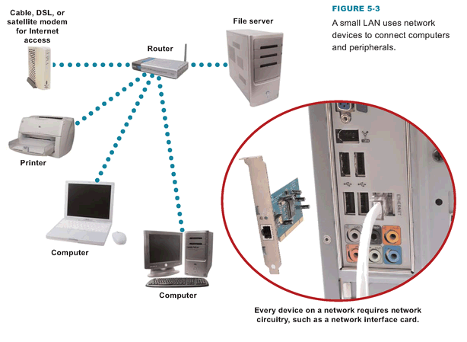
Network device
such as Router , hub , switch, repeater.
Network Peripheral
Such as printer, scanner
Storage device
Network interface card (NIC)

Slide 12
Network devices
A network device, or network appliance, is any electronic device that broadcasts network data, boosts signals, or routes data to its destination.
Network devices include hubs, switches, routers, gateways, bridges, and repeaters.
A Router is the most important network device, which act as a central distribution point for a network.

Slide 13
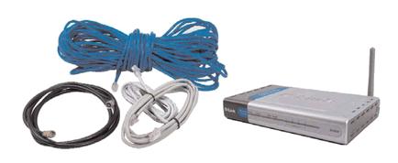
3) Network Links
What connects the nodes of a network ?
Data in a network with wired links travels from one device to another over cables
Networks without wires transport data through the air

Slide 14
Bandwidth
What's bandwidth ?
Bandwidth is the transmission capacity of a communications channel.
The bandwidth of a digital channel is usually measured in bits per second(bps).
The bandwidth of a analog channel is typically measured in herz(Hz).
※ Broadband ※ Narrowband

Slide 15
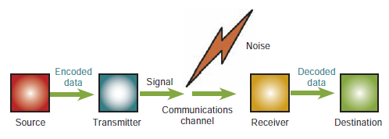
4) Communication system model
A communications system basically sends information from a source to a destination.

Slide 16
Signals
What kind of signals travel over computer networks?
When data is transmitted over a network link, it usually takes the form of an electromagnetic signal.
You can think of these signals as waves that ripple through cables or through the air.

Slide 17
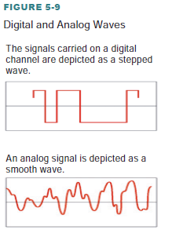
Signals
Digital signals are transmitted as bits using a limited set of frequencies.
Analog signals can assume any value within a specified range of frequencies.

Slide 18
Circuit switching
Some communications networks, such as the telephone system, use a technology called circuit switching, which essentially establishes a dedicated, private link between one telephone and another for the duration of a call.
Unfortunately, circuit switching is rather inefficient.

Slide 19
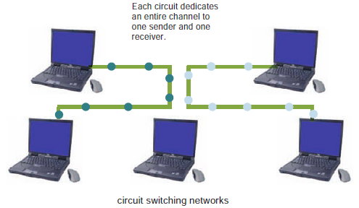

Slide 20
Packet switching
A more efficient alternative to circuit switching is packet switching, which divides a message into several equal-size packets that can be routed independently to their destination.
Packets from many different messages can share a single communications channel, or circuit.

Slide 21
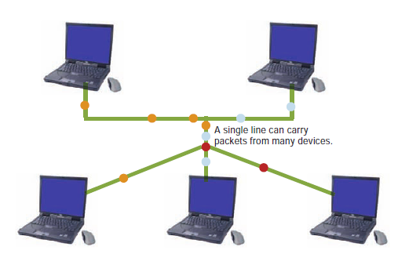

Slide 22
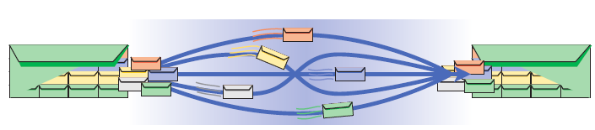
Packets
A packet is a parcel of data that is sent across a computer network.
Each packet contains the address of its sender, the destination address, a sequence number, and some data.
When packets reach their destination, they are reassembled into the original message according to the sequence numbers.

Slide 23
Internet
Internet is a computer network that connects millions of computers across a number of countries.
There is no central authority that controls the Internet; different organizations own different pieces of it.
The Internet was originally conceived of by the Advanced Research Project Agency (ARPA) of the U.S. government in the 1960s.

Slide 24
Internet
The Internet is a global system of interconnected computer networks that uses the standard Internet protocol suite (TCP/IP) to link billions of devices worldwide.
It is a network of networks that consists of millions of private, public, academic, business, and government networks of local to global scope, linked by a broad array of electronic, wireless, and optical networking technologies.
Introduction to Computer Systems

Slide 25
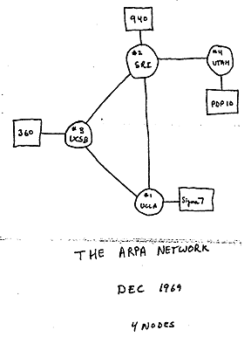
ARPANET
The Internet stems from the ARPANET.
  The ARPANET, created in 1969, connected computers at UCLA, Stanford Research Institute,University of Utah, and University of California at Santa Barbara.

Slide 26
ARPANET (Cont.)
The ARPANET was an early packet switching network and the first network to implement the protocol suite TCP/IP. Both technologies became the technical foundation of the Internet.

Slide 27
NSFNet
In 1986, the National Science Foundation (NSF) used ARPANET technology to create a larger network, linking not just a few mainframe computers, but entire LANs at each site.
Connecting two or more networks creates an internetwork, or internet. The NSF network was an internet.
As this network grew throughout the world, it became known as the Internet.

Slide 28
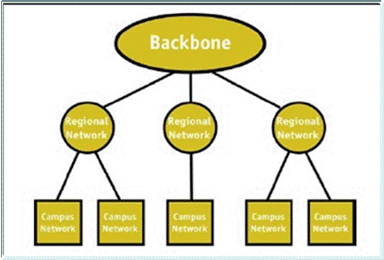
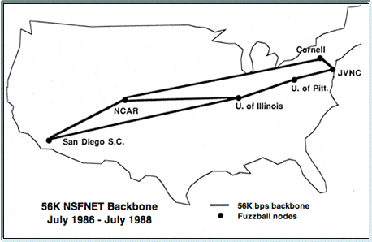
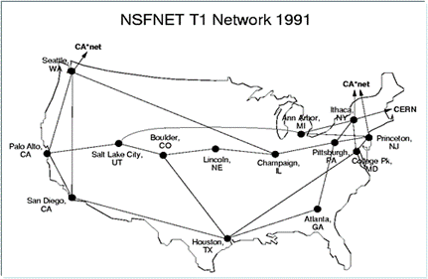
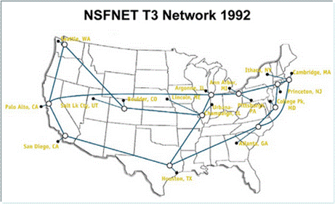
NSF's three tiered network architecture
56-kbit/s backbone, 1986-1988
1.5 Mbit/s (T1) backbone, July 1988- 1991
45Mbit/s(T3) Backbone,1991-1995

Slide 29
Communication Protocols
A communications protocol refers to a set of rules for efficiently transmitting data from one network node to another.
What can communications protocols do?
  Protocols set standards for encoding and decoding data, guiding data to its destination, and mitigating the effects of interference.

Slide 30
Internet Protocols
The Internet protocol suite is the set of communications protocols used for the Internet and other similar networks. It is commonly known as TCP/IP from its most important protocols: TCP and IP.

Slide 31
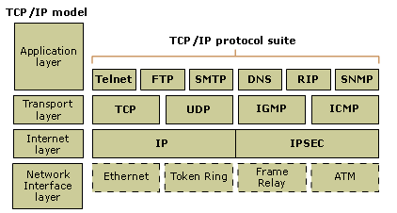
TCP/IP Reference Model
TCP/IP is based on a four-layer reference model

Slide 32
TCP/IP 的体系结构
网际协议：完成数据从源发送到目的的基本任务。
传输协议：能够解决诸如端到端可靠性（“数据是否已经到达目的地？”）和保证数据按照正确的顺序到达这样的问题。
应用层协议：负责将网络传输的东西转换成我们能够识别的信息。
各种应用层协议
HTTP, FTP,
SMTP, DNS 等
应用层
传输层
TCP
UDP
网际层
IP
网络
接口层
Introduction to Computer Systems

Slide 33
TCP and IP
TCP (Transmission Control Protocol) breaks a message into packets.
IP (Internet Protocol) is responsible for addressing packets so that they can be routed to their destination.
Introduction to Computer Systems

Slide 34
IP is a connectionless,unreliable, best-effort delivery protocol.
The TCP ensures the reliability of data transmission across Internet connected networks. TCP checks packets for errors and submits requests for re-transmissions if errors are found.

Slide 35
message
11010011101 • • • • • • • • 00101001110
transmitter
payload
header
payload
header
payload
header
packet
packet
packet
payload
header
payload
header
payload
header
receiver
11010011101 • • • • • • • • 00101001110
数 据
数 据
数 据
Company Logo

Slide 36
Internet Connectivity
1) Dial-up Connections
2) DSL
3) Cable Internet Service
4) Satellite Internet Service
5) Fixed Wireless Service

Slide 37
1) Dial-up Connections
A dial-up connection uses POTS (plain old telephone service) to transport data between your computer and your ISP.
Modem (voiceband modem) is used to convert between binary bits and sounds transmitted as analog electrical signals over the telephone line.

Slide 38
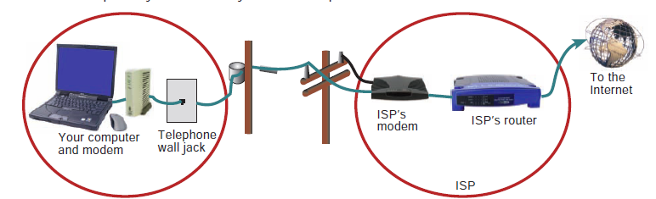
Dial-up Connections

Slide 39
Dial-up Connections
Primary advantage of the telephone system for computer communications is inexpensive access.
The principal drawback of Dial-up connection is their limited speed.
  The fastest modems available for purely analog phone lines run at 56 kps( kilobits per second).

Slide 40
2) DSL
DSL (digital subscriber line) is a high-speed, digital, always-on, Internet access technology that runs over standard phone lines.

Slide 41
DSL
DSL Data is transmitted to and from your local telephone switching station in pure digital form.
  The result is fast data transmission over standard copper telephone cable.
  DSL uses some fairly sophisticated technology to superimpose digital signals over the unused frequency spectrum of an ordinary telephone line.
A DSL connection can simultaneously carry voice and data, if permitted by your DSL provider.

Slide 42
ADSL
Different types of xDSL technologies exist, such as ADSL, HDSL,VDSL
ADSL, or asymmetric digital subscriber line, is called asymmetric because the speed of upstream and downstream transmissions are different.
Upstream rate 16Kbps ~ 1Mbps.
Downstream rate 1Mbps~10Mbps.

Slide 43
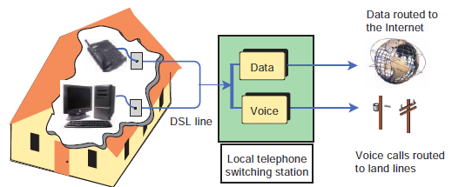
DSL

Slide 44
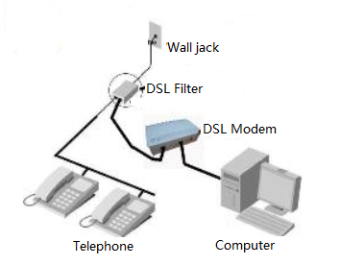
DSL
DSL installations typically require a modem and filters.
A DSL modem is a device that connects a computer to a telephone line and converts computer data signs into signals compatible with DSL.

Slide 45
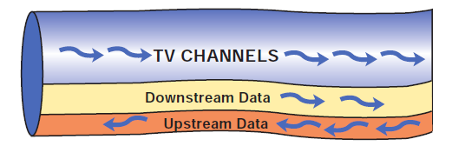
3) Cable Internet Service
Cable television companies have begun providing data connections to residential customers over their existing cable lines.
  Standard plan:
    10 Mbps downstream, 384 Kbps upstream.
  Premium plans:
    30 Mbps downstream, 2 Mbps upstream.

Slide 46
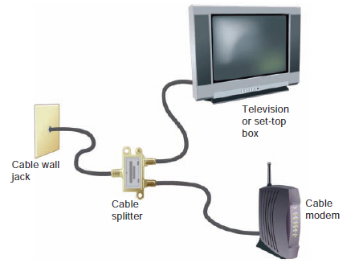
Cable Internet Service
Cable modem is used to convert your computer’s signal into one that can travel over television cable.
Computers are usually connected to cable modems through Ethernet interfaces.

Slide 47
4) Satellite Internet Service
Satellite Internet service is a means of distributing always-on, high-speed asymmetric Internet access by broadcasting signals to and from a personal satellite dish.
In many rural areas, satellite Internet service is the only alternative to a dial-up connection.
Downstream : 1.0 to 1.5 Mbps
Upstream: 100 to 256 Kbps

Slide 48
Devices required for satellite internet access
A satellite modem is a device that modulates the data signals from a computer into a frequency band that can be carried to the satellite dish, where it is converted to another frequency, amplified, and transmitted.

Slide 49
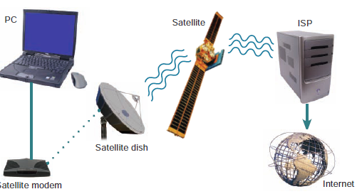
Satellite data transport is subject to latency delays of one second or more, which occur as your data is routed between your computer and a satellite that orbits 22,200 miles above the Earth.

Slide 50
5) Fixed Wireless Service
Fixed wireless Internet service (also called wireless broadband service) is designed to offer Internet access to homes and businesses by broadcasting data signals over areas large enough to cover most cities and outlying areas.
Fixed wireless technologies are MAN standards, in contrast to technologies such as Wi-Fi, which are LAN standards.
One of the most well-known fixed wireless standards is WiMAX.

Slide 51
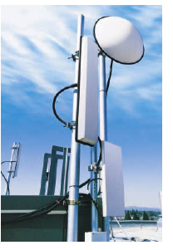
WiMAX
WiMAX, which stands for Worldwide Interoperability for Microwave Access, is an Ethernet-compatible network standard designated as IEEE 802.16.
A WiMAX system transmits
data to and from WiMAX
antennas mounted on towers.
A single tower can serve a
large geographical area.

Slide 52
WiMAX
Under ideal conditions, WiMAX can transmit data at 70 Mbps. Current services claim speeds of 1 to 5 Mbps downstream.
  WiMAX can be distributed as symmetrical or asymmetrical service.
Your wireless service provider typically supplies a wireless modem that you connect to your computer. The modem includes a transceiver to send and receive signals to a wireless point of access, usually located on a nearby communications tower.

Slide 53
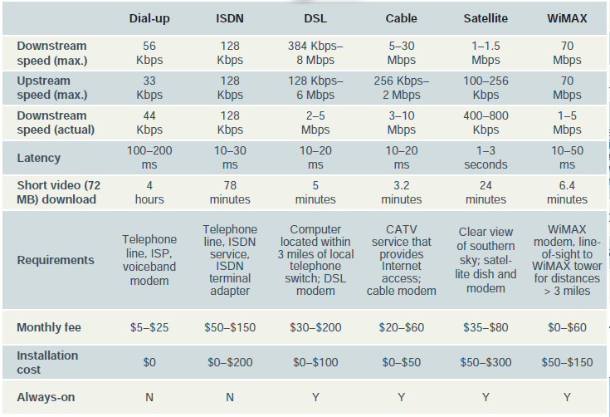
Summary : Fixed Internet Access Options

Slide 54
Internet的特点
1．全球信息浏览。
2．检索、交互信息方便快捷。
3．Internet采用了目前网络中最为流行的客户机/服务器网络程序方式，大大增加了网络信息服务的灵活性。
4．Internet把网络技术、多媒体技术和超文本技术融为一体。

Slide 55
Internet的特点
5．灵活多样的入网方式。
6．收费低廉。
7．有丰富的信息资源、而且多数是免费的。
8．丰富的信息服务功能和友好的用户接口使Internet可以做到雅俗共赏。

Slide 56
Internet基本服务
WWW(World Wide Web)浏览
E-mail电子邮件
Telnet远程登录
FTP(File Transfer Protocol)文件传输
PPP(Point to Point Protocol)通信
BBS(Bulletin Board Service)广告牌
网上聊天
E-Business电子商务
电子政务
网上电话和网上视频
注意: 网络病毒、保密、黑客(Huckman)
  上网费用:电话费、网络费

Slide 57
Internet的主要服务
WWW服务
  WWW是World Wide Web的缩写，常简称为Web，中文译名为“万维网”。
  它把Internet上的现有资源统统连接起来，用户能够在Internet上访问已经建立的WWW服务器上的超文本、超媒体资源文档。

Slide 58
Internet的主要服务
电子邮件（E-mail）
  电子邮件是Internet上使用最早的信息传递方式。
  电子邮件系统是在一些特定的计算机上运行相应的软件使之充当“电子邮局”，用户可以使用这台计算机上的一个“电子邮箱”来收发信件。
  电子邮件系统可以传送文本、声音、图像、视频等信息。

Slide 59
Internet的主要服务
文件传输（FTP）
  FTP是文件传输协议（File Transfer Protocol）的缩写。它是人们从因特网上获取远程主机文件的主要手段。
  当文件从客户端送往远地主机时，称为“文件上传”（Upload）；反之，称为“文件下载”（Download）。
  传送的文件可以是文本文件、可执行文件、声音文件、图像文件、数据压缩文件等。

Slide 60
Internet的主要服务
远程登录（Telnet）
  远程登录就是在网络通信协议Telnet的支持下，用户通过Internet注册到网络上的另一台主机，分享该主机提供的资源和服务，感觉就像在该主机上操作一样,而用户的机器则作为该主机的虚拟终端。
  也就是说用户的机器仅仅是作为一台虚拟终端向远程主机传送击键信息并回显结果。

Slide 61
Word Wide Web
the Web, WWW or W3
Portion of the computers on the Internet that can communicate with each other using a computer-network protocol called HTTP (Hypertext Transfer Protocol ).
All browsers use HTTP to request and receive Web pages from other computers.

Slide 62
World Wide Web
什么是WWW ?
  WWW起源于1989年3月，是由欧洲量子物理实验室CERN开发的分布式主从结构超文本系统。
  WWW是一个全球性的信息系统，使计算机能够在Internet上相互传送基于超媒体的数据信息。
  WWW也可以用来建立Intranet(企业内部网)信息系统。
  WWW是成千上万个网站连接而成的页面式网络信息系统。

Slide 63
World Wide Web
WWW三要素
  统一的资源命名方式：URL（统一资源定位符，即网址）
  统一的资源访问方式：HTTP（超文本传输协议）
  统一的信息组织方式：HTML（超文本标记语言）

Slide 64
World Wide Web
WWW特点
  分布式的信息资源
  统一的用户界面
    Web浏览器：IE，NetScape …
  支持各种信息资源和各种媒体的演播
    Text, Photo, Voice, Video …
  广泛的用途
    搜索信息，发布信息

Slide 65
Surfing
Browse on the Web
page, place, site, web site
  Locations on the Web that you can visit and view through a browser
homepage
No one can certify that information presented on the Web is accurate, correct, and up-to-date.

Slide 66
Internet Service Provider ( ISP )
互联网服务供应商
An ISP is any one of a number of companies that enable people not only to connect to the Internet and surf the Web but also to publish Web pages.
All Web sites must have unique names or addresses—one per machine

Slide 67
1.1 Using the Web
1.1.1 Surfing the Web
1.1.2 Your Web Pages
1.1.3 Clients, Servers, and URLs
1.1.4 Searching the Web
1.1.5 Commerce on the Web
1.1.6 Some Ethical Considerations

Slide 68
1.1.2 Your Web Pages
“Reasonable Person Principle” -When hosting a website, pages should be maintained for others to view
Information on the pages should be correct and up-to-date.
Presenting email information on web page implies being responsive to emails by surfers.
Displaying personal information on web pages not a good idea.

Slide 69
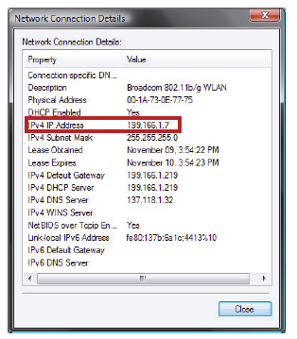
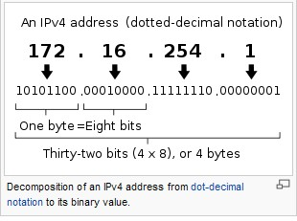
IP Address
An IP address is a numerical label assigned to each device (e.g., computer, printer) participating in a computer network that uses the Internet Protocol for communication.
Introduction to Computer Systems

Slide 70
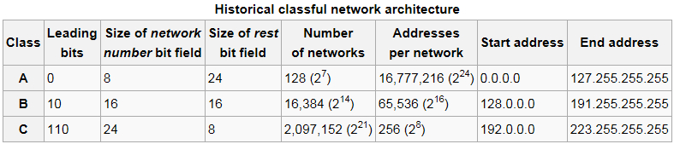
Network number and host number
network administrators interpreted an IP address in two parts: network number portion and host number portion.
The highest order octet (most significant eight bits) in an address was designated as the network number and the remaining bits were called the rest field or host identifier and were used for host numbering within a network.

Slide 71
Dynamic IP address
A computer can have a permanently assigned static IP address or a temporarily assigned dynamic IP address.
As a general rule, computers on the Internet that act as servers use static IP addresses.
  Typically, ISPs, Web sites, Web hosting services, and e-mail servers that always need to be found at the same address require static IP addresses.
Most other Internet users have dynamic IP addresses.
Why doesn’t everyone have a static IP address?

Slide 72
How do I get a dynamic IP address?
Every ISP controls a unique pool of IP addresses. If you have the type of Internet connection, your ISP’s DHCP (Dynamic Host Configuration Protocol) server assigns a temporary IP address to your computer for use as long as it remains connected. When you end a session, that IP address goes back into a pool of addresses that can be distributed to other subscribers when they log in.

Slide 73
Routable IP Address
Your router has its own IP address, typically obtained from your Internet service provider’s DHCP server.
It is also possible for your router to have a fixed IP address set up by you or an installer.
The key point about your router’s IP address is that it is routable. A routable IP address is one which can be accessed by packets on the Internet.

Slide 74
Private IP Address
When you connect your computer to a router and request an IP address, your router answers your request, not the ISP.
Most routers are configured to assign private IP addresses. A private IP address is a non-routable IP address that can be used within a LAN, but not for Internet data transport.
  three ranges of addresses were reserved for internal or private use:
    A: 10.0.0.0 to 10.255.255.255,
    B: 172.16.0.0 to 172.31.255.255,
    C: 192.168.0.0 to 192.168.255.255

Slide 75
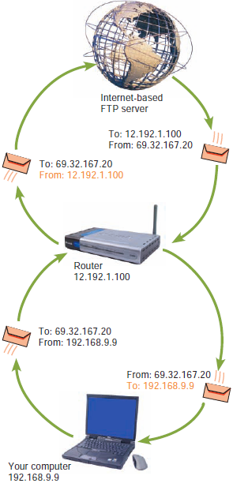
NAT
Network address translation (NAT) is the process your router uses to keep track of packets and their corresponding private or public IP addresses.

Slide 76
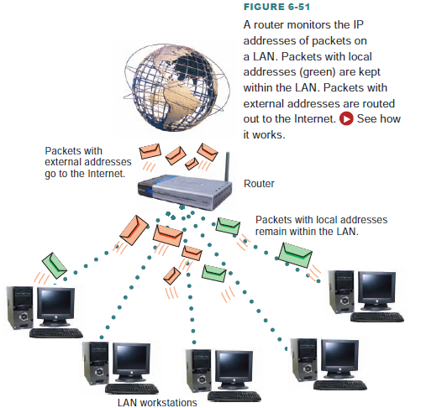
Router and NAT

Slide 77
IPv6
The designers of the Internet Protocol defined an IP address as a 32-bit number and this system, known as Internet Protocol Version 4 (IPv4), is still in use today.
However, due to the enormous growth of the Internet and the predicted depletion of available addresses, a new version of IP (IPv6), using 128 bits for the address, was developed in 1995.
An example of IPv6 Address: 2001:db8:0:1234:0:567:8:1

Slide 78
Domain Names Services
What’s a domain name?
A domain name, short for “full qualified domain name”, is an identifying name by which host computers on the Internet are familiarly known.

Slide 79
A domain name is a key component of Web addresses, e-mail addresses, and addresses on the Web called URLs. It is the Web server name in a Web address and the e-mail server name in an e-mail address.
For example, in the Web address www.msu.edu/infotech, the domain name is msu.edu. In the e-mail address jbillings@msu.edu, the domain name is also msu.edu.

Slide 80
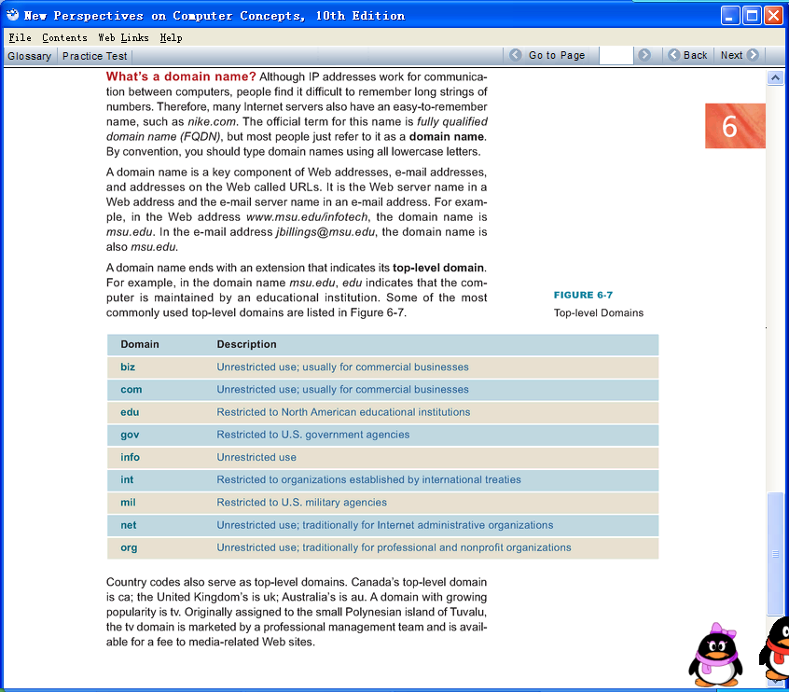
Top Level Domains
A domain name ends with an extension that indicates its top-level domain.
A

Slide 81
Domain Name Resolution
How are domain names related to IP addresses?
Every domain name corresponds to a unique IP address that has been entered into a huge database called Domain Name System(DNS).
Any computer that hosts this database is referred to as a domain name server.
A

Slide 82
Domain Name Resolution
1.为什么要进行域名解析？
  用户希望使用记忆和书写较为方便的域名
  主机之间的通信仍然需要通过IP地址进行
  必须提供一种机制进行域名与IP地址之间的映射
2.域名解析
  将域名映射为对应的IP地址（或将IP地址映射为对应的域名）
  域名解析需要借助于一组既相互独立又相互协作的域名服务器完成
Introduction to Computer Systems

Slide 83
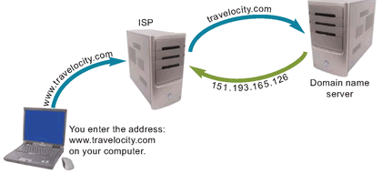
A domain name must be converted into an IP address before packets can be routed to it.

Slide 84
域名服务器 DNS (Domain Name Server)
因特网中设有很多的域名服务器 DNS，用来把域名转换为 IP 地址。
例如，DNS 收到 www.cctv.com 后，经过查询过程，就把这个域名转换为 IP 地址,用点分十进制表示就是：
58.53.220.133
Introduction to Computer Systems

Slide 85
Do I need my own domain name?
For client-style Internet activities, you do not need your own domain name. However you might want it, if you plan to operate your own Web server or if you establish a Web site using servers provided by a Web site hosting service.
How do I get a domain name?
The first step in registering a domain name is to find out whether the name is available. By connecting to an Accredited Domain Registrar Web site, you can enter a domain name.
A

Slide 86
1.1 Using the Web
1.1.1 Surfing the Web
1.1.2 Your Web Pages
1.1.3 Clients, Servers, and URLs
1.1.4 Searching the Web
1.1.5 Commerce on the Web
1.1.6 Some Ethical Considerations

Slide 87


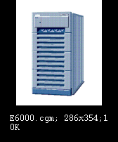
Browse Sample
浏览武大网站：http://www.whu.edu.cn
武汉大学的网页

Slide 88
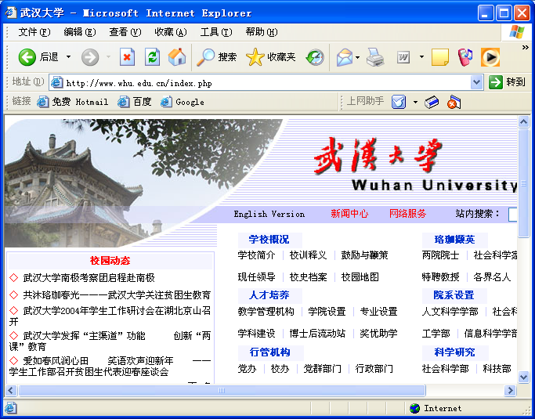

Slide 89
Clients, Servers
Clients, Servers
  A client application requests information from a server application or asks the server to perform some task.
  Client asks for service.
  Server provides the service.
The site that supplies the information is considered a server.
请求服务
The browser is considered a client.
提高服务

Slide 90
Clients, Servers
Server applications are typically run on powerful computers, since they need to be able to serve concurrent requests from a number of clients.
Client applications are typically run on less powerful computers, such as PCs or workstations.

Slide 91
http://www.whu.edu.cn/index.php

Slide 92
URLs
Uniform Resource Locator naming scheme
  Provides user with a way to access Web resources using a uniform means for addressing resources.
  [protocol]://[name of machine][name of resource]
Notes:
和IP地址的区别

Slide 93
URLs (Cont)
[protocol]://[name of machine][name of resource]
  ex: http :// www.icarnegie.com/courses.html
name of the resource addressed by the URL
Hypertext Transfer Protocol
—— a communication protocol
name of the machine hosting the resource
  ftp:// www.icarnegie.com/index.htm
  http://202.114.35.66

Slide 94
(1) 协议
常见URL访问方法：
http: HTTP协议 news: USENET新闻
ftp: FTP协议 gopher:Gopher 协议
file : 本地文件系统 WAIS:广域信息服务
telnet:登录到其他主机
(2) :// 是URL规范要求的标记。
(3) 主机名: 要访问的服务器名字，也可以是服务器IP地址
(4) 文件路径: 服务器上保存目标文件的目录
所有WWW服务器应用程序的省缺端口号都内定为 80

Slide 95
Basic Work Model
Client sends a request for a resource
  A protocol (How do I get the resource?).
  The server (What server has this resource?).
  The resource itself (What resource specifically?).
Server
  Locates the resource requested.
  Transmits a copy of the resource back to the client using the specified protocol.

Slide 96
Browse Sample
浏览武大网站：http://www.whu.edu.cn
武汉大学的网页
Dynamic Web Content
—— extend the basic client-server model

Slide 97
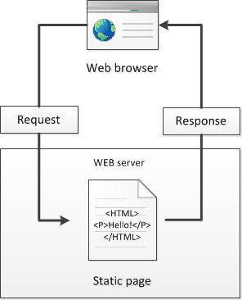
Basic Model
  Server locates the resource

Slide 98
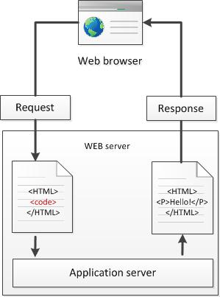
Beyond the Basic Model
step4: the web server return this new page to the client
Step 1: a client ask for a dynamic page
step 2: web server look for the page and send it to application server to perform some tasks
Step3: the application server accomplish these tasks and form a new page to return to the web server.
  Server executes auxiliary applications.

Slide 99
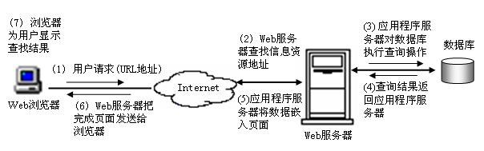

Slide 100
Web应用开发技术
Web客户端开发技术
  1. HTML
    HTML是构成Web页面的语言，是一种文本形式的标记符号语言。 是Web技术应用基础，现已有多种工具可以完成可视化的编程任务。 是浏览器浏览的基础。由于下载后再浏览，因此下载者可以看到编写的原代码，没有保护和安全性。技术最为简单。
  2.CSS
    层叠样式表(英文全称：Cascading Style Sheets)是一种用来表现HTML或XML（标准通用标记语言的一个子集）等文件样式的计算机语言。CSS不仅可以静态地修饰网页，还可以配合各种脚本语言动态地对网页各元素进行格式化。

Slide 101
Web应用开发技术
Web客户端开发技术
  3. 脚本技术
    JavaScript--Sun和Netscape公司开发的一种解释性脚本语言，不需要编译，可以直接插入HTML文档中。它比Java更简单有效，且具有Java的许多特性。使用JavaScript很容易设计与用户交互的界面。
    VBScript--Microsoft公司推出的Web页面编程语言，继承了很多VB的语言特征。必须嵌入到HTML文档中，随同页面下载到客户端，由浏览器解释执行。VBScript可以和ActiveX控件集成，用于开发交互式页面，它也能够进行服务器端的编程。

Slide 102
Web应用开发技术
Web客户端开发技术
  4. XML技术
    XML(extensible Markup Language)是一种可扩展的源标记语言，是可以定义其他语言的语言。它是 SGML的一个简化子集，专门为Web环境而设计的。应用XML制作页面的基本思想是：将内容与内容的显示方式分别定义，以使编码人员将精力集中于内容本身

Slide 103
Web应用开发技术
Web服务器端开发技术
  5. JSP(Java Server Pages)技术
    JSP是Sun Microsystem公司在1999年6月推出的一种动态网页新技术。在HTML页面中加入Java程序段和JSP标记就构成了JSP网页。JSP是基于Java用于网上应用开发的Web开发技术。JSP的结构与ASP很相似，但应用JSP开发的基于Web的应用具有跨平台的特性，可以在大多数Web Server 上运行。JSP将用户界面与底层的应用分开，使开发人员在不改变应用的情况下改变页面布局。正由于 JSP的种种优点，它对于建立商业级的应用具有独到的优势，可以使Web开发人员轻松、高效地创建与维护动态网站。

Slide 104
Web应用开发技术
Web服务器端开发技术
  6. Python技术
    Python是一门跨平台、开源、免费的解释型高级动态编程语言。Python支持命令式编程、函数式编程，完全支持面向对象程序设计，语法简洁清晰，拥有大量的几乎支持所有领域应用开发的成熟扩展库。
    胶水语言：可以把多种不同语言编写的程序融合到一起实现无缝拼接，更好地发挥不同语言和工具的优势，满足不同应用领域的需求。
    Python主要有以下三大主要应用：
      Web开发
      数据科学（机器学习、数据分析和数据可视化）
      脚本

Slide 105
Web应用开发技术
Web服务器端开发技术
  7. ASP(Active Server Pages)与ASP.NET技术
    ASP技术是Microsoft公司在1996年底推出一种运行于服务器端Web应用程序开发技术。
    ASP不是一种开发语言，也不是一种开发工具，它是一种技术框架，是一种内含在IIS/PWS中的可以集成脚本语言（如：VBScript或JavaScript）到HTML主页的服务器端开发环境。
    主要功能是：为生成动态、交互并且高效的Web服务器应用程序提供一种功能强大的技术或方法。
    主要特点：把HTML/DHTML、脚本和数据库访问功能结合在一起，组成在服务器端的应用程序。ASP的开发效率和可用性远远超过CGI编程。

Slide 106
Web应用开发技术
Web服务器端开发技术
  8. CGI技术
    CGI(Common Gateway Interface)的技术含义是公共网关接口，是Web开发应用中使用最早的一种技术。CGI是动态Web页面的基础，也是Web与其它应用交互的基础。CGI是扩展Web服务器功能的一种接口，通过它可以与访问Web页面的用户进行交互，也可以通过数据库编程接口与数据库服务器进行通信。
    CGI可以采用任何语言编写出来由脚本语言完成的Web应用。比较多见的是用perl语言编写。它也是在服务器端解释，传输到客户点浏览。编程较为复杂。

Slide 107
Web应用开发技术
Web服务器端开发技术
  8. PHP(Personal Home Page Tools)技术
    PHP由创始人Rasmus Lerdorf在1994年提出，1995年发布第一个公开版本，是自由软件，自发布起流行非常迅速。是服务器端的Web应用程序开发技术，具有多平台特性，能够无缝运行在Unix、Linux和 Windows平台上。它支持数种通用Web服务器(如IIS,Apache等)，用户变换平台时，不需要改变PHP代码。PHP对数据库的操作具有很强的兼容性，几乎支持所有的主流和非主流数据库，如：Oracle、Sybase、MySQL、mSQL、PostgreSQL、informix、Solid、Access和dBase等。

Slide 108
Web 数据库
数据库技术是管理信息系统的核心技术和基础技术，也是Web技术的一个重要组成。数据库是存放数据的仓库，数据库管理系统是一个系统软件，它的主要作用是：科学地组织和存储信息，高效地获取和维护信息。

Slide 109
数据库
  存储数据的仓库，即存储在计算机系统中结构化的、可共享的相关数据的集合
数据库管理系统（Database Management System，DBMS）
  用于管理数据的计算机软件
  定义数据、操作数据以及维护数据
目前流行的数据库管理系统产品
  适合于企业用户的网络版DBMS：如Oracle、Microsoft SQL Server、IBM DB2等
  适合于个人用户的桌面DBMS：如Microsoft Access等

Slide 110
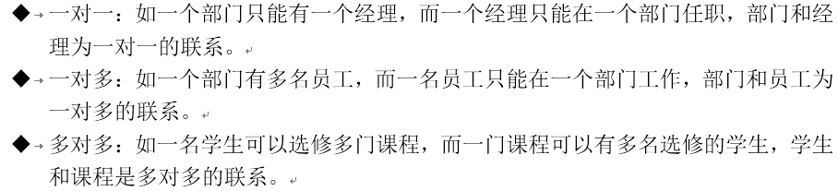
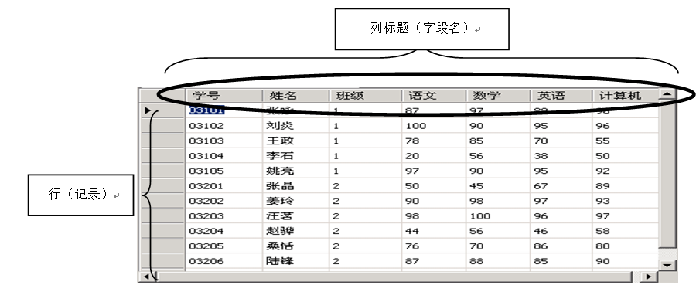
关系数据库
常用的数据库模型
  层次模型（Hierarchical Model）、网状模型（Network Model）、关系模型（Relational Model）和面向对象的数据模型（Object Oriented Model）
关系模型
  世界由实体（Entity）和联系（Relationship）构成
  三种联系
数据库中的表
  行（Row）
  列（Column）
主关键字（Primary Key）
  用于唯一确定一条记录

Slide 111
什么是Web数据库访问技术
Web数据库访问技术：通过Web方式访问数据库
特点：
  • 客户端统一的界面。
  • 统一的开发标准。HTML是Web信息的组织方式，是一种国际标准，Web服务器与浏览器都遵循该标准。基于数据库的应用都可以通过浏览器来实现，通过Web来访问数据库。开发者需要掌握的主要技术标准是HTML，这在很大程度上降低了开发难度，同时也减少了开发成本。
  • 跨平台运行。由于采用了统一的标准，用HTML标准开发的数据库应用，可以跨平台运行，减少了开发的工作量。

Slide 112


Web数据库访问的工作过程
• 提供中间件连接Web服务器和数据库服务器；
• 把应用程序下载到客户端，在客户端直接访问数据库
中间件
客户端
数据库
Web服务器
中间件是Web服务器与数据库服务器之间桥梁，负责他们之间通信并提供应用程序服务。中间件可以直接调用脚本或外部程序来访问数据库，并将访问结果转换成HTML格式，通过Web服务器返回给客户端浏览器。

Slide 113



常用Web数据库访问技术
1. JSP
②触发JSP引擎
③JSP引擎翻译
①JSP请求
JSP
Servlet
因特网
客户
浏览器
数据库服务器
Web服务器
⑤ 返回结果
④访问数据库，并返回结果

Slide 114
JSP工作过程
(1) 客户在浏览器地址栏目输入要请求的 *.jsp页面的URL，发出一个jSP请求。
(2) Web服务器接受“.jsp”的请求，触发JSP引擎。
(3) JSP引擎检查JSP文件是新的还是修改过的，针对不同情况对文件进行翻译和编译，把JSP标签、Java代码HTML内容都转换为Servlet代码，扩展名“.java”的文件。
(4)将产生的Servlet代码编译执行。
(5) 将结果返回浏览器,浏览器解释执行HTML页面，把结果展示给用户。

Slide 115
1.1 Using the Web
1.1.1 Surfing the Web
1.1.2 Your Web Pages
1.1.3 Clients, Servers, and URLs
1.1.4 Searching the Web
1.1.5 Commerce on the Web
1.1.6 Some Ethical Considerations

Slide 116
Searching the Web
Browsing and searching
Search engine is a program that allows one to search for keywords in files at one or more Internet sites.
  Google: www.google.com

Slide 117
How to search
Use a search site
Type key words of your search into the search engine
Search….
Use the help information offered by each search engine.

Slide 118
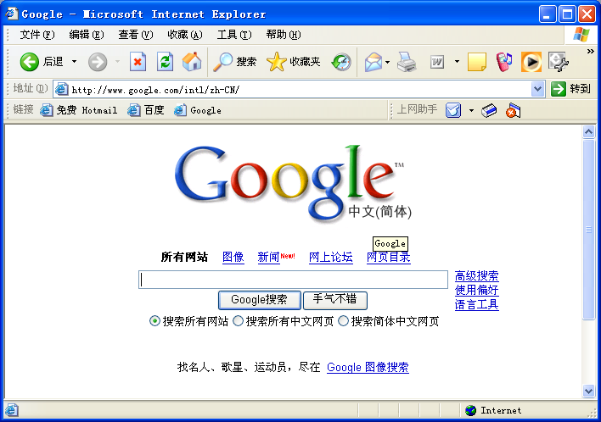
A search Sample
http://www.google.com/intl/zh-CN/

Slide 119
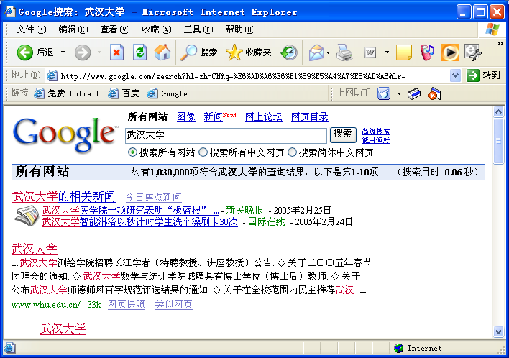

Slide 120

Searching the Web (Cont)
Two types of Search Sites
  Sites that feature a search engine
    Sites of this type maintain indexes or databases of the addresses of virtually all of the pages and documents on the Web. These indexes and databases are updated regularly and automatically by programs known as "spiders”

Slide 121
Searching the Web (Cont)
Two types of Search Sites
  Sites that feature a Web directory
    it organizes information available on the Web into different categories and subcategories.

Slide 122
Commerce on the Web
Web-based Internet commerce
  Internet Service Providers (ISPs)
    sell you access to the Internet
  Advertising
  Commercial Transactions

Slide 123
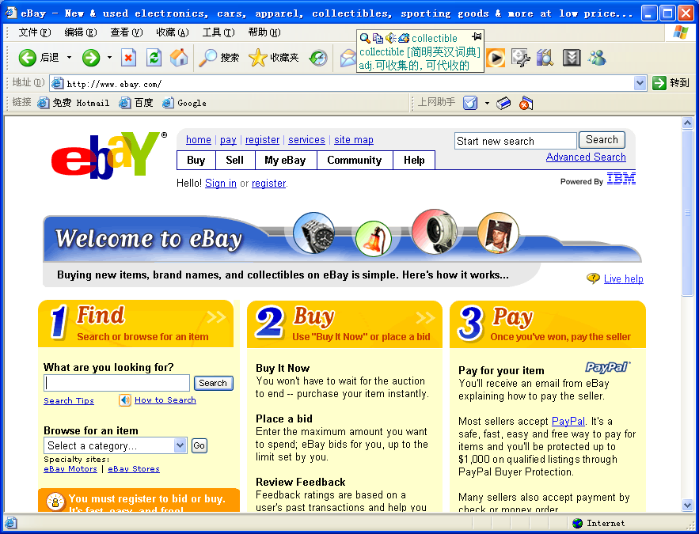

Slide 124
Some Ethical Considerations
Can you go to your favorite sports team's Web page, make a copy of the .jpeg or .gif file that is their logo and put that logo on your Web page?
Can you put a link on your page to the home page of your favorite sports team?

Slide 125
Summary
World Wide Web
  Internet
    Internet services
  WWW, Web information system
Clients, Servers, and URLs
Searching the Web
  Search engine
Commerce on the Web
Some Ethical Considerations

Slide 126
Quiz 1
1. Which of the following is true about the accuracy of information on the Web?
(a) Web server programs ensure that information on the Web is accurate.
(b) Web administrators ensure that information on the Web is accurate.
(c) Web organizations ensure that information on the Web is accurate.
(d) Information on the Web might not be accurate.
Notes:
d

Slide 127
2. Valid URLs include which of the following?
I ftp://ftp.carnegietech.org/courses/course2.html
II http://www.carnegietech.org/courses/
course2.html
III http:/www.whitehouse.gov/president/
(a) II only
(b) III only
(c) I, II, and III
(d) I and II only
Notes:
d

Slide 128
3. You can call an application a client in a client/server architecture if
(a) your computer provides information to the general public
(b) you pay to your ISP to get on Internet
(c) the application requests information from a computer on the Internet that provides information to many consumers
(d) you only use a Web browser produced by a single company
Notes:
c

Slide 129
4. Which of the following is (are) true about regulation of information on the Web?
I The Advanced Research Project Agency (ARPA) ensures that the contents of Web pages are accurate.
II The Web administrator regulates all of the content on the Web to ensure it is accurate.
(a) I and II only
(b) II only
(c) None
(d) I only
Notes:
c

Slide 130
5. In the following URL, what is the name of the server?
http://www.carnegietech.org/courses/course1.html
(a) www.carnegietech.org
(b) courses
(c) courses/course1
(d) http
Notes:
a

Slide 131
6. The first part of a fully-specified URL is
(a) the domain name of the Web server
(b) always www
(c) the protocol identifier
(d) always http
Notes:
c

Slide 132
7. A program that finds Web pages based on user input is typically referred to as a
(a) search client
(b) search engine
(c) help server
(d) Uniform Resource Locator
Notes:
b

Slide 133
8. The Internet is
(a) a collection of HTML documents
(b) a worldwide computer network
(c) an internal part of the World Wide Web
(d) a system of computers built to support e-mail delivery
Notes:
b

Slide 134
9. The term Web server refers to a
(a) special computer used to run powerful Web browsers
(b) Web browser used on a client computer
(c) person who collects and manipulates Web pages
(d) program that provides information requested by a Web client
Notes:
d

Slide 135
10. When you browse the Web, you typically want to examine information stored
(a) on a variety of Web servers in different places
(b) on your local computer
(c) at your local library
(d) at World Wide Web headquarters
Notes:
a

Slide 136
Thank you ！

