Slide 1
SSD1: Introduction to Information Systems
Unit 1: Using the Web
Wuhan University

Slide 2
1.3 Introduction to HTML Forms and Servlets
Dynamic Web Page
Form
Servlet

Slide 3
1.3 Introduction to HTML Forms and Servlets
A detailed look at the FORM element and a basic set of form controls.
A high-level look at Java servlets and the role they play in extending the basic client-server model.
Gain experience in creating and submitting forms to a supplied servlet.
Notes:
表单在Web网页中用来给访问者填写信息，从而能获得用户信息，使网页具有交互的功能。一般是将表单设计在一个Html文档中，当用户填写完信息后做提交(submit)操作，于是表单的内容就从客户端的浏览器传送到服务器上，经过服务器上的 ASP 或 CGI 等处理程序处理后，再将用户所需信息传送回客户端的浏览器上，这样网页就具有了交互性。

Slide 4
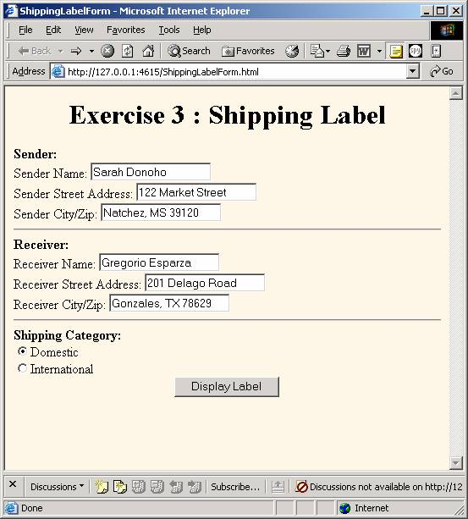

Slide 5
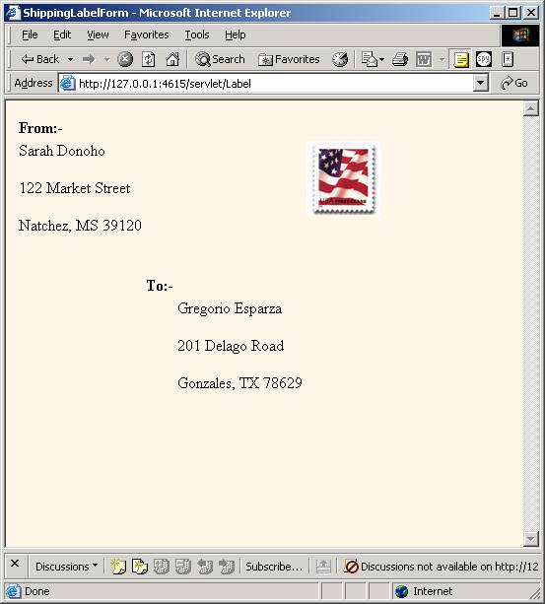

Slide 6
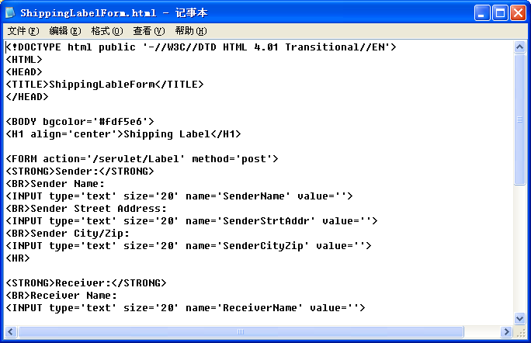

Slide 7
The FORM Elements
The FORM element is a container element that creates a special area on an HTML page known as a form.
  FORM
    INPUT
    LABEL
    FIELDSET
    TEXTAREA
Notes:
<form> 标签用于为用户输入创建 HTML 表单。
表单能够包含 input 元素，比如文本框、复选框、单选框、提交按钮等等。
表单还可以包含select、button、textarea、fieldset、 label 等元素。

Slide 8
Form Element表单
FORM
<FORM element attributes >
form content ...
</FORM>
<FORM action='http://example.com/servlts/myprog' method='post'>
form content ...
</FORM>
Provides the name of the program that will process the form data
has only two valid options—post and get
Notes:
get是把参数数据队列加到提交表单的ACTION属性所指的URL中，值和表单内各个字段一一对应，在URL中可以看到。post是通过HTTPpost机制，将表单内各
个字段与其内容放置在HTML HEADER内一起传送到ACTION属性所指的URL地址。用户看不到这个过程。
get传送的数据量较小，不能大于2KB。post传送的数据量较大，一般被默认为不受限制。但理论上，IIS4中最大量为80KB，IIS5中为100KB。
get安全性非常低，post安全性较高。

Slide 9
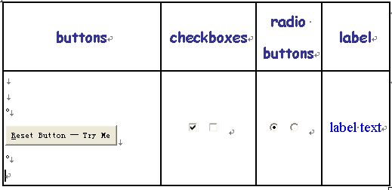
Form Controls表单控件

Slide 10
Form Controls
Button按钮
  Three types of buttons: push button, reset buttons, and submit buttons
Checkbox复选框
  Checkbox controls allow users to toggle them “on” and “off”
Radio buttons单选框
  A radio button group is created by assigning all of the radio buttons that are to be in the group the same control name.
Label标签
  Label controls are used to specify label text for form controls.

Slide 11
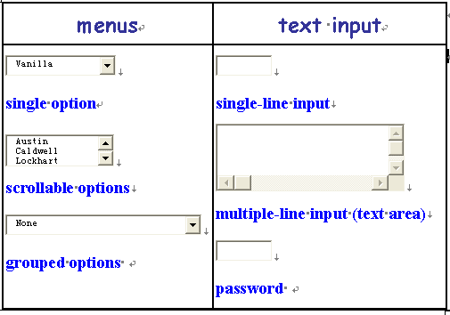
Form Controls

Slide 12
Form Controls
Menu
  allow users to choose from set of predetermined options.
  Three types: single-option drop-down lists, scrollable-option list, and grouped-option drop-down list.
Text input controls
  allow users to input text.
  Three types: one for single-line input, one for multiple-line input, and one for text that should not be displayed as it is being typed.

Slide 13


Form Controls
File select
  File select controls allow users to browse to files, select files, and submit the contents of a file or files with a form.
Image Controls
  Image controls are submit buttons

Slide 14
Quick Facts About Controls
Each control has a control name, which is designated by its name attribute.
All controls can have both an initial value and a current value.
When a form is submitted for processing, the controls that have values have their names and values combined into name-value pairs, which are then submitted to a server with the form
在表单被提交给服务器处理前，要绑定控件的名称(name)和值(value)。

Slide 15
Form Controls
All controls submitted with a form, are known as successful controls; controls that remain undefined are not considered successful controls, and are not sent to a server.

Slide 16




Form Controls
Text & Password
rendered control | source
 | <input type='text' name='txtline'>
 | <input name='txtline2'>
 | <input name='txtline3' type='text' value=‘default value‘ size='12' maxlength='200'>
 | <input name='withoutdefault' type='password' size='8' maxlength='8'>

Slide 17
INPUT element
Password.
This type option creates a single-line text input control that obscures from view with a special character, such as an asterisk (*), the characters that are entered into it.
Example source:
  <input name='withoutdefault' type='password' size='8' maxlength='8'>

Slide 18
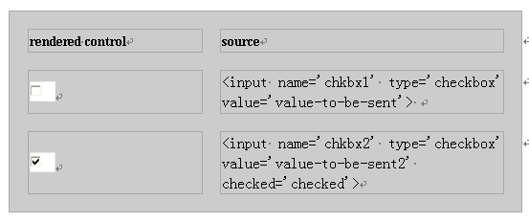
INPUT element
CheckBox
checkbox types must include a value attribute.

Slide 19
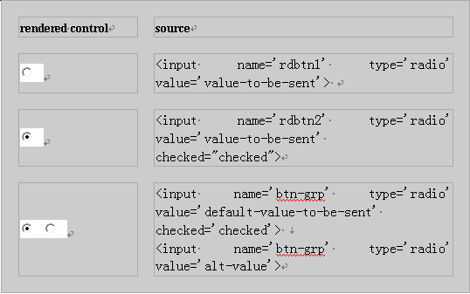
INPUT element (Cont)
Radio
radiobox types must include a value attribute.

Slide 20
Form Controls (Cont)
Checkbox & Radio both must include a value attribute.
Radio buttons differ from checkboxes
  Radio buttons are commonly used in groups in which only one button can be selected at a time.
  INPUT controls of type radio are made into a group by assigning each control that is to be in the group the same value for its name attribute.
    同一组的单选按钮所用的名字属性是一样的。

Slide 21
Form Controls (Cont)
File
Rendered control
source | <input name='select-a-file' type='file'>

Slide 22


Submit (“提交按钮”的两种实现方式, input 和button)
Rendered control | source | source for the equivalent button using the BUTTON element
 | <input type='submit' name='subbtn'> | <BUTTON name=‘subbtn’ value=‘submit’ type=‘submit’>提交查询内容</BUTTON>
 | <input name='subbtn2' type='submit' value='Submit Answer'> | <BUTTON name='subbtn2' value='submit' type='submit'>Submit Answer</BUTTON>
Notes:
value可定义按钮所显示的文本

Slide 23

Submit(Cont)
Rendered control | source | source for the equivalent button using the BUTTON element
 | <input name='subbtn3' type='submit' value='Log On'> | <BUTTON name='subbtn3' value='Log On' type='submit'>Log On</BUTTON>
 | <input name='graphicsubbtn' type='image' src='tools.gif' alt='Submit Tools Information Form'> | <BUTTON name='graphicsubbtn' type='submit'><IMG src='tools.gif' alt='Submit Tools Information Form'></BUTTON>

Slide 24

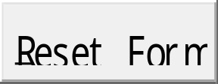
Reset
Rendered control | source
 | <input name='resetbtn' type='reset'>
 | <input name='resetbtn2' type='reset' value='Reset Form'>

Slide 25
Label
Label用于给某控件标注一个名字或注解
Rendered control | source
 | <LABEL> Wuhan Univ.<INPUT name='city' type='checkbox' value='wuhan'> </LABEL>
 | <LABEL FOR='han'> Wuhan Univ.</LABEL> <INPUT name=‘city' type='checkbox' value=‘wuhan' id='han'>
Notes:
for属性规定 label 绑定到哪个表单元素。

Slide 26
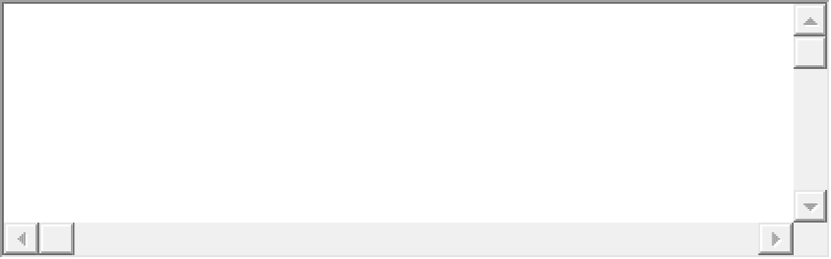
TEXTAREA
Rendered control
source | <TEXTAREA name='textarea' cols='40' rows='5'></TEXTAREA>

Slide 27
Attributes of INPUT
The name and value attributes and a set of “event” attribute
Attributes dedicated to its function as an element— principally the type attribute
  控件的功能由type属性设定
Attributes that limit a control's input (the checked, disabled, readonly, size, and maxlength attributes)
  属性设定了控件的输入情况
Attributes such as: the tabindex and accesskey attributes
  可以通过使用Tab键或快捷键来选中某控件，选中的方式通过设定tabindex或accesskey的值来决定。
Notes:
tabindex和accesskey是全局属性，可用于任何 HTML 元素

Slide 28
Attributes of Controls
Name
  Each control has a name.
  The control name allows the control to be referred to by other client-side programming entities.
    通过控件名的标识，客户端的程序实体可以找到相应的控件。
Value
  all controls can have both an initial value and a current value.
  The initial value is designated by value attribute.
  A control’s initial value never changes.
  The current value can be modified.
  Controls that have no initial values specified are considered undefined when their current values have not been modified.

Slide 29
Attributes of Controls
type
  Control what type of control is created.
    Type属性设定了控件的类型，指明哪种控件被创建。
  Options for the type attribute include text, password, checkbox, radio, file, hidden, submit, image, reset, and button.
Notes:
button定义可点击按钮（多数情况下，用于通过 JavaScript 启动脚本）。checkbox定义复选框。file定义输入字段和 "浏览"按钮，供文件上传。hidden定义隐藏的输入字段。image定义图像形式的提交按钮。password定义密码字段。该字段中的字符被掩码。radio定义单选按钮。reset定义重置按钮。重置按钮会清除表单中的所有数据。submit定义提交按钮。提交按钮会把表单数据发送到服务器。text定义单行的输入字段，用户可在其中输入文本。默认宽度为 20 个字符。

Slide 30
Control Attributes
readonly allow users to see the contents of a control but not be able to change the contents.
  “只读”属性使得控件的内容只能被读取，但无法改变内容。
tabindex specify the order in which users can move the cursor or focus from control to control on the form using the TAB key.
  Tabindex设定使用Tab键来选中控件的顺序。
accesskey allows page authors to assign "access keys" to individual controls.
alt attribute can be used to controls accessible to, say, users who rely on text recognition software to read computer interfaces.
  alt属性设定某控件的替代文本显示内容

Slide 31
<form action="server/server" method="post">
<input type="hidden" name="date" value="July, 2000">
<label>Name:
<input type="text" name="text1" value="Enter your Name"><br>
</label>
<label>Password:
<input type="password" name="text1" value="blinky"><br>
</label>
<input type="checkbox" name="genre" value="drama" checked>drama
<input type="checkbox" name="genre" value="comedy" checked>comedy
<input type="checkbox" name="genre" value="romance">romance
<input type="checkbox" name="genre" value="action">action<br>
<input type="radio" name="price" value="lt4">under $4.00
<input type="radio" name="price" value="4-6" checked>$4.00 to $6.00
<input type="radio" name="price" value="6-8">$6.00 to $8.00
<input type="radio" name="price" value="gt8">over $8.00<br>
<textarea name="info" rows="10" cols="40">
Please enter a list of all your top 5 favorite movies:
1.
2.
3.
4.
5.</textarea><br><br>
<select name="view" size="2">
<option>theater
<option>drive-in
<option>video/DVD
<option>television
</select><br>
<button name="senddata" type="submit">Submit Data</button>
<button name="cleardata" type="reset">Clear Data</button>
</form>
Notes:
button 定义可点击按钮（多数情况下，用于通过 JavaScript 启动脚本）。 checkbox 定义复选框。 file 定义输入字段和 "浏览"按钮，供文件上传。 hidden 定义隐藏的输入字段。 image 定义图像形式的提交按钮。 password 定义密码字段。该字段中的字符被掩码。 radio 定义单选按钮。 reset 定义重置按钮。重置按钮会清除表单中的所有数据。 submit 定义提交按钮。提交按钮会把表单数据发送到服务器。 text 定义单行的输入字段，用户可在其中输入文本。默认宽度为 20 个字符。

Slide 32
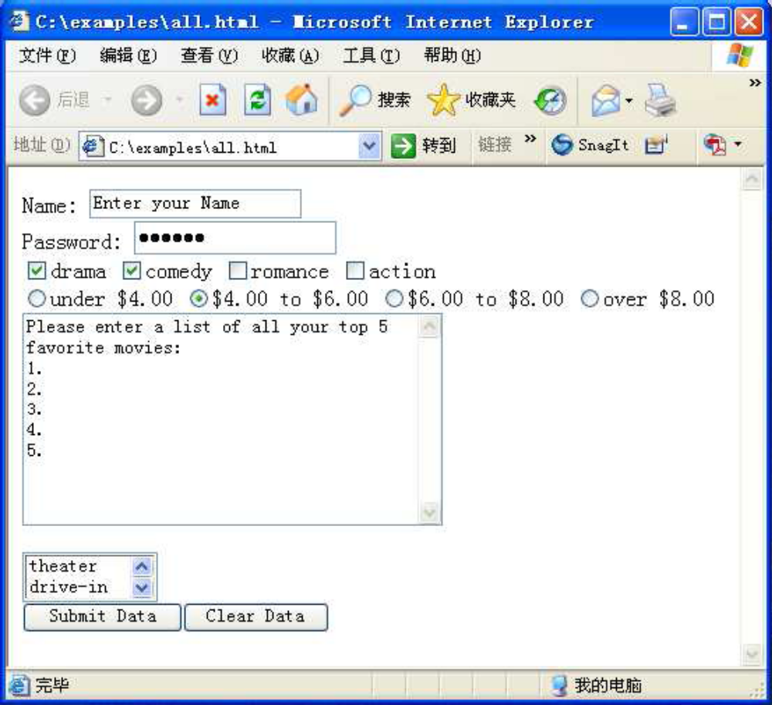

Slide 33

Brief Summary to HTML Controls
Other elements:
  BUTTON
  SELECT
  FILEDSET
Use the HTML resource sites on the Web
  W3C(World Wide Web Consortium )
  http://wdvl.com/Authoring/HTML/4/Tags/forms.html
  http://wdvl.internet.com/Quadzilla/Tag_Ref/form.html
  ……

Slide 34
Dynamic HTML Content
Servlets
HTTP Connections
Server Push-Client Pull
Refresh

Slide 35
Servlets
server-side of the solution to dynamic content
Servlets are typically called from HTML forms (remember the action attribute), and form controls are the agency through which input is created for servlets.
  从客户端的HTML表单调用服务器端的Servlets程序

Slide 36
Servlets
Servlets are programs that run inside of complex software programs known as Web servers (hereafter referred to as "servers").
  Servlets是运行在Web服务器中的程序
It is the servers that run servlets, in order to construct dynamic responses to client requests.
run servlets to deal with the request from client
request
Client
Server
Servlet
Reponse by results returned from servlets
return results
Notes:
Request即请求，指为了获得服务器上的一个资源(可以是文本、图像或任何可以被包含在页面内的元素)，浏览器和它连接的服务器之间进行的一次单一连接。

Slide 37
A user using a Web browser sends a request to a server.
Client
responds by serving the appropriate page to the browser.
forwards the response on to the client browser
Server
determines if the request is for a static HTML page or for an application, such as a servlet.
Loads and initializes the servlet.
passes the request on to the servlet.
Servlet
Deal with the request.
get result from servlets

Slide 38
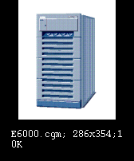

HTTP Connections
A connection is opened
Request Information
Provide Information
A connection is closed
HTTP Connection
(request-response exchange )

Slide 39
HTTP Connections (Cont)
User Sessions
  Series of interactions a user has with a server to carry out a user task.
  用户会话是指某个用户和某服务器为完成用户的事务所进行的一系列交互行为。
  The user session begins when the user first accesses the server through an initial HTTP connection, and the session ends when the user either completes or cancels the task

Slide 40
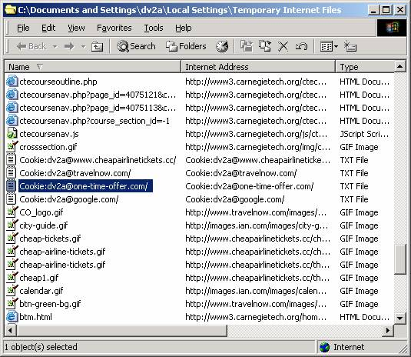
HTTP Connections (Cont)
A cookie is a piece of data generated by a web server and stored on the browser's computer for future reference.

Slide 41
Server Push–Client Pull
Server Push (服务器推技术)
  Control of the client-server transaction is maintained directly by the server.
  The HTTP connection is left open, and the server sends data to the client any time it wants until either the server signals the end of the transaction or the transaction is interrupted by the client
  推技术就是建立一个连接以后，由服务器主动的把最新信息源源不断的推送到客户端
  不需要不停的建立断开连接，不需要刷新页面，
Notes:
Server Push
Control of the client-server transaction is maintained directly by the server.
事物处理由服务器控制
The HTTP connection is left open, and the server sends data to the client any time it wants until either the server signals the end of the transaction or the transaction is interrupted by the client.
HTTP连接保持开启状态；服务器端根据需要，随时发送数据到客户端；服务器端发送连接关闭信号或客户端中断事务处理时，HTTP连接被关闭。

Slide 42
Server Push–Client Pull
Client Pull
Client PULL(客户端拉技术) 不停的建立连接，刷新信息，断开连接，这样效率很低，而且速度很慢.(如果加快速度，频繁的建立断开连接刷新页面都会增加服务器与客户端的资源消耗)
  Requests are generated automatically, without user action, at specified intervals.
  The HTTP connection life cycle follows the pattern typical of client-server transactions initiated by user action.
  With client pull, HTTP response headers, whether generated by an application like a servlet or by HTML tags, direct the browser to retrieve either the same page or another page after a specified interval of time.

Slide 43
Refresh
Server responses that servers send to clients usually consist of the following parts:
  a status line
  one or more response headers
  a blank line
  an HTML document.

Slide 44
Refresh(Cont)
In client pull model
  With the application-generated-response-header approach to implementing client pull, the information directing the client to retrieve a page at a specified interval is inserted into the response as a header by an application, such as a servlet.
  Client pull can be implemented with information provided by an HTML document using the HTML META element.

Slide 45
META
META element provides a means by which an author can specify information about an HTML document.
  META标签是HTML语言HEAD区的一个辅助性标签，它位于HTML文档头部的<HEAD>标记和<TITLE>标记之间，它提供用户不可见的信息。
META elements are enclosed by <HEAD> and </HEAD>.
When HTTP servers serve the document, they read its META elements and create HTTP response headers for all items defined by an http-equiv attributes and assigned values with accompanying content attributes.

Slide 46
META
META element provides a means by which an author can specify information about an HTML document.
  通过META元素，网页作者可以设定HTML文档的一些信息。
META has two attributes:
  name
  http-equiv

Slide 47
META attribute--Name
name属性主要用于描述网页，与之对应的属性值为content，content中的内容主要是便于搜索引擎机器人查找信息和分类信息用的。
meta标签的name属性语法格式是：
  ＜meta name=“参数” content=“具体的参数值”＞

Slide 48
META attribute--Name
<meta name=‘parameter’ content=‘value’>
parameters
  keyword用来告诉搜索引擎你网页的关键字是什么。
  <meta name =‘keywords’ content=‘science, education’>
  description用来告诉搜索引擎你的网站主要内容
  <meta name=‘description’ content=‘This page is about Wuhan University. ’>
  robots用来告诉搜索机器人哪些页面需要索引，哪些页面不需要索引
  <meta name=‘robots’ content=‘none’ >
  author标注网页的作者
  <meta name=‘author’ content = ‘zhangyun, zy@163.com’>

Slide 49
META attribute—http-equiv
<meta http-equiv =‘parameter’ content=‘value’>
parameters
  Expires用于设定网页的到期时间。一旦网页过期，必须到服务器上重新传输。
  <meta http-equiv=‘expires’ content=‘Fri, 12 Jan 2001 18:18:18 GMT’>
  Refresh自动刷新并指向新页面。
  <meta http-equiv='refresh' content='2;URL=http://www.whu.edu.cn'>

Slide 50
META attribute—http-equiv
  Pragma:禁止浏览器从本地计算机的缓存中访问页面内容。
  <meta http-equiv=‘Pragma’content=‘no-cache’>
  Set-Cookie 如果网页过期，那么存盘的cookie将被删除。
  <meta http-equiv=‘Set-Cookie’ content=‘cookievalue=xxx; expires=Friday, 12-Jan-2013 18:18:18 GMT； path=/’>
  Window-Target强制页面在当前窗口以独立页面显示。
  <meta http-equiv=‘Window-target’ content=‘_top’>
  Content-Type设定页面使用的字符集。
  <meta http-equiv=‘content-Type’ content=‘text/html; charset=gb2312’>

Slide 51
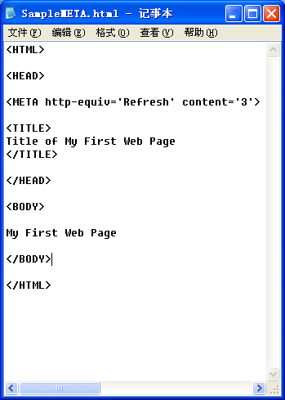
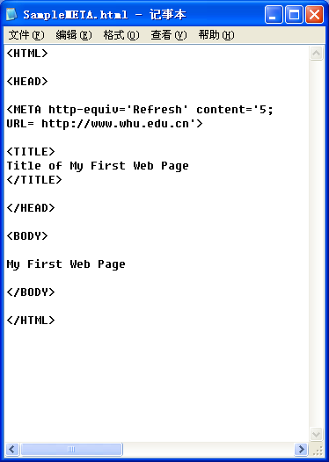
Sample for META

Slide 52
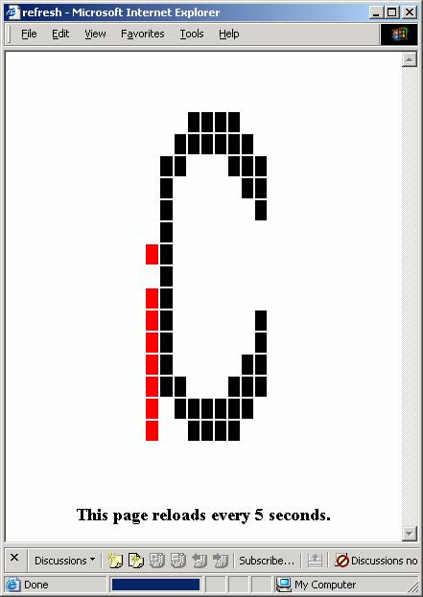
Client-Pull Demo refresh.htm
<meta http-equiv="Refresh" content="5">

Slide 53
Redirect by META
Not all browsers support http-equiv initiated refresh.
  If you use this technique to redirect traffic to another page, be sure to include a link to the new page on the page doing the redirect.
Some browsers, if they are busy when the time for the redirect arrives, may fail to execute the redirect.
  It is important to set the length of the interval long enough to allow the page to load completely over the slowest connection your users might be expected to use.

Slide 54
Use Forms with Servlets
The process of sending forms to servers and then to servlets consists of four steps
  All successful controls are identified.
  A form data set is built of control name-value pairs.
  The form data set is encoded.
  The form data set is sent to a server addressed to a servlet or other processing agent.

Slide 55
First Step
This process begins with the activation of a form submit button.
The process identifies all successful controls—that is, all controls with current values that are valid for submitting to a server.
  关联成功的控件，即所有控件具备了有效的值
  In general, these include all controls that have initial values set with their value attributes or have valid current values as a result of actions occurring after the form was loaded.
  Exceptions to this are radio buttons单选按钮 and checkbox controls. To be successful, radio buttons and checkbox controls must 1) be "checked" and 2) must have initial values that are assigned with value attributes.

Slide 56
Second & Third Steps
Once all successful controls are identified, the browser builds the form data set.
  浏览器构建表单数据集
  This data set consists of the name-value pairs of all successful controls.
Once this data set of name-value pairs is assembled, the set is encoded and sent to a server, addressed to a processing agent.
  数据集被编码后，将被发送到某服务器，该服务器具有处理该数据集的程序

Slide 57
Fourth Step
The way the data set is sent to the server and the agent to which it is sent are determined by a FORM element's action and method attributes.
The action attribute identifies the agent (such as a servlet) by name and its location on the server, relative to the server's root directory.
  Action属性指明用于处理表单数据的程序在服务器中的位置
The method attribute identifies the protocol by which the data set is to be sent.
  Method属性设定表单数据集将以何种方式传送
  post is used for transactions that involve large amounts of data or when security is a requirement.
  get is used for transactions that do not involve a large amount of data and when security is not a requirement.

Slide 58
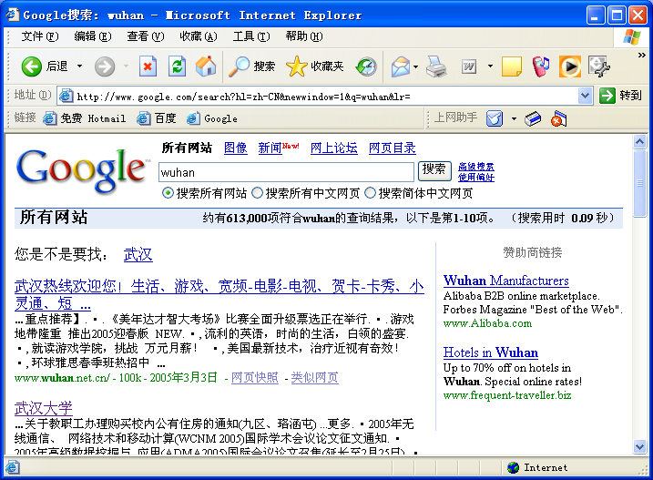
http://www.google.com/search?hl=zh-CN&newwindow=1&q=wuhan&lr=
Notes:
<form name='someName' method='get' action='/search'>, <input type=text name=q value=''>, and <input type=submit name='btnG' value='Google Search'>.
？将处理程序和数据集分开，=连接符，&将name value对分隔开

Slide 59
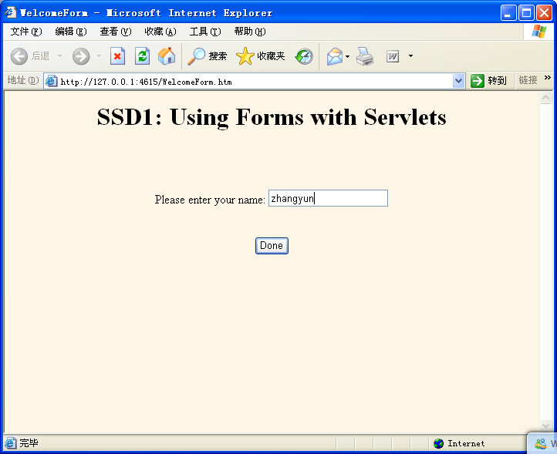
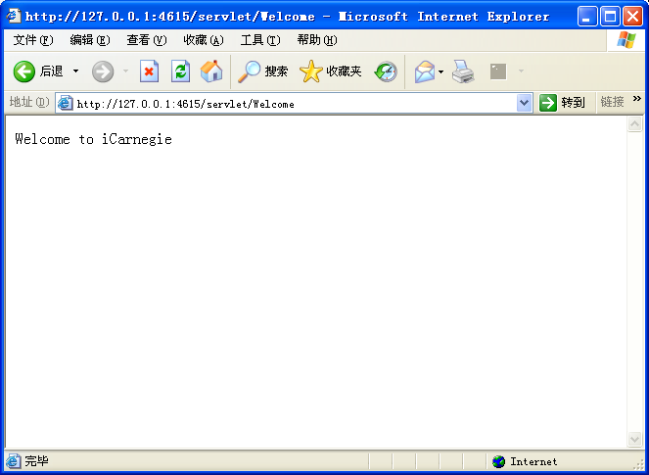
The WelcomeForm Example

Slide 60
<!DOCTYPE html public '-//W3C//DTD HTML 4.01 Transitional//EN'>
<HTML>
<HEAD>
<TITLE>WelcomeForm</TITLE>
</HEAD>
<BODY bgcolor='#fdf5e6'>
<H1 align='center'>SSD1: Using Forms with Servlets</H1>
<FORM action='/servlet/Welcome' method='post'>
<BR>
<BR>
<BR>
<CENTER>
Please enter your name:
<INPUT type='text' size='20' name='Name' value=''>
<BR>
<BR>
<BR>
<INPUT type='submit' value='Done' name='userRequest'>
</CENTER>
</FORM>
</BODY>
</HTML>

Slide 61
A Hands-On Example — The PersonalWelcomeForm

Slide 62
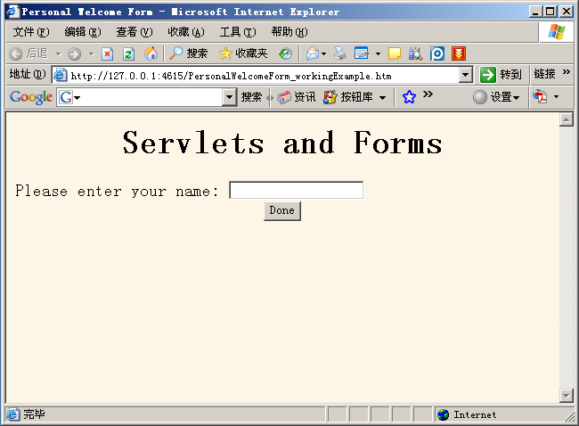
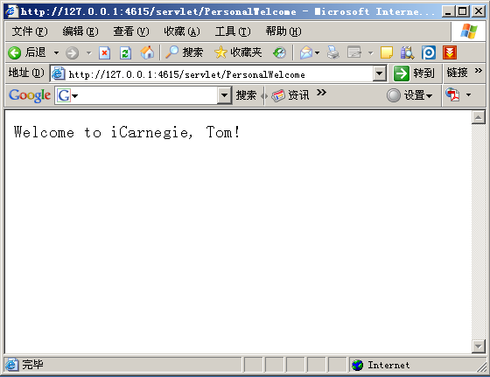

Slide 63
Summary
Dynamic Web Page
Form
  Form Controls
Servlets
  Dynamic HTML Content

Slide 64
Q & A

