Slide 1
Introduction to Software Technology
Unit 1: Using the Web
By Wang Liwei
School of Computer science
Wuhan University

Slide 2

Unit 1: Using the Web
Introduce the World Wide Web and its workings.
  Using the Web
  What's in the Web?
  Introduction to HTML Forms and Servlets

Slide 3
1.1 Using the Web
1.1.1 Surfing the Web
1.1.2 Your Web Pages
1.1.3 Clients, Servers, and URLs
1.1.4 Searching the Web
1.1.5 Commerce on the Web
1.1.6 Some Ethical Considerations

Slide 4
1.1.1 Surfing the Web
Internet
World Wide Web
Internet Service Provider ( ISP )

Slide 5
Internet
Internet is a computer network that connects millions of computers across a number of countries.
There is no central authority that controls the Internet; different organizations own different pieces of it.

Slide 6
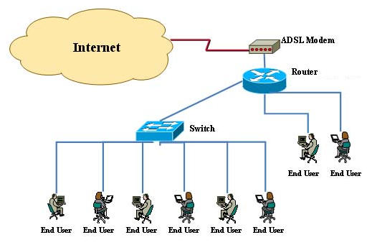
Asymmetric Digital Subscriber Line (ADSL)

Slide 7
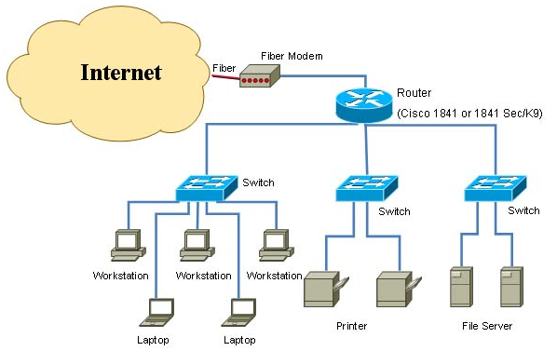
Local Area Network

Slide 8
History of the Internet
The Internet comes from ARPAnet created by the U.S. Defense Advanced Internet Research Projects Agency (DARPA) in 1969.
In 1983, ARPAnet split into ARPAnet and military MILNET, they are referred to as the early Internet backbone network.
This year in January, Transport Control Protocol/Internet Protocol (TCP/IP) officially become the standard protocol for ARPAnet.

Slide 9
History of the Internet
In 1985, the National Science Foundation (NSF) provided huge amounts of money to build the five supercomputing centers.
In 1987, NSF established its own computer network NSFnet based on TCP/IP protocol.
In 1990, NSFnet completely replaced the ARPAnet and becomes Internet backbone.
In 1995, the Internet began large-scale commercial application in the field.

Slide 10
Characteristics of the Internet
A network of networks
Informative and resourceful
Fast and convenient
Endless online activities
Information diversity
…

Slide 11

The main Internet services
WWW (World Wide Web)
  WWW is used for Information searching and releasing
  Users can manipulate the mouse to find hypertext, hypermedia document provided by all sites built on WWW servers.

Slide 12
The main Internet service
E-mail (Electronic mail)
  E-mail system uses SMTP protocol to send e-mail from the user's computer to the mail server.
  E-mail system uses the POP3 protocol to transfers the message from the mail server to the user.
  E-mail messages can send non-text files, such as graphic images and sound files, as attachments sent in binary streams

Slide 13
The main Internet service
FTP (File Transfer Protocol)
  FTP is the primary means of getting files from the remote host on the Internet
  When the file is sent from client to a remote host, known as the “file upload” (Upload); otherwise, known as the "File Download" (Download).
  Transferred files can be text files, executable files, sound files, image files, data compression files.

Slide 14
The main Internet service
Telnet
  Telnet is a network protocol used on the Internet or local area networks to provide a bidirectional interactive communications facility via a terminal connection.
  User logs on to another host via a virtual terminal connection and enjoys the resources and services provided by the host.

Slide 15
World Wide Web
What is WWW ?
  WWW (or “the web”) refers to that portion of the computers on the Internet that can communicate with each other using a computer-network protocol called HTTP.
  WWW is a system of interlinked hypertext documents with client-server model

Slide 16

World Wide Web
Three elements of WWW
  Unified resource naming :Uniform Resource Locator (URL)
  Unified resource accessing：Hypertext Transfer Protocol (HTTP)
    All browsers use HTTP to request and receive Web pages from other computers.
  Unified information Organization ：HyperText Markup Language (HTML)

Slide 17
World Wide Web
Characteristics of WWW
  Distributed information resources
  Unified user interface
    Web browser：IE (MS)；Safari (Apple) ; Chrome (Google); Firefox (Mozilla)
  Supports a variety of media resources
    Text, Photo, Voice, Video …
  Searching and publishing information
  Client-Server model
    Web Brower, Web Server

Slide 18
Internet Service Provider ( ISP )
An ISP is any one of a number of companies that enable people not only to connect to the Internet and surf the Web but also to publish Web pages.

Slide 19
1.1.2 Your Web Pages
“Reasonable Person Principle” -When hosting a website, pages should be maintained for others to view
Information on the pages should be correct and up-to-date.
Presenting email information on web page implies being responsive to emails by surfers.
Displaying personal information on web pages not a good idea.

Slide 20
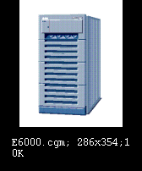

1.1.3 Clients, Servers, and URLs
Client asks for the resource and deals with it.
Server provide the resource.
The site that supplies the information is considered as a server.
Ask for the resource
The browser is considered as a client.
Provide the resource

Slide 21
Clients, Servers, and URLs
Clients-An application that requests information from a server application or asks the server to perform some task.
Servers-Applications that run on relatively more powerful computers, to service concurrent requests from a number of clients.

Slide 22
Clients, Servers, and URLs
Servers
  Microsoft Internet Information Server(IIS)
  Apache Server
  IBM Websphere

Slide 23
URLs
Uniform Resource Locator naming scheme
  Provides user with a way to access Web resources using a uniform means for addressing resources.
  [protocol]://[name of machine] [name of resource]

Slide 24
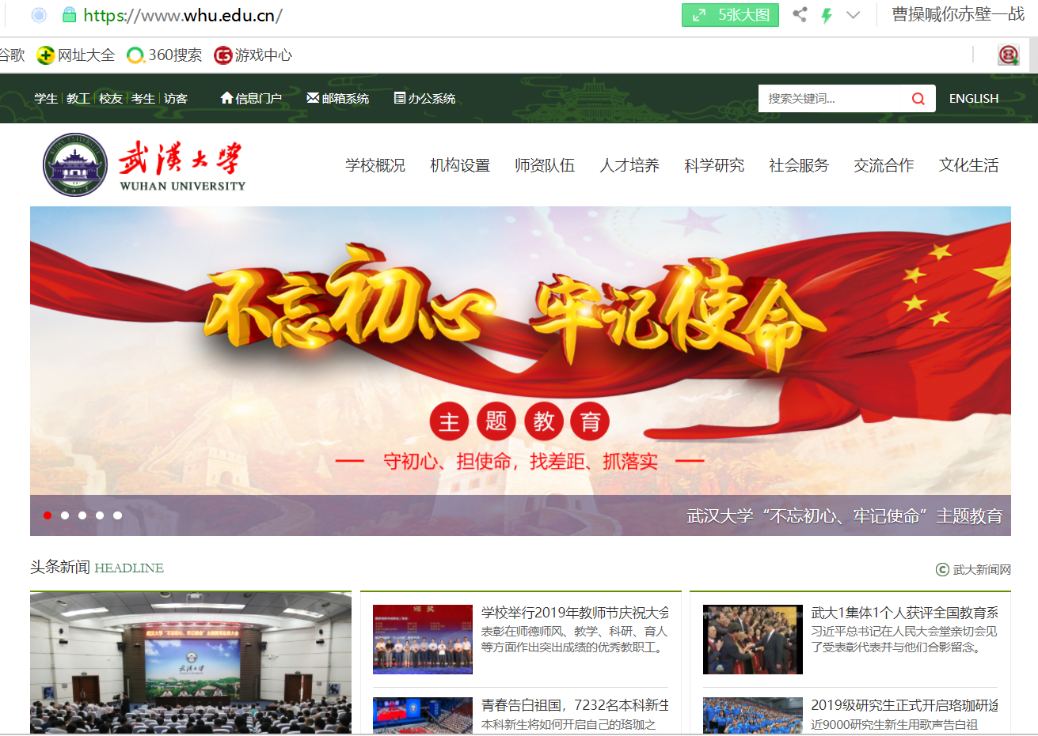
http://www.whu.edu.cn/index.html

Slide 25
URLs (Cont)
[protocol]://[name of machine][name of resource]
  Eg: http :// www.whu.edu.cn/index.html
name of the resource addressed by the URL
What resource specifically?
Hypertesxt Transfer Protocol
—— a communication protocl
How do I get this resource
name of the machine hosting the resource
What Server has this resource?
  ftp://ftp.zju.edu.cn/ ;
  http://202.114.35.66

Slide 26
Clients, Servers, and URLs
Client-Server (C/S)
  Disadvantage: fat clients
Browser-Server (B/S)
  Belong to C/S
  Advantage: Client is web browser

Slide 27
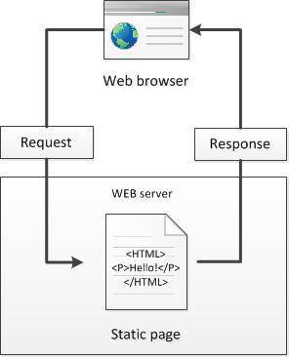

Basic Model
  Server locates the resource

Slide 28
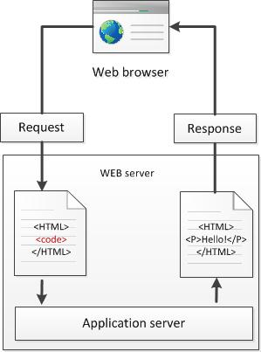
Beyond the Basic Model
step4: the web server return this new page to the client
Step 1: a client ask for a dynamic page
step 2: web server look for the page and send it to application server to perform some tasks
Step3: the application server accomplish these tasks and form a new page to return to the web server.
  Server executes auxiliary applications.

Slide 29
1.1.4 Searching the Web
Browsing vs.Searching
  Browsing-Unfocused random passing from link to link around the web
  Searching-Using a search engine to locate a resource on the web.
  Searching may eventually run into browsing.

Slide 30
Search engine
Search engine is a program that allows one to search for keywords in files at one or more Internet sites.
  Google: www.google.com
  Baidu: www.baidu.com
  Yahoo:http://www.yahoo.com/
  Excite: www.excite.com
  Lycos: www.lycos.com
  AltaVista: www.altavista.com
http://en.wikipedia.org/wiki/Web_search_engine

Slide 31
Types of Search Sites
Search Engine – Featured
  Sites that maintain indexes or databases of the addresses of virtually all of the pages and documents on the Web.
  These indexes or databases maintained regularly using “spiders” for addresses of new documents that become available on the net.
  Eg: google

Slide 32
Types of Search Sites
Web Directory-Featured
  Information organized into categories and subcategories, mostly based on human effort.
  Owners of relevant Web sites responsible for inclusion of their sites.
  Eg:Yahoo!

Slide 33
How to search
Use a search site
Type keywords of your search into the search engine
Search….
Use the help information offered by each search engine.

Slide 34
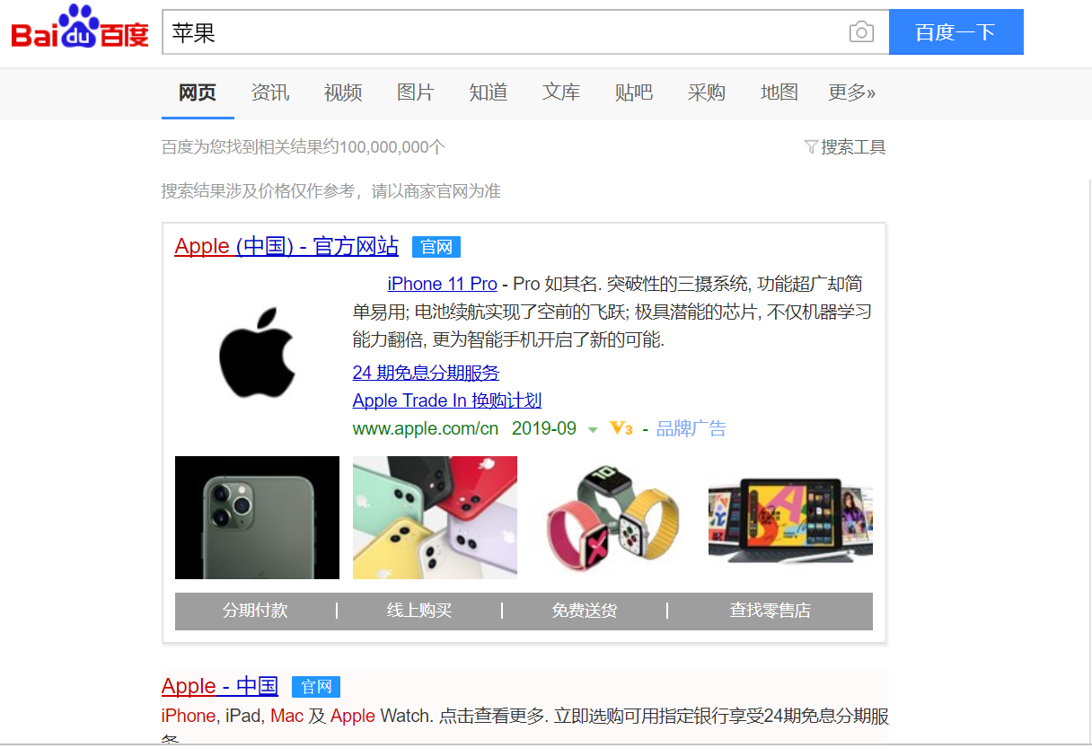
A search sample
--- results

Slide 35
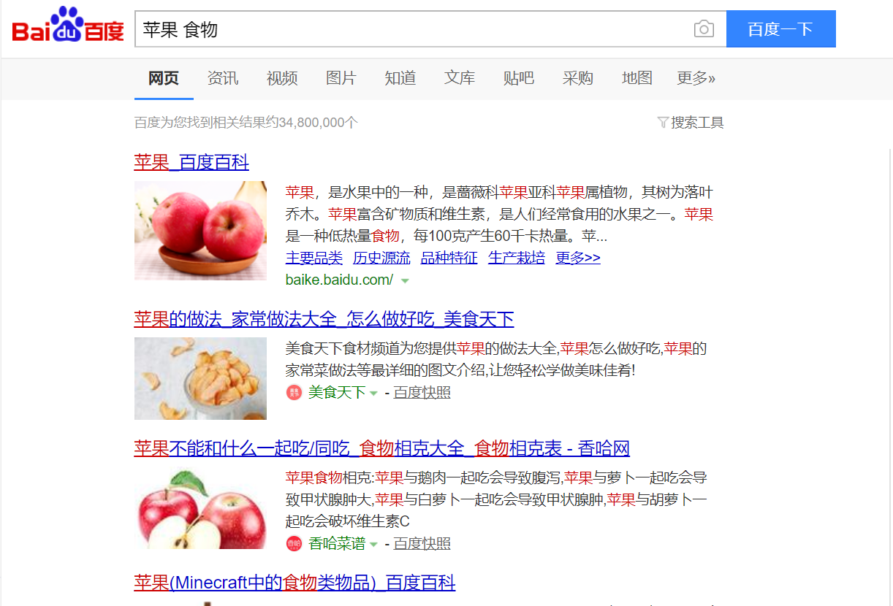
A search sample --- results

Slide 36
1.1.5 Commerce on the web
Advertising
  A way for search engine companies to make money by displaying “visual clutter”
  Ads displayed based on what is being searched for, and can be linked
Commercial Transactions
  Growing percentage of Internet commerce that includes ordering goods, buying tickets, making bookings on the web.
  Many commercial sites on the web now, for eg, www.amazon.com, www.ebay.com, www.taobao.com

Slide 37
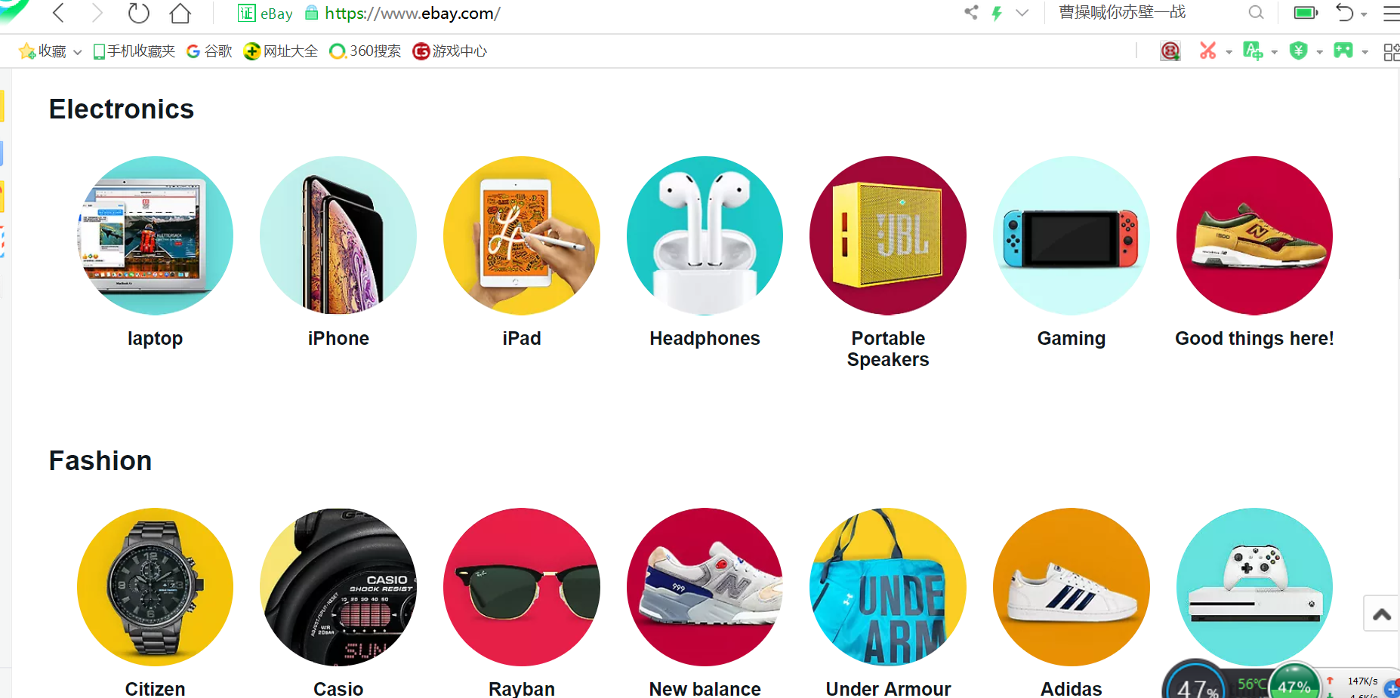

Slide 38
1.1.6 Web Ethics
Can you go to your favorite sports team's Web page, make a copy of the .jpeg or .gif file that is their logo and put that logo on your Web page?
Can you put a link on your page to the home page of your favorite sports team?

Slide 39
Web Ethics
Illegal to put copyrighted information on your webpage without permission. The material may include text, graphics, etc.
Other web pages can be linked or cited on your web pages. Restricting information access is then that web page’s responsibility.
Simply don’t use information you don’t own. If you do, state the sources.

Slide 40
Summary
World Wide Web
  Internet
  WWW
Clients, Servers, and URLs
Searching the Web
  Search engine
Commerce on the Web
Some Ethical Considerations

