Slide 1
Introduction to Software Technology
Unit 1: Using the Web
1.2 What's in a Web Page?
Liwei WANG
liwei.wang@whu.edu.cn
school of computer science

Slide 2

What’s in a web page?
Web browsers can be used to view web pages which are formatted using a language called HTML (Hypertext Markup Language )
HTML elements can be viewed by selecting view source or equivalent option after right clicking on a web page.
A web page’s source is a normal text file; different tags in HTML render formatting like bold, underlined or even links to other pages.

Slide 3
Outline
A First Look at HTML
HTML basics
Main HTML Components
Physical and Logical Styles
Size and Color
Special characters
Structure tag
List
Link
Table
Multimedia
Creating web page

Slide 4

A First Look at HTML
HTML－ Hypertext Markup Language
  Language is a medium for communicating with web browsers
  Markup use tags to convey formatting directions to make text more meaningful.
  Text refers to the words on the computer screen which are plain characters in ASCII(American Standard Code for Information Interchange) format, that we are marking up.
  Hyper is a concept used to create nonlinear links for pages that are related..

Slide 5
A First Look at HTML
HTML
  Combine text, images, sound and animation in a single page document.
  These documents can be displayed by Web browser,
  hyperlinks can be used to access other information resources.
Using HTML’s tags and elements，you can：
  Control the appearance of style and content of the page
  Publish online documentation
  use the link to retrieve online information
  Create online form to collect user information and execute transctions, etc.

Slide 6
A First Look at HTML
HTML Browser
HTML Editor
  Mozilla Firefox
  Microsoft Internet Explorer
  …
  Microsoft FrontPage
  Macromedia Dreamweaver
  Notepad
  ……

Slide 7
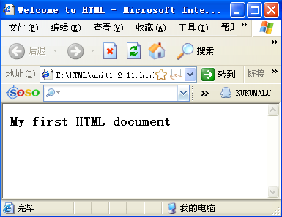
A First Look at HTML
<HTML>
<HEAD>
<TITLE>Welcome to HTML</TITLE>
</HEAD>
<BODY>
<H3>My first HTML document</H3>
</BODY>
</HTML>
Would be displayed like this:

Slide 8
A First Look at HTML
An editor that can save files using .htm or .html extension required to create an HTML page.
.html files identified by web browsers and displayed using HTML markup tags in the file.

Slide 9
A First Look at HTML
Web file names
  No spaces
  No special characters（e.g “&” ），allowing alphanumeric and “_”
  Case sensitive
  Default home page file name：index.htm or index.html

Slide 10
HTML Basics
HTML tags enclosed within “<” and “>”, generally come in pairs with opening and closing tags as <Tagname> and </Tagname>
  <p>…</p>: a pair of tags that identify a section of text as a paragraph
Some tags like <BR> for break does not come in pair

Slide 11
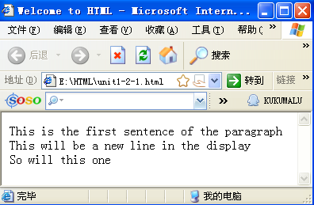
HTML Basics
<HTML>
<HEAD>
<TITLE>Welcome to HTML</TITLE>
</HEAD>
<BODY>
<P>
This is the first sentence of the paragraph
<BR>
This will be a new line in the display
<BR>
So will this one
</P>
</BODY>
</HTML>
Would be displayed like this:

Slide 12
HTML Basics
Text within tags wrapped to fit in browser’s window
Either lowercase or uppercase can be used for tags
Tag can have various attributes，such as size、color、 text 、 etc.
Tags can be nested.

Slide 13

Main HTML Components
Main structure：
  <HTML>
  <HEAD>
  <TITLE>Welcome to HTML</TITLE>
  </HEAD>
  <BODY>
  <H3>My first HTML document</H3>
  </BODY>
  </HTML>
HTML
Document head
Document body
Would be displayed like this:

Slide 14
Main HTML Components
—Tag
HTML tag format：
<ELEMENT ATTRIBUTE = value>
Attribute’s value
Tag’s attribute
tag name

Slide 15
Main HTML Components
—HTML Tag
HTML Tag
  Any HTML document should begin and end with this tag pair
  <HTML>
  . . .
  </HTML>

Slide 16


Main HTML Components
—HEAD Tag
HEAD Tag
  <head> tag is immediately after the <HTML> to denote the document header.
The contents within <head> tags aren’t displayed in browser window.
  TITLE tag is under the <head>tags
    <title> tag specifies the title of the document.
    The contents between <title> and </title> will be displayed in the title bar of the Web page
    <title></title> must appear in pairs, and only be placed within <head> tags.

Slide 17
Main HTML Components
—META Tag
  META Tag is under the <head>tags
    META tag is used to describe the properties of a HTML web page document, such as author, date and time, page descriptions, keywords, page refreshes and so on.
1. Web page information
<META name=“Author” content=“Graham Browne”>
<META name=“KEYWORDS” content=“...”>
<META name="DESCRIPTION" content="...">
Search engine used to mark the page
Description for web page
Author information

Slide 18
<META http-equiv="Expires" content=“Fri, 21 Sep 2016 8:25:27 GMT">
Expires: Fri, 21 Sep 2016 8:25:27 GMT
Automatically refresh the page
<META http-equiv="Refresh" content="10; url=http://yourlink">
Eg: Online real-time news
Text encoding used by Web page
<META http-equiv="Content-Type" content="text/html;
charset=gb2312">
Eg: display Chinese correctly in different browsers

Slide 19
Main HTML Components
—BODY Tag
BODY Tag: Main part of HTML document
  Follow the HEAD
  Almost all of a Web page's content will come between <body> and </body>
  There are Many other tags and their attributes within BODY tags.

Slide 20
Physical Styles
Certain styles can be enforced to the browser by using following tags
  <B></B> Bold
  <I></I> Italics
  <TT></TT> Monospace (fixed width)
  <U></U> Underline
  <SUB></SUB> _{Subscript}
  <SUP></SUP> ^{Superscript}

Slide 21
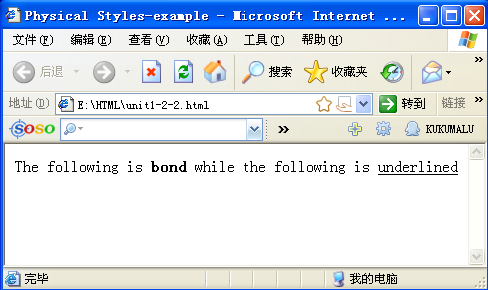
Physical Styles-example
<HTML>
<HEAD>
<TITLE>Physical Styles-example</TITLE>
</HEAD>
<BODY>
<P>The following is <B>bond</B> while the following is <U>underlined</U>
</P>
</BODY>
</HTML>
Would be displayed like this:

Slide 22
Logical Styles
Certain styles allow browser to decide the display of text using following tags.
  <EM></EM> Emphasized text
  <STRONG></STRONG> Strong emphasized text
  <CITE></CITE> Text in citation
  <SAMP></SAMP> Text in a screen output sample
Logical Styles vary from browser to browser

Slide 23
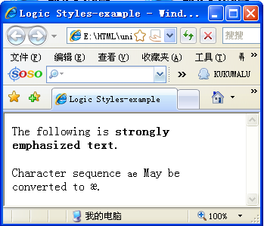
Logic Styles-example
<HTML>
<HEAD>
<TITLE>Logic Styles-example</TITLE>
</HEAD>
<BODY>
<P>The following is <STRONG>strongly emphasized text.</STRONG></P>
<p>Character sequence <samp>ae</samp> May be converted to &aelig.</p>
</BODY>
</HTML>
Would be displayed like this:

Slide 24
Size and Color
Font Size can be set as follows.
  <FONT SIZE = 7>
  Size of the font would then remain 7 until </FONT>
Font color can be set as follows.
  <FONT COLOR = RED>
  Color of the font would then remain RED until </FONT>
Background color of a web page can be set by including in body tag like following.
  <BODY BGCOLOR = RED>
Colors can also be chosen using hexadecimal RGB color codes.
  <BODY BGCOLOR = “#FF0000”>

Slide 25
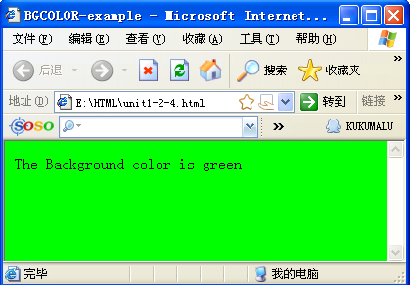
BODY Tag Attribute
bgcolor
<HTML>
<HEAD>
<TITLE>BGCOLOR-example</TITLE>
</HEAD>
<BODY BGCOLOR = “#00FF00”>
The Background color is Green
</BODY>
</HTML>

Slide 26
Color
HTML uses 16 hexadecimal RGB color values
A RGB color code consists of a sequence of three two-digit hexadecimal values, values that can range from 00 to FF
16 hexadecimal:
  0, 1, 2, 3, 4, 5, 6, 7, 8, 9, a, b, c, d, e, f.

Slide 27
16 hexadecimal RGB color
Color | RGB Value
Black | #000000
Silver | #c0c0c0
Red | #ff0000
Blue | #0000ff
White | #ffffff
Yellow | #ffff00
Green | #00ff00

Slide 28
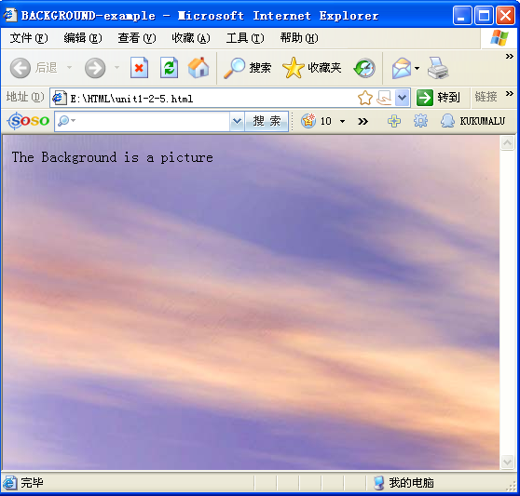
BODY Tag Attribute
background
  Display HTML document‘s background image 。
    Eg: background=“images/bg.gif"
<HTML>
<HEAD>
<TITLE>BACKGROUND-example</TITLE>
</HEAD>
<BODY background="images/bg.jpg">
The Background is a picture
</BODY>
</HTML>

Slide 29
BODY Tag Attribute
bgproperties=fixed
  bgproperties=fixed: picture does not scroll with the scroll bar.
text
  HTML document‘s body text color
    Eg：text=“#FF6666”。
  The color will be applied to entire document

Slide 30
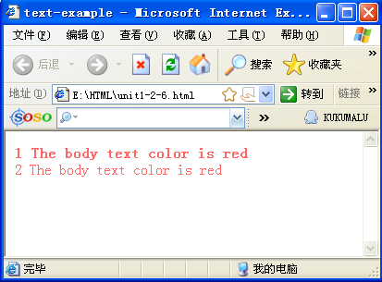
<HTML>
<HEAD>
<TITLE>text-example</TITLE>
</HEAD>
<BODY text="#FF6666">
<B>1 The body text color is red</B>
<BR>
2 The body text color is red
</BODY>
</HTML>

Slide 31
BODY Tag Attribute
Hyperlink Color
  link、vlink and alink separately control colors of ordinary hyperlinks, visited hyperlink and active hyperlink.

Slide 32
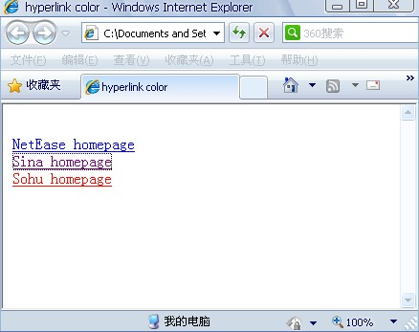
<HTML>
<HEAD>
<TITLE>hyperlink color</TITLE>
</HEAD>
<BODY link="#0000ff" vlink="#00ff00“ alink="ff0000">
<br>
<A href='http://www.163.com'>NetEase homepage</A>
<br>
<A href='http://sina.com.cn'>Sina homepage</A>
<br>
<A href='http://sohu.com'>Sohu homepage</A>
</BODY>
</HTML>

Slide 33
BODY Tag Attribute
leftmargin, topmargin
  Set the distance between the main content of page and top of the page and the left of the page Eg：leftmargin=“50" topmargin=“80“

Slide 34
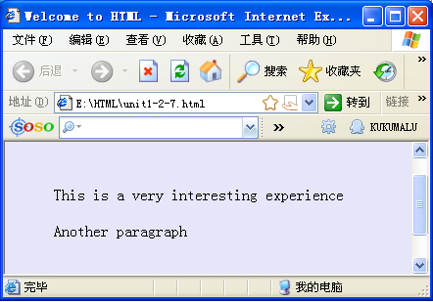
<HTML>
<HEAD>
<TITLE>Welcome to HTML</TITLE>
</HEAD>
<BODY BGCOLOR = lavender leftmargin="50" topmargin="80">
<P>This is a very interesting experience</p>
<P>Another paragraph</p>
</BODY>
</HTML>

Slide 35
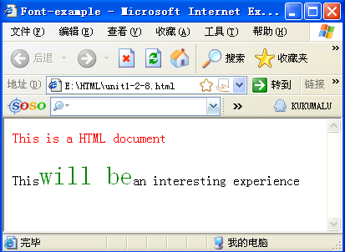
FONT Tag Attribute
Font tag is used to control the display of text on the page, including size, color, style and other properties.
<HTML>
<HEAD>
<TITLE>Font-example</TITLE>
</HEAD>
<BODY>
<FONT SIZE = 3 COLOR = red FACE = “MS PGothic”>This is a HTML document</FONT>
<P>This<FONT COLOR = green SIZE = 6 >will be</FONT>an interesting experience</p>
</BODY>
</HTML>

Slide 36
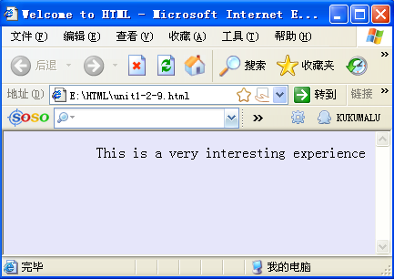
Align
<HTML>
<HEAD>
<TITLE>Welcome to HTML</TITLE>
</HEAD>
<BODY BGCOLOR=lavender>
<P align = right>This is a
very interesting experience </P>
</BODY>
</HTML>
Left
Center
Right
Right align
Would be displayed like this:

Slide 37
Special Characters in HTML
HTML special characters
  Eg：display “<“，&lt; or &#60；
  display “×“，&times; or &#215；
  display “ ” “，&quot; or &#34；

Slide 38
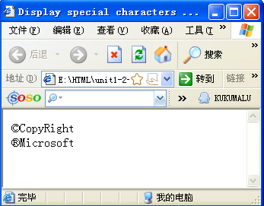
<HTML>
<HEAD>
<TITLE>Display special characters</TITLE>
</HEAD>
<BODY>
&copy;CopyRight<br>
&reg;Microsoft<br>
</BODY>
</HTML>

Slide 39
COMMENT Tag
Comment
  "<!--" and "-->"
  a remark to be put in among the page content but DO NOT want these to be displayed by a browser,
  Ex. <!-- This is a comment. -->

Slide 40
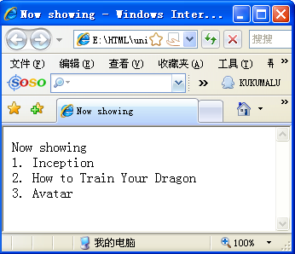
<HTML>
<HEAD>
<TITLE>Now showing</TITLE>
</HEAD>
<body>
<!--This information is provided by the Wuhan University cinema-->
Now showing<br>
1. Inception <br>
2. How to Train Your Dragon <br>
3. Avatar <br>
</body>
</HTML>

Slide 41
Headings
Seven Levels of Heading tags which come in pairs
<H1>and</H1>used to delimit the highest-level headings
<H7>and</H7>used to delimit the lowest-level headings
Size decreases from H1 to H7

Slide 42
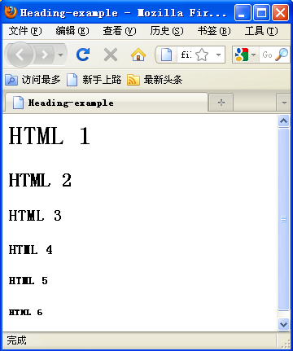
<HTML>
<HEAD>
<TITLE>Heading-example</TITLE>
</HEAD>
<BODY>
<H1>HTML 1</H1>
<H2>HTML 2</H2>
<H3>HTML 3</H3>
<H4>HTML 4</H4>
<H5>HTML 5</H5>
<H6>HTML 6</H6>
</BODY>
</HTML>

Slide 43
Horizontal Lines
<HR> used to create shaded horizontal lines across width of the web page
Line’s size is adjusted with page’s width by the browser.
Attributes supported are as follows.
  SIZE=5:SIZE sets the line’s thickness in terms of pixels-5pixels in this example
  WIDTH=50:sets the line width in terms of a percent of the width of the Web page displayed-50% in this example
  ALIGN=LEFT: justifies the line against either the right or the left margin or centers it in the window
  NOSHADE: removes the line’s default shading

Slide 44
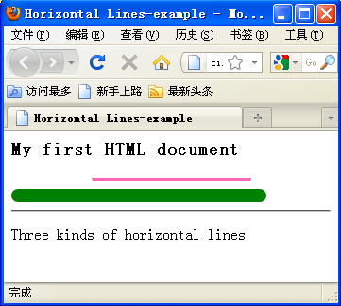
<HTML>
<HEAD>
<TITLE>Horizontal Line-example</TITLE>
</HEAD>
<BODY>
<H3>My first HTML document</H3>
<HR noshade size = 5 color = hotpink align = center width = 50>
<HR size = 15 color = green align = left width = 80>
<HR>
<P>Three kinds of horizontal lines
</BODY>
</HTML>

Slide 45
BLOCKQUOTE
The BLOCKQUOTE element defines a block quotation.
BLOCKQUOTE is used for references and appear as indented paragraphs..

Slide 46
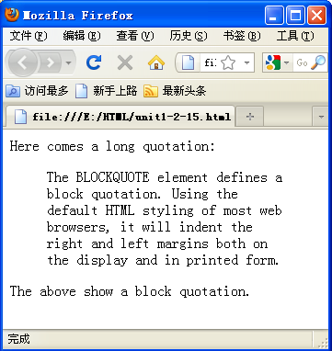
<html>
<body>
Here comes a long quotation:
<blockquote>
The BLOCKQUOTE element defines a block quotation.
Using the default HTML styling of most web browsers, it will indent the right and left margins both on the display and in printed form.
</blockquote>
The above show a block quotation.
</body>
</html>

Slide 47
SPAN and DIV
<DIV>…</DIV> defines a division or a section in a HTML document. It is often used to group block-elements across paragraphs to format them with styles.
<SPAN>…</SPAN> provides a way to add a hook to a part of a paragraph. When the text is hooked in a span element you can add styles to the content

Slide 48
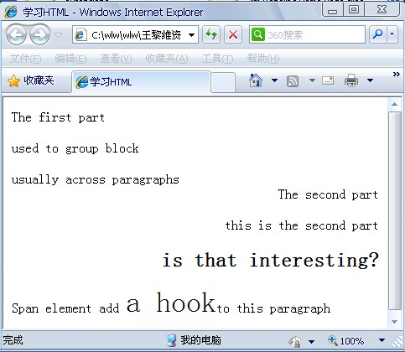
<HTML>
<HEAD>
<TITLE>学习HTML</TITLE>
</HEAD>
<BODY>
<DIV>
The first part
<P>used to group block</p>
<P>usually across paragraphs</p>
</DIV>
<DIV align = right>
The second part
<P>this is the second part
<BR>
<H2>is that interesting?
</H2>
</DIV>
<P>Span element add
<SPAN STYLE =“font-size:35”>
a hook</SPAN>to this paragraph
</BODY>
</HTML>

Slide 49
Preformatted Text
<PRE> and </PRE> tags used when you do not want browsers to decide how to display text
Text then displayed as formatted within the <PRE> tags, without considering logical styles
This might not be true always, hence you need to verify the web page.

Slide 50
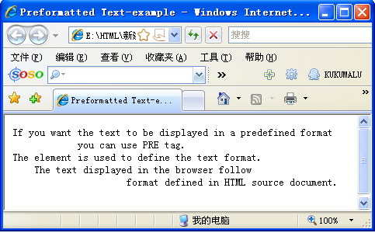
<HTML>
<HEAD>
<TITLE>Preformatted Text-example</TITLE>
</HEAD>
<BODY>
<PRE>
If you want the text to be displayed in a predefined format
you can use PRE tag.
The element is used to define the text format.
The text displayed in the browser follow
format defined in HTML source document.
</PRE>
</BODY>
</HTML>

Slide 51
Lists
Ordered List (OL)
Unordered List (UL)
Definition List (DL)

Slide 52
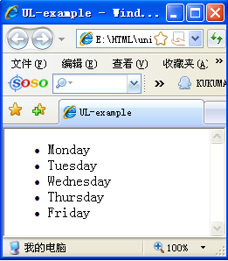
Unordered list
Unordered list created using <UL> and </UL>
Every item in the list created using <LI> tag in front
<HTML>
<HEAD>
<TITLE>UL-example</TITLE>
</HEAD>
<BODY>
<UL>
  <LI>Monday <LI>Tuesday
  <LI>Wednesday
  <LI>Thursday
  <LI>Friday
</UL>
</BODY>
</HTML>

Slide 53
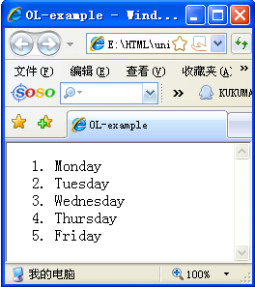
Ordered list
Ordered lists requires <OL> and </OL>, and automatically numbers list starting at 1.
<HTML>
<HEAD>
<TITLE>OL-example</TITLE>
</HEAD>
<BODY>
<OL>
<LI>Monday
<LI>Tuesday
<LI>Wednesday
<LI>Thursday
<LI>Friday
</OL>
</BODY>
</HTML>

Slide 54
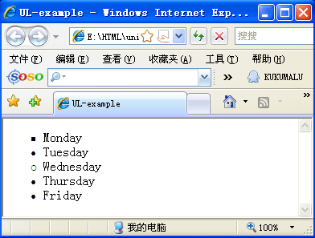
user-defined bullet
<LI TYPE = square>square bullet
<LI TYPE = disc>disc bullet
<LI TYPE = circle>circle bullet

Slide 55
user-defined bullet
Uppercase Roman <LI TYPE = I>; Lowercase Roman <LI TYPE = i>
Uppercase alphabetic <LI TYPE = A>; Lowercase alphabetic <LI TYPE = a>
Number from the N-th value <OL START = n>

Slide 56
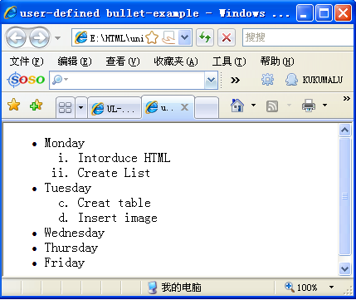
<HTML>
<HEAD>
<TITLE>user-defined bullet-example</TITLE>
</HEAD>
<BODY>
<UL>
<LI>Monday
  <OL>
  <LI TYPE = i>Intorduce HTML
  <LI TYPE = i>Create List
  </OL>
<LI>Tuesday
<OL start = 3>
<LI TYPE = a>Creat table
<LI TYPE = a>Insert image
</OL>
<LI>Wednesday
<LI>Thursday
<LI>Friday
</UL>
</BODY>
</HTML>

Slide 57
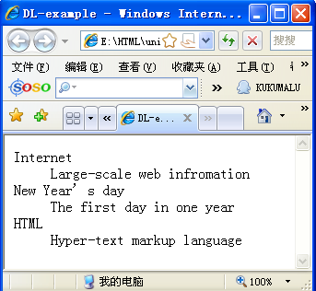
Definition List
Definition list created using <DL> and </DL>
<DT>: Specify the terms to be defined.
<DD>: Definitions of terms
<HTML>
<HEAD>
<TITLE>DL-example</TITLE>
</HEAD>
<BODY>
<DL>
<DT>Internet
<DD>Large-scale web infromation
<DT>New Year’s day
<DD>The first day in one year
<DT>HTML
<DD>Hyper-text markup language
</DL>
</BODY>
</HTML>

Slide 58

Creating Links to Other Documents
1、Position：
Available position……
2、Teaching Resources：
Teaching Resources for Software Engineering
Click here to view the video
3、Alliance：
We have many alliances……

Slide 59
Creating Links to Other Documents
Link Type
- - - - - - -
Internal Links
- - - - - - -
- - - - - - -
•A Link to a place on the Same Web Page or the Same Site
- - - - - - -
- - - - - - -
- - - - - - -
- - - - - - -
- - - - - - -
- - - - - - -
- - - - - - -
External links
•A Link to a place on other web sites or servers.
Web site 1
Web site 2

Slide 60

Creating Links to Other Documents
To create a hyperlink, you must specify the two parts
Full address or URL of file to be linked
The full address of the file
C:\internet\index.html
http://www.sina.com.cn
service/index.html
Absolute URL
Relative URL
  Hot spot：text or image.

Slide 61
URL
Uniform Resource Locator
Format:protocol://host.domain:port/path/filename
  Eg:http://www.whu.edu.cn/index.html
  http is Protocol
    telnet, ftp
  Host.domain: The Internet address of the server
  Port The port number of the server
  /path/filename Resources in server

Slide 62


DNS
Domain Name System ( DNS)
Converted the domain name into the IP address that the network can identify
Please Convert www.whu.edu.cn
DNS Server
202.114.64.2
IP address of www.whu.edu.cn is
: 202.114.64.110
No problem
I would like to view your home page
WWW Server
202.114.64.110

Slide 63

DNS(cont)
Type of Domain Name
  com – commercial organizations
    www.163.com
  edu – educational entities
    www.whu.edu.cn
  gov – government agencies
    www.china.gov
  net – network service providers
  org – non-profit organizations

Slide 64
Links and Relative URLs
Links
  Absolute Links
    A complete URL.
    http://www.cs.cmu.edu/afs/cs/user/jar/www/index.html
  Relative Links
    Relative to root
    Relative to resource

Slide 65
Relative-to-Root
Relative Links
  Relative to root
    begins with a slash (/)
    describes the location of a resource in relation to a host's root directory
    Example
    The page containing the link has the URL:
    http://www.whu.edu.cn/user/jar/index.html
    relative-to-root URL : /web123.html
    The browser would construct complete URL: http://www.whu.edu.cn/web123.html

Slide 66
Relative-to-Resource
Relative Links
  Relative to resource
    does not begin with a slash (/)
    describes the location of a resource in relation to the location of the resource (that is, page) containing the link
    Example 1
    The page containing the link has the URL: http://www.whu.edu.cn/afs/cs/user/jar/www/index.html
    relative-to-resource URL : courses.html
    The browser would construct complete URL:
    http://www.whu.edu.cn/afs/cs/user/jar/www/courses.html

Slide 67
Relative-to-Resource
    Example 2
    The page containing the link has URL: http://www.whu.edu.cn/afs/cs/user/jar/www/index.html
    relative-to-resource URL: fall2007/courses.html
    The browser would construct complete URL:
    http://www.whu.edu.cn/afs/cs/user/jar/www/fall2007/courses.html

Slide 68
Advantages of Relative-To-Resource
Useful when you are working with a collection of files that go together logically
If these URLs used for links, those files can be moved to different locations. Links between files work without having them to be updated

Slide 69
Advantages of Relative-To-Root
Useful when the resource to which the link is being made is not in the same directory or one of that directory’s subdirectories as the file containing the link
Browser constructs a complete URL using only the protocol identifier and host name from the URL of the file containing the link, appending those to the relative URL.

Slide 70
Creating Links
Creating Links to Other Files
Creating Links to specific places in the same or different page
Creating Links to Electronical Mails

Slide 71
Creating Links to Other Files
A HERF tag
  <A HREF = protocol://host.domain:port/path/filename> Hypertext </A>
  HREF attribute specifies the link target address, use the URL
  Hypertext text or image as hyperlink
<a href="http://www.whu.edu.cn">Wuhan Uni</a>
<a href="http://www.whu.edu.cn">
<img src="images/whu.jpg">
</a>

Slide 72
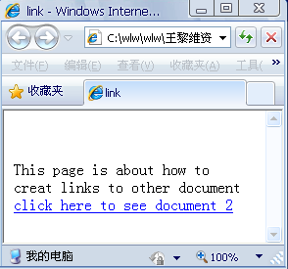
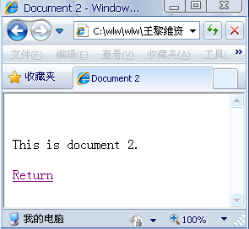
<HTML>
<HEAD>
<TITLE>link</TITLE>
</HEAD>
<BODY>
<BR><BR>
<P>This page is about how to creat links to other document
<A HREF = Doc2.html>click here to see document 2</A>
</BODY>
</HTML>
<HTML>
<HEAD>
<TITLE>Document 2</TITLE>
</HEAD>
<BODY>
<BR><BR>
<P>This is document 2.
<BR><BR>
<A HREF= Doc1.html>Return</A>
</BODY>
</HTML>

Slide 73
Assuming the current directory structure is / root/layer1/layer2, root is the root directory, current user is in a page of the layer1
Relative URL | Description
Href=“../index.htm” | ".." represent to back up to upper level, the browser will find index.htm in the root directory, because the root is the parent directory of layer1.
Href=”layer2/mynote.htm” | Browser in the current level (layer1) to find layer2, and then find mynote.htm in layer2
Href=”/help.htm” | Slash "/" represents directly return to the root directory. The browser will jump to the root directory, and then find help.htm in the root directory
Href=”../layer11/submit.htm” | At this point the browser will first return to the upper directory, and find a subdirectory called layer11 this directory , which is the same level with layer1, and then find submit.htm in layer11

Slide 74
Creating Links to specific places in the same or different page
A NAME tag
  First anchor tag used with name attribute to specify target
  Next anchor tag used to create link to jump to target
  :# used to display the section of Jim.html where the office target is found
<A name = ‘office’>
<H2>Jim’s Office</H2>
</A>: target
<A href = ‘Jim.html#office’>
Jim’s Office
</A>: link to target

Slide 75
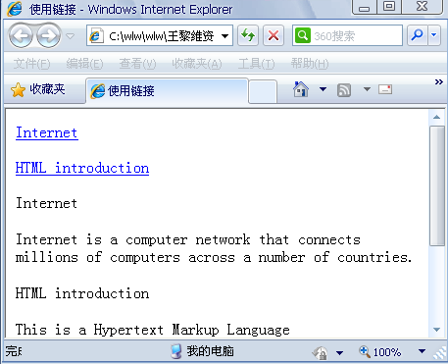
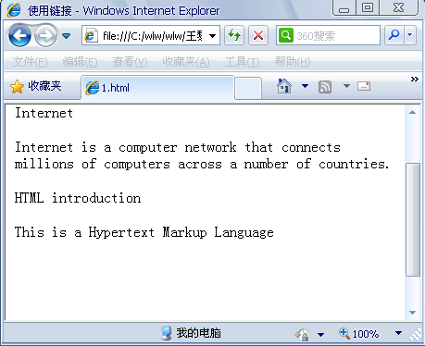
Link to the same page
<HTML>
<HEAD><TITLE>使用链接</TITLE></HEAD>
<BODY>
<A HREF = #Internet>Internet</A><BR><BR>
<A HREF = #HTML>HTML introduction </A><BR><BR>
<A name = Internet>Internet</A><BR>
<P>Internet is a computer network that connects millions of computers across a number of countries.
</P>
<A name = HTML>HTML introduction</A><BR>
<P>This is a Hypertext Markup Language</P>
<BR><BR><BR><BR><BR><BR>
</BODY>
</HTML>
单击

Slide 76
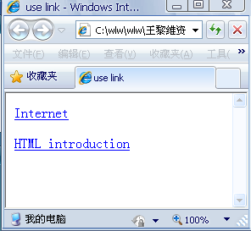
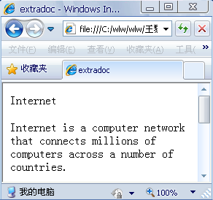
Link to different page
click
<HTML>
<HEAD>
<TITLE>main document</TITLE>
</HEAD>
<BODY>
<A HREF=extradoc.html#Internet>Internet</A>
<BR>
<BR>
<A HREF=extradoc.html#HTML>HTML Introduction</A>
<BR>
</BODY>
</HTML>

Slide 77
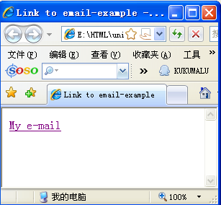
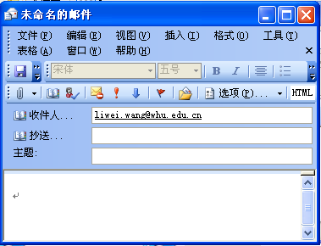
Creating Links to Electronical Mails
Users directly open e-mail client to send e-mail by clicking a link on a web page
Inserting Mailto value to HERF tag.
<A HREF="mailto:liwei.wang@whu.edu.cn">My e-mail</A>

Slide 78
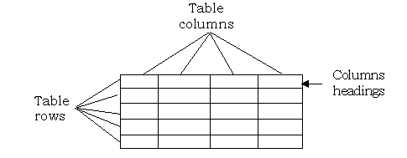
HTML Tables
column
Table
header
row

Slide 79
Table’s Tags
<TABLE> … /TABLE> | Table tag
<TR> … </TR> | Row tag
<TD> … </TD> | Table data tag
<CAPTION> …< CAPTION> | Caption Tag
<TH> … </TH> | Table header tag

Slide 80
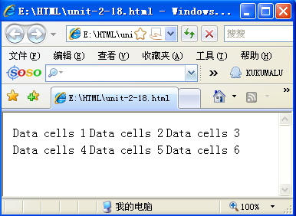
Create Table
<TABLE>
<TR>
<TD>Data cells 1</TD>
<TD>Data cells 2</TD>
<TD>Data cells 3</TD>
</TR>
<TR>
<TD>Data cells 4</TD>
<TD>Data cells 5</TD>
<TD>Data cells 6</TD>
</TR>
</TABLE>

Slide 81
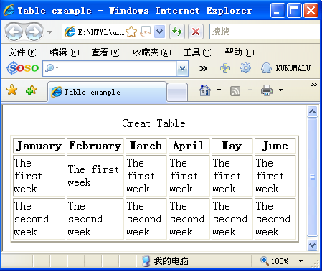
<HTML>
<HEAD>
<TITLE>Table example</TITLE>
</HEAD>
<BODY>
<TABLE BORDER = 2>
<CAPTION>Creat Table</CAPTION>
<TH ALIGN = CENTER>January</TH>
<TH ALIGN = CENTER>February</TH>
<TH ALIGN = CENTER>March</TH>
<TH ALIGN = CENTER>April</TH>
<TH ALIGN = CENTER>May</TH>
<TH ALIGN = CENTER>June</TH> <TR>
<TD>The first week</TD>
<TD>The first week</TD>
<TD>The first week</TD>
<TD>The first week</TD>
<TD>The first week</TD>
<TD>The first week</TD </TR>
<TR>
<TD>The second week</TD>
<TD>The second week</TD>
<TD>The second week</TD>
<TD>The second week</TD>
<TD>The second week</TD>
<TD>The second week</TD> </TR>
</TABLE>
</BODY>
</HTML>

Slide 82
Combine data cells
  you can use COLSPAN attribute in <TH> Or <TD> tags to set the column number spanned by cells.
  you can use ROWSPAN attribute in <TH> Or <TD> tags to set the row number spanned by cells.

Slide 83
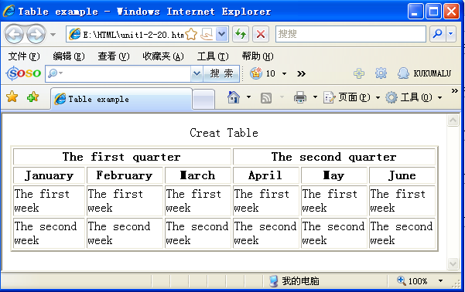
<HTML>
<HEAD>
<TITLE>Table example</TITLE>
</HEAD>
<BODY>
<TABLE BORDER = 2>
<CAPTION>Creat Table</CAPTION>
<TH ALIGN = CENTER COLSPAN = 3>The first quarter</TH>
<TH ALIGN = CENTER COLSPAN = 3>The second quarter</TH>
<TR>
<TH ALIGN = CENTER>January</TH>
<TH ALIGN = CENTER>February</TH>
<TH ALIGN = CENTER>March</TH>
<TH ALIGN = CENTER>April</TH>
<TH ALIGN = CENTER>May</TH>
<TH ALIGN = CENTER>June</TH>
</TR>
<TR>
<TD>The first week</TD>
<TD>The first week</TD>
<TD>The first week</TD>
<TD>The first week</TD>
<TD>The first week</TD>
<TD>The first week</TD>
</TR>
<TR>
<TD>The second week</TD>
<TD>The second week</TD>
<TD>The second week</TD>
<TD>The second week</TD>
<TD>The second week</TD>
<TD>The second week</TD>
</TR>
</TABLE>
</BODY>
</HTML>

Slide 84

Combine data cells
CELLSPACING Define the spacing between cells (Pixels)
CELLPADDING Define the spacing between the cell contents and cell boundaries.
  <TABLE BORDER = 3 CELLSPACING = 6 CELLPADDING = 9>

Slide 85
Align and Valign
Align = left
Align = center
Align = right
Valign = top
Valign = middle
Valign = bottom
<TD ALIGN = left VALIGN = bottom>table cell</TD>

Slide 86
Multimedia in HTML
Document
Add image
Add Animation
Add Sound
Add Video

Slide 87
Image
JPEG（Joint Photographic Experts Group）(.JPG)
  .jpg files are compressed (takes lesser time for images to be displayed by browser)
  Supports an entire range of colors and hence can impact image quality, due to loss of some.
GIF（Graphics Interchange Format ）(.GIF)
  .gif compression done differently from .jpg so that no original image information lost
  .gif files limited in range of colors they supported than .jpg
  Support Animation
.jpg used for photographs, and .gif for drawings and icons on web

Slide 88
IMG Tag
<IMG SRC=“path\sound filename”>
<IMG> tag used to embed pictures in web pages
src attribute used to specify URL of the image
Alt: When the browser can not display the image, places the string assigned alt attribute to replace the image
Border: Set the image border. An integer greater than or equal to 0
Width and Height：Set the image width and Height in pixels or percentage.
Vspace and Hspace: Set the distance between image and text
Align: used to justify the image to left, center or right

Slide 89
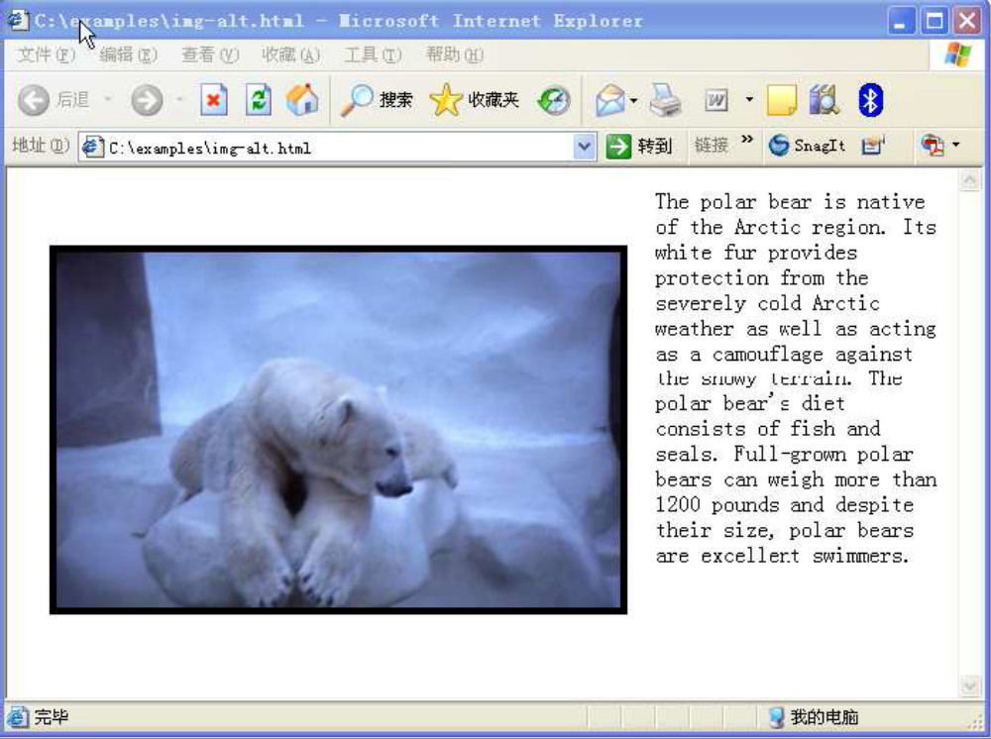
<body>
<img src="polar_bear.jpg" align="left" hspace="20" vspace=40"
border="5" alt ="My friend, the polar bear">
The polar bear is native of the Arctic region. Its white fur provides
protection from the severely cold Arctic weather as well as acting as
a camouflage against the snowy terrain. The polar bear's diet consists
of fish and seals. Full-grown polar bears can weigh more than 1200
pounds and despite their size, polar bears are excellent swimmers.
</body>

Slide 90
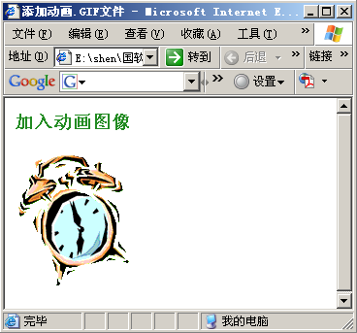
Gif Animation
<HTML>
<HEAD>
<TITLE>adding a Gif Animation</TITLE>
</HEAD>
<BODY>
<H3>
<FONT SIZE=3 COLOR=FORESTGREEN><B>adding a Animation</B></FONT>
</H3>
<IMG SRC=Jumping alarm clock.gif ALT=“Jumping alarm clock">
</BODY>
</HTML>

Slide 91
Sound
<BGSOUND SRC=“path\sound filename” loop = “Play Count”>
loop: if Play Count is infinite，Sound will loop until the page is closed.
<HTML>
<HEAD>
<TITLE>Add sound</TITLE>
</HEAD>
<BODY>
<H3><FONT SIZE=3 COLOR=FORESTGREEN><B>Play XP startup sound</B></FONT></H3>
<BGSOUND SRC="Windows XP startup.wav">
</BODY>
</HTML>

Slide 92
Video
<EMBED ALIGN=CENTER WIDTH= “280" HEIGHT= “350" SRC= "\path\file name" AUTOSTART= "TRUE " LOOP= “FALSE”>
  LOOP = false: Play once.

Slide 93
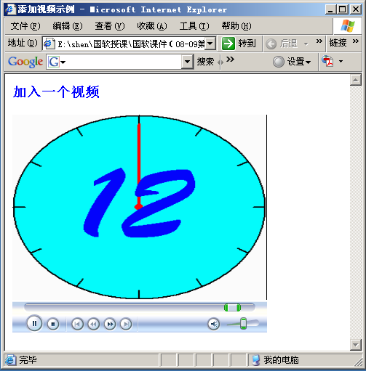
<HTML>
<HEAD>
<TITLE>adding a video</TITLE>
</HEAD>
<BODY>
<H41><FONT SIZE=3 COLOR=Blue>
<B>adding a video</B> </FONT></H4>
<EMBED SRC=clock.avi HEIGHT=300 WIDTH=350>
</BODY>
</HTML>

Slide 94
Java Applet
Java can write two types of procedures:
  Application: can run independently,
  Applet: can not be run independently, but to be embeded in HTML files
<applet code = FirstApplet width=200 height= 200> </applet>

Slide 95
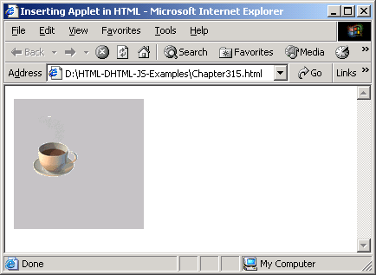
<HTML>
<HEAD>
<TITLE>Inserting Applet in HTML</TITLE>
</HEAD>
<BODY>
<APPLET code = AppletDemo width = 150 height = 150>
<PARAM name = "image" value = "coffeecup.gif">
</APPLET>
</BODY>
</HTML>

Slide 96
Creating a Web Page
Define the Web page content
Plan the look of the page and the links needed
Implement the Web page by writing it incrementally in small steps
Evaluate the Web page in two ways: a) test to see that it's HTML is correct and b) check to see that its appearance satisfies you and, as you have opportunity, other people.

Slide 97
Verification vs. Validation
Verification answers “Is the HTML page that has been created what the specifications ask for?”
Validation answers “Does an HTML page conform to the syntax and grammar published in the appropriate HTML specifications?”

Slide 98
HTML Validators
Validator is a tool that catches HTML source code for gross errors.
Validators useful for today’s forgiving browsers. Checks if HTML code conforms to a particular published specification
Verifies and validates HTML code before they can be retrieved and rendered by other applications
WDG HTML Validator is such tool that can be explored for this course.

Slide 99
DOCTYPE element
DOCTYPE- tell validators, Web browsers, etc. about the HTML specification used in the file’s source.
Always on the first line of a file, before beginning <HTML> tag.
DOCTYPE element used for this course is:
<! DOCTYPE HTML PUBLIC ‘-//W3C//DTD HTML 4.0 Transitional//EN’>
Above declares an HTML document with specification 4.0, may include obsolete elements permitted in transitional edition.

Slide 100
Some Final Thoughts
Web pages should not be cluttered with .jpg or .gif files
More images you have on web page, more time it takes to download
Use most of HTML’s formatting capabilities instead of graphics
Do not use copyright information without permission in web pages
Use software to reduce size of image files.

Slide 101
Summary
HTML commands are called tags (Tag), is used to control the content and appearance of the HTML document.
The basic structure and tags of HTML documents.
The use of HTML tags to create hyperlinks.

