Slide 1
Introduction to Software Technology
Unit 1: Using the Web
1.3 Introduction to HTML
Forms and Servlets
Liwei WANG
liwei.wang@whu.edu.cn
school of computer science

Slide 2

1.3 Introduction to HTML
Forms and Servlets
Dynamic Web Page
Form
Servlets

Slide 3
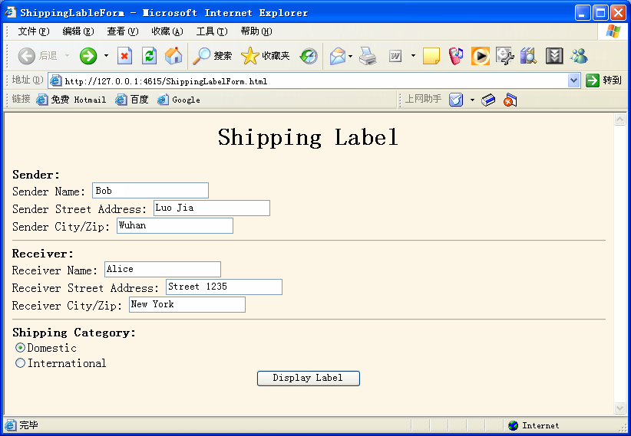

Slide 4
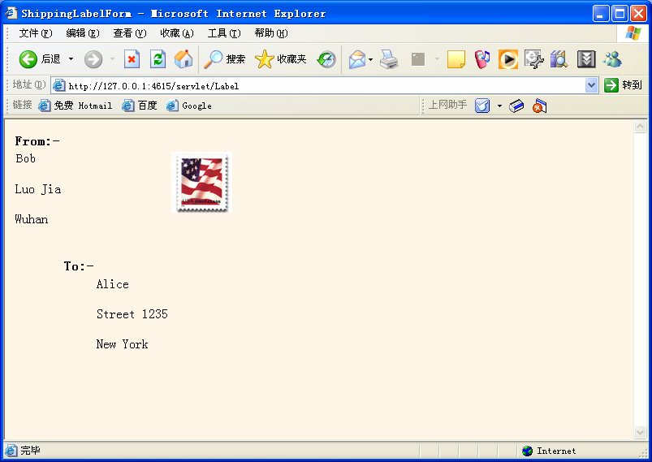

Slide 5
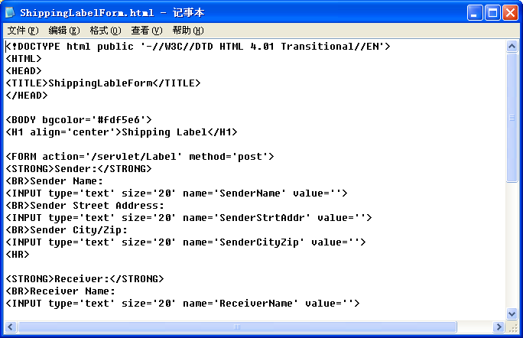

Slide 6

The FORM Elements
The FORM element is a container element that creates a special area on an HTML page known as a FORM.
  Page content
  Markup tags and
  Controls or widgets for user interaction with the form

Slide 7
Form Element
action, method, enctype, accept……
FORM
<FORM element attributes >
form content ...
</FORM>
<FORM action='http://example.com/servlts/myprog' method='post'>
form content ...
</FORM>
Provides the name of the program that will process the form data
specifies HTTP method of sending data to the server

Slide 8
The FORM Element
The action attribute is
  Specified with single quotation marks
  Can include a complete path name or a site URL.
The method attribute has two valid options
  Post
    causes changes to server data
  Get
    does not cause any changes in server data
Other FORM attribute include enctype, accept, name, title, etc.
Common event attributes are onsubmit, onreset, onclick, ondblclick, onmouseover and onkeypress

Slide 9
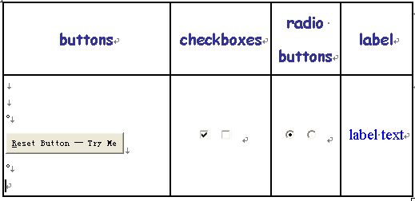
Form Controls

Slide 10
Form Controls
Button
  Reset Button: Form reset to initial values
  Submit Button: Form submitted to server
  Push Button: take some action as specified by JavaScript
Checkbox
  Toggle to ON causes data(name-value pair) to be submitted to server
  Toggle to OFF indicates unsuccessful control
Radio buttons
  A radio button group is created by assigning all of the radio buttons with the same control name to a group . The user can only select one of them at a time
Label
  Label controls are used to specify label text for form controls.

Slide 11
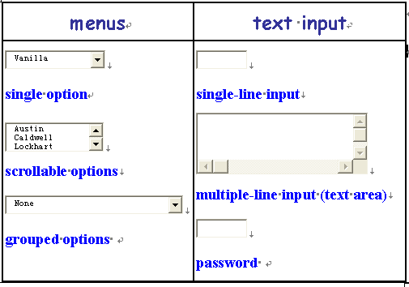
Form Controls

Slide 12
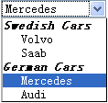

Form Controls
Menu
  allow users to choose from set of predetermined options.
  Three types: single-option drop-down lists, scrollable-option list, and grouped-option drop-down list.
Text input
  allow users to input text.
  Three types: one for single-line input, one for multiple-line input, and one for text that should not be displayed as it is being typed.

Slide 13


Form Controls
File select
  File select controls allow users to browse to files, select files, and submit the contents of a file or files with a form.

Slide 14
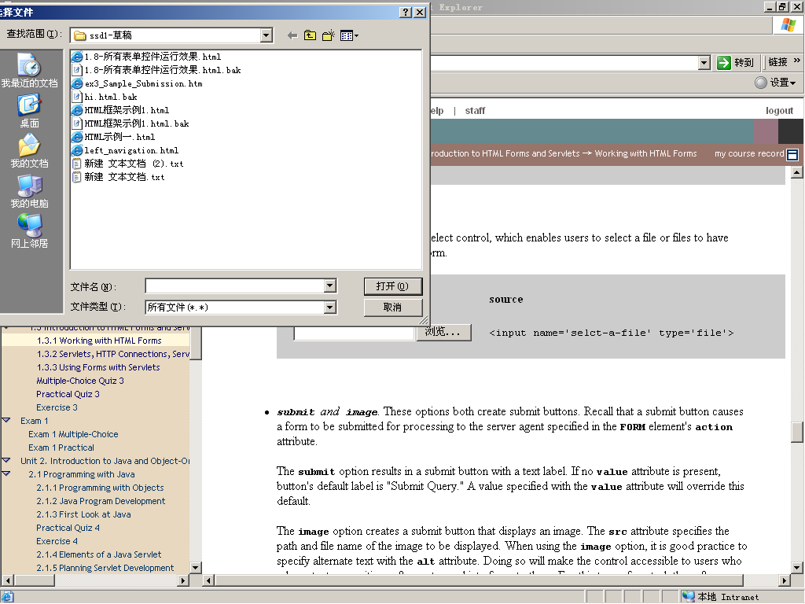

Slide 15

Form Controls
Image Controls
  Image controls are submit buttons, instead displaying a textual button label on their face, image buttons display a graphic image.

Slide 16
Quick facts about controls
Each control has a control name, which is designated by its name attribute.
All controls can have both an initial value and a current value.
When a form is submitted for processing, the controls that have values have their names and values combined into name-value pairs, which are then submitted to a server with the form

Slide 17
Quick facts about controls
All controls submitted with a form, are known as successful controls; controls that remain undefined are not considered successful controls, and are not sent to a server.
controls that have no initial values are considered undefined when their current values have not been modified—either after the form is first loaded or after it is reset

Slide 18
Form Control Elements
The INPUT element is a general-purpose element that can be used to create most of the controls introduced earlier.

Slide 19

INPUT element
<INPUT element attributes>
Attributes:
  NAME provides a unique identification for INPUT element
  VALUE indicates an initial or default value that the INPUT element sends to the server upon submission
  TYPE (required)
    What type of control is created
      TYPE = “text” inserts a one-line text box

Slide 20
INPUT element
<INPUT element attributes>
Attributes:
  SIZE
    For TYPE = “text”, specifies the width of the text input, measured in characters
  MAXLENGTH
    For TYPE = “text”, sets a limit on the number of characters that can be entered into the text control
  CHECKED: the value has been checked
  DISABLED: the user can’t do anything with this element

Slide 21
Form Controls (Cont)
Text & Password
PASSWORD types usually be in conjunction with the size and maxlength
rendered control | source
 | <input type='text' name='txtline'>
 | <input name='txtline2'>
 | <input name='txtline3' type='text' value=‘default value‘ size='12' maxlength='200'>
 | <input name='withoutdefault' type='password' size='8' maxlength='8'>

Slide 22
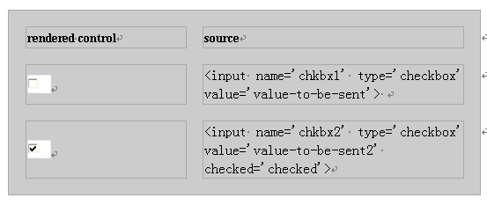
Form Controls (Cont)
The checked attribute is valid only for checkbox and radio INPUT types
CheckBox
checkbox types must include a value attribute.

Slide 23
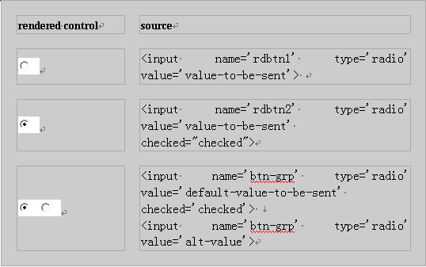
Form Controls (Cont)
Radio
radio types must include a value attribute.
radio types commonly used in groups in which only one button can be selected at a time

Slide 24
Type
Checkbox & Radio both must include a value attribute.
Radio buttons differ from checkboxes
  Radio buttons are commonly used in groups in which only one button can be selected at a time.
  INPUT controls of type radio are made into a group by assigning each control that is to be in the group the same value for its name attribute.

Slide 25
Form Controls (Cont)
File
Rendered control
source | <input name='select-a-file' type='file'>

Slide 26


Submit
If no value attribute is present, submit button's default label is "Submit Query."
Rendered control | source | source for the equivalent button using the BUTTON element
 | <input type='submit' name='subbtn'> | <BUTTON name='subbtn' value='submit' type='submit'>Submit Query</BUTTON>
 | <input name='subbtn2' type='submit' value='Submit Answer'> | <BUTTON name='subbtn2' value='submit' type='submit'>Submit Answer</BUTTON>

Slide 27

Submit(Cont)
Rendered control | source | source for the equivalent button using the BUTTON element
 | <input name='subbtn3' type='submit' value='Log On'> | <BUTTON name='subbtn3' value='LogOn' type='submit'>Log On</BUTTON>
 | <input name='graphicsubbtn' type='image' src='tools.gif' alt='Submit Tools Information Form'> | <BUTTON name='graphicsubbtn' type='submit'><IMG src='tools.gif' alt='Submit Tools Information Form'></BUTTON>

Slide 28
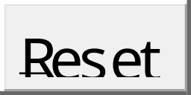
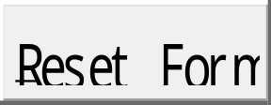
If no value attribute is present in the reset button control, the button's default label is "Reset."
Reset
Rendered control | source
 | <input name='resetbtn' type='reset'>
 | <input name='resetbtn2' type='reset' value='Reset Form'>

Slide 29
Label
Rendered control | source
 | <LABEL> Wuhan Univ. <INPUT name=‘city' type='checkbox' value='wuhan'> </LABEL>
 | <LABEL for=‘han'> Wuhan Univ.</LABEL> <input name=‘city' type='checkbox' value=‘wuhan' id='han'>
LABEL element's for attribute is set equal to the control's id attribute.

Slide 30
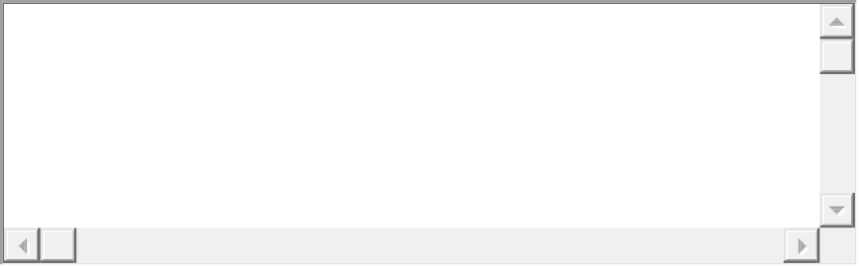
TEXTAREA
Rendered control
source | <TEXTAREA name='textarea' cols='40' rows='5'></TEXTAREA>

Slide 31
Form Design: Taking Users into Consideration
Some useful form control attributes
  readonly allow users to see the contents of a control but not be able to change the contents.
  tabindex specify the order in which users can move the cursor or focus from control to control on the form using the TAB key.
  accesskey attribute allows page authors to assign "access keys" to individual controls

Slide 32

Topics and Resources for Further Study
Elements:
  BUTTON
  SELECT
  FILEDSET
  LEGEND
Use the HTML resource sites on the Web
  W3C(World Wide Web Consortium )
for creating menu controls
provide structure to forms

Slide 33
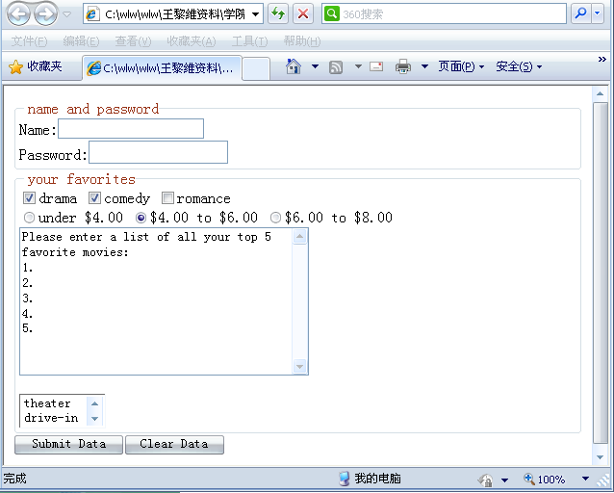

Slide 34
<form action="server/server" method="post">
<fieldset>
<legend>name and password</legend>
<label>Name:<input type="text" name="text1"><br></label>
<label>Password:<input type="password" name="text1"><br></label>
</fieldset>
<fieldset>
<legend>your favorites</legend>
<input type="checkbox" name="genre" value="drama" checked>drama
<input type="checkbox" name="genre" value="comedy" checked>comedy
<input type="checkbox" name="genre" value="romance">romance<br>
<input type="radio" name="price" value="lt4">under $4.00
<input type="radio" name="price" value="4-6" checked>$4.00 to $6.00
<input type="radio" name="price" value="6-8">$6.00 to $8.00<br>
<textarea name="info" rows=“50" cols="40">
Please enter a list of all your top 5 favorite movies:
1.
2.
3.
4.
5.</textarea><br><br>
<select name="view" size="2">
<option>theater
<option>drive-in
<option>video/DVD
</select><br>
</fieldset>
<button name="senddata" type="submit">Submit Data</button>
<button name="cleardata" type="reset">Clear Data</button>
</form>

Slide 35
Servlets, HTTP Connections, Server Push–Client Pull, and Refresh
Servlets
HTTP Connections and Connection Life Cycle
Server Push–Client Pull
Refresh
Two Client-Pull Demos

Slide 36
Servlets
Servlets are programs that run inside of complex software programs known as Web servers (hereafter referred to as "servers").
  It is the servers that run servlets, in order to construct dynamic responses to client requests.
Servlets are typically called from HTML forms (remember the action attribute), and form controls are the agency through which input is created for servlets.
Servlet is server-side of solution to dynamic content

Slide 37
A user using a Web browser sends a request to a server.
Client
responds by serving the appropriate page to the browser.
forwards the response on to the client browser
Server
determines if the request is for a static HTML page or for an application, such as a servlet.
Loads and initializes the servlet.
passes the request on to the servlet.
Servlet
Deal with the request.
get result from servlets

Slide 38
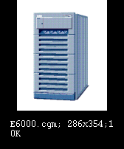

HTTP Connections and Connection Life Cycle
A connection is opened
Request Information
Provide Information
A connection is closed
HTTP Connection
(request-response exchange )

Slide 39
Sessions
User Sessions
  Series of interactions a user has with a server to carry out a user task.
  The user session begins when the user first accesses the server through an initial HTTP connection,
  and the session ends when the user either completes or cancels the task

Slide 40
Cookies
There are many situations in which a server must not only keep track of information from one transaction to the next, but also keep track of which client the information came from.
To keep track of these details, servers drop cookies into the client browsers.
A cookie is a piece of data generated by a web server and stored on the browser's computer for future reference.

Slide 41
Server Push–Client Pull
Server Push
  Control of the client-server transaction is maintained directly by the server.
  The HTTP connection is left open, and the server sends data to the client any time it wants until either the server signals the end of the transaction or the transaction is interrupted by the client.

Slide 42
Server Push–Client Pull
Client Pull
  Requests are generated automatically, without user action, at specified intervals.
  The HTTP connection life cycle follows the pattern typical of client-server transactions initiated by user action.
  With client pull, HTTP response headers, whether generated by an application like a servlet or by HTML tags, direct the browser to retrieve either the same page or another page after a specified interval of time.

Slide 43
Refresh (Cont)
In client pull model
  With the application-generated-response-header approach to implementing client pull, the information directing the client to retrieve a page at a specified interval is inserted into the response as a header by an application, such as a servlet, that is, this information does not come from the HTML page that is served in the response.
  Client pull can be implemented with information provided by an HTML document using the HTML META element.

Slide 44
META
META element provides a means by which an author can specify information about an HTML document.
META elements are enclosed by <HEAD> and </HEAD>.
META has two attributes:
  name
  http-equiv
When HTTP servers serve the document, they read its META elements and create HTTP response headers for all items defined by an http-equiv attributes and assigned values with accompanying content attributes.

Slide 45
META attribute--Name
<meta name=‘parameter’ content=‘value’>
parameters:
  <meta name=“generator" content="Microsoft FrontPage 3.0">
  <meta name =‘keywords’ content=‘science, education’>
  <meta name=‘description’ content=‘This page is about Wuhan University. ’>
  <meta name=‘robots’ content=‘none’ >
  <meta name=‘author’ content = ‘name@163.com’>

Slide 46
META attribute—http-equiv
<meta http-equiv =‘parameter’ content=‘value’>
parameters
  Expires
  Refresh
  Pragam
  Set-Cookie
  Window-Target
  Content-Type

Slide 47
META example
<!DOCTYPE HTML PUBLIC '-//W3C//DTD HTML 4.01 Transitional//EN'>
<HTML>
<HEAD>
<META http-equiv='Refresh' content='5'>
<TITLE>ACME Demo Page</TITLE>
</HEAD>
<BODY>
<H1>ACME Demo Page!</H1>
This page demonstrates an implementation of basic client pull. The page will reload every five seconds.
</BODY>
</HTML>
Listing 1 Simple client pull with a five second reload interval
equivalent to the following HTTP response header
Refresh: 5

Slide 48
META example
<!DOCTYPE HTML PUBLIC '-//W3C//DTD HTML 4.01 Transitional//EN'>
<HTML>
<HEAD>
<META http-equiv='Refresh' content='15; URL= http://www.example.com/ACME/newACMEDemoPage.html'>
<TITLE>ACME Demo Page</TITLE>
</HEAD>
<BODY>
<H1>ACME Demo Page!</H1>
This page demonstrates an implementation of a "redirect" using client pull. The page will redirect traffic after this page is displayed for 15 seconds.
</BODY>
</HTML>
Listing 2
equivalent to the following HTTP response header
Refresh: 15; URL= http://www.example.com/ACME/newACMEDemoPage.html

Slide 49
Redirect by META
Not all browsers support http-equiv initiated refresh.
Some browsers, if they are busy when the time for the redirect arrives, may fail to execute the redirect.

Slide 50
Using Forms with Servlets
Form Submission and Servlets
Examples

Slide 51
Form Submission and Servlets
We analyze the client side of things including form submission process.
The process of sending forms to servers and then to servlets consists of four steps

Slide 52
First Step
This process begins with the activation of a form submit button.
The process identifies all successful controls—that is, all controls with current values that are valid for submitting to a server.
  In general, these include all controls that have initial values set with their value attributes or have valid current values as a result of actions occurring after the form was loaded.
  Exceptions to this are radio buttons and checkbox controls. To be successful, radio buttons and checkbox controls must 1) be "checked" and 2) must have initial values that are assigned with value attributes.

Slide 53
Second & Third Steps
Once all successful controls are identified, the browser builds the form data set.
  This data set consists of the name-value pairs of all successful controls.
Once this data set of name-value pairs is assembled, the set is encoded and sent to a server, addressed to a processing agent.

Slide 54
Fourth Step
The way the data set is sent to the server and the agent to which it is sent are determined by a FORM element's action and method attributes.
The action attribute identifies the agent (such as a servlet) by name and its location on the server, relative to the server's root directory.
The method attribute identifies the protocol by which the data set is to be sent.
  post is used for transactions that involve large amounts of data or when security is a requirement.
  get is used for transactions that do not involve a large amount of data and when security is not a requirement.

Slide 55
Examples
WelcomeForm.html
PersonalWelcomeForm.html

Slide 56
Summary
Dynamic Web Page
Form
  Form Controls
Servlets
  Dynamic HTML Content

