Slide 1
Introduction to Software Technology
Unit 2: Introduction to Java and Object-Oriented Programming
Liwei WANG
liwei.wang@whu.edu.cn
School of computer science

Slide 2

Outline
Programming Language
JAVA
Programming with Java

Slide 3
Programming Language
A programming language is a formal language designed to communicate instructions to a machine, particularly a computer.
Programming languages can be used to create programs that control the behavior of a machine and/or to express algorithms precisely.
You can use different expression methods (different programming languages) to describe the same behavior of a machine or the same algorithm

Slide 4
The classification of Programming Language
Machine language：machine instruction，execute directly.
Assembly Language：Symbolic, Assembler
Advanced programming language（Compilation）
Advanced programming language（Interpretation）

Slide 5
Advanced Programming Language
There are two basic approaches to perform a program specified by an advanced programming language
  Compilation execution：translate the program from high-level language to machine language in advance. For example C++。
  Interpretation execution：use the high-level language program as input, but instead of translating the whole program, it carries out the instructions of the program directly. Sometimes in order to improve efficiency, it can be compiled into an intermediate code. For example, Java.

Slide 6
Advanced Programming Language
FORTRAN(FORmular TRANslation)，IBM，1950
Pascal：N.Wirth，1968，(Delphi，Borland)
COBOL(COmmon Business Oriented Language)： U.S. Department of Defense，1960
C and C++：Dennis Retchie, 1972; Bjarne Stroustrup,1983, Bell
Basic(Beginner's All-purpose Symbolic Instruction Code)： U.S. Department of Defense ，1964
Ada: U.S. Department of Defense , 1983
Java语言： 1991，SUN MicroSystem

Slide 7





JAVA History
Green Project
1991
James Gosling
Oak
1995

Slide 8
Java characteristics
Architecture neutral & Portable
Object oriented
Multithreaded
Dynamic Loading

Slide 9
Architecture neutral & Portable
Compile
Java program
Java
Byte Code
Java VM
For PC
Java VM
For UNIX
Java VM
For Mac
PC
UNIX
Mac
Write Once, Run Anywhere (WORA)

Slide 10

Object-Oriented
Possible to directly represent real world objects in the computer system
Data-oriented model
Object-oriented model
Real world
Software system
Real world
Software system

Slide 11
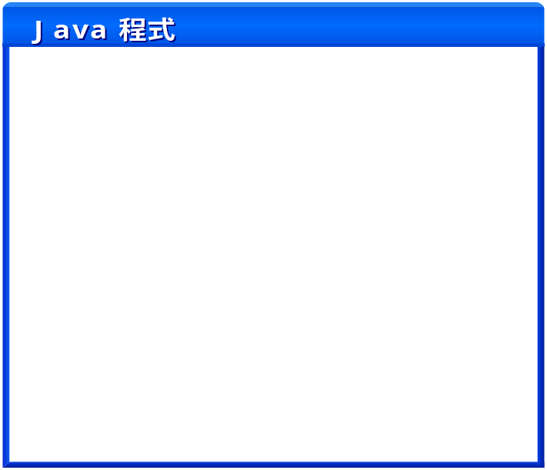

Multithreaded
a Java program use Thread to divided the program into several parts so that each part can be executed simultaneously
Thread 1
Thread 2
Thread 3

Slide 12
Dynamic Loading
Some program languages
Java language
When Program start to run, all members will be required
Loaded and can not be changed during operation
load the member
When you need a member

Slide 13
2.1 Programming with Java
Programming with Objects
Java Program Development
First Look at Java
Element of a Java Servlet
Planning Servlet Development
Guidelines for Java Development

Slide 14
2.1.1 Programming with Objects
Object-Oriented Programs
Fish Simulation: An OO Program that Simulates Aquatic Life

Slide 15
Computers and Programs
Programs are texts that can make a computer do a task.
Programs are written in a specialized language, called a programming language.
The content of a program is called code.
When a computer carries out or runs a program we say that it executes the code.
Java is one of the hundreds of programming languages. It’s an object-oriented language.
What’s object-oriented language?

Slide 16
Programs and Models
A model is a simplified representation. It includes features that are considered important to its user while neglecting others.

Slide 17
Model Example
The service dispatcher for a Gas company keeps track of 43 repair trucks in an area using a large map.
  Pushpin represents repair truck’ most recent location. When a repair truck calls in a new position, the pin is moved.
  Thumbtack represents custom’s location when a call for service come in. When service is completed, the thumbtack is removed.

Slide 18
Programs and Models
Every model shares following characteristics
  Elements of the model represent other, more complex things.
  These model elements exhibit consistent behavior.
  The model elements can be grouped into different categories based on their common behaviors.
  Action external to a model element cause the behavior of the model element.

Slide 19
Object-Oriented Programs
Model elements are called objects.
Objects that share a common behavior can be grouped into distinct categories called classes
Objects that work together to perform a task communication with each other by sending messages

Slide 20
Example
Suppose a software development business might have a president and a couple of vice presidents.
Each vice president is supported by many programmers, groups of whom are supervised by project managers.
How to model it?

Slide 21

Objects, Classes, and Messages
Object
  Model elements in Java programs are called objects.
    For example, one President object、two VicePresident objects、multiple Project manager objects，a lot of programmer objects。
Attributes
  Members that record features of Object，which can be read or set a value
    VicePresident objects have their own names and the department they belong to
    Project manager have their own names and the team they belong to.

Slide 22
Objects, Classes, and Messages
Behavior
  The same kind of objects share a common behavior
    Programmer objects may be working on different projects, but they share some common behaviors: generate code, etc.
    VicePresident objects share different common behaviors from Programmer objects: ask their staff for data, generate reports, etc.

Slide 23
Objects, Classes, and Messages
Message
  Objects that work together to perform a task communication with each other by sending messages
    VicePresident assign tasks to the project manager. Programmers need to regularly submit progress reports to the project manager.
    Not everyone needs to respond to each message.
  Each message sent must specify which object is to receive it, what task that object should perform in response, and further details that must be supplied to describe the task adequately.

Slide 24
Objects, Classes, and Messages
Java Program
  A collection of objects that correspond to the important problem elements of the problem being solved or the computation being performed.
  A group of objects communicate by sending messages.

Slide 25
Objects, Classes, and Messages
Class
  A category of model elements (share a common behavior) is called a class in Java.
  The fundamental job of a Java programmer is providing class definitions, or descriptions of how objects in each class must behavior.
  Program running can generate multiple objects of a class. Each object is called an instance of that class.

Slide 26
Objects, Classes, and Messages
Predefined Objects and Classes
  Many programs have some behavior in common
    printing characters on the screen.
  Java comes with some classes and objects already defined.
    programmers writing new programs can take advantage of such classes and objects
    The program code can be reused.

Slide 27
Object-Oriented Programs
What to do? Writing a Java program to model something in real life could be a complex task.
How to do? We should limit ourselves to certain objective and abstract attributes and behaviors of objects that contribute to our objective.

Slide 28
Example (cont)
The task we wish to model is that of writing a project proposal
This task involves the Vice President of a department and the Project Manager of one of the many project teams the Vice President manages.
How to model it ?

Slide 29
Example (cont)
Need two objects to model them
  an object that models the Vice President
  another that models the Project Manager.
If the two objects have similar attributes and exhibit the same behavior, the program would need only one class definition to create the two objects.
If the two objects have different attributes and exhibit different behavior, the program would need two class definitions to create the two objects.
——the program will need two classes to model them.

Slide 30
Example (cont)
Attributes for the Vice President object:
  Name
  Department
Attributes for the Project Manager object:
  Name
  Team

Slide 31
Example (cont)
The Vice President requests the Project Manager to write a proposal for a project.
In response to this message, the Project Manager starts writing the proposal and realizes that financial data is needed from the Vice President.
The Project Manager asks the Vice President for financial data.
In response to this message, the Vice President sends the financial data to the Project Manager.
The Project Manager completes the proposal with the financial data and other necessary information.

Slide 32
Example (cont)
Message(s) from the Vice President object that the Project Manager object must respond to :
  Write project proposal
Message(s) from the Project Manager object that the Vice President object must respond to:
  Provide financial data

Slide 33
Example (cont)
VicePresident
ProjectManager
-name
-department
-name
-team
+provideFinacialData()
+writeProjectProposal()
Classes to model Vice President and Project Manager

Slide 34
Fish Simulation: An OO Program that Simulates Aquatic Life
Fish Simulation System models aquatic life in a lake and to see how the movement of catfish and crocodiles and the growth of algae are affected by the size and density of the populations.
  For now, the organisms being modeled include catfish, crocodiles, and algae.

Slide 35
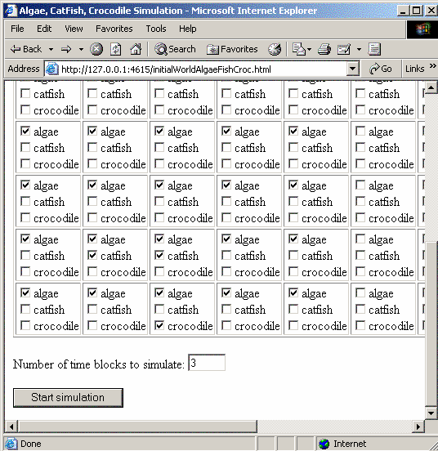

Slide 36
Fish Simulation: An OO Program that Simulates Aquatic Life
Catfish are capable of eating algae, and crocodile are capable of eating catfish.
Both catfish and crocodiles can move from cell to cell, while algae are stationary.
Algae require sunlight to survive. Random amounts of sunlight per cell are provided by the program.
Typically, a choice of 20–30 time steps is enough to observe the behavior of the organisms and draw some conclusions.

Slide 37
Fish Simulation: An OO Program that Simulates Aquatic Life
What classes would be required to build such a model that simulates the life of organisms in a lake?
Does the simulation program always need to create objects of these classes?
How does the number of organisms selected by you in the initial configuration of the lake affect the number of objects created by the program?

Slide 38
Fish Simulation: An OO Program that Simulates Aquatic Life
What would be the attributes of the classes you thought of as answer to #1?
Does the crocodile’s behavior change based on the presence or absence of catfish?
Does the catfish’s behavior change based on the presence or absence of algae?

Slide 39
Fish Simulation: An OO Program that Simulates Aquatic Life
It is also acceptable if you feel that you do not have enough information at this point in the course to answer a particular question.
As you progress through the rest of the course, we will look at more details about how this simulation program is built in Java.

Slide 40
2.1 Programming with Java
Programming with Objects
Java Program Development
First Look at Java
Element of a Java Servlet
Planning Servlet Development
Guidelines for Java Development

Slide 41
2.1.2 Java Program Development
Writing Java Source Code
Compiling Java Source Code
Creating an HTML Form
Running a Java Program

Slide 42
Writing Java Source Code
To run a java program, you will need a Java Virtual Machine
To develop a program in the Java programming language, you will need the Java 2 Platform Standard Edition (J2SE) development kit.
Example: the servlet Welcome
  Edit
    Starting an editor program, typing in the Java program and saving the contents to a file called Welcome.java.

Slide 43
Writing Java Source Code
Java Rule
  Java has a set of rules, Writing Java source code must follow these rules.
identifier
  A class or a behavior must have a name-an identifier.
  Java is case sensitive, that means it can recognize the distinction between uppercase and lowercase.
    System& system
  Name of each class and program begin with a captical letter, other identifiers (such as method names) begin with lowercase letters.

Slide 44
Writing Java Source Code
keyword
  Keywords are special words with predefined meanings in the Java Language, like class, public, static, etc.
The order of Java statements
  They are executed by the computer in the order of appearance.
format
  Two adjacent identifier or keywords must be separated by at least one space.
  Write one statement per line. If the statement is too long to fit on a line, break it up at some reasonable point.
  All statements end using “;”
  Use the TAB key to indent at the beginning of the statement.
comment
  Any text that starts with /* and ends with */ is a comment. Once // appears on a line, all text on the rest of the line is a comment.
  There should be a comment before the line that starts with the keyword class, indicating the purpose and behavior of the code.

Slide 45
Writing Java Source Code
Java source code file name
  the source code file must have the same name as the class
  the file name have the same uppercase and lowercase as the class name.

Slide 46
Compiling Java Source Code
Editor
(such as notepad)
Java bytecode
  Java program(.java source code file)
Java compiler
Java interpreter
Java Byte Code(.class file)
Computer hardware

Slide 47
Compiling Java Source Code
Java program(.java) are translated using java complier to java bytecode(.class), not a true machine language.
Jave interpreter interprets the bytecode file.

Slide 48
Compiling Java Source Code
Java 2 Standard Edition has been installed on your computer and setting environment variables including Path and Classpath
using “cmd” into the command line
using the javac command at the system prompt to invoke the Java compiler to get .class file.
  javac Welcome.java
Using the .java command to interpret the .class file and run it.
  java Welcome

Slide 49
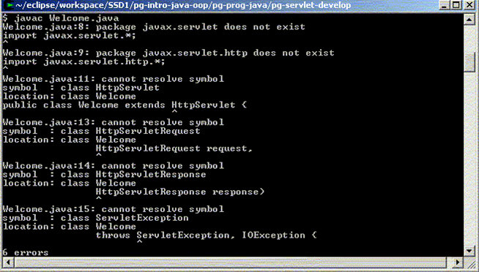
Compiling Java Source Code

Slide 50
Compiling Java Source Code
Note that, while the J2SE SDK is sufficient to compile most Java programs, we need something additional to compile a Java servlet. This is because the source code for the servlet uses some pre-written Java source code that is not part of the J2SE SDK.
  Find the javax.servlet.jar in lib directory of Tomcat.
Notice:
  Add the path of javax.servlet.jar;.to environment classpath.

Slide 51
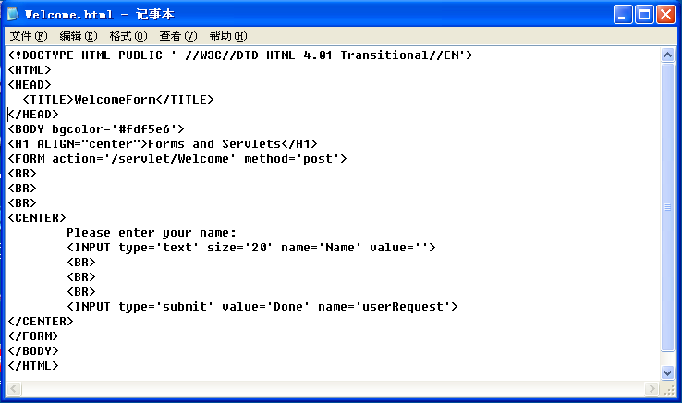
Creating an HTML Form

Slide 52
Running a Java Program
Load HTML files (.html) to TOMCAT
Load servlet (.class) to TOMCAT
Select specific HTML file within TOMCAT and open it in browser to test servlet
  Example 1：Welcome
  Example 2：Catfish

Slide 53
2.1 Programming with Java
Programming with Objects
Java Program Development
First Look at Java
Element of a Java Servlet
Planning Servlet Development
Guidelines for Java Development

Slide 54
2.1.3 First Look at Java
Examine the source code of Catfish class
  Class Definition
  Attributes of Catifish Class
  Behavior of Catfish Class
  If Statement

Slide 55
Java Identifiers
the identifier is used to identify variables, methods, objects, classes, interfaces, and package name, etc.
the identifier must follow some rules.
  Identifiers must a sequence of characters starting with a letter, underscore (_), dollar sign ($).
  In addition to the first character, the identifier is a sequence of characters which consist of letters, numbers, underscores (_), dollar sign ($)
  Identifiers are case sensitive.
  Identifiers have no maxlength limitation.
  Identifiers do not include spaces and hyphens
  Keywords can not be used as identifiers.

Slide 56
Java Identifiers
Java identifiers
  StudentName
  get_up
  _sys_path
  $pay
  $9test
  7go
  %super
  public
  get-name
Invalid identifiers

Slide 57
Identifiers in Catfish
Open Catfish.java and look through it :
Identifiers
  row
  column
  imageFileName
  getRow
  swimRightIfPossible

Slide 58
Java keywords
a part of the system-defined identifier, has a special meaning and purpose
abstract assert boolean break byte case catch char class const continue default do double else extends final finally float for goto if implements import instanceof int interface long native new package private protected public return short static strictfp super switch synchronized this throw throws transient try void volatile while
In Java, true (true), false (false) and null (blank value) are lowercase, they are not Java keywords, but the program can not use them as identifiers.

Slide 59
Keywords in Catfish
Keywords
  public, private
  class
  return
  String, int
  If…else

Slide 60
Class Definition
Class definition of Catfish.java
  The description is provided by the source code enclosed within the opening brace and the closing brace.
Contents in class definition
  attributes
  behaviors

Slide 61
Catfish
-row: int -column: int -imageFileName: String
+getRow(): int +getColumn(): int +getImage(): String +swimRightIfPossible() +swimLeftIfPossible() +swimDownIfPossible() +swimUpIfPossible()
attribute
Message
behavior

Slide 62
Class Definition Format
[Class modifier] class name [extends superclass name][implements interface name{, interface name}]{class body}
public class Catfish {
class body
}
Class name
Class modifier
Public modifier：If a class is declared to be public, then classes are not in the same package as the class can also use this class by reference the package where this class is. Otherwise, this class can only be used with a package.

Slide 63
Class Definition Format (cont)
[Class modifier] class name [extends superclass name][implements interface name{, interface name}]{class body}
Class modifier
Class name
superclass name
public class Welcome extends HttpServlet {
Class body
}
inherit

Slide 64
Attributes of Catfish Class
Attributes
  private int row;
  private int column;
  private String imageFileName;
Private: a keyword in Java indicating that these attributes can only be accessed by Catfish objects.
Int and String: indicate the type of values the attributes can take.
  int row: row can take integer values.
  String imageFileName: imageFileName is a string.

Slide 65
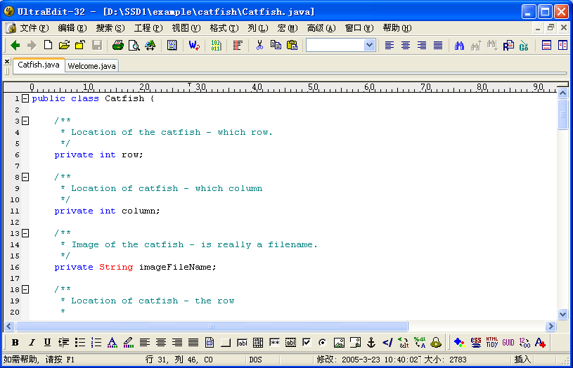

Slide 66
Variables
A variable is an identifier that can have a value. To create a variable, we must declare it by indicating the type of value it contain.
The form of a declaration statement is
type identifier1, identifier2, …;
Naming variables start with a lowercase letter.
In above example, each of these declarations includes a keyword that specifies the access to the attribute
  private int row;

Slide 67
Assignment
Variables are given values by assignment.
An assignment statement has the form
variable = value
The value must be consistent with the variable’s declared type.

Slide 68
Behavior of Catfish Class
It describes how the Catfish object would respond to the following messages:
  getRow
  getColumn
  getImage
  swimRightIfPossible
  swimLeftIfPossible
  swimUpIfPossible
  swimDownIfPossible
Allowing any other objects that communicate with Catfish objects to get information about their attributes
Describe the behavior of Catfish objects that attempt to swim to the right, left, up or down in the grid.

Slide 69
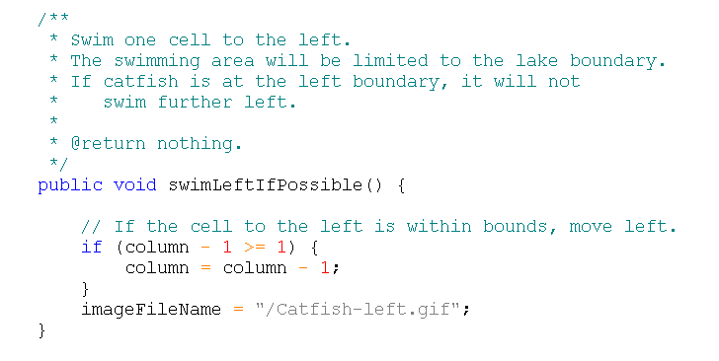
以swimLeftIfPossible()为例

Slide 70
Student Activity
How to create a Java Class
  Open Alife-basic.zip and load all files into the TOMCAT and run the simulation program
  Copy the source code from Listing 1 into Catfish.java file.
  Edit Catfish.java to use a new set of images for the fish.
  Compile Catfish.java
  Load the new version of Catfish.class created above into the TOMCAT.
  Run the new version of the simulation program

Slide 71
If-Statement

Slide 72
If-Statement
The execution of If-Statement
false
condition
true
Execute the statement

Slide 73
The basic process of software systems development
1. Requirements Analysis
(Analysis of the entire system)
6.Complete entire system
2. describe the relationship
between objects
5. Generate multiple objects
from class definition,
3. classify objects and
Identify their attributes
and behavior
4.Class definition
(attributes and methods)

Slide 74
Summary
Programming with Objects
Java Program Development
First Look at Java

