Slide 1
Introduction to Software Technology
Unit 2: Introduction to Java and Object-Oriented Programming
Liwei WANG
liwei.wang@whu.edu.cn
School of computer science

Slide 2

2.1 Programming with Java
Programming with Objects
Java Program Development
First Look at Java
Element of a Java Servlet
Planning Servlet Development
Guidelines for Java Development

Slide 3
2.1.4 Elements of a Java Servlet
The Welcome Servlet
More Servlets
Getting User Input
Debugging a Servlet

Slide 4
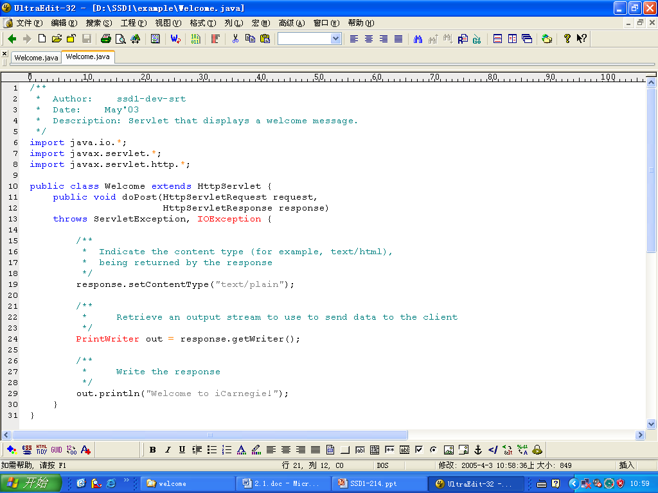
（comment）
/* */

Slide 6
Keywords
Import
public
class
extends
void
throws

Slide 7
Identifiers
Welcome
HttpServlet
doPost
HttpServletRequest
HttpServletResponse
PrintWriter
ServletException
IOException
request
response
out
setContentType
getWriter
println

Slide 8
Import all the clssses contained in java.io, which are required by the servlet to do any input or output task

Slide 9
The description for the Welcome class.
the servlet receives a doPost message and response it.

Slide 10
Sending setContentType message to response object (invoking method)
setContentType is used to set the format of a file generated by a servlet ：
“text/plain” specify a plain text；
“text/html” specify a HTML web page；
“ text/gif” specify a
GIF.

Slide 11
send the getWriter message to the response object

Slide 12
println message requires one resource actual text to execute,

Slide 13
More Servlets
Writing servlets that send a Web page to the browser.
Writing servlets that send an image instead of displaying a welcome message .
  out.println("<IMG src='/sf.jpg' alt='San Francisco'>");
Example: HtmlWelcome servlet

Slide 14
Getting User Input
While the form in My WelcomeForm.html allowed the user to enter a name, the message sent by the Welcome servlet had nothing to do with the name entered by the user.
This is because the source code for the Welcome servlet we examined did not attempt to find out what the user entered and to include that information in the Web page sent to the browser.

Slide 15
Getting User Input
Save the MyWelcomeForm.java as PersonalWelcome.java and modify it to get user’s input parameter.
String userName = request.getParameter("Name");
Compile the source file and modify the form correspond.
Reload the class file and html file to debug.

Slide 16
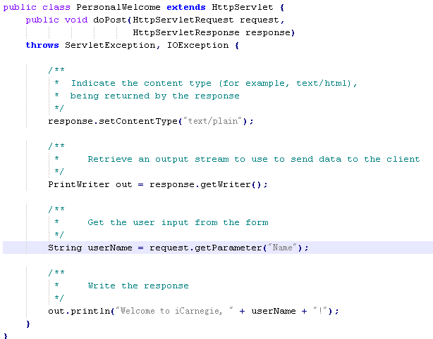
send the getParameter message to request object

Slide 17
2.1 Programming with Java
Programming with Objects
Java Program Development
First Look at Java
Element of a Java Servlet
Planning Servlet Development
Guidelines for Java Development

Slide 18
2.1.5 Planning Servlet Development
Thinking Ahead
Defining the Problem
Planning the Solution
Coding the Servlet
Testing and Evaluating

Slide 19
Thinking ahead
J2SE SDK installation
  J2SE
  Environment variables setting: path and classpath
Tomcat server installation
  This requires that the file javax.servlet-api.jar from Tomcat installation be added to your classpath.

Slide 20
Defining the Problem
Define types, number, and names for all controls
Define the name of servlet and how to invoke it in the web page
Define the response results after processing the servlet.
download TravelRequest.zip to the directory where you plan to work
  TravelRequest.java is a skeleton Java source file (.java) for the TravelRequest servlet.
  See TravelRequest.java Template File, complete it.

Slide 21
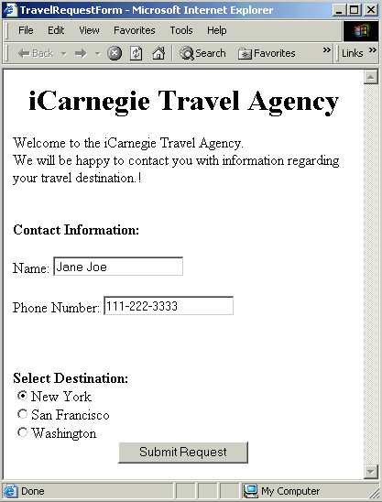

Slide 22
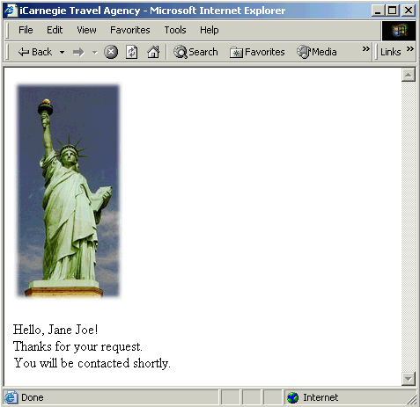

Slide 23
Planning the Solution
Indicate the content type being returned by the response
Retrieve an output stream to send data to the client
Get user input from the form: name and destination
Start by building the Web page header
Add the image
Add the confirmation message, with the name
End by building the Web page footer

Slide 24
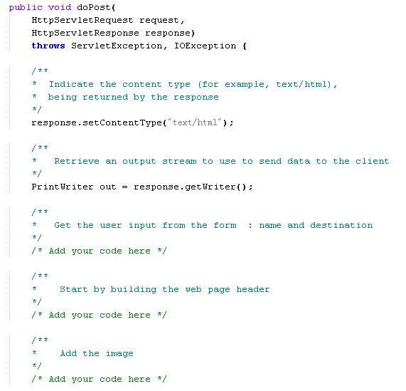

Slide 25
Questions 1？
The servlet needs to get only two of the three user inputs from the form: the name and the destination.
How to obtain these inputs in our servlet.
  Send the getParameter message to the HttpServletRequest object to get the value of the text input control Name.
  Send the getParameter message to the HttpServletRequest object to obtain the value of the radio button input control Destination from the form that actually provides the name of the image file for the destination city selected.

Slide 26
Questions 2？
How the servlet would generate the Web page based on the user inputs obtained from the form.
  To build a Web page, the servlet must output all the HTML code for the Web page.
  HTML code needs an IMG tag
  The HTML code must include a line of text
  string concatenation
  out.println statement should be used.

Slide 27
Steps
Write the code to build the Web page with a header, a footer, and a confirmation message built with some dummy name.
Write the code to obtain the user's choice of destination city and to construct a Web page with the image for the destination city.
Write the code to obtain the user's name and substitute that for the dummy name in the confirmation message.

Slide 28
Steps
For each step, we should
  Edit the servlet source file TravelRequest.java to include the code for that step.
  Compile the servlet source file using the javac command
  Run the servlet using the form in TravelRequestForm.html and the TOMCAT to see result.

Slide 29
Coding a Servlet
Example
  Step1:
    output the confirmation message including the dummy name Visitor
    Compile and Run
  Step2:
    The getParameter statement for obtaining the value of the radio button input control called Destination
    The out.println statements that output HTML code from the servlet. including the HTML code for the IMG tag whose src and alt attributes both specify the image file obtained earlier.
    Compile and Run
  Step3:
    Add the getParameter statement for obtaining the value of the text input control called Name
    Edit the out.println statement that outputs the greeting in the confirmation message to include the value obtained above instead of the dummy name Visitor.
    Compile and Run

Slide 30
Testing and Evaluating the Servlet
We do need to check that the response generated by our servlet is indeed as specified to us.
We also need to make sure that the Web page constructed by the servlet is valid HTML. (WDG)
Remember to follow the steps
  Define the problem you are attempting to solve.
  Make a plan on how you can do this.
  Code the solution as per your plan above.
  Evaluate your solution against the specification given to you.

Slide 31
2.1 Programming with Java
Programming with Objects
Java Program Development
First Look at Java
Element of a Java Servlet
Planning Servlet Development
Guidelines for Java Development

Slide 32
2.1.6 Guidelines for Java Development
The process of Programming
The Java API Documentation
Coding Style
Commenting Source Code
Javadoc

Slide 33
Developing Web pages
Defining Web page content
Planning the look of the page and the needed links
Implementing the Web page by writing it incrementally in small steps
Evaluating the Web page in two ways

Slide 34
The process of Programming
Definition Phase
  Define and/or redefine the problem
Planning Phase
  Plan a solution to the problem
Coding Phase
  Code the solution
Evaluation Phase
  Evaluate and test everything

Slide 35
define
/redefine
plan
evaluate/test
code
more time you spend on paper with this process, the less time you spend at the keyboard

Slide 36
Notes on Process
Process becomes significant as the complexity of programs increases.
Most of the time spent in evaluation and testing
Evaluate your restatement to ensure correct problem being solved
Use divide-and-conquer to solve a big problem
Code the small piece, inspect, and validate before moving to next piece.
More time spent on process implies less time spent programming.
Programming is not coding. Coding is not programming.

Slide 37
Java API Documentation
One or more of API s need to be used for Java
API provides a set of classes and methods to a programmer, thus providing a re-usable foundation to build upon.
Java has its own Java API Documentation site that is useful for finding accurate information fast.
For example, classes and methods used in the Welcome servlet can be looked up at the Java Servlet Specification site.

Slide 38
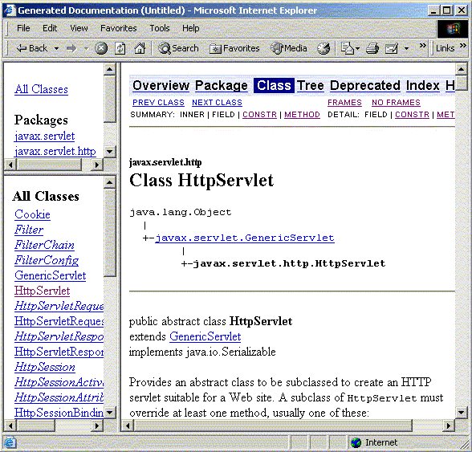

Slide 39
Coding Style
Code should be written so as to be readable
  By the author at a later time
  Others expected to work on it for extending functionality or debugging
Code should be efficient, to function as expected in the most optimal way in terms of time and usage of system resources.
  This comes with experience and thorough knowledge of the language.
Java Coding Conventions document presents an exhaustive set of rules and guidelines for writing Java Code.

Slide 40
Commenting Source Code
Comments an essential element of documenting code
Well-commented code is more maintainable for other developers, and reduces Software’s cost of ownership
Well-written comments should explain the purpose of the class near the beginning of the class
Each method should have at least one comment immediately before the method name to explain its purpose
Important to express intent behind code than just restating.

Slide 41
Javadoc
The Java SDK offers a tool for documenting code called Javadoc .
If you type your comments in a specified format, you can run the Javadoc program on your class and an HTML document will automatically be generated that contains your comments in Java's standard documentation format.

Slide 42
Summary
2.1Programming with Java
Programming with Objects
Java Program Development
First Look at Java
Element of a Java Servlet
Planning Servlet Development
Guidelines for Java Development

