Slide 1
Introduction to Software Technology
Unit 2: Introduction to Java and Object-Oriented Programming
Liwei WANG
liwei.wang@whu.edu.cn
School of computer science

Slide 2
2.2 Fundamentals of Object-Oriented Programming
Designing Classes
Transforming English Specification into Java
Lifecycle of Objects
The HtmlPage Class
Using Class Documentation
The AlgaeColony Class

Slide 3

2.2.1 Designing Classes
What classes would be required to build such a model that simulates the life of organisms in a lake?
For each class, what would be the attributes and behaviors of the class?
Please implement them using Java programs.

Slide 4
Objects
Objects are fundamental building blocks of Object-Oriented Programming (OOP).
Objects in the real world
  physical objects
  Abstract(conceptual) objects
Software objects in a program
  An object in a program represents some real-world object, be it physical or conceptual
  An object encapsulates data (attribute) and the mechanisms (behavior) that operate on the data.

Slide 5
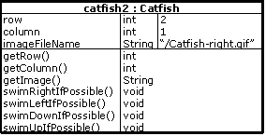
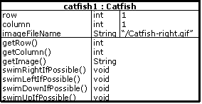
Two Catfish objects, their values of attribute Row are different.

Slide 6
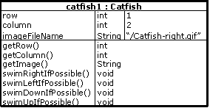
Attributes Values, and State
The values for all attributes of the fish object taken collectively define the state of the object.
The state of an object can change over time.

Slide 7
Behavior
In OOP, an object‘s operations are also called its behaviors, or method .
Some behaviors manipulate data of attributes
  swimRightIfPossible
    the value of column attribute
    the value of the imageFileName attribute
    If possible, increments the value of column attribute, and changes the value of the imageFileName attribute
  swimUpIfPossible.
    the value of row attribute
    the value of the imageFileName attribute
    If possible, decreases the value of row attribute, and changes the value of the imageFileName attribute

Slide 8
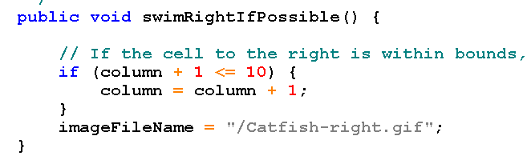
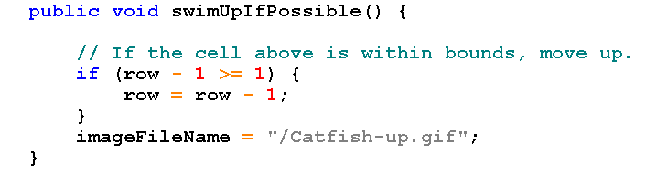
modifier
Return type
Behavior name
No parameters

Slide 9
Behavior
Some behaviours query and return the object state only:
  getRow()
  getColumn()
  getImage()

Slide 10



Return Type
Behavior name
No parameters
modifer

Slide 11
Class
A class is defined as "a software construct that defines the data (state) and methods (behavior) of the specific concrete objects that are subsequently constructed from that class"
A class just like a template, using to describe all characteristics of an object.
An object is an instance of a class. All objects will have all the attributes and behaviors defined in the class
An object cannot have any data or perform any operation that is absent in its class definition

Slide 12
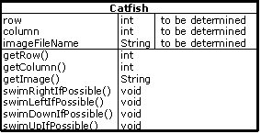
Catfish Class definition
an Catfish2 object

Slide 13




Class & Object
In real world, there are many objects which belong to the same class/kind/type .
Class: A group of individuals linked by characteristics held in common.
Girl
A class named Girl
Jodie
Daria
Jane
Brittany
Four objects of Girl class

Slide 14
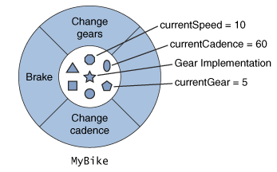

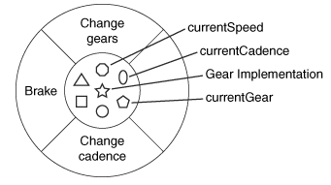
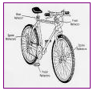

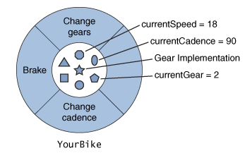

Class & Object
Bicycle blueprint
class Bicycle

Slide 15
class classname{
type instantce-variables1;
type instantce-variables2;
//……
type instantce-variablesN;
type methodname1(parameter-list){
// body of method;
}
//……
type methodnameM(parameter-list){
// body of method;
}
}

Slide 16
Object's Interface
Accessibility: public vs. private
Example of car designing：gear，steering wheel
  As a driver
  Which parts should be public or private?
If we are too generous in giving access, unnecessary mistakes can occur.

Slide 17

Accessibility
When we design classes, we can think of things in a very similar way as designing cars.
  The private aspects of a class much like the internals of a car, interact only with other parts of the car.
    gears
  The public aspects of the objects are available to the users of the object for interacting with the object
    steering wheel

Slide 18
Accessibility
Objects of other classes can manipulate only the public attributes of objects and can use only the public services of an object.
We call the collection of all public aspects of a class its interface.

Slide 19
Accessibility
Information hiding is a term we use to describe that certain properties are inaccessible for public use. Java uses the keyword private to indicate such properties
  The purpose of class is to encapsulate complexity within the class, thus a class should have a mechanism to hide complex information.
How to access a member of a class depends on its access modifier declared

Slide 20
Catfish example
In OOP, an object usually keeps its attributes private.
This forces other objects to send a message requesting state change instead of directly manipulating the state.
In our simple catfish example, we made the row, column and imageFileName attributes private. Therefore, they are inaccessible to objects of other classes:

Slide 21
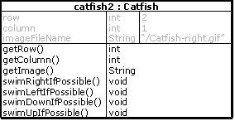
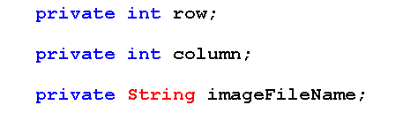
Private attributes.
Only accessed by getRow,getColumn,getImage,swimRightIfpossible, swimLeftIfPossible,swimDownIfPossible,swimUpIfPossible

Slide 22
Return value of method
The type of data returned by the method must be compatible with the return type specified in method.
  For example, if a method's return type is an integer, it is impossible to return a Boolean.
The type of variable using to receive return value of the method must also be compatible with the return type specified in method.
  For example, if the type of the variable is integer, it is impossible to accept a Boolean as a return value.
Method can return any type of data, including the class type

Slide 23
Class Attributes
Most attributes have values specific to object.
  each catfish instance has its own location values (i.e., row and column).
Some attribute values, however, are common to all object of a class.
  For example, all catfish have to spend a certain amount of energy to swim to an adjacent cell.
  Since this amount does not depend on the state of any object, it is a property of the class as a whole. We call such properties class attributes.
A class property does not belong to any single object of that class. Instead, it belongs to the class.

Slide 24
Constants
The value for an attribute usually changes during the lifetime of the object
  Values of row and column in a Catfish object.
but there are some attributes for which the value does not change once it is set. This type of attribute is a constant.
  The energy to swim of catfish
  The minimum energy to survive of catfish.

Slide 25
final
A variable can be declared as final, the purpose of doing so is to prevent its contents being modified.
The final variable can be initialized only once, then its value can not be modified any more.
A final variable is essentially a constant.
final variables need to be initialized.
class FinalDemo {
public static void main(String args[]){
final int noChange = 20;
noChange = 30;
}
}
Final variable can not be modified

Slide 26
static
If you define a class member, and its use is completely independent of any object in this class
  Then Adding Static keyword before the member's statement to create such a static member.
  Static members can be referenced by the name of the class without having to be referenced by an object of the class.
  Both class methods and variables can be declared as static.
  Variables declared as static is essentially a global variable.

Slide 27
static
No matter how many instances of the class are created, the class has only one copy of a static variable.
The approach to use
static variables:
  By referencing any instance of the class
  By referencing the class name
class StaticDemo {
static int x = 0;
StaticDemo(){x++;}
}
StaticDemo d1 = new StaticDemo();
StaticDemo d2 = new StaticDemo();
d1.x = 100 ;
d2.x = 200;
testVariable = d1.x;
StaticDemo d1 = new StaticDemo();
StaticDemo d2 = new StaticDemo();
StaticDemo.x = 100;
StaticDemo.x = 200;
testVariable = StaticDemo.x;
By referencing class instances
Not a good method
By referencing class name

Slide 28
Designing a Class
The most important step in designing a class is to identify all the object attributes and behaviors.
  To identify attributes of an object, look for noun
    row, column, energyLevel, age
  To identify behaviors, look for verbs.
    Swim*ifpossible, Getrow, Getcolumn, lookForFoodInNeighborhood

Slide 29
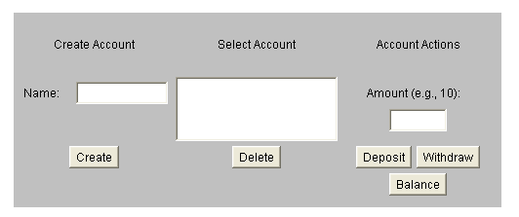
Design Process Example:
Bank Teller
Introduction
  Run the applet

Slide 30
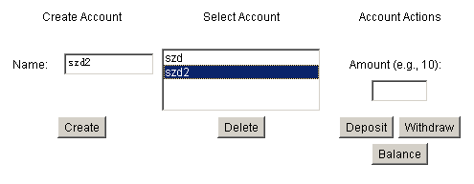

Slide 31

Decomposing the Problem
Decomposing the Problem
  What are the components of this system?
    The Graphical User Interface (GUI for short) (we can see)
    BankAccount (we can’t see)
      models a bank account, keeping track of the balance, handling withdrawals, handling deposits, and providing the balance when asked.
    AccountsLedger (we can’t see)
      models a ledger – maintaining a collection of accounts, creating and deleting accounts when asked, and looking up accounts.

Slide 32
BankAccount
Designing the BankAccount Class
  Identify the behaviors of object instances:
    Deposit:
      The amount of money is specified as an integer number
      Increase the balance by the specified amount
      The operation does not generate a reply.
      This operation should be part of the public interface of BankAccount since the objects of other classes should be able to send deposit messages to BankAccount objects

Slide 33
BankAccount
Designing the BankAccount Class
  Identify the behaviors of object instances:
    Withdraw:
      The amount of money is specified as an integer number with the integer
      Decrease the balance of the account by the specified amount of money.
      The operation does not generate a reply.
      This operation is also part of the public interface of BankAccount since objects of other classes should be able to send withdraw messages to BankAccount objects.

Slide 34
BankAccount
Designing the BankAccount Class
  Identify the behaviors of object instances:
    getBalance (inquiry) :
      The balance returned is an integer.
      We need to store the account balance as part of the object's state.
      The operation generate a reply, that is the current balance of the account This behavior is also part of the public interface of BankAccount since the GUI object should be able to send getBalance messages to BankAccount objects and in response get the balance.

Slide 35
BankAccount
Designing the BankAccount Class
  Identify the behaviors of object instances:
    Constructor
      When creating a new instance of this class, and this instance of the class will need to be initialized. Account’s name and the beginning balance.
      This constructor is also part of the public interface since the AccountsLedger object should be able to create new bank accounts.

Slide 36
Constructor
When creating an object, it is initialized by constructor.
  It has the same name with class name.
  Once you define a constructor, the constructor automatically calls immediately after the object is created
  It return nothing, just initialized the states of objects.

Slide 37
BankAccount
  Identify the attributes of object:
    Balance: private
    Name: public constant
  Identify the class attributes of BankAccount
    minimum balance:

Slide 38
BankAccount
attribute | -balance | Int，the total amount of money in the account，not a constant
 | +name | String，the customer name, is a constant
behavior | +Constructor | Create an account for the person whose name is specified as a character string and set the beginning balance to $0.
 | +deposit | Increase the balance of the account by the specified amount of money. returns nothing.
 | +withdraw | Decrease the balance of the account by the specified amount of money. returns nothing.
 | +getBanlance | Return the current balance of the account as an integer.

Slide 39
Design Process Example: AccountsLedger
Behaviors:
  Create.
    Create a new BankAccount object for a customer whose name is specified as a character string.
    This behavior is public since the GUI can send messages of this kind.
    Nothing needs to be returned
    We need a collection of BankAccount objects as an attribute accounts.
  Delete BankAccount.
    Remove a BankAccount object from the accounts collection
  Lookup BankAccount
    returns a BankAccount object.
  Constructor.
    accounts attribute should be initialized to an empty collection.

Slide 40
AccountsLedger
Attributes:
  Accounts: instance attribute, private
    A collection of BankAccounts maintained in the ledger.
  No class attributes

Slide 41
Student Activity
The ability to identify the properties and behaviors
The ability to identify the appropriate accessibility criteria (private or public)
The ability to distinguish between object attributes and class attributes
The ability to identify constants

Slide 42
2.2 Fundamentals of Object-Oriented Programming
Designing Classes
Transforming English Specification into Java
Lifecycle of Objects
The HtmlPage Class
Using Class Documentation
The AlgaeColony Class

Slide 43

2.2.2 Transforming English Specification into Java
Mapping English Terms to Java Terms
Java Rules and Conventions
Mapping BankAccount to Java Code
  BankAccount

Slide 44
Mapping English Terms to Java Terms
Terms used in English specification | Technical term in Java
attribute | field
object attribute | instance variable
class attribute | static variable (also known as static field)
constant attribute | final field
public | public
private | private
integer | int
string | String
collection of objects | Vector
behavior | method
sending a message | invoking a method
specifications to be sent with messages | method parameters
constructor | constructor (constructor name should be identical to class name)
returns nothing | void

Slide 45
BankAccount
type | -balance | Int，the total amount of money in the account，not a constant
 | +name | String，the customer name, is a constant
behavior | +Constructor | Create an account for the person whose name is specified as a character string and set the beginning balance to $0.
 | +deposit | Increase the balance of the account by the specified amount of money. returns nothing.
 | +withdraw | Decrease the balance of the account by the specified amount of money. returns nothing.
 | +getBanlance | Return the current balance of the account as an integer.

Slide 46
BankAccount
public final: String name private: int balance
public: BankAccount(String initialName) void deposit(int amount) void withdraw(int amount) int banlance()

Slide 47
Java Rules and Conventions
Class Name
  Class names should be nouns and cannot contain a space. Each word in the name should start with an upper case letter. The rest of the letters are lowercase.
    BankAccount
Variables
  Variable names start with lower case letters and should be meaningful relative to their purpose in the program.
    balance，name

Slide 48
Java Rules and Conventions
Constructor
  constructors must use the same name as the class and should not return any values.
    BankAccount
Method Names
  Each word other than the first should start with an upper case letter. Use words indicating the purpose of the method, no space between two words.
    getBalance, withdraw, despoit

Slide 49
Java Rules and Conventions
Parameter
  If a method has no parameters, then the parentheses have nothing inside them
    getBalanc()
  Otherwise, each parameter has a name, and the type of each parameter goes before the name.
    deposit(int amount)
Return Values
  The return value type is specified before the method name.
    int getBalance()
  When a method returns nothing, we use void.
    void deposit(int amount)

Slide 50
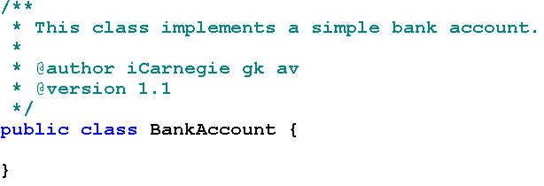
Mapping BankAccount to Java Code
Class name
the class itself is publicly accessible to all other classes.
Readability will be an important factor when grading your submissions.

Slide 51
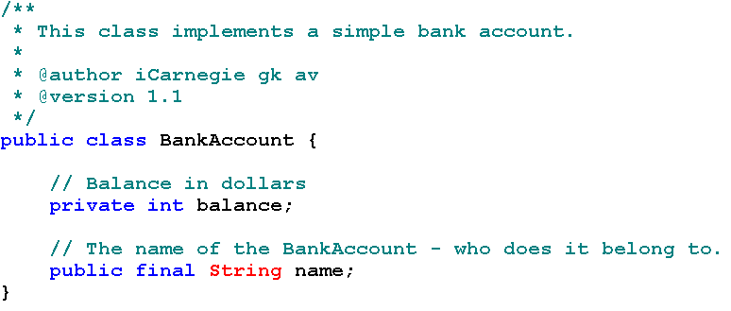
Mapping BankAccount to Java Code
Private attribute balance, type is int
○
Public attribute name，type is String，constant
○

Slide 52
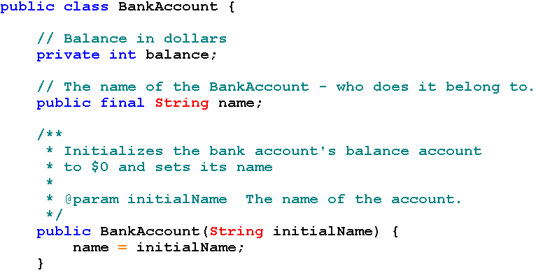
Constructor of BankAccount, it has the same name as the class name, parameter is type String, return nothing.

Slide 53
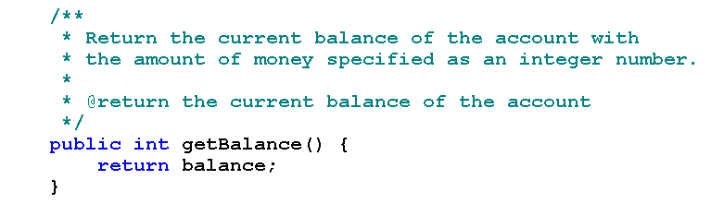
getBalance method，no parameters，Return type is int;
this method return account balance.

Slide 54
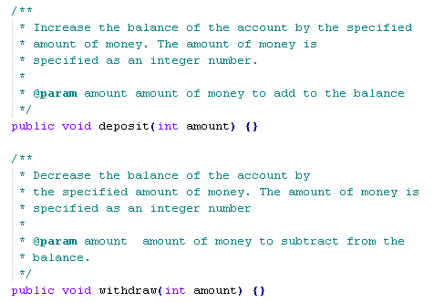

Slide 55
Thinking and practice
The class implementation is not complete until we implement the methods.
AccountsLedger maintains a collection of BankAccount objects: creates BankAccount objects, deletes them, and looks them up.
AccountsLedger does this by holding on to a collection of references to the BankAccount objects in a Vector. Before we discuss AccountsLedger, we need to understand object creation, deletion, object references, and collections. We will discuss these in the next page.
Before you proceed to the next page, we recommend that you complete the following student activity.
  2.2.2 student activity

Slide 56
Summary
Designing Classes
Transforming English Specification into Java

