Slide 1
Introduction to Software Technology
Unit 2: Introduction to Java and Object-Oriented Programming
Liwei WANG
liwei.wang@whu.edu.cn
School of computer science

Slide 2
2.2 Fundamentals of Object-Oriented Programming
Designing Classes
Transforming English Specification into Java
Lifecycle of Objects
The HtmlPage Class
Using Class Documentation
The AlgaeColony Class

Slide 3

2.2.3 Lifecycle of Objects
Lifecycle of Objects
  Creating Objects
  Referencing Objects
  Garbage Collecting Objects and null
  Multiple References to an Object
  Vector
  Transforming AccountsLedger class

Slide 4

Creating Objects
instantiation: The process of creating an object instance of a class
  We use the New operator to create BankAccount object for “Bob ”
  new BankAccount(“Bob”)

Slide 5
Referencing Objects
A reference variable can hold a reference to an object. A reference variable is any variable in Java whose type is a class.
Three concepts
  an object
  a reference to the object
  a reference variable

Slide 6
Referencing Objects
BankAccount account1;
BankAccount account2;
account1 = new BankAccount("Achebe");
account2 = new BankAccount("Bob");
New BankAccount(“Achebe”) create a new object，and return a reference to Achebe's BankAccount；
Account1 is a reference variable，account1=new BankAccoutn(“Achebe”), means account1 holding a reference to new created BankAccount object instance.

Slide 7
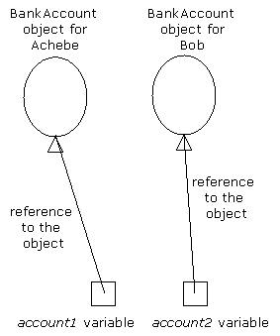
account1 reference variable is to reference new created BankAccount(“Achebe”) object.
account2 reference variable is to reference new created BankAccount(“Bob”) object.

Slide 8
Garbage Collecting Objects and nulls
A reference variable that refers to "nothing" is said to have a null value.
  If in the previous example, the account1 did not store any reference to an object, then value of the reference variable is NULL.
The unreachable objects will "fly away."
  If in the previous example, the newly created object through new BankAccount(“Achebe”) doesn’t be assigned to any reference variable, there would be no way of using the newly created objects since they are unreachable.
In Java terminology, unreachable objects will be "garbage collected" by the JVM.
  In Java terminology, unreachable objects will be "garbage collected" by the JVM（garbage collected）”

Slide 9
Garbage Collecting Objects and nulls
BankAccount account1; // has null value
BankAccount account2; // has null value
new BankAccount("Achebe"); // reference is lost. Achebe is unreachable!
new BankAccount("Bob"); // reference is lost. Bob is unreachable!
The two newly created BankAccount objects don’t be assigned to any reference variable，then these two objects are unreachable, will be "garbage collected"

Slide 10
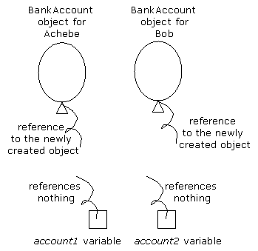

Slide 11
Multiple references to an object
BankAccount account1; // has null value
BankAccount account2; // has null value
account1 = new BankAccount("Achebe"); // account1 has Achebe's reference
new BankAccount("Bob"); // Reference lost. Bob is unreachable!
account2 = account1; // account2 also has Achebe's reference
A number of reference variables can reference the same object.

Slide 12
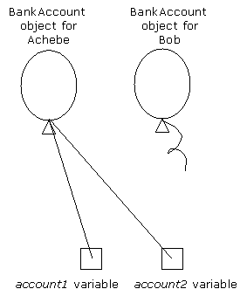
A number of reference variables can reference the same object.

Slide 13
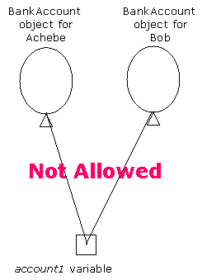
A variable can hold only one reference at a time

Slide 14
Multiple references to an object
BankAccount account1; // has null value
BankAccount account2; // has null value
account1 = new BankAccount("Achebe");
account2 = new BankAccount("Bob");
account1 = account2; // Reference to Achebe is lost.
The reference stored in a reference variable can change over time. When, the reference variable stores a new reference, the old reference is lost.

Slide 15
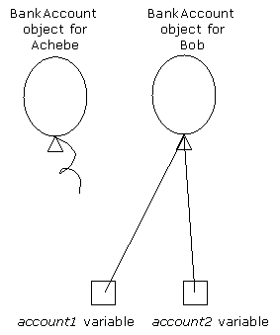
When, the reference variable stores a new reference, the old reference is lost.

Slide 16
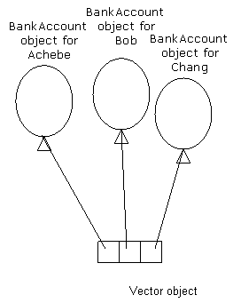
Vector
A Vector object can hold a collection of object references.

Slide 17
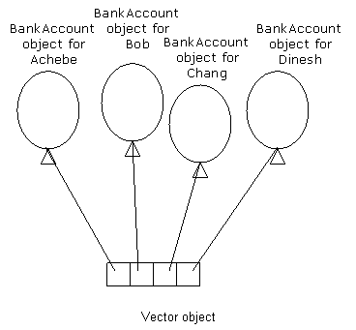
Vector
A Vector can grow to accommodate additional object references.

Slide 18
The references in a Vector are ordered.
The starting index is zero. Therefore, the last element will have an index of size - 1.
first
second
fourth
third

Slide 19
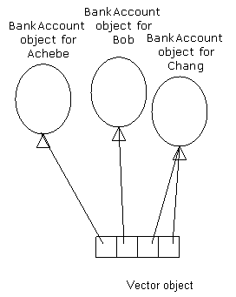
Vector can hold duplicates references

Slide 20
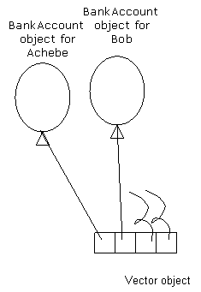
A Vector can hold references to nothing

Slide 21
Vector
A Vector holds only references to the objects. In other words, the Vector does not contain the object itself.
Each slot in the Vector acts like a reference variable. Each slot can hold only one reference.
In Java, the Vector class is defined in the java.util package.

Slide 22
Vector
A reference variable can be declared to hold a Vector reference
  Vector accounts; // has null value.
  accounts is a variable, its type is Vector, the variable hasn’t been assigned any value.
Reference variable hold a reference to an actual Vector object
  Vector accounts = new Vector();
  accounts is used to reference a vector object.

Slide 23
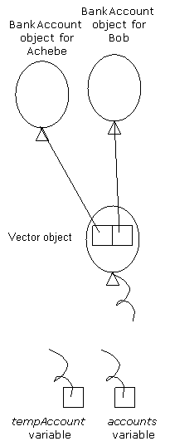
Vector accounts = new Vector();
BankAccount tempAccount = new BankAccount("Achebe");
accounts.add(tempAccount);
tempAccount = new BankAccount("Bob");
accounts.add(tempAccount);
accounts = null;
tempAccount = null;

Slide 24
AccountsLedger class
AccountLedger
private: Vector accounts
public: AccountLedger() void addAcount(String name) void deleteAccount(String name) BankAccount lookUpAccount(String name)

Slide 25
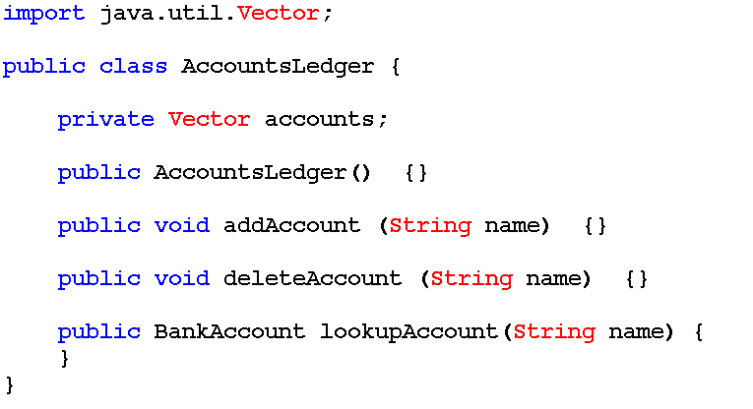

Slide 26
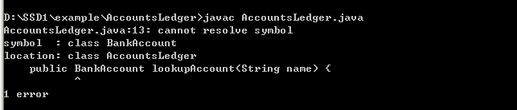
D:\SSD1\example\AccountsLeger> javac AccountsLedger.java
AccountsLedger.java:13: cannot reslove symbol
symbol: class BankAccount
location: class AccountsLedger
public BankAccount lookupAccount(String name){
^
1 error

Slide 27
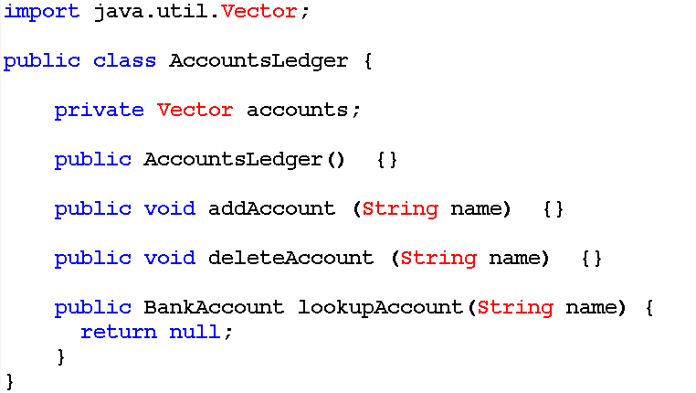

Slide 28
2.2 Fundamentals of Object-Oriented Programming
Designing Classes
Transforming English Specification into Java
Lifecycle of Objects
The HtmlPage Class
Using Class Documentation
The AlgaeColony Class

Slide 29
2.2.4 The HtmlPage Class
Designing the HtmlPage Class
English Specification for HtmlPage Class
Mapping English Specification to Java Code
Building Response Web Page with HtmlPage Class
Compiling and Running Multiple Classes

Slide 30
Questions?
From servlets we have seen, some part of Web page generation is common to all servlets.
  HtmlWelcome servlet
  TravelRequest servlet
We need one out.println statement per line of HTML code in the servlet source code.
Is there some ways to simple the task?

Slide 31
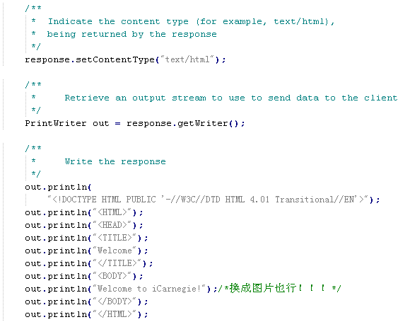

Slide 32
A way
It would be useful to design a class that models the attributes and behavior of a Web page.
Using a class to construct the Web page helps us localize HTML code generation to one class, which makes the task of HTML validation a lot easier.

Slide 33
Designing the HtmlPage Class
The unique service provided by this class is the construction of a Web page with valid HTML code.
  A header built with tags: <HTML>,<HEAD>,</HEAD>,<TITLE> and </TITLE>.
  A footer built with tag: </HTML>
  A body <BODY> and </BODY>enclosed between the header and the footer.

Slide 34

Designing the HtmlPage Class
Others should be considered
  The Web page must include the <DOCTYPE> element
    <!DOCTYPE HTML PUBLIC '-//W3C//DTD HTML 4.01 Transitional//EN'>
  Users may specify a background image or a background color for the Web page.

Slide 35

English Specification for the HtmlPage Class
Behaviors of HtmlPage objects
  Constructor：Create an HtmlPage object. Set the initial values of all attributes to be empty strings
  getHeader：Build the HTML code for the Web page header. Returns a String object.
  getFooter：Build the HTML code for the Web page footer. Returns a String object.

Slide 36
English Specification for the HtmlPage Class
Behaviors of HtmlPage objects
  setTitle：Set the value of the attribute that models the Web page title as specified. Returns nothing.
  setBackgroundImage：Set the value of the attribute that indicates the background image for the Web page as specified. Returns nothing.
  setBackgroundColor：Set the value of the attribute that indicates the background color for the Web page as specified. Returns nothing.

Slide 37
Designing the HtmlPage Class
Behaviors of HtmlPage objects
  getBody：Build the HTML code for the body of the Web page. Returns a String object.
    Start with the <BODY> tag, including the background and bgcolor attributes from the corresponding attributes for the Web page.
    Include the HTML code for the body of the Web page
    End with the </BODY> tag.
  getDoctype： Build the HTML code for the <DOCTYPE> element to be included at the start of the Web page. Returns a String object.

Slide 38
Designing the HtmlPage Class
Behaviors of HtmlPage objects
  addText： Modify the value of the attribute that models the body of the Web page by adding a line of text. Returns nothing.
  buildHtml： Complete the construction of the Web page. Returns a String object.
    Get <DOCTYPE>element using getDoctype method
    HTML code returned by getHeader method
    HTML code returned by getBody method
    HTML code returned by getFooter method

Slide 39
Designing the HtmlPage Class
HtmlPage对象的属性
  pageTitle：Represents the Web page title. Stored as a String.
  pageBody： Represents the body of the Web page. Stored as a String.
  bgImage： Represents the name of the image file to be used as background image for the Web page. Stored as a String.
  bgColor： Represents the background color for the Web page. Stored as a String.

Slide 40
Mapping English Specification to Java Code
Write, Compile and debug HtmlPage.java file

Slide 41
Think
How does the class design ensure that the Web page generated would always have the right structure consisting of the <DOCTYPE> element, a header, a footer, a body, and a footer?
Why are all of the attributes pageTitle, pageBody, bgColor, and bgImage private?
Why are the behaviors getDoctype, getHeader, getFooter, and getBody private?
Suppose you decide to use the HtmlPage class in your servlet to generate a Web page. You therefore create an instance of the HtmlPage class and send the buildHtml message to that instance. Would you still get a valid Web page?

Slide 42
Building Response Web Page with HtmlPage Class
Watch HtmlWelcome.java file created before.
Write the HtmlWelcome.java using an instance of the HtmlPage class to generate the response Web page.
Compare the two files: HtmlWelcome (before) and HtmlWelcome.

Slide 43
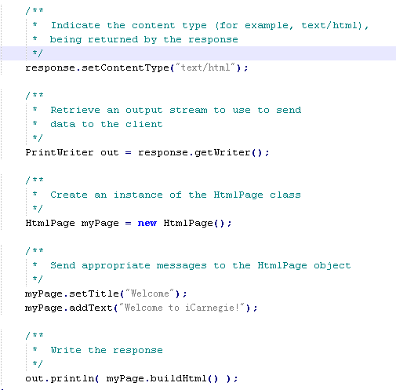
Create an object of the HtmlPage class using the constructor for the HtmlPage class
just one out.println statement to build the same Web page

Slide 44
Compiling and Running Multiple Classes
Compile HtmlPage.java file
Compile HtmlWelcome.java file
Load the class file to workbench
Open HtmlWelcomeForm.html in workbench and submit the form to see result.

Slide 45
2.2 Fundamentals of Object-Oriented Programming
Designing Classes
Transforming English Specification into Java
Lifecycle of Objects
The HtmlPage Class
Using Class Documentation
The AlgaeColony Class

Slide 46
2.2.5 Using HtmlImage Class
The HtmlImage Class
Documentation for the HtmlImage Class
Using the HtmlImage Class

Slide 47
Review
When working with object-oriented programs in Java, you may design classes that others must use or you may need to use classes designed by others.
Good programming practices dictate that one must not need to examine the source code for a class to be able to use it in a program.

Slide 48
The HtmlImage Class
Our goal is to re-write the TravelRequest servlet
We are told that we can separate all HTML code generation from the servlet if we use both HtmlPage and HtmlImage classes.

Slide 49
The HtmlImage Class
We re-write the source code for the TravelRequest servlet to use the HtmlPage class.
  myPage.addText(
  "<IMG src='/" + destination + "' alt='"
  + destination + "'>");

Slide 50
Documentation for the HtmlImage Class
The HtmlImage class is a simple class with one constructor and one method
The values for the src and alt attributes are passed as parameters to the constructor when the HtmlImage class is instantiated
We can send the buildHtml message to the HtmlImage class to obtain the HTML code for the IMG tag that we can then add to our Web page.

Slide 51
Using the HtmlImage Class
First, we create an instance of the HtmlImage class
  HtmlImage destinationImage =
  new HtmlImage( "/" + destination, destination );
Next, we add the image to the Web page
  myPage.addText( destinationImage.buildHtml() );
Last, Compile the files and prepare to execute.

Slide 52
2.2 Fundamentals of Object-Oriented Programming
Designing Classes
Transforming English Specification into Java
Lifecycle of Objects
The HtmlPage Class
Using Class Documentation
The AlgaeColony Class

Slide 53
2.2.6 The AlgaeColony Class
Designing the AlgaeColony Class
English Specification for AlgaeColony Class
Mapping English Specification to Java Code

Slide 54
Prepare
To proceed with the design, download the new version of the simulation program.
Try some of the conditions you chose earlier and observe the behavior of the AlgaeColony as best as you can to prepare for designing the class that models the algae colonies in the simulation.
demo

Slide 55
Designing the AlgaeColony Class
The simulation program generates random amounts of sunlight per cell, a portion of which is converted to life energy by the AlgaeColony.
The energy of any organism at any given time must be between the minimum amount needed to stay alive and the maximum amount of energy that it can carry. If the energy carried by the organism falls below the minimum, it will die.
An AlgaeColony that is dead disappears from the lake.
An AlgaeColony that is alive changes color based on the level of energy it carries.

Slide 56
Designing the AlgaeColony Class
When an AlgaeColony is eaten by a Catfish, it must give up some energy.
All organisms expend some energy to live.
Every organism belongs to a certain species of living beings.
a certain age measured in terms of blocks of time. One block of time is equivalent to one step of simulation.

Slide 57
Designing the AlgaeColony Class
We can observe the following about the behavior of AlgaeColony from running the simulation:
  An AlgaeColony does not move.
  The color of an AlgaeColony changes between three shades of green and black.
  When Catfish are located close to an AlgaeColony, the Catfish move differently.

Slide 58
Designing the AlgaeColony Class
We can thus identify the following behaviors at this time:
  Constructor. Create an instance of the AlgaeColony class.
  Live. Live a block of time or a step of simulation.
  Die. Update living status. Give up energy. If eaten by Catfish, relinquish energy.

Slide 59
Designing the AlgaeColony Class
We identify the attributes of object instances:
  Location. Location in the grid that represents the lake, expressed in terms of the row and column
  Life status. Whether it is dead or alive
  Energy level. The amount of energy it has
  Color. Can be several shades of green based on the level of energy if it is alive or black if it is dead
  Identification. Some form of identification for the object instance, which could be a name

Slide 60
Designing the AlgaeColony Class
We identify class attributes:
  Species
  Minimum energy required by newborn AlgaeColony to stay alive
  Maximum energy that can be carried by a newborn AlgaeColony
  Amount of energy used to live a block of time

Slide 61
Designing the AlgaeColony Class
Others
  The way different organisms are represented during their lifetime varies.
    Catfish and Crocodile are represented by images that disappear when they are dead. The color of their images does not change during their lifetime.
    On the other hand, AlgaeColony is represented by a change of color.
  An AlgaeColony must obtain sunlight.
  AlgaeColony objects must be created in the location(s) specified by the user.

Slide 62
Summary
Designing Classes
Transforming English Specification into Java
Lifecycle of Objects
The HtmlPage Class
Using Class Documentation
The AlgaeColony Class

