Slide 1
Introduction to Software Technology
2.3 Fundamentals of Java
Liwei WANG
liwei.wang@whu.edu.cn
School of computer science

Slide 2

2.3 Fundamentals of Java
2.3.1 Data Types and Variables
2.3.2 Arithmetic Operators and Expressions
2.3.3 Boolean and Relational Operators and Expressions
2.3.4 Control Flow
2.3.5 Iteration (loop)
2.3.6 Using Vector

Slide 3
2.3.1 Data Types and Variables
Data Types
  Primitive Types
  Reference Types
Variables
Using Variables

Slide 4
What is a Data Type
Data type-concept of how OOP classifies the real world information
Each attribute (characteristics of an object) accepts only specific kind of information based on its data type.
In programming terms, we would say that an attribute has a specific data type.
the terms type and data type refer to a specific kind of information.

Slide 5
Data Types
We can broadly categorize Java's types into two kinds: Primitive types and reference types.
For example :
  int column;
  int energyLevel = 10;
  double salary；
  BankAccount account1;
  Catfish afish;

Slide 6
Data Types
Data types not limited to attributes
They are important when defining and calling methods.
The method accepts only specific values as parameters based on its data type defined in the method declaration
  Println(3) will not compile as it takes only string as its argument.

Slide 7
Primitive types
Primitive types are the simplest kinds of information available in Java.
Other classes are built on these fundamental types
A type’s size is one of its important characteristics
Primitive types are identified by keywords in JAVA
JAVA has 8 primitive types

Slide 8
Primitive types
Primitives are represented by lower case nouns
Type | Represents | Size | Example
boolean | Boolean value (true or false) | 1 bit | true
double | Floating Point (from +-4.9E-324 to +-1.7976931348623157E+308) | 64 bits | 3.14
int | Integer value (from -2,147,483,648 to 2,147,483,647) | 32 bits | 6

Slide 9
Reference Types
Every JAVA class is a reference type as a “reference” to a class instance.
Range between simple classes to complex types
  Simple-built solely from primitives
    Eg: String class
  Complex-composed of other reference types
    Eg: HttpServlet
Review your submission for the previous practical quiz and see if you can find the following reference types:
For example: Catfish.java

Slide 10
Reference Types
By creating a class, a new reference type is created
All classes in java inclusive of classes provided by JAVA’s packages can be used as reference types
Reference types are represented by upper case nouns

Slide 11
What is a Variable?
Variables- basic building blocks of programming
They facilitate the mechanism that programming languages use to store information
They can be assigned different values in different contexts.
  Eg: 2+x=y

Slide 12
Use of Variables
Variables represent a memory location where values can be stored and accessed, and accomplish above functions.
Some calculations needed to store immediate results for later manipulation
Different input values passed to methods
Shorten time necessary to run a program by saving results in memory
Code reusability for complex computations

Slide 13
Java is Strongly Typed
Every variable in Java must be of a certain data type
If a program accepts a value with an unexpected type, the results can be unpredictable.
most operations can only be meaningfully performed on specific data types. Arithmetic operations, for example, can only be performed on numbers, such as int or double.
Strict typing affects memory use and allocation, since every data type limits possible range of values
JVM needs to know amount of space to be allocated for each variable

Slide 14
Importance of Dependability
If you have a saving account; interest represented in double
Your bank could not use a double but int
Interest rate thus becomes 3% from actual 3.4%, creating a significant impact
Explicit designation of a data type when declaring a variable hence important

Slide 15
Declaring Variables
Declaring a variable involves specifying data type and an identified name for it.
  DataType variableName;
    int x;public
    boolean continue;public
    String personalGreeting;private
    HTMLPage indexPage;
Declaring a variable only allocates space for the variable — it does not actually store any information in that space.
To access information stored in that space, you need only refer to the identifier.

Slide 16
Guidelines on Declaring Variables
Rules:
  Identifiers can contain letters, underscores ( _ ), or the dollar sign ( $ ).
  Identifiers cannot start with a number.
  Identifiers may not contain spaces or other special characters or punctuation marks.
  Identifiers cannot be a Java keyword.
Conventions:
  Variable identifiers should begin with a lower-case letter (a convention).
  Variable identifiers should be descriptive nouns, adjectives, or noun/adjective phrases (a convention).

Slide 17

Assignment
Variables assigned values using assignment operator =
Statement “x = y” should be read as “x is assigned the value of y” or “x gets y”
Example:
  Assume declarations
    String myStr; int x; int y;
  Possible Assignments
    myStr = “A string”; x=myStr; myStr = y;
    Is it right?

Slide 18
Initialization and Default Values
Initialization: assign a value when you declare the variable .
String myStr = "This is a string";
  is equivalent to:
    String myStr;
    myStr= "This is a string";
If a variable has no value, Java helps by initializing the variable to a default value.
  JVM initializes primitive data types to default specified by that type;
  Reference variables are initialized to null

Slide 19
Scope
Scope: region of the program within which variable declared can be referred to using a simple name.
Program cannot compile with a variable used outside its scope

Slide 20
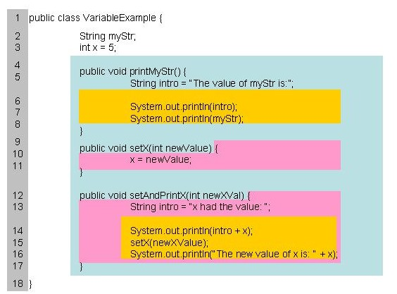
Member Variable Scope
Parameter Scope
Local Variable Scope

Slide 21
Lifetime
Class Variable: Static
  Comes into existence even before the first object of that class is created
  JVM allocates memory for a class variable right after loading a class
Instance variable
  JVM allocates memory for an instance variable just before executing the constructor code
  Recovers the memory when garbage collecting the object instance

Slide 22
Lifetime
Local Variable
  memory allocated before executing the block of code where declaration exists
  memory recovered after executing the block
Parameters
  memory allocated before the method or constructor starts executing
  memory recovered when the message processing is complete

Slide 23
Name
Simple Name
  Consists of only the identifier
  Sufficient since the entities (variables, methods, classes) to refer to are often within scope
Qualified Name
  Consists of a sequence of qualifying identifiers separated by periods or dots preceding the name
  Used to refer to entities outside their scope

Slide 24
Qualified Name-Example
public class person{
private String name=null;
private int age;
public void setName(String name){
this.name=name; }
public String getName(){ return name; }
}

Slide 25
2.3.2 Arithmetic Operators and Expressions
Arithmetic Operators
Using Arithmetic Operators and Expressions
AlgaeColony
Casting
Increment Operator

Slide 26
Arithmetic Expressions
Information storage not useful, unless manipulations and evaluations allowed on it
In java, the manipulation and evaluation are done using operators and expressions respectively
Expression
  Contains one or more values manipulated by an operator
  All expressions evaluate to a value
    Eg. Int x = 4; is same as int x = 2+2;

Slide 27
Arithmetic Operators
Operators
  Manipulates operands, that evaluate to a resulting value
  Eg: x = 100
Operation | Operator | Example | Evaluates to:
Addition | + | x + 5 | 105
Subtraction | - | x - 5 | 95
Multiplication | * | x * 2 | 200
Division for Quotient | / | x / 2 | 50
Division for Remainder | % | x % 2 | 0

Slide 28
Using Arithmetic Operators and Expressions
The SimpleCalculator class, detailed below, uses the HTML file SimpleCalculatorForm.html to submit input.
Lines 26-30, offers an example of each of the five arithmetic operators that you'll be expected to use in this course.

Slide 29
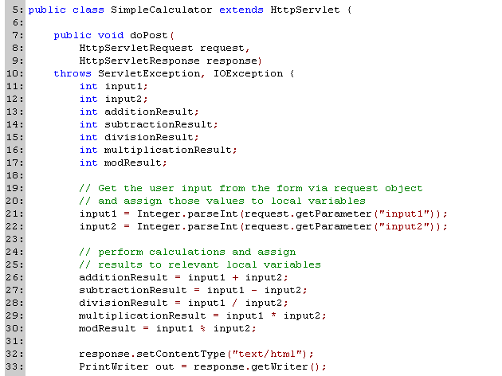

Slide 30
AlgaeColony
An algae needs to do two things while living:
  Grow older (i.e., age).
  Convert energy from sunlight into life-energy.
To grow older, we need to increment the value of instance variable age.
Regarding energy conversion, algae will convert half the available solar energy into life energy.

Slide 31
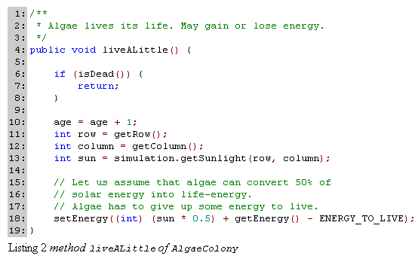

Slide 32
OOP Practice: Use an Accessor when Available
Getters (Accessors)
  Used to access the value of an instance variable within the program
Setters (Mutators)
  Used to set the value of an instance variable within a program
Advantages
  Any change to the instance variable would require changes only to the corresponding accessors and mutators.
  Other sections remain untouched, provided they make use of the accessors and mutators.

Slide 33
Casting
To convert a numeric value of one type to a similar value of another numeric type at run time, Java provides casting.
To cast, specify within parentheses the type you want to cast to.
Example:
  double a=3.14159;
  int b = (int) a; //here b’s value is 3;
Typecasting can be performed on Reference types

Slide 34
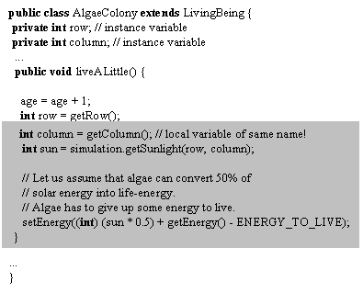
Shadowing
Declaring a variable with the same name as another variable that is already in scope, the new declaration is said to shadow the declaration of the variable that was already in scope.
Shadowing continues until the new declaration goes out of scope.

Slide 35
Increment Operator
There is a shortcut in Java to increment the numeric value stored in a variable by one, the ++ operator, called the increment operator. The two statements below are equivalent :
Example:
  age = age + 1 ;
  ++age ;

Slide 36
2.3.3 Boolean and Relational Operators and Expressions
Relational Operators
Boolean Operators
  AND Operator
  OR Operator
  NOT Operator
  Complex Boolean Operators
Boolean Type and Boolean Variables
Rules for Evaluating a Boolean Operator

Slide 37
Relational Operators
  we need to compare two entities (numeric values, reference values, Boolean values). This is done using relational operators, such as "greater than" and "less than."
Operator | Symbol
Greater than | >
Less than | <
Greater than or equal to | >=
Less than or equal to | <=
Exactly equal to | ==
Not equal to | !=
Instance of | instanceof

Slide 38
Boolean Operators
Operator | Symbol
AND | X&&Y evaluates to true only when both X and Y Boolean expressions evaluate to true
OR | X||Y evaluates to true only when either X or Y, or both X and Y Boolean expressions evaluate to true.
NOT | !X evaluates to true only when X is false

Slide 39
Boolean Type and Boolean Variables
  Boolean is a type just like int and double. Just as you can have variables of type int and double, you can also have variables of type boolean.
a | b | a&&b | a ||b | !a
true | true | true | true | false
true | false | false | true | false
false | true | false | true | true
false | false | false | false | true

Slide 40
Rules for Evaluating a Boolean Operator
Notice that the Boolean operator && (AND) and || (OR) require two operands, while the ! (NOT) operator requires only one operand.
When you use the Boolean AND operator, and the first operand evaluates to false, the second operand will not be evaluated.
For the OR operator, the second operand is not evaluated when the first operand evaluates to true.

Slide 41
2.3.4 Control Flow
Sequential Execution and Control Structures
If-Else-Statement
Example
Nested If-Statements
Implementing Catfish
Student Activity

Slide 42
What is Control Flow?
Program may need to do different things depending on certain conditions
Control Flow – “The order in which the individual statements of a program are executed or evaluated”
Control flow statement – “A statement whose execution results in a choice being made as to which of two or more paths should be followed”
Control Flows can be Simple or Advanced

Slide 43
Simple Control Flow
Different options to control order of execution known as Control Structure
  Sequential execution is when statement are executed in the order in which they appear
  If-else statements are used when there are two ways to proceed depending on the state(true/false) of a condition
  If-statements are used when there are multiple conditions to be checked and evaluated
Flowcharts generally used to depict control structures.

Slide 44
Flowcharts for Control Structures
Flowchart-a graphical representation of order in which statements executed
Flowchart semantics
  Diamond- used to evaluate a test for its falsity/truthfulness
  Rectangle-used for sequential execution of statements in the rectangle
  Flow lines-used to denote flow of execution between above symbols (in the direction of arrow)
  Circle- junction point where multiple flow-lines meet

Slide 45
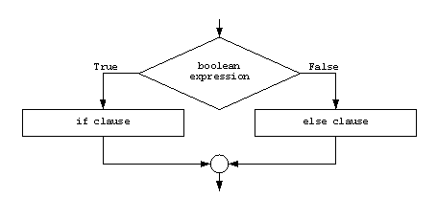
If-Else-Statement
The syntax of an if-else-statement is:
  if (booleanExpression)
  statement
  else
  statement

Slide 46
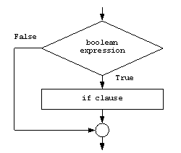
If-Statement
If there is no else-clause, the flowchart looks like the following

Slide 47
If-else Examples
if (isRaining) canPlay = false; // A single statement
if (isRaining); // Null statement. Does nothing.
if (isRaining) { canPlay = false; takeUmbrella = true;} // block of statements
if (order > 50.00) { freeShipping = true;} else { freeShipping = false;}

Slide 48
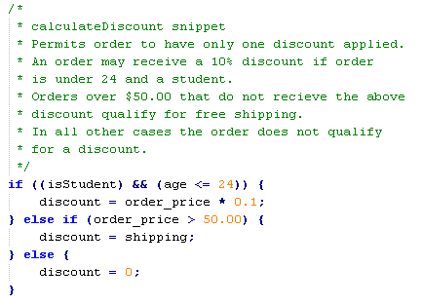
Example

Slide 49
Advanced Control Flow
When there is a need to further control program flow based on earlier statements, nesting is done.

Slide 50
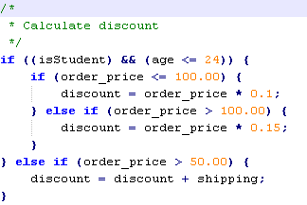
Nested If-Statements
Place an if-statement inside the body of another if-statement

Slide 51
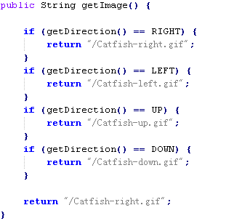
Implementing Catfish
getImage()

Slide 52
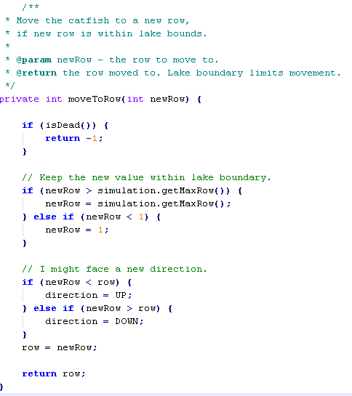
Implementing Catfish
MovetoRow()

Slide 53
2.3.5 Iteration
The Need for Iteration
The While-Loop
While-Loop Example
The For-Loop
For-Loop Example

Slide 54
The Need for Iteration
Iteration allows the program to repeat statements until some condition is met.
Constructs of an Iteration
  Statements
    Set of statement to be executed.
  Condition
    An expression that evaluates to a boolean value
    Check for a condition and continue only if it’s true.

Slide 55
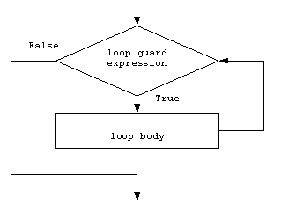
The While Loop
Execute the statements in Loop Body until the Guard expression evaluates to false.

Slide 56
While-Loop Example
  int i;
  i = 1;
  while (i < 5) {
  out.println("<br>value of i is " + i);
  i = i+1;
  }
  The output would be:
  value of i is 1
  value of i is 2
  value of i is 3
  value of i is 4

Slide 57
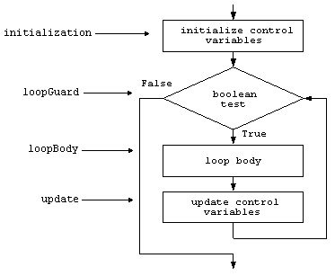
The For-Loop
you can do anything with a for-loop that you can do with a while-loop.
Form of a for-loop
  for (initialization; loopGuard; update) loopBody

Slide 58
For-Loop Example
  int i;
  for (i = 0; i < 5; i = i + 1)
  {
    out.println("value of i is " + i);
  }
  The output for this is:
  value of i is 0
  value of i is 1
  value of i is 2
  value of i is 3
  value of i is 4

Slide 59
2.3.6 Using Vector
Adding New Living Beings to Simulation
Catfish Looks for Food
Iterating through Elements in a Vector
Instance of Operator
Casting

Slide 60
Adding New Living Beings to Simulation
User specifies organisms to be created using checkboxes in HTML form
When Start Simulation button clicked, SimulationServlet receives the browser POST request
SimulationServlet invokes createLivingBeing method of the LivingBeing class for each organism to be created.
New algae/catfish/crocodile object created based on species value, and added to simulation by sending an addLivingBeing message.

Slide 61
public static void createLivingBeing( Simulation sim, String species, String value)
{
  int rowAndCol = Integer.parseInt(value);
  int row = rowAndCol / 100;
  int column = rowAndCol - (100 * row);
  if (species.equals("algae"))
  {
  sim.addLivingBeing(new AlgaeColony(row, column, sim));
  }
  if (species.equals("catfish"))
  {
  sim.addLivingBeing(new Catfish(row, column, sim));
  }
  if (species.equals("crocodile"))
  {
  sim.addLivingBeing(new Crocodile(row, column, sim));
  }
}

Slide 62
Adding New Living Beings to Simulation
After all living being objects are added to the Simulation object, the Simulation object sends a liveALittle message to each living being object.
Our catfish chooses to live by eating and swimming.
When a Catfish object gets its turn to live, it should look for food (algae) if hungry and eat food if available.
Let us examine the code needed to look for food

Slide 63
Catfish Looks for Food
Let us first state in high-level English how we would implement "looking for food."
Then we will convert our English statements into Java statements:
  Spend ENERGY_TO_LOOK_FOR_FOOD
  If I am dead, return immediately.
  Ask simulation object to give the list of all my neighbors.
  If a neighbor is algae, then that neighbor is food. Return that neighbor.
  If none of the neighbors is algae, return null.

Slide 64
private Catfish lookForFoodInNeighborhood()
{
  int neighborIndex; // Looking for food consumes energy.
  setEnergy(getEnergy() - ENERGY_TO_LOOK_FOR_FOOD);
  if (isDead())
  return null;
  Vector neighbors = simulation.getNeighbors(getRow(), getColumn(), 1);
  for (neighborIndex = 0; neighborIndex < neighbors.size(); ++neighborIndex)
  {
  if (neighbors.get(neighborIndex) instanceof AlgaeColony)
  {
  return (AlgaeColony) neighbors.get(neighborIndex);
  }
  }
  return null;
}

Slide 65
Iterating through Elements in a Vector
The getNeighbors method returns a reference to a Vector object.
We store that reference in a local variable named neighbors.
We use a for-loop to do that. The loop iterates through each member of the set starting from the element at index 0 and going up to (and including) the element at index size - 1.

Slide 66
instanceof Operator
OOP allows an object to be an instance of multiple classes at the same time.
  All algae objects are also instances of the LivingBeing class because AlgaeColony.java has declared that AlgaeColony extends LivingBeing. When AlgaeColony extends LivingBeing, AlgaeColony is said to "inherit" from LivingBeing.

Slide 67
instanceof Operator
The instanceof operator is a relational operator that compares two entities.
The two entities are a reference and a reference type (i.e., a class or null).
The result of the comparison is true only if the reference refers to an instance of the specified type.

Slide 68
Casting
The get method returns a reference of type Object.
If the reference refers to an instance of AlgaeColony, we need to cast the reference type from Object to AlgaeColony.
You can cast a value of some type to another type by specifying the destination type in parentheses:
  (AlgaeColony) neighbors.get(neighborIndex)

Slide 69
Summary
2.3.1 Data Types and Variables
2.3.2 Arithmetic Operators and Expressions
2.3.3 Boolean and Relational Operators and Expressions
2.3.4 Control Flow
2.3.5 Iteration (loop)
2.3.6 Using Vector

