Slide 1
Introduction to Software Technology
Unit 3: Inheritance
Liwei WANG
liwei.wang@whu.edu.cn
School of computer science

Slide 2

3.1 Introduction to Inheritance
Introduction
Terminology
Inheritance in Action
Advantages of Programming with Inheritance
When Not to Use Inheritance
Inheritance in Java

Slide 3
Introduction
Bank accounts can be further subdivided into groups such as savings accounts, and checking accounts.
Defining much of the same code for both checking accounts and savings accounts.
Using inheritance, an object acquires all the methods and attributes of the class from which it inherits.

Slide 4
Terminology
The class inherited by other class is called parent class, super class, base class or supertype.
The class that inherits parent class is called subclass, derived class or subtype.

Slide 5
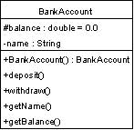
Inheritance in Action
It may seem very abstract at this point that a class can use the attributes and methods of another class without declaring them.

Slide 6
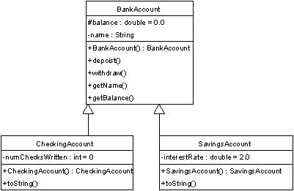

Slide 7

CheckingAccount
CheckingAccount Class
  An instance variable：numChecksWritten，representing the total number of checks in this back account
  Using inheritance, CheckingAccount class have all methods and attributes from BankAccount

Slide 8
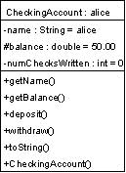
An instance of CheckingAccount Class

Slide 9

SavingsAccount
SavingsAccount Class
  an instance variable：interestRate，representing the deposit interest in this saving account.
  Using inheritance, SavingsAccount class have name and balance attributes and all methods from BankAccount

Slide 10
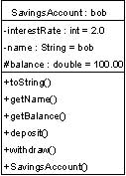
An instance of SavingsAccount Class

Slide 11
Advantages of Programming with Inheritance
First, inheritance allows programmers to design systems in an intuitive, in a top-down fashion.
Second, it provides a framework for code re-use.
  All of Catfish, Crocodile and Algae classes require a method die() to describe the behavior of biological dead. Since the implementation to die() method for these three organisms are the same. Using inheritance, you just need to implement the method die() only once instead of three times.
  LivingBeing class define the common attributes and methods for AlgaeColony, Crocodile, and Catfish.
  LivingBeing class can further be categorized into animal class and non-animal class.

Slide 12
LivingBeing
animals
Catfish
Crocodile
AlgaeColony

Slide 13
When Not to Use Inheritance
Age, energy level, are alive (or not) should be generalized into the LivingBeing class
It does not make sense to include the ability to move in the LivingBeing class since AlgaeColony cannot move.

Slide 14
Inheritance in Java
In Java, all classes are subclasses of Object and inherit all of Object's attributes and methods.
  We can design objects starting with their least specific forms, where all general behavior is shared in one place.
  We can then proceed to derive specific versions of these general objects.

Slide 15
3.2 Using Inheritance
Introduction
Controlling Access
Polymorphism
Downcasting
Overriding Methods
The super Keyword
The Complete Source Code

Slide 16
Introduction
Using extends to implement inheritance to superclasses.
modifier class classname extends superclass{
class body
}

Slide 17
Controlling Access
Access control modifiers determine what classes may access another class' methods and variables.
Java provides three levels of access:
  public
  private
  protected

Slide 18
Controlling Access
public access allows code from outside a class definition to access a variable or a method directly.
private access does not allow access from outside a class.
protected access allows access to methods and instance variables from within the class that defines them, or from all of its subclasses, or from all classes within the same package.

Slide 19
Controlling Access
Classes cannot access private class members in their superclasses.
An instance of a subclass must be an instance of its superclass.
SuperClass a = new SuperClass();
SubClass b = new SubClass();
a = b;

Slide 20
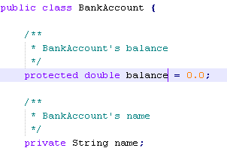
Example
The balance is a protected double. It is protected because we will want BankAccount's subclasses to access it and modify it.
The instance variable name is left private because subclasses will not need to change an account's name.

Slide 21
Polymorphism
Subclass can inherit attributes and methods of its superclass.
A method in a subclass has the same name as some method in its superclass.
The method in different subclasses with the same superclass can have the same name.
which method is called if using the same method name?
polymorphism : One method name, multi version.

Slide 22
Polymorphism
A Func()
B Func()
C
D Func()
E Func()
F Func()
G

Slide 23

Example
Consider the CheckingAccount and SavingsAccount objects（BankAccount）

Slide 24
Example
We would like the toString method of the AccountsLedger to return a String that contains information about all of the accounts including:
  the type of account (checking or savings)：
  the name of the account, and the balance
  the interest rate that the account earns if it is a savings account

Slide 25
Example
One way to go about implementing this method is to have special code that tests the type of account and builds a string representation for each type.
  First use if-statement to check the type of account.
  Then print corresponding information.

Slide 26
A possible toString method
//in AccountsLedger
public String toString() {
String accountString = "";
for (int i=0; i < accounts.size(); i++ ) {
if (accounts.get(i) instanceof CheckingAccount) {
accountString = accountString + "Checking account: "
+ getName() + " balance: $ " + balance ;
}
if (accounts.get(i) instanceof SavingsAccount) {
accountString = accountString + "Savings account : "
+ getName() + " balance: $ " + balance
+ " earning " + interestRate
+ " % interest";
}
}
return accountString;
}

Slide 27
Adding further subclasses of BankAccounts to our example requires additional modifications to the toString method of AccountsLedger.
What if we could write a single line of code that calls the toString method for each object in the AccountsLedger so that the system automatically calls the appropriate class' method at run-time?
We write toString method respectively in CheckingAccount and SavingsAccount.

Slide 28
CheckingAccount
/**
* Return a string representation of this account.
*
* @return String - string of all account info
*/
public String toString() {
/**
* Call the getName accessor method of the BankAccount
* class to return the name of the account. The balance
* is protected, so we can access it directly.
*/
return new String( "Checking account: " + getName()
+ " balance: $ " + balance );
}

Slide 29
SavingAccount
/**
* Return a string representation of this account.
*
* @return - a string containing information about this account.
*/
public String toString() {
/**
* Call the getName accessor method of the BankAccount
* class to return the name of the account. The balance
* is protected, so we can access it directly.
*/
return new String( "Savings account : " + getName()
+ " balance: $ " + balance + " earning "
+ interestRate + " % interest");
}

Slide 30
AccountsLedger
public String toString() {
for( int i=0; i < accounts.size(); i++ ) {
accountString = accountString + accounts.get(i).toString()
+ "\n";
}
}
0, SavingAccount toString()
1, CheckingAccount toString()
2, CheckingAccount toString()
3, SavingAccount toString()
The Java interpreter determines what type the current element in the Vector named accounts is at run-time and automatically calls the toString method for that element's type.
  accounts.get(i).toString()
4, CheckingAccount toString()
5, SavingAccount toString()

Slide 31
Overriding Methods
CheckingAccount and SavingsAccount have the same name method toString
A method is overridden when the parent class' method signature is maintained but the implementation changes.
A method's signature includes its name and its parameter list.
  If a method in a subclass have the same name as some method in its superclass, then we called the method in the subclass override a method in its superclass.

Slide 32
Example
If the number of checks written exceeds a set threshold (ten for example) then a one-dollar fee is charged for each withdrawal. How to do this?
This may be implemented by overriding the withdraw method in the CheckingAccount class.

Slide 33
/* BankAccount withdraw method */
public void withdraw(double amount)
{
balance = balance - amount;
}

Slide 34
/* CheckingAccount withdraw method */
public void withdraw(double amount)
{
balance = balance - amount; numChecksWritten = numChecksWritten + 1;
if ( numChecksWritten >10 )
  {
  balance = balance - 1.00;
  }
}

Slide 35
Note
  You should not change the intended meaning of an overridden method, the same meaning .
  If you intend to override a method in a sub class, it should still have the same general effect as the method of the super class，the same return value.

Slide 36
The super Keyword
Can we use the parent class' version of a method which saves us from having to copy the parent class' code?
The super keyword represent superclass.
The super keyword may be used to access methods including constructors.
Reference to the overridden withdraw method of the CheckingAccount class

Slide 37
/* CheckingAccount withdraw method */
public void withdraw(double amount)
{
  super.withdraw(amount);
  numChecksWritten = numChecksWritten + 1;
  if ( numChecksWritten >10 )
  {
  amount = amount + 1.00;
  }
}

Slide 38
/* Constructor calls the BankAccount class constructor * in addition to setting the new interest rate. */
public SavingsAccount(String initialName, double initialBalance, double initialInterestRate )
{
  super(initialName, initialBalance);
  interestRate = initialInterestRate;
}

Slide 39
The Complete Source Code
The complete source code for the classes are as follows:
  BankAccount
  CheckingAccount
  SavingsAccount
  AccountsLedger

Slide 40
3.3 Designing a Class Hierarchy
What Is Designing a Class Hierarchy?
The Design Process
The Simulation Class Hierarchy
  The LivingBeing Class
  The Animal Class
  The AlgaeColony Class
  The Catfish Class
Guidelines for Designing a Class Hierarchy

Slide 41
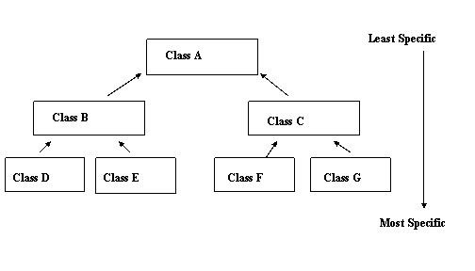
What Is Designing a Class Hierarchy?

Slide 42
The Design Process
First, examine all of the classes you intend to categorize for common attributes and methods.
Second, identify an appropriate superclass structure using the information you have gathered in the first step.
Third, move the common characteristics from the subclass to the superclass.

Slide 43
The Design Process
Finally, you should look at the overall hierarchy and see if there are any characteristics that can be moved across the different classes in the hierarchy.
The design process typically goes in the direction：
  a general hierarchy is established first, and then the details are established and factored into each class.

Slide 44
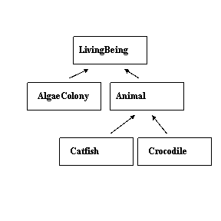
The Simulation Class Hierarchy

Slide 45
The LivingBeing Class
The following instance variables are common to the AlgaeColony, Catfish, and Crocodile classes
  row. Row in which the living being is located
  column. Column in which the living being is located
  deadOrAlive. Is the living being dead or alive
  energy. Amount of energy the living being has
  age. Age expressed as blocks of time lived
  name. Name of this living being
  simulation. The simulation to which this living being belongs
  minEnergy. Minimum energy level needed to survive
  maxEnergy. Maximum energy level that the living being could carry

Slide 46
The LivingBeing Class
The following class variables are common to the AlgaeColony, Catfish, and Crocodile classes
  ALIVE. The value "alive" indicating the being is still alive
  DEAD. The value "dead" indicating the being is dead

Slide 47
The LivingBeing Class
The following methods are common to the AlgaeColony, Catfish, and Crocodile classes.
  getRow. Get the row at which the living being is located
  getColumn. Get the column at which the living being is located
  getAge. Get the living being's age
  getColor. Get the color of the living being expressed in hex notation
  getName. Get the name of this living being
  getImage. Get the filename that contains the image of the living being
  getDisplayMechanism. Get the preferred display mechanism for living being

Slide 48
The LivingBeing Class
  getMinEnergy. Get the minimum energy needed to live
  getMaxEnergy. Get the maximum energy that the living being can carry
  getSpecies. Returns the species
  getEnergy. Get the energy currently carried by the living being
  setEnergy. Sets energy level
  die. Change the deadOrAlive to DEAD
  isDead. Is the living being dead
  liveALittle. The living being's age increases by one time block

Slide 49
The Animal Class
The following class variables are common to the Catfish and Crocodile classes.
  RIGHT. Represents moving right
  LEFT. Represents moving left
  UP. Represents moving up
  DOWN. Represents moving down

Slide 50
The Animal Class
The following methods are common to the Catfish, and Crocodile classes.
  isHungry. Is the animal hungry
  getDirection. Get the direction faced by the animal
  moveToRow. Move the animal to a new row, if new row is within lake bounds
  moveToColumn. Move the animal to a new column, if new column is within lake bounds

Slide 51
The Animal Class
Next, we must move the shared attributes and behaviors out of the subclasses and into the superclasses.
Part of this process is setting the appropriate access modifiers for the methods and variables.

Slide 52
The AlgaeColony Class
The following class variables are specific to the AlgaeColony class:
  BABY_MIN_ENERGY. Lowest possible energy needed for a baby to survive
  BABY_MAX_ENERGY. Maximum energy that a baby can store
  ENERGY_TO_LIVE. Amount of energy needed to live for a block of time
  SPECIES. Name of species

Slide 53
The AlgaeColony Class
The AlgaeColony class uses one unique method, giveUpEnergy, which makes an AlgaeColony loose energy when it is being eaten.
AlgaeColony must override a number of methods from the LivingBeing class. These methods are as follows:
  getDisplayMechanism
  getSpecies
  getColor
  liveALittle

Slide 54
The Catfish Class
At the bottom of our class hierarchy are the two animals themselves, the Catfish and Crocodile classes.

Slide 55
Guidelines for Designing a Class Hierarchy（1/5）
Subclasses extend the superclass in a class hierarchy by modifying and adding behavior.
  For that reason, common behavior should be pushed as high as possible in the class hierarchy.
  For example, not all LivingBeings can move, and not all Animals can swim. We added the ability to swim to the class Catfish, and the ability to move to the Animal class.

Slide 56
Guidelines for Designing a Class Hierarchy （2/5）
Subclasses are specialized forms of superclasses.
  Therefore, each subclass may require specialized forms of methods implemented in the superclass.
  You can specialize the behavior of subclasses by overriding methods.
  Recall that the AlgaeColony, Catfish, and Crocodile classes live their lives differently, and, hence, override the liveALittle method.

Slide 57
Guidelines for Designing a Class Hierarchy （3/5）
When deciding between public, private, and protected access for a method or attribute, ask yourself what other classes need access to that method or attribute.

Slide 58
Guidelines for Designing a Class Hierarchy （4/5）
If you intend to override a method in a subclass, it should still have the same general effect as the method of the superclass.
  For example, consider the getSpecies method of LivingBeing. This method is intended to return a String representing the name of a species.
  This method, if overridden in Catfish, should perform the same operation.

Slide 59
Guidelines for Designing a Class Hierarchy （5/5）
All features (public behaviors and attributes) in a superclass must also apply to a subclass.

