Slide 1
Windows内核（补充）

Slide 2
一、操作系统结构
（Windows Core 第二章）

Slide 3
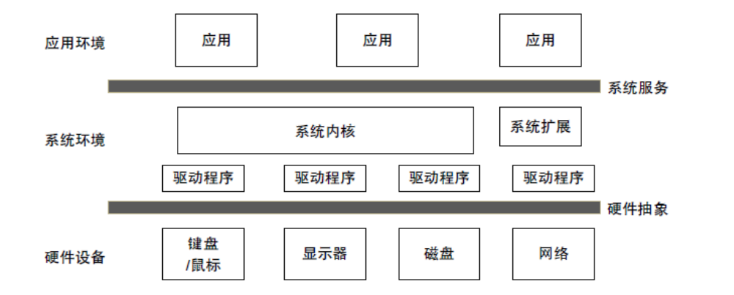
Windows NT 体系结构 (1)

Slide 4
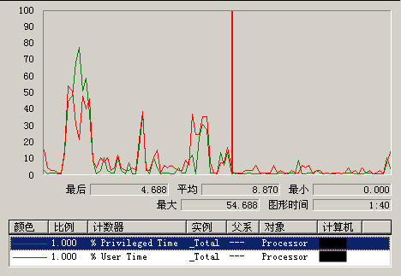
用户模型
  环境子系统
  集成子系统
内核模式
  执行体
  硬件抽象层
  内核模式驱动程序
  Windows驱动程序模式

Slide 5
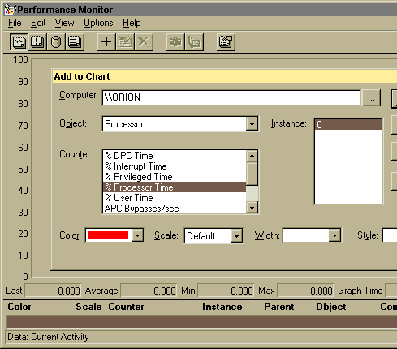
Accounting for Kernel-Mode Time
“Processor Time” = total busy time of processor (equal to elapsed real time - idle time)
“Processor Time” = “User Time” + “Privileged Time”
“Privileged Time” = time spent in kernel mode
“Privileged Time” includes:
  Interrupt Time
  DPC Time
  other kernel-mode time (no separate counter for this)
Screen snapshot from: Programs |
Administrative Tools | Performance Monitor
click on “+” button, or select Edit | Add to chart...

Slide 6
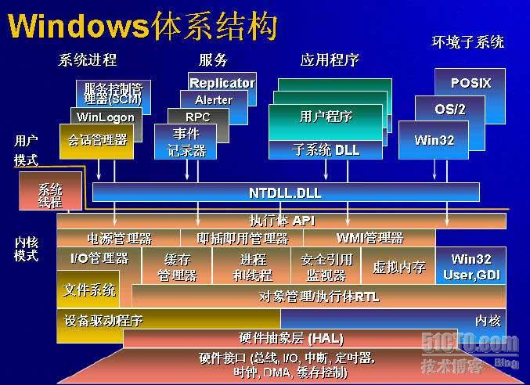

Slide 7
Simplified OS Architecture
System
support
processes
Service
processes
User
applications
Environment
subsystems
User
Mode
Subsystem DLLs
Kernel
Mode
Executive
Windowing
and graphics
Kernel
Device drivers
Hardware Abstraction Layer (HAL)

Slide 8
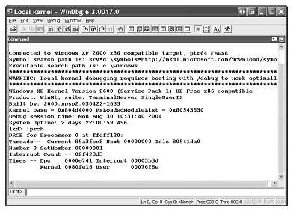
本地内核调试

Slide 9

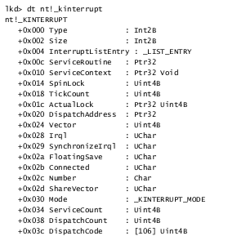
内核数据结构的类型信息

Slide 10
Windows Architecture
System Processes
Services
Applications
Environment
Subsystems
Service
Control Mgr.
Windows
LSASS
SvcHost.Exe
Task Manager
WinMgt.Exe
Explorer
WinLogon
SpoolSv.Exe
OS/2
User
Application
User
Mode
Session Manager
Services.Exe
POSIX
Subsystem DLLs
Windows DLLs
System
Threads
NTDLL.DLL
Kernel
Mode
System Service Dispatcher
(kernel mode callable interfaces)
Windows
USER,
GDI
I/O Mgr
File
System
Cache
Object
Mgr.
Plug and
Play Mgr.
Power
Mgr.
Security
Reference
Monitor
Virtual
Memory
Processes
&
Threads
Configura-
tion Mgr
(registry)
Local
Procedure
Call
Device &
File Sys.
Drivers
Graphics
Drivers
Kernel
Hardware Abstraction Layer (HAL)
hardware interfaces (buses, I/O devices, interrupts,
interval timers, DMA, memory cache control, etc., etc.)

Slide 11
Windows application
call
WriteFile
(
É
)
WriteFile
call
NtWriteFile
Windows-
in Kernel32.
Dll
return to caller
specific
NtWriteFile
Int
2E or SYSCALL or SYSENTER
used by all
in
NtDll
.
Dll
return to caller
subsystems
U
software interrupt
K
KiSystemService
call
NtWriteFile
in
NtosKrnl
.Exe
dismiss interrupt
NtWriteFile
do the operation
in
NtosKrnl
.Exe
return to caller

Slide 12
Key Windows System Files
Core OS components:
NTOSKRNL.EXE** Executive and kernel
HAL.DLL Hardware abstraction layer
NTDLL.DLL Internal support functions and system service dispatch stubs to executive functions
Core system processes:
SMSS.EXE Session manager process
WINLOGON.EXE Logon process
SERVICES.EXE Service controller process
LSASS.EXE Local Security Authority Subsystem
Windowing subsystem:
CSRSS.EXE* Windows subsystem process
WIN32K.SYS USER and GDI kernel-mode components
KERNEL32/USER32/GDI32.DLL Windows subsystem DLLs
Notes:
CSRSS stands for "client/server run-time subsystem"--but all the subsystems are client/server run-time subsystems
** Remember that there are two versions of NTOSKRNL on the Windows CD-ROM: one for uniprocessors and one for multiprocessor systems. The correct one is copied to the local system at installation time. Also, the filename NTOSKRNL is a bit misleading because the kernel is only a small percentage of the total code in this file. (The majority of the code comprises the executive.)

Slide 13
执行体
提供系统服务和内部规范
主要包括
  I/O管理器
  安全参数监视器
  进程通信管理器
  虚拟内存管理器
  进程管理器
  即插即用管理器
  电源管理器
  窗口管理器和图形用户接口
  对象管理器

Slide 14
硬件抽象层
  以动态链接库形式实现硬件层及平台支持
  Windows 2000/XP/2003支持如下几种硬件结构
    Hal.dll 标准PC
    Halacpi.dll 高级配置和电源接口(APIC)PC
    Halapic.dll 高级可编程中断控制器(APIC)PC
    Halaacpi.dll APIC ACPI PC
    Halmps.dll 多处理器PC
    Halmacpi.dll 多处理器ACPI PC
内核模式驱动程序
  包括：
    窗口管理器:控制窗口显示、管理屏幕输出、收集来自键盘鼠标和其它设备的输入、把用户消息传递给应用程序。
    图形设备接口(GDI)：这是针对图形输出设备的函数库，包括画线、文本和各种图形的函数，以及一些用于控制图形操作的函数。
  特性：
    可移植性
    硬件和软件的配置能力
    执行优先级高和可中断的
    以对象为基础
    通过可重用的IRP实现包驱动的I/O
    支持异步I/O

Slide 15
HAL - Hardware Abstraction Layer
Responsible for a small part of “hardware abstraction”
  Components on the motherboard not handled by drivers
    System timers, Cache coherency, and flushing
    SMP support, Hardware interrupt priorities
Subroutine library for the kernel & device drivers
  Isolates Kernel and Executive from platform-specific details
  Presents uniform model of I/O hardware interface to drivers
Reduced role as of Windows 2000
  Bus support moved to bus drivers
  Majority of HALs are vendor-independent
HAL also implements some functions
that appear to be in the Executive
and Kernel
Selected at installation time
  See \windows\repair\setup.log to find out which one
  Can select manually at boot time with /HAL= in boot.ini
HAL kit
  Special kit only for vendors that must write custom HALs (requires approval from Microsoft)
  see http://www.microsoft.com/whdc/ddk/HALkit/default.mspx

Slide 16
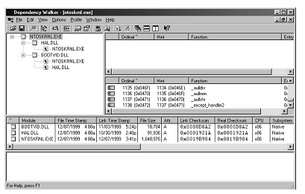
Ntoskrnl与HAL的映像相依性

Slide 17
Windows驱动程序模型
  最高级/中级/最低
  WDM层次体系结构
    微驱动程序
      对所有微软支持的硬件设备类型
    类驱动程序
      驱动程序的驱动程序，具有类相关的功能
    操作系统服务
      从为驱动程序中抽象了所有操作系统有关的功能
    虚拟驱动程序
      虚拟了硬件的接口，并不直接访问硬件

Slide 18
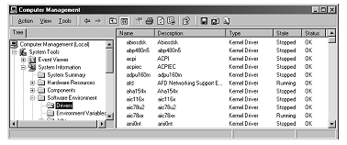
已安装驱动程序列表

Slide 19
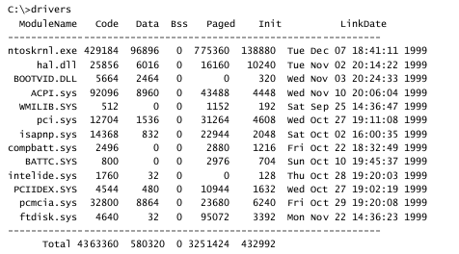
Drivers实用工具

Slide 20
Kernel-Mode Device Drivers
Separate loadable modules (drivername.SYS)
  Linked like .EXEs
  Typically linked against NTOSKRNL.EXE and HAL.DLL
  Only one version of each driver binary for both uniprocessor (UP) and multiprocessor (MP) systems…
  but drivers call routines in the kernel that behave differently for UP vs. MP Versions
Defined in registry
  Same area as Windows services (t.b.d.) - differentiated by Type value
Several types:
  “ordinary”, file system, NDIS miniport, SCSI miniport (linked against port drivers), bus drivers
  More information in I/O subsystem section
To view loaded drivers, run drivers.exe
  Also see list at end of output from pstat.exe – includes addresses of each driver
To update & control:
  System properties->Hardware Tab->Device Manager
  Computer Management->Software Environment->Drivers

Slide 21
Ntdll.dll
内部支持函数和执行体函数的存根函数，将用户模式的请求转译为内核模式，在这一层上CPU进行环境切换(sysenter/sysexit)。
用户程序与系统的交互也就是用户模式和内核模式的切换方式如下，
  （1）、用户程序通过子系统直接调用内核执行体所提供的函数
  （2）、用户程序通过子系统调用Win32 User/GDI，直接从用户模式切换到内核模式，调用完成后返回。
  （3）、用户程序通过环境子系统csrss.exe，相对过程要经过4次环境切换，效率较低。

Slide 22
Building WRK experiment environment
Install Visual Studio and Source Insight.
Configure Source Insight to read WRK files.
Install WS03E on Virtual PC.
Configure Loopback,Shared Folders, etc.
Install WinDbg.
Establish debugging environment.
Configure this experiment environment in all the computers by start-up recovery from a server in our lab

Slide 23
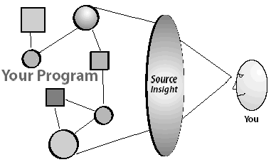
Use SourceInsight to read codes
There are over 800k lines of code and about 750 files in WRK-v1.2. It is really a hard work to read the code and do some modifications
Source Insight acts as an information server that surrounds our project’s source code
Instant access
to symbolic and textual
info in our program

Slide 24
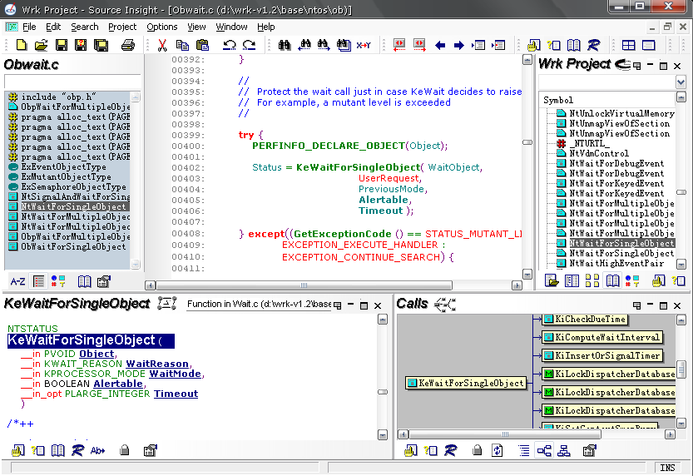
SourceInsight3 Application Window
Source file Window for editing and viewing code
Symbol Window shows symbols and other information in current file
Project Window - shows all of the source files’ names, symbols and so on
Context Window – automatically shows declarations and other information while you click on the things or type
Relation Window-shows references, call trees and so on

Slide 25
Windows code analysis reports based on WRK
Based on WRK, analysis the OS teaching contents, including scheduling, task, process, thread, stack, memory management and so on
Analysis reports of Thread Scheduling
Study and experiment of four demos in TRK

Slide 26
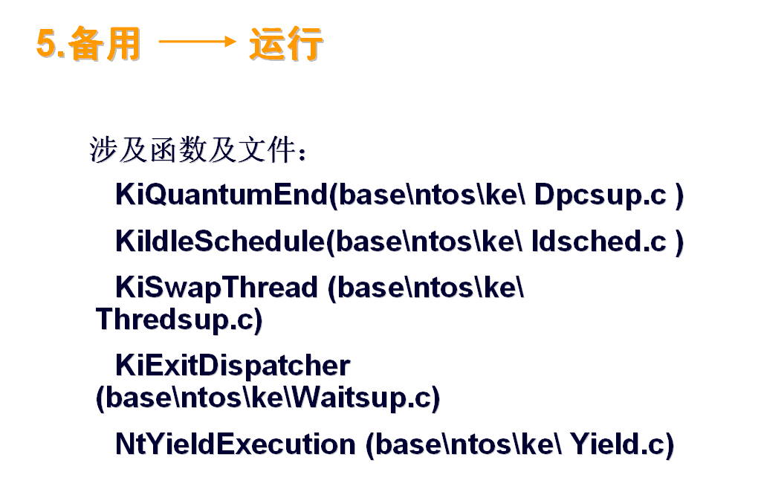
Student reports examples-1

Slide 27
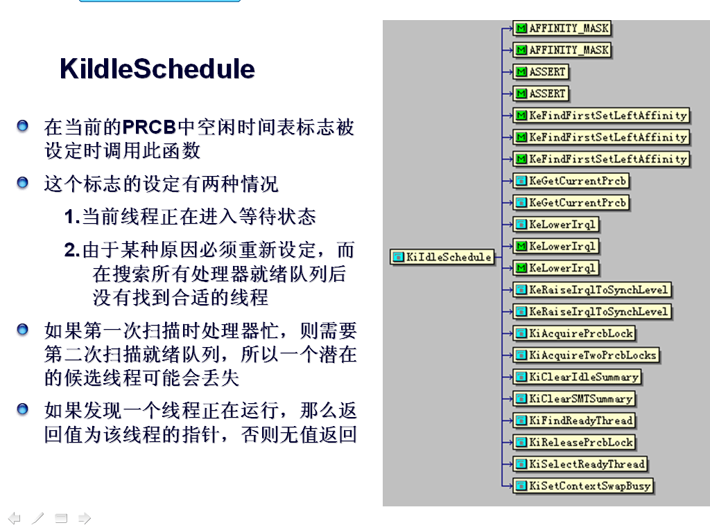
Student reports examples-2

Slide 28
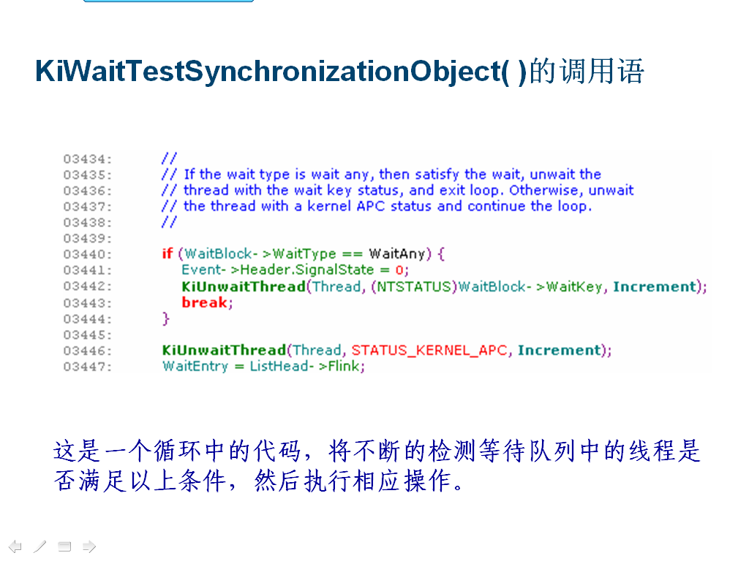
Student reports examples-3

Slide 29
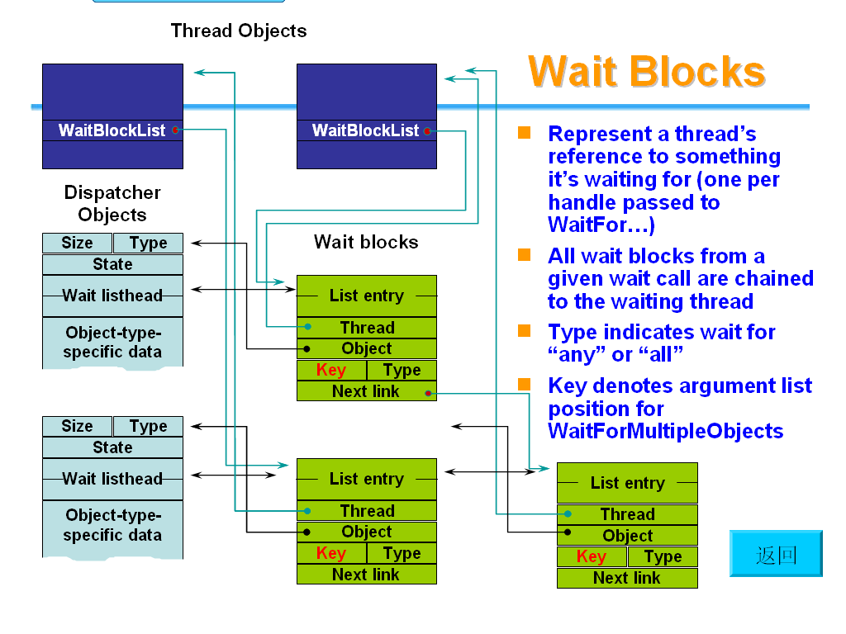
Student reports examples-4

Slide 30
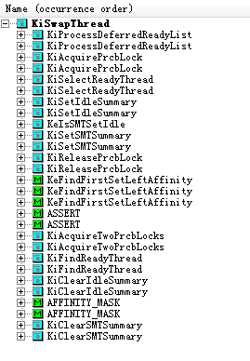
KiSwapThread
该函数用于为处理器选择下一个要执行的线程，并把环境参数放到这个被选择的线程中

Slide 31
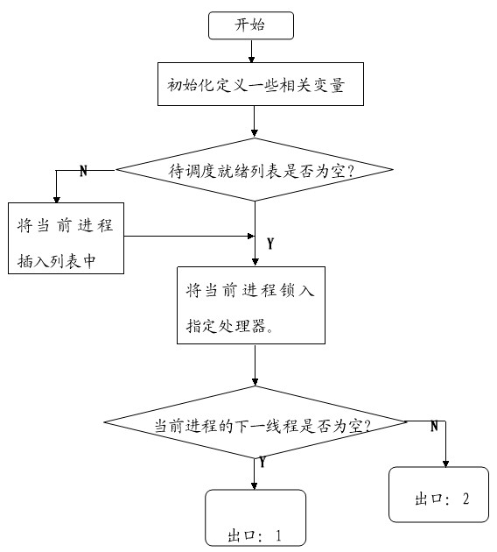
KiSwapThread 函数流程图（1）

Slide 32
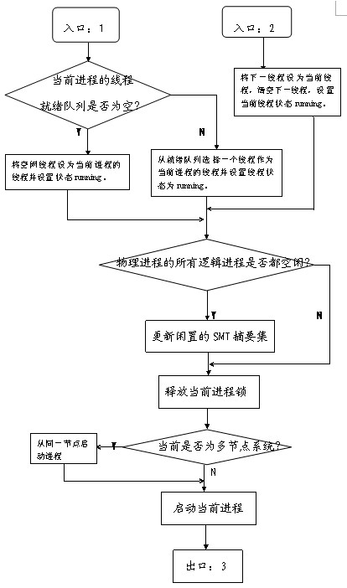
KiSwapThread 函数流程图（2）

Slide 33
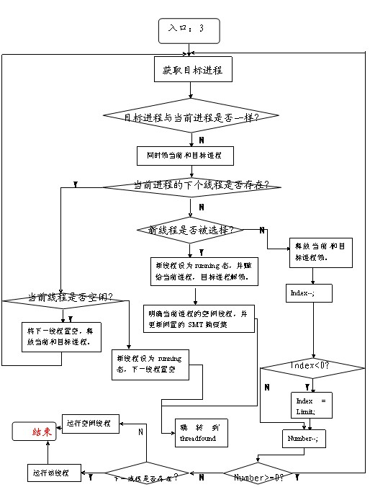
KiSwapThread 函数流程图（3）

Slide 34
KiSwapThread 关键代码分析
NewThread = CurrentPrcb->NextThread
//当前线程的下一线程保存在newthread中；
NewThread = KiSelectReadyThread(0, CurrentPrcb)
//从当前进程的就绪线程列表中选择一个线程保存到newthread中；
//newthread变量用来保存选择即将运行的线程。
CurrentPrcb->CurrentThread = NewThread;//更新当前线程；
NewThread->State = Running;//设置线程状态为运行；
if ((NewThread = CurrentPrcb->NextThread) != NULL)
//判断当前进程是否存在下一个线程。

Slide 35
第三章 系统机制

Slide 36
Trap dispatching
Trap: processor‘s mechanism to capture executing thread
当异常或者中断发生时，处理器捕捉到一个执行线程，并且将控制权转移到操作系统中某一固定地址处。
  Switch from user to kernel mode
  Interrupts – asynchronous（可在任何时候发生，与处理器当前正在执行的任务无关）
    I/O设备、处理器始终、定时器
  Exceptions – synchronous（是一个特殊指令执行的结果）
    内存访问违例、特定的调试器指令、除零错误

Slide 37
陷阱分发
Interrupt
service
routines
Interrupt
service
routines
Interrupt
service
routines
Interrupt
Interrupt
dispatcher
System service call
System
service
dispatcher
System
services
System
services
System
services
HW exceptions
SW exceptions
Exception
handlers
Exception
dispatcher
Exception
handlers
Exception
handlers
Virtual address
exceptions
Virtual memory
manager‘s pager

Slide 38
中断分发
硬件中断
  I/O设备激发
系统软件中断
  内核激发软件中断，触发线程分发，以异步方式打断线程的执行
内核的中断陷阱处理器响应设备的中断
  中断外部例程ISR：设备中断
  内部内核例程：其他类型的中断

Slide 39
中断请求IRQ
中断服务外部例程ISR（设备驱动程序提供）
内核中断处理例程（内核）
中断分发表IDT
中断号
中断控制器PIC

Slide 40
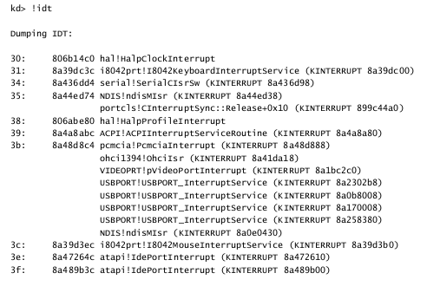
中断列表

Slide 41
Interrupt Dispatching
user or kernel mode
code
kernel mode
Note, no thread or process context switch!
interrupt !
Interrupt dispatch routine
Disable interrupts
Record machine state (trap
frame) to allow resume
Mask equal- and lower-IRQL interrupts
Find and call appropriate ISR
Dismiss interrupt
Restore machine state (including mode and enabled interrupts)
Interrupt service routine
Tell the device to stop interrupting
Interrogate device state, start next operation on device, etc.
Request a DPC
Return to caller

Slide 42
Interrupt Precedence via IRQLs (x86)
IRQL = Interrupt Request Level
  the “precedence” of the interrupt with respect to other interrupts
  Different interrupt sources have different IRQLs
  not the same as IRQ
IRQL is also a state of the processor
Servicing an interrupt raises processor IRQL to that interrupt’s IRQL
  this masks subsequent interrupts at equal and lower IRQLs
User mode is limited to IRQL 0
No waits or page faults at IRQL >= DISPATCH_LEVEL
31
High
30
Power fail
29
Interprocessor Interrupt
28
Clock
Profile & Synch (Srv 2003)
Hardware interrupts
.
.
.
Device 1
2
Dispatch/DPC
Deferrable software interrupts
1
APC
normal thread execution
0
Passive/Low

Slide 43
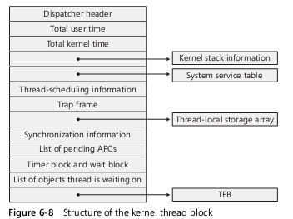
线程阻断

Slide 44
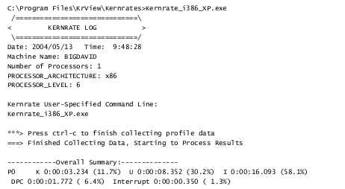
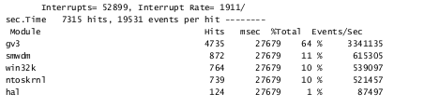
使用内核性能剖析程序来分析性能

Slide 45
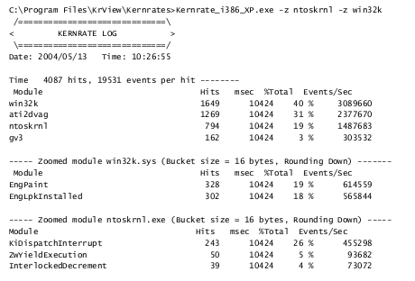

Slide 46
Interrupt processing
Interrupt dispatch table (IDT)
  Links to interrupt service routines
x86:
  Interrupt controller interrupts processor (single line)
  Processor queries for interrupt vector; uses vector as index to IDT
After ISR execution, IRQL is lowered to initial level

Slide 47
Interrupt object
Allows device drivers to register ISRs for their devices
  Contains dispatch code (initial handler)
  Dispatch code calls ISR with interrupt object as parameter
  (HW cannot pass parameters to ISR)
Connecting/disconnecting interrupt objects:
  Dynamic association between ISR and IDT entry
  Loadable device drivers (kernel modules)
  Turn on/off ISR
Interrupt objects can synchronize access to ISR data
  Multiple instances of ISR may be active simultaneously (MP machine)
  Multiple ISR may be connected with IRQL

Slide 48
31: 8a39dc3c i8042prt!I8042KeyboardInterruptService (KINTERRUPT 8a39dc00)
kd> dt nt!_kinterrupt 8a39dc00
nt!_KINTERRUPT
+0x000 Type : 22
+0x002 Size : 484
+0x004 InterruptListEntry : _LIST_ENTRY [ 0x8a39dc04 - 0x8a39dc04 ]
+0x00c ServiceRoutine : 0xba7e74a2 i8042prt!I8042Keybo ardInterruptService+0
+0x010 ServiceContext : 0x8a067898
+0x014 SpinLock : 0
+0x018 TickCount : 0xffffffff
+0x01c ActualLock : 0x8a067958 -> 0
+0x020 DispatchAddress : 0x805 31140 nt!KiInterr uptDispatch+0
+0x024 Vector : 0x31
+0x028 Irql : 0x1a ’’
+0x029 SynchronizeIrql : 0x1a ’’
+0x02a FloatingSave : 0 ’’
+0x02b Connected : 0x1 ’’
+0x02c Number : 0 ’’
+0x02d ShareVector : 0 ’’
+0x030 Mode : 1 ( Latched )
+0x034 ServiceCount : 0
+0x038 DispatchCount : 0xffffffff
+0x03c DispatchCode : [106] 0x56535554

Slide 49
Predefined IRQLs
High
  used when halting the system (via KeBugCheck())
Power fail
  originated in the NT design document, but has never been used
Inter-processor interrupt
  used to request action from other processor (dispatching a thread, updating a processors TLB, system shutdown, system crash)
Clock
  Used to update system‘s clock, allocation of CPU time to threads
Profile
  Used for kernel profiling (see Kernel profiler – Kernprof.exe, Res Kit)

Slide 50
Predefined IRQLs (contd.)
Device
  Used to prioritize device interrupts
DPC/dispatch and APC
  Software interrupts that kernel and device drivers generate
Passive
  No interrupt level at all, normal thread execution

Slide 51
IRQLs on 64-bit Systems
x64
IA64
15
High/Profile
High/Profile/Power
14
Interprocessor Interrupt/Power
Interprocessor Interrupt
13
Clock
Clock
12
Synch (Srv 2003)
Synch (MP only)
Device n
Device n
.
.
4
.
Device 1
3
Device 1
Correctable Machine Check
2
Dispatch/DPC
Dispatch/DPC & Synch (UP only)
1
APC
APC
0
Passive/Low
Passive/Low

Slide 52
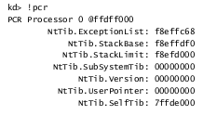
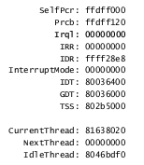
查看IRQL
（处理控制区）

Slide 53
Interrupt Prioritization & Delivery
IRQLs are determined as follows:
  x86 UP systems: IRQL = 27 - IRQ
  x86 MP systems: bucketized (random)
  x64 & IA64 systems: IRQL = IDT vector number / 16
On MP systems, which processor is chosen to deliver an interrupt?
  By default, any processor can receive an interrupt from any device
    Can be configured with IntFilter utility in Resource Kit
  On x86 and x64 systems, the IOAPIC (I/O advanced programmable interrupt controller) is programmed to interrupt the processor running at the lowest IRQL
  On IA64 systems, the SAPIC (streamlined advanced programmable interrupt controller) is configured to interrupt one processor for each interrupt source
    Processors are assigned round robin for each interrupt vector

Slide 54
Software interrupts
Initiating thread dispatching
  DPC allow for scheduling actions when kernel is deep within many layers of code
Delayed scheduling decision, one DPC queue per processor
Handling timer expiration
Asynchronous execution of a procedure in context of a particular thread
Support for asynchronous I/O operations

Slide 55
Flow of Interrupts
0
2
3
Peripheral Device Controller
CPU Interrupt Controller
n
CPU Interrupt Service Table
ISR Address
Read from device
Raise IRQL
Spin Lock
Grab Spinlock
Acknowledge-Interrupt
Dispatch Code
Drop Spinlock
Request DPC
Lower IRQL
Interrupt Object
KiInterruptDispatch
Driver ISR
Notes:
EXPERIMENT: Examining Interrupt Internals
Using the kernel debugger, you can view details of an interrupt object, including its IRQL, ISR address, and custom interrupt dispatching code. First, execute the !idt command and locate the entry that includes a reference to I8042KeyboardInterruptService, the ISR routine for the PS2 keyboard device:
31: 8a39dc3ci8042prt!I8042KeyboardInterruptService(KINTERRUPT 8a39dc00)
To view the contents of the interrupt object associated with the interrupt, execute dt nt!_kinterrupt with the address following KINTERRUPT:
kd> dt nt!_kinterrupt 8a39dc00
nt!_KINTERRUPT
+0x000Type : 22
+0x002Size : 484
+0x004InterruptListEntry :_LIST_ENTRY [0x8a39dc04- 0x8a39dc04 ]
+0x00cServiceRoutine : 0xba7e74a2 i8042prt!I8042KeyboardInterruptService+0
+0x010ServiceContext : 0x8a067898
+0x014SpinLock : 0
+0x018TickCount : 0xffffffff
+0x01cActualLock : 0x8a067958 -> 0
+0x020DispatchAddress : 0x80531140 nt!KiInterruptDispatch+0
+0x024Vector : 0x31 +0x028Irql : 0x1a’’
+0x029SynchronizeIrql : 0x1a’’
+0x02aFloatingSave : 0’’
…
In this example, the IRQL Windows assigned to the interrupt is 0x1a (which is 26 in decimal). Because this output is from a uniprocessor x86 system, we calculate that the IRQ is 1, because IRQLs on x86 uniprocessors are calculated by subtracting the IRQ from 27. We can verify this by opening the Device Manager, locating the PS/2 keyboard device, and viewing its resource assignments.

Slide 56
Deferred Procedure Calls (DPCs)
Used to defer processing from higher (device) interrupt level to a lower (dispatch) level
  Also used for quantum end and timer expiration
Driver (usually ISR) queues request
  One queue per CPU. DPCs are normally queued to the current processor, but can be targeted to other CPUs
  Executes specified procedure at dispatch IRQL (or “dispatch level”, also “DPC level”) when all higher-IRQL work (interrupts) completed
  Maximum times recommended: ISR: 10 usec, DPC: 25 usec
queue head
DPC object
DPC object
DPC object
Notes:
NOTES: Technically every CPU has its own DPC queue head and normally DPCs are queued to the CPU from which they’re requested. However the scheduler idle loop “peeks” at other CPUs’ DPC queues, so if one CPU is busy with high-IRQL code its DPCs may be processed by other CPUs. Also, KiSetTargetCpuDpc (or something like that) can be used to direct the DPC object to a particular CPU.
Nor is the queue always FIFO; KiSetImportanceDpc allows a DPC object to be set to high priority, which means that it goes at the head of the queue instead of the tail.
LAB:
Perfmon: Interrupts/sec,
%Interrupt time,
%DPC time,
other DPC counters

Slide 57
Delivering a DPC
1. Timer expires, kernel
queues DPC that will
release all waiting threads
Kernel requests SW int.
DPC routines can‘t
assume what
process address
space is currently
mapped
DPC
Interrupt
dispatch table
high
Power failure
2. DPC interrupt occurs
when IRQL drops below
dispatch/DPC level
3. After DPC interrupt,
control transfers to
thread dispatcher
DPC
DPC
DPC
Dispatch/DPC
dispatcher
DPC queue
APC
Low
DPC routines can call kernel functions
but can‘t call system services, generate
page faults, or create or wait on objects
4. Dispatcher executes each DPC
routine in DPC queue
Notes:
The kernel always raises the processor‘s IRQL to DPC/dispatch level or above when it need to synchronize access to shared kernel structures. This disables additional software interrupts and thread dispatching. When the kernel detects that dispatching should occur, it requests a DPC/dispatch level interrupt. But because the IRQL is at or above that level, the processor holds the interrupt in check.
When the kernel completes its current activity, it sees that it‘s going to lower the IRQL below DPC/dispatch level and checks to see whether any dispatch interrupts are pending. If there are, the IRQL drops to DPC/dispatch level and the dispatch interrupts are processed.

Slide 58
Asynchronous Procedure Calls (APCs)
Execute code in context of a particular user thread
  APC routines can acquire resources (objects), incur page faults,
  call system services
APC queue is thread-specific
User mode & kernel mode APCs
  Permission required for user mode APCs
Executive uses APCs to complete work in thread space
  Wait for asynchronous I/O operation
  Emulate delivery of POSIX signals
  Make threads suspend/terminate itself (env. subsystems)
APCs are delivered when thread is in alertable wait state
  WaitForMultipleObjectsEx(), SleepEx()

Slide 59

Asynchronous Procedure Calls
(APCs)
Special kernel APCs
  Run in kernel mode, at IRQL 1
  Always deliverable unless thread is already at IRQL 1 or above
  Used for I/O completion reporting from “arbitrary thread context”
  Kernel-mode interface is linkable, but not documented
“Ordinary” kernel APCs
  Always deliverable if at IRQL 0, unless explicitly disabled
  (disable with KeEnterCriticalRegion)
User mode APCs
  Used for I/O completion callback routines (see ReadFileEx, WriteFileEx); also, QueueUserApc
  Only deliverable when thread is in “alertable wait”
Thread
Object
K
APC objects
U

Slide 60
IRQLs and CPU Time Accounting
Interval clock timer ISR keeps track of time
Clock ISR time accounting:
  If IRQL<2, charge to thread’s user or kernel time
  If IRQL=2 and processing a DPC, charge to DPC time
  If IRQL=2 and not processing a DPC, charge to thread kernel time
  If IRQL>2, charge to interrupt time
Since time servicing interrupts are NOT charged to interrupted thread, if system is busy but no process appears to be running, must be due to interrupt-related activity
  Note: time at IRQL 2 or more is charged to the current thread’s quantum (to be described)
Notes:
Note: if you’re at IRQL 2 the time appears as %DPC time, even though you might not be running a DPC. Similarly, if you’re at IRQL >2 the time appears as %interrupt time, even though you might not be servicing an interrupt. You might have just done a KeRaiseIrql.

Slide 61
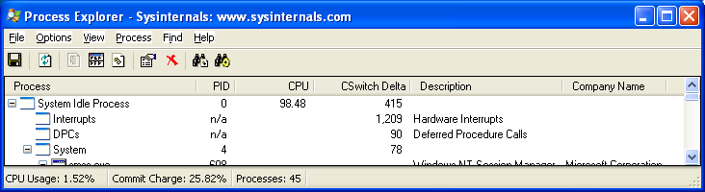
Interrupt Time Accounting
Task Manager includes interrupt and DPC time with the Idle process time
Since interrupt activity is not charged to any thread or process, Process Explorer shows these as separate processes (not really processes)
  Context switches for these are really number of interrupts and DPCs

Slide 62
Time Accounting Quirks
Looking at total CPU time for each process may not reveal where system has spent its time
CPU time accounting is driven by programmable interrupt timer
  Normally 10 msec (15 msec on some MP Pentiums)
Thread execution and context switches between clock intervals NOT accounted
  E.g., one or more threads run and enter a wait state before clock fires
  Thus threads may run but never get charged
View context switch activity with Process Explorer
  Add Context Switch Delta column

Slide 63

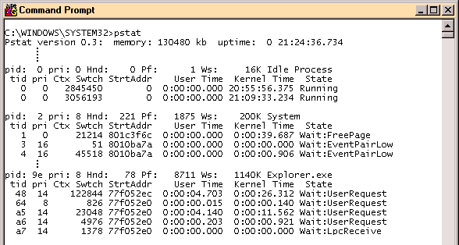
Looking at Waiting Threads
For waiting threads, user-mode utilities only display the wait reason
Example: pstat
To find out what a thread is waiting on, must use kernel debugger

Slide 64
Synchronization on SMP Systems
Synchronization on MP systems use spinlocks to coordinate among the processors
Spinlock acquisition and release routines implement a one-owner-at-a-time algorithm
  A spinlock is either free, or is considered to be owned by a CPU
  Analogous to using Windows API mutexes from user mode
A spinlock is just a data cell in memory
  Accessed with a test-and-modify operation that is atomic across all processors
  To implement synchronization, a single bit is sufficient
31
0

Slide 65
Kernel Synchronization
Processor A
Processor B
.
.
.
.
.
.
do
acquire_spinlock(DPC)
until (SUCCESS)
begin
remove DPC from queue
end
release_spinlock(DPC)
do
acquire_spinlock(DPC)
until (SUCCESS)
begin
remove DPC from queue
end
release_spinlock(DPC)
spinlock
DPC
DPC
Critical section
A spinlock is a locking primitive associated
with a global data structure, such as the DPC queue
Notes:
The concept of mutual exclusion is crucial in operating systems development. It refers to the guarantee that one, and only one, thread can access a particular resource at a time. Mutual exclusion is necessary when a resource does not lend itself to shared access or when sharing would result in unpredictable outcome. In general, writeable resources cannot be shared without restrictions.
The issue of mutual exclusion is especially important for a tightly coupled, symmetric multiprocessing (SMP) operating system such as Windows 2000, in which the same system code runs simultaneously on more than one processor, sharing certain data structures stored in global memory. In Windows 2000, it is the kernel‘s job to provide mechanisms that system code can use to prevent two threads from modifying the same structure at the same time. The kernel provides mutual exclusion primitives that it and the rest of the executive use to synchronize their access to global data structures.
Because the IRQL is an effective synchronization mechanism on uniprocessors, the spinlock acquisition and release functions of uniprocessor HALs do not implement spinlocks – they simply raise and lower the IRQL.

Slide 66
Queued Spinlocks
Problem: Checking status of spinlock via test-and-set operation creates bus contention
Queued spinlocks maintain queue of waiting processors
First processor acquires lock; other processors wait on processor-local flag
  Thus, busy-wait loop requires no access to the memory bus
When releasing lock, the first processor’s flag is modified
  Exactly one processor is being signaled
  Pre-determined wait order

Slide 67
SMP Scalability Improvements
Windows 2000: queued spinlocks
  !qlocks in Kernel Debugger
XP/2003:
  Minimized lock contention for hot locks (PFN or Page Frame Database) lock
  Some locks completely eliminated
    Charging nonpaged/paged pool quotas, allocating and mapping system page table entries, charging commitment of pages, allocating/mapping physical memory through
    AWE functions
  New, more efficient locking mechanism (pushlocks)
    Doesn’t use spinlocks when no contention
    Used for object manager and address windowing extensions (AWE) related locks
Server 2003:
  More spinlocks eliminated (context swap, system space, commit)
  Further reduction of use of spinlocks & length they are held
  Scheduling database now per-CPU
    Allows thread state transitions in parallel

Slide 68
Waiting
Flexible wait calls
  Wait for one or multiple objects in one call
  Wait for multiple can wait for “any” one or “all” at once
    “All”: all objects must be in the signalled state concurrently to resolve the wait
  All wait calls include optional timeout argument
  Waiting threads consume no CPU time
Waitable objects include:
  Events (may be auto-reset or manual reset; may be set or “pulsed”)
  Mutexes (“mutual exclusion”, one-at-a-time)
  Semaphores (n-at-a-time)
  Timers
  Processes and Threads (signalled upon exit or terminate)
  Directories (change notification)
No guaranteed ordering of wait resolution
  If multiple threads are waiting for an object, and only one thread is released (e.g. it’s a mutex or auto-reset event), which thread gets released is unpredictable
  Typical order of wait resolution is FIFO; however APC delivery may change this order

Slide 69
Executive Synchronization
Waiting on Dispatcher Objects – outside the kernel
Create and initialize thread object
Initialized
Wait is complete;
Set object to
signaled state
Thread waits
on an object
handle
Waiting
Ready
Terminated
Transition
Standby
Running
Interaction with thread scheduling
Notes:
The focus within the process state diagram depicted here is on the ready, waiting, and running states (the states related to waiting on objects). The other states and the complete Windows approach to thread scheduling are covered in Unit OS 4.

Slide 70
Interactions between Synchronization and Thread Dispatching
User mode thread waits on an event object‘s handle
Kernel changes thread‘s scheduling state from ready to waiting and adds thread to wait-list
Another thread sets the event
Kernel wakes up waiting threads; variable priority threads get priority boost
Dispatcher re-schedules new thread – it may preempt running thread it it has lower priority and issues software interrupt to initiate context switch
If no processor can be preempted, the dispatcher places the ready thread in the dispatcher ready queue to be scheduled later

Slide 71
What signals an object?
Dispatcher
object
System events
and resulting
state change
Effect of signaled state
on waiting threads
Owning thread releases mutex
Mutex (kernel mode)
nonsignaled
signaled
Kernel resumes one
waiting thread
Resumed thread acquires mutex
Owning thread or other
thread releases mutex
Mutex
(exported to user mode)
nonsignaled
signaled
Kernel resumes one
waiting thread
Resumed thread acquires mutex
One thread releases the
semaphore, freeing a resource
Semaphore
nonsignaled
signaled
Kernel resumes one
or more waiting threads
A thread acquires the semaphore.
More resources are not available
Notes:
The signaled state is defined differently for different objects. A thread object is in the nonsignaled state during its lifetime and is set to the signaled state by the kernel when the thread terminates. Similarly, the kernel sets a process object to the signaled state when the process’s last thread terminates. In contrast, the timer object, like an alarm, is set to “go off” at a certain time. When its time expires, the kernel sets the timer object to the signaled state.
When choosing a synchronization mechanism, a program must take into account the rules governing the behavior of different synchronization objects. Whether a thread’s wait ends when an object is set to the signaled state varies with the type of object the thread is waiting for.

Slide 72
What signals an object? (contd.)
Dispatcher object
System events and resulting
state change
Effect of signaled state
on waiting threads
A thread sets the event
Event
nonsignaled
signaled
Kernel resumes one
or more waiting threads
Kernel resumes one
or more threads
Dedicated thread sets one
event in the event pair
Event pair
nonsignaled
signaled
Kernel resumes waiting
dedicated thread
Kernel resumes the
other dedicated thread
Timer expires
Timer
nonsignaled
signaled
Kernel resumes all
waiting threads
A thread (re) initializes the timer
Notes:
When an object is set to the signaled state, waiting threads are generally released from their wait states immediately. Some of the kernel dispatcher objects and the system events that induce their state changes are shown here.
For example, a notification event object (called a manual reset event in the Windows API) is used to announce the occurrence of some event. When the event object is set to the signaled state, all threads waiting for the event are released. The exception is any thread that is waiting for more than one object at a time; such a thread might be required to continue waiting until additional objects reach the signaled state.
In contrast to an event object, a mutex object has ownership associated with it. It is used to gain mutually exclusive access to a resource, and only one thread at a time can hold the mutex. When the mutex object becomes free, the kernel sets it to the signaled state and then selects one waiting thread to execute. The thread selected by the kernel acquires the mutex object, and all other threads continue waiting.

Slide 73
What signals an object? (contd.)
Dispatcher object
System events and resulting
state change
Effect of signaled state
on waiting threads
IO operation completes
File
nonsignaled
signaled
Kernel resumes waiting
dedicated thread
Thread initiates wait
on an IO port
Process terminates
Process
nonsignaled
signaled
Kernel resumes all
waiting threads
A process reinitializes
the process object
Thread terminates
Thread
nonsignaled
signaled
Kernel resumes all
waiting threads
A thread reinitializes
the thread object
Notes:
This brief discussion wasn’t meant to enumerate all the reasons and applications for using the various executive objects but rather to list their basic functionality and synchronization behavior. For information on how to put these objects to use in Windows programs, see the Windows reference documentation on synchronization objects or Jeffrey Richter’s Programming Applications for Microsoft Windows.

Slide 74
Source Code References
Windows Research Kernel sources
  \base\ntos\ke\i386 (similar files for amd64)
    Trap.asm, Trapc.c – Trap dispatcher
    Spinlock.asm – Spinlocks
    Clockint.asm – Clock Interrupt Handler
    Int.asm, Intobj.c, Intsup.asm – Interrupt Processing
  \base\ntos\ke
    eventobj.c - Event object
    mutntobj.c – Mutex object
    semphobj.c – Semaphore object
    timerobj.c, timersup.c – Timers
    wait.c, waitsup.c – Wait support
  \base\ntos\inc\ke.h – structure/type definitions

Slide 75
Source Code References
Windows Research Kernel sources
  \base\ntos\ke
    Dpcobj.c, dpcsup.c – Deferred Procedure Calls
    Apcobj.c, apcsup.c – Asynchronous Procedure Calls
    interobj.c - Interrupt Object
    wait.c, waitsup.c – Wait support
  \base\ntos\ke\i386 (similar files for amd64)
    Clockint.asm – Clock Interrupt Handler
  \base\ntos\inc\ke.h – structure/type definitions

