Slide 1
SpaCare
Spa/Salon Management System
Final report · Requirements Analysis and Design
Ly Phuc Hai – 524H0013 | Le Hoai An – 524H0077
Advisor: Dr. Ho Thi Linh · Ton Duc Thang University
Notes:
Introduce the team and the topic: a management system for spas/salons covering booking, staff and loyalty. About 30 seconds.

Slide 2
The problem today
Double bookings
High no-show rate
Appointments are noted by hand and staff availability is asked in group chats, so staff or beds get booked twice.
Reminders are manual and often forgotten, leaving empty slots and lost revenue.
Loyalty by paper card
Slow, late reports
Points and tiers are written by hand, easy to lose and hard to verify, so customers drift away.
Commission, attendance and revenue are compiled in Excel at month end, so decisions lack data.
SpaCare · Requirements Analysis and Design
2
Notes:
Four pain points found in the survey (Chapter 2): double booking, no reminders, manual loyalty, slow reporting.

Slide 3
Objectives and scope
The system does
It does not
Booking with conflict detection
Staff, shifts, attendance, commission
Payment, invoices, promotions
Loyalty: points, tiers, redemption
Basic inventory and reports
Full financial accounting
Medical records of clinics
E-commerce with delivery
Real payment gateways (simulated only)
SpaCare · Requirements Analysis and Design
3
Notes:
Scope as defined in Chapter 1. Emphasize that the Java demo covers five core functions.

Slide 4
Requirements at a glance
19
9
17
Functional requirements
Non-functional requirements
Use cases (7 specified)
MoSCoW prioritization
Must
11 requirements: booking, conflicts, staff, shifts, payment, points
Should
6: reminders, commission, tiers, packages, reports
Could
2: inventory, reviews
SpaCare · Requirements Analysis and Design
4
Notes:
FR-01 to FR-19, NFR-01 to NFR-09, prioritized with MoSCoW (Chapter 3).

Slide 5
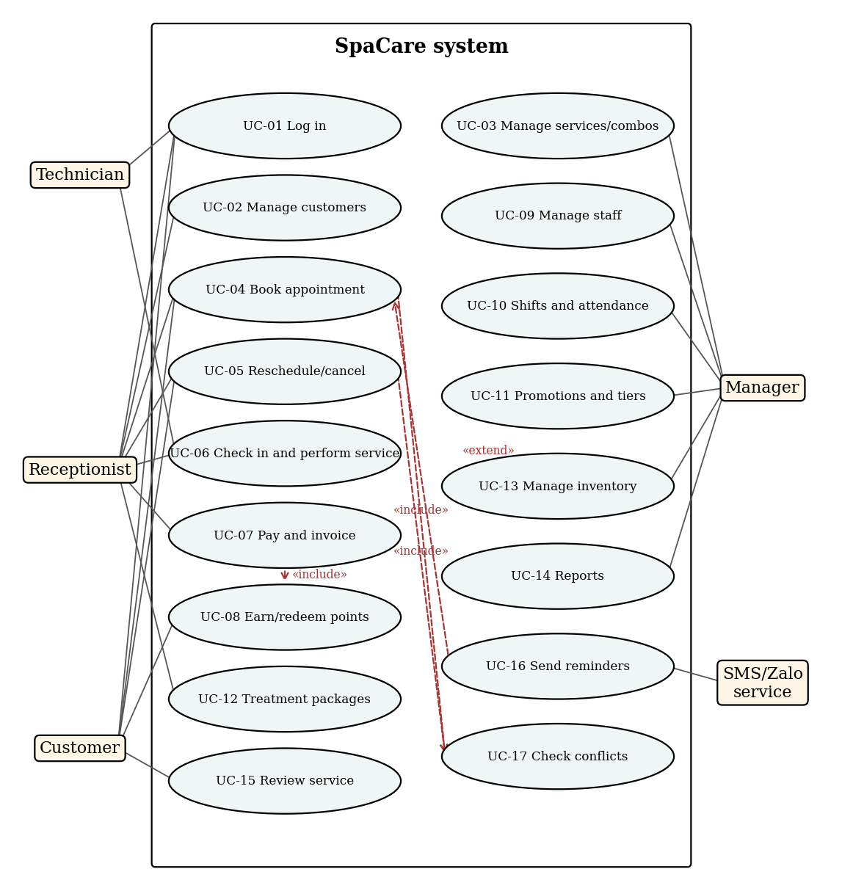
Use case model
5 actors: Customer, Receptionist, Technician, Manager, Notification service
17 use cases; UC-04 Book appointment includes UC-17 Check conflicts
UC-07 Payment includes UC-08 Earn/redeem points
Seven use cases specified in detail (UC-01, 04, 05, 06, 07, 08, 10)
SpaCare · Requirements Analysis and Design
5
Notes:
Walk through the use case diagram (Figure 4.1). Point out the include relationships.

Slide 6
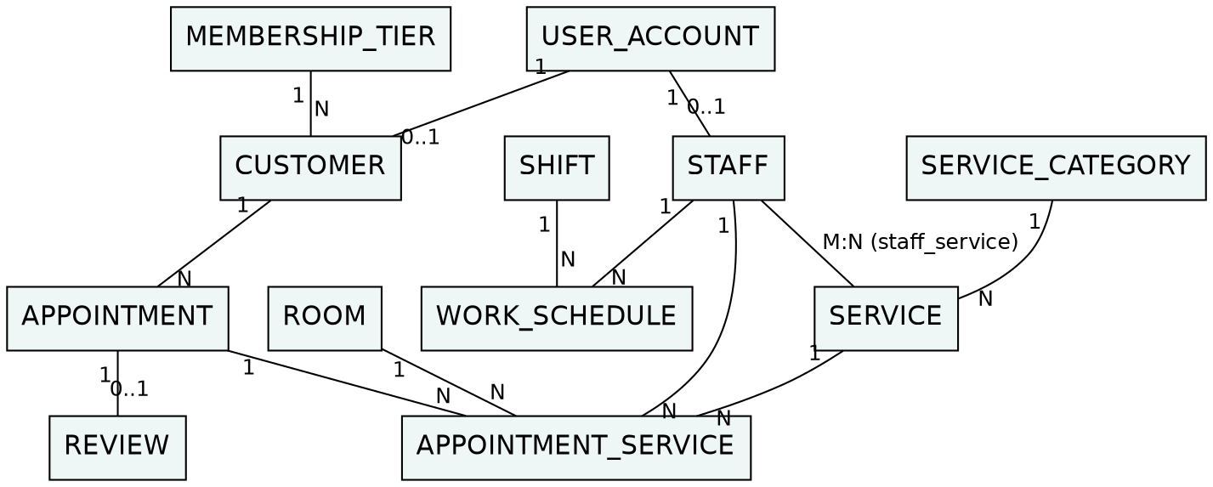
Data model (ERD)
Billing, loyalty, packages and inventory are in ERD part 2 (report, Figure 4.3). 22 entities in total, normalized to 3NF.
SpaCare · Requirements Analysis and Design
6
Notes:
appointment_service links an appointment to a service, a staff member and a room, which is what makes conflict detection possible.

Slide 7
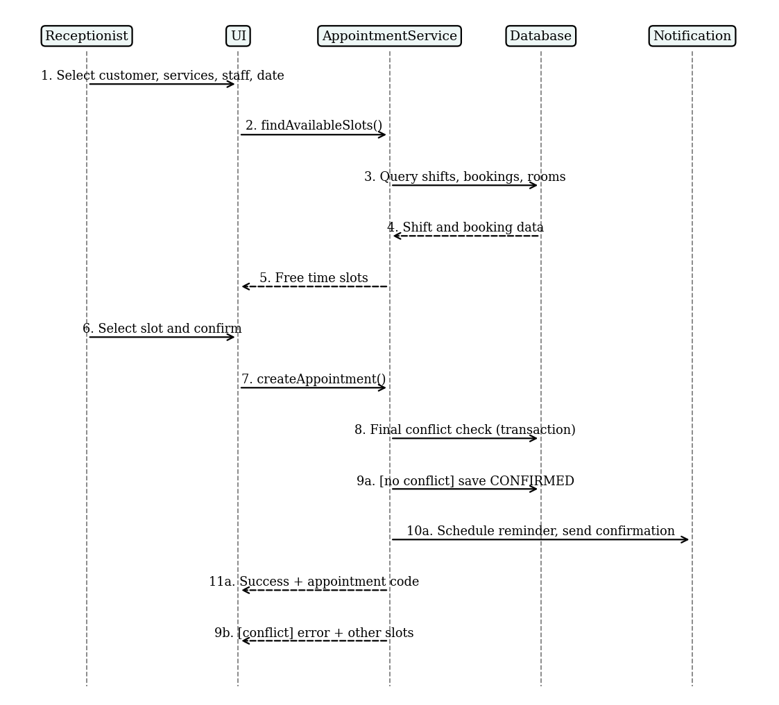
Booking flow with conflict check
System lists only free slots inside the staff shift
Final check runs again inside a transaction
If someone booked meanwhile, the user gets an error and new suggestions
Same rule covers rooms and rescheduling
SpaCare · Requirements Analysis and Design
7
Notes:
Key design decision: re-check conflicts inside the transaction to avoid race conditions.

Slide 8
Loyalty program rules
Tier | Spending (12 months) | Points multiplier | Discount
Silver | from 0 | x 1.0 | 0%
Gold | from 10 million VND | x 1.2 | 5%
Platinum | from 30 million VND | x 1.5 | 10%
Earn: points = invoice total / 10,000 VND, times the tier multiplier
Redeem: 100 points = 10,000 VND, at most 50% of the invoice
Tier upgrades automatically when 12-month spending reaches the threshold
Every point change is logged with the balance after the transaction
SpaCare · Requirements Analysis and Design
8
Notes:
These thresholds are business assumptions of the group and are configurable.

Slide 9
User interface design
M1 Login
M2 Appointments
M3 Book
Role-based access
Day grid by staff, status colors
Services, staff, free slots
M5 Payment
M6 Loyalty profile
M9 Reports
Tier discount, points, methods
Tier progress, point history
Revenue, no-show, top services
Clickable UI prototypes: 03_Demo/0X_*/UI/index.html (any browser), one per function.
SpaCare · Requirements Analysis and Design
9
Notes:
Switch to the browser prototype here and click through booking, check-in and payment.

Slide 10
Live demo plan (12–15 minutes)
1
Problem, scope, requirements
Hai · 2 min
2
Use cases, ERD, database
An · 2 min
3
Demo 1: Login (UI + Java)
Hai · 1.5 min
4
Demo 2: Booking and conflict (UI + Java)
Hai · 2.5 min
5
Demo 3: Reschedule and cancel (UI + Java)
Hai · 1.5 min
6
Demo 4: Check-in and service (UI + Java)
An · 1.5 min
7
Demo 5: Payment, points, Gold upgrade (UI + Java)
An · 2.5 min
8
Conclusion and future work
Hai · 1 min
SpaCare · Requirements Analysis and Design
10
Notes:
Both members present. Java demo: mvn -q compile exec:java, login letan01 / 123456, use tomorrow's date.

Slide 11
Results, limitations, next steps
Delivered
Limitations
Next steps
Report with 9 chapters; 17 use cases; ERD and database design; 6 screens; five demos, each with its own UI prototype and Java program (6 of 7 specified use cases).
Business rules are assumptions; Java demo is a console app; reminders and payments are simulated; no load testing.
Mobile/Web booking and Zalo Mini App; VNPay/MoMo and e-invoicing; no-show prediction; multi-branch chains.
SpaCare · Requirements Analysis and Design
11
Notes:
Be honest about limitations; it improves the answer quality during Q&A.

Slide 12
Thank you
Questions?

