Slide 1

Toothbrush Sales
Presented by: Tracey Ly
Last Updated: 14th September 2022

Slide 2
Contents
Introduction: The Company
Methodology: Creating an ETL pipeline
Data Analysis
Methodology key notes
Insights
Summary
Questions

Slide 3

Introduction: The Company
A toothbrush company wants to:
Understand order and delivery data for different types of toothbrushes
Understand customer’s demographics and purchasing habits to better market their product
We have been provided with a python script that generates the orders data.

Slide 4
Overview of Method
Build an ETL pipeline on AWS that extracts raw data from the SFTP server, processes it, and automatically loads it onto a database on a daily basis
Setup an SFTP server on an EC2 Ubuntu instance to run the data generation script
Perform data analysis on the clean data to derive insights

Slide 5
Overview of ETL Pipeline
EC2 instance 1: SFTP Server
CRON job schedules python script that generates toothbrush data
Amazon EventBridge Rule: start instances
EC2 instance 2: Data Processor
Lambda Function: starts EC2 and RDS instances
Starts
EC2 instance 2 CRON job schedules python script to, retrieve, process, and upload data to an S3 bucket
Lambda Function with S3 trigger
Amazon EventBridge Rule: stop instances
Lambda Function: stop EC2 and RDS instances
Stops
Lambda function uploads any uploaded csv files on S3 bucket to a RDS instance
RDS instance: stores processed data and logs of processed files

Slide 6
Data Analysis
Order Number | Toothbrush Type | Order Date | Customer Age | Order Quantity | Delivery Postcode | Billing Postcode | is_first | Dispatch Status | Dispatched Date | Delivery Status | Delivery Date
BRU00009303 | Toothbrush 4000 | 40:29.3 | 24 | 8 | SE5 9DF | EX16 6EN | 1 | Dispatched | 49:49.9 | In Transit | 40:01.2
BRU00008892 | Toothbrush 4000 | 50:44.4 | 22 | 4 | SN4 8JP | M29 7AS | 1 | Dispatched | 42:01.8 | In Transit | 47:15.0
BRU00009466 | Toothbrush 2000 | 36:54.3 | 78 | 2 | TS20 2UF | BH10 5AF | 1 | Dispatched | 35:43.5 | In Transit | 53:31.7

Slide 7
Data Analysis: Methodology Key Notes
Removed ages below 11
Legal UK age to own a debit card is 11. Some ages were clearly erroneous as some were negative.
Recommendation: Perform age verification checks that prevent orders from customers with unrealistic ages going through. These may be fraudulent orders and requires further investigation.
Combined the toothbrush orders data with population data published by ONS for the 2011 Census.
Measuring success of the company’s sales:
1) Number of orders
2) Number of successful deliveries

Slide 8
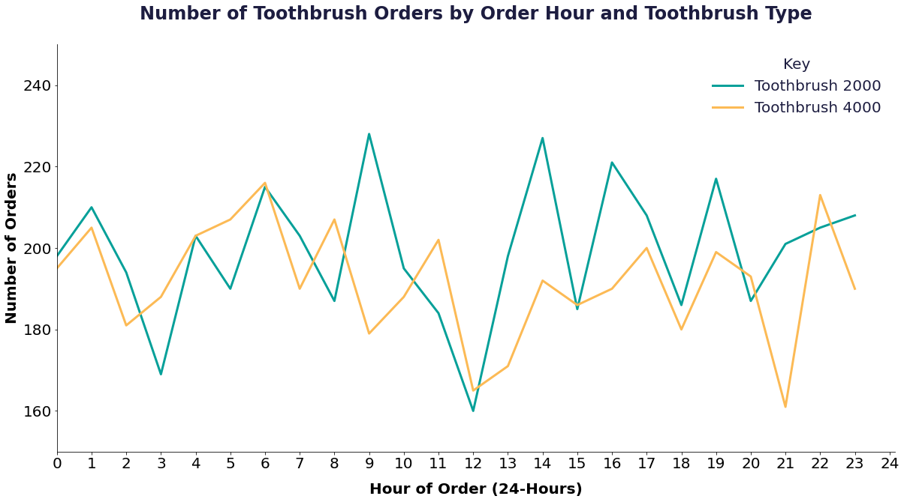
Data Analysis: Insight 1 – Order Time and Toothbrush Type
Recommendation: Time marketing ads to coincide with peak ordering times for each toothbrush type. Do not invest a lot on ads for either type at midday.

Slide 9
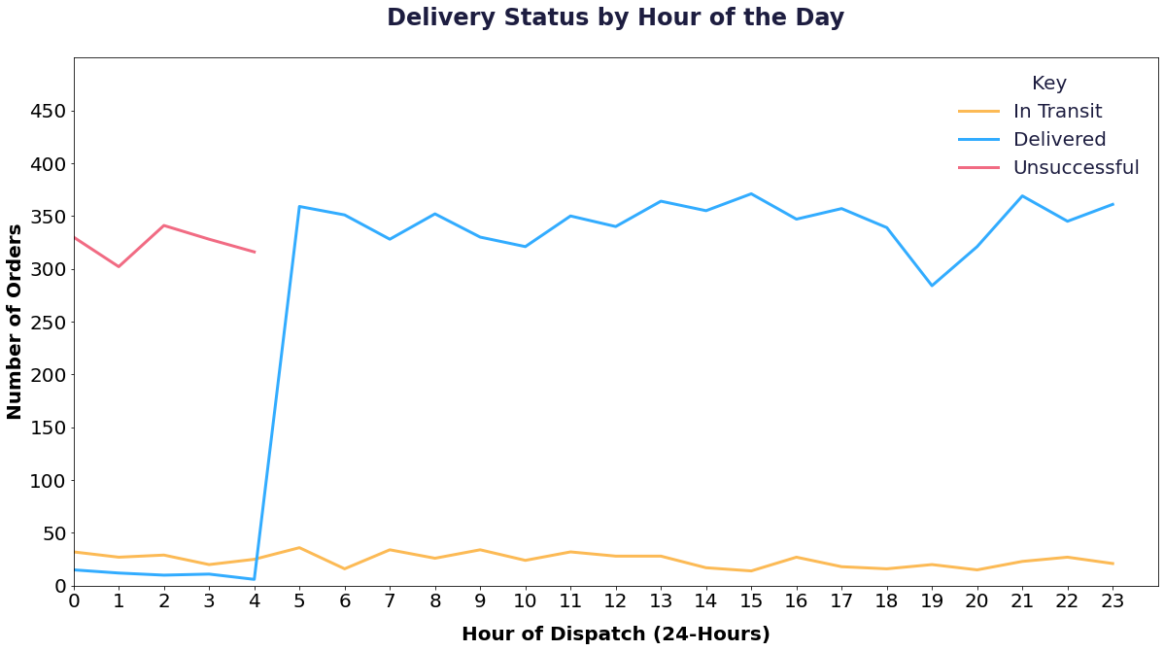
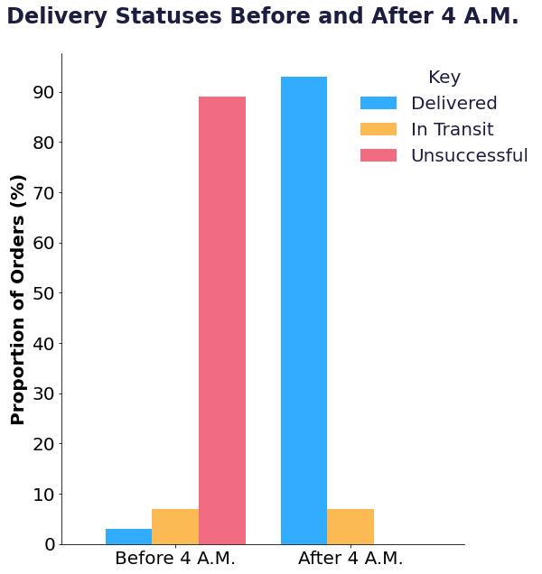
Data Analysis: Insight 2 – Dispatch Times and Delivery Success
Recommendation: Dispatch Orders after 4 A.M. for higher rates of delivery success.

Slide 10
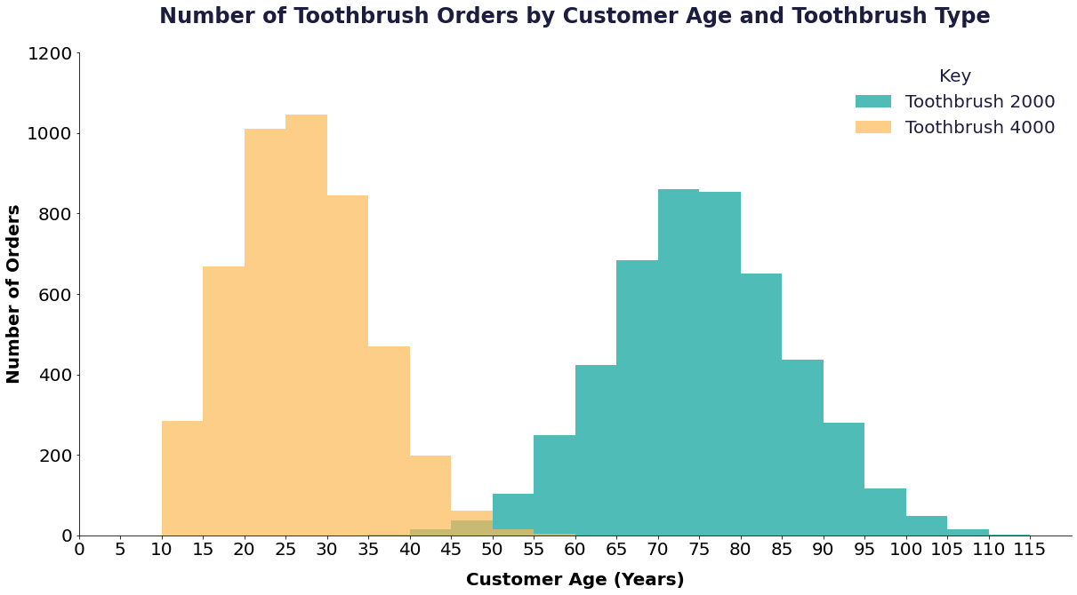
Data Analysis: Insight 3 - Customer Age and Toothbrush Type
Recommendation: Target Toothbrush 4000 ads to 11-45 year olds and Toothbrush 2000 ads to 45+

Slide 11
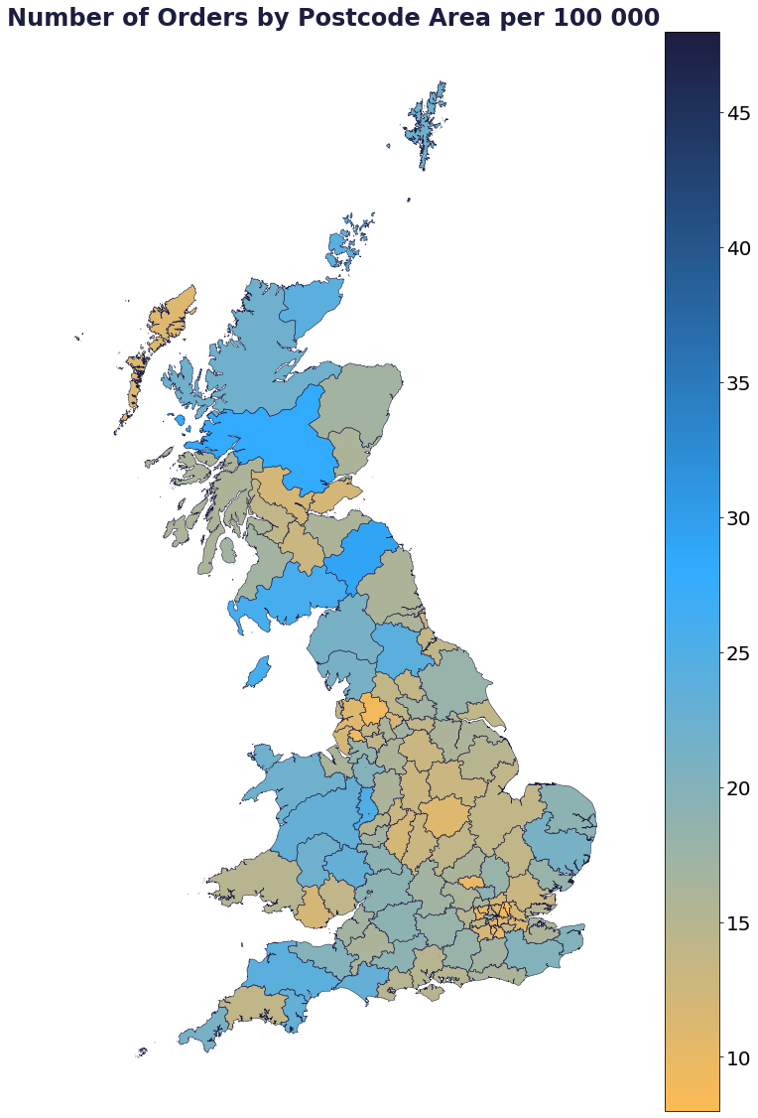
Data Analysis: Insight 4 – Postcode Area
Postcode Area | Number of Orders | Postcode Area Name | Population | per 100000
EC | 16 | London EC | 33205 | 48
WC | 15 | London WC | 35995 | 42
TD | 27 | Galashiels | 94483 | 29
PH | 46 | Perth | 165367 | 28
JE | 27 | Jersey | 97857 | 28
Postcode Area | Number of Orders | Postcode Area Name | Population | per 100000
IG | 27 | Ilford | 335694 | 8
SM | 20 | Sutton | 217048 | 9
E | 94 | London E | 990035 | 9
WN | 28 | Wigan | 308483 | 9
BB | 43 | Blackburn | 488917 | 9
Recommendation: Investigate further into why these toothbrushes are more popular in certain areas like London East and West Central but not in other parts of London.

Slide 12
Other Recommendations
Useful data to collect in the future:
Prices of different toothbrush types
Selling design features of each toothbrush type. Get feedback from a questionnaire if possible
Gender

Slide 13
Summary
Introduction to client
Methods used to create to create ETL pipeline on the cloud
Data Analysis
Methodology key notes
Insights
Summary
Questions

Slide 14
Questions
Thank you for listening!

