Slide 1


Members:
Ly Hoang Vu - ITITIU18260
Luu Trung Duc - ITDSIU20003
Do Le Phuong Nhi - ITDSIU20075
Chau Khac Dinh Phong - ITDSIU20076
Nguyen Anh Do - ITDSIU20059

Slide 2
Table of contents
01
04
Introduction
Game Interface
02
05
Game Instruction
Architecture
03
Game Objects

Slide 3
Introduction
Bomberman is a strategic, maze-based game that has been popular for a long time.
Our team decides to remake this well-known game for the OOP course to familiarize ourselves with OOP concepts and gain more experience in using the library LibGDX – a framework for game development written in Java.

Slide 4

02
Game Instruction

Slide 5

Like the original version, the player must place bombs to destroy all the enemies.
To make things easier and more interesting, the player can absorb PowerUps (like moving faster, range explosion wider, placing more bombs at a time, …).
The game ends when all the enemies are destroyed (win) or the bomber is out of health (lose).

Slide 6
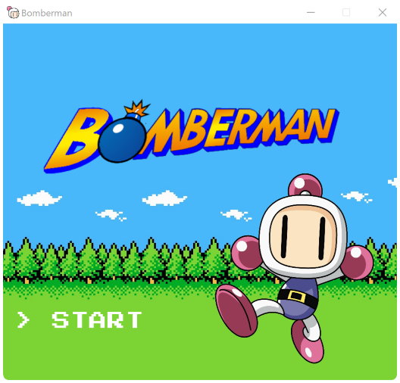
Starting screen
Press ‘Start’ to enter the game

Slide 7
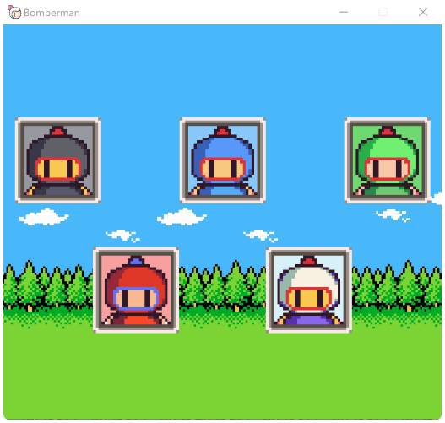
Select Bomber
They are all similar, just different color :))))))

Slide 8
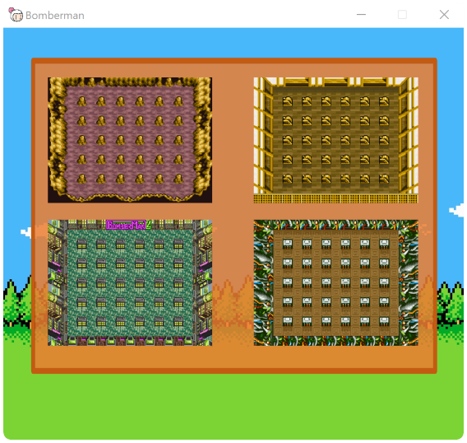
Stage Selection Screen

Slide 9
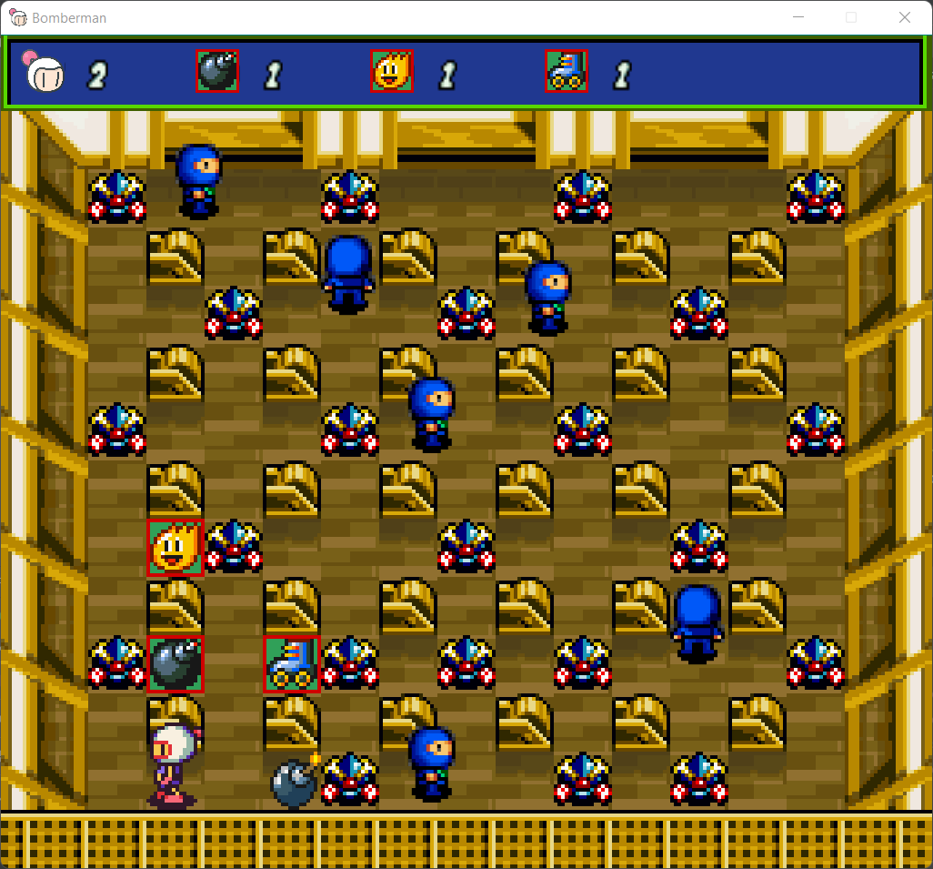
In-game screen
HUD
Enemy
Soft
Solid
Power Up
Bomber
Bomb

Slide 10
HOW TO PLAY
Press W/S/A/D to move UP/DOWN/LEFT/RIGHT
Press E to place a bomb

Slide 11
RULES
If the bomber collides with the enemy or is in range of the bomb explosion, then the bomber loses 1 health.
The initial bomber’s health is 3.
If the bomber’s health is 0, the game ends.
Bomber and enemy can’t go through the obstacle.
There are 2 types of obstacles: solid and soft: the soft is destroyed when it collides with the explosion, while the solid can’t be destroyed.
There are some PowerUps during the gameplay, the bomber can easily get the PowerUps just by passing it.

Slide 12



Power Up
Accelerator: Speed Up Bomber
Bomb up: Increase number of Bomb can be placed at a time
Fire up: Increase the range of explosion

Slide 13

03
Game Objects

Slide 14
Game Objects
ScreenManager class:
designed based on the singleton structure, the implication is that the number of screens can only be one.
Abstract class Enemy and PowerUps:
Those abstract classes are like a blueprint that allows us to create different forms of Enemies and PowerUps and help us in improving the extensibility.
Abstract class AbstractScreen:
Provide a few common methods between each screen, allowing for extensibility without scarifying functionalities.
StageSelectScreen.java:
we have 4 stages, this class gives 4 options to choose.

Slide 15
Game Objects
Item.java
Stage:
GameStage.java, HUD.java, Soft.java, Solid.java, SpawnSoft.java, SpawnSolid.java
Player:
Player.java, PlayerInput.java, PlayerAnimation.java, Explosion.java, Bomb.java
Enemy:
Enemy.java, Alien.java, NinjaBlue.java, Caveman.java, EnemyAnimation.java, SpawnEnemies.java
PowerUps:
PowerUps.java, FireUps.java, IncreaseBomb.java, IncreaseSpeed.java, SpawnPowerUps.java

Slide 16

04
Game Interface

Slide 17

05
Achitecture

Slide 18
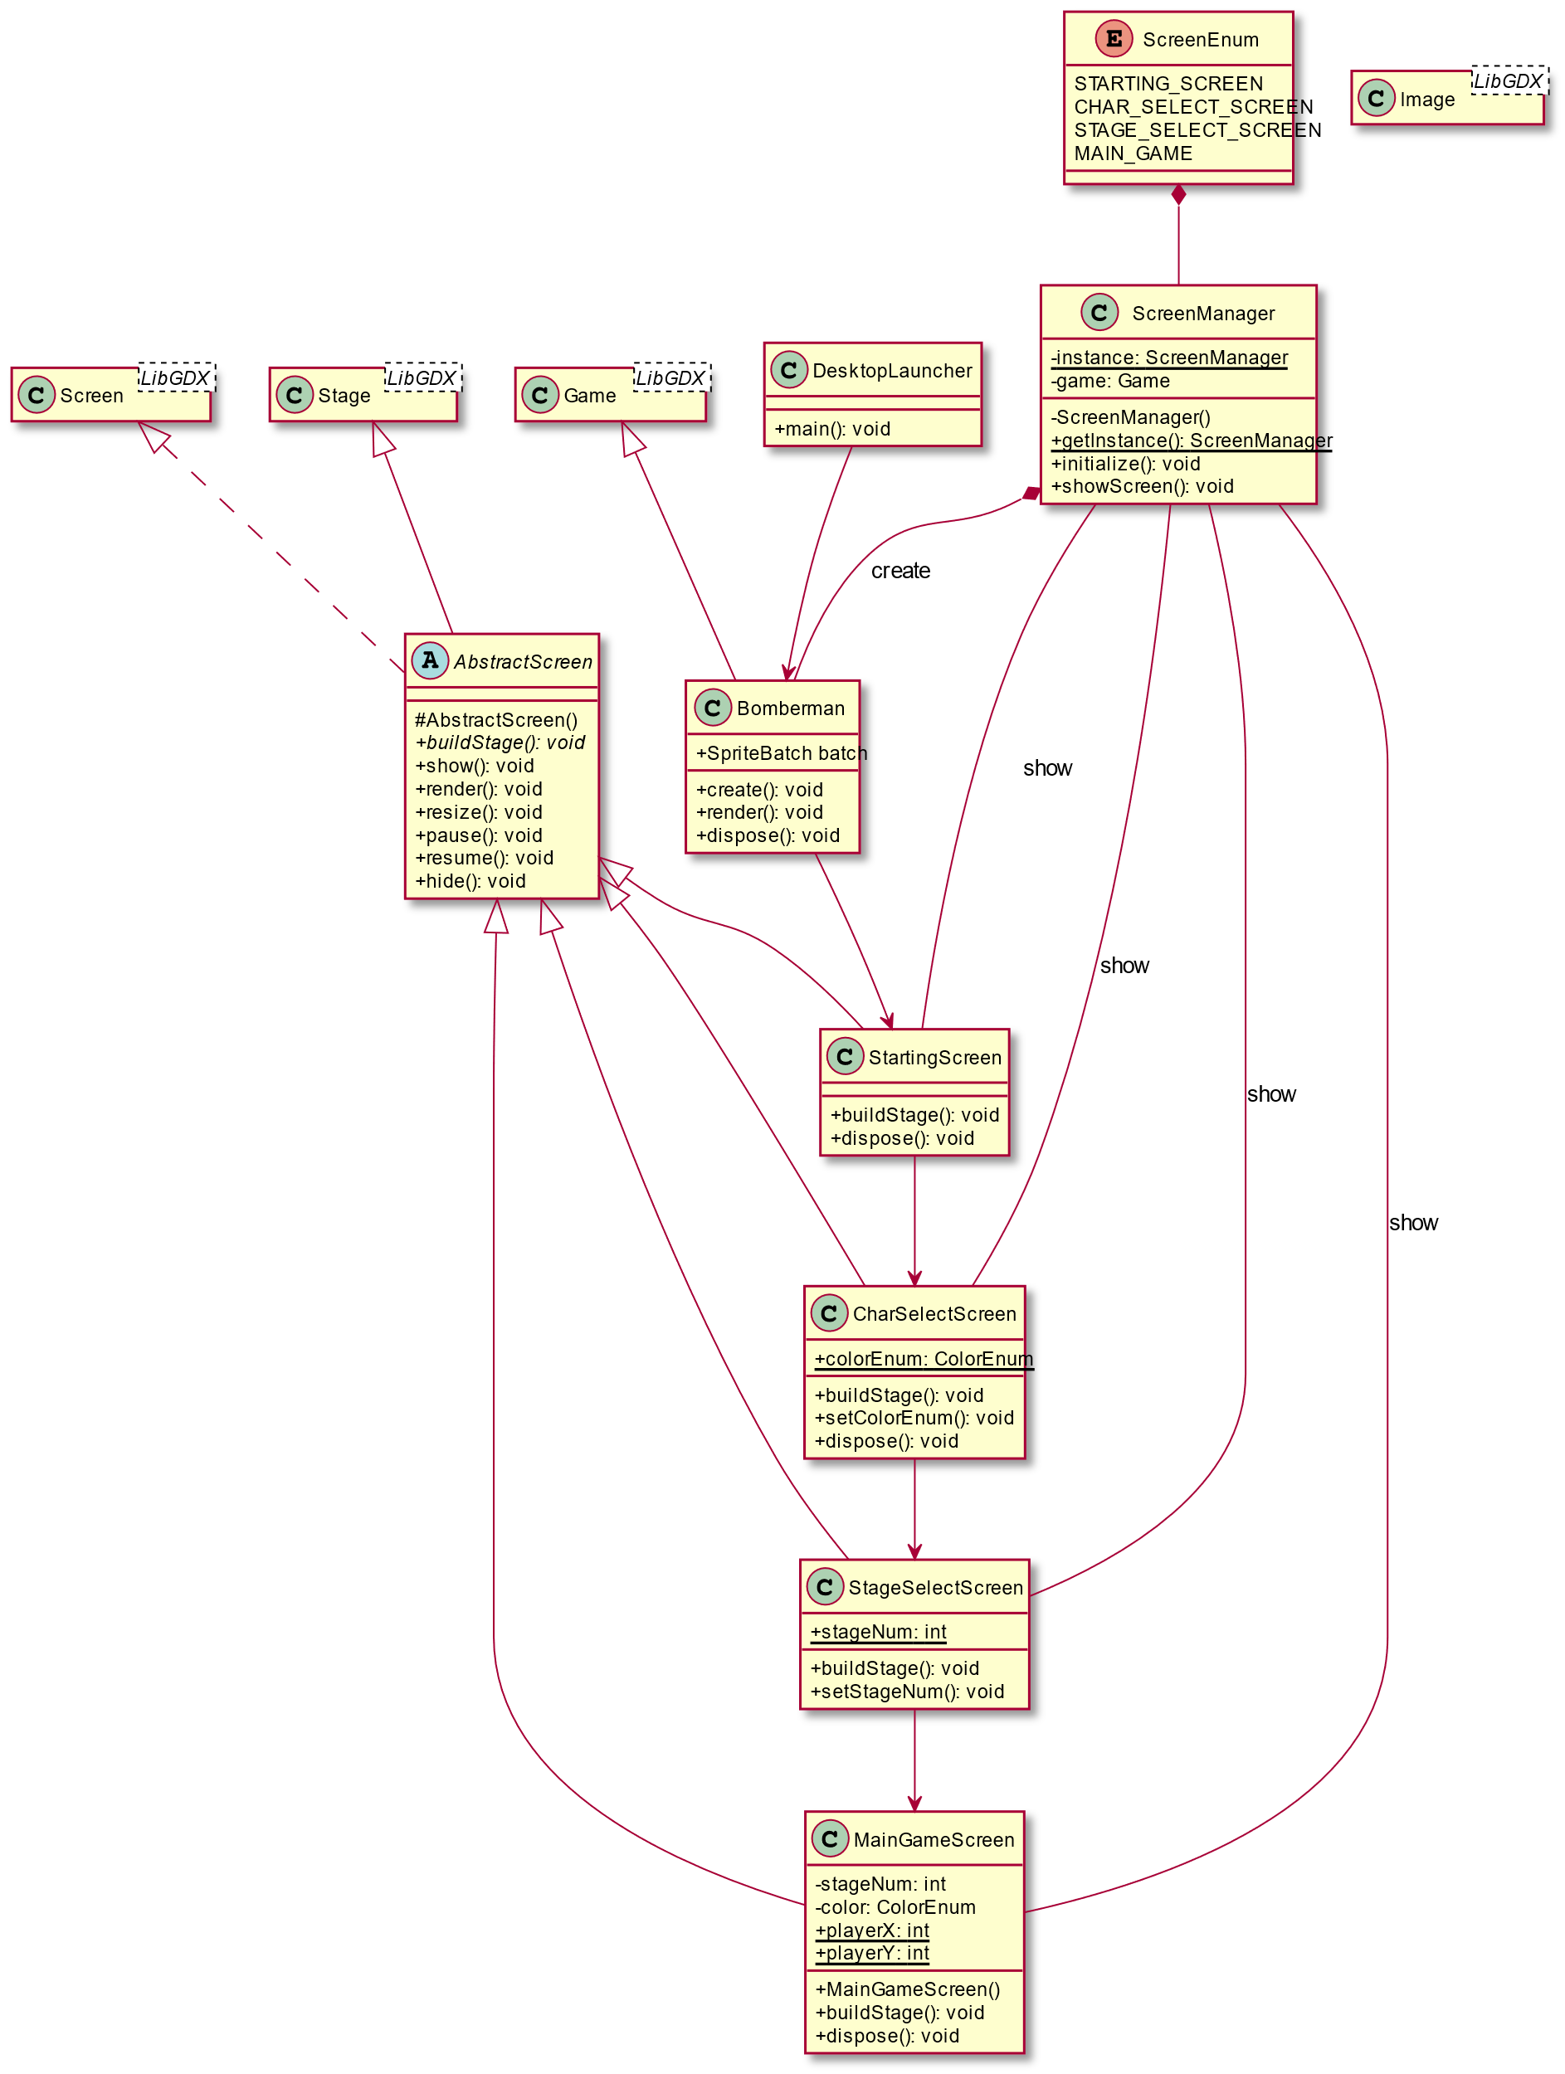
Screen

Slide 19
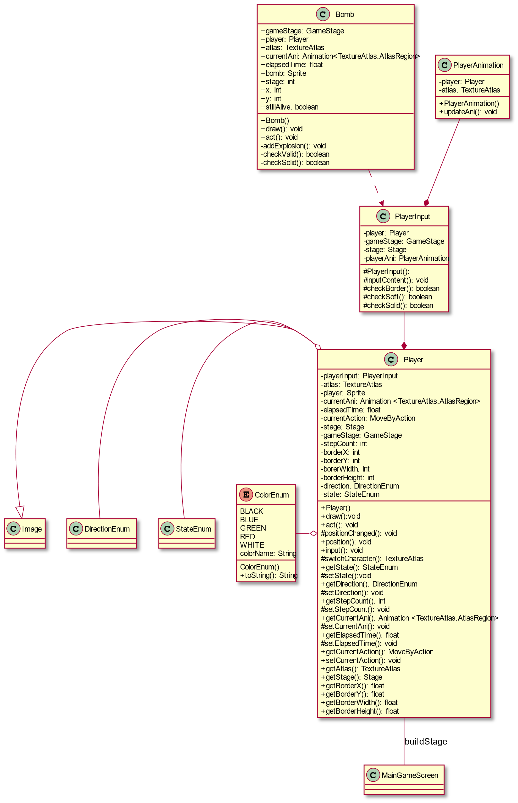
Player

Slide 20
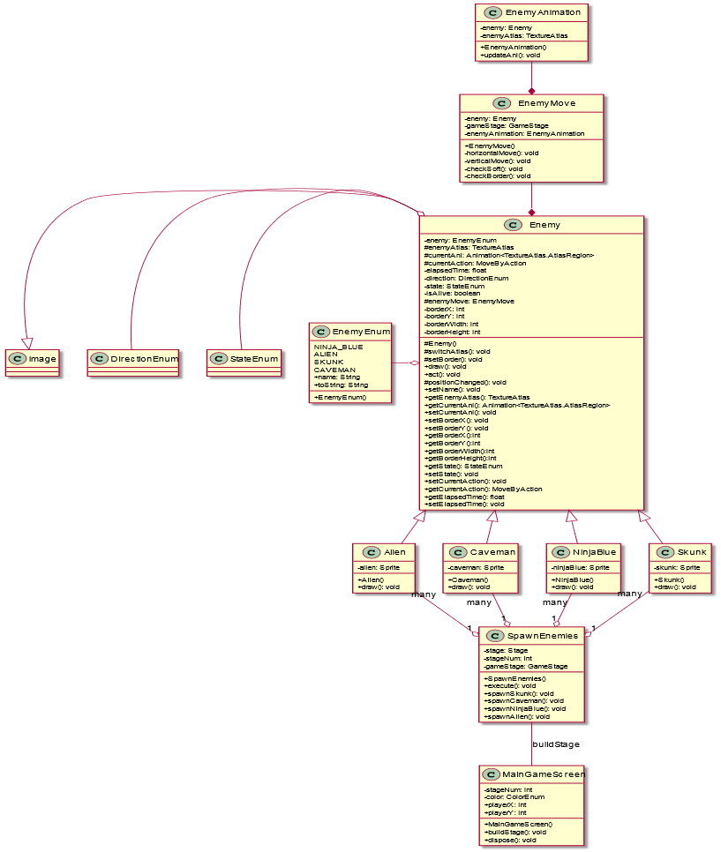
Enemy

Slide 21
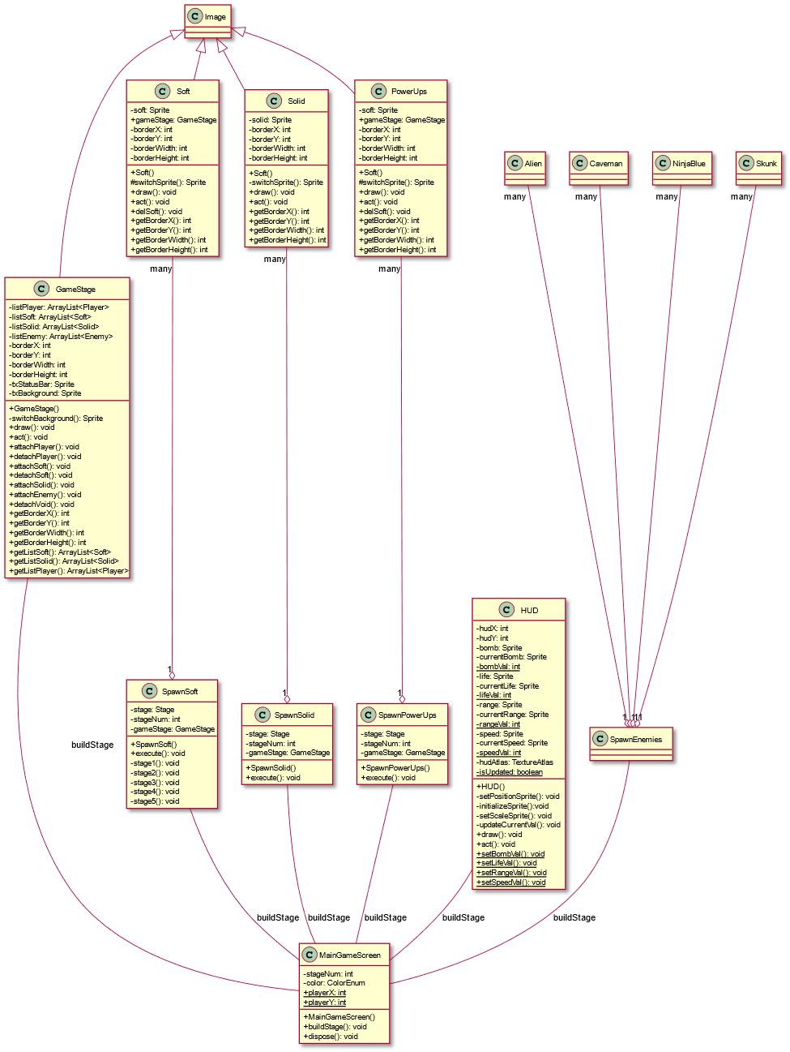
Item

Slide 22
Thanks for listening!
Do you have any questions?

