Slide 1
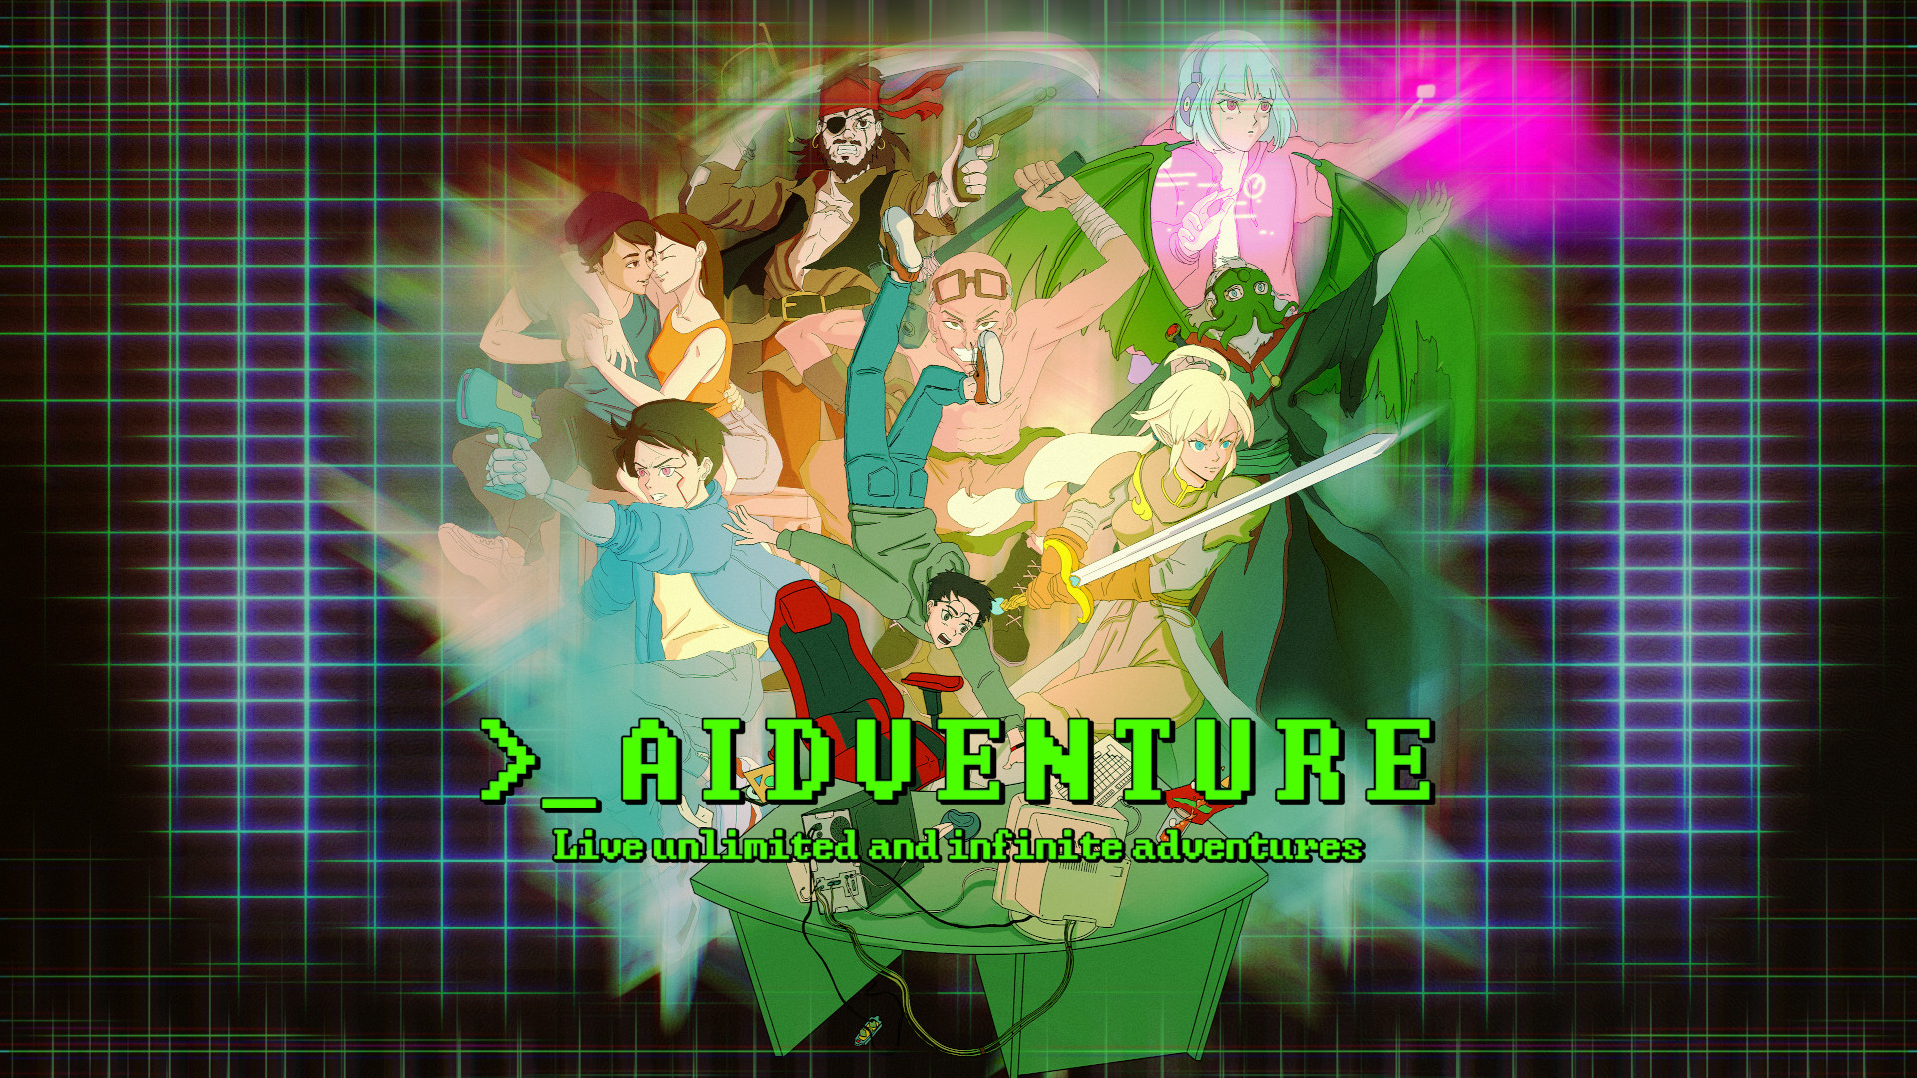

Slide 2

Game overview
Genre : Text Based Interactive Fiction/RPG Adventure
Platform : PC
Engine : Godot Engine
Game Length : Infinite
Released : 25/12/2021

Slide 3
The initial offer
« Protect Europe from the overpopulation by enforcing the tough Law on life, a life for a birth. Or flip the table and fight the cruel plutocracy to free humanity.
Survive the zombie apocalypse, but will your humanity survive in the process?
Inherit a corrupt kingdom and survive the court's intrigues.
Survive the harsh Dark Ages in the skin of a peasant, witch or squire. Wake up within a tube in a post-apocalyptic world. Plunder on the seven seas or just help your neighbour's wife with her plumbing problems.
The choice is yours. »

Slide 4
Features
Customisable : Don't like the AI? Don't like the settings? Change them!
Memory system : The AI has both a short and long term memory.
Easy to use interactions : Choose the mode of interaction with the AI between Say/Try/Do/Story.
RPG system : Create your character's stats and fail or succeed in your own actions.
Generate multiple AI's responses : If you hesitate you can ask the AI to generate another response.
Community friendly : Stories and scenarios are stored in json files. It's easy to share and add new content to your game.
No censorship : Keep control of your stories
Privacy safe : Your data remain on your PC and only you can access it.
21 scenarios : From fantasy to Lovecraft or Zombies, the starting scenarios will help you discover the game
GPU support : The game supports CUDA to improve the performances.

Slide 5

About Lyaaaaa Games
Lyaaaaa Games was formed France in 2022 and is on a quest to design the games the community deserves
Lyaaaaa Games is a one man studio directed by Lyaaaaa. Lyaaaaa has followed software engineering at university and has some experience with open source projects.
AIdventure is the first game published by Lyaaaaa Games.

Slide 6



Thank you !
www.lyaaaaagames.com

