Slide 1
How often should a robot replan?
Execution-prefix length for SmolVLA in LIBERO
Research problem
A policy call predicts 50 actions. The executor decides how many to execute.
A shorter prefix obtains fresh feedback sooner but requires more policy calls.
Experimental question
How do fixed execution intervals and adaptive DVAC affect task success
and policy-call cost when they start from the same physical situations?
Amir Sadreev and Vasilii Liamin

Slide 2
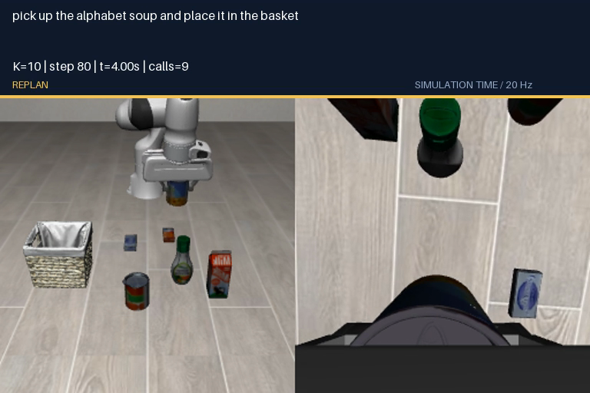
Policy input, pretrained SmolVLA, and the simulator
Input at each replanning call
Vision–Language–Action (VLA) takes:
Two images, a task instruction, and robot state.
State = [x,y,z, rx,ry,rz, gL,gR] (8 numbers).
Robot state and task instruction
Position: x,y,z. Orientation: axis-angle rx,ry,rz.
gL,gR: positions of the two gripper fingers.
Text: “pick up the alphabet soup and place it
in the basket”. We use pretrained weights.
Video: soup can into basket, K=10, 6.9 s
Output: 50 relative 7D actions.
3 translations + 3 rotations + 1 gripper command.
LIBERO executes commands; MuJoCo updates physics.
Left: external camera. Right: wrist camera.
Each observation contains two 256×256 RGB images.

Slide 3
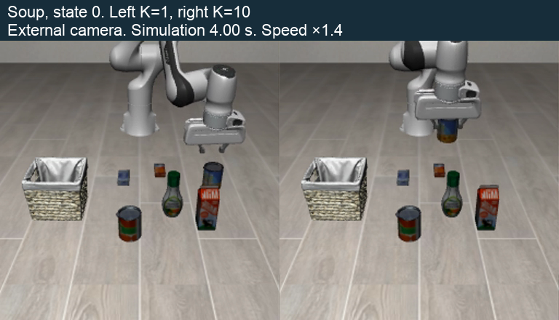
Action generation and execution: H, M, K, and C
Parameter | Meaning | Value
H | Actions predicted per policy call | 50
M | Flow-matching iterations from noise to an action block | 10
K | Actions executed before the next observation | 1…50
C | Maximum prefix length allowed for DVAC | 5 / 10 / 25 / 50
K | Simulation interval
1 | 0.05 s
10 | 0.5 s
50 | 2.5 s
Video: K=1 fails (280 calls); K=10 succeeds (14 calls)

Slide 4
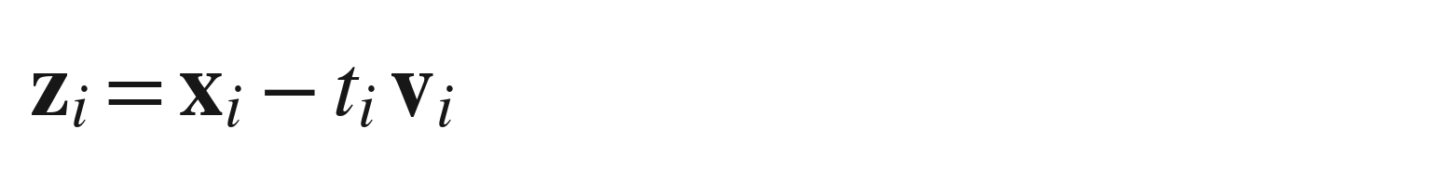
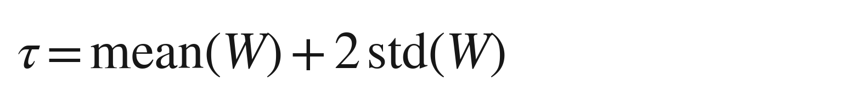
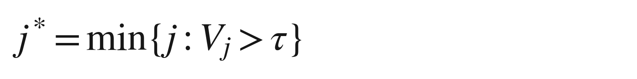
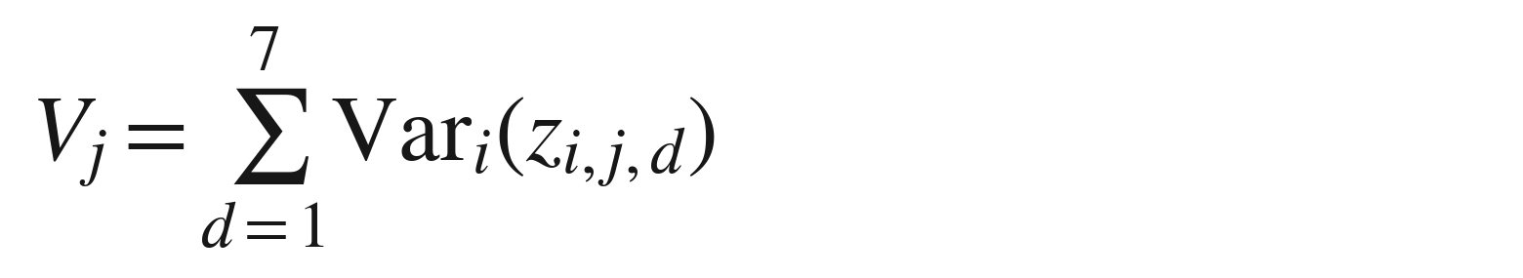
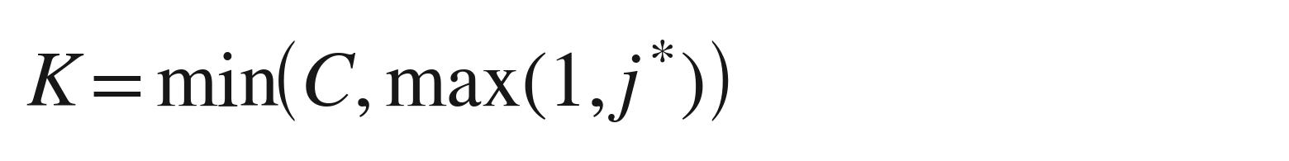
DVAC: Denoising-Variance Adaptive Chunking
1. Measure internal agreement
2. Choose when to observe again
Use the last five clean-action estimates:
W contains variance values from up to 5 past calls.
x: noisy action block; t: flow time; v: flow velocity.
Each estimate contains 50 actions × 7 coordinates.
j* is the first zero-based position above the threshold.
If there is no crossing, use K = min(C, 50).
First call: K=1; update W after choosing K.
Example: j*=4 and C=10 → execute 4 actions.
For each future action j, sum the variance
over its 7 coordinates. Larger values mean
less agreement between the five estimates.

Slide 5
Experimental design: matched starts and controlled variables
Design choice | How it controls the comparison
30 paired settings | 3 tasks × 10 initial states, reused for all 9 methods
Exact initial match | Same simulator state, images, and first 50×7 prediction
Only execution changes | 5 fixed K values versus 4 capped-DVAC rules
Episode accounting | 280/300-step limits; failed episodes remain in the cost
Fixed across methods
Checkpoint and weights
H=50, M=10, FP32
20 Hz simulation control
One policy seed: 11
The same physical starting state
Execution rules and sample size
Measured outcomes
Fixed K: 1, 5, 10, 25, 50.
DVAC caps C: 5, 10, 25, 50.
150 reused fixed controls + 120 adaptive episodes.
Success: LIBERO task criterion.
Cost: mean policy calls per episode,
including failed episodes.

Slide 6
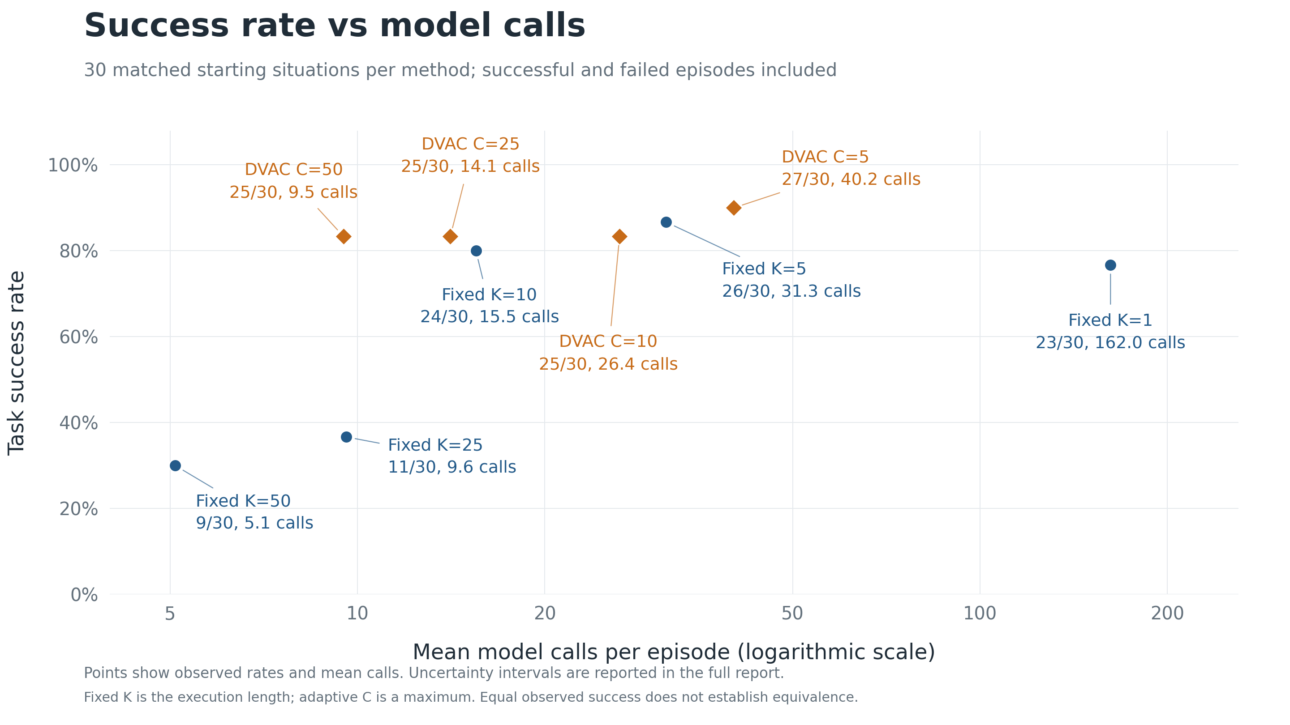

Slide 7
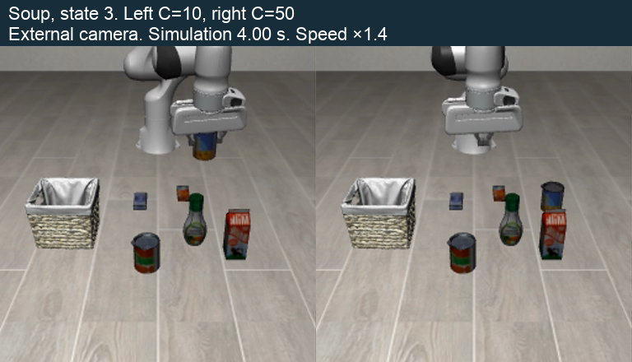
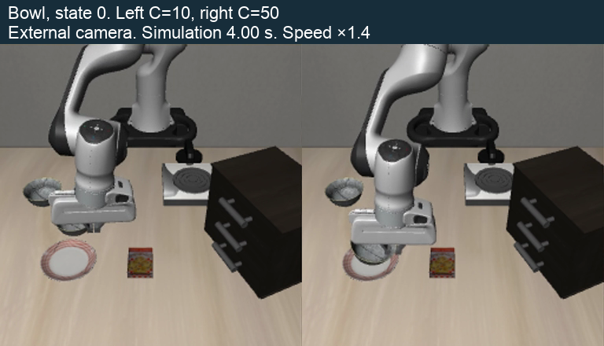
Two examples: the same cap gives opposite outcomes
Soup: transport without the object
Bowl: C=50 completes the placement
Video: C=10 vs C=50, 10 seconds
Video: C=10 vs C=50, 10 seconds
C=10 succeeds at step 143.
C=50 moves an empty gripper and fails by step 280.
C=50 succeeds at step 81.
C=10 keeps repositioning and fails by step 280.

Slide 8
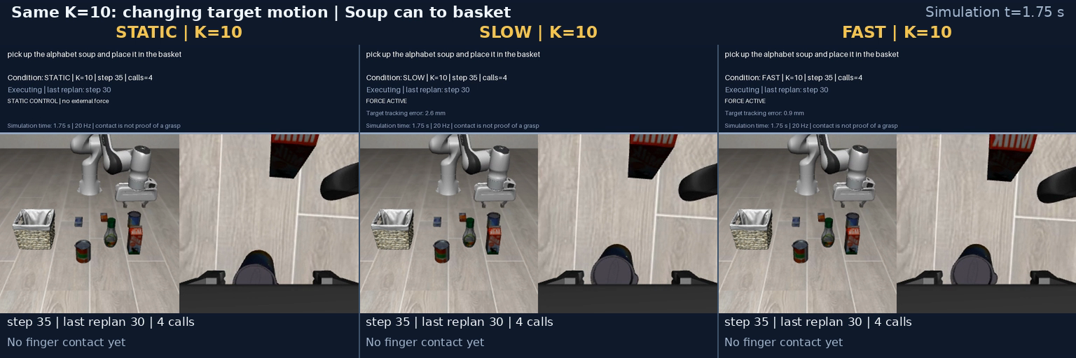
Additional protocols: new states and target perturbations
48 episodes: DVAC on new states
135 episodes: force perturbation
Method | Success | Calls
K=5 | 11/12 | 28.2
K=10 | 9/12 | 16.2
K=25 | 6/12 | 8.6
DVAC | 9/12 | 10.2
Condition | K=5 | K=10 | K=50
Static | 12/15 | 13/15 | 6/15
Slow | 8/15 | 13/15 | 5/15
Fast | 13/15 | 15/15 | 6/15
3 tasks, 6 physical settings, 2 policy seeds.
DVAC and K=10 each complete 9/12.
Equal totals do not establish equal reliability.
This cohort is analysed separately.
Video: static, slow, and fast conditions at K=10

Slide 9
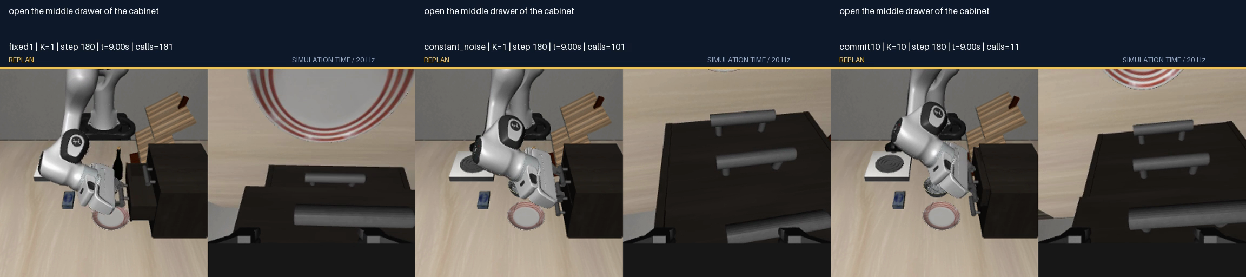
122 additional rollouts: heuristic and controlled continuations
Testing an action-based heuristic
Exact continuations from step 80
Use K=5 for a predicted gripper-sign change
or a sharp change in translation direction.
Otherwise use K=10 when closing, K=25 when opening.
Continuation | Success /7
Original K=1 | 5/7
Fixed sampling noise | 3/7
Execute 10 actions | 4/7
Cohort | Heuristic | K=10
Primary evaluation | 6/12 | 9/12
Replication | 7/12 | 10/12
Separate Apple Silicon/MPS cohort.
The heuristic does not improve either evaluation.
50/50 successful replays retain the goal
after forced gripper opening after the policy ends.
Video: one prefix, three continuations, 12 seconds
Neither intervention rescues
the two original K=1 failures.

Slide 10
Conclusions, limitations, and next experiment
What the data support
Limits of the evidence
Success is not monotonic in replanning frequency.
K=5 completes 26/30 with 31.3 calls in the main cohort.
DVAC changes the success/call trade-off through C.
The observed 27/30 and 26/30 are close;
superiority is not established.
Main cohort: 3 tasks, 30 settings, 1 policy seed.
The simulator pauses during inference.
New states, seeds, and observation delays need testing.
The results do not establish a universally best K.
Next validation
Control | Question it answers
A fixed schedule with the same call budget | Does the DVAC signal help beyond spending more calls?
Unseen states, repeated seeds, realistic delays | Does the observed trade-off hold outside these starts?

