Slide 1
VISION–LANGUAGE–ACTION ROBOTICS
How often should
a robot replan?
RESEARCH QUESTION
How does replanning frequency change
task success and model-call cost?
Pretrained SmolVLA in the LIBERO simulator
Amir Sadreev and Vasilii Liamin
Notes:
We study the number of actions a pretrained VLA executes before receiving a new observation. Each SmolVLA call predicts a block of 50 actions. We compare five fixed execution intervals with four DVAC caps on the same 30 starting settings. The research question is how the execution interval changes observed task success and model-call cost.

Slide 2
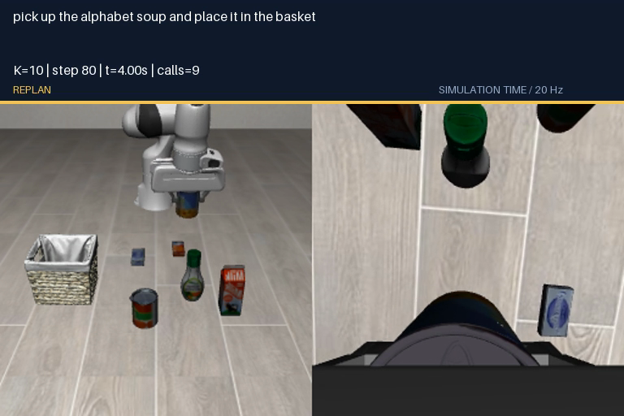
One observation produces 50 candidate actions
INPUT
Two camera images, an instruction
and the robot state
256 × 256 RGB per camera
8 state values: position, orientation, fingers
PRETRAINED SMOLVLA
50 × 7
actions per call × action coordinates
3 translations + 3 rotations + gripper
LIBERO executes commands in MuJoCo.
“Pick up the alphabet soup and place it in the basket.”
02
Notes:
A Vision–Language–Action model receives an external image, a wrist image, the language instruction and robot state [x,y,z,rx,ry,rz,gL,gR]. Orientation uses axis-angle coordinates. gL and gR are finger positions. The output is 50 relative 7D actions. The demonstration uses fixed K=10. LIBERO defines the task and MuJoCo simulates physics. We use pretrained weights without fine-tuning.

Slide 3
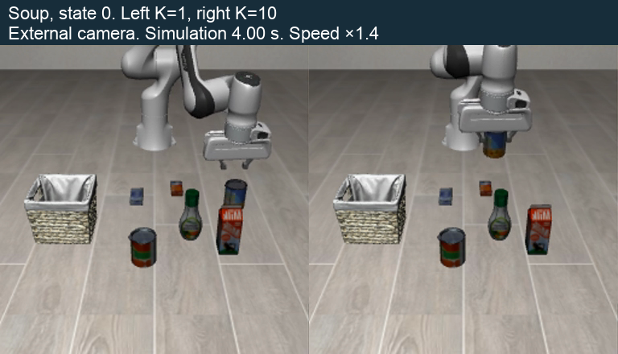
The executor sets the replanning interval
Prediction stays fixed. Execution changes.
Term | Meaning | Value
H | Predicted actions | 50
M | Flow-matching steps | 10
K | Actions executed | 1–50
C | Maximum DVAC K | 5–50
At 20 Hz, K=1 / 10 / 50 executes
0.05 / 0.5 / 2.5 seconds before a new observation.
Same start: K=1 fails, K=10 succeeds
280 calls versus 14 calls in this example
03
Notes:
SmolVLA always predicts H=50 actions using M=10 flow-matching iterations. The executor consumes only the first K actions, obtains a new observation and discards the unused suffix. DVAC selects K with a maximum C. H is not the execution interval. Fixed K values are 1,5,10,25,50 and DVAC caps are 5,10,25,50. The video shows soup state 0. This single episode illustrates behavior, but is not evidence of aggregate superiority.

Slide 4
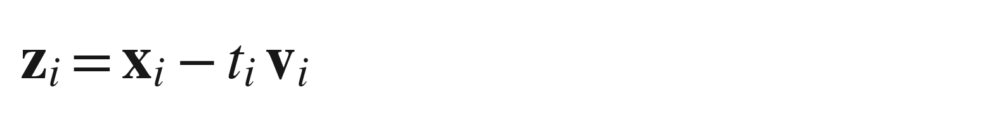
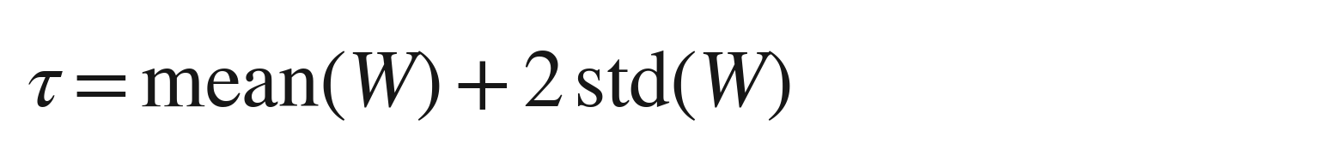
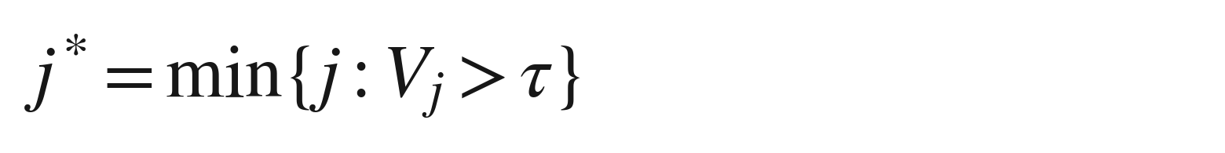
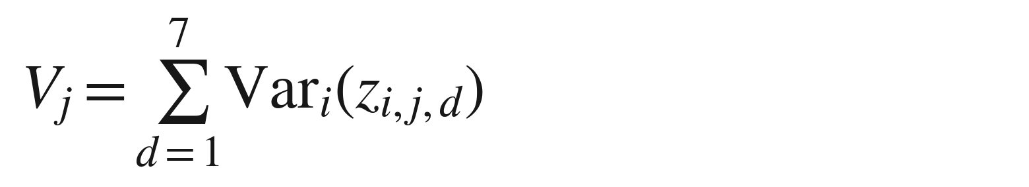
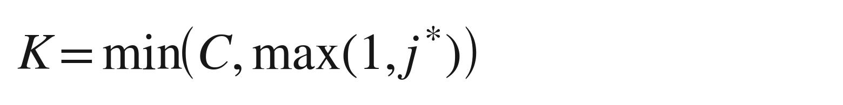
DVAC selects K from internal FM disagreement
Denoising-Variance Adaptive Chunking
1. Measure disagreement
2. Choose the next observation
Use the last five clean-action estimates.
W stores variance values from up to 5 past calls.
x: noisy block t: flow time v: flow velocity
Each estimate contains 50 × 7 coordinates.
Vⱼ sums variance across the 7 coordinates.
Larger Vⱼ means less agreement on action j.
First crossing j* uses zero-based indexing.
No crossing: K = min(C, 50). First call: K = 1.
Update W after choosing K.
Example: j* = 4 and C = 10 executes 4 actions.
04
Notes:
The five clean estimates come from the final five flow-matching solver iterations inside the same model call. z_i = x_i − t_i v_i. For each future action index j, V_j = sum_d Var_i(z_i,j,d). W contains variance values from up to five previous policy calls. tau = mean(W) + 2 std(W). j* is the first zero-based index with V_j greater than tau. K=min(C,max(1,j*)). If no index crosses, K=min(C,50). Bootstrap K=1 for the first call. Update W only after choosing K. This is internal disagreement, not calibrated confidence. The main comparison does not isolate the variance signal from the schedule or call budget.

Slide 5
Nine execution rules, the same 30 starts
270
FIXED INTERVALS
K = 1, 5, 10, 25, 50
episodes in the main comparison
ADAPTIVE DVAC CAPS
3 tasks × 10 initial states × 9 rules
C = 5, 10, 25, 50
Soup transfer, bowl placement, drawer opening
Matched comparison | Evaluation
Same state, camera images and first prediction | LIBERO task-success criterion
Same weights, H=50, M=10, FP32 and seed 11 | Mean model calls include failures
Same 20 Hz control and task step limits | 280 / 300 steps per episode
05
Notes:
The same 30 paired settings comprise three tasks with ten initial states each. All nine methods reuse each physical start. We verify equal initial simulator state, camera images and first 50×7 prediction. We hold checkpoint, weights, H=50, M=10, FP32 precision, policy seed 11 and 20 Hz control fixed. There are 150 fixed-rule episodes and 120 DVAC episodes, totaling 270. The episode caps are 280 or 300 steps depending on the task. Failures remain in cost averages. The tasks involve soup transfer, bowl placement and opening a drawer.

Slide 6
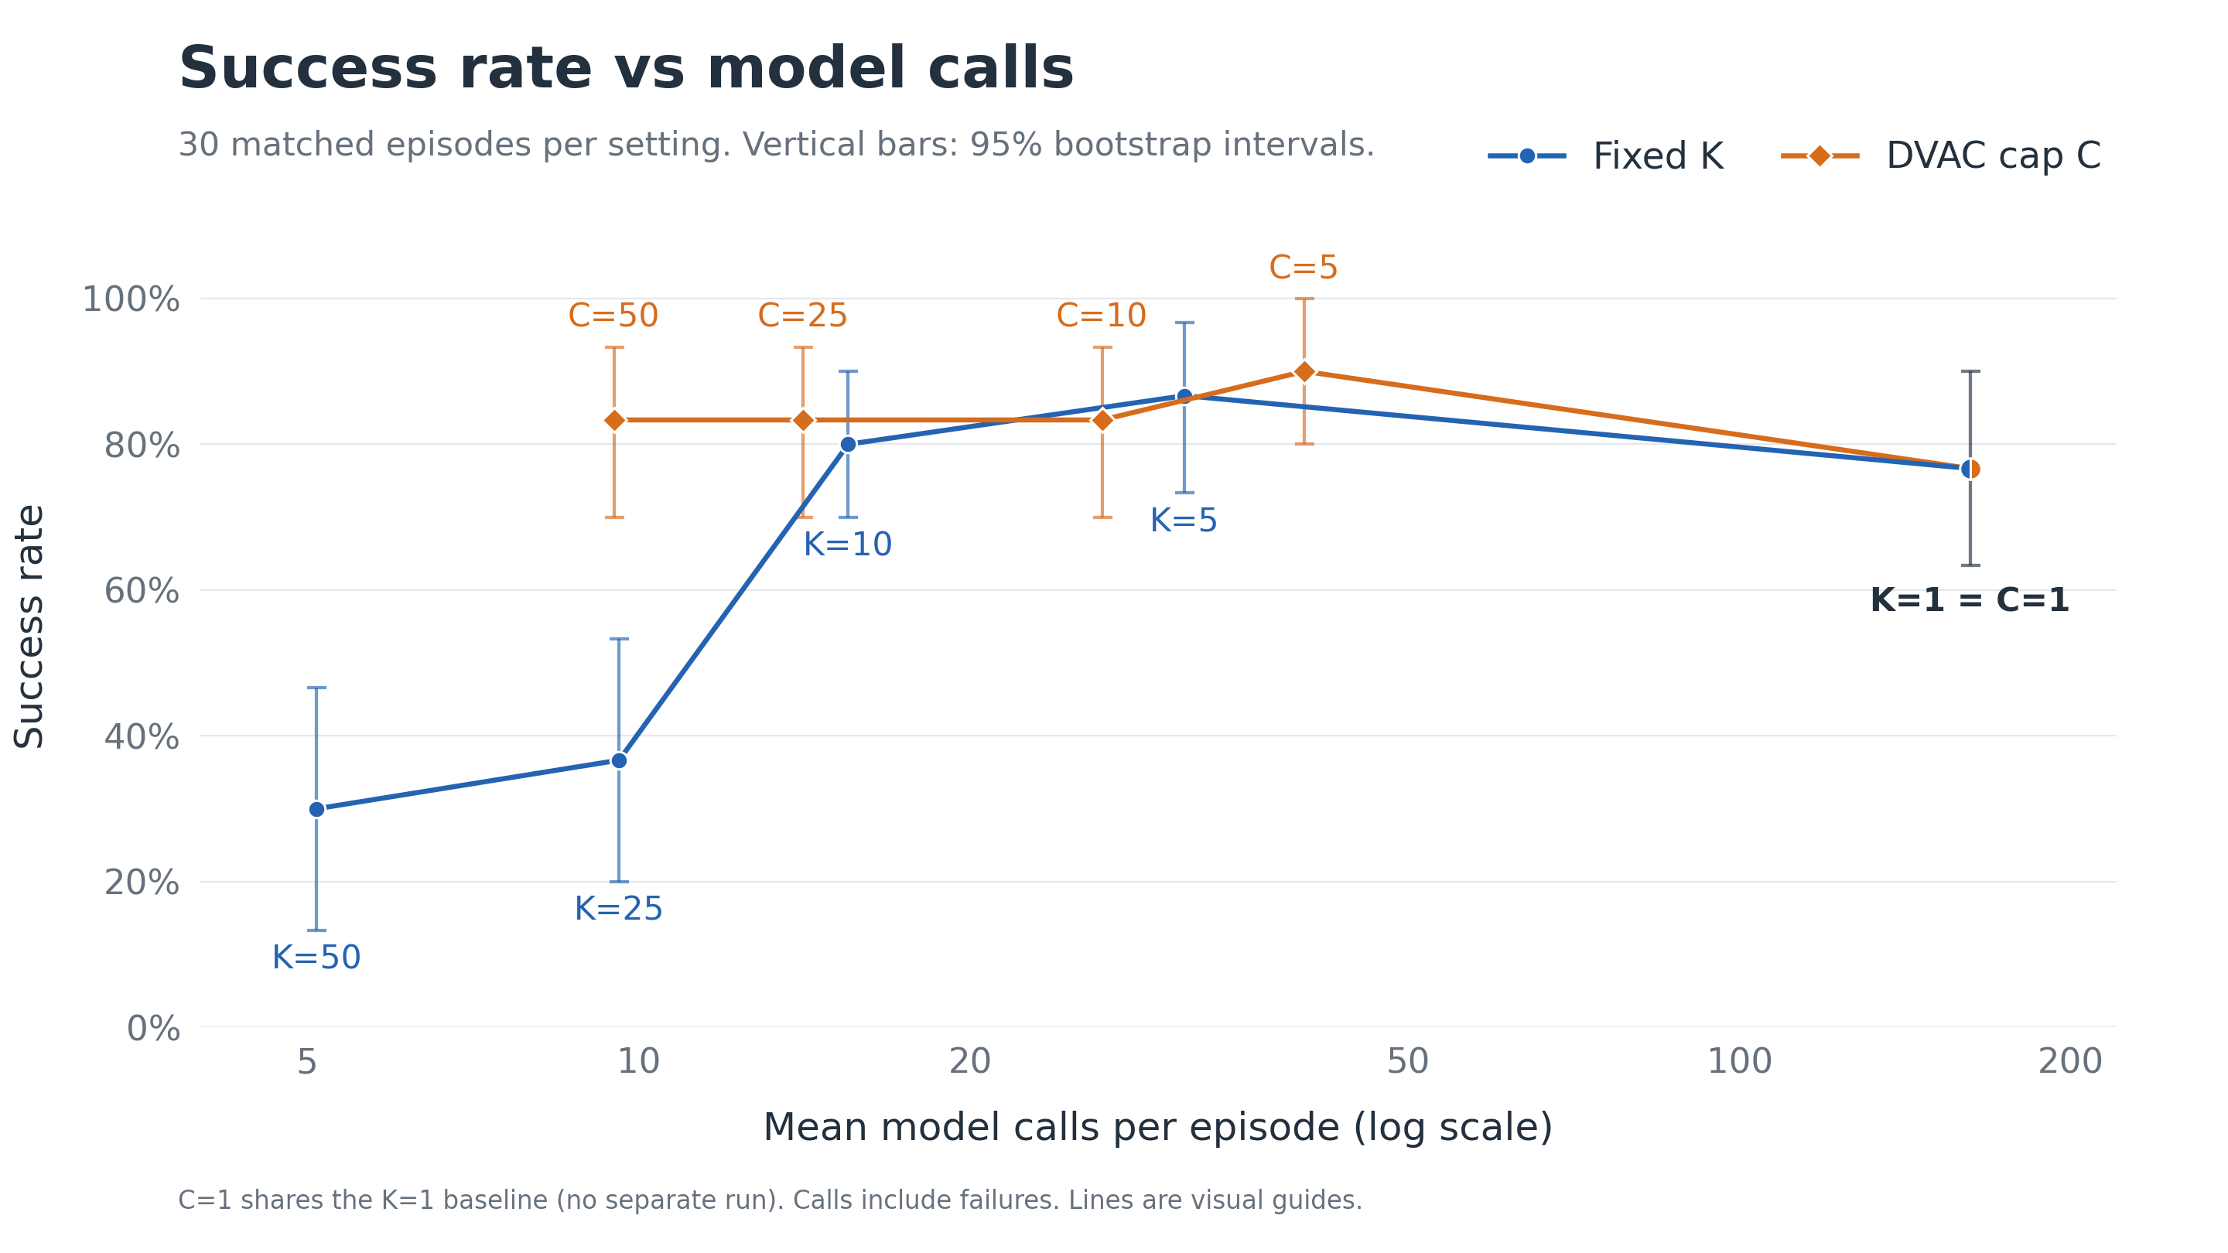
Notes:
Each method uses the same 30 starting settings. Fixed results: K1 23/30,162.033 mean calls; K5 26/30,31.333; K10 24/30,15.5; K25 11/30,9.6; K50 9/30,5.1. DVAC results: C5 27/30,40.233; C10 25/30,26.367; C25 25/30,14.1; C50 25/30,9.5. The x-axis is logarithmic. Lines guide the eye, without interpolated measurements. C=1 executes exactly one action before each observation and shares the measured K=1 baseline, with no separate run. Calls include both successes and failures. C50 and K25 have similar mean calls but very different observed success. C50 uses about 70% fewer calls than K5 with 25 versus 26 observed successes. The sample does not establish equal reliability. Vertical bars show the recorded descriptive 95% task-stratified state-bootstrap intervals for success rate. The analysis uses 10,000 paired resamples of initial states within each task, seed 20261024, with equal task weights. The endpoints are the 2.5th and 97.5th percentiles. There are no horizontal intervals. The shared K=1/C=1 point uses the K=1 interval once. These intervals describe variation across the observed starting states with one policy seed, and interval overlap is not a test of paired method differences. Source: outputs/capped-report/analysis.json, methods[].success_ci_low/high, generated by scripts/analyze_capped.py.

Slide 7
The best observed K depends on the task
Task success rate over the same 10 initial states per task (fixed K).
Best observed K: soup 10, bowl 1, drawer 5 or 10.
Small samples: descriptive results, not a universal optimum.
07
Notes:
Each panel shows the observed success rate over the same ten initial states of one task, for fixed K=1,5,10,25,50. Soup successes:6,9,10,6,3. Bowl:8,7,4,4,3. Drawer:9,10,10,1,3. Soup reaches10/10 atK10, drawer10/10 atK5andK10, bowl peaks8/10 atK1. These task-specific results explain why the aggregate success curve does not imply a universal bestK. Each cell has only ten episodes with one policyseed, so rankings are descriptive. Source: outputs/capped-report/episodes.csv and analysis.json in this project.

Slide 8
Model calls fall as K increases
Fixed intervals. The same 30 starting settings for every K.
K=1: 162.0 calls K=5: 31.3 calls K=50: 5.1 calls
Means include failures. Episode lengths also differ between settings.
08
Notes:
This is the simple cost view of the fixed-interval experiment. X: numberK of actions executed before observing and replanning. Y: mean model calls per episode. Values:K1=162.0333333333,K5=31.3333333333,K10=15.5,K25=9.6,K50=5.1. All30episodes per setting contribute, including failures. The calls for one fixed-K episode are ceil(steps/K). The observed mean is not simply a common constant divided byK because success and early termination change episode length. Lower calls alone do not establish a better method: compare success on the preceding results slides. Source: outputs/capped-report/episodes.csv and analysis.json. No new simulation episodes were required.

Slide 9
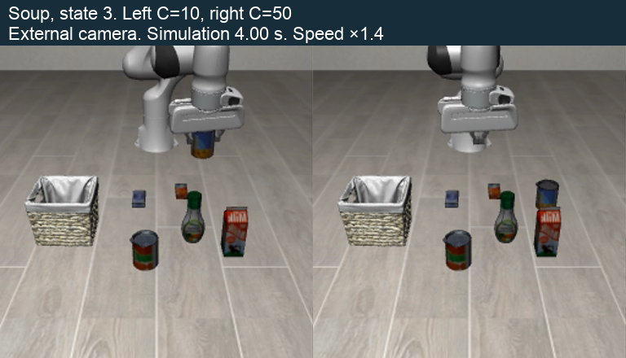
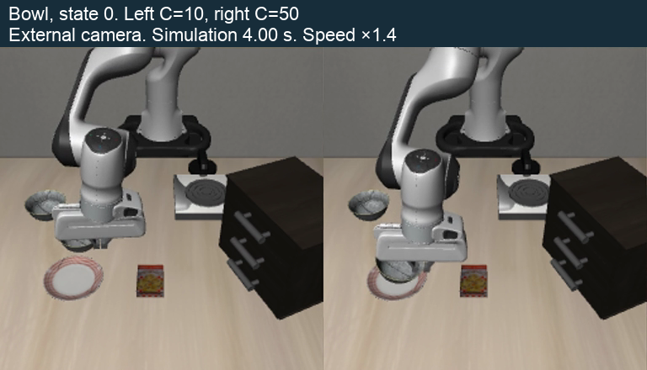
The same cap can produce opposite outcomes
Soup transfer
Bowl placement
C=10 succeeds at step 143
C=50 succeeds at step 81
C=50 moves an empty gripper and fails.
C=10 keeps repositioning and fails.
09
Notes:
Left video: soup state 3, C10 on the left and C50 on the right. C10 succeeds after 143 steps, while C50 transports an empty gripper and reaches the 280-step limit. Right video: bowl state 0, C10 left and C50 right. C50 succeeds after 81 steps while C10 keeps repositioning until the 280-step limit. These examples describe visible behavior. They do not establish a causal mechanism or a universal optimal cap.

Slide 10
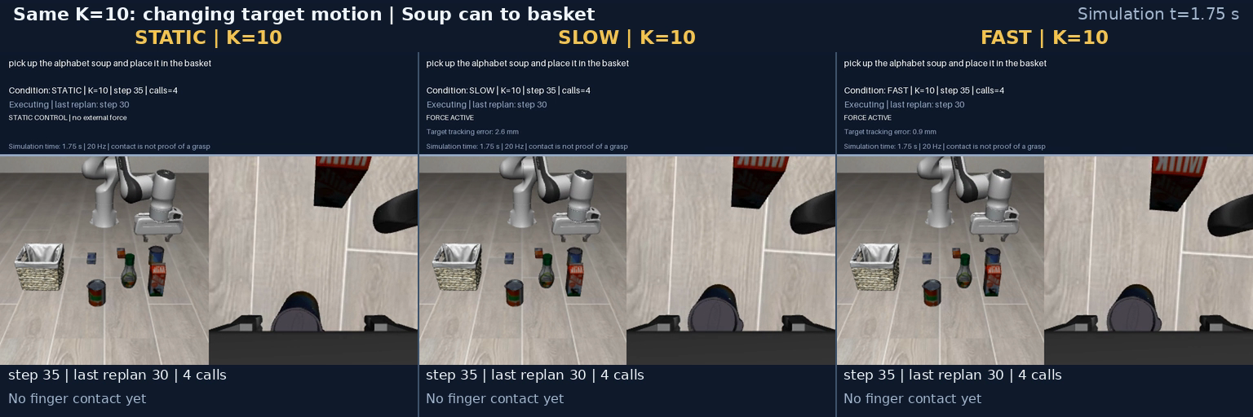
Additional tests: new starts and disturbances
New initial states
Target-force disturbances
48 episodes
135 episodes
Method | Success | Calls
K=5 | 11/12 | 28.2
K=10 | 9/12 | 16.2
K=25 | 6/12 | 8.6
DVAC | 9/12 | 10.2
Condition | K=5 | K=10 | K=50
Static | 12/15 | 13/15 | 6/15
Slow | 8/15 | 13/15 | 5/15
Fast | 13/15 | 15/15 | 6/15
3 tasks, 6 physical settings, 2 policy seeds.
DVAC and K=10 each complete 9/12.
Equal totals do not establish equal reliability.
10
Notes:
These additional cohorts are analyzed separately from the main 270-episode comparison. New-state cohort: three tasks, six physical settings and two policy seeds, twelve episodes per method and 48 total. DVAC and K10 each solve 9/12, but equal totals do not prove equal reliability. Target-force experiment: five states × three seeds × three K values × three conditions =135 episodes. Static/slow/fast are separate force-disturbance conditions. The video shows K10 under all three conditions. These results are not action-dropout results.

Slide 11
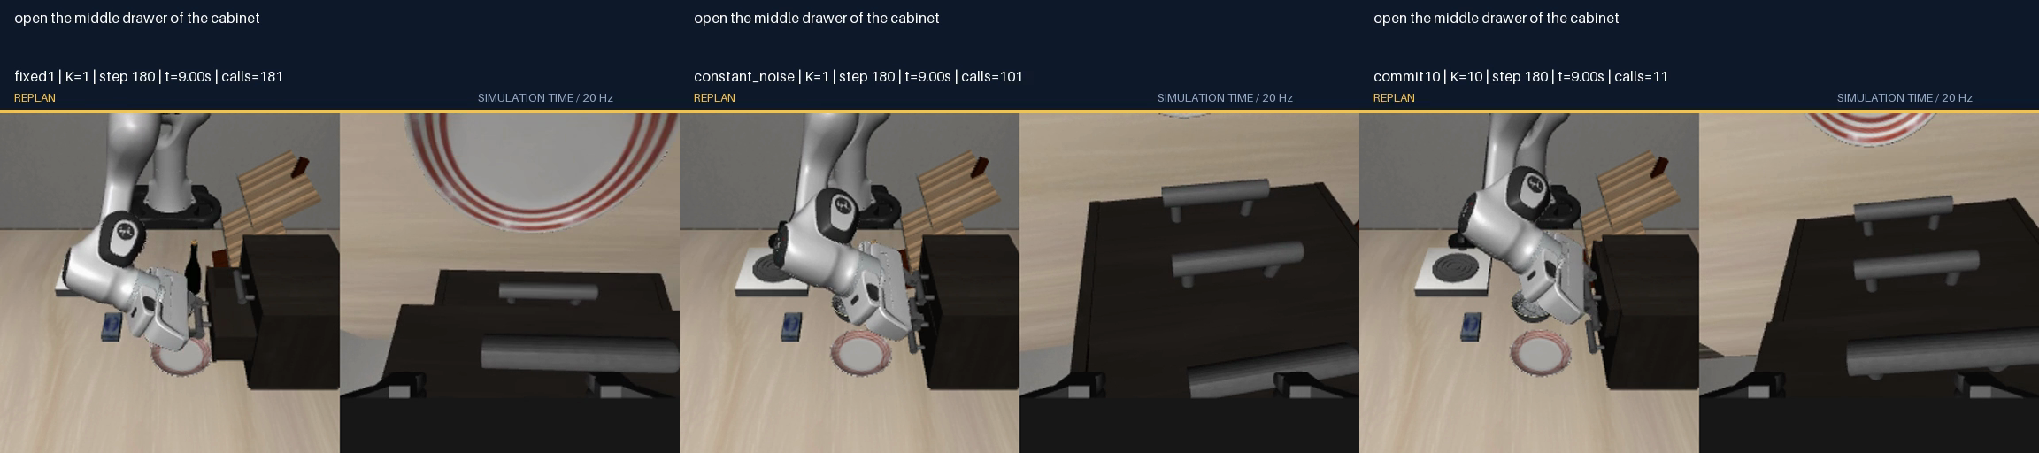
Additional controls did not resolve the failures
Action-based heuristic
Continuation from exactly step 80
K=5 near gripper or direction changes.
Otherwise K=10 while closing, K=25 while opening.
Continuation | Success
Original K=1 | 5/7
Fixed sampling noise | 3/7
Execute 10 actions | 4/7
Cohort | Heuristic | K=10
Primary | 6/12 | 9/12
Replication | 7/12 | 10/12
No improvement in either cohort.
Separate Apple Silicon / MPS evaluation.
Release check: 50/50 successful replays
retain the goal after forced gripper opening.
Neither intervention rescues the two
original K=1 failures.
11
Notes:
This slide reports 122 additional rollouts across the controls shown. The action-based heuristic uses K5 near predicted gripper-sign changes or sharp translation-direction changes, otherwise K10 for a closing gripper and K25 for opening. The heuristic evaluation runs in a separate Apple Silicon/MPS cohort, with 6/12 versus K10 9/12 in the primary evaluation and 7/12 versus 10/12 in replication. Exact continuations branch from saved step-80 simulator and policy state. Original K1 succeeds in5/7, fixed sampling noise3/7, execute10actions4/7. Neither intervention rescues the two original failures. The goal-retention check replays 50 successful episodes and forcibly opens the gripper after policy termination. All50 retain the goal. This is a separate replay cohort, not a guarantee for all main-cohort outcomes.

Slide 12
Random action dropout
What changes
What we compare
At each step, the translation command
is skipped with probability p.
3 tasks × 10 initial states
Same starts for every method
Rotation and gripper commands still run.
Fixed K and adaptive DVAC
p = 0.1, 0.2, 0.3
Task success and model calls
p = 0 provides the reference.
Does higher p make shorter replanning intervals more useful?
12
Notes:
This experiment tests whether unreliable translation commands change the useful replanning interval or the success-versus-call trade-off. At each policy-controlled 20 Hz step, the wrapper applies a Bernoulli dropout mask to the clipped XYZ command only. The 7D action is (translation,rotation,gripper); applied action is ((1-b_t)translation,rotation,gripper). The simulation step still runs. The policy receives no extra failure flag and sees the true state only at its next scheduled observation. Settling steps are unperturbed. A private counter-based disturbance stream depends on matched start,disturbance seed20261025 and control-step index,not method or policy call count. The same uniforms generate nested masks across probabilities. The target is30starts for each of9methods and each probability. The historical p0 reference is the main270-episode RTX2060 cohort. Home collects p0.1 and0.3 for the eight methods excludingK1. Separate Kaggle notebooks collectK1 at0.1/0.3 and all9methods at0.2. Short p0 wrapper checks on Kaggle are not a new30-episode same-GPU baseline. The working hypothesis is conditional,not an established result. Source: configs/action-dropout.json,action_dropout/core.py,action_dropout/config.py,scripts/build_action_dropout_kaggle_bundle.py.

Slide 13
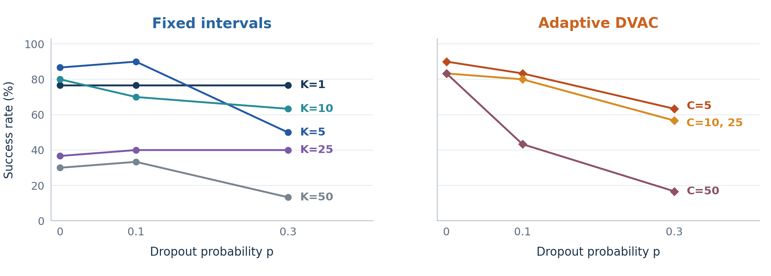
Task success under action dropout
Task success rate for fixed intervals and adaptive DVAC.
Best fixed K: 5 at p=0 and 0.1. At p=0.3: K=1.
Illustrative data
13
Notes:
Illustrative data. This slide uses the current user-supplied JSON summaries, including manually edited values. It was rebuilt without checking experimental logs and should not be interpreted as verified experimental evidence. Sources: input/analysis.json, input/baseline.json and input/k1/k1_results.json in the private build snapshot. Success rate is the supplied successes divided by episodes. Model calls use the supplied mean across all episodes. The shared K=1/C=1 point is one displayed value, not a separate run. p=0.2 has no supplied data.

Slide 14
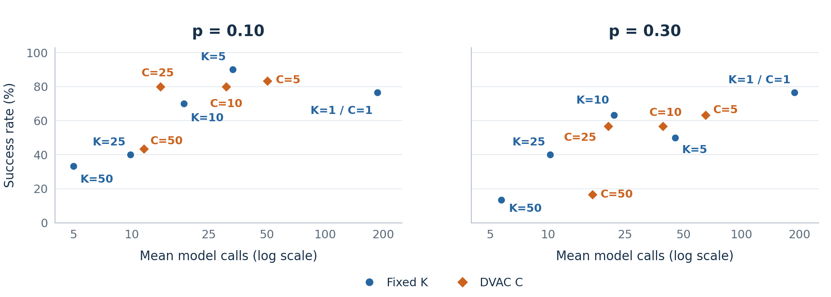
Success and model calls under dropout
Higher success and fewer calls are preferable. Both panels use the same axes.
At p=0.3, K=1 uses 8.6× more calls than K=10 for 4 more successes.
Illustrative data
14
Notes:
Illustrative data. This slide uses the current user-supplied JSON summaries, including manually edited values. It was rebuilt without checking experimental logs and should not be interpreted as verified experimental evidence. Sources: input/analysis.json, input/baseline.json and input/k1/k1_results.json in the private build snapshot. Success rate is the supplied successes divided by episodes. Model calls use the supplied mean across all episodes. The shared K=1/C=1 point is one displayed value, not a separate run. p=0.2 has no supplied data.

Slide 15
OUR ANSWER
The useful interval depends
on execution conditions
Clean execution: K=5 balances success and calls.
26/30 with 31.3 calls, versus 23/30 with 162.0 calls for K=1.
At high dropout, K=1 wins on task success.
At p=0.3: 23/30 with 187.8 calls. K=10: 19/30 with 21.9 calls.
On average, DVAC suffers more from random action dropout.
Success drops 36.7 pp for DVAC versus 16.7 pp for fixed K.
Drop from p=0 to p=0.3, averaged over K/C=5, 10, 25, 50. One policy seed.
15
Notes:
These are descriptive conclusions for the tested configurations. At p=0.3, K=1 has the highest observed task success,23/30, but requires187.8 calls versus K=10 with19/30 and21.9 calls. The claim that DVAC suffers more is an average comparison over the same four limits5,10,25,50, not every individual cap. At p=0, DVAC totals102/120 and fixed K totals70/120. At p=0.3, these totals are58/120 and50/120. Thus the average success-rate loss is36.7 percentage points for DVAC and16.7 for fixed K. C=5 is an exception: its decline is smaller than fixed K=5. The conclusion does not establish a universal optimum or statistical superiority. The original clean-execution result remains K=5:26/30 with31.3 mean calls versus K=1:23/30 with162.0. One policy seed and three tasks were used.

Slide 16
Appendix: main results (p=0)
The same 30 starting settings for all nine execution rules.
Method | Soup /10 | Bowl /10 | Drawer /10 | Total /30 | Mean calls
Fixed K=1 | 6 | 8 | 9 | 23 | 162.0
Fixed K=5 | 9 | 7 | 10 | 26 | 31.3
Fixed K=10 | 10 | 4 | 10 | 24 | 15.5
Fixed K=25 | 6 | 4 | 1 | 11 | 9.6
Fixed K=50 | 3 | 3 | 3 | 9 | 5.1
DVAC C=5 | 10 | 7 | 10 | 27 | 40.2
DVAC C=10 | 10 | 7 | 8 | 25 | 26.4
DVAC C=25 | 10 | 8 | 7 | 25 | 14.1
DVAC C=50 | 9 | 7 | 9 | 25 | 9.5
Task columns show successful episodes out of 10. Total is out of 30.
Calls are means across all episodes, including failures.
16
Notes:
Full main-comparison table reconstructed from outputs/capped-report/episodes.csv, 270 unique episodes across nine rules. Each task contributes the same 10 initial states and policy seed 11. Soup, bowl and drawer counts sum to the Total /30 column. Model calls are arithmetic means across all 30 episodes including failures, rounded to one decimal. The original main success-versus-calls graph is preserved in the main body.

Slide 17
Dropout results: task success
Successful episodes / completed episodes
p = 0.1 and p = 0.3 shown. p = 0.2 pending.
Method | p = 0 | p = 0.10 | p = 0.20 | p = 0.30
Fixed K=1 | 23/30 | 23/30 | — | 23/30
Fixed K=5 | 26/30 | 27/30 | — | 15/30
Fixed K=10 | 24/30 | 21/30 | — | 19/30
Fixed K=25 | 11/30 | 12/30 | — | 12/30
Fixed K=50 | 9/30 | 10/30 | — | 4/30
DVAC C=5 | 27/30 | 25/30 | — | 19/30
DVAC C=10 | 25/30 | 24/30 | — | 17/30
DVAC C=25 | 25/30 | 24/30 | — | 17/30
DVAC C=50 | 25/30 | 13/30 | — | 5/30
— = p=0.2 results pending.
Illustrative data
17
Notes:
Illustrative data. This slide uses the current user-supplied JSON summaries, including manually edited values. It was rebuilt without checking experimental logs and should not be interpreted as verified experimental evidence. Sources: input/analysis.json, input/baseline.json and input/k1/k1_results.json in the private build snapshot. Success rate is the supplied successes divided by episodes. Model calls use the supplied mean across all episodes. The shared K=1/C=1 point is one displayed value, not a separate run. p=0.2 has no supplied data.

Slide 18
Dropout results: model calls
Mean model calls per episode — all completed episodes
p = 0.1 and p = 0.3 shown. p = 0.2 pending.
Method | p = 0 | p = 0.10 | p = 0.20 | p = 0.30
Fixed K=1 | 162.0 | 186.4 | — | 187.8
Fixed K=5 | 31.3 | 33.3 | — | 45.3
Fixed K=10 | 15.5 | 18.6 | — | 21.9
Fixed K=25 | 9.6 | 9.8 | — | 10.2
Fixed K=50 | 5.1 | 5.0 | — | 5.7
DVAC C=5 | 40.2 | 50.2 | — | 65.1
DVAC C=10 | 26.4 | 30.9 | — | 39.1
DVAC C=25 | 14.1 | 14.1 | — | 20.4
DVAC C=50 | 9.5 | 11.5 | — | 16.9
Lower means fewer model calls. Read alongside the task success results.
Illustrative data
18
Notes:
Illustrative data. This slide uses the current user-supplied JSON summaries, including manually edited values. It was rebuilt without checking experimental logs and should not be interpreted as verified experimental evidence. Sources: input/analysis.json, input/baseline.json and input/k1/k1_results.json in the private build snapshot. Success rate is the supplied successes divided by episodes. Model calls use the supplied mean across all episodes. The shared K=1/C=1 point is one displayed value, not a separate run. p=0.2 has no supplied data.

