Slide 1






Team Guru
“A truly diverse team built to empower every TE on the planet to achieve more.”
~ Satya Nadella
Anders (Denmark)
Ori (Israel)
Stijn (Belgium)
Sophie (Greece)
Ryan (Ireland, USA)

Slide 2
Who here has ever faced a difficult problem and needed additional support?
Notes:
A logical next step is to find someone to help… but how?

Slide 3
Have you ever tried to find a TE who has…
come across a similar bug or roadblock?
a certain area of expertise?
worked with a certain customer?
Notes:
Certain customer
Area of expertise
Hit a similar roadblock?
If you’re like me, you might troll Yammer, or hit one of the MANY DX TE aliases – and get that answer.
A few weeks later, you’ll see the same question on the alias or Yammer…

Slide 4

Let us solve this problem for you.
Get Me a Guru
We call him GMaG for short.
Notes:
TO solve this problem, I’ll introduce you to the GET ME A GURU BOT.
We call him GMaG – because we’re Microsoft employees and that’s what we do.

Slide 5














GMaG Bot Architecture
LUIS
Ingest Engagement (w/ LUIS)
Alias, Title, Description, Location, Company, Date, Tech, Resources
GMaG
WebJob
User
Groups
Sync
Query (Dialog)
Tech, Level, Location
DXCRM
Azure Search
DocumentDB
Microsoft Graph
Notes:
You might ask: How to get started.
Either add GMaG to Skype or hit the web interface (additional channels coming soon)
You’d then get to chatting, where you’ll be given two options.
Add an engagement
Where LUIS is used to interpret your command and pull out who you are, what the session was, and when it happened.
You might say, “I'm orzohar, I've been working on iot and Azure in Italy with IBM in a hackfest on January 12th 2001”
This engagement then gets stored in DocumentDB
You can also find a GURU
GMaG will present you with some cards to choose Technology, Level, and the Location
Azure Search is kept in sync with DocumentDB and will return a few people worth contacting
Looking forward we’d like to hookup a WebJob to interface with some common and important data sources for Microsoft
DX Next
LinkedIn
Yammer
Office Groups
DX CRM
Me.microsoft (just in case people start using that service…)
Microsoft Graph – get user credentials/vcard
Important bits: Conversations platform, LUIS - Cognitive services, Azure Search….
AND of course => DEVOPS

Slide 6


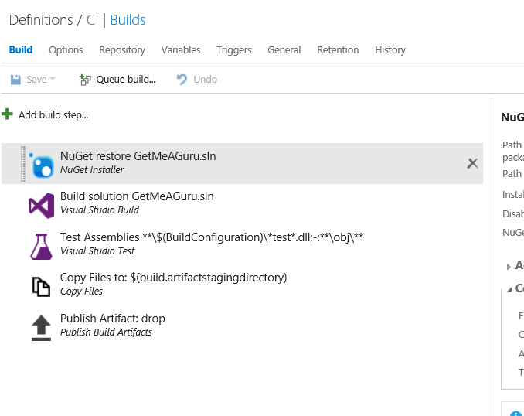
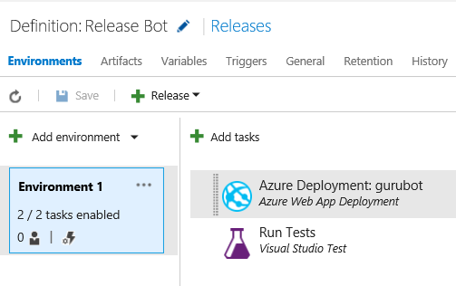

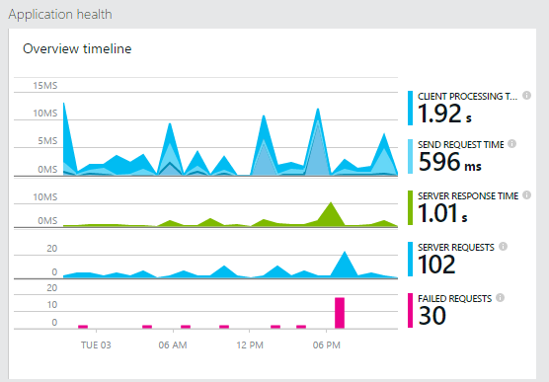

DevOps!!!
Source Control
CI/CD
Build
Release
Monitor
+
ARM Template
(Infrastructure as Code)
Notes:
Our source control is GitHub
We’re doing Continuous Integration and Delivery with Visual Studio Team Services
Build, Release, and Infrastructure as code through an ARM template
Once we deploy – we use Application insights to Monitor everything in action.

Slide 7
Shut up and show me GMaG
http://aka.ms/AddGMaG

