Slide 1

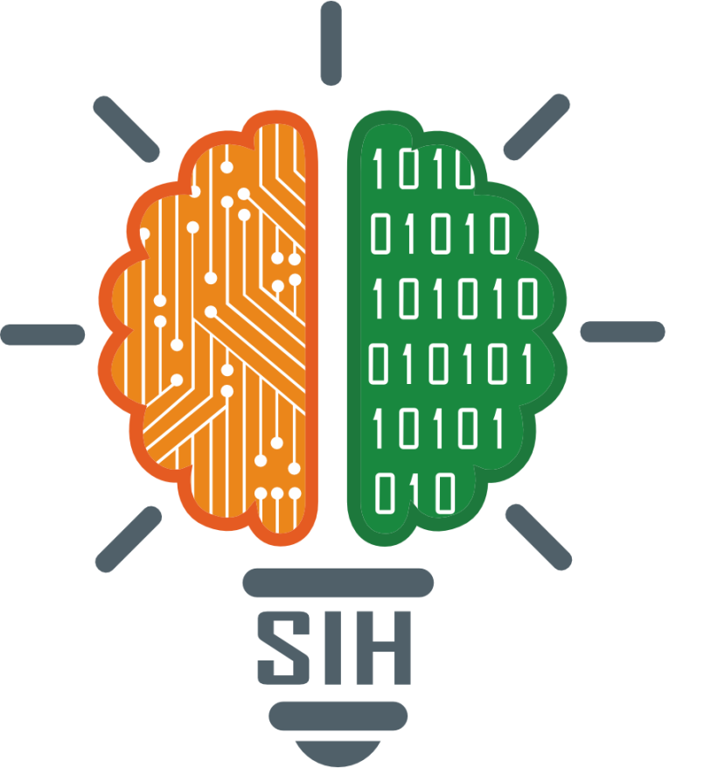
SMART INDIA HACKATHON 2025
GoTrek: A Digital Heritage Platform for Sikkim’s Monasteries
Problem Statement ID – 25061
Problem Statement Title- Digitize and Showcase Monasteries of Sikkim for Tourism and Cultural Preservation
Theme- Travel & Tourism
PS Category- Software
Team ID-
Team Name: GoTrek

Slide 2

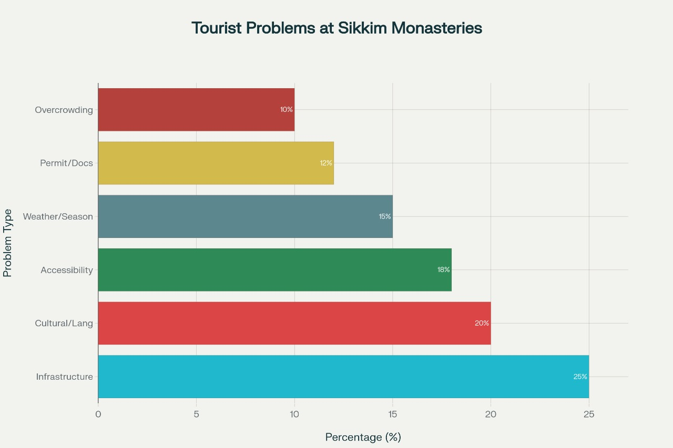
The Untapped Treasure: Problem Overview
Rich Heritage, Limited Access
Sikkim's 200+ historic monasteries are treasures of culture and spirituality, yet remain largely inaccessible to the world.
Fragmented Digital Presence
Existing digital records are scattered and incomplete, failing to provide a unified view of this rich heritage.
A Gap in Tourism
A lack of immersive digital tools limits exploration for tourists and researchers, capping tourism and academic interest.
The Urgent Need
A centralized digital platform is essential to unlock, preserve, and globally showcase Sikkim's monastic legacy.

Slide 3
TECHNICAL APPROACH
Our platform is built on a modern, scalable, and robust technology stack.
Data Acquisition:
Web & Mobile: React/Vue.js for a dynamic web experience; React Native/Flutter for cross-platform mobile apps.
Backend & Database: Node.js/Python backend with a PostgreSQL/MongoDB database to manage data efficiently.
AI-Powered Search: Computer Vision and NLP models for intelligent search and tagging within the digital archives.
Immersive Experience:
Web-based 360° viewers with potential for future VR/AR integration.
Cloud Infrastructure: Deployed on AWS/Azure for scalability, reliability, and global content delivery.
High-fidelity 360° cameras, drones, and high-resolution scanners to capture visuals and digitize artifacts.

Slide 4
TECHNICAL APPROACH
Solutions:
Interactive Discovery Map:
Living Digital Archives:
Smart Audio Guide App:
Cultural Events Calendar:
Virtual tours:
Explore geo-tagged monastery locations, plan travel routes, and find nearby attractions, with direct links to local tourism services.
A rich, searchable repository of high-resolution manuscripts, murals, and historical artifacts, powered by AI for intelligent categorization.
A dynamic schedule of monastery festivals, events, and rituals, offering tourists booking and participation options.
Step inside with stunning 360° panoramic views and guided, narrated walkthroughs available in multiple languages.
An intuitive mobile app providing location-aware audio commentary via GPS or Bluetooth beacons, complete with an offline mode for remote locations.

Slide 5
FEASIBILITY AND VIABILITY
Technological Feasibility:
Utilizes mature, well-documented, and proven technologies successfully implemented in similar projects.
Operational Feasibility:
We will partner with local authorities, monastery administrations, and community members for data collection.
Challenges & Stratergies
Remote Locations: Deploy mobile, self-sufficient digitization teams with offline data capture equipment.
Cultural Sensitivity: Work under the direct guidance of monastic bodies to ensure all content is respectful and accurate.
Data Volume & Cost: Phased rollout, starting with major monasteries; seek grants and partnerships with cultural and tourism bodies.

Slide 6
IMPACT AND BENEFITS
Monastery360 will create a lasting, positive impact across multiple fronts.
Our vision is to build a bridge between Sikkim's ancient wisdom and the digital future, fostering global appreciation and ensuring this priceless heritage thrives.
Impact
Preserve Cultural Heritage:
Empower Local Communities:
Support Global Education:
Boost Tourism:
Provide a rich, interactive resource for researchers, students, and spiritual seekers worldwide.
Foster ownership and create new economic opportunities through tourism integration.
Create a permanent digital archive, safeguarding cultural assets for future generations.
Drive economic growth by creating a more accessible and engaging destination for global travelers.

