Slide 1
R-wave detection SRS Presentation
Junwei Lin
Electrical and Computer Engineering MEng student
January 28, 2025

Slide 2

Introduction
R-wave detection is an important task in ECG signal processing
heart rate calculation
arrhythmia analysis
heart disease diagnosis
Electric shock?
Digital signal
Analog signal
1/10

Slide 3
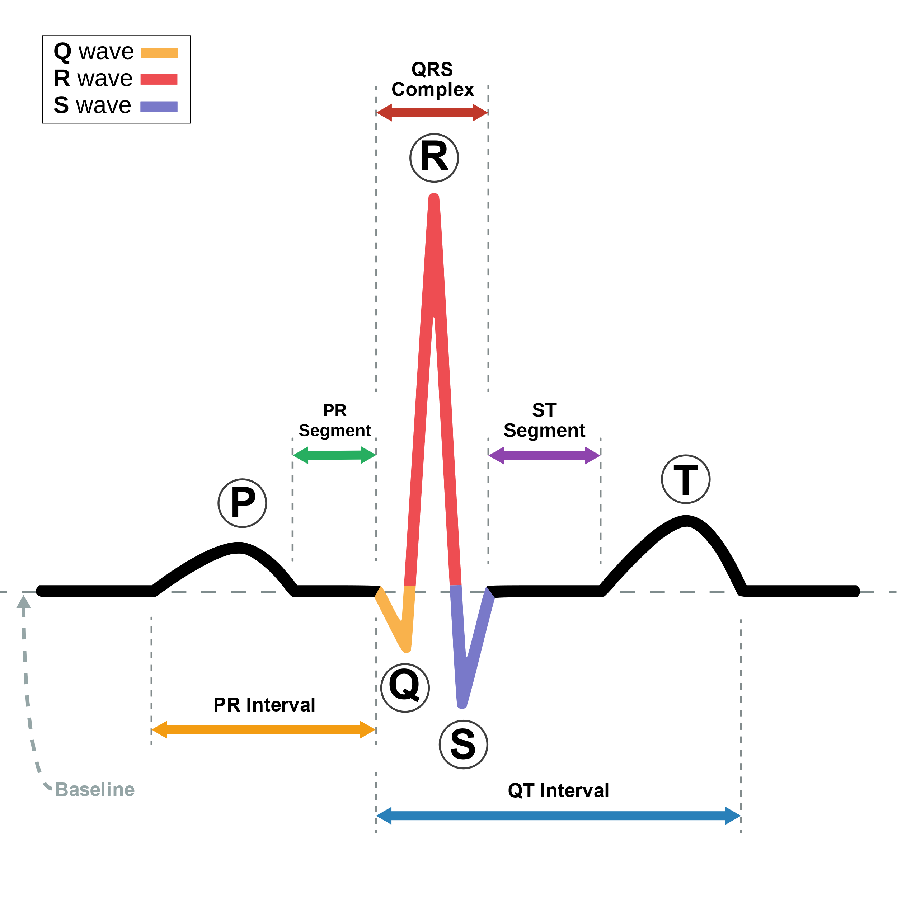
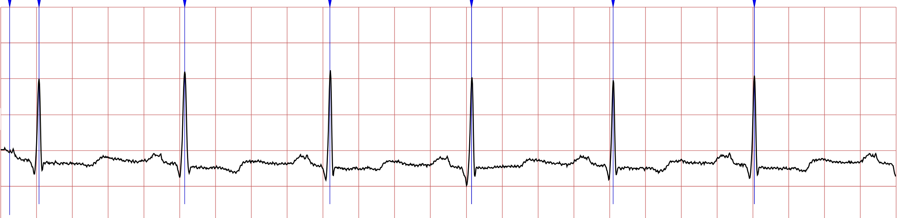
Introduction
Real ECG wave from MIT-BIH
normal sinus rhythm ECG wave
2/10

Slide 4
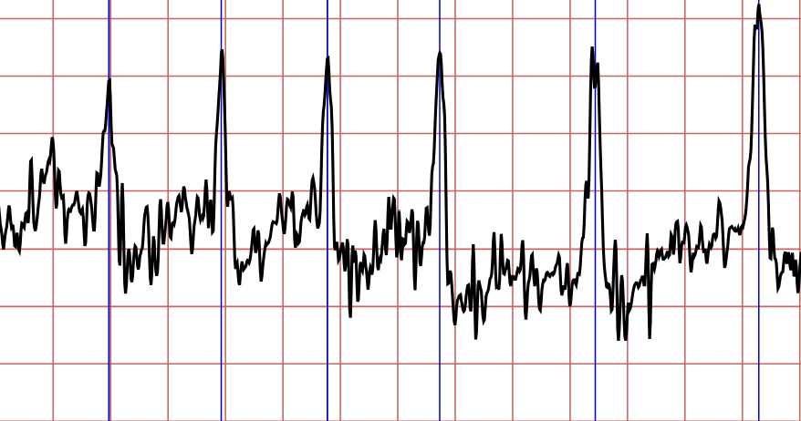
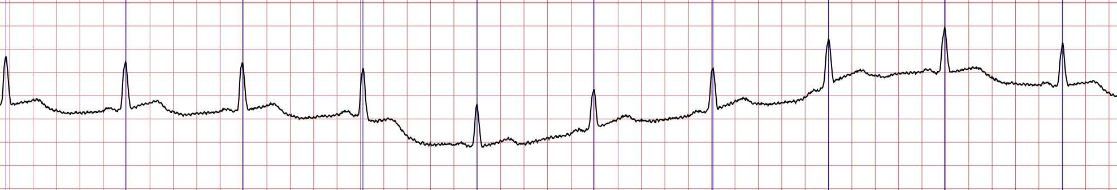
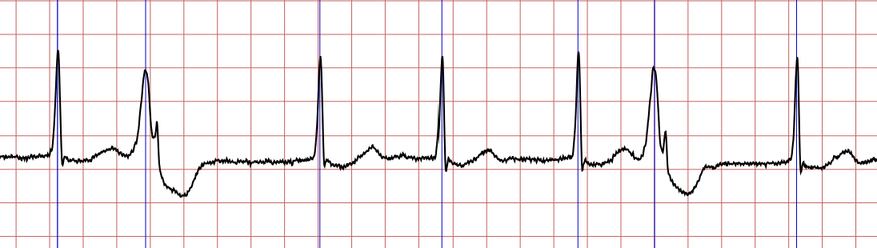
Challenge
Noise
Baseline shift
Premature ventricular contractions
3/10

Slide 5
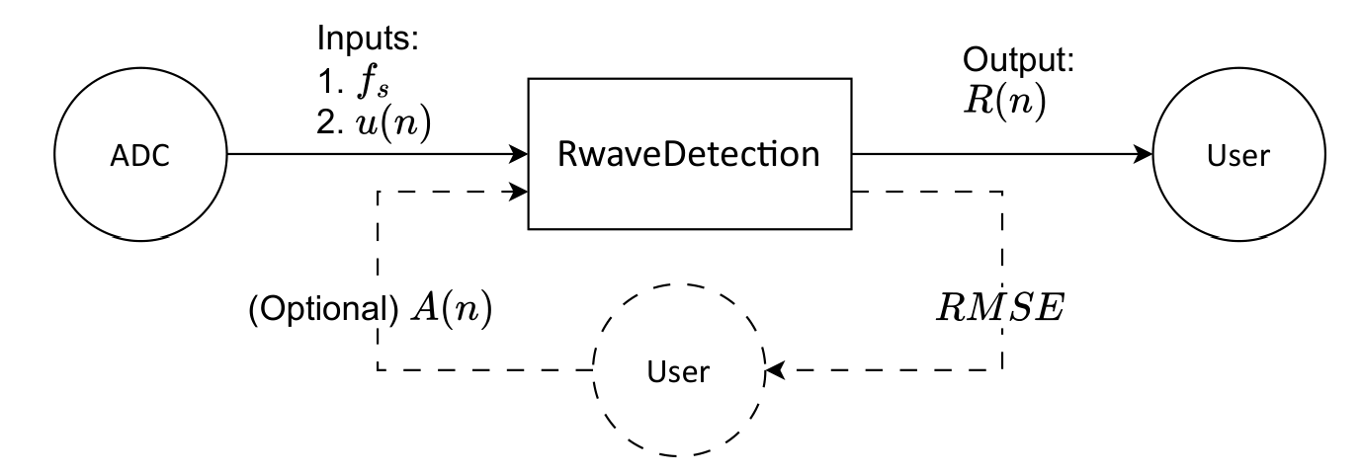
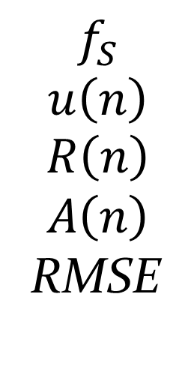
General System Description
$$f_{S}$$
$$u\left(n\right)$$
$$R\left(n\right)$$
$$A\left(n\right)$$
RMSE
sampling frequency
Discrete-time ECG signal
Index of the calculated n-th R wave
Index of the annotated n-th R wave
Root Mean Square Error
4/10

Slide 6
Goals Statement
Goal ID | Goal description
G1 | Develop an efficient algorithm that can accurately detect R waves in ECG signals
G2 | Automatically derive filter-related parameters in the G1 algorithm
5/10

Slide 7
Assumptions
Assumption ID | Assumption description
A1 | The sampling frequency is not lower than the Nyquist frequency
A2 | The R-wave has peak characteristics that can be discerned by the naked eye.
A3 | The input ECG signal is of high quality and has no defects.
A4 | Noise in data can be filtered out, within expectations
6/10

Slide 8
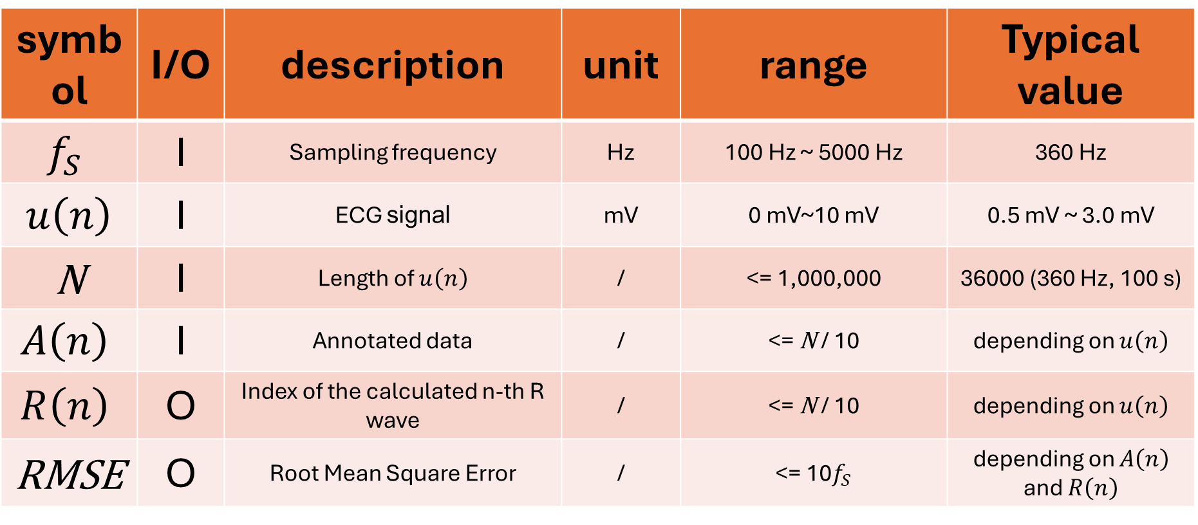
Inputs and Outputs variables
symbol | I/O | description | unit | range | Typical value
$$f_{S}$$ | I | Sampling frequency | Hz | 100 Hz ~ 5000 Hz | 360 Hz
$u\left(n\right)$ | I | ECG signal | mV | 0 mV~10 mV | 0.5 mV ~ 3.0 mV
N | I | Length of $u\left(n\right)$ | / | <= 1,000,000 | 36000 (360 Hz, 100 s)
$$A\left(n\right)$$ | I | Annotated data | / | <= N / 10 | depending on $u\left(n\right)$
$$R\left(n\right)$$ | O | Index of the calculated n-th R wave | / | <= N / 10 | depending on $u\left(n\right)$
RMSE | O | Root Mean Square Error | / | <= 10$f_{S}$ | depending on $A\left(n\right)$ and $R\left(n\right)$
7/10

Slide 9
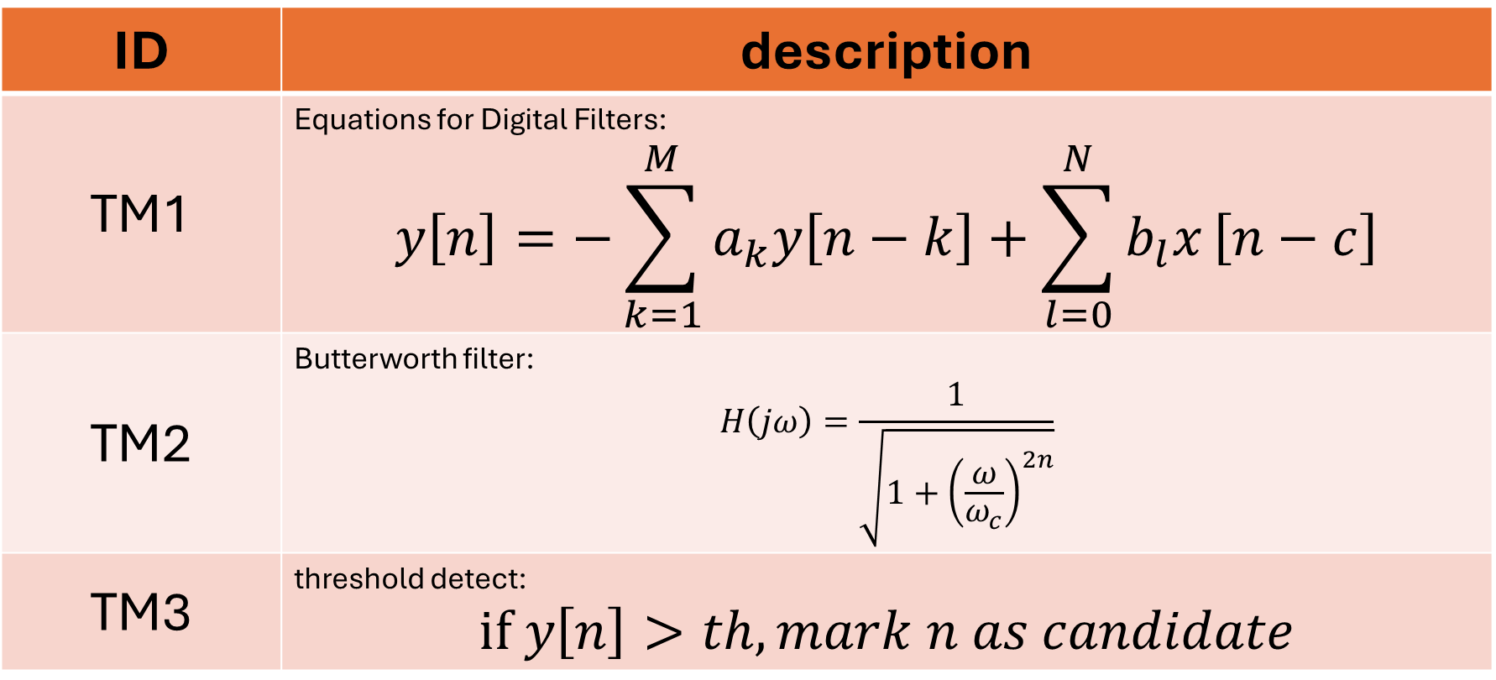
Theoretical Models
ID | description
TM1 | Equations for Digital Filters: $$y\left[n\right]=−\sum_{k=1}^{M}{a_{k}y\left[n−k\right]}+\sum_{l=0}^{N}{b_{l}x}\left[n−c\right]$$
TM2 | Butterworth filter: $$H\left(jω\right)=\frac{1}{\sqrt{1+{\left(\frac{ω}{ω_{c}}\right)}^{2n}}}$$
TM3 | threshold detect: $$if y\left[n\right]>th, mark n as candidate$$
8/10

Slide 10
Instanced Models
ID | description
IM1 | 11Hz Low-pass filter for removing utility frequency and noise, Ref. TM1, TM2
IM2 | 5Hz High-pass filter for removing baseline shift, Ref. TM1, TM2
IM3 | Moving window, Ref. TM1
IM4 | R-wave detect in filtered signal by flexible threshold, Ref. TM3
8/10

Slide 11
Requirements (Not complete)
Req ID | Requirement description
R1 | Implement basic low-pass and high-pass filters using difference equations
R2 | Implement parameter derivation of widely used filters, including Butterworth, Chebyshev
R3 | Implement mathematical functions including squaring, thresholding
R4 | Combine mathematical functions and filters to calculate R-wave position
R5 | User-friendly input and output formats, and echoing the inputs as part of the output
NFR1 | Write cross-platform and portable code
NFR2 | Code needs to pass static analysis
9/10

Slide 12
Thank you for listening. Any questions?
10/10

