Slide 1
R-wave detection VnV Presentation
Junwei Lin
Electrical and Computer Engineering MEng student
February 14, 2025

Slide 2
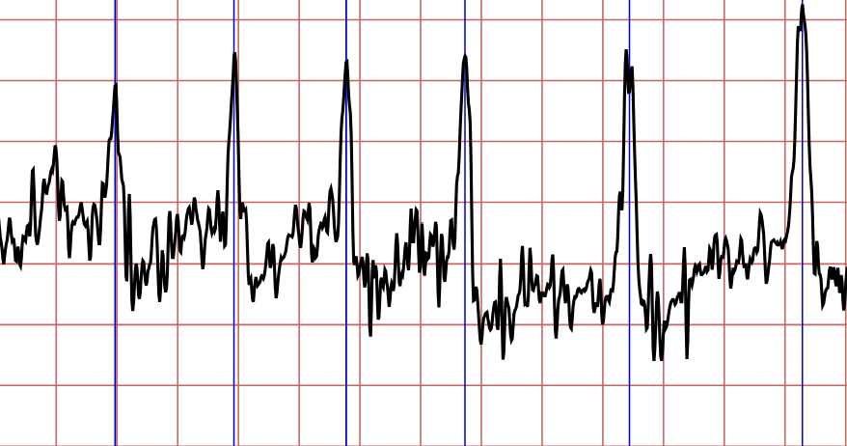
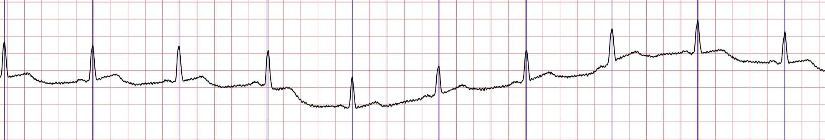
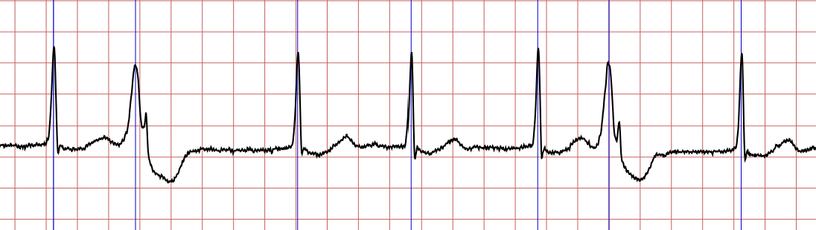
Reintroduction
GS1: Given a single-channel unfiltered ECG signal, find the index of each R-wave peak.
GS2: Given correct annotated data, calculate the RMSE between each detected R-wave peak time and annotated time.
1/12

Slide 3
Objectives
In scope:
Correctness: build confidence in the software correctness
Robustness: test robustness against noisy ECG signals
Out of scope:
Usability: The project does not include user experience testing for a graphical interface or integration into medical workflow systems.
Clinical Validation: The algorithm will be evaluated using publicly available datasets but will not undergo clinical trials.
2/12

Slide 4
SRS Verification Plan
Checklist:
Completeness: Included GS, A, GD, DD, TM, IM, etc.
Formatting: The document has a clear, logical structure, and properly organized.
Verifiability: Each requirement is testable with a clear pass/fail standard.
Traceability: Each requirement is linked to an IM
3/12

Slide 5
Design Verification Plan
Checklist:
Low module coupling: modules can be reused anywhere and do not affect others.
Good Hierarchy: make sure the hierarchy is clear and easy to maintain.
4/12

Slide 6
Verification and Validation Plan Verification Plan
Checklist:
Completeness : VnV plan includes all necessary sections.
Formatting: The document has a clear, logical structure, and properly organized.
Appropriateness: Confirm that the methods and tools proposed in the VnV plan are appropriate for the project.
Coverage: Make sure the VnV plan covers all the requirements.
5/12

Slide 7
Implementation Verification Plan
Checklist:
Static code check
Code coverage test
Unit test
Code review
6/12

Slide 8
Automated testing and verification tools
Static code checker: cpplint
Check for array out-of-bounds errors
Check for memory leaks
Check for coding style
Unit test: gTest
Run test cases automatically
Local code quality control: git pre-commit
Check code quality when commit, before pushing
cpplint and gTest can be invoked
Continuous integration: GitHub Actions
Automatically run tests and verifications triggered by PRs or Pushes
cpplint and gTest can be invoked
Doxygen docker action
7/12

Slide 9
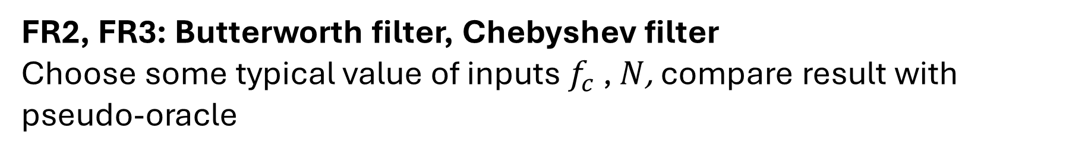
Software Validation Plan - Tests for FR
Use scipy.signal as pseudo-oracle
FR1: Basic IIR and FIR Filters
Test with some randomly generated filter parameters and input data with gaussian noise, compare result with pseudo-oracle
FR2, FR3: Butterworth filter, Chebyshev filter
Choose some typical value of inputs $f_{c}$ , $N$, compare result with pseudo-oracle
8/12

Slide 10
Software Validation Plan - Tests for FR
FRs related to mathematical functions
Test data comes from both manually selected and automatically generated.
FR4: squaring function
Sample input: [1.2, -2.1, -1.0, 2.0, 3.0]
Sample output: [1.44, 4.2, 1.0, 4.0, 9.0]
FR5: thresholding function
Sample input: [1.44, 4.2, 1.0, 4.0, 9.0], dynamic threshold = [3.7, 3.8, 3.9, 3.6, 3.2]
Sample output: [0, 4.2, 0, 4.0, 9.0]
FR6: RMSE calculating function
Input A = [100, 200, 300, 400, 500] B = [99, 203, 300, 398, 501]
Sample output: RMSE = 1.732
Use a threshold to check the equality of output real number
9/12

Slide 11
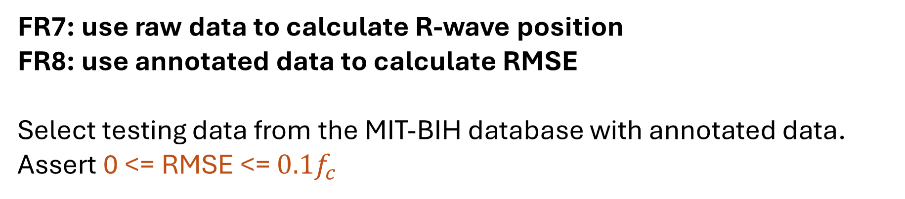
Software Validation Plan - Tests for FR
FRs combine FR1 to FR6, use the same test case
FR7: use raw data to calculate R-wave position
FR8: use annotated data to calculate RMSE
Select testing data from the MIT-BIH database with annotated data.
Assert 0 <= RMSE <= ${0.1f}_{c}$
10/12

Slide 12
Software Validation Plan - Tests for NFR
NFR1: Usability
Verify that external tool (Doxygen) successfully generates a structured and readable user manual.
NFR2: Maintainability
Ensure that all modules are covered by tests.
NFR3: Portability
Confirm that the software builds and runs correctly on both Linux and Windows without modifications.
NFR4: Reusability
Check that the code is modular, and check if modules are used in different contexts.
11/12

Slide 13
Unit Test
Units:
Data loader
Input preprocessing
Filter
Mathematical function
Post processing
Module interfaces
12/12

Slide 14
Thank you for listening. Any questions?

