Slide 1
R-wave detection VnV Presentation
Junwei Lin
Electrical and Computer Engineering MEng student
February 14, 2025

Slide 2
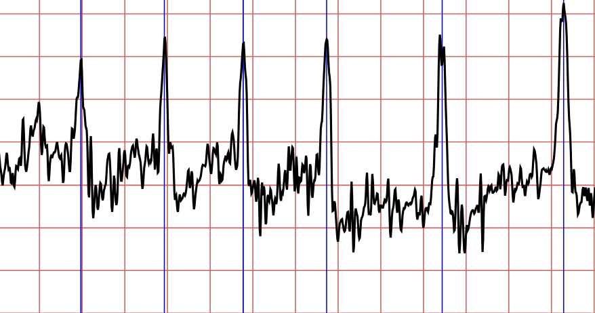
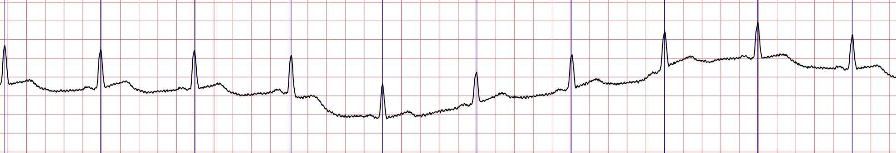
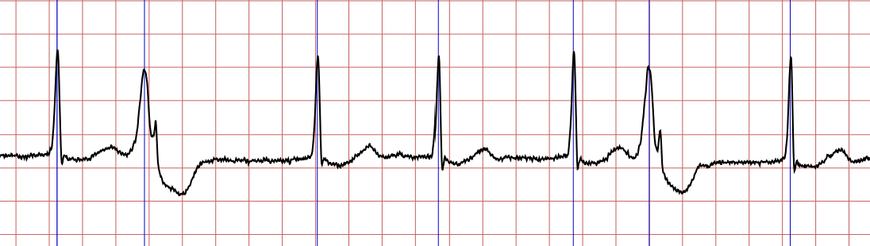
Reintroduction
GS1: Given a single-channel unfiltered ECG signal, find the index of each R-wave peak.
GS2: Given correct annotated data, calculate the RMSE between each detected R-wave peak time and annotated time.
1/10

Slide 3
Objectives
1/10

Slide 4
SRS Verification Plan
1/10

Slide 5
Design Verification Plan
1/10

Slide 6
Verification and Validation Plan Verification Plan
1/10

Slide 7
Implementation Verification Plan
1/10

Slide 8
Automated testing and verification tools
Static code checker: cpplint
Check for array out-of-bounds errors
Check for memory leaks
Check for coding style
Unit test: gTest
Run test cases automatically
Local code quality control: git pre-commit
Check code quality when commit, before pushing
cpplint and gTest can be invoked
Continuous integration: GitHub Actions
Automatically run tests and verifications triggered by PRs or Pushes
cpplint and gTest can be invoked
Doxygen docker action
1/10

Slide 9
Software Validation Plan - Tests for FR
1/10

Slide 10
Software Validation Plan - Tests for NFR
1/10

Slide 11
Unit Test
1/10

Slide 12
Thank you for listening. Any questions?

