Slide 1
R-wave detection Implementation Presentation
Junwei Lin
Electrical and Computer Engineering MEng student
April 1, 2025

Slide 2
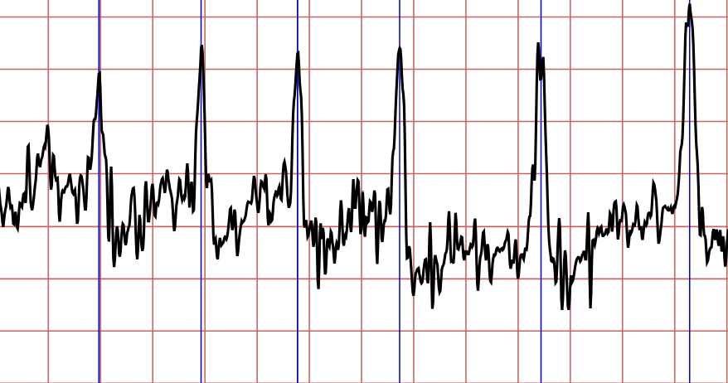
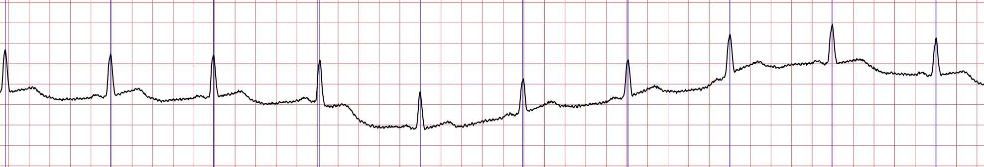
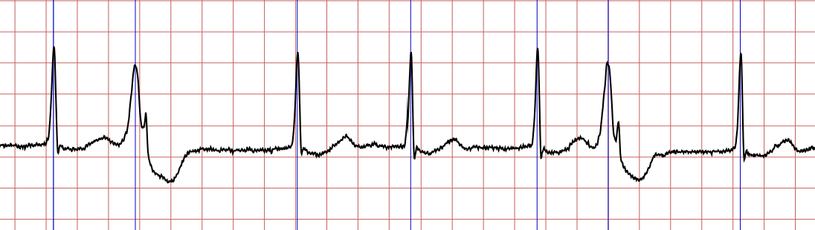
Reintroduction
Given a single-channel unfiltered ECG signal, find the index of each R-wave peak.
1/5

Slide 3
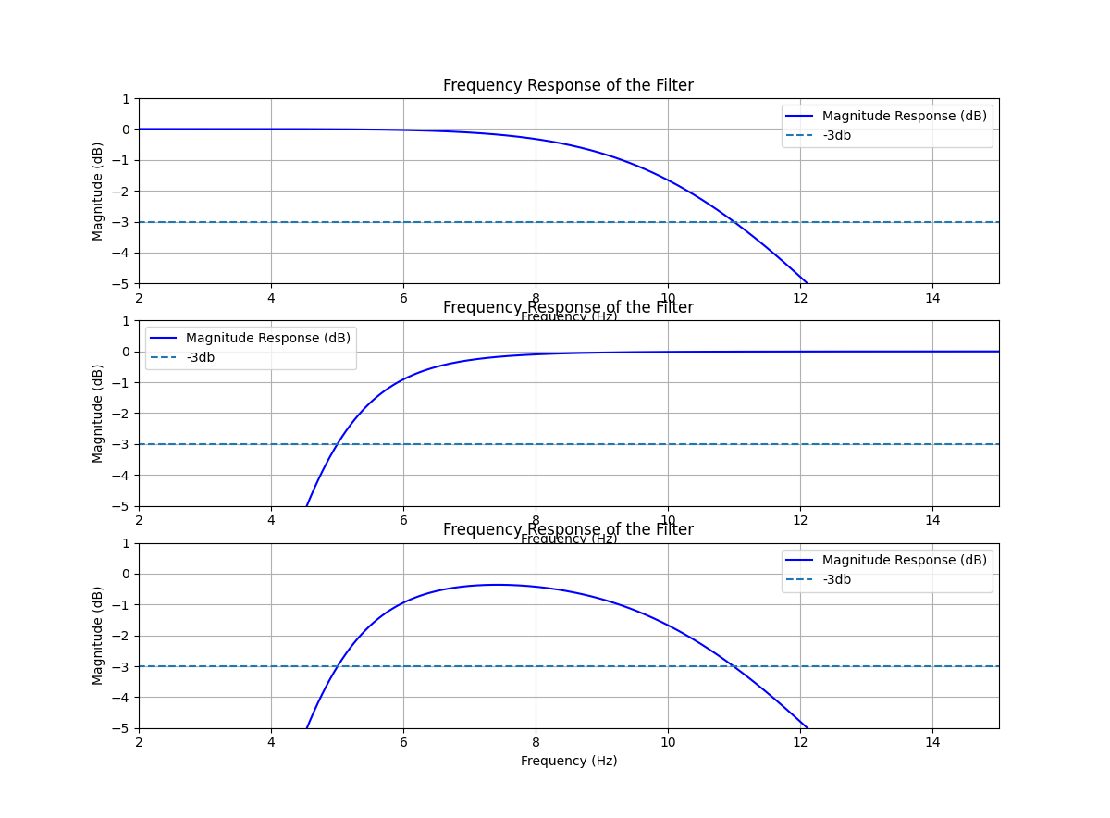
Filter frequency response
LPF
HPF
Band pass
2/5

Slide 4
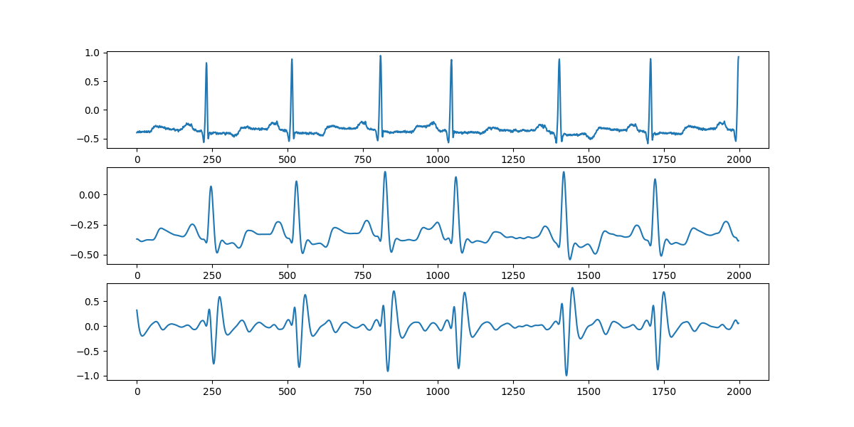
Step 1
Raw input
LPF
HPF
3/5

Slide 5
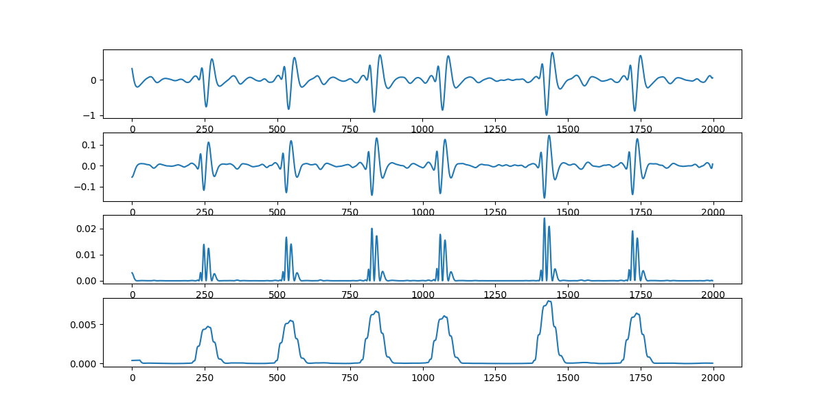
Step 2
from Step 1
Derivative
Square
Window
4/5

Slide 6
Technology overview
Already added:
Cmake/Ninja
Docker
Cpplint
Cppcheck
Google Test
Pre-commit
Can be triggered by bash scripts
Will be added:
Github action CI
Doxygen
Coverage test tool
Use bash script to trigger
5/5

Slide 7
Code walkthrough

