Slide 1
R-wave detection VnV Presentation
Junwei Lin
Electrical and Computer Engineering MEng student
February 14, 2025

Slide 2
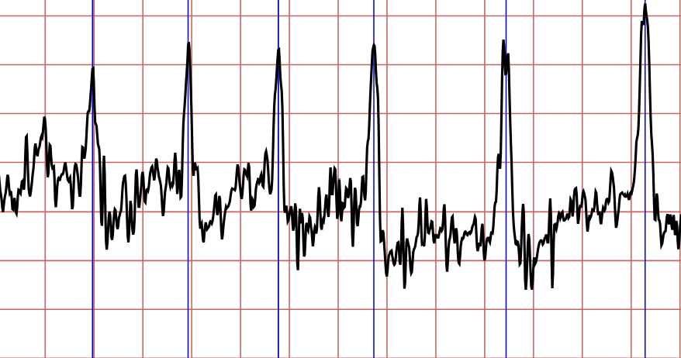
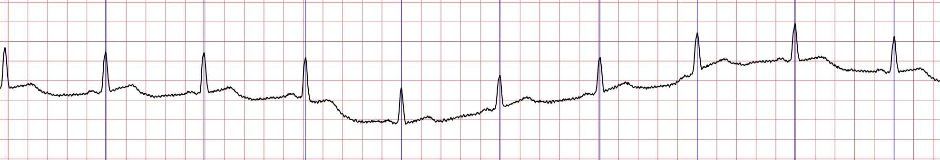
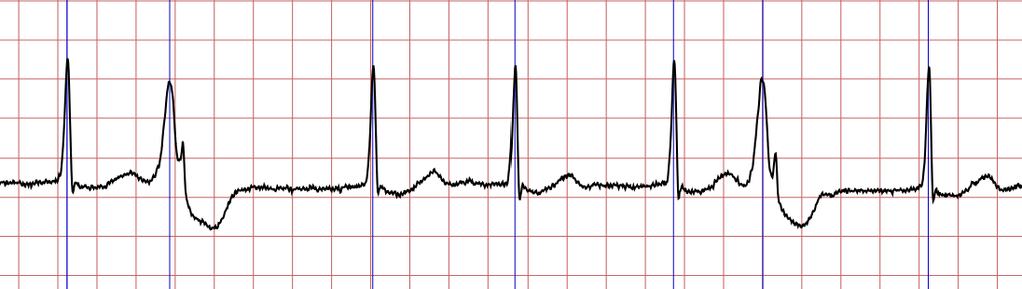
Quick Reintroduction
GS1: Given a single-channel unfiltered ECG signal, find the index of each R-wave peak.
GS2: Given correct annotated data, calculate the RMSE between each detected R-wave peak time and annotated time.
1/10

Slide 3
Thank you for listening. Any questions?

