Slide 1
Chapter 2
Basic Linear Algebra
to accompany
Operations Research: Applications and Algorithms
4th edition
by Wayne L. Winston
Copyright (c) 2004 Brooks/Cole, a division of Thomson Learning, Inc.

Slide 2
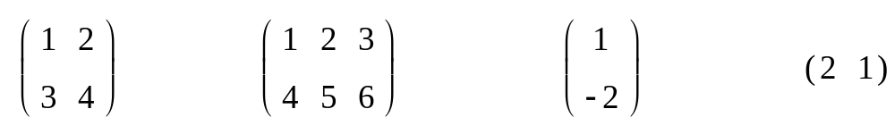
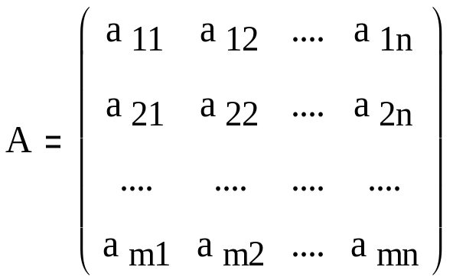
2.1 - Matrices and Vectors
A matrix is any rectangular array of numbers
If a matrix A has m rows and n columns it is referred to as an m x n matrix.
m x n is the order of the matrix. It is typically written as

Slide 3
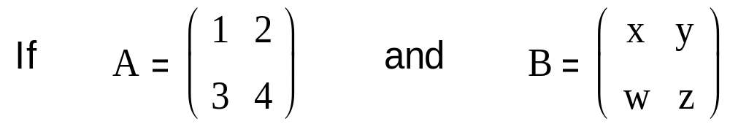
The number in the ith row and jth column of A is called the ijth element of A and is written a_{ij}.
Two matrices A = [a_{ij}] and B = [b_{ij}] are equal if and only if A and B are the same order and for all i and j, a_{ij} = b_{ij}.
A = B if and only if x = 1, y = 2, w = 3, and z = 4

Slide 4

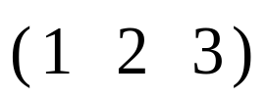
Any matrix with only one column is a column vector. The number of rows in a column vector is the dimension of the column vector.
R^{m} will denote the set all m-dimensional column vectors
Any matrix with only one row (a 1 x n matrix) is a row vector. The dimension of a row vector is the number of columns.

Slide 5
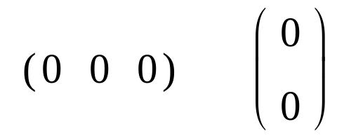
Any m-dimensional vector (either row or column) in which all the elements equal zero is called a zero vector (written 0).
Any m-dimensional vector corresponds to a directed line segment in the m-dimensional plane.
  For example, the two-dimensional vector u corresponds to the line segment joining the point (0,0) to the point (1,2)

Slide 6
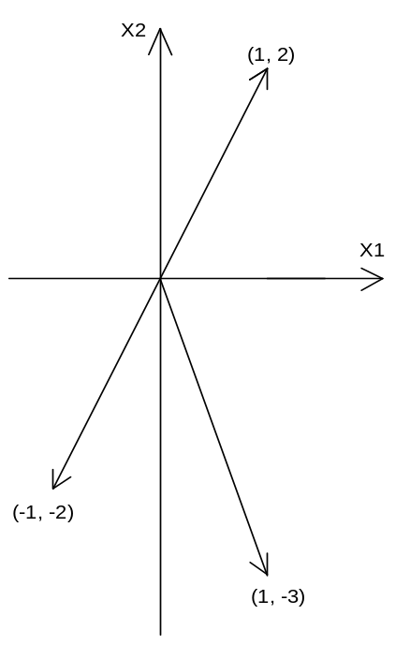
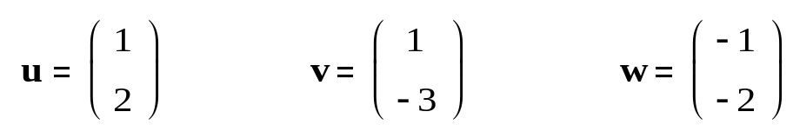
The directed line segments (vectors u, v, w) are shown.

Slide 7
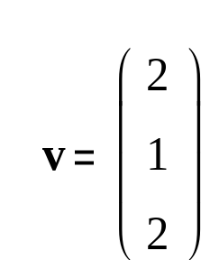


The scalar product is the result of multiplying two vectors where one vector is a column vector and the other is a row vector.
  For the scalar product to be defined, the dimensions of both vectors must be the same.
The scalar product of u and v is written:

Slide 8
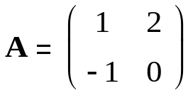
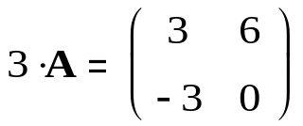
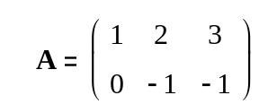
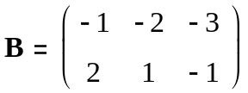
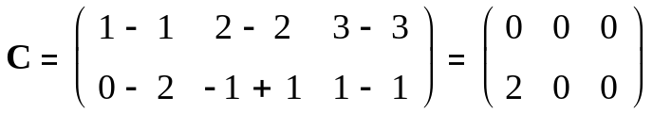
The Scalar Multiple of a Matrix
  Given any matrix A and any number c, the matrix cA is obtained from the matrix A by multiplying each element of A by c.
Addition of Two Matrices
  Let A = [a_{ij}] and B =[b_{ij}] be two matrixes with the same order. Then the matrix C = A + B is defined to be the m x n matrix whose ijth element is a_{ij} + b_{ij}.
  Thus, to obtain the sum of two matrixes A and B, we add the corresponding elements of A and B.

Slide 9

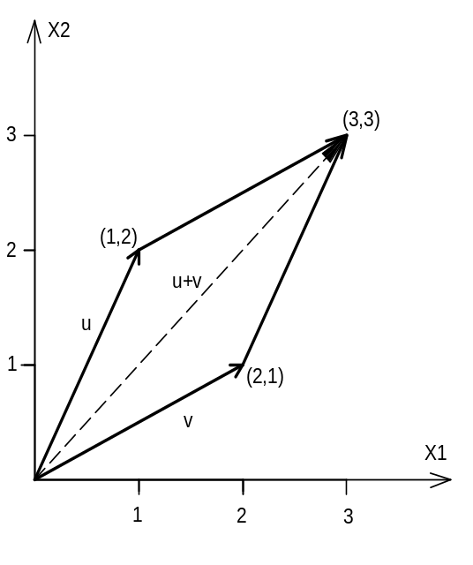


This rule for matrix addition may be used to add vectors of the same dimension.
Vectors may be added using the parallelogram law or by using matrix addition.

Slide 10
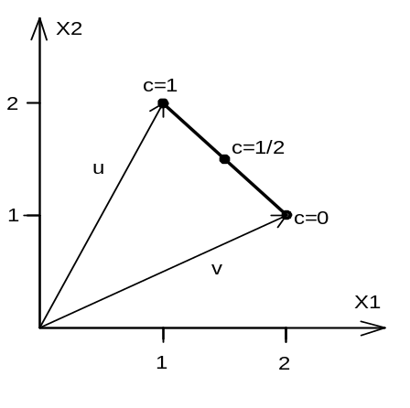
Line segments can be defined using scalar multiplication and the addition of matrices.
  If u=(1,2) and v=(2,1), the line segment joining u and v (called uv) is the set of all points in the m-dimensional plane corresponding to the vectors
  cu +(1-c)v, where 0 ≤ c ≤ 1.

Slide 11
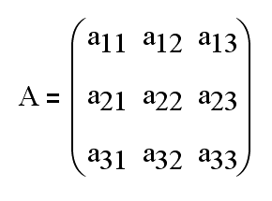
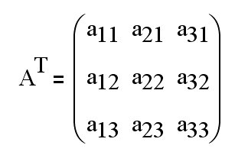
The Transpose of a Matrix
  Given any m x n matrix the transpose of A (written A^{T}) is the n x m matrix.
For any matrix A, (A^{T})^{T}=A.

Slide 12
Matrix Multiplication
  Given to matrices A and B, the matrix product of A and B (written AB) is defined if and only if the number of columns in A = the number of rows in B.
The matrix product C = AB of A and B is the m x n matrix C whose ijth element is determined as follows:
  ijth element of C = scalar product of row i of A x column j of B

Slide 13
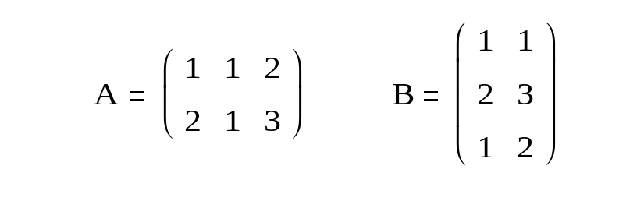
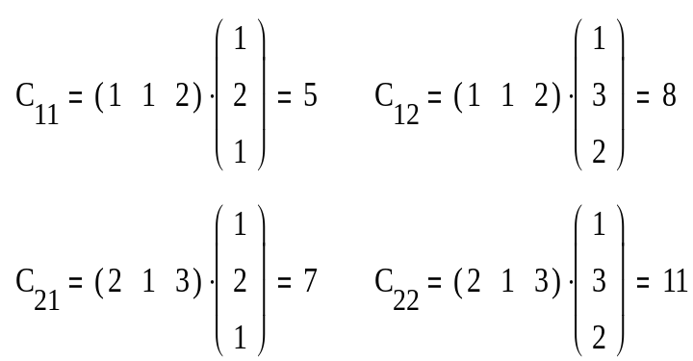
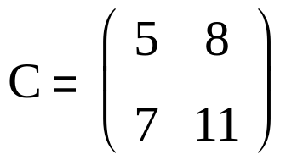
Example 1: Matrix Multiplication
Computer C = AB for
Solution
Because A is a 2x3 matrix and B is a 3x2 matrix, AB is defined, and C will be a 2x2 matrix.

Slide 14
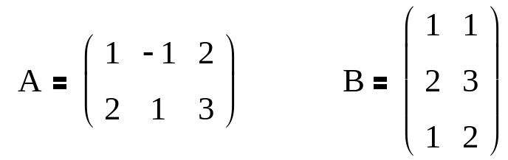
Many computations that commonly occur in operations research can be concisely expressed by using matrix multiplication.
Some important properties of matrix multiplications are:
  Row i of AB = (row i of A)B
  Column j of AB = A(column j of B)

Slide 15
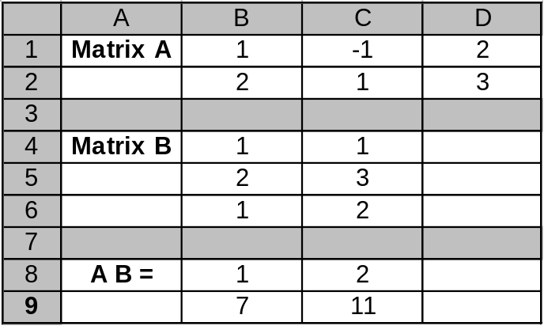
Use the EXCEL MMULT function to multiply the matrices:
  Enter matrix A into cells B1:D2 and matrix B into cells B4:C6.
  Select the output range (B8:C9) into which the product will be computed.
  In the upper left-hand corner (B8) of this selected output range type the formula:
  = MMULT(B1:D2,B4:C6).
  Press Control-Shift-Enter

Slide 16
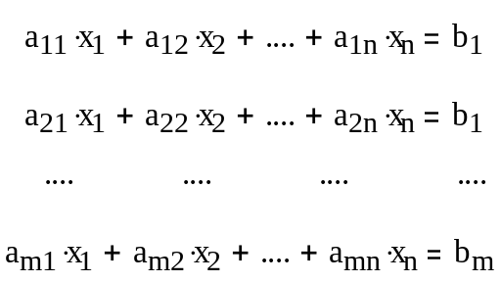
2.2 Matrices and Systems of Linear Equations
Consider a system of linear equations.
  The variables, or unknowns, are referred to as x₁, x₂, …, x_{n} while the a_{ij}’s and b_{j}’s are constants.
  A set of such equations is called a linear system of m equations in n variables.
A solution to a linear set of m equations in n unknowns is a set of values for the unknowns that satisfies each of the system’s m equations.

Slide 17
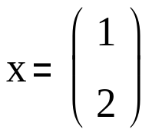


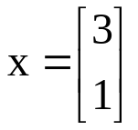
Example 5: Solution to Linear System
Show that
a solution to the linear system
and that
is not a solution to the linear system.

Slide 18
Example 5 Solution
To show that
is a solution, x₁=1 and x₂=2 must be substituted in both equations. The equations must be satisfied.
The vector
is not a solution, because x₁=3 and x₂=1 fail to satisfy 2x₁-x₂=0

Slide 19
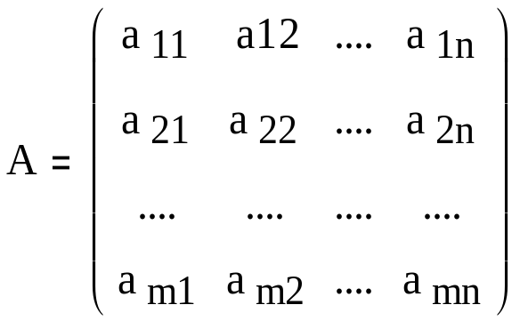
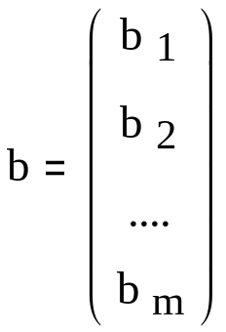
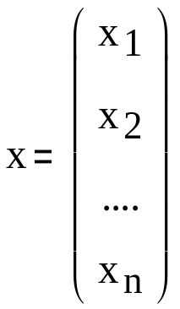
Matrices can simplify and compactly represent a system of linear equations.
This system of linear equations may be written as Ax=b and is called it’s matrix representation.
This will sometimes be abbreviated A|b.

Slide 20
2.3 – The Gauss-Jordan Method
Using the Gauss-Jordan method, it can be shown that any system of linear equations must satisfy one of the following three cases:
  Case 1 The system has no solution.
  Case 2 The system has a unique solution.
  Case 3 The system has an infinite number of solutions.
The Gauss-Jordan method is important because many of the manipulations used in this method are used when solving linear programming problems by the simplex algorithm.

Slide 21
Elementary row operations (ERO) transforms a given matrix A into a new matrix A’ via one of the following operations:
  Type 1 ERO –A’ is obtained by multiplying any row of A by a nonzero scalar.
  Type 2 ERO – Multiply any row of A (say, row i) by a nonzero scalar c. For some j ≠ i, let row j of A’ = c*(row i of A) + row j of A and the other rows of A’ be the same as the rows of A.
  Type 3 ERO – Interchange any two rows of A.

Slide 22
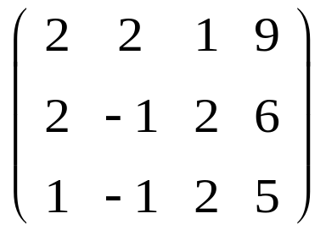
The Gauss-Jordan method solves a linear equation system by utilizing EROs in a systematic fashion.
The steps to using the Gauss-Jordan method
  The augmented matrix representation is
A|b =

Slide 23
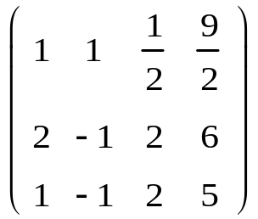
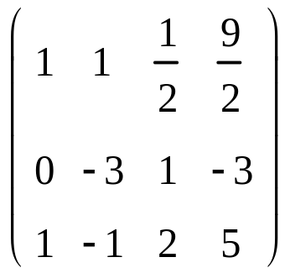
Step 1 Multiply row 1 by ½. This Type 1 ERO yields
Step 2 Replace row 2 of A₁|b₁ by -2(row 1 A₁|b₁) + row 2 of A₁|b₁. The result of this Type 2 ERO is
A₁|b₁ =
A₂|b₂ =

Slide 24
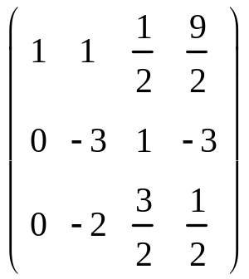
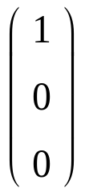
Step 3 Replace row 3 of A₂|b₂ by -1(row 1 of A₂|b₂) + row 3 of A₂|b₂ The result of this Type 2 ERO is
The first column has now been transformed into
A₃|b₃ =

Slide 25
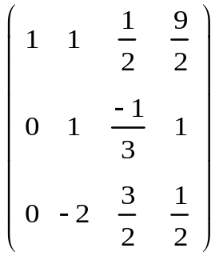
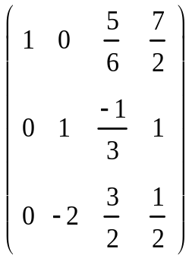
Step 4 Multiply row 2 of A₃|b₃ by -1/3. The result of this Type 1 ERO is
Step 5 Replace row 1 of A₄|b₄ by -1(row 2 of A₄|b₄) + row 1 of A₄|b₄. The result of this Type 2 ERO is
A₄|b₄ =
A₅|b₅ =

Slide 26
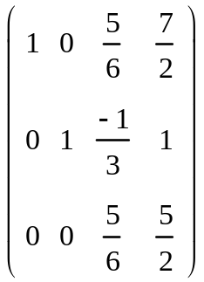

Step 6 Place row 3 of A₅|b₅ by 2(row 2 of A₅|b₅) + row 3 of A₅|b₅. The result of this Type 2 ERO is
Column 2 has now been transformed into
A₆|b₆ =

Slide 27
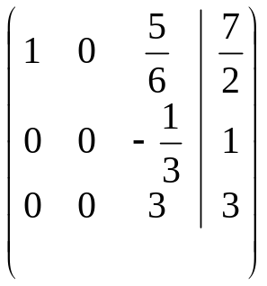
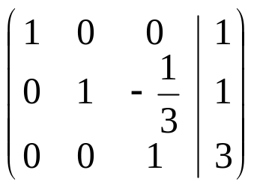
Step 7 Multiply row 3 of A₆|b₆ by 6/5. The result of this Type 1 ERO is
Step 8 Replace row 1 of A₇|b₇ by -5/6(row 3 of A₇|b₇)+A₇|b₇. The result of this Type 2 ERO is
A₇|b₇ =
A₈|b₈ =

Slide 28
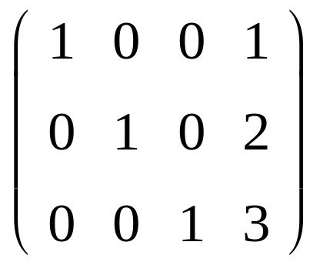
Step 9 Replace row 2 of A₈|b₈ by 1/3(row 3 of A₈|b₈)+ row 2 of A₈|b₈. The result of this Type 2 ERO is
A₉|b₉ represents the system of equations and thus the unique solution
A₉|b₉ =

Slide 29
After the Gauss Jordan method has been applied to any linear system, a variable that appears with a coefficient of 1 in a single equation and a coefficient of 0 in all other equations is called a basic variable (BV).
Any variable that is not a basic variable is called a nonbasic variable (NBV).

Slide 30
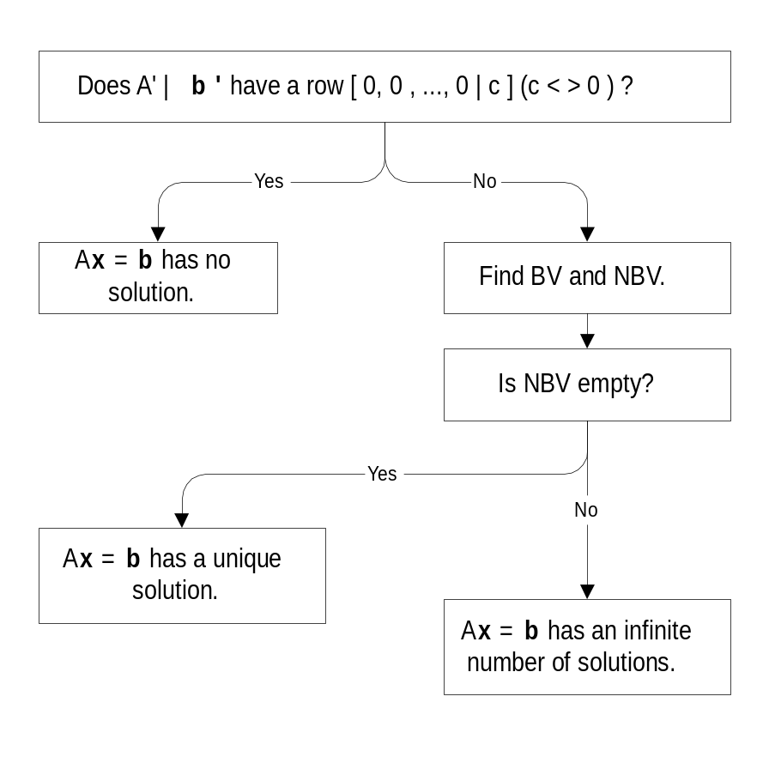
Summary of Gauss-Jordan Method

Slide 31
2.4 Linear Independence and Linear Dependence
A linear combination of the vectors in V is any vector of the form c₁v₁ + c₂v₂ + … + c_{k}v_{k} where c₁, c₂, …, c_{k} are arbitrary scalars.
A set of V of m-dimensional vectors is linearly independent if the only linear combination of vectors in V that equals 0 is the trivial linear combination.
A set of V of m-dimensional vectors is linearly dependent if there is a nontrivial linear combination of vectors in V that adds up to 0.

Slide 32
Example 10: LD Set of Vectors
Show that V = {[ 1 , 2 ] , [ 2 , 4 ]} is a linearly dependent set of vectors.
Solution
Since 2([ 1 , 2 ]) – 1([ 2 , 4 ]) = (0 0), there is a nontrivial linear combination with c₁ =2 and c₂ = -1 that yields 0. Thus V is a linear independent set of vectors.

Slide 33
What does it mean for a set of vectors to linearly dependent?
A set of vectors is linearly dependent only if some vector in V can be written as a nontrivial linear combination of other vectors in V.
If a set of vectors in V are linearly dependent, the vectors in V are, in some way, NOT all “different” vectors.
  By “different we mean that the direction specified by any vector in V cannot be expressed by adding together multiples of other vectors in V. For example, in two dimensions, two linearly dependent vectors lie on the same line.

Slide 34
Let A be any m x n matrix, and denote the rows of A by r₁, r₂, …, r_{m}. Define R = {r₁, r₂, …, r_{m}}.
The rank of A is the number of vectors in the largest linearly independent subset of R.
To find the rank of matrix A, apply the Gauss-Jordan method to matrix A.
  Let A’ be the final result. It can be shown that the rank of A’ = rank of A. The rank of A’ = the number of nonzero rows in A’. Therefore, the rank A = rank A’ = number of nonzero rows in A’.

Slide 35
A method of determining whether a set of vectors V = {v₁, v₂, …, v_{m}} is linearly dependent is to form a matrix A whose ith row is v_{i}.
If the rank A = m, then V is a linearly independent set of vectors.
If the rank A < m, then V is a linearly dependent set of vectors.

Slide 36
2.5 – The Inverse of a Matrix
A square matrix is any matrix that has an equal number of rows and columns.
The diagonal elements of a square matrix are those elements a_{ij} such that i=j.
A square matrix for which all diagonal elements are equal to 1 and all non-diagonal elements are equal to 0 is called an identity matrix. An identity matrix is written as I_{m}.

Slide 37
For any given m x m matrix A, the m x m matrix B is the inverse of A if BA=AB=I_{m}.
Some square matrices do not have inverses. If there does exist an m x m matrix B that satisfies BA=AB=I_{m}, then we write B=A⁻¹.
The Gauss-Jordan Method for inverting an m x m Matrix A is
  Step 1 Write down the m x 2m matrix A|I_{m}
  Step 2 Use EROs to transform A|I_{m} into I_{m}|B. This will be possible only if rank A=m. If rank A<m, then A has no inverse.

Slide 38
Matrix inverses can be used to solve linear systems.
The Excel command =MINVERSE makes it easy to invert a matrix.
  Enter the matrix into cells B1:D3 and select the output range (B5:D7 was chosen) where you want A-1 computed.
  In the upper left-hand corner of the output range (cell B5), enter the formula = MINVERSE(B1:D3)
  Press Control-Shift-Enter and A-1 is computed in the output range

Slide 39
2.6 – Determinants
Associated with any square matrix A is a number called the determinant of A (often abbreviated as det A or |A|).
If A is an m x m matrix, then for any values of i and j, the ijth minor of A (written A_{ij}) is the (m - 1) x (m - 1) submatrix of A obtained by deleting row i and column j of A.
Determinants can be used to invert square matrices and to solve linear equation systems.

