Slide 1
Concept of Wireless Network
Wireless Computer Communications
Min-Xiou Chen

Slide 2
Outline
History
Why Wireless
Types of Wireless Systems
Broadband Wireless Technology
Limitations and Difficulties

Slide 3
History
Guglielmo Marconi
  The father of radio
  Sending wireless signals over a distance of one and a half miles in 1895.
  Communication by encoding alphanumeric characters in analog signal
  Transmitting the first wireless signals across the Atlantic Ocean
US Army & Navy
  Security transmission
  Battle of Jutland

Slide 4
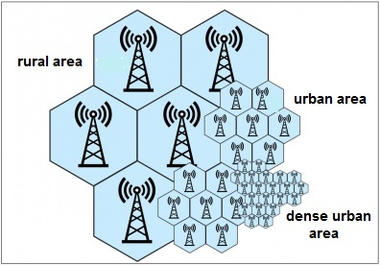
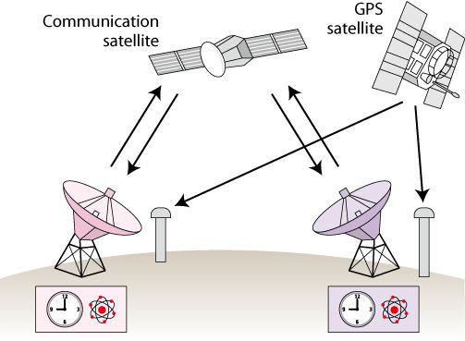
History
Bell Lab.
  Cellular Network
  1940s
Communications satellites
  1960s (Sputnik)

Slide 5
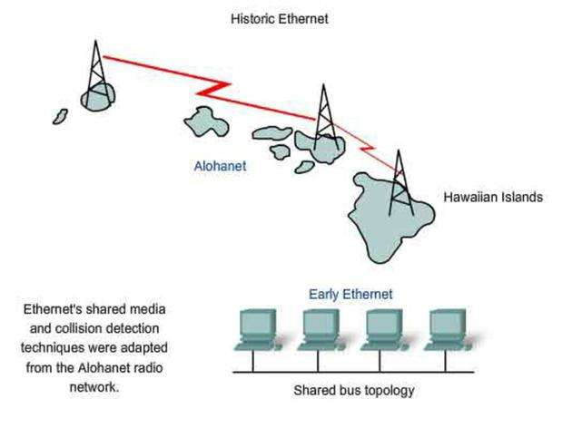
History
University of
Hawaii
  ALOHNET
  Bi-directional star
  topology
  7 campuses over
  4 islands
  Centered at the Oahu island
  The first wireless network and the first packet based radio communications network

Slide 6
History
Cellular Network (1G) (Analog signal)
  Nordic Mobile Telephone (NMT): Ericsson
  Advanced Mobile Phone Service (AMPS): AT&T
Cellular Network (2G) (Digital signal)
  Groupe Special Mobile (GSM)
  Conference of European Postal and Telecommunications Administrations (CEPT)
  1982

Slide 7
Why Wireless?
Communications on the movable objects
  Fleets of trucks, taxis, buses, etc.
Portable office
For rescue workers at disaster sites
Military use
Reducing line costs
Cable replacement

Slide 8
Types of Wireless Systems
Infrastructure Wireless Network
  Wireless PANs (無線個人網路)
    Bluetooth
  Wireless LANs (無線區域網路)
    Cordless telephones (無線電話)
    WLAN
  Wireless WANs (無線廣域網路)
    Cellular telephones (蜂巢式行動電話)
    Personal communication services (個人通訊服務) Communication Satellites (通訊衛星)
Un-infrastructure Wireless network
  Wireless Ad hoc Networks (無線隨意網路)
  Wireless Sensor Networks (無線感測網路)

Slide 9
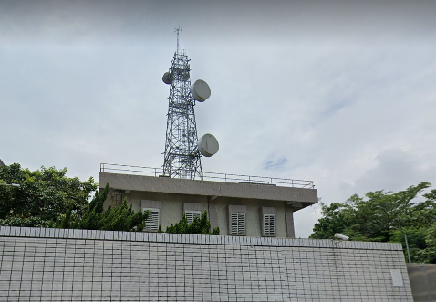
Types of Transmission Mediums
Radio(無線電廣播)
  Narrowband Microwave(窄頻微波)
  WLAN
  Bluetooth
  GSM, …
Optical
  Infrared (紅外線)
  Laser (雷射)

Slide 10
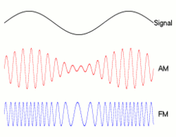
Types of Transmission Signal
Analog modulation schemes
  Amplitude modulation (AM)
  Frequency modulation (FM)
  Require much less bandwidth
  Continuously variable by nature
  Need to adjustment at the receiver end in order to reconstruct the transmitted signal.

Slide 11
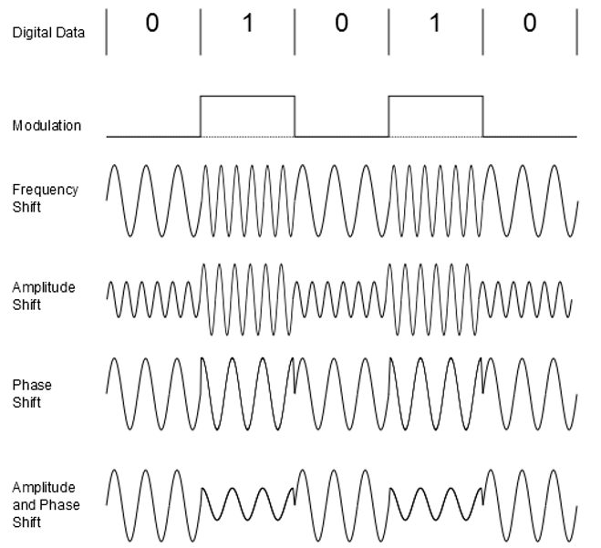
Types of Transmission Signal
Digital modulation scheme
  Only uses 1’s and 0’s to encode the signal
  Simpler means of reconstructing the signal.
  Circuitry required for digital transmission is more complex

Slide 12
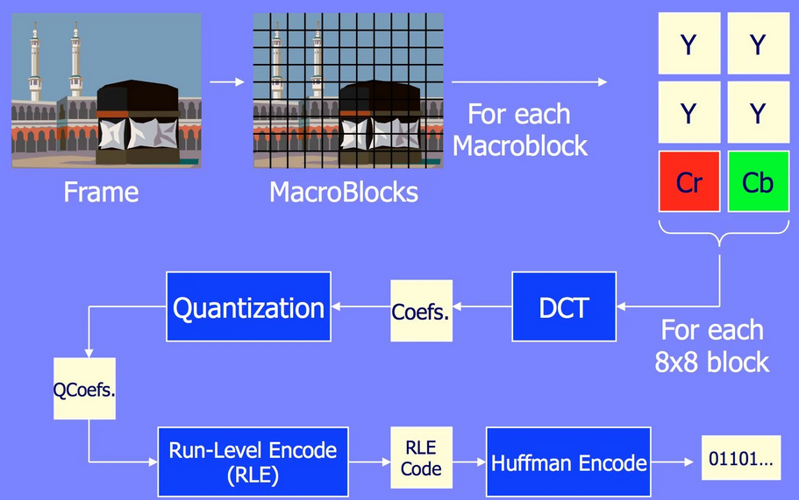
Broadband Wireless Technology
Higher data rates obtainable with broadband wireless technology
  Graphics, video, audio

Slide 13
Broadband Wireless Technology
Shares same advantages of all wireless services: convenience and reduced cost
  Service can be deployed faster than fixed service
  No cost of cable plant
  Service is mobile, deployed almost anywhere

Slide 14
Limitations and Difficulties of Wireless Technologies
Wireless is convenient and less expensive
Limitations and political and technical difficulties inhibit wireless technologies
Lack of an industry-wide standard
Device limitations
  E.g., small LCD on a mobile telephone can only displaying a few lines of text
  E.g., browsers of most mobile wireless devices use wireless markup language (WML) instead of HTML

Slide 15
Wireless Communications: Media Access Control (MAC)
Wireless Computer Communications
Min-Xiou Chen

Slide 16
What is it all about?
Consider an audioconference where
  if one person speaks, all can hear
  if more than one person speaks at the same time, both voices are garbled
How should participants coordinate actions so that
  the number of messages exchanged per second is maximized
  time spent waiting for a chance to speak is minimized
This is the multiple access problem

Slide 17
Some Simple Solutions
Use a moderator
  a speaker must wait for moderator to call on him or her, even if no one else wants to speak
  what if the moderator’s connection breaks?
Distributed solution
  speak if no one else is speaking
  but if two speakers are waiting for a third to finish, guarantee collision
Designing good schemes is surprisingly hard!

Slide 18
Contexts for the Multiple Access Problem
Broadcast transmission medium
  message from any transmitter is received by all receivers
Colliding messages are garbled
Goal
  maximize message throughput
  minimize mean waiting time

Slide 19
Solving the Problem
First, choose a base technology
  to isolate traffic from different stations
  can be in time domain or in frequency domain
Then, choose how to allocate a limited number of transmission resources to a larger set of contending users

Slide 20
Design Choices
Centralized vs. distributed design
  is there a moderator or not?
  in a centralized solution one of the stations is a master and the others are slaves
  in a distributed solution, all stations are peers
Circuit-mode vs. packet-mode
  do stations send steady streams or bursts of packets?
  with streams, doesn’t make sense to contend for every packet
  with packets, makes sense to contend for every packet to avoid wasting bandwidth

Slide 21
Constraint: Spectrum Scarcity
radio spectrum is hard to come by
only a few frequencies available for long-distance communication
multiple access schemes must be careful not to waste bandwidth

Slide 22
Constraint: Radio Link Properties
radio links are error prone
  fading
  multipath interference
hidden terminals
  transmitter heard only by a subset of receivers
capture
  on collision, station with higher power overpowers the other
  lower powered station may never get a chance to be heard

Slide 23
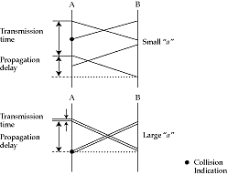
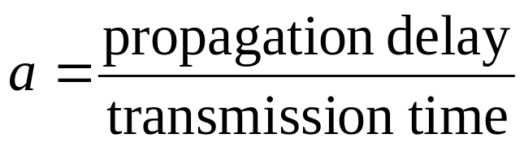
The Parameter ‘a’
The number of packets sent by a source before the farthest station receives the first bit

Slide 24
Performance Metric: Normalized Throughput
fraction of link capacity used to carry non-retransmitted packets
example
  with no collisions, 1000 packets/sec
  with a particular scheme and workload, 250 packets/sec
  goodput = 0.25

Slide 25
Performance Metric: Stability
with heavy load, is all the time spent on resolving contentions?
  Yes ⇨ unstable
with a stable algorithm, throughput does not decrease with offered load
  if infinite number of uncontrolled stations share a link, then instability is guaranteed
  but if sources reduce load when overload is detected, can achieve stability

Slide 26
Performance Metrics: Mean Delay and Fairness
Mean delay
  amount of time a station has to wait before it successfully transmits a packet
    depends on the load and the characteristics of the medium
Fairness
  no single definition
  ‘no-starvation’: source eventually gets a chance to send

Slide 27
Base Technologies
Isolates data from different sources
Three basic choices
  Frequency division multiple access (FDMA)
  Time division multiple access (TDMA)
  Code division multiple access (CDMA)

Slide 28
FDMA
Simplest
Best suited for analog links
Each station has its own frequency band, separated by guard bands
Receivers tune to the right frequency
Number of frequencies is limited
  reduce transmitter power; reuse frequencies in non-adjacent cells

Slide 29
TDMA
All stations transmit data on same frequency, but at different times => needs time synchronization
Pros
  users can be given different amounts of bandwidth
  mobiles can use idle times to determine best base station
  can switch off power when not transmitting
Cons
  synchronization overhead
  greater problems with multipath interference on wireless links

Slide 30
CDMA
frequency hopping
  Users separated both by time and frequency
  Send at a different frequency at each time slot
Or, convert a single bit to a code (direct sequence)
  receiver can decipher bit by inverse process
Pros
  hard to spy
  immune from narrowband noise
  no need for all stations to synchronize
  no hard limit on capacity of a cell
  all cells can use all frequencies

Slide 31
CDMA
Cons
  implementation complexity
  need for power control
    to avoid capture
  need for a large contiguous frequency band (for direct sequence)
  problems installing in the field

Slide 32
FDD and TDD
Two ways of converting a wireless medium to a duplex channel
In Frequency Division Duplex, uplink and downlink use different frequencies
In Time Division Duplex, uplink and downlink use different time slots
Can combine with FDMA/TDMA
Examples
  TDD/FDMA in second-generation cordless phones
  FDD/TDMA/FDMA in digital cellular phones

Slide 33
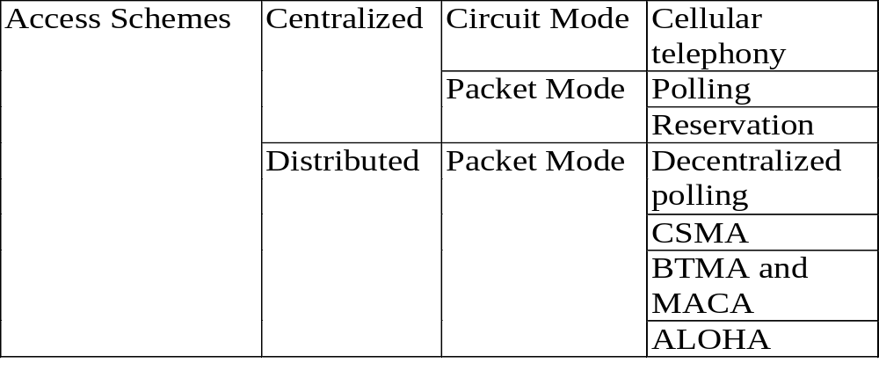
Classification of Multiple-Access Schemes

Slide 34
Centralized Access Schemes
One station is master, and the other are slaves
  slave can transmit only when master allows
Natural fit in some situations
  wireless LAN, where base station is the only station that can see everyone
  cellular telephony, where base station is the only one capable of high transmit power

Slide 35
Centralized Access Schemes
Pros
  simple
  master provides single point of coordination
Cons
  master is a single point of failure
    need a re-election protocol
    master is involved in every single transfer => added delay

Slide 36
Centralized Circuit-Mode Access Schemes
When station wants to transmit, it sends a message to master using packet mode
Master allocates transmission resources to slave
Slave uses the resources until it is done
No contention during data transfer
Used primarily in cellular phone systems
  EAMPS: FDMA
  GSM/IS-54: TDMA
  IS-95: CDMA

Slide 37
Centralized Packet-Mode Access Scheme: Polling
master asks each station in turn if it wants to send (roll-call polling)
inefficient if only a few stations are active, overhead for polling messages is high, or system has many terminals

Slide 38
Centralized Packet-Mode Access Scheme: Probing
stations are numbered with consecutive logical addresses
assume station can listen both to its own address and to a set of multicast addresses
master does a binary search to locate next active station
BS
polls
01*
0**
00*
collide
collide
Station
replies
Station
transmits
000
001
(assumed addresses: 000-111)

Slide 39
Centralized Packet-Mode Access: Reservation-Based Schemes
master coordinates access to link using reservations
Some time slots devoted to reservation messages
  can be smaller than data slots => minislots
Stations contend for a minislot (or own one)
Master decides winners and grants them access to link
Packet collisions are only for minislots, so overhead on contention is reduced

Slide 40
Minislots
minislots
data
slots
data
slots
data
slots
data
slots
data
slots
data
slots
reserved
Reservation
requests

Slide 41
Distributed Schemes
Compared to a centralized scheme
  more reliable
  have lower message delays
  often allow higher network utilization
  but are more complicated
Almost all distributed schemes are packet mode (why?)

Slide 42
Decentralized Polling
Just like centralized polling, except there is no master
Each station is assigned a slot that it uses
  if nothing to send, slot is wasted
Also, all stations must share a time base

Slide 43
Decentralized Probing
0
1
Also called tree based multiple access
without a master (BS)
Works poorly with many active stations, or when all active stations are in the same subtree
0
1
0
1
0
1
All 0**
stations
transmit
packets
All 00*
stations
transmit
packets
station
000
transmits
packet
station
001
transmits
packet
All 01*
stations
transmit
packets
(assumed
addresses:
000-111)
collide
collide

Slide 44
Carrier Sense Multiple Access (CSMA)
A fundamental advance: check whether the medium is active before sending a packet (i.e carrier sensing)
Unlike polling/probing a node with something to send doesn’t have to wait for a master, or for its turn in a schedule
If medium idle, then can send
If collision happens, detect and resolve
Works when ‘a’ is small

Slide 45
Simplest CSMA Scheme
Send a packet as soon as medium becomes idle
If, on sensing busy
  wait for idle → persistent
  set a timer and try later → non-persistent
Problem with persistent: two stations waiting to speak will collide

Slide 46
Reducing Collision Probability: P-Persistent CSMA
A waiting station does not launch a packet immediately when the channel becomes idle
p: the probability of sending a packet when the medium becomes idle
hard to choose p
  if p small, then wasted time
  if p large, more collisions
Best p depends on
the number of
contending nodes

Slide 47
Handling the Collision Problem: Exponential Backoff
Each station, after transmitting a packet, checks whether the packet transmission is successful
on collision, choose timeout randomly from doubled range
backoff range adapts to number of contending stations
no need to choose p
need to detect collisions: collision detect circuit => CSMA/CD

Slide 48
CSMA/CD Transmit Algorithm in Ethernet
If line is idle…
  send immediately
  upper bound message size of 1500 bytes
  must wait 9.6μs between back-to-back frames
If line is busy…
  wait until idle and transmit immediately (persistent sending)
If collision…
  immediately (without completing current frame), expend a 32-bit jam sequence, then stop transmitting frame

Slide 49
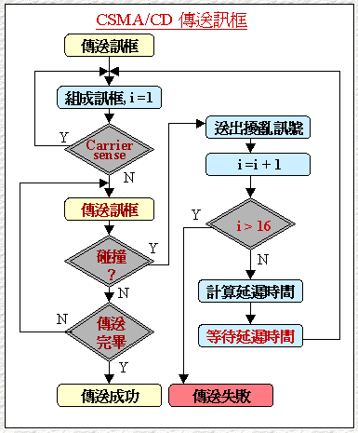
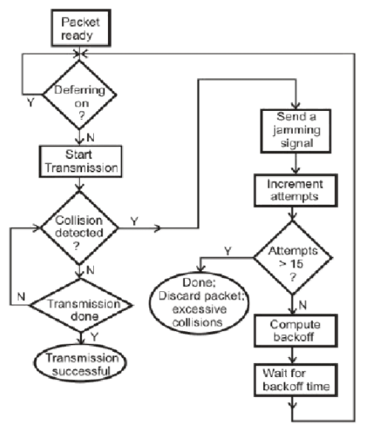
CSMA/CD

Slide 50
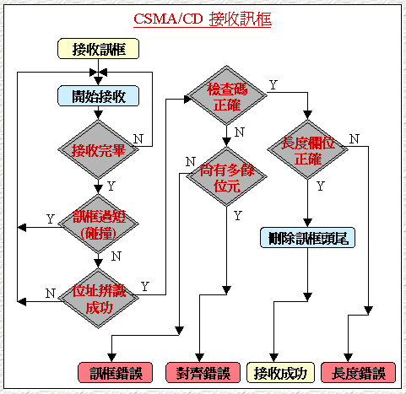
CSMA/CD

Slide 51
Frame cannot be too short
A
B
C
D
F
A
B
C
D
F
A and F can detect collision
A cannot detect collision

Slide 52
CSMA/CD
Ethernet Protocol
IEEE 802.3: 1-persistent CSMA/CD
five versions: 10BASE5: Ethernet
10BASE2: Cheapernet(thinnet)
1BASE5: StarLAN
10BASE-T:
10BROAD36
transmission
rate in Mbps
use twisted-pair

Slide 53
CSMA/CA (Collision Avoidance)
Used in wireless LANs
Can’t detect collision because transmitter overwhelms colocated receiver (Why?)
So, need explicit acks
But this makes collisions more expensive
  try to reduce number of collisions

Slide 54
CSMA/CA Algorithm
First check if medium is busy
If so, wait for medium to become idle
Wait for interframe spacing
Set a contention timer to an interval randomly chosen in the range [1, CW]
On timeout, send packet and wait for ack
If no ack, assume packet is lost
  try again, after doubling CW
If another station transmits while counting down, freeze CW and unfreeze when packet completes transmission

Slide 55
Collision Avoidance Algorithm
A
B
C
D
RTS: Request To Send
CTS: Clear To Send
A
RTS
Data
B
CTS
ACK
C
defer access
Back-off
RTS
D

Slide 56
Hidden Terminal and Exposed Terminal Problems
Hidden terminal
  some stations in an area cannot hear transmissions from others, though base can hear both
Exposed terminal
  some (but not all) stations can hear transmissions from stations not in the local area
collide
B
A
C
B
A
D
C
deferred
transmission

Slide 57
Hidden Terminal Problem
A
B
C
Hidden terminals
  A and C cannot hear each other.
  A sends to B, C cannot receive A.
  C wants to send to B, C senses a “free” medium (CS fails)
  Collision occurs at B.
  A cannot receive the collision (CD fails).
  A is “hidden” for C.
Solution?
  Hidden terminal is peculiar to wireless (not found in wired)
  Need to sense carrier at receiver, not sender!
  “virtual carrier sensing”: Sender “asks” receiver whether it can hear something. If so, behave as if channel busy.

Slide 58
RTS/CTS
RTS
A
B
C
CTS
CTS
802.11 avoids the problem of hidden terminals
  A and C want to send to B
  A sends RTS to B
  B sends CTS to A
  C “overhears” CTS from B
  C waits for duration of A’s transmission

Slide 59
Dealing with Hidden and Exposed Terminals
CSMA/CA works when every station can receive transmissions from every other station
Not always true
In both cases, CSMA/CA doesn’t work (why?)
  with hidden terminal, collision because carrier not detected
  with exposed terminal, idle station because carrier incorrectly detected

Slide 60
Busy Tone Multiple Access (BTMA)
uses a separate “busy-tone” channel
when station is receiving a message, it places a tone on this channel
everyone who might want to talk to a station knows that it is busy
  even if they cannot hear transmission that that station hears
this avoids both problems

Slide 61
Problem with BTMA
BTMA requires us to split frequency band
  more complex receivers (need two tuners)
Separate bands may have different propagation characteristics
  scheme fails!
Instead, use a single frequency band, but use explicit messages to tell others that receiver is busy (MACA)

Slide 62
Multiple Access Collision Avoidance (MACA)
In MACA, before sending data, send a Request to Sent (RTS) to intended receiver
Station, if idle, sends Clear to Send (CTS)
Sender then sends data
If station overhears RTS, it waits long enough for a CTS to be sent by a receiver
If a station hears CTS, it waits long enough for the data packet to be transmitted

Slide 63
ALOHA and Its Variants
ALOHA is one of the earliest multiple access schemes
Just send it!
Wait for an ack
If no ack, try again after a random waiting time
  no exponential backoff

Slide 64
Pure Aloha
A
B
C
D
E
t
window of vulnerability (2*t)

Slide 65








Vulnerable Period
ALOHA
collides with start of target frame
collides with end of target frame
slotted
collides with start of target frame

Slide 66
Evaluating ALOHA
Pros
  useful when ‘a’ is large, so carrier sensing doesn’t help
    satellite links
  simple
    no carrier sensing, no token, no timebase synchronization
  independent of ‘a’
Cons
  under some mathematical assumptions, goodput is at most .18
  at high loads, collisions are very frequent
  sudden burst of traffic can lead to instability
    unless backoff is exponential

Slide 67
Slotted ALOHA
A simple way to double ALOHA’s capacity
Make sure transmissions start on a slot boundary
Halves window of vulnerability
Used in cellular phone uplink
window of vulnerability
2L
ALOHA
Slotted ALOHA
L
time
L
L
L
time
L
Earliest start time for colliding packet
Latest start time for colliding packet

Slide 68
Slotted Aloha
tic
tic
tic
tic
tic
tic
tic
tic
tic
tic
tic
tic
tic
A
B
C
D
E
t
window of
vulnerability (t)
Potentially unnecessary delay
t

Slide 69
Reservation ALOHA
Combines slot reservation with slotted ALOHA
Contend for reservation minislots using slotted ALOHA
Stations independently examine reservation requests and come to consistent conclusions
Simplest version
  divide time into frames = fixed length set of slots
  station that wins access to a reservation minislot using S-ALOHA can keep slot as long as it wants
  station that loses keeps track of idle slots and contends for them in next frame

Slide 70
Evaluating R-ALOHA
Pros
  supports both circuit and packet mode transfer
  works with large ‘a’
  simple
Cons
  arriving packet has to wait for entire frame before it has a chance to send
  cannot preempt hogs
  variants of R-ALOHA avoid these problems

