Slide 1
Mobility Management
Wireless Computer Communications
Min-Xiou Chen

Slide 2
Outline
Introduction
Handoff
Roaming Management
Roaming Management under SS7
Roaming Management for CT2
Summary

Slide 3
Introduction
There are two aspect of mobility in a PCS network
  Handoff : occur when a mobile user holds on, the MS move from one BS to another
  Roaming : occur when a mobile user moves from one PCS system to another
Protocols that support mobility management
  IS-41(EIA/TIA Interim Standard 41)
  MAP(GSM Mobile Application Party)

Slide 4
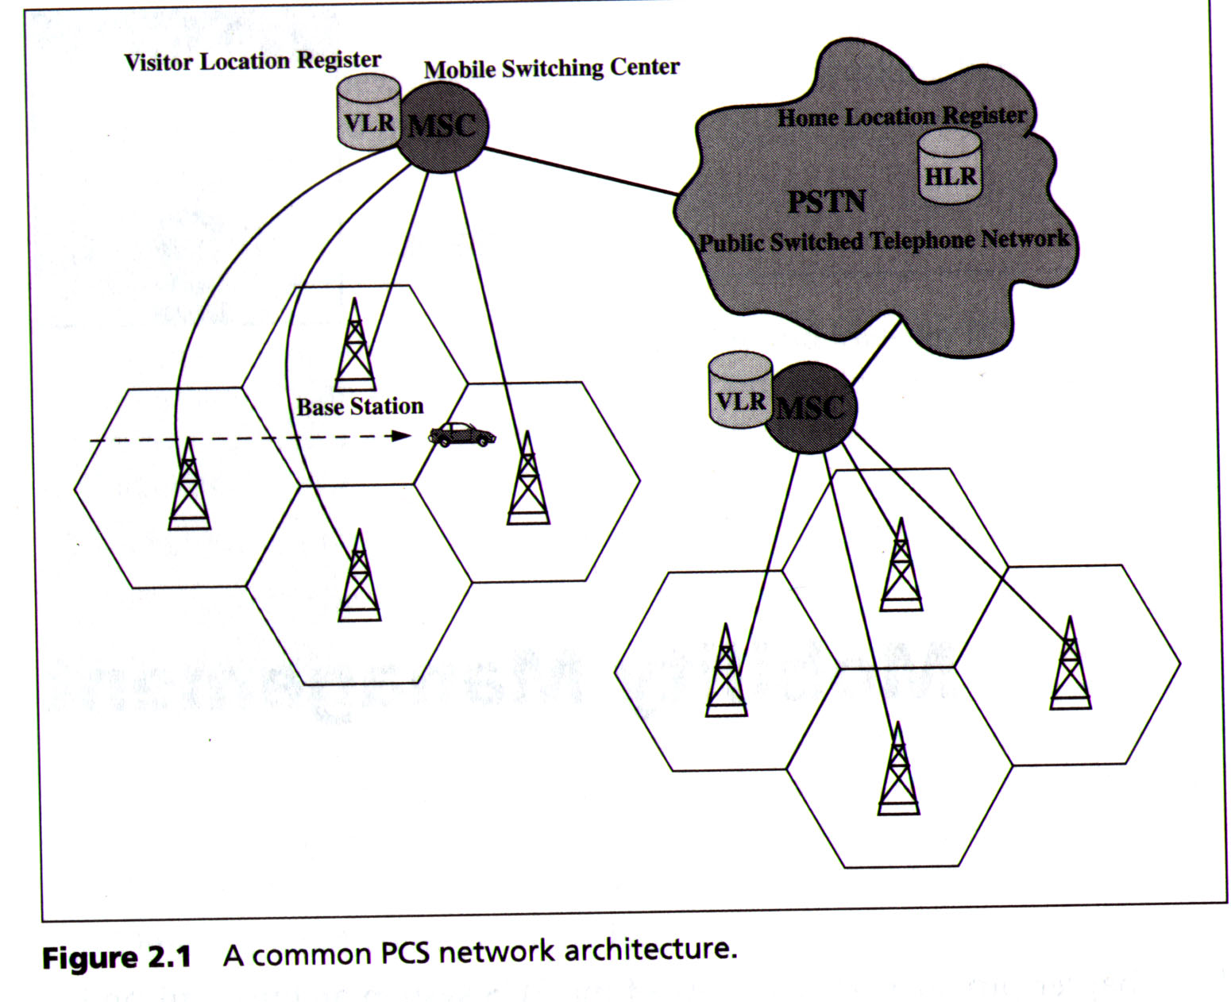
Introduction (cont.)

Slide 5
Introduction(cont.)
PCS system architecture
  MS (Mobile Station)
    Refered to as handset, mobile phone, protable etc.
  BS (Base Station)
    Relaying the call to and from the MS
  MSC (Mobile Switch Center)
    Telephone exchange specifically configured for mobile applications
  HLR (Home Location Register) and VLR (Visitor Location Register)
    Databases that store and manage mobile users’ information for roaming management
Two kinds of handoff
  soft handoff vs. hard handoff

Slide 6
Handoff
Three strategies have been proposed to detect the need for handoff
  Mobile-controlled handoff (MCHO- DECT, PACS)
    MS monitors the signals of the surrounding BSs
    MS initiates the handoff process
  Network-controlled handoff (NCHO- AMPS)
    Surrounding BSs measure the signal from the MS
    The network initiates the handoff process
  Mobile-assisted handoff (MAHO-GSM, IS-95)
    Network asks the MS to measure the signal from the surrounding BSs
    The network initiates the handoff process

Slide 7
Handoff
Three-Stage of process for handoff
  1. Initiation: the user, a network agent, or changing network condition
  2. New connection generation: finding new resources and performing routing operation
  3. Data flow control : delivery of data according to agreed-upon service guarantees

Slide 8
Handoff
Handoff protocols usually rely on
  routing
  resource management
  data delivery systems
That is, handoff algorithms are network-protocol-dependent
It needs standardized wireless netowork architecture to access regional, national and global services as efficiently as those on the local level

Slide 9
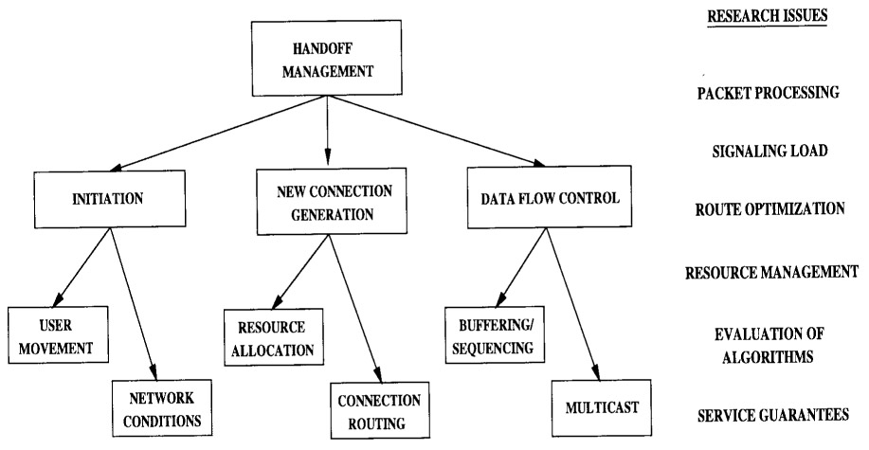

Slide 10
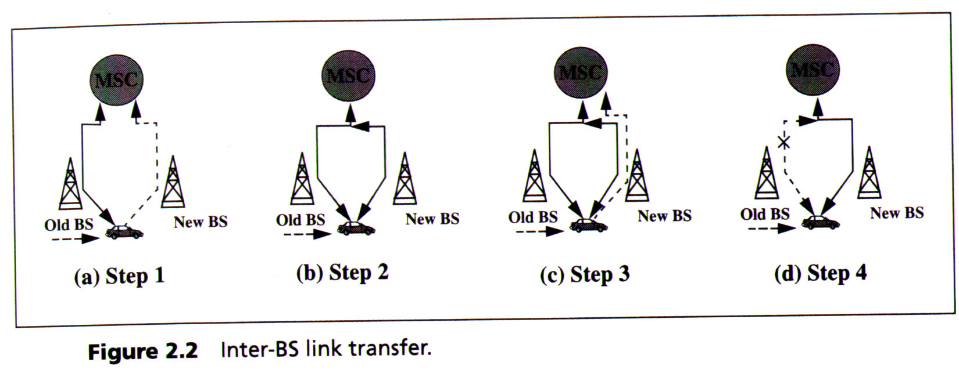
Inter-BS Handoff
The new and old BSs are connected to the same MSC
Ex : Inter-BS link transfer using MCHO

Slide 11
Handoff Channel Assignment
Forced termination : if the new BS has no idle channel, the handoff call may be dropped
Three channel assignment schemes to reduce forced termination
  Reversed scheme
    Some channels in each BS are reversed for handoff calls
  Queueing priority scheme
    Buffers the handoff request in a waiting queue
  Subrate scheme
    Creates a new channel by sharing resources with an existing call

Slide 12
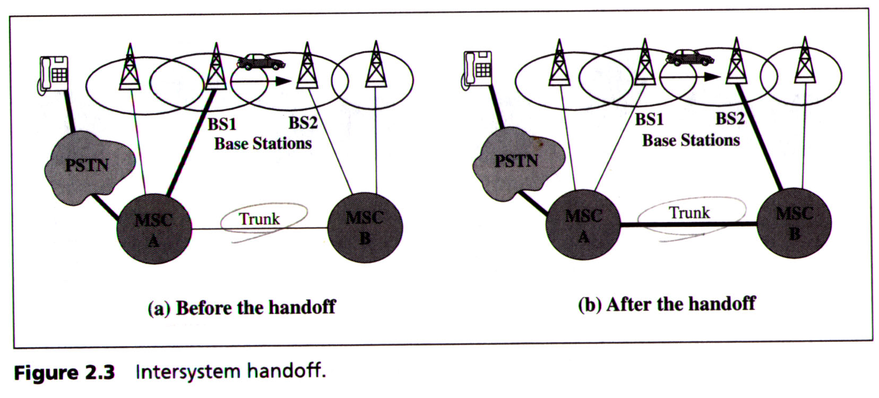
Intersystem Handoff
The new and old BSs are connected to two different MSCs
EX : Intersystem handoff of IS-41 using NCHO

Slide 13
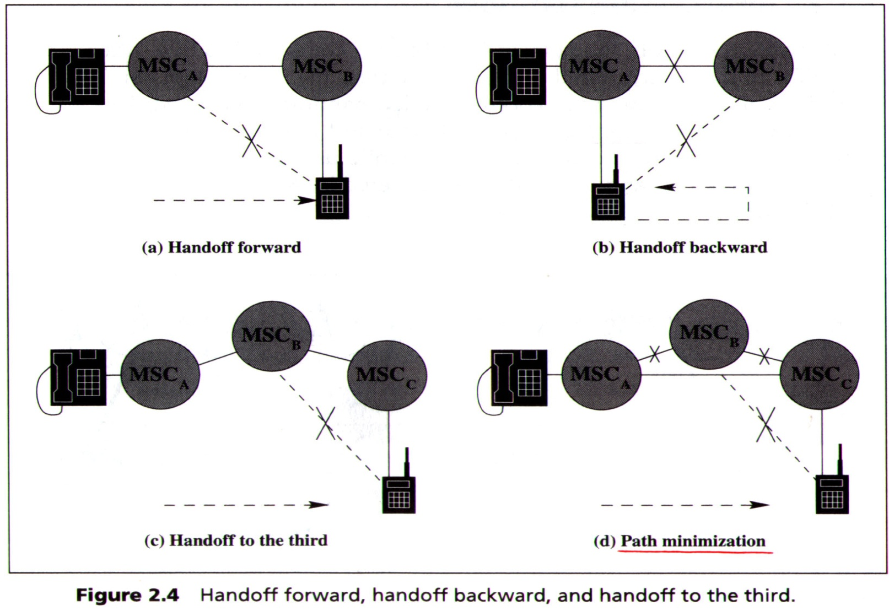
Intersystem Handoff(cont.)

Slide 14
Roaming Management
Two basic operations in roaming management
  Registration
    MS informs the system of its location
  Location tracking
    the system locates the MS for call delivery

Slide 15
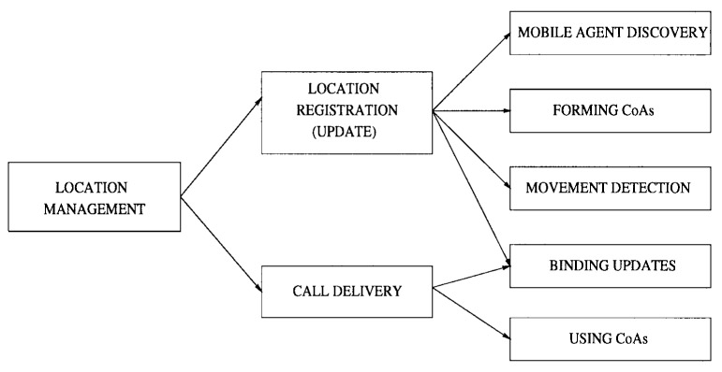

Slide 16
Roaming Management(cont.)
Home Location Register (HLR)
  When a user subscribes to the service of a PCS network, a record is created in home system
Visitor Location Register (VLR)
  When the mobile user visited another PCS network, a temporary record for mobile user is created in visited system

Slide 17
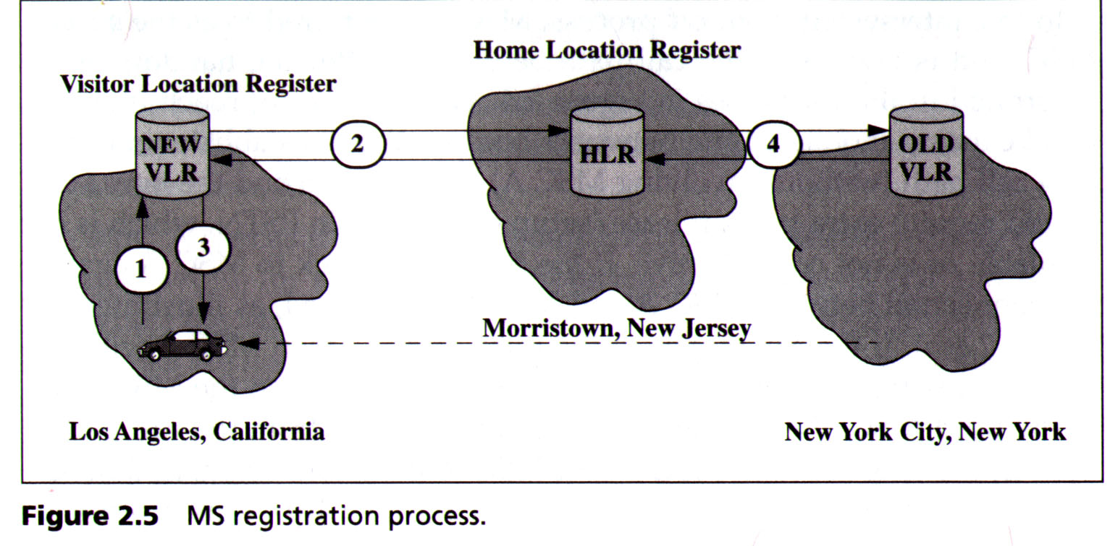
Roaming Management(cont.)
EX : MS registration process

Slide 18
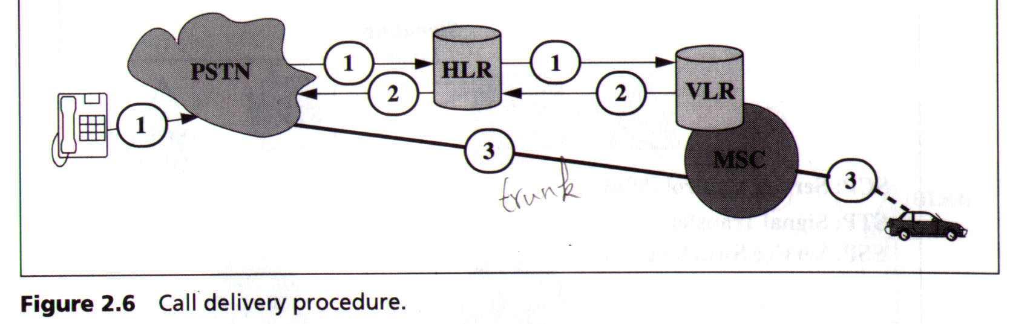
Roaming Management(cont.)
EX : Call delivery procedure

Slide 19
Roaming Management under SS7
Common Channel Signaling (CCS)
  Signaling method in telephone network
  Provide control and management functions
  Uses a separate out-of-band signaling network to carry signaling message
CCS channel convey messages
  Initiate and terminate calls
  Determinate the status of some part of network
  Control the amount of traffic allowed

Slide 20
Roaming Management under SS7
Signaling System NO. 7 (SS7)
  Improvement the easier signaling systems which lacked the sophistication required to deliver
  Signaling between a PCS and the PSTN are typically achieved by the SS7 network

Slide 21
Roaming Management under SS7
The SS7 network consistent of three distinct components
  Service Switch Point (SSP)
    Perform call processing on calls that originate, tandem, or terminate at that node
    An SSP in PSC network is called a MSC(Mobile Switch Center)
  Signaling Transfer Point (STP)
    Route the message to the correct outgoing signaling links
  Service Control Point (SCP)
    Contain databases for providing enhanced service
    In mobile application, an SCP may contain an HLR or a VLR

Slide 22
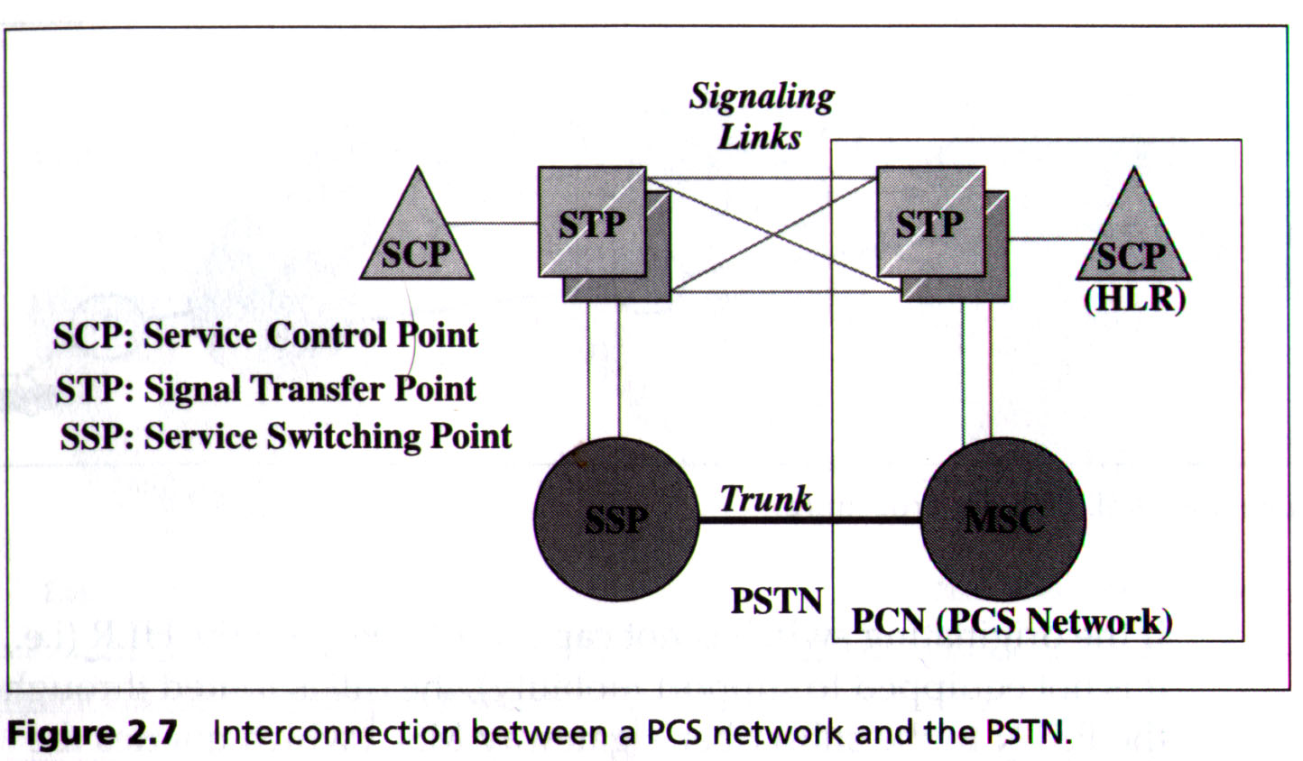
Roaming Management under SS7
EX : Interconnection between a PCS network and the PSTN

Slide 23
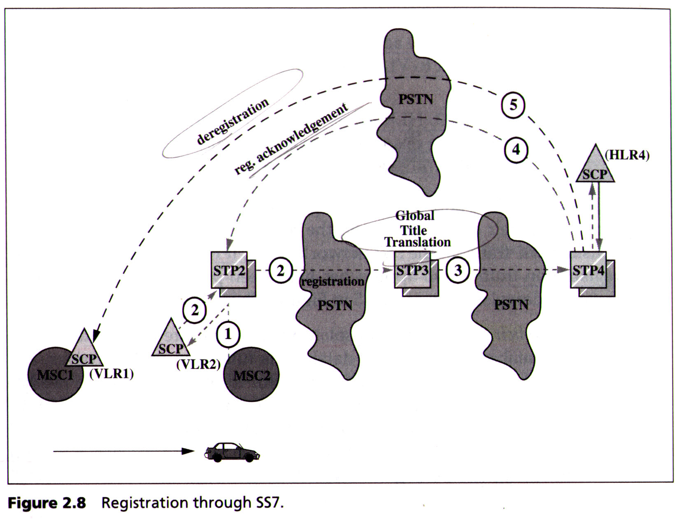
Registration
EX : Registration through SS7

Slide 24
Registration(cont.)
Two approaches have been proposed to reduced the cost of deregistration
  Implicit deregistration
    Obsolete VLR records are not deleted until the database is full
  Periodic registration
    The MS periodically registers to the VLR

Slide 25
Registration(cont.)
Pointer forwarding scheme consists of two operations to reduce the registration traffic
  Move operation (registration)
    When MS moves from one VLR to another, a pointer is created from the old VLR to the new VLR
  Find operation (call delivery)
    When the HLR attempted to locate the MS for call delivery, the pointer chain be traced

Slide 26
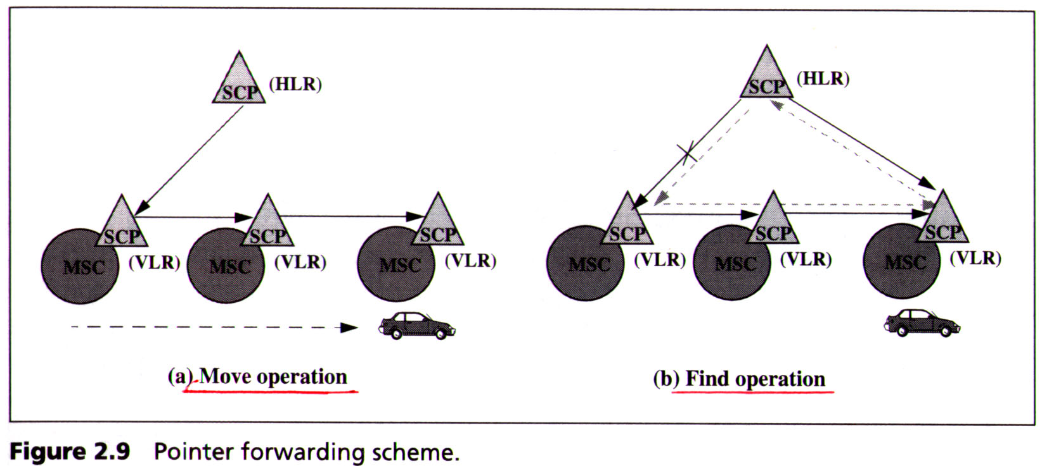
Registration(cont.)
Pointer forwarding scheme

Slide 27
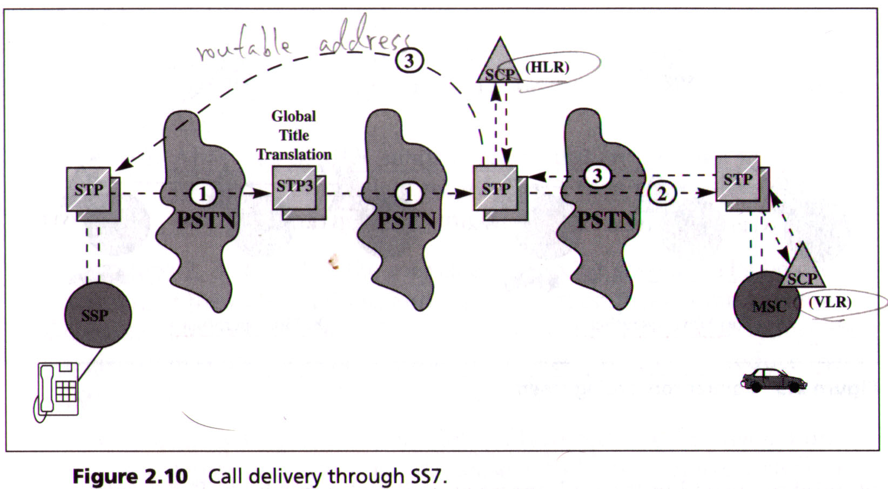
Call Delivery
Call delivery through SS7

Slide 28
Call Delivery(cont.)
To reduce the call delivery traffic
  Cache scheme
    In the originating SSPs or in the STP that performs GTTs
    A entry consist of two fields
      MIN of an MS
      Current visited VLR of the MS
    There are three possibilities
      Case 1 : The cache entry does not exist
      Case 2 : The cache entry exists and is current
      Case 3 : The cache entry exists but is obsolete

Slide 29
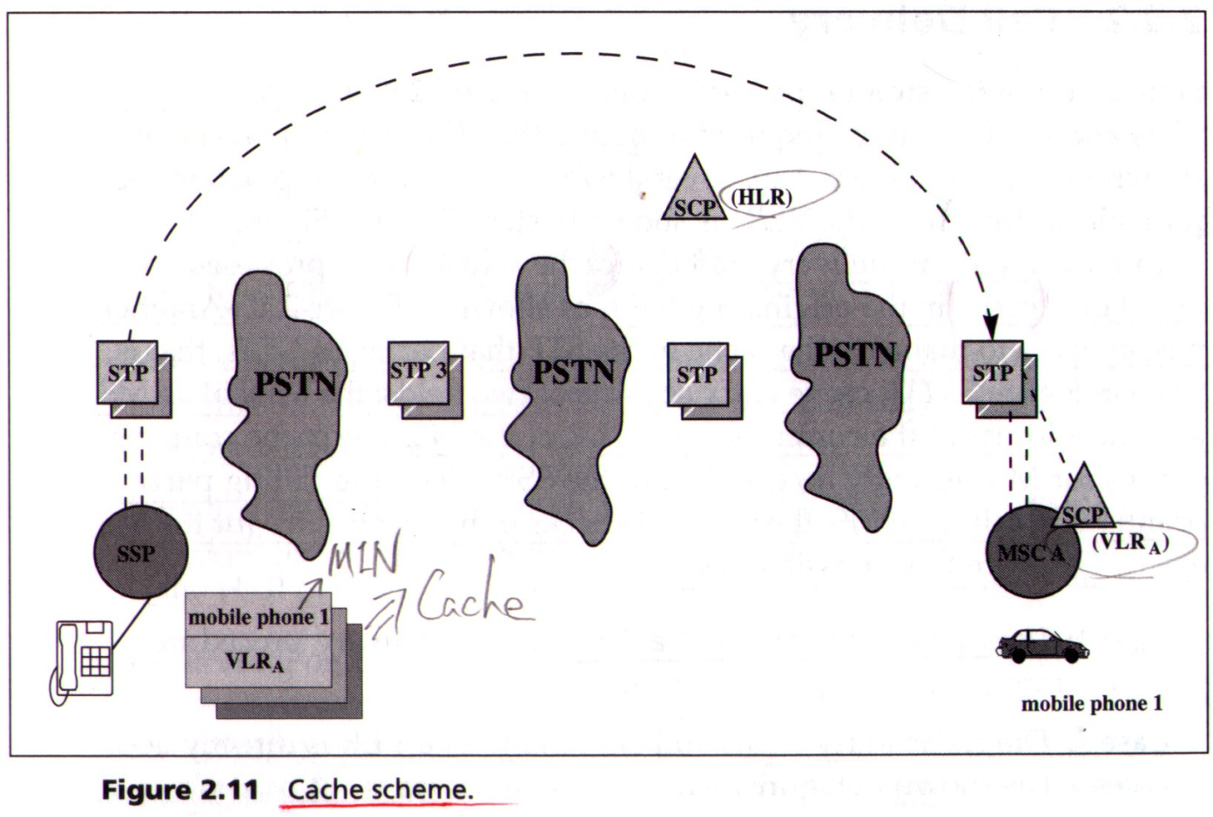
Call Delivery(cont.)
Cache scheme

Slide 30
Call Delivery(cont.)
Two ways to determine the cache entry is current
  Cache hit ratio
  Period that a MS resides in a VLR as indicated in the cache entry

Slide 31
Summary
Mobility management
  Handoff
    Handoff detection
    Handoff channel assignment
    Inter-BS and intersystem system

Slide 32
Summary(cont.)
  Roaming
    Reduce deregistration traffic
      Implicit deregistration and periodic registration
    Reduce registration traffic
      Pointer forwarding scheme
    Reduce call delivery traffic
      Cache scheme
  CT2 as a example for roaming management

