Slide 1
Introduction:
無線廣域網路
陳旻秀
東華大學資訊工程學系

Slide 2
廣域無線網路演進
第一代
  AMPS
第二代
  GSM, CDMA
第2.5代
  GPRS
第三代
  EDGE, UMTS
第四代(Beyond 3G, B3G)

Slide 3
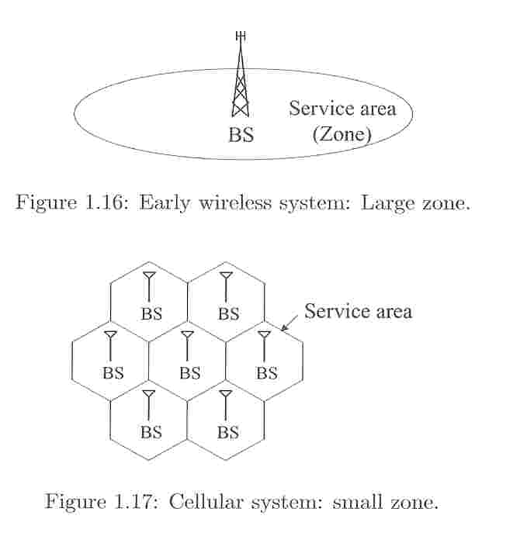
Cellular
起因
  提昇頻道承載能量
  基地台功率有限
  地形地物影響
特色
  Frequency reuse
  Mobility of the subscriber
  Handoffs
MSC (Mobile Switching Center)
  connects to the PSTN (Public Switched Telephone Network) or postal, telegraph, and telephone (PTT) systems

Slide 4
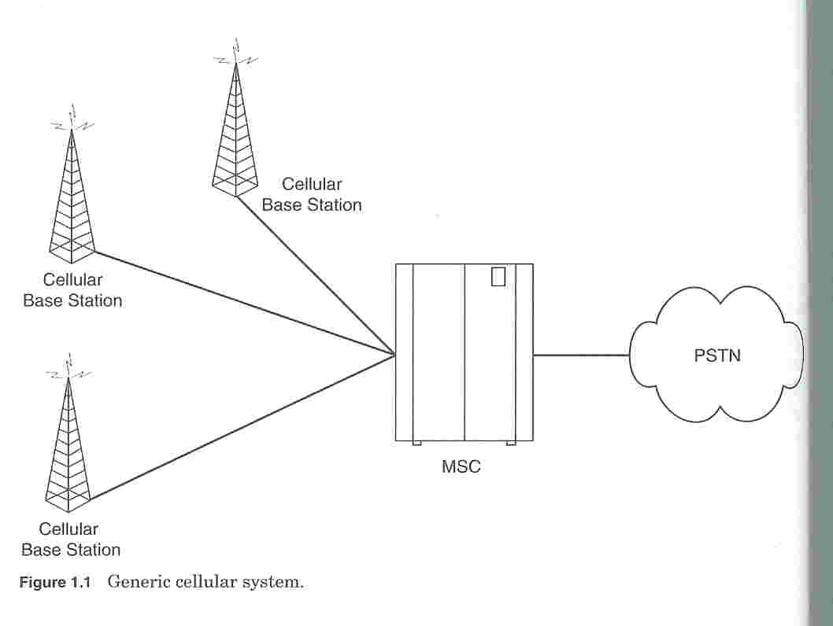
Cellular

Slide 5
Cellular
To provide a link
  The MS needs to be in the area of one of the cells (and hence a BS) so that mobility of the MS can be supported
  Several BSs are connected through hardwires and are controlled by a BS controller (BSC), which in turn in connected to a mobile switching center (MSC)
  Several MSCs are interconnected to a PSTN (public switched telephone network) and the ATM (Asynchronous Transfer Mode) backbone

Slide 6
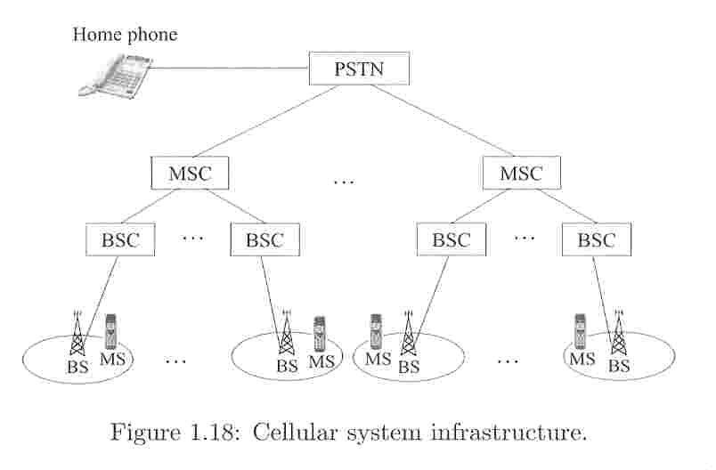
Cellular

Slide 7
Cellular
The shape of the cell
  circular around the microwave transmitting tower or base station.
  indicating a true coverage area, may be of a zigzag shape
  approximated by a hexagon
The radius of the circle
  equal to the reachable range of the transmitted signal

Slide 8
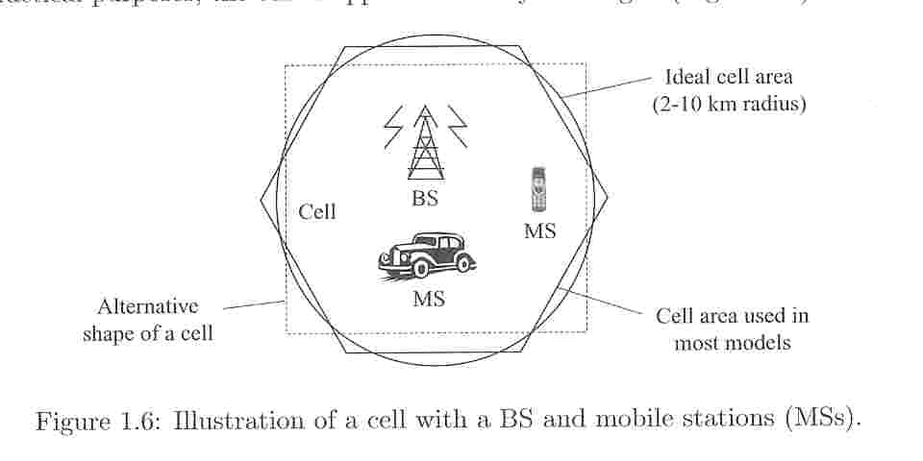
Cellular

Slide 9
Cellular
In each cell area, multiple users or subscribers are served by a single BS
Only a limited amount of bandwidth is allocated for the wireless service
  To increase the effectiveness of the overall system, some kind of multiplexing technique need to be employed
  FDMA (frequency division multiple access)
  TDMA (time division multiple access)
  CDMA (code division multiple access)

Slide 10
Circuit Switching
A dedicated channel must be created before the transmission starts
Guaranteed transmission rate
Inefficient utilization of the communication channels for many types of sessions
Example:
  Telephone network

Slide 11
Packet Switching
Need not allocate channel before transmission
Uses communication links on demand basis
Variable transmission rate
Efficient utilization of communication links
Example
  Internet

Slide 12
Duplex Operations
Simplex
Half-Duplex
  Time-Division Duplex (TDD)
Full-Duplex
  Frequency-Division Duplex (FDD)

Slide 13
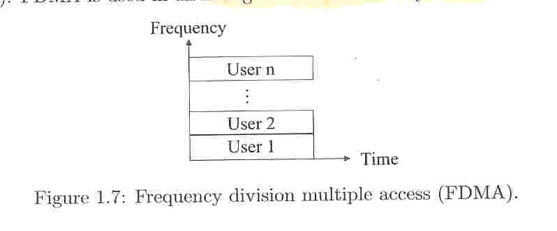
Frequency division multiple access (FDMA)
Channels
  The allocated frequency band is divided into a number of subbands
  One channel is allocated by the BS to each user
FDMA is used in all first-generation cellular systems
  AMPS (advanced mobile phone service)

Slide 14
Frequency-Division Multiple Access (FDMA)
Each user is assigned a different radio frequency (channel)
Channel information may be transmitted in a dedicated frequency
Simple but inefficient
Frequency
guard
band
. . .

Slide 15
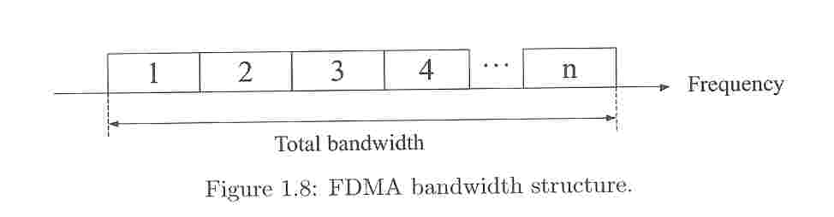
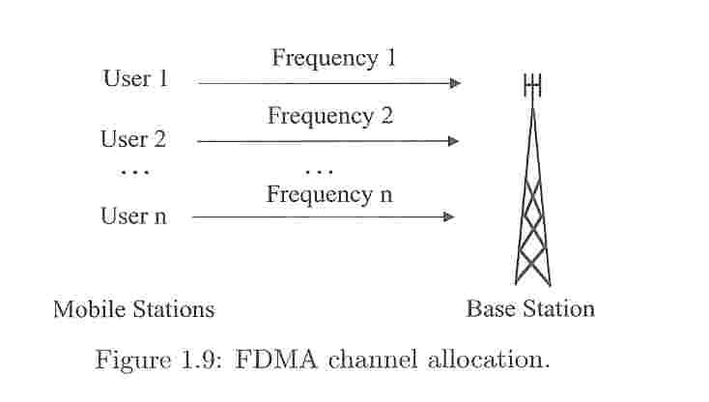
Frequency division multiple access (FDMA)

Slide 16
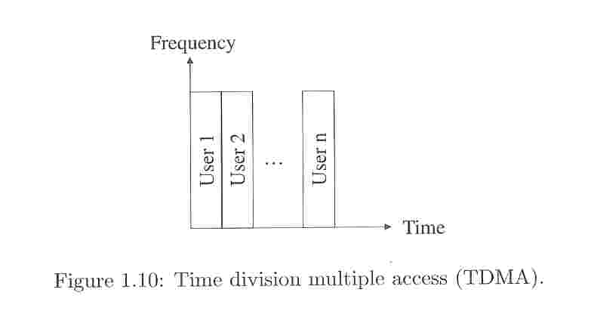
Time division multiple access (TDMA)
One channel is used by several users, with BS assigning time slots for different users, and each is served in a round-robin method
Most second-generation cellular systems are based on TDMA

Slide 17
Time-Division Multiple Access (TDMA)
Users are assigned time slots to share a physical channel
Cellular systems always overlays TDMA on top of an FDMA structure
guard time
frame
. . .
. . .
. . .
Time

Slide 18
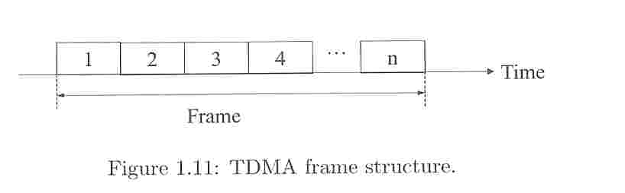
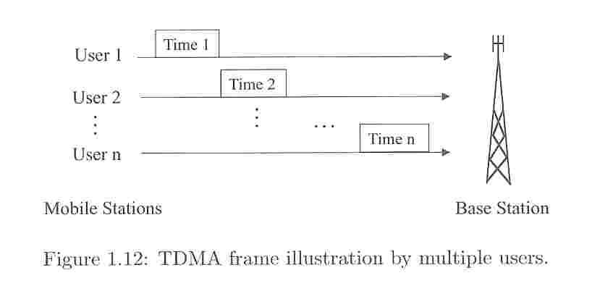
Time division multiple access (TDMA)

Slide 19
TDMA Over FDMA
Frequency
. . .
. . .
. . .
. . . .
. . . .
. . . .
Time

Slide 20
Code division multiple access (CDMA)
The third and most promising CDMA technique utilizes a wider frequency band for each user
As the transmission frequency is distributed over the allocated spectrum, this technique is also known as spread spectrum (展頻)
  One unique code is assigned by the BS to each user and distinct codes are used for different users

Slide 21
Code division multiple access (CDMA)
CDMA allows each station to transmit over the entire frequency spectrum all the time.
Each station is assigned a unique chip sequence
  to send a 1 bit, sends its chip sequence
  to send a 0 bit, sends the complement
  all chip sequences are pairwise orthogonal
  to receive, just compute the normalized inner product

Slide 22
CDMA: Basic Principle
Break each bit into k chips
  according to a fixed pattern specific to each user
  Bit data rate D ⇒ kD chips per second
Example: the code for A: c_{A}=⟨1,-1,-1,1,-1,1⟩
k =6
1
⟨1,-1,-1,1,-1,1⟩
1 -1 -1 1 -1 1
×
1 -1 -1 1 -1 1
User A
Decoding
function
1 1 1 1 1 1
Σ=6
0
⟨-1,1,1,-1,1,-1⟩
-1 1 1 -1 1 -1
(complement)
×
1-1 -1 1 -1 1
-1-1 -1-1 -1 -1
Σ=-6

Slide 23
CDMA: Multiple Users
User A
1
-1
-1
1
-1
1
c_{A}
User B
1
1
-1
-1
1
1
c_{B}
User C
1
1
-1
1
1
-1
c_{C}
⟨1, 1,-1,-1, 1, 1⟩
1 1 -1 -1 1 1
User B
×
1 -1 -1 1 -1 1
c_{A}
Decoding with c_{A}
1 -1 1 -1 -1 1
Σ=0
⟨-1, 1, 1,-1, 1,-1⟩
-1 1 1 -1 1 -1
User A
×
1 1 -1 -1 1 1
c_{B}
Decoding with c_{B}
-1 1 -1 1 1 -1
Σ=0
c_{A} and c_{B} are orthogonal

Slide 24
CDMA Example: k = 8
A: (-1 -1 -1 +1 +1 -1 +1 +1)
B: (-1 -1 +1 -1 +1 +1 +1 -1)
C: (-1 +1 -1 +1 +1 +1 -1 -1)
D: (-1 +1 -1 -1 -1 -1 +1 -1)
C
B+C
A+B’
A+B’+C
A+B+C+D
A+B+C’+D
S₁= (-1 +1 -1 +1 +1 +1 -1 -1)
S₂ = (-2 0 0 0 +2 +2 0 -2)
S₃ = (0 0 -2 +2 0 -2 0 +2)
S₄ = (-1 +1 -3 +3 +1 -1 -1 +1)
S₅ = (-4 0 -2 0 +2 0 +2 -2)
S₆ = (-2 -2 0 -2 0 -2 +4 0)
S₁• C = S₁× C / k = 1
S₂ • C = S₂× C / k = 1
S₃ • C = S₃× C / k = 0
S₄ • C = S₄× C / k = 1
S₅ • C = S₅× C / k = 1
S₆ • C = S₆× C / k = -1

Slide 25
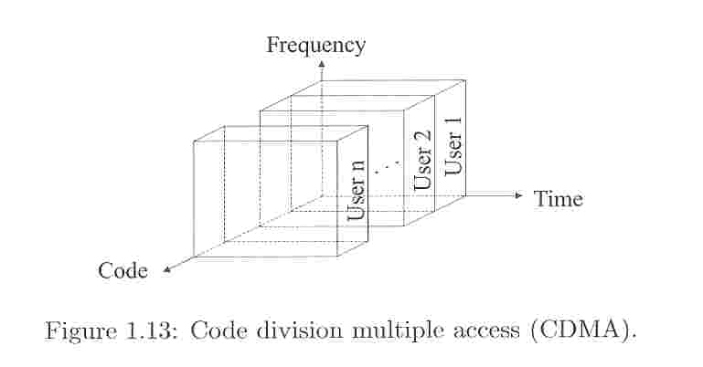
Code division multiple access (CDMA)

Slide 26
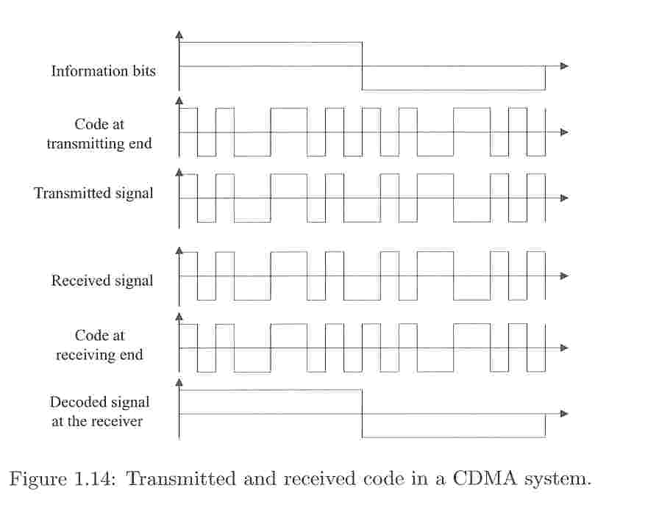
Code division multiple access (CDMA)

Slide 27
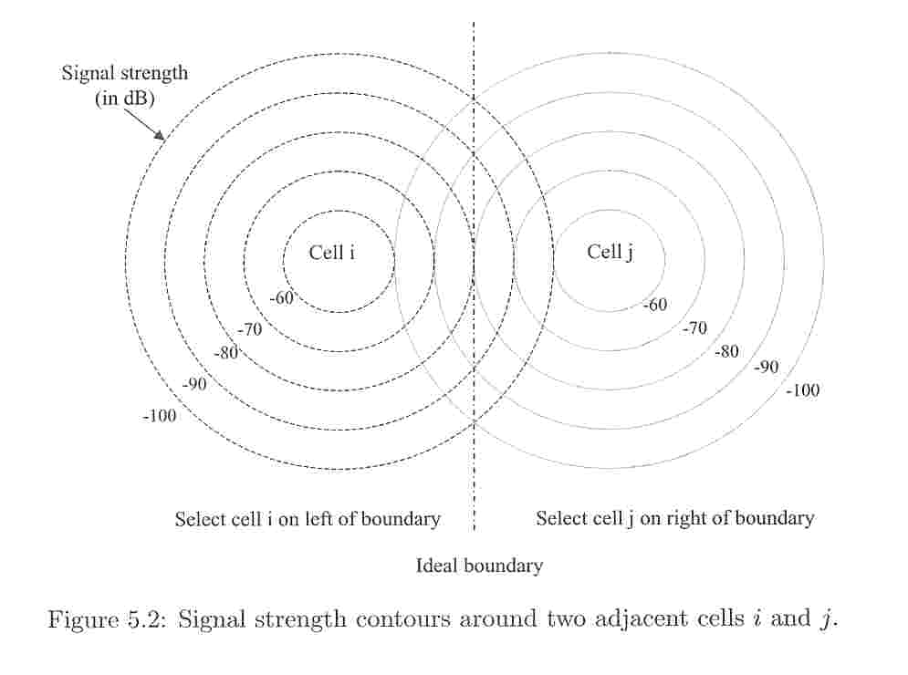
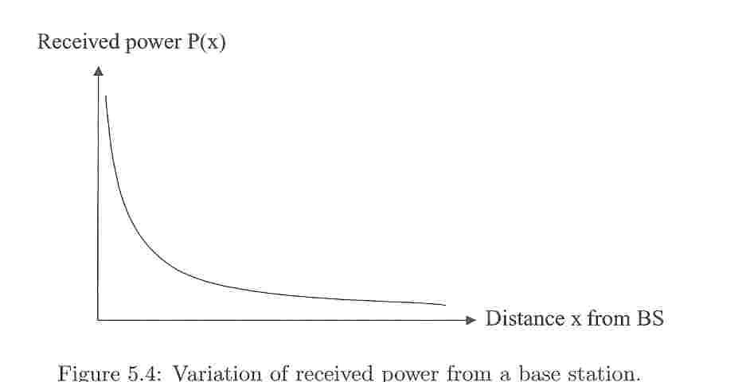
Signal Strength and Cell Parameter
As the MS moves away from the BS of the cell, the signal strength weakens, and at some point a phenomenon known as
  Handoff, hand-off, or hand off
  Handover outside North America

Slide 28
Handoff
To receive and interpret the signals correctly at the MS, the radio received signals must be at a given minimum power level Pmin.
The MS can be served by either BSi or BSj between points X3 and X4.
If the MS has a radio link with BSi and is continuously moving away toward BSj , then the change of linkage from BSi to BSj is known as handoff
ping-pong’ effect

Slide 29
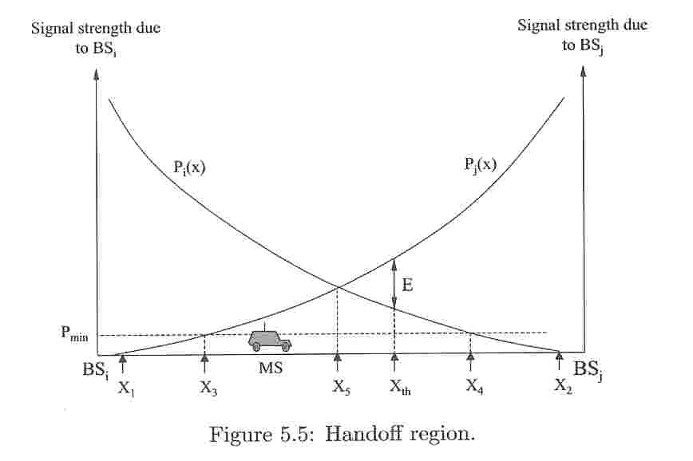
Handoff

Slide 30
Frequency Reuse
Earlier cellular systems employed FDMA, and the range was limited to a radius of from 2 to 20 km
The same frequency band or channel used in a cell can be ‘reused’ in another cell as long as the cell are far apart and the signal strength do not interfere with each other

Slide 31
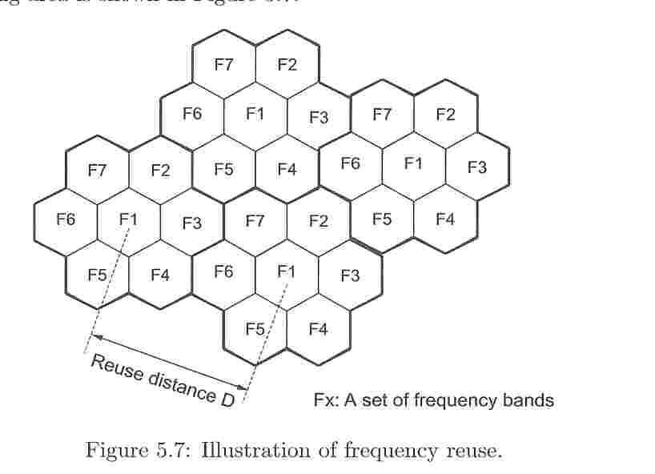
Frequency Reuse

Slide 32
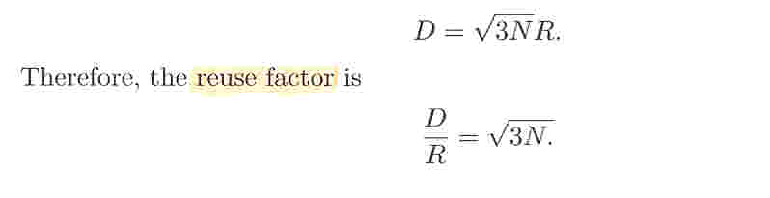
Reuse distance
The distance between the two cells using the same channel is known as the ‘reuse distance’ and is represented by D.
There is a close relationship between D, R (the radius of each cell), and N (the number of cells is a cluster), which is given by

Slide 33
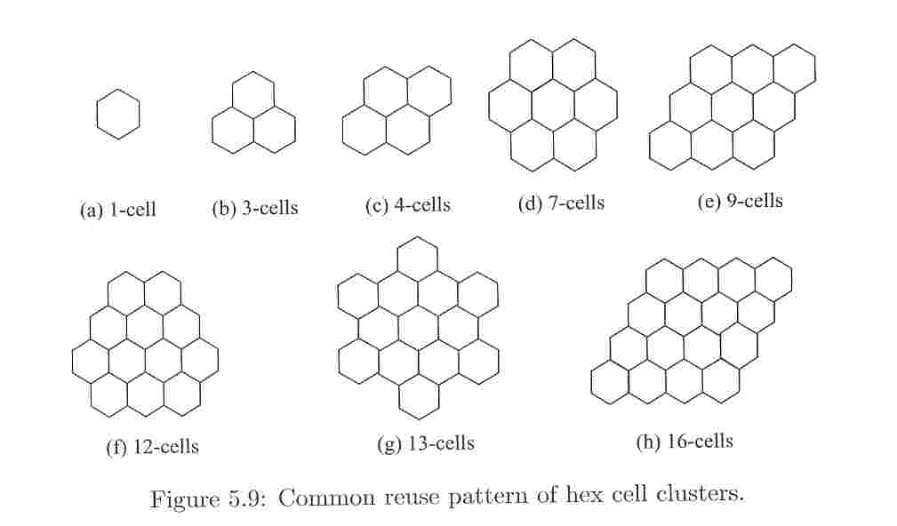
Reuse pattern

Slide 34
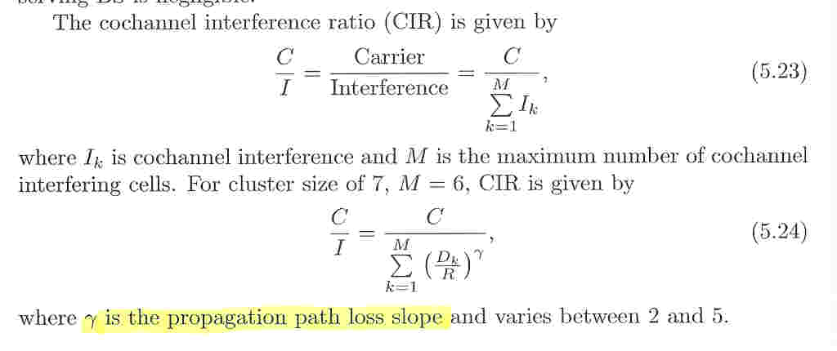
Cochannel Interference

Slide 35
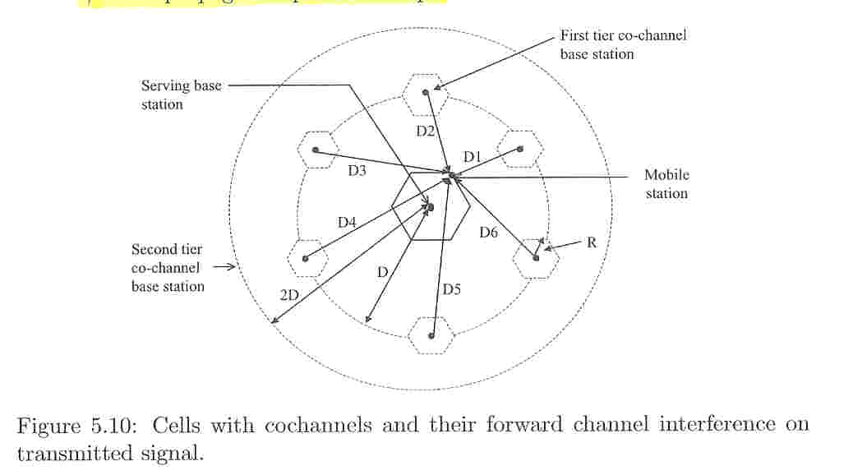
Cochannel Interference

Slide 36
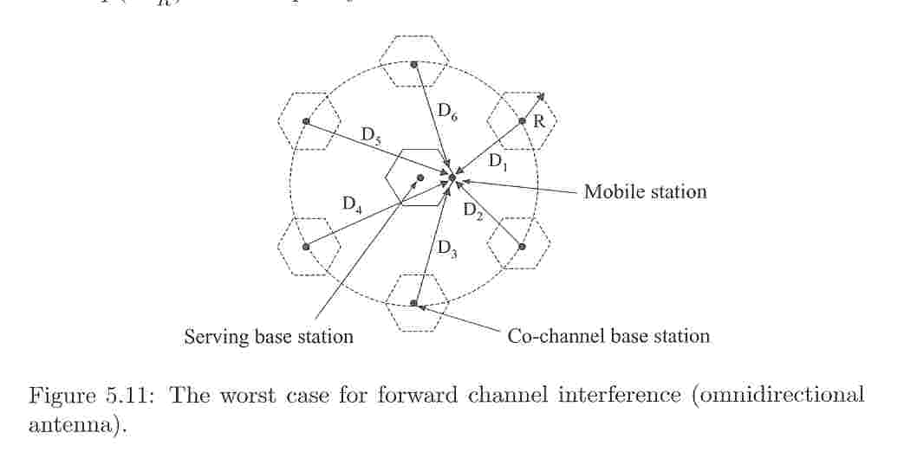
Cochannel Interference

Slide 37
Classification of Channel Assignment Schemes
Fixed Channel Assignment
  Each cell is assigned a fixed subset of frequencies
  low response time with low utilization
Dynamic Channel Assignment
  Does not give any frequency to any cell a priori
  high response time with high utilization

Slide 38
A Typical Fixed Channel Assignment Scheme
All channels are divided
into 7 disjoint sets
7
2
6
1
3
7
2
7
2
5
4
6
1
3
2
6
1
3
7
2
5
4
7
1
3
5
4
6
1
3
7
2
6
4
7
2
5
4
6
1
3
5
6
1
3
7
2
5
4
5
4
6
1
3
5
4

Slide 39
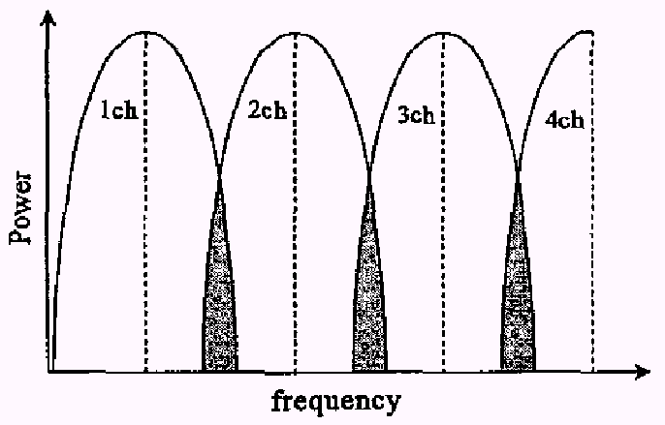
Adjacent channel interference

Slide 40
To reduce interference
Cell splitting
Cell sectoring
  directional antennas

Slide 41
訊號衰減
地形地物
  距離遠近
    訊號接收品質與發射源距離成反比
  Rice Fading
    一個直接波與數個反射波組成的訊號衰落效應
      直接波:電波傳播的路徑中，無任何阻隔，直接入射至接收機
      反射波:數個不同路徑，由不同的反射物，反射訊號後再入射至接收機
    行動接收需考慮所有的直接波與反射波還必須加上都普勒效應
  Rayleigh Fading(multi-path fading)
    與RICE Fading 很類似，但只有反射波，無直接波的存在
移動
  都普勒效應(Doppler effect)
    訊號接收機與發射源間的相對速度所產生的頻率偏移現象
Delay spread

Slide 42
行動通訊術語 (1)
Base Station (Access Point in WLAN, Node B in WCDMA)
  架在固定位置(高點)，負責與mobile station通訊的基地台
Mobile Station
  個人或車上的行動載具，如手機
Mobile Switching Center (MSC)
  Switching center which coordinated the routing of calls in a large service area. In a cellular radio system, the MSC connects the cellular base stations and the mobiles to the PSTN. (Public Switched Telephone Network.)

Slide 43
行動通訊術語 (2)
Roaming
  漫遊，從user所申請的業者的服務範圍移動到其他業者的服務範圍
HLR/VLR (Home Location Register; Visitor Location Register)
  database for storing user profile.
Handover or Handoff
  The process of transferring a MS from a channel or a BS to another

Slide 44
行動通訊術語 (3)
Forward channel (Downlink channel): BS -> MS
Reverse channel (Uplink channel): MS -> BS
Full duplex
  TX & RX are allowed simultaneously
  GSM, IS-95, CT2, DECT
Half duplex
  TX or RX is allowed at any given time
  radio taxi, police radio
Simplex
  only one-way transmission
  paging

Slide 45
行動通訊術語 (4)
Control Channel
  Radio channels used for transmission of call setup, call request, call initiation, and other beacon or control purposes.
Page
  A brief message which is broadcast over the entire service area, usually in a simulcast fashion by many base stations at the same time.

Slide 46
第一代 (1G)
AMPS (advanced mobile phone service)
  Introduced in 1983 in the USA
  Analog Voice Technology
  666 duplex channels
  40 MHz of spectrum in the 800 MHz band
  30 KHz for one way bandwidth
  Forward and reverse channels in each pair are separated by 45 MHz
  In 1989, the FCC granted an additional 166 channels (10 MHz) to U.S. cellular service providers.

Slide 47
第二代 (2G)
Challenges for a 2nd generation cellular system
  Digital transmission
  Ciphering
  Increased transmission quality
  International roaming
  Reduced costs

Slide 48
第二代 (2G)
A: high speed, high BS power, low traffic density, few BSs.
B: low speed, low BS power, high traffic density, many BSs
US
  A: USDC (IS-54/136), DCS1900, IS-95 (CDMA)
  B: PACS
Europe
  A: GSM, DCS1800
  B: CT2 (TDD), DECT(TDD)
Japan
  A: PDC
  B: PHS (TDD)

Slide 49
2G
目前正使用的系統
  GSM
    900, 1800 MHz
    台灣、歐洲、美國 (1900)、…
  CDMA
    韓國、美國

Slide 50
GSM Standard
Parameter | (E-)GSM- 900 | GSM-1800 (DCS, PCN) | GSM-1900 (PCS) | GSM-R
Frequency Range (Uplink) | 890 - 915 MHz E-GSM: 880 - 890 Mhz | 1710 - 1785 MHz | 1850 - 1910 MHz | 876 - 880 MHz
Carrier Spacing | 200 kHz | 200 kHz | 200 kHz | 200 kHz
Duplex Spacing | 45 MHz | 95 MHz | 80 MHz | 45 MHz

Slide 51
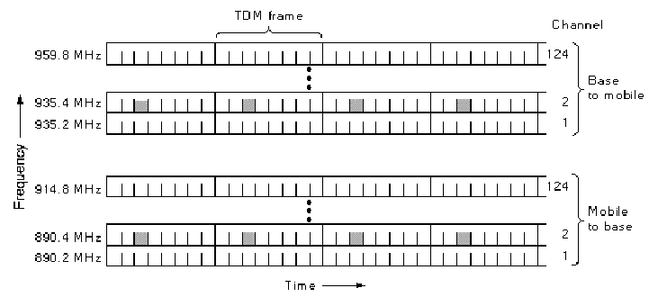
Global System for Mobile Communications
8 slots
FDM+TDM

Slide 52
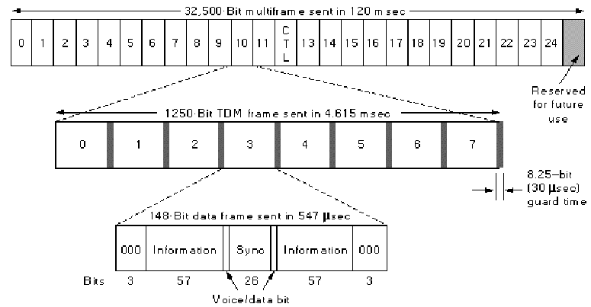
GSM
framing
framing

Slide 53
Time Division Duplex
MS and BTS do not transmit simultaneously
(MS transmits 3 time slots after the BTS)
Downlink
5
6
7
0
1
2
3
4
5
6
7
0
1
2
Uplink
2
3
4
5
6
7
0
1
2
3
4
5
6
7
Timing advance: MS transmits its data a little earlier as
demanded by the “three time slots delay rule”.

Slide 54
Timing Advance
Propagation delay
Base station
send
recv
Mobile station
recv
send
send
Original timing
Timing advance
~ Propagation delay * 2

Slide 55
GSM Frame Structure
1 hyperframe (~3.5hr)= 2048 superframes
For speech
  1 superframe = 51 multiframes = 6.12s
  1 multiframe = 26 frames = 120ms
For Signaling
  1 superframe = 26 multiframes
  1 multiframe = 51 frames
1 frame = 8 time slots = 4.615 ms
1 time slot = 156.25 bit duration = 0.577ms

Slide 56
GSM Frame Hierarchy
3.48hr
Hyper
frame
…
2047
0 1
Super
frame
…
48 49 50
6.12s
0 1
Multi-
frame
…
23 24 25
120ms
0 1
Frame
0 1 2 3 4 5 6 7
4.615ms
0.57692ms
28 bits
Time
Slot
Encrypted bits
Encrypted bits
8.25
guard bits
57 bits
57 bits
3 tail bits
3 tail bits
Training sequence
Stealing bit

Slide 57
Burst
透過GSM傳送的資料都是以burst的型式加以封裝，再將資料放入時槽中傳送。
時槽內容包括burst與guard time。
Burst的種類：
  Normal burst用於傳送使用者語音或數據資料。
  F burst放置基地台廣播的信號，讓MS校正頻率，以維持與基地台頻率上的同步。
  S burst放置基地台廣播的信號，讓MS校正時間，以維持與基地台時間上的同步。
  A burst是當手機想要打電話時，上傳A burst告知基地台欲使用無線電資源。

Slide 58
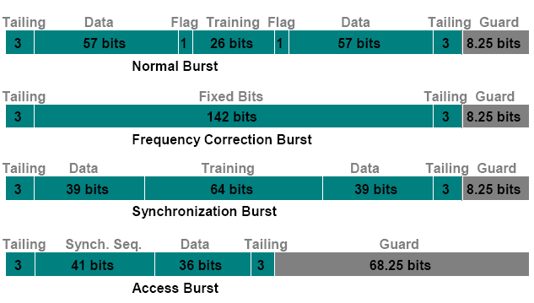
Burst

Slide 59
GSM
Control channels
  Broadcast control channel
    base station identity, channel status
  Dedicated control channel
    location management, call setup
  Common control channel
    paging channel
      announce incoming call
    random access channel (RACH)
      mobile station requests for channel
      runs slotted ALOHA
    access grant channel (AGCH)
      inform mobile station of assigned channel

Slide 60
GSM Logical Channels (I)
Speech traffic channels (TCH)
  Full-rate TCH (TCH/F)
    傳送13kbps之語音或12、6、3.6kbps的數據資料。
    使用整個Normal Burst來傳送。
  Half-rate TCH (TCH/H)
    提供7kbps語音傳輸，6或3.6kbps數位資料傳輸。
    只使用Normal burst中一個Data欄位來傳送資料。
Broadcast channels (BCH)
  基地台廣播系統資訊給各手機的邏輯通道。
  Frequency correction channel (FCCH)
  Synchronization channel (SCH)
  Broadcast control channel (BCCH)
  Cell broadcast channel (CBCH)

Slide 61
GSM Logical Channels (II)
Common control channels (CCCH)
  用於BTS對一支手機間信令的通訊，但是所有手機共用這些控制頻道，所以被稱為共用控制通道
  Paging channel (PCH)
  Access grant channel (AGCH)
  Random access channel (RACH)
Dedicated control channel (DCCH)
  BTS分配給手機的專屬邏輯通道。
  Slow associated control channel (SACCH)
  Stand-alone dedicated control channel (SDCCH)
  Fast associated control channel (FACCH)

Slide 62
Broadcast Channels (BCH)
Frequency correction channel (FCCH)
  the “lighthouse” of a BTS
  傳送F burst，提供頻率校正的資訊。
Synchronization channel (SCH)
  PLMN/base identifier of a BTS plus synchronization information (frame number)
  傳送S burst，讓MS取得與BTS訊框架構的同步。
Broadcast control channel (BCCH)
  to transmit system information 1-4, 7-8 (differs in GSM 900, GSM 1800, and PCS 1900)
  提供手機有關基地台的資料

Slide 63
CBCH and CCCH
CBCH (Cell Broadcast Channel)
  transmits cell broadcast messages
  提供簡訊的廣播服務（short message service cell broadcast messages）。
PCH (Paging Channel)
  carries PAG_REQ message
  當有電話打該手機時，BTS透過PCH呼叫手機。
AGCH (Access Grant Channel)
  SDCCH channel assignment
  基地台透過AGCH告知手機可以使用的無線電通道。
RACH (Random Access Channel)
  communication request from MS to BTS
  手機主動打電話時，手機在RACH上傳送A burst，告知基地台欲使用無線電資源。

Slide 64
Dedicated control channel
Stand along Dedicated Control Channel(SDCCH)
  傳送建立電話的控制訊號，或使用者之簡訊。
Slow Associated Control Channel (SACCH)
  非緊急的維運資訊，例如power control及time alignment等控制資訊，以及無線電線路訊號測量結果
Fast Associated Control Channel (FACCH)
  傳送time-critical signaling，包括電話線路的設定、authentication以及handover
  FACCH佔用訊務通道的時槽。

Slide 65
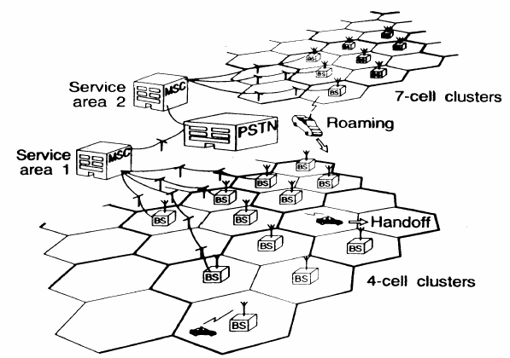
第二代系統架構

Slide 66
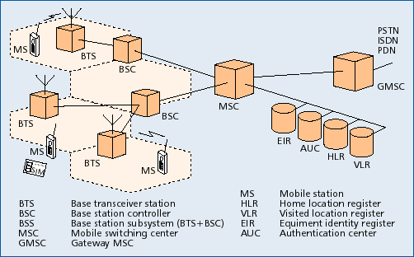
GSM 架構

Slide 67

Call Delivery for Mobile Terminated Call
request roaming number
GMSC
(INTX)
1
HLR
1
VLR
dial MSISDN
2
2
1
1
allocate MSRN
3
MSC
other
switches
routing
other
switches
3
3
paging
MS

Slide 68
Handoff Management
Ongoing calls are modified under two conditions: signal strength deterioration and user mobility
intra-cell and inter-cell handoffs
  within and between cells
soft handoff and hard handoff
  without and with interruptions in radio links

Slide 69
Technical Terms
Call drop rate
  The probability that an ongoing call is dropped due to handoff
Call blocking rate
  The probability that a new call is denied due to lack of available channel
Usually call drop rate is more important than call blocking rate

Slide 70
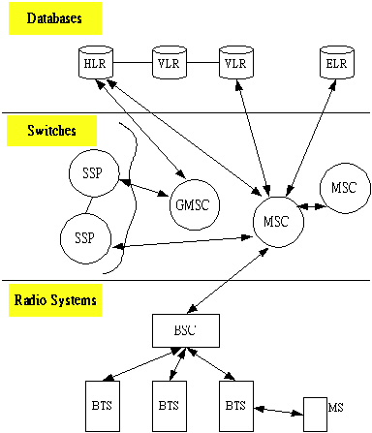
GSM Architecture

Slide 71
Periodical Registration
MS 在roaming 時，藉由註冊程序，HLR 隨時可知道手機的正確位置。
但GSM 亦要求手機定期向網路再註冊（reregistration）。
系統會告訴MS periodically registration 的
period，時間到時則以一般registration 的方式做註冊的動作，其週期範圍為6分鐘至24小時。

Slide 72
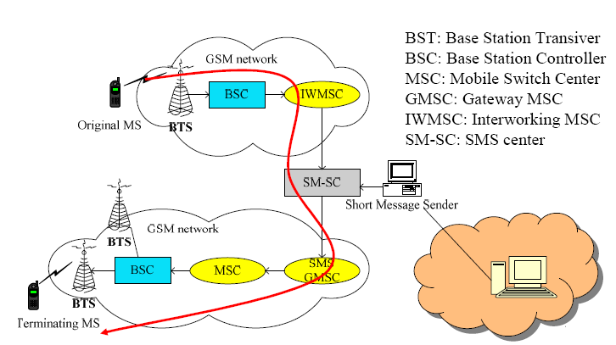
Short Message Service

Slide 73
2.5G: GPRS
GSM
Visited
MSC/VLR
Gateway
MSC/VLR
PSTN
BSS
HLR
PCU
GPRS
Gb
Gn
Gi
External
Data
Network
SGSN
GGSN

Slide 74
GPRS
General Packet Radio Service
  GSM 2+
  Packet switched
Uplink channels
  dedicated for GPRS (e.g., master channel)
  on-demand allocated to GPRS
  voice traffic has higher priority

Slide 75
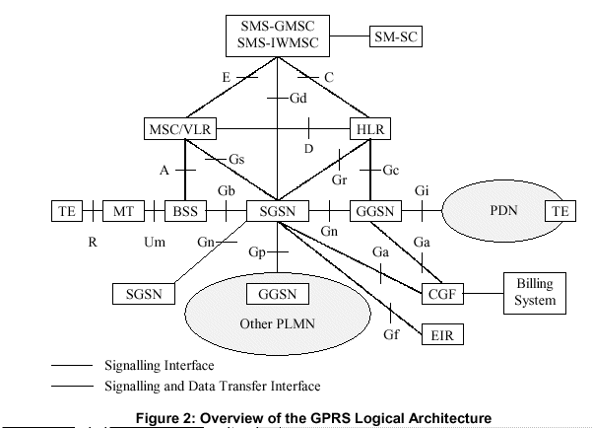
GPRS

Slide 76
SGSN and GGSN
SGSN (Serving GPRS Support Node)
  Packet routing and transfer
  Mobility management
  Attach/detach management
  Location management
  Authentication and check IMSI
  Logical link management
  Charge function
GGSN (Gateway GPRS Support Node)
  Convert packets
  Readdress of incoming data packets
  Authentication and charge function
  Interface to external PDN for SGSNs
  SGSN can route over different GGSNs

Slide 77
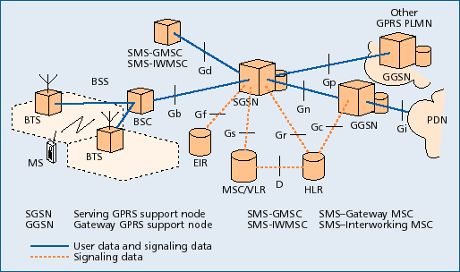
GPRS架構

Slide 78
GPRS Data Transmission
For each frequency
  TMDA: 8 time slots
  Each time slot can be used as a Packet Data Channel (PDCH)
To request for data service
  MS sends packet channel request on PRACH (Packet Random Access Channel)
  BS responds with Packet Immediate Assignment or Packet Resource Assignment on PAGCH(Packet Access Grant Channel)

Slide 79
GPRS Data Transmission
Support of QoS
  multi-slot
    A MS may request for more than one time slot which will be assigned to multiple PDCHs (up to 8, to within one frequency)
    Maximum speed: 8x21.4 = 171.2 kbps
  multiplexing
    More than one MS’s may be assigned to the same PDCH. Scheduling policy, such as round robin, is needed. Assignment is passed to MS’s using USF(Uplink State Flag)

Slide 80
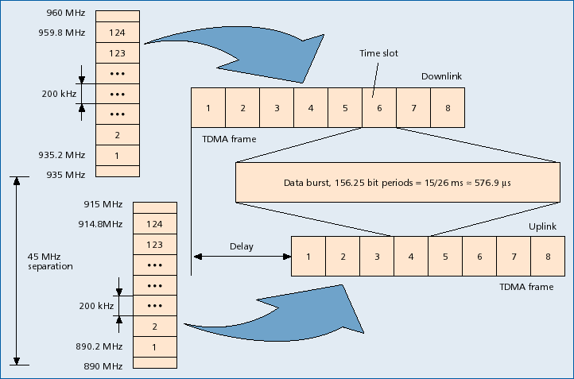
GPRS Data Transmission

Slide 81
Architecture of GPRS(con’t)
Two kinds of GPRS backbone
  Intra-PLMN backbone
  Inter-PLMN backbone
Border gateway
  Between the PLMNs and the external inter-PLMN backbone

Slide 82
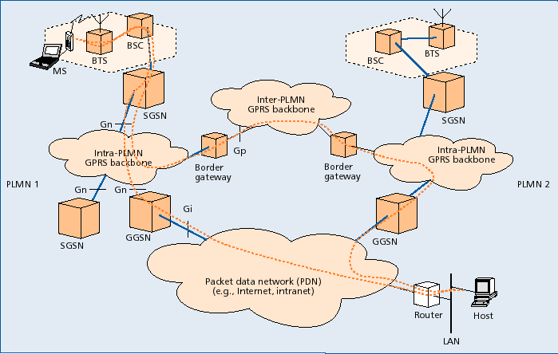
GPRS and PDN 架構

Slide 83
Operation of GPRS
Attachment
  Copy the user profile from HLR to SGSN
  Assign a packet temporary mobile subscriber identity(P-TMSI)
Detachment
  Disconnection from GPRS network

Slide 84
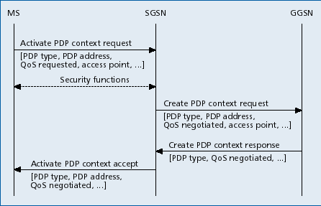
Operation of GPRS(con’t)
Session management
  PDP address
  PDP context(PDP type, PDP address, requested QoS, GGSN address)→MS, SGSN, GGSN
PDP context activation procedure

Slide 85
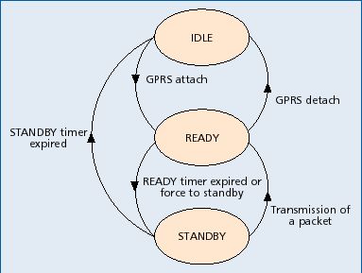
Operation of GPRS(con’t)
Location management
  Keep track of user’s current location to route incoming packets
  State model definition for GPRS location management
Two levels of mobility management:
  Micro mobility management
    Track current routing area or cell of the MS
  Macro mobility management
    Track MS’s current SGSN

Slide 86
Air Interface - Physical Layer
A combination of FDMA and TDMA for multiple access in GSM
The recurrence of one particular time slot defines a physical channel
Allow a MS to transmit on multiple time slots of the same TDMA frame in GPRS
Uplink and downlink allocated separately
PDCH: physical channels allocated by a cell for GPRS traffic
Capacity on demand principle

Slide 87
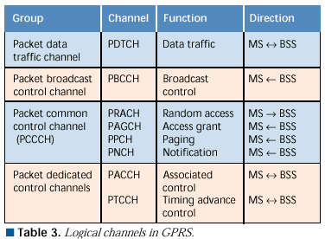
Air Interface - Physical Layer
Logical Channels in GPRS

Slide 88
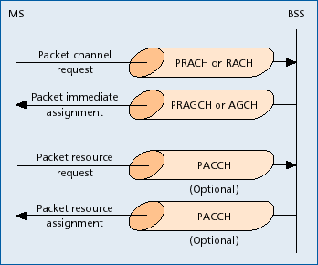
Example of Logical Channel

Slide 89
Air Interface - Physical Layer
Channel Coding
Protect the transmitted data packets against errors
Choosing of coding schemes
  Depend on the quality of the channel
  achieve either a high bit rate or strong error protection
Four different coding schemes are defined(CS-1, CS-2, CS-3, CS-4)

Slide 90
Protocol Architecture
Transmission Plane
GPRS Backbone: SGSN ­ GGSN
  GPRS Tunneling Protocol (GTP)
  Below GTP, the standard protocols TCP or UDP are employed to transport the GTP packets within the backbone network.
  Employ IP to route packets through the backbone
Subnetwork Dependent Convergence Protocol
  transfer data packets between SGSN and MS

Slide 91
Protocol Architecture
Transmission Plane(cont.)
Air Interface
  Data Link Layer
    The LLC layer provides a highly reliable logical link between an MS and its assigned SGSN
    The RLC/MAC layer
      RLC: establish a reliable link between the MS and the BSS
      MAC: controls the access attempts of an MS on the radio channel shared by several MSs.
  Physical Layer
    The PLL layer provides a physical channel between the MS and the BSS.
    The RFL layer deals with modulation and demodulation.
BSS ­ SGSN Interface
  The BSS GPRS Application Protocol (BSSGP) delivers routing and QoS-related information between BSS and SGSN.

Slide 92
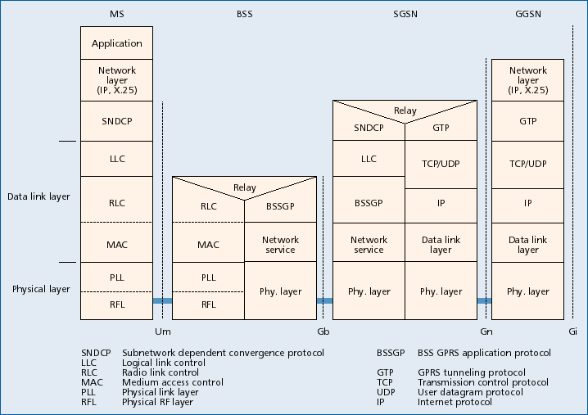

Slide 93
Signaling Plane
Signaling plane comprises protocols for control and support of the functions of the transmission plane
GPRS Mobility Management and Session Management (GMM/SM) protocol: mobility and session management
Some GSM protocols have been extended
  enhanced Mobile Application Part(MAP)
  BSSAP+

Slide 94
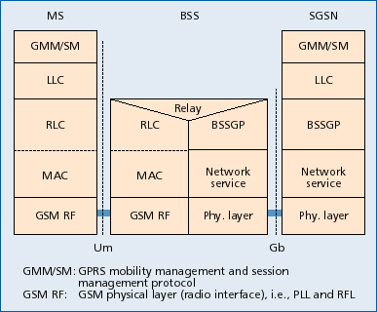

Slide 95
Conclusion
High bit rate
  9.05Kbps~21.4Kbps per channel for GSM
  Use 1~8 channel at the same time for GPRS, 171.2Kbps
  Browse WWW, e-mail …

Slide 96
Conclusion(con’t)
Use packet switching
  Circuit switching(GSM) vs. Packet switching(GPRS)
  High efficiency of using radio resource
  Support PDN protocol, e.g. IP and X.25

Slide 97
Conclusion(con’t)
High-speed call setup time
  Resource reservation
  Connect quickly like always connected
Together with GSM
  Not waste on the past resource
  Improve whole efficiency

Slide 98
Conclusion(con’t)
Use radio resource flexibly
Charge for the amount of data
Prepare for 3G

Slide 99
3G: UMTS
System architecture
  UTRAN (UMTS Terrestrial Radio Access Network)
Uu
Iu
Node B
CS
USIM
RNC
3G MSC/VLR
GMSC
Node B
RNS
Iub
Iur
HLR
Node B
ME
RNC
SGSN
GGSN
Node B
PS
RNS
UE
UTRAN
Core Network

Slide 100
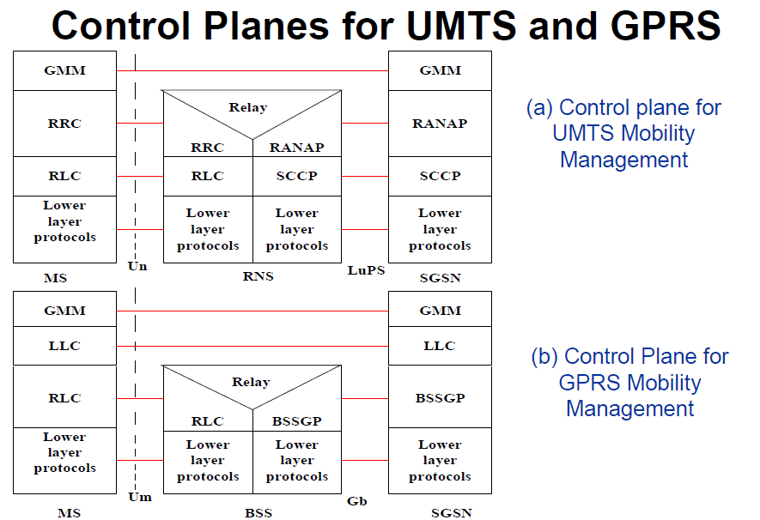


Slide 101
Control Planes for UMTS and GPRS
GPRS 中, MS 與SGSN 之間可靠的連線是由LLC 所保證. 但在UMTS 中並沒有LLC layer, SGSN 也不再負責任何與radio 相關的事務.
UMTS 切成兩斷
  Radio Resource Control (RRC) protocol 負責MS 與UTRAN 之間的可靠連線(包含所有radio resource 的管理)
  Signaling Connection Control Part (SCCP) 則負責UTRAN 與SGSN 之間的可靠連線.
  Radio Access Network Application Part (RANAP) protocol, 支援介於MS 與CN 之間的行動管理信號傳送, 而UTRAN 並不會處理這些訊號. RANAP 也負責serving RNC 的重置relocation, radio access bearer (RAB) management 等等.
  使用GPRS Mobility Management (GMM) protocol 支援行動管理功能. 在UMTS 的GMM 也稱為UMTS MM (UMM).

Slide 102
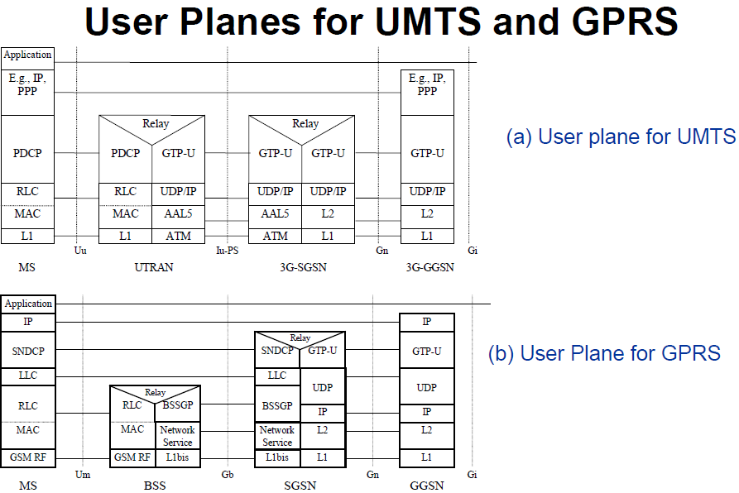

Slide 103
User Planes for UMTS and GPRS
在GPRS, SubNetwork Dependent Convergence Protocol (SNDCP) 在MS 與SGSN 之間的LLC 層的頂端, 負責傳送NPDUs (Network Packet Data Units).
在UMTS 中, 在MS 與UTRAN 的RLC 層上方的Packet Data Convergence Protocol (PDCP), 負責傳送MS 與UTRAN 之間的packet. UTRAN 與CN 間則由GTP-U (GTP for the user plane protocol) 則負責建立 在UDP/IP link (Iu link).
執行MM signaling procedures 時, 可能會lost 掉User data 的封包.

