Slide 1
Unit 06: Datapath Units

Slide 2
Outline
Adders
Comparators
Shifters
Multi-input Adders
Multipliers
Slide <number>

Slide 3
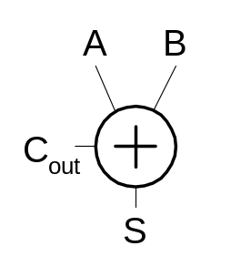
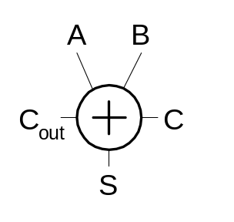
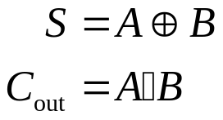
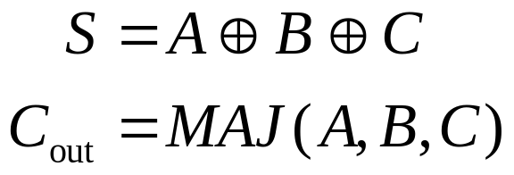
Single-Bit Addition
Half Adder Full Adder
A | B | C_{out} | S
0 | 0 | 0 | 0
0 | 1 | 0 | 1
1 | 0 | 0 | 1
1 | 1 | 1 | 0
A | B | C | C_{out} | S
0 | 0 | 0 | 0 | 0
0 | 0 | 1 | 0 | 1
0 | 1 | 0 | 0 | 1
0 | 1 | 1 | 1 | 0
1 | 0 | 0 | 0 | 1
1 | 0 | 1 | 1 | 0
1 | 1 | 0 | 1 | 0
1 | 1 | 1 | 1 | 1
Slide <number>

Slide 4
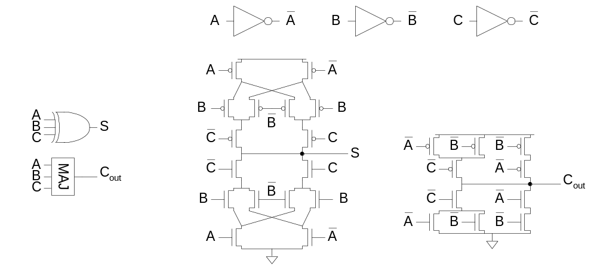
Full Adder Design I
Brute force implementation from eqns
11: Adders
Slide <number>

Slide 5
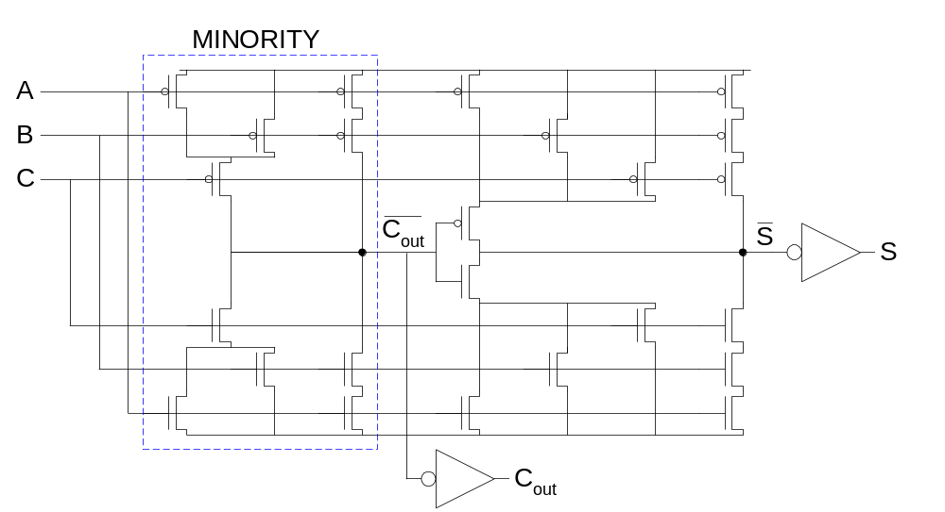
Full Adder Design II
Factor S in terms of C_{out}
S = ABC + (A + B + C)(~C_{out})
Critical path is usually C to C_{out} in ripple adder
11: Adders
Slide <number>

Slide 6
PGK
For a full adder, define what happens to carries
  Generate: C_{out} = 1 independent of C
    G =
  Propagate: C_{out} = C
    P =
  Kill: C_{out} = 0 independent of C
    K =
11: Adders
Slide <number>

Slide 7
PGK
For a full adder, define what happens to carries
  Generate: C_{out} = 1 independent of C
    G = A • B
  Propagate: C_{out} = C
    P = A ⊕ B
  Kill: C_{out} = 0 independent of C
    K = ~A • ~B
11: Adders
Slide <number>

Slide 8
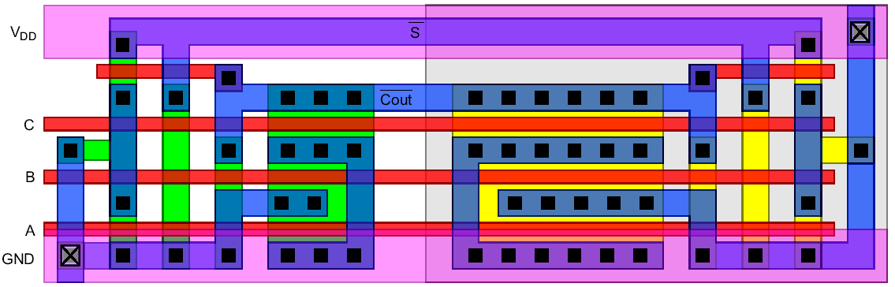
Layout
Clever layout circumvents usual line of diffusion
  Use wide transistors on critical path
  Eliminate output inverters
Slide <number>

Slide 9
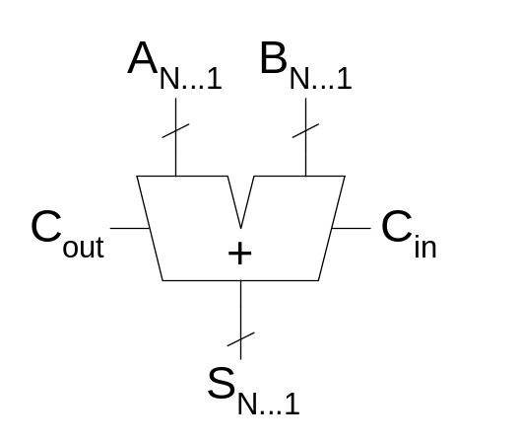
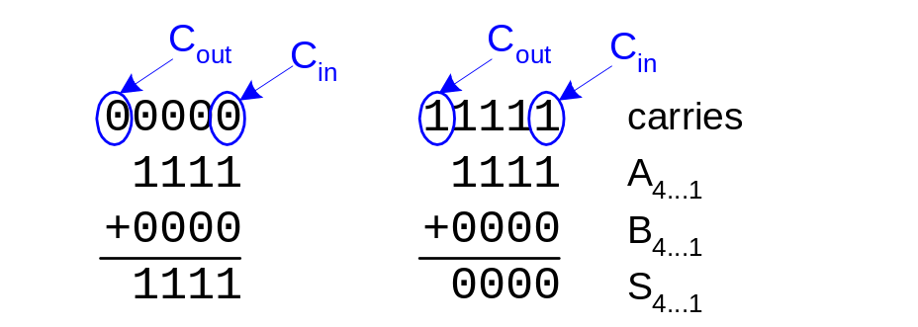
Carry Propagate Adders
N-bit adder called CPA
  Each sum bit depends on all previous carries
  How do we compute all these carries quickly?
Slide <number>

Slide 10
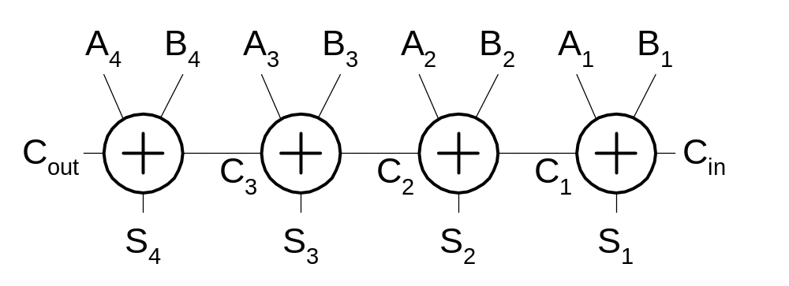
Carry-Ripple Adder
Simplest design: cascade full adders
  Critical path goes from Cin to Cout
  Design full adder to have fast carry delay
Slide <number>

Slide 11
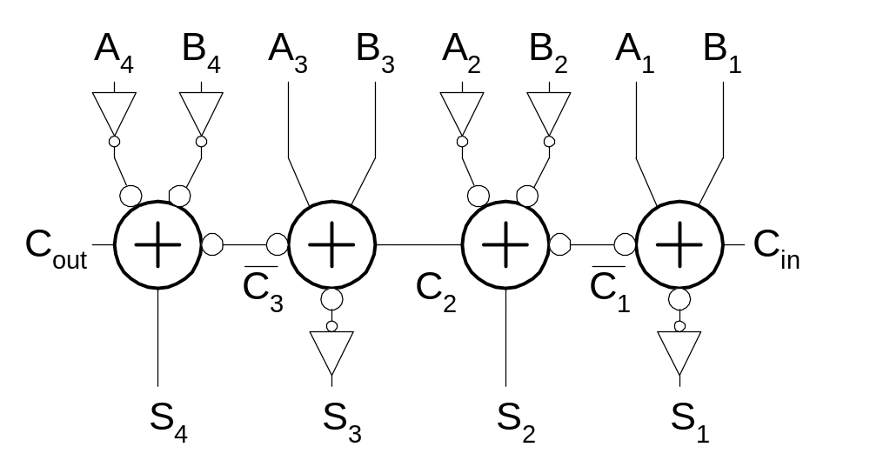
Inversions
Critical path passes through majority gate
  Built from minority + inverter
  Eliminate inverter and use inverting full adder
Slide <number>

Slide 12
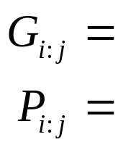
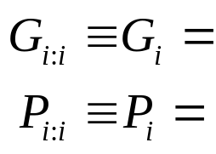
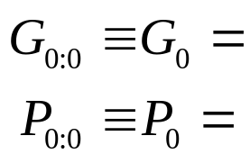

Generate / Propagate
Equations often factored into G and P
Generate and propagate for groups spanning i:j
Base case
Sum:
11: Adders
Slide <number>

Slide 13
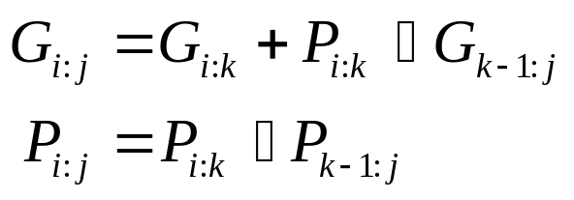
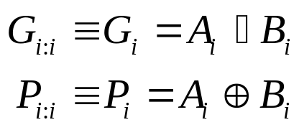
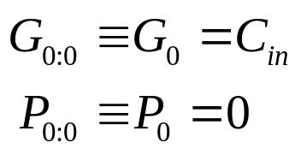

Generate / Propagate
Equations often factored into G and P
Generate and propagate for groups spanning i:j
Base case
Sum:
11: Adders
Slide <number>

Slide 14
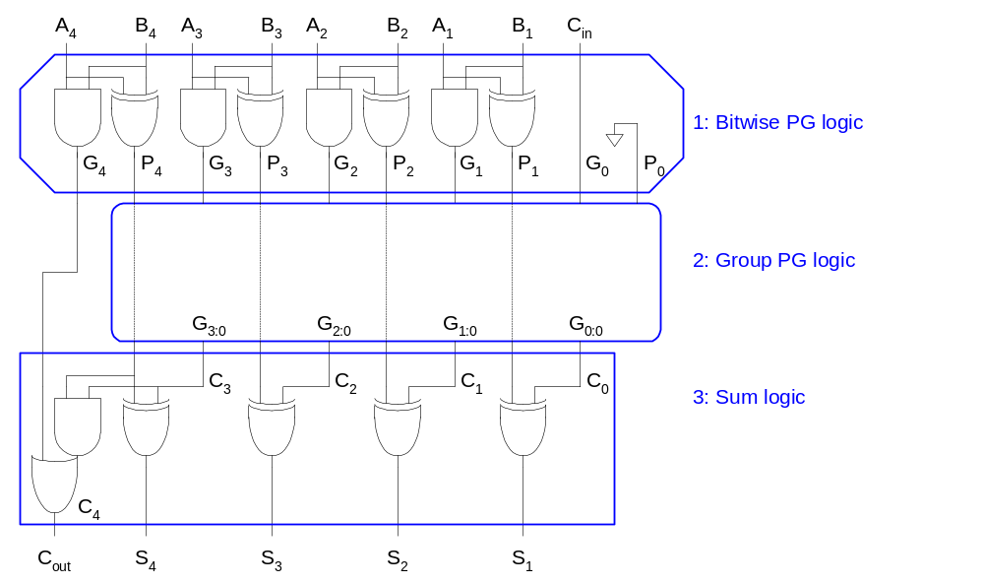
PG Logic
11: Adders
Slide <number>

Slide 15
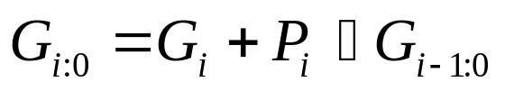
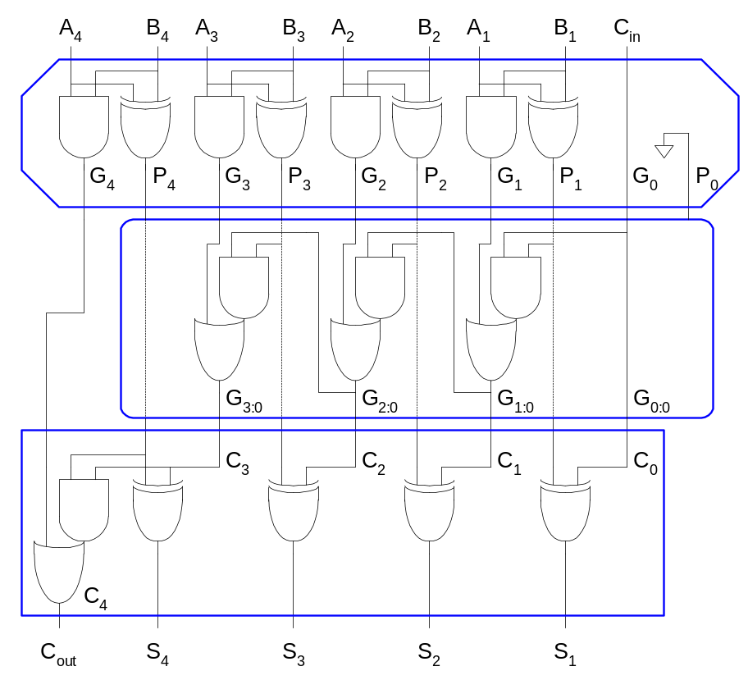
Carry-Ripple Revisited
11: Adders
Slide <number>

Slide 16
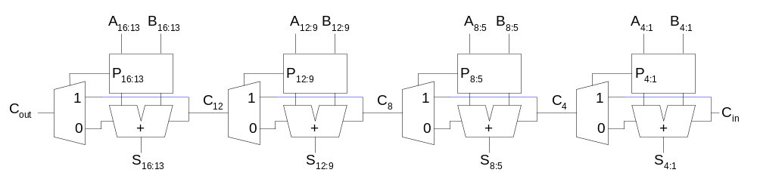
Carry-Skip Adder
Carry-ripple is slow through all N stages
Carry-skip allows carry to skip over groups of n bits
  Decision based on n-bit propagate signal
Slide <number>

Slide 17
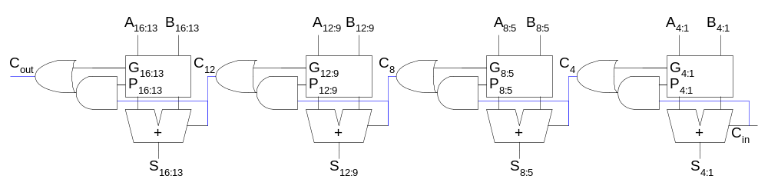
Carry-Lookahead Adder
Carry-lookahead adder computes G_{i:0} for many bits in parallel.
Slide <number>

Slide 18
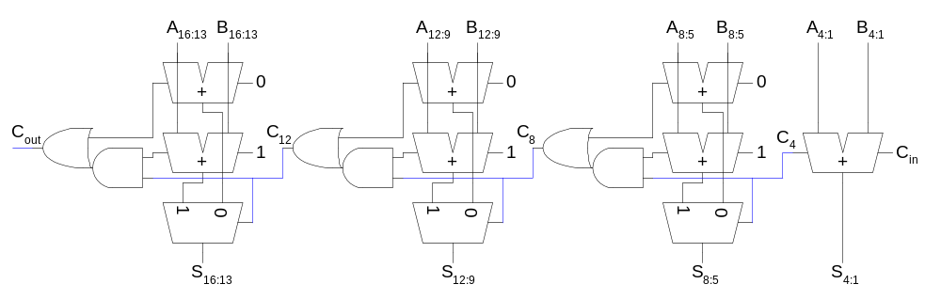
Carry-Select Adder
Trick for critical paths dependent on late input X
  Precompute two possible outputs for X = 0, 1
  Select proper output when X arrives
Carry-select adder precomputes n-bit sums
  For both possible carries into n-bit group
Slide <number>

Slide 19
Tree Adder
If lookahead is good, lookahead across lookahead!
  Recursive lookahead gives O(log N) delay
Many variations on tree adders
Slide <number>

Slide 20
Comparators
0’s detector: A = 00…000
1’s detector: A = 11…111
Equality comparator: A = B
Magnitude comparator: A < B
Slide <number>

Slide 21
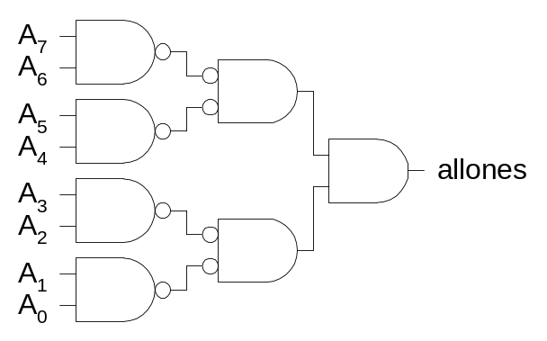
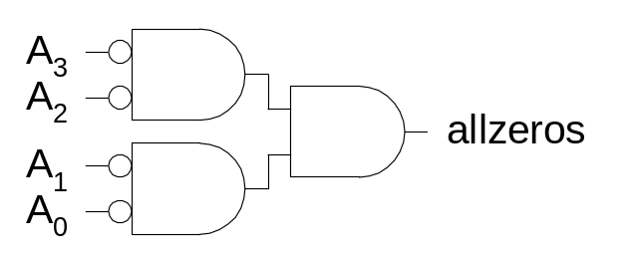
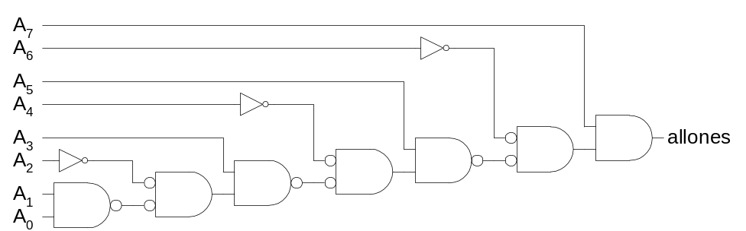
1’s & 0’s Detectors
1’s detector: N-input AND gate
0’s detector: NOTs + 1’s detector (N-input NOR)
Slide <number>

Slide 22
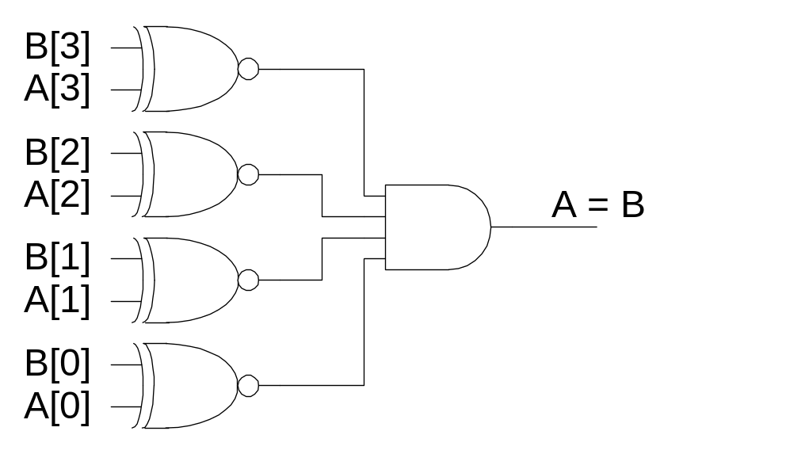
Equality Comparator
Check if each bit is equal (XNOR, aka equality gate)
1’s detect on bitwise equality
Slide <number>

Slide 23
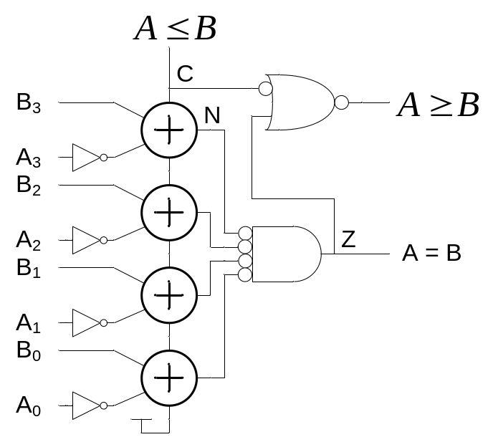
Magnitude Comparator
Compute B-A and look at sign
B-A = B + ~A + 1
For unsigned numbers, carry out is sign bit
Slide <number>

Slide 24
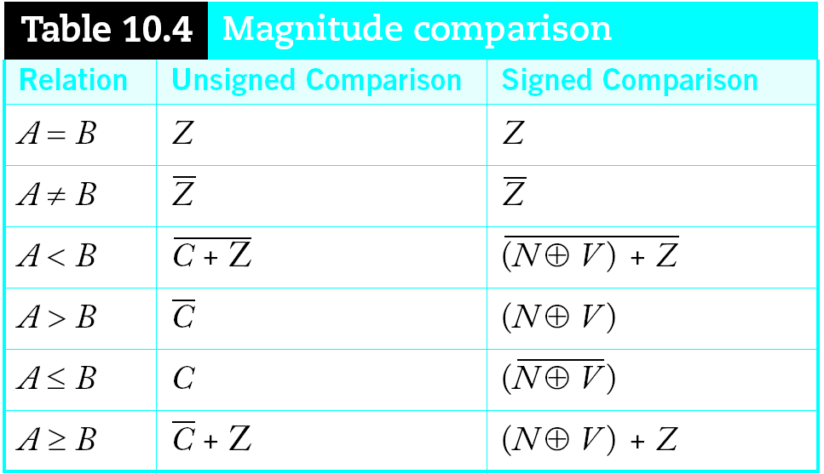
Signed vs. Unsigned
For signed numbers, comparison is harder
  C: carry out
  Z: zero (all bits of A-B are 0)
  N: negative (MSB of result)
  V: overflow (inputs had different signs, output sign ≠ B)
Slide <number>

Slide 25
Shifters
Logical Shift:
  Shifts number left or right and fills with 0’s
    1011 LSR 1 = 0101 1011 LSL1 = 0110
Arithmetic Shift:
  Shifts number left or right. Rt shift sign extends
    1011 ASR1 = 1101 1011 ASL1 = 0110
Rotate:
  Shifts number left or right and fills with lost bits
    1011 ROR1 = 1101 1011 ROL1 = 0111
Slide <number>

Slide 26
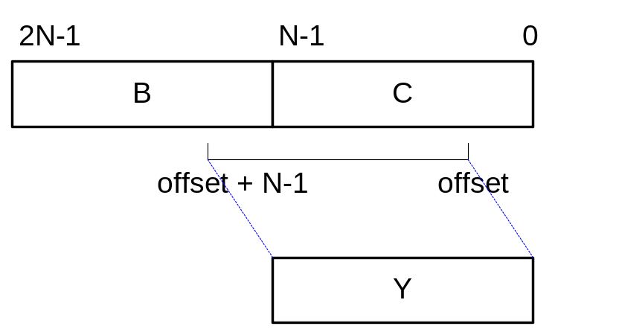
Funnel Shifter
A funnel shifter can do all six types of shifts
Selects N-bit field Y from 2N-bit input
  Shift by k bits (0 ≤ k < N)
Slide <number>

Slide 27
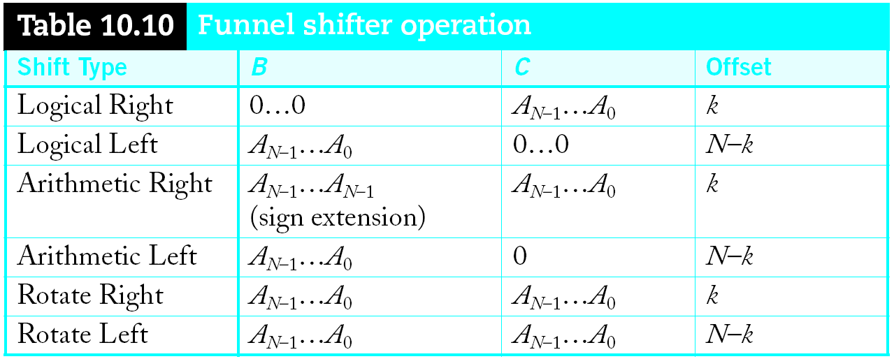
Funnel Shifter Operation
Computing N-k requires an adder
Slide <number>

Slide 28
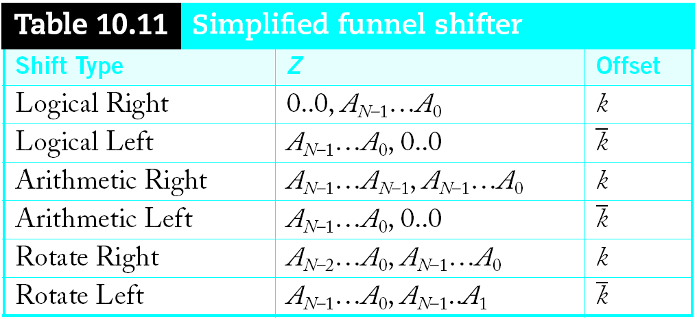
Simplified Funnel Shifter
Optimize down to 2N-1 bit input
Slide <number>

Slide 29
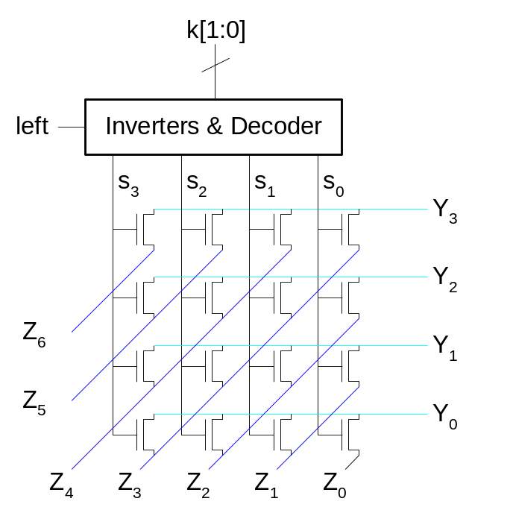
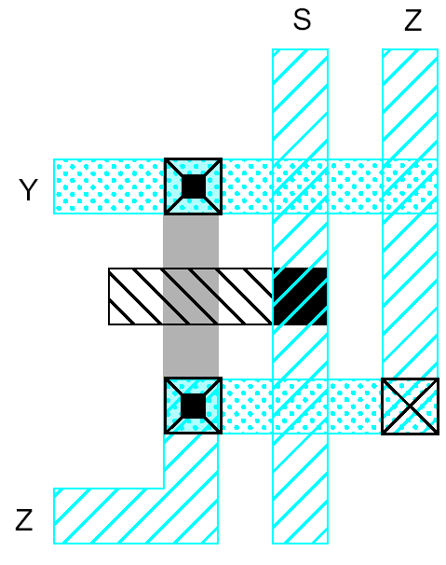
Funnel Shifter Design 1
N N-input multiplexers
  Use 1-of-N hot select signals for shift amount
  nMOS pass transistor design (V_{t} drops!)
Slide <number>

Slide 30
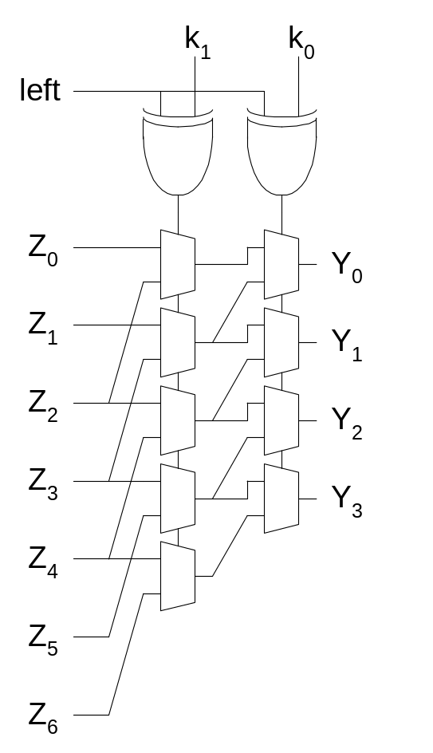
Funnel Shifter Design 2
Log N stages of 2-input muxes
  No select decoding needed
Slide <number>

Slide 31
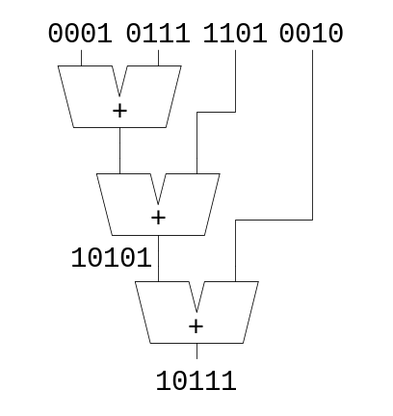
Multi-input Adders
Suppose we want to add k N-bit words
  Ex: 0001 + 0111 + 1101 + 0010 = 10111
Straightforward solution: k-1 N-input CPAs
  Large and slow
Slide <number>

Slide 32
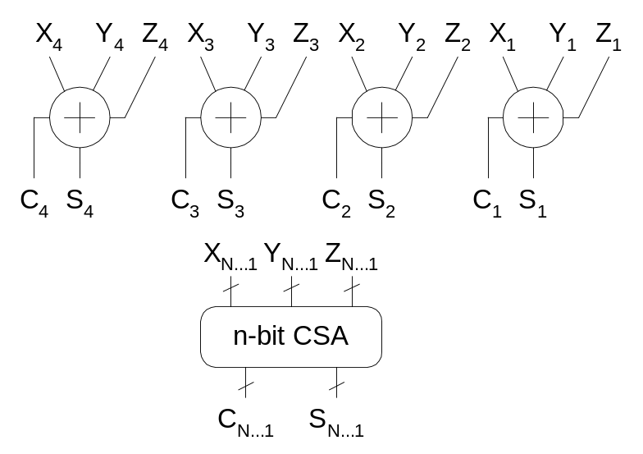
Carry Save Addition
A full adder sums 3 inputs and produces 2 outputs
  Carry output has twice weight of sum output
N full adders in parallel are called carry save adder
  Produce N sums and N carry outs
Slide <number>

Slide 33
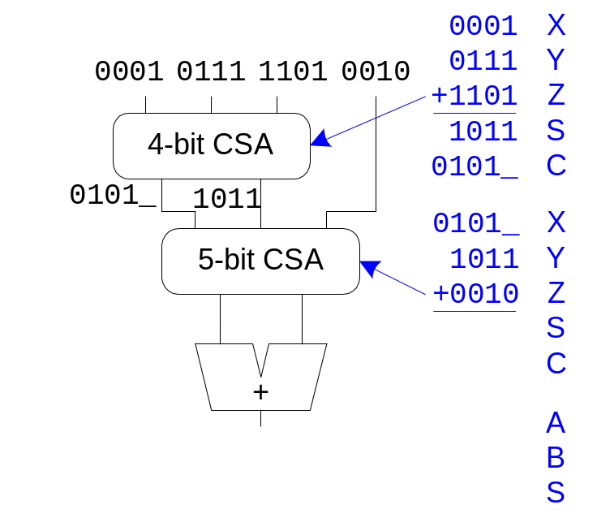
CSA Application
Use k-2 stages of CSAs
  Keep result in carry-save redundant form
Final CPA computes actual result
Slide <number>

Slide 34
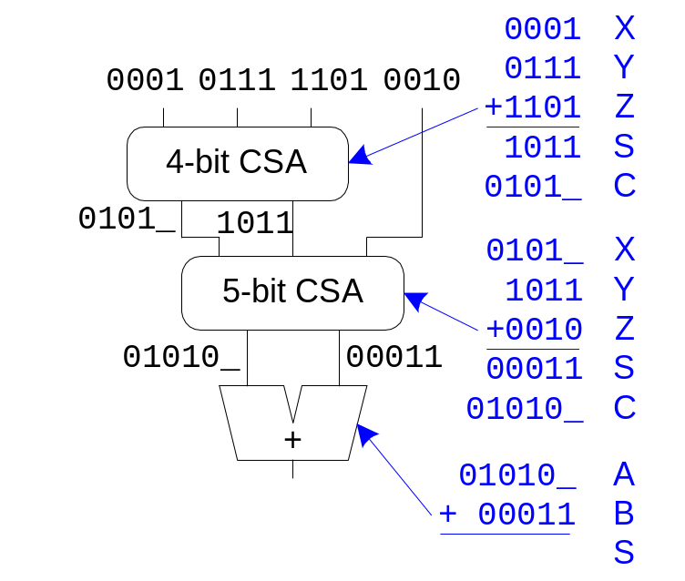
CSA Application
Use k-2 stages of CSAs
  Keep result in carry-save redundant form
Final CPA computes actual result
Slide <number>

Slide 35
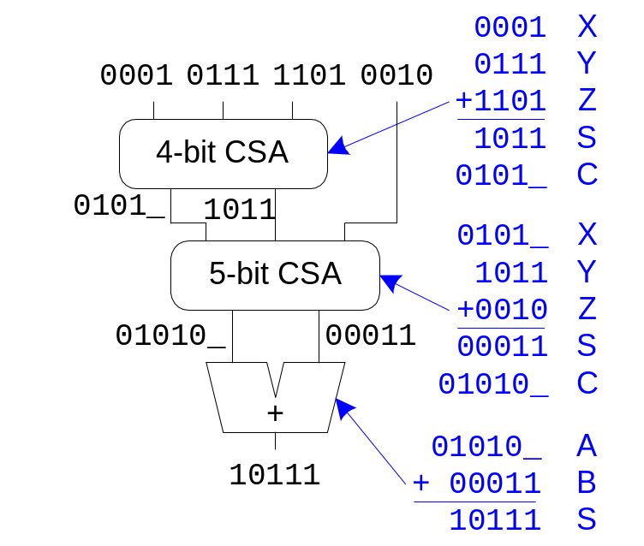
CSA Application
Use k-2 stages of CSAs
  Keep result in carry-save redundant form
Final CPA computes actual result
Slide <number>

Slide 36
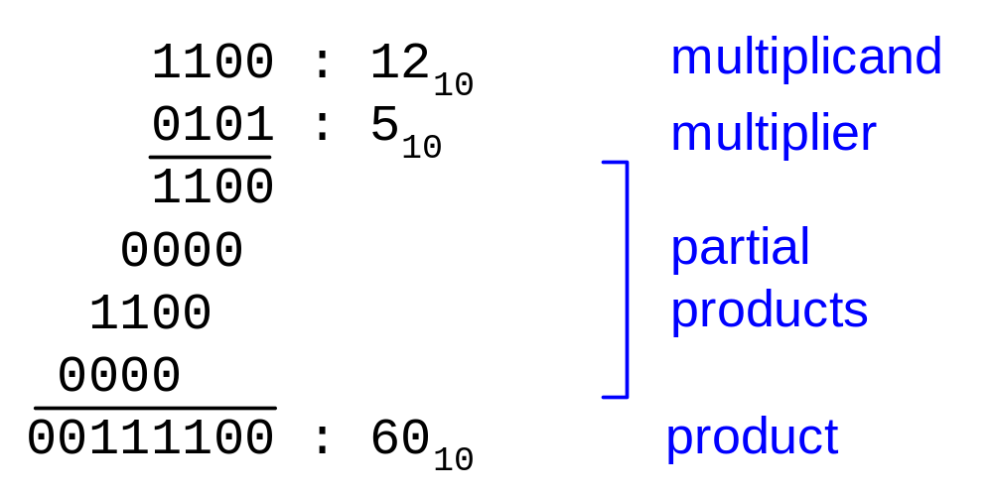
Multiplication
Example:
M x N-bit multiplication
  Produce N M-bit partial products
  Sum these to produce M+N-bit product
Slide <number>

Slide 37
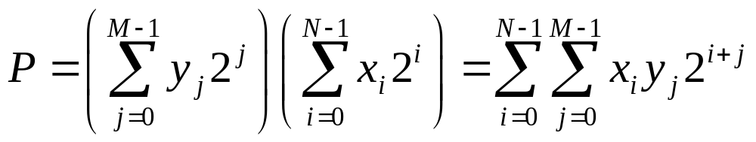
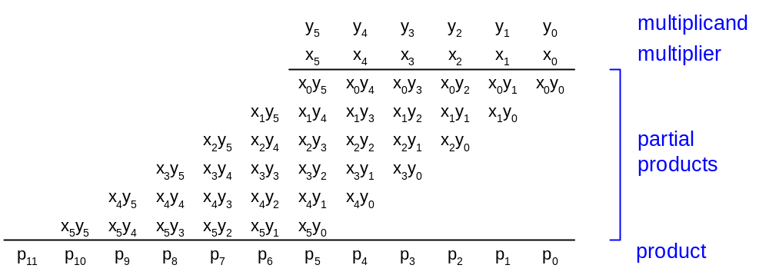
General Form
Multiplicand: Y = (y_{M-1}, y_{M-2}, …, y₁, y₀)
Multiplier: X = (x_{N-1}, x_{N-2}, …, x₁, x₀)
Product:
Slide <number>

Slide 38
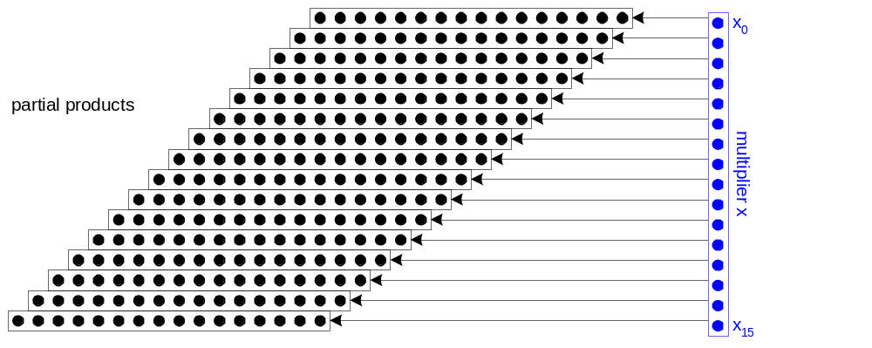
Dot Diagram
Each dot represents a bit
Slide <number>

Slide 39
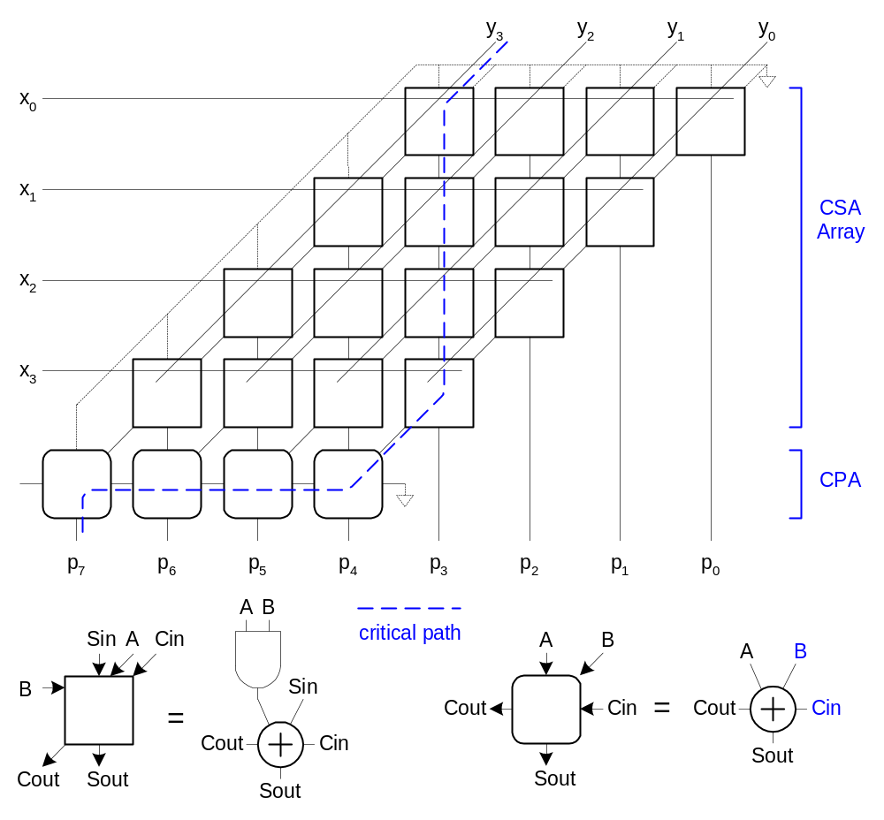
Array Multiplier
Slide <number>

Slide 40
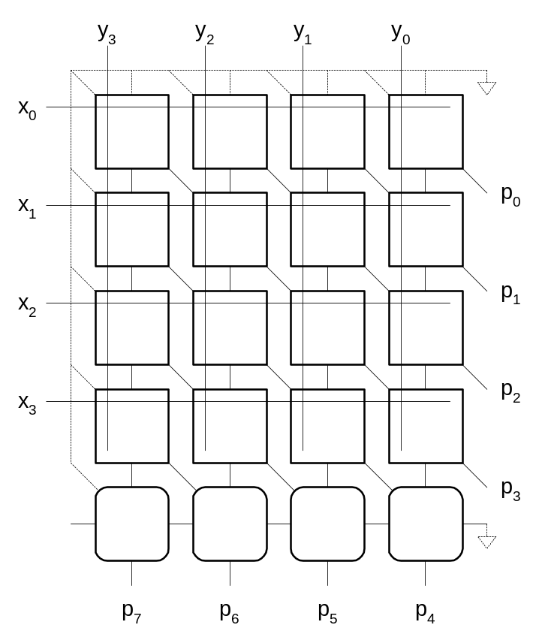
Rectangular Array
Squash array to fit rectangular floorplan
Slide <number>

Slide 41
Fewer Partial Products
Array multiplier requires N partial products
If we looked at groups of r bits, we could form N/r partial products.
  Faster and smaller?
  Called radix-2^{r} encoding
Ex: r = 2: look at pairs of bits
  Form partial products of 0, Y, 2Y, 3Y
  First three are easy, but 3Y requires adder ☹
Slide <number>

Slide 42
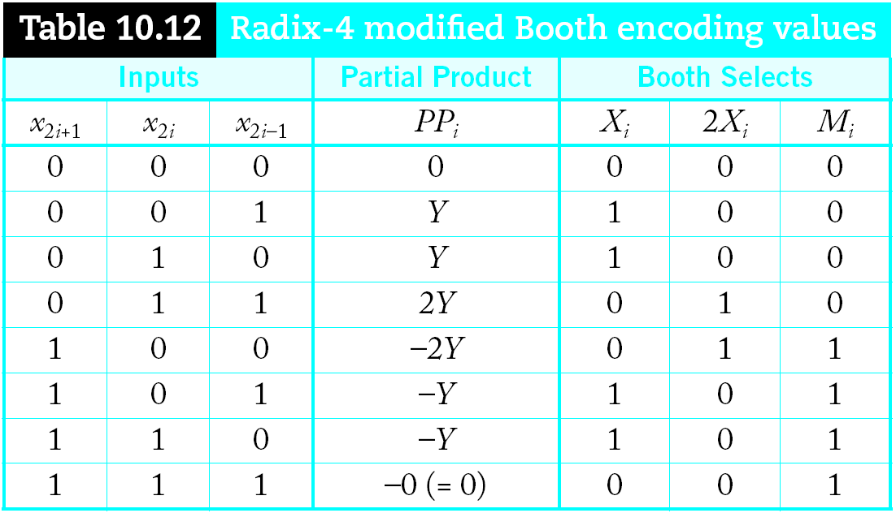
Booth Encoding
Instead of 3Y, try –Y, then increment next partial product to add 4Y
Similarly, for 2Y, try –2Y + 4Y in next partial product
Slide <number>

Slide 43
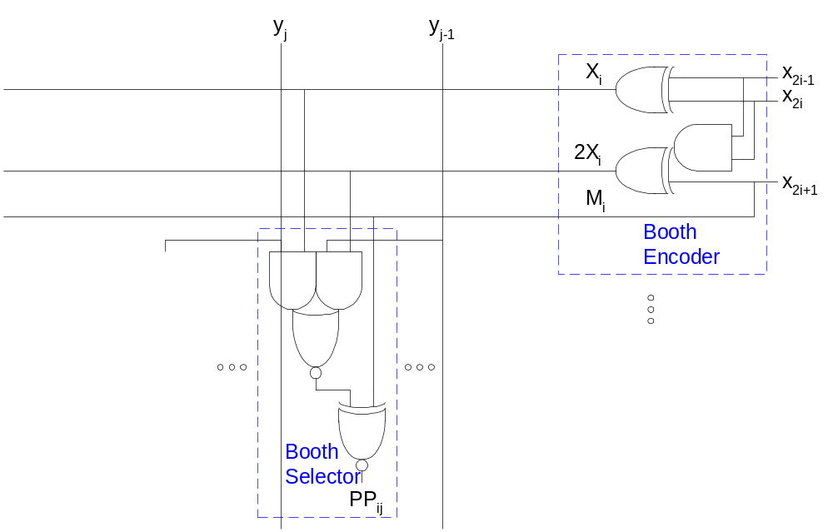
Booth Hardware
Booth encoder generates control lines for each PP
  Booth selectors choose PP bits
Slide <number>

Slide 44
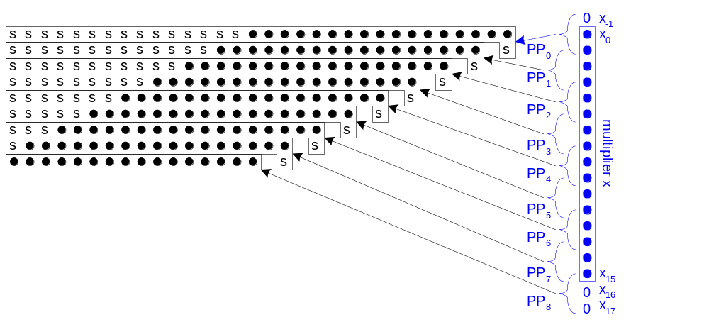
Sign Extension
Partial products can be negative
  Require sign extension, which is cumbersome
  High fanout on most significant bit
Slide <number>

Slide 45
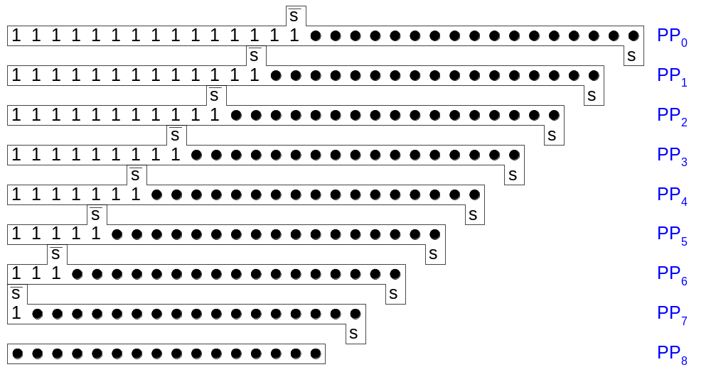
Simplified Sign Ext.
Sign bits are either all 0’s or all 1’s
  Note that all 0’s is all 1’s + 1 in proper column
  Use this to reduce loading on MSB
Slide <number>

Slide 46

Even Simpler Sign Ext.
No need to add all the 1’s in hardware
  Precompute the answer!
Slide <number>

Slide 47
Advanced Multiplication
Signed vs. unsigned inputs
Higher radix Booth encoding
Array vs. tree CSA networks
Slide <number>

