Slide 2
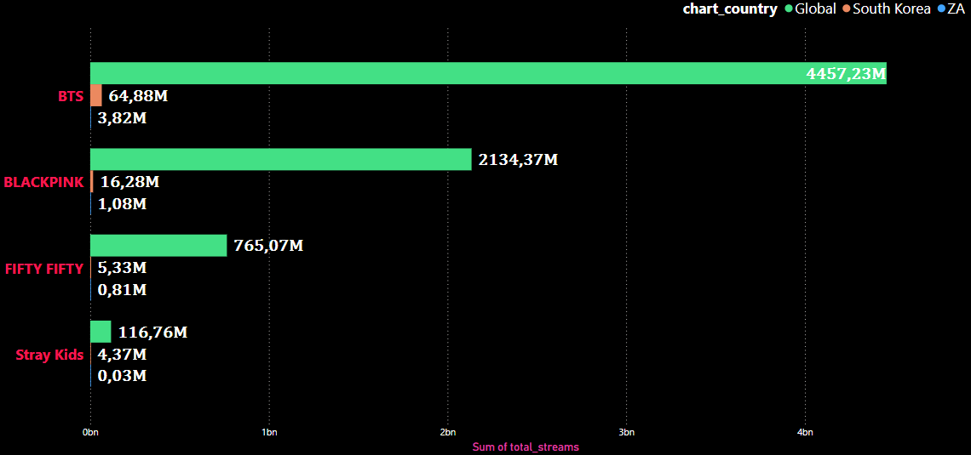
4,46 billion
2,13 billion
812 180
28 318

