Slide 1
Divvy Bike Share
Turning Casual Members Into Full Members

Slide 2
Problem
How can Divvy convert casual members into full members?
Casual members pay for a single ride or a day pass
Full members pay for an annual subscription

Slide 3
Solution
Create advertising showing advantages of commuting on bicycle
Cost effective
Environmentally friendly
No traffic
Show benefits of using Divvy over owning a bicycle
Space saving
No maintenance
Place ads at the stations most frequented by casual members

Slide 4
Analysis

Slide 5
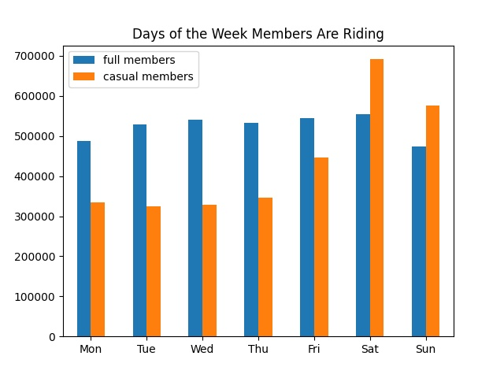
Days Members Are Riding
Spike among casual usage on the weekend
Relatively low casual usage during the week
Full member usage stays relatively steady

Slide 6
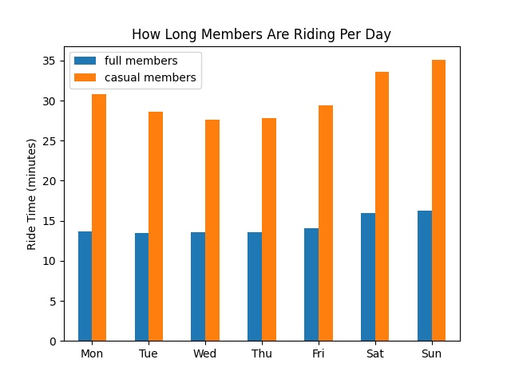
How Long Members Are Riding
Casual members take the longest rides
Casual members’ ride time increases on the weekend
Full members’ ride time remains relatively steady

Slide 7
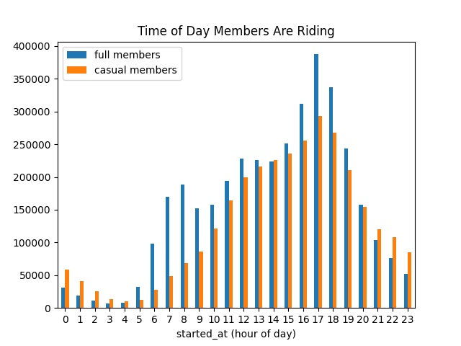
Time of Day Members Are Riding
All rider usage peaks in the late afternoon
Casual usage increases steadily through the day
Full member usage sees a smaller spike at 7-9am

Slide 8
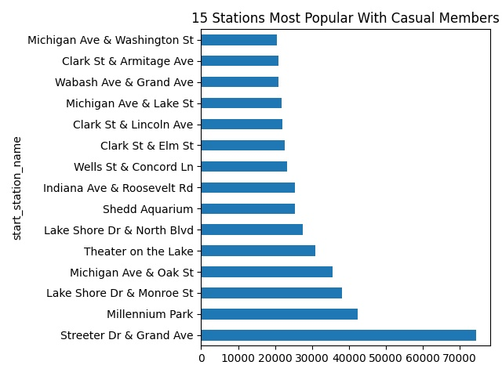
Where to Advertise

Slide 9
Who Is the Full Member?
Rides everyday
Rides for the same amount of time each day
Rides during commute hours
Someone who uses Divvy everyday on a schedule, such as for a commute

Slide 10
Who Is the Casual Member?
Uses Divvy the most on the weekends
Takes longer rides, with the longest on the weekends
Usually rides around 5:00pm
Uses Divvy for intermittent activities, such as leisure or occasional exercise

Slide 11
Summary
Full members likely use Divvy to commute and for leisure
Casual members likely use Divvy for leisure
To convert casual members to an annual subscription, they’ll need to see the benefits of commuting with Divvy.

