Slide 1
Divvy Bike Share Customer Analysis

Slide 2
Introducing Divvy
Bike sharing company in Chicago, IL
Owned by the Chicago Department of Transportation
Operated by Lyft
Users retrieve and return bicycles from stations
Users can choose electric bikes or classic bikes

Slide 3
Divvy Users
Two categories of users:
Full members
Casual members
Full members pay an annual subscription
Casual members:
Pay for a 24-hour pass or,
Pay for a single ride

Slide 4
Purpose of this Analysis
Discover how full members and casual members use Divvy differently

Slide 5
Data
Collected by Divvy
Publicly available on their website
Covers April 2020 to August 2021

Slide 6
Data Features
ride_id
rideable_type
started_at
ended_at
start_station_name
start_station_id
end_station_name
end_station_id
start_lat
start_lng
end_lat
end_lng
member_casual

Slide 7
Data Cleaning and Manipulating
Added ride_length feature
Added day_of_week feature
Removed negative ride_length values
Removed ride_length outliers

Slide 8
Analysis

Slide 9
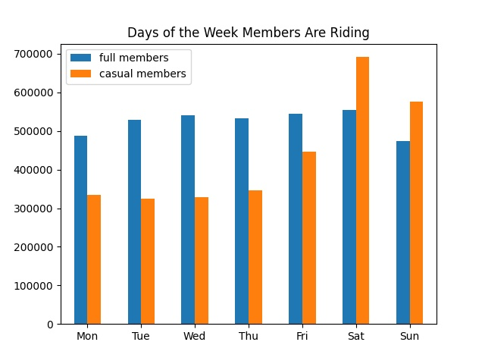
Days Members Are Riding
Relatively low casual users during the week
Spike among casual users on the weekend
Full member users stays relatively steady
CV_{full} = 5.81%
CV_{casual} = 33.3%

Slide 10
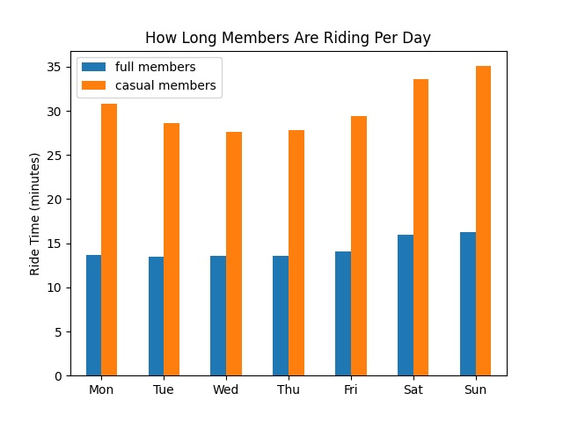
How Long Members Are Riding
Casual users take the longest rides, avg≈30min
Casual users’ ride time increases on the weekend
Full users’ ride time remains relatively steady, avg≈14min
σ_{full} = 1.21
σ_{casual} = 2.91

Slide 11
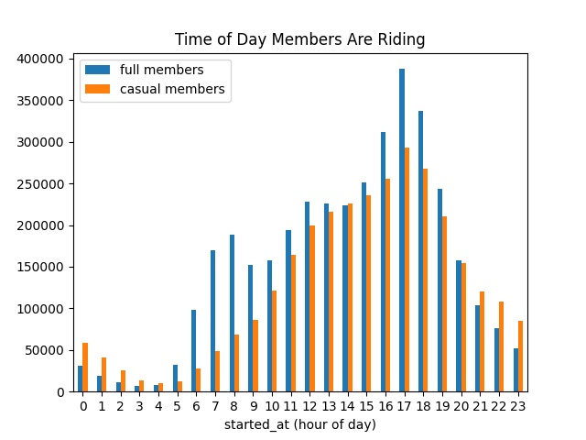
Time of Day Members Are Riding
All rider usage peaks in the late afternoon
Casual users increase steadily through the day
Full users see a smaller spike at 7-9am

Slide 12
Who Is the Full Member?
Rides everyday
Rides for the same amount of time each day
Rides during commute hours
Someone who uses Divvy everyday on a schedule, such as for a commute

Slide 13
Who Is the Casual Member?
Uses Divvy the most on the weekends
Takes longer rides, with the longest on the weekends
Usually rides around 5:00pm
Uses Divvy for intermittent activities, such as leisure or occasional exercise

Slide 14
Summary
Full members likely use Divvy to commute and for leisure
Casual members likely use Divvy for leisure

Slide 15
Appendix

Slide 16
Days Members Are Riding Summary
Full members:
count 7.000000
mean 523666.714286
std 30428.976101
min 474518.000000
25% 508194.500000
50% 533592.000000
75% 543032.500000
max 555103.000000
Casual members:
count 7.000000
mean 435614.428571
std 145219.908620
min 325418.000000
25% 332119.000000
50% 347117.000000
75% 510467.000000
max 691594.000000

Slide 17
How Long Members Are Riding Summary
Full members:
count 7.000000
mean 14.364814
std 1.205916
min 13.495684
25% 13.552917
50% 13.683586
75% 15.018388
max 16.231821
Casual Members:
count 7.000000
mean 30.408553
std 2.909379
min 27.666963
25% 28.176802
50% 29.361944
75% 32.203226
max 35.070906

Slide 18
Time of Day Members Are Riding Summary
Full members:
count 24.00000
mean 152736.12500
std 110899.37234
min 6328.00000
25% 47185.50000
50% 157565.50000
75% 226097.75000
max 387649.00000
Causal Members:
count 24.000000
mean 127054.208333
std 91713.551537
min 9729.000000
25% 46951.000000
50% 114152.000000
75% 212217.250000
max 293232.000000

Slide 19
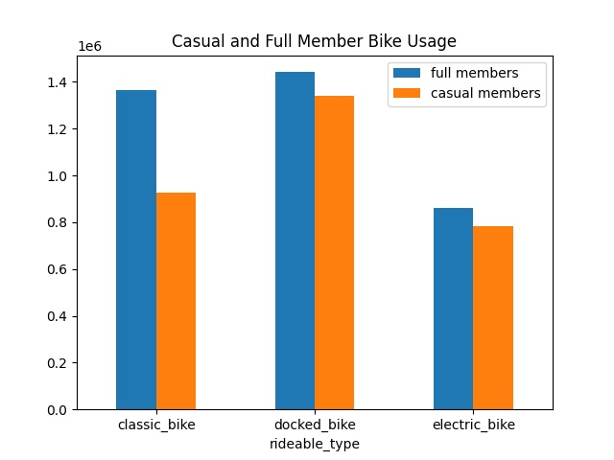

Slide 20
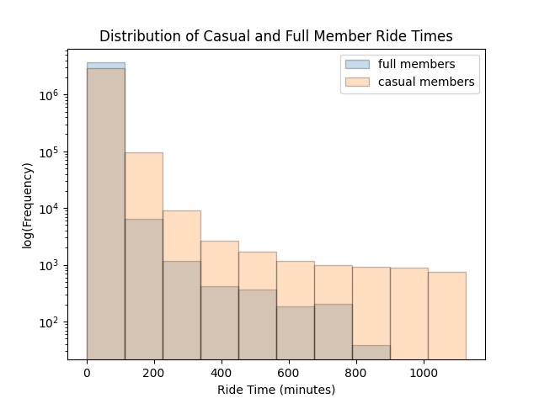

Slide 21
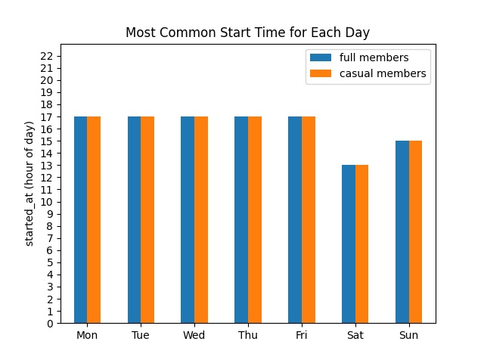
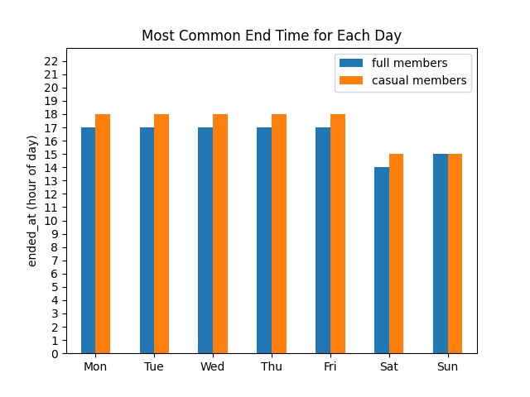
Start and End Times

Slide 22
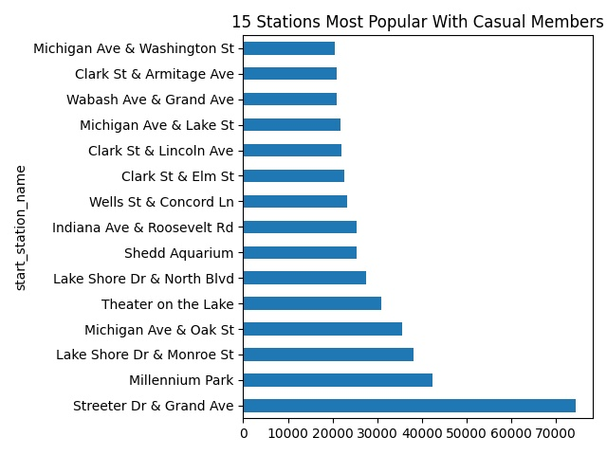
Where to Advertise

