Slide 1
面向对象软件方法学
张波

Slide 2
Textbook and Reference
Mark Priestley, 2000, Practical object-oriented design with UML (面向对象设计的UML实践), Tsinghua University Press, Reprint. Originally published: McGraw-Hill, 2000. ISBN 7302040982.
Erich Gamma, Richard Helm, Ralph Johnson and John Vlissides, 2002, Design Patterns: Elements of Reusable Object-Oriented Software, 机械工业出版社.
张波, Qt中的C++技术，2012年,机械工业出版社
Notes:
Online resources:
C++ examples.
Answers to exercises.

Slide 3
Outline of this course
Chapter 1 Introduction
Why do we need modeling?
What kinds of modeling methods available?
Why do we need UML?
Fundamental elements of UML
  Views
  Diagrams
Chapter 2 Modeling with Objects
Properties, Navigibility, Message Passing,
Strength of OOP

Slide 4
Introduction to UML
Software development
Wide sense / narrow sense
The process of software development
Requirement
Specification
Source
Code
Notes:
Concepts: documents, the dashed line (dependent relationship)
Requirement Specification can be:
Programmer’s information understanding (no documents)
Informal outline of the requirements
Formal (highly detailed) documents.

Slide 5
A more complex process
Requirement Specification
Structure Chart
Source Code

Slide 6
Model
Definition: the intermediate descriptions (documents) produced in the process.
Features:
  Abstract view of a system.
  Easy to understand.
  A valuable means for communication.
Analysis models
Design models
Notes:
Analysis models are also used in commerce and industry domain, indicating that
Analysis models can be independent of the software development process.

Slide 7
Relationship between analysis models and design models
Analysis models ➔ design models
What if different languages are used for the two phases?
Information can not be accurately translated.
OO technology: use the same kinds of models in the two phases.
  The analysis models will be preserved and recognized in the design phase.
  Design phase: just adding some details.
  Thus, the course only covers the design phase.

Slide 8

Methodologies
Methodologies
Language
Process
Models
Notations
Notes:
Methodologies: just some successful strategies used for developing software.
Notations: often in graphical forms, supplemented with text explanations.
When you document the meaning of the models out, you get notations.

Slide 9
Classes of methodologies
Structured methods
  Models
  a collection of data +
  functions external to the data
  Notations: data flow diagrams
Object-oriented methods
  Models: to be covered in Chapter 2
  Notations
  ➔ Unified Modeling Language (UML)

Slide 10
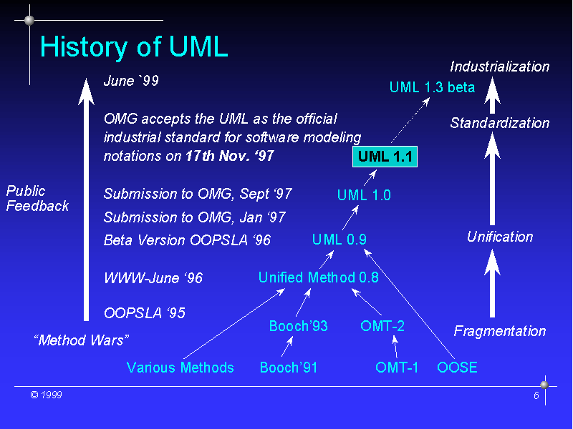
Rumbaugh
Jacobson
17/6/25
Taken from http://ias.uni-klu.ac.at/projects/uml/OTG99/sld006.htm
Notes:
OOPSLA: ACM Conference on Object-Oriented Programming, Systems, Languages, and Applications

Slide 11
A brief Introduction to UML
The dominant language in OO modeling
It can be used with a wide range of software processes
Views
Models
  Model elements
Diagrams
Notes:
Model elements: such as: classes, operations, and function calls.

Slide 12

Views
Design
View
Implementation
View
Use Case
View
Process
View
Deployment
View
Notes:
Different Views: highlight different aspects of the software system.
Use case view: the requirement of the system.
Design view: program components, principal classes, specification of the data.
Implementation view: executable files, libraries of code and databases.
Related to configuration management and system integration.
Process View: poorly developed in UML.

Slide 13
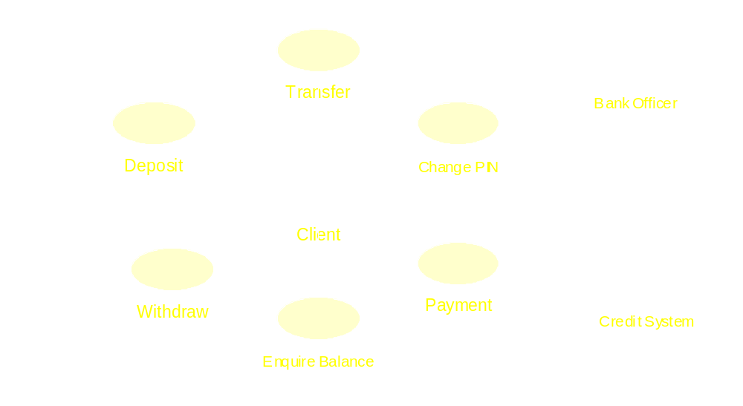
An example of the use case view

Slide 14
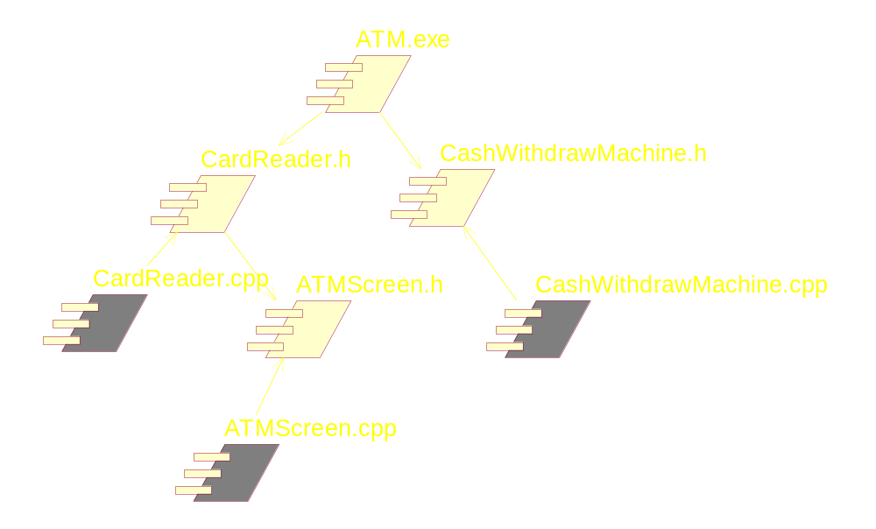
An example of the implementation view
Notes:
The yellow: task specification
The white: task body.

Slide 15
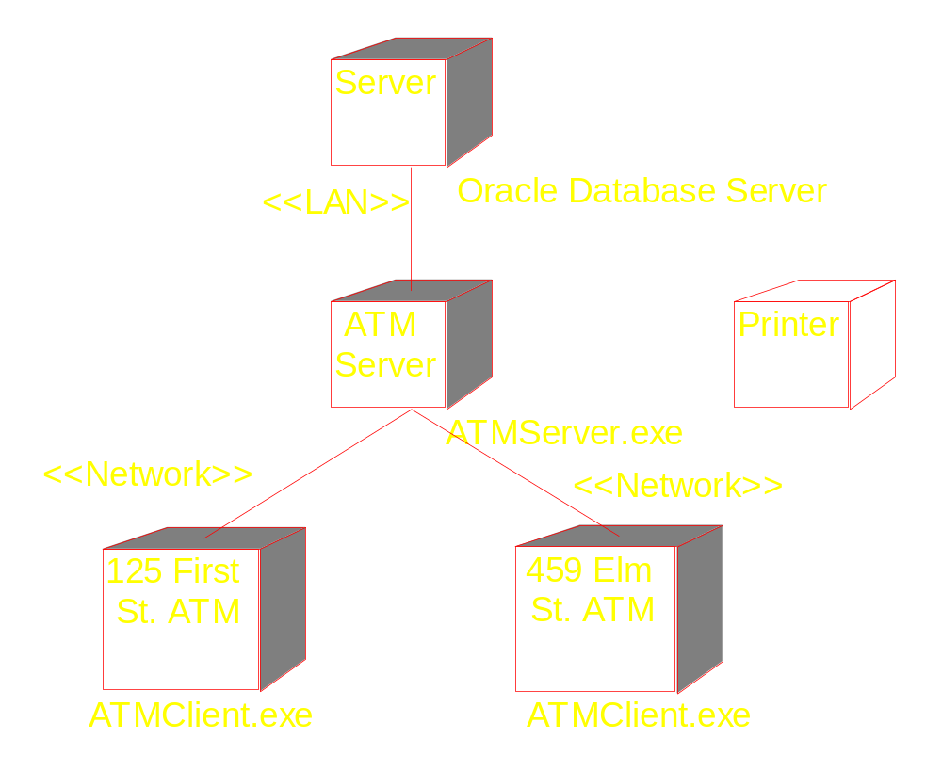
An example of deployment view

Slide 16
Diagrams
A diagram presents certain aspect of the underlying system model.
Diagrams are just like programs, but more abstract (object structure).
Do not be overwhelmed by the details of the diagrams.
Some types of diagrams can be used in both use case and design views

Slide 17
UML’s diagram types
Diagram | View
1 Use case diagram | Use case view
2 Object diagram | Use case & design view
3 Sequence diagram | Use case & design view
4 Collaboration diagram | Use case & design view
5 Class diagram | Design view
6 Statechart diagram | Design view
7 Activity diagram | Design view
8 Component diagram | Implementation view
9 Deployment diagram | Deployment view

Slide 18
The software development process
Linear or waterfall model
Analysis
Designing
Development
Testing
Deployment

Slide 19
Iterative model
Detailed Analysis
Deployment
Designing
Testing
Development
Notes:
A more accurate reflection of the way much software is in fact developed.
System development starts without a clear idea of what the system should do.
Software design is still a rather experimental activity.
But when documenting a completed system, linear mode is used.

Slide 20
Chapter 2:
Modeling with Objects
The object model
  Data + Operations
  Execution of a program: a dynamic network of intercommunicating objects.
  Nodes (object) + links (sending messages)
  The semantic foundation for UML’s design models
The stock control example
  Name,catalogue,cost

Slide 21
Objects
Design: how to split up a system’s data and overall functionality.
A frequently used rule: real-world objects
Class
myScrew:Part
name=“screw” number=28834 cost=0.02

Slide 22
Object Properties
State: the aggregate of the data values contained in an object’s attributes
Behavior
shown in the class diagram
Identity: address in memory
Object names: a convenient alias for its identity.
Notes:
Object-based encapsulation: An object’s data can only be accessed by
the object’s operations (even not the objects of the same class).

Slide 23
Avoiding data replication
Data in the previous object model is replicated
  Waste storage
  Difficult to consistently update all objects
Links

Slide 24
:Part
<Describes
:CatalogueEntry
Name=“screw”
Number=28834
Cost=0.02
:Part
Information: attributes & links

Slide 25
#include <iostream>
using namespace std;
class CatalogueEntry {
public:
CatalogueEntry(string p_name, long p_number, double p_cost){
name = p_name ;
number = p_number;
cost = p_cost ;
}
string getName() { return name;};
long getNumber() { return number; };
double getCost() { return cost;};

Slide 26
private:
string name;
long number;
double cost;
};
class Part{
public:
Part(CatalogueEntry * e){
entry = e;
}
private:
CatalogueEntry * entry;
}

Slide 27
main()
{
CatalogueEntry *screw = new
CatalogueEntry("screw",28834,0.02);
Part * screw1 = new Part(screw);
}

Slide 28
Navigability
:Part
:CatalogueEntry
Name=“screw”
Number=28834
Cost=0.02
entry
Notes:
If there is no arrowhead: bi-directional.

Slide 29
Message Passing
0.02:=cost( )
0.02:=getCost( )
:CatalogueEntry
Name=“screw”
Number=28834
Cost=0.02
client
:Part
Notes:
The first source stopped here (slide 29 of course1.ppt) on Nov. 22.
The class name can be omitted
Return values can be specified.

Slide 30
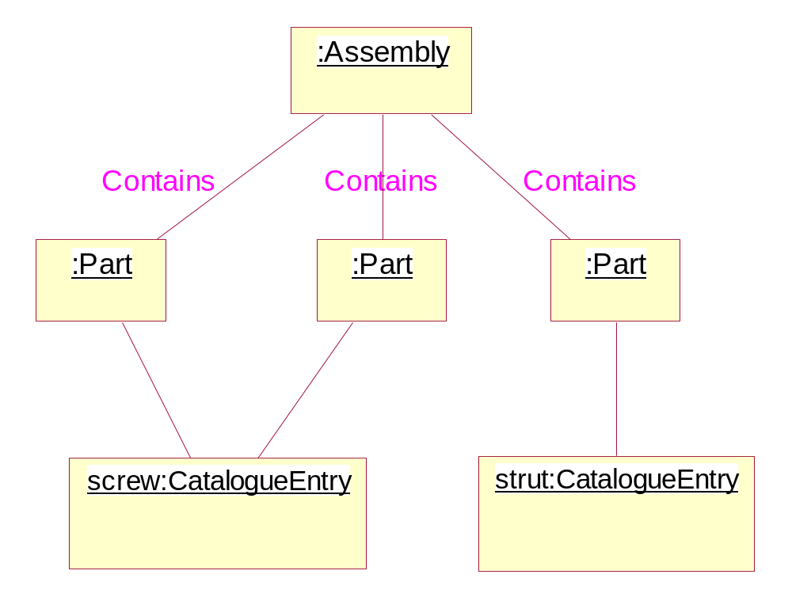
A simple structure
Notes:
Problem: No hierarchy

Slide 31
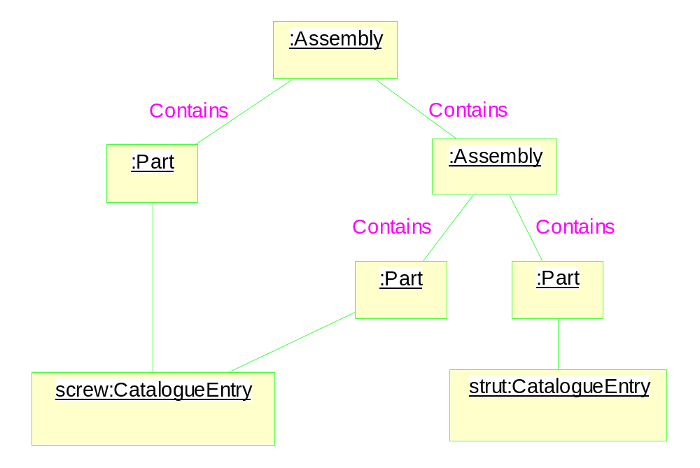
A more realistic structure
Impossible for implementation!

Slide 32
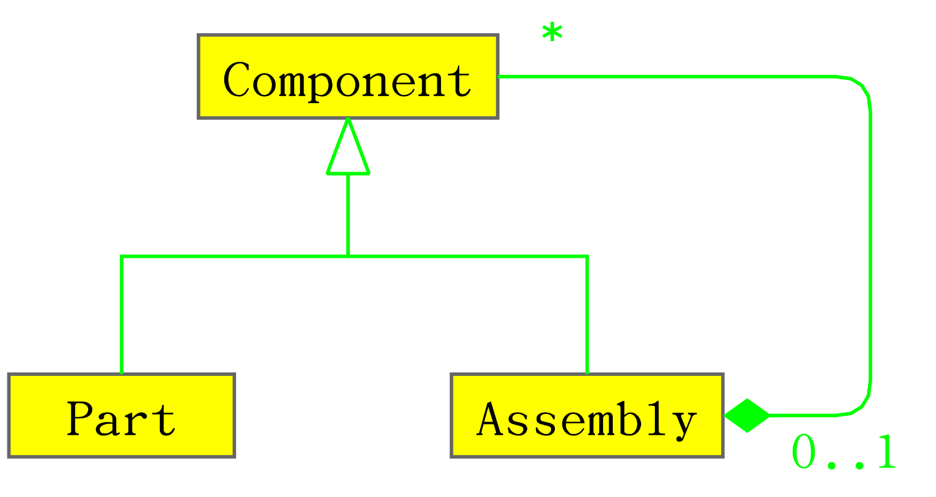
Use of abstract class

Slide 33
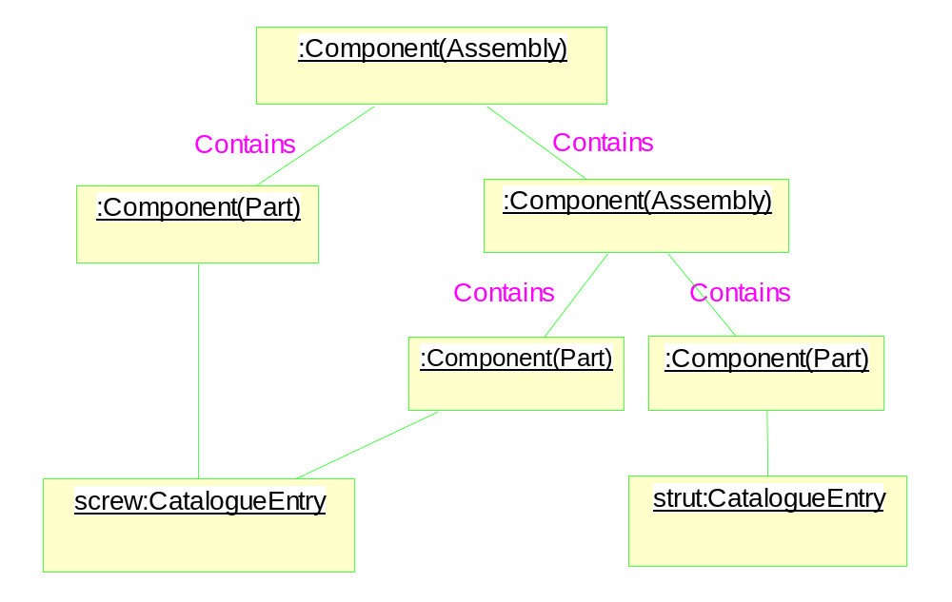
Object diagram

Slide 34
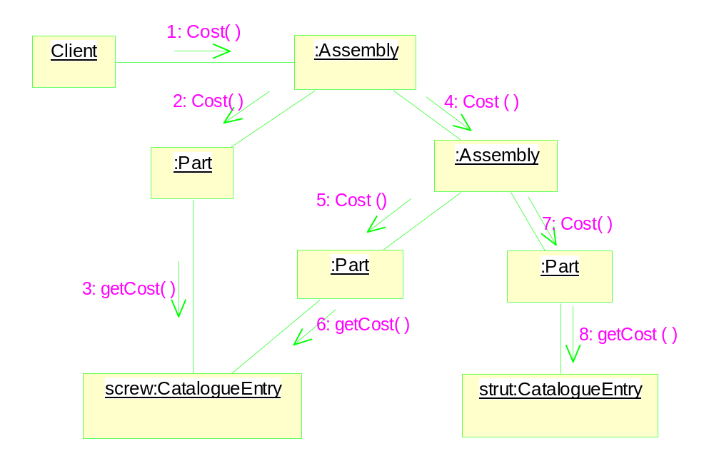
Late Binding & Polymorphism
Notes:
Here: the term “polymorphism” in the textbook has a different meaning from that
used in the “Thinking in C++” course.

Slide 35
Class Diagrams
Object diagrams: can only show a small subset of a program’s possible states.
We need to describe the software system in a more abstract level: class diagrams.
  Similar to object diagram
  Types of the attributes are shown
  Association (linkage counter)
  Inheritance

Slide 36
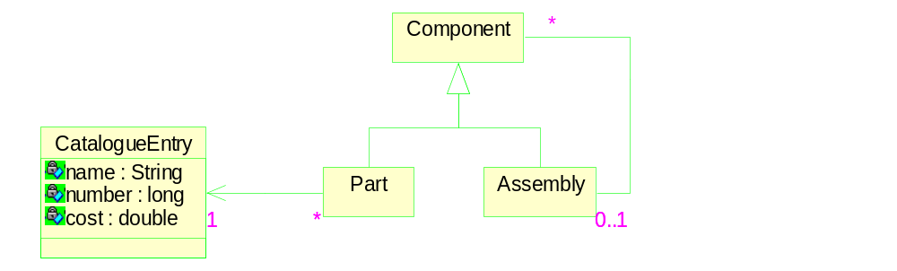
An example of class diagram

Slide 37
The applicability of the object model
Often: object (real world) ➔ object model
Exceptions: the example above
Message passing: no direct association
  Example: people bump
  Objects + events ➔ Objects + messages
Strength of OO
  Localization of data and operations
  In most cases, the following mapping holds
  real world object ➔ object model

