Slide 1
Overview
Iterator Pattern
  Robust Iterator
  Pre-order traversing
Visitor Pattern

Slide 2
Outline
The builder pattern
The factory method pattern
The prototype pattern

Slide 3

Builder pattern: Motivation
The problem: convert RTF document into plain text, TeX and TextWidget formats.
A segment of RTF document

Slide 4
{\rtf1\ansi\ansicpg936\deff0\deflang1033\deflangfe2052
{\fonttbl{\f0\fmodern\fprq6\fcharset134\'cb\'ce\'cc\'e5;}
{\f1\fswiss\fprq2\fcharset0 Arial;}
}
\viewkind4\uc1\pard\lang2052\f0\fs20
This is a line in SongTi, 10 points.\par
\par
\f1\fs28 Here is another line in Arial, 14 points.\f0\fs20\par
}

Slide 5

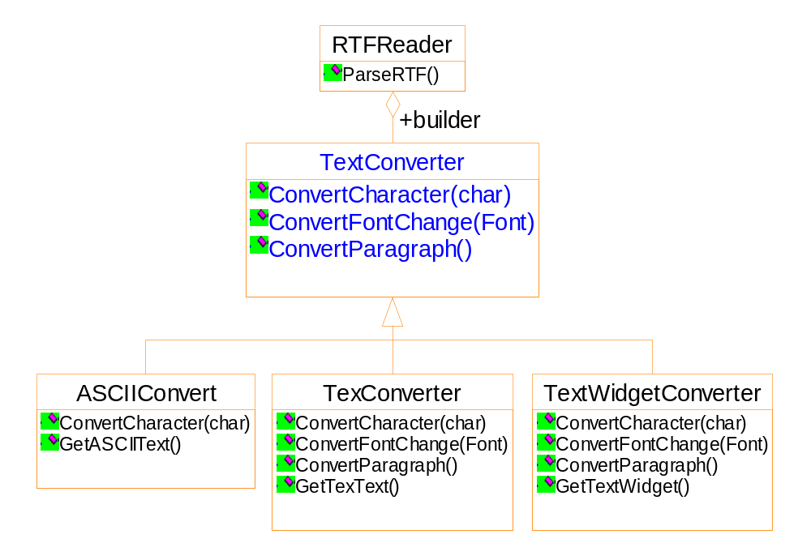

Slide 6
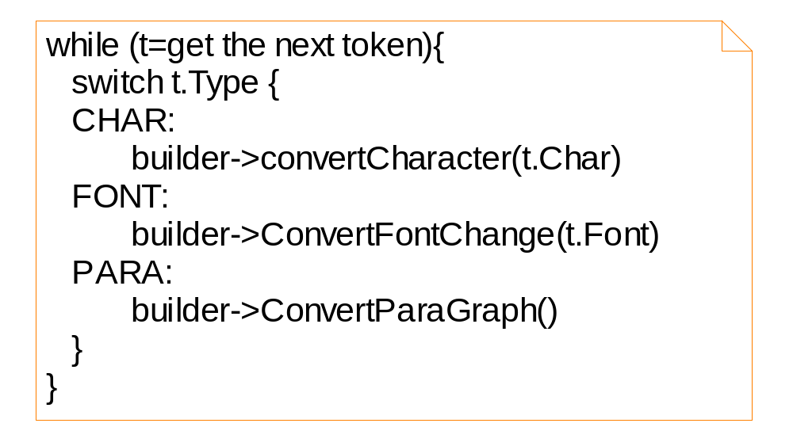

Slide 7
Features of the solution
Separate the converter from the reader
Hiding the details of creating and assembling a complex object
Re-use of the parsing algorithm

Slide 8
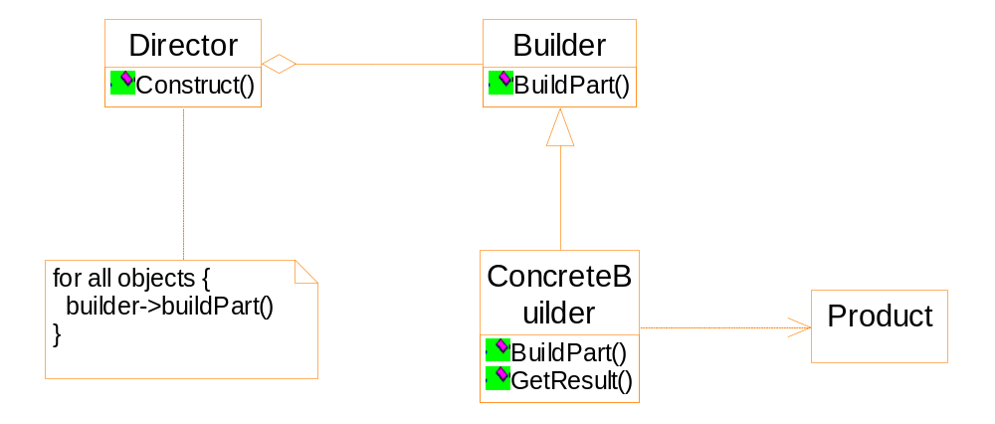
General structure of the Builder pattern

Slide 9
Participants
Builder
  specifies the abstract interface
Concrete Builder
  Constructs and assembles the parts
  Possibly by interacting with other objects
  Retrieving the product
Director
  Calling the builder to construct the product

Slide 10
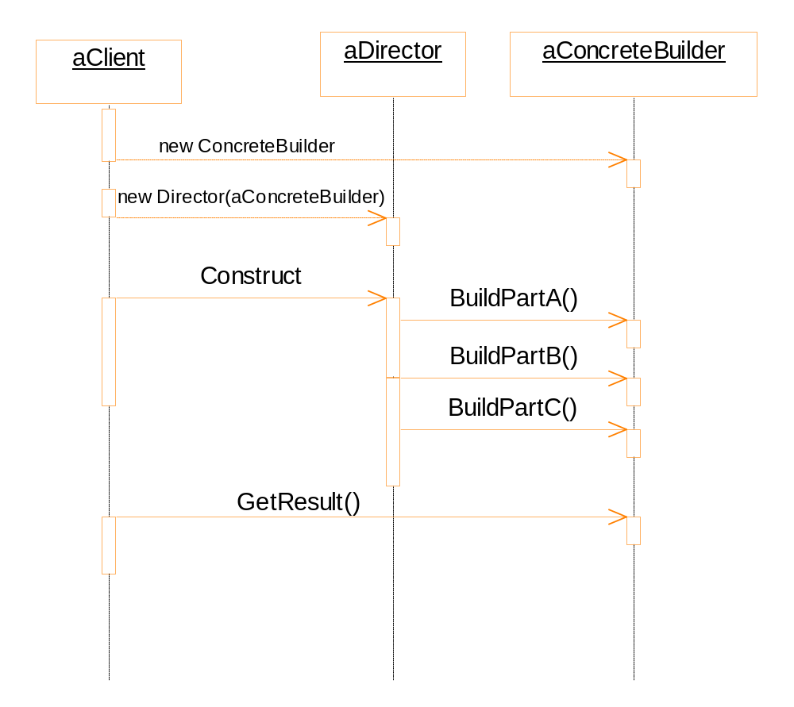

Slide 11

Consequence
The builder hides the internal structure and the details of the assembling of the product ➔ Modularity and code reuse
ASCIIText
RTFReader
TeXText
SGMLReader
TextWidget

Slide 12
Implementation
The builder interface must be general
Sometimes we may need access to parts of the product constructed earlier.

Slide 13
Discussion
The problem
Different vehicles are assembled in a step-by-step fashion. The Shop uses VehicleBuilders to construct a variety of Vehicles in a series of sequential steps.
Discussion
What is the difference between the builder pattern and the abstract factory pattern?
Notes:
Builder pattern:
The builder class is responsible to assemble the product, possibly by calling other classes.
The builder class manufactures and assembles the product step-by-step.
Abstract factory pattern:
The client of the abstract factory pattern is responsible to assemble the product.
The factory class manufactures all the parts in one shot.

Slide 14
The vehicle example
A vehicle is made up of a frame, an engine, wheels and doors.
Vehicle | Engine | Wheels | Doors
Motor cycle | 500 cc | 2 | 0
Car | 2500 cc | 4 | 4
Scooter | None | 2 | 0

Slide 15
The difference
Builder pattern
  The builder class is responsible to assemble the product, possibly by calling other classes.
  The builder class manufactures and assembles the product step-by-step.
Abstract factory pattern
  The client of the abstract factory pattern is responsible to assemble the product.
  The factory class manufactures all the parts in one shot.

Slide 16
Factory method: an example
The multiple document framework
  Open multiple documents
  Active document
  Window: tile, cascade
  Close all
Notes:
一个新的模式

Slide 17
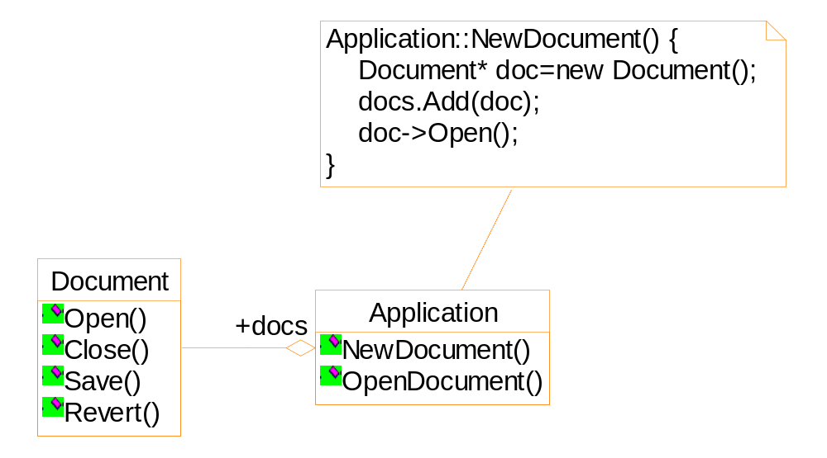
Suppose we want to create a drawing application...

Slide 18
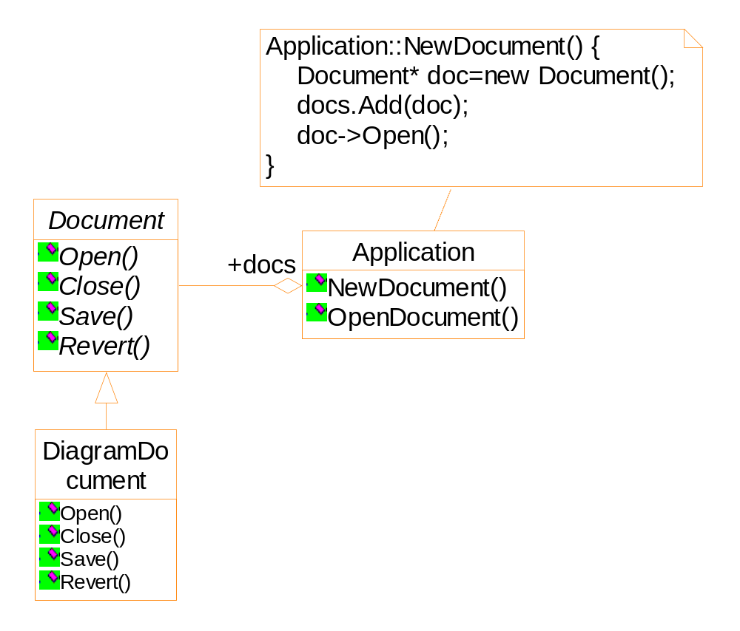
Framework
There is no chance that an object of DiagramDocument can be integrated into the framework.

Slide 19
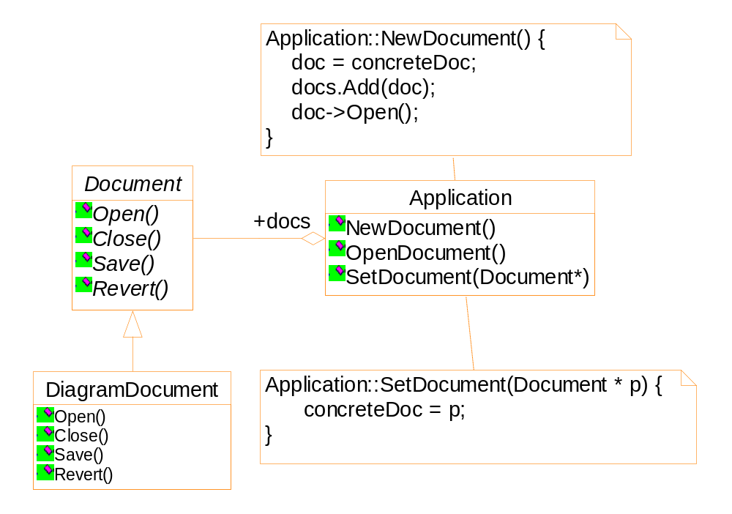
Framework
Is there any problem?
Notes:
The problem: The method Application::NewDocument is called when the user select
a menu item possibly called “New diagram”. But when the method is called, it is still
not aware of the existence of the class DiagramDocument, and thus it can not new
an object of the class.

Slide 20
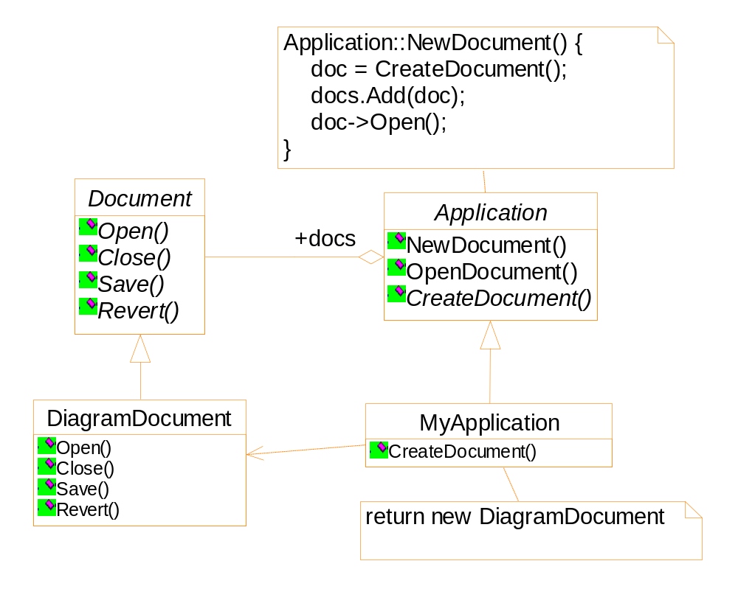
Framework

Slide 21
Applicability
A class can’t anticipate the class of object it must create.
A class wants its subclass to specify the objects it creates.

Slide 22
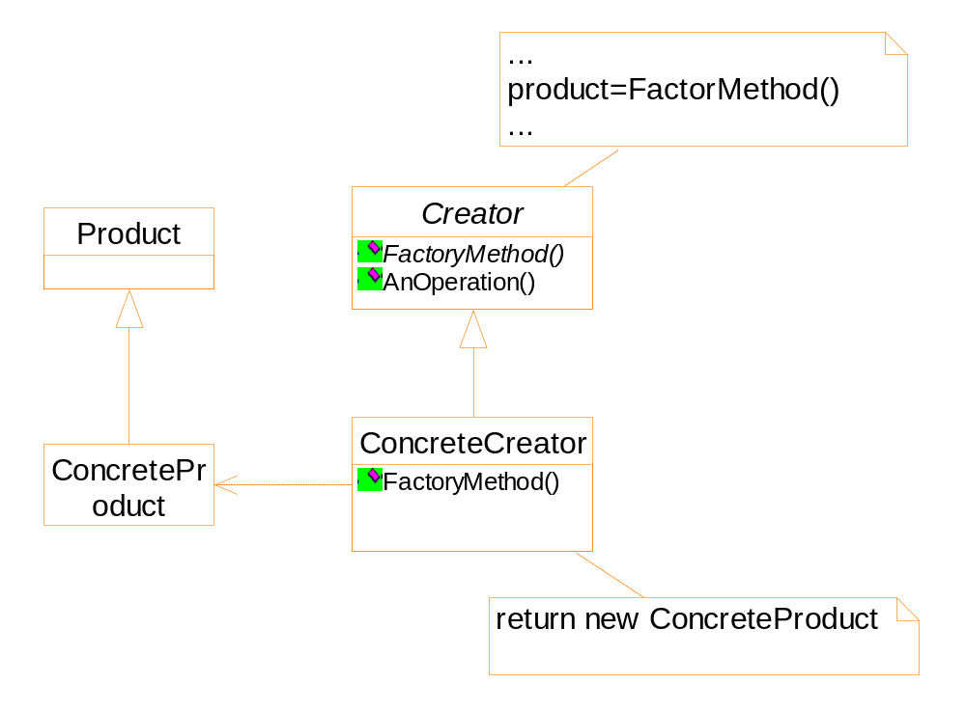
Structure

Slide 23
Consequence
Connect parallel class hierarchy
An example:
  Diagram editor
  Manipulation of the diagram elements:
    Stretch
    Move
    Resize
    Rotate

Slide 24
Analysis of the problem
Implementation of the interaction is complex
Some information should be stored and updated during the manipulation
e.g. angle of the element
Difference elements behave differently
e.g. resize of a line and a line of text

Slide 25
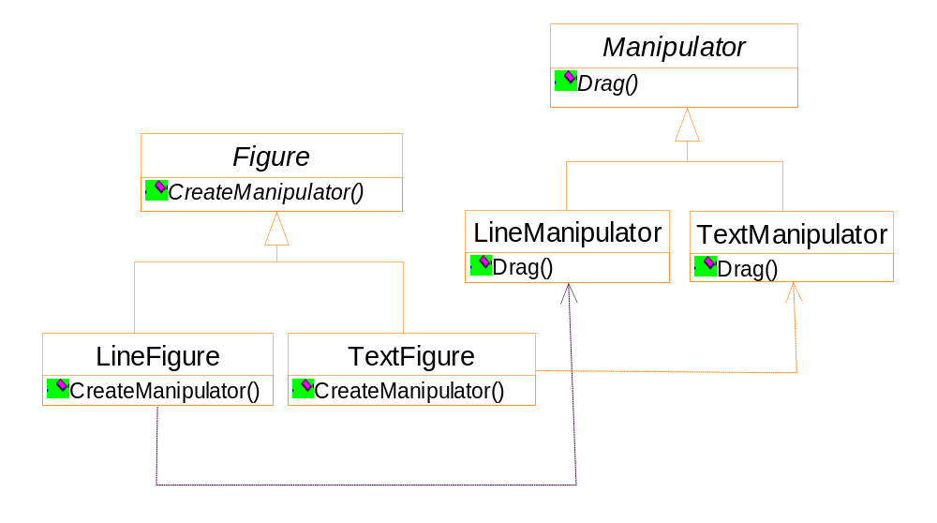
Possibly, the hierarchy is partially parallel
Notes:
When the Figure::CreateManipulator is a virtual (not a pure virtual) function,
and the Figure subclasses simply inherit the function, the hierarchy is partially parallel.

Slide 26
Implementation
Whether the Creator has a default implementation for the factory method
Parameterized factory method
  An example
  The Unidraw graphical editing program
Template could be used to avoid sub-classing of the creator class

Slide 27
class Creator {
virtual Product * Create(ProductID id) {
if (id==MINE) return new MyProduct;
if (id==YOURS) return new YourProduct;
...
}
};
class MyCreator: public Creator {
virtual Product * Create(ProductID id) {
if (id==YOURS) return new MyProduct;
if (id==MINE) return new YourProduct;
if (id==THEIRS) return new TheirProduct;
...
return Creator::Create(id);
}
}
Notes:
The last line: for other values of id, using default implementation of the factory method.

Slide 28
class Creator {
public:
virtual Product * CreateProduct() = 0;
};
template <class TheProduct>
class StandardCreator: public Creator{
public:
virtual Product* CreateProduct() {
return new TheProduct;
}
}
StandardCreator<ProductA> aCreator;
StandardCreator<ProductB> bCreator;

Slide 29
Prototype
A creational pattern in which new objects are created based on an existing prototype object.
Applicability
  It is expensive to construct an object from the scratch.
  Want an object which is the copy of an existing one.
An editor for music scores
  Customizing a general framework
  There are tools for adding new graphic objects
  There are tools for manipulating graphic objects

Slide 30
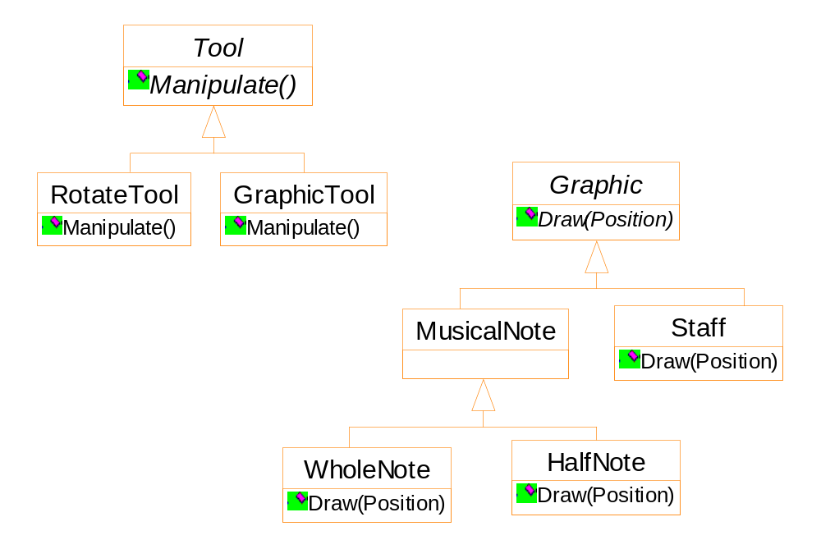
Framework
GraphicTool does not know how to create the score objects

Slide 31
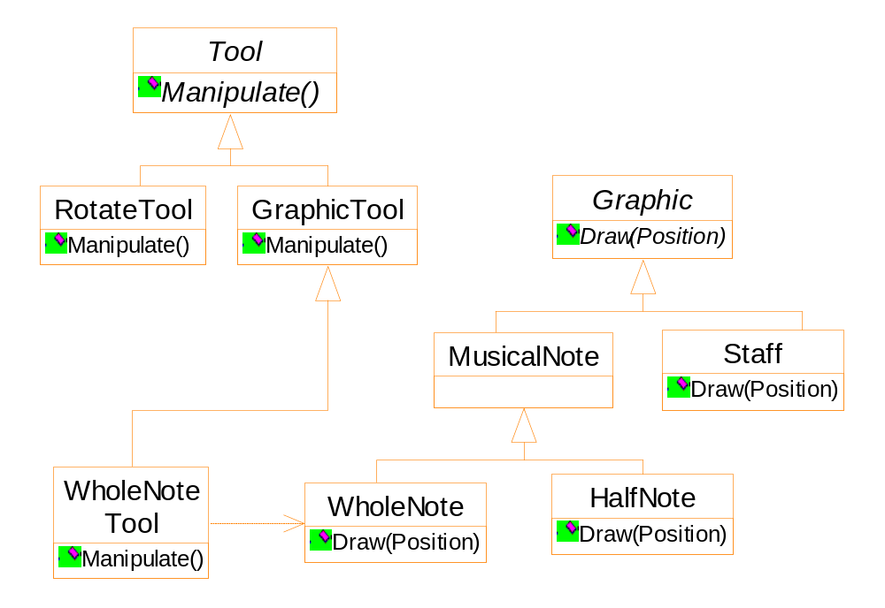
Framework
One Possible solution is using the Factory Method pattern
Notes:
Too many GraphicTool subclasses!

Slide 32
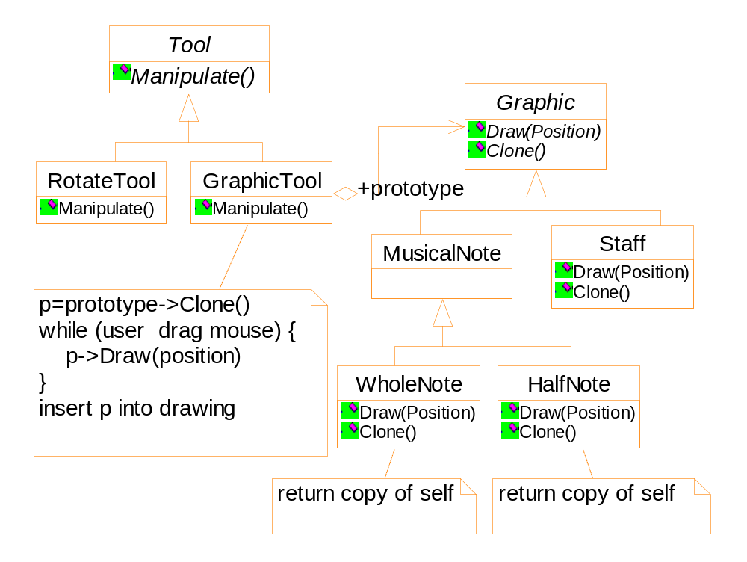
by class composition

Slide 33
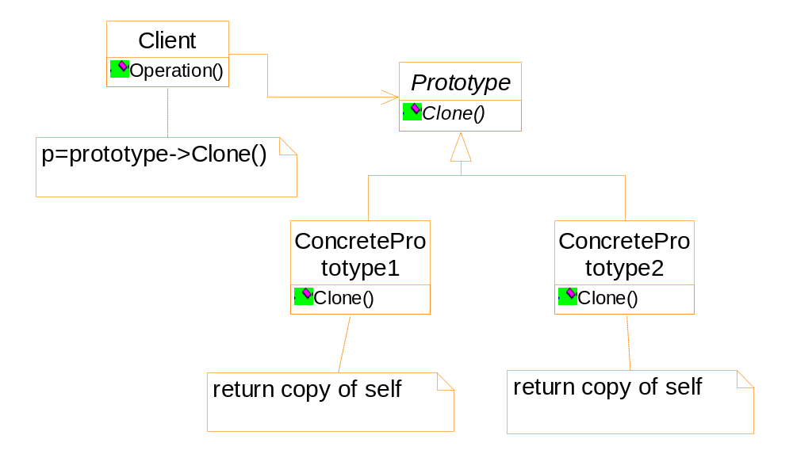
prototype
Notes:
此图右侧和Factory Method有些类似。但是左面没有Factory Method的类树。

Slide 34



class CPrototypeMonster
{
protected:
CString _name;
public:
CPrototypeMonster();
CPrototypeMonster( const CPrototypeMonster& copy );
~CPrototypeMonster();
virtual CPrototypeMonster* Clone() const=0;
void Name( CString name );
CString Name() const;
};
Notes:
The example code is taken from http://pages.cpsc.ucalgary.ca/~faneael/Prototype_document.htm#Known%20uses

Slide 35
class CGreenWigglyMonster : public CPrototypeMonster
{
protected:
int _numberOfArms;
double _slimeAvailable;
public:
CGreenWigglyMonster();
CGreenWigglyMonster(const CGreenWigglyMonster&
copy );
~CGreenWigglyMonster();
virtual CPrototypeMonster* Clone() const;
void NumberOfArms( int numberOfArms );
void SlimeAvailable( double slimeAvailable );
int NumberOfArms() const;
double SlimeAvailable() const;
};

Slide 36
class CPurpleLongNoseMonster : public CPrototypeMonster
{
protected:
int _intensityOfBadBreath;
double _lengthOfWhiplikeAntenna;
public:
CPurpleLongNoseMonster();
CPurpleLongNoseMonster( const
CPurpleLongNoseMonster& copy );
~CPurpleLongNoseMonster();
virtual CPrototypeMonster* Clone() const;
void IntensityOfBadBreath( int intensityOfBadBreath );
void LengthOfWhiplikeAntenna( double
lengthOfWhiplikeAntenna );
int IntensityOfBadBreath() const;
double LengthOfWhiplikeAntenna() const;
};

Slide 37
class CGreenPotBellyMonster : public CPrototypeMonster
{
protected:
double _roomAvailableInBelly;
public:
CGreenPotBellyMonster();
CGreenPotBellyMonster( const CGreenPotBellyMonster&
copy );
~CGreenPotBellyMonster();
virtual CPrototypeMonster* Clone() const;
void RoomAvailableInBelly( double
roomAvailableInBelly );
double RoomAvailableInBelly() const;
};

Slide 38
CPrototypeMonster::CPrototypeMonster( const
CGreenWigglyMonster& copy )
{
_name = copy._name;
}
CGreenWigglyMonster::CGreenWigglyMonster( const
CGreenWigglyMonster& copy ) :
CPrototypeMonster( copy )
{
_numberOfArms = copy._numberOfArms;
_slimeAvailable = copy.slimeAvailable;
}

Slide 39
CPurpleLongNoseMonster::CPurpleLongNoseMonster( const
CPurpleLongNoseMonster& copy ) :
CPrototypeMonster( copy )
{
_intensityOfBadBreath = copy._intensityOfBadBreath;
_lengthOfWhiplikeAntenna =
copy._lengthOfWhiplikeAntenna;
}
CGreenPotBellyMonster::CGreenPotBellyMonster( const
CGreenPotBellyMonster& copy ) :
CPrototypeMonster( copy )
{
_roomAvailableInBelly = copy._roomAvailableInBelly;
}

Slide 40
CPrototypeMonster*
CGreenWigglyMonster::Clone() const
{
return new CGreenWigglyMonster(*this);
}
CPrototypeMonster*
CPurpleLongNoseMonster::Clone() const
{
return new CPurpleLongNoseMonster(*this);
}
CPrototypeMonster*
CGreenPotBellyMonster::Clone() const
{
return new CGreenPotBellyMonster(*this);
}

Slide 41
void DoCoolStuffWithAMonster( const CPrototypeMonster*
originalMonster )
{
CPrototypeMonster* newMonster =
originalMonster->Clone();
ASSERT( newMonster );
newMonster->Name("A name");
// Add code doing all sorts of cool stuff with the monster.
delete newMonster;
}

Slide 42
Implementation
Using a prototype manager
Register, browse and un-register of a prototype
Implementing the clone operation
  Shallow copy
  pointers point to the same memory block
  Deep copy

Slide 43
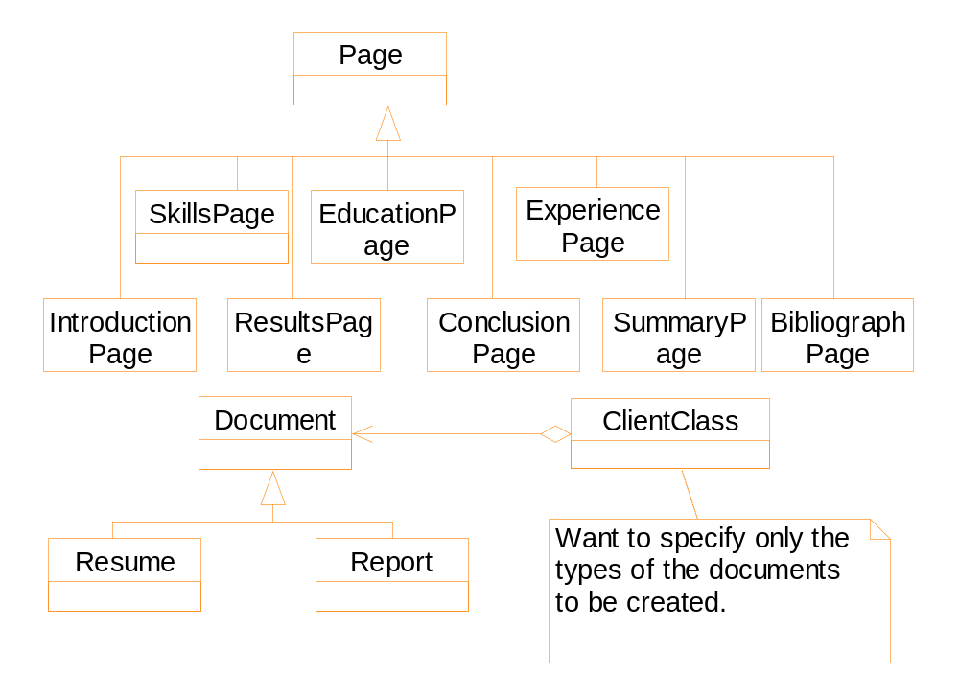

Slide 44
class CBasePrototype
{
protected:
CString _name;
public:
CBasePrototype();
CBasePrototype( const CBasePrototype& copy );
~CBasePrototype();
virtual CBasePrototype* Clone(CString _name) const=0;
void Name( CString name );
CString Name() const;
};

Slide 45
class CPrototypeManager
{
protected:
std::list<CBasePrototype*> _prototypeList;
public:
CPrototypeManager();
CPrototypeManager( const CPrototypeManager& copy );
~CPrototypeManager();
unsigned int NumberOfPrototypes() const;
void AddPrototype( CBasePrototype* prototype );
void DeletePrototype( const CString* label );
void DeleteAllPrototypes();
CBasePrototype* FindPrototype( const CString* label );
const CBasePrototype* FindPrototype(const CString* label );
std::list<CString> AvailablePrototypes() const;
};

