Slide 1
Outline
Facade Pattern
Chain of Responsibility
Interpreter pattern

Slide 2
Facade Pattern
Motivation
  Most users want a subsystem to have a simplified interface.
  Whereas other users want direct access to all components of a subsystem.
An example
  A compiler system

Slide 3
Facade
Illustration of a facade pattern
Notes:
比喻：傻瓜相机、专业相机、专业傻瓜相机

Slide 4
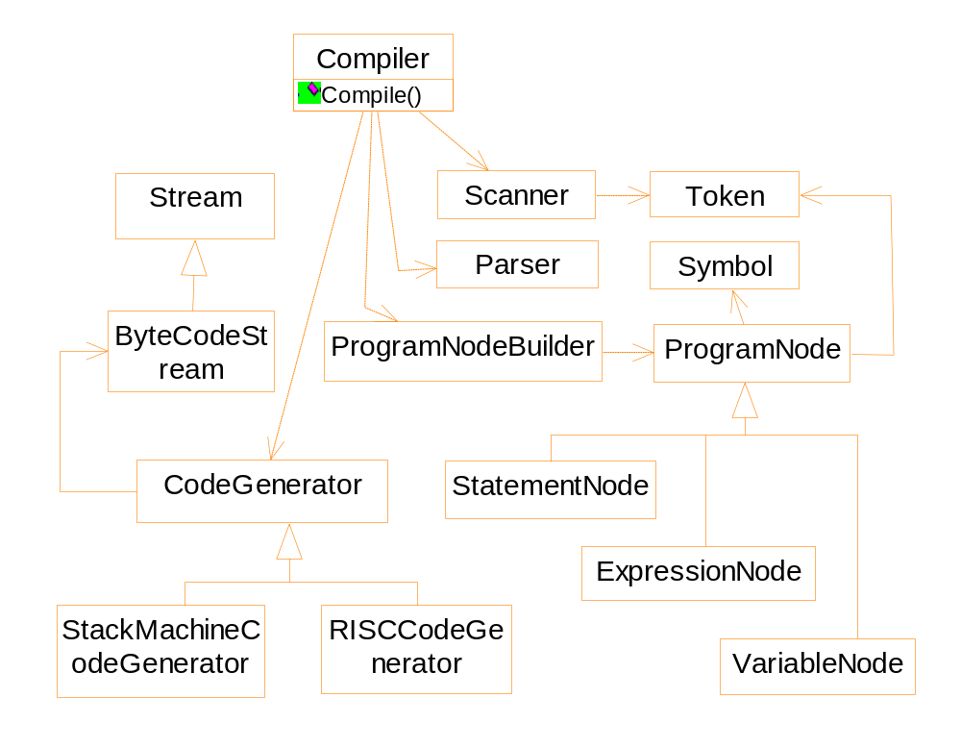
A compiler subsystem

Slide 5
Applicability
“Most patterns, when applied, result in more and smaller classes. This makes the subsystem more reusable and easier to customize, but it also becomes harder to use for the clients that do not need to customize it.”
A facade can provide a simple default interface.

Slide 6
Chain of responsibility
Motivation
  Context sensitive help
  Specific help ➔ general help ➔ even general help
  The sender does not know explicitly who will response to the request
Illustration of the solution

Slide 7
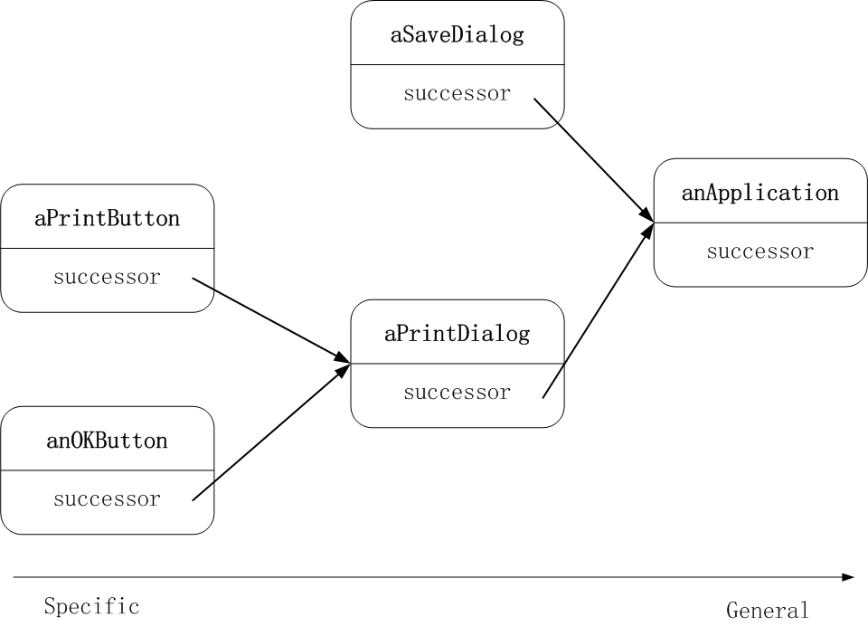

Slide 8
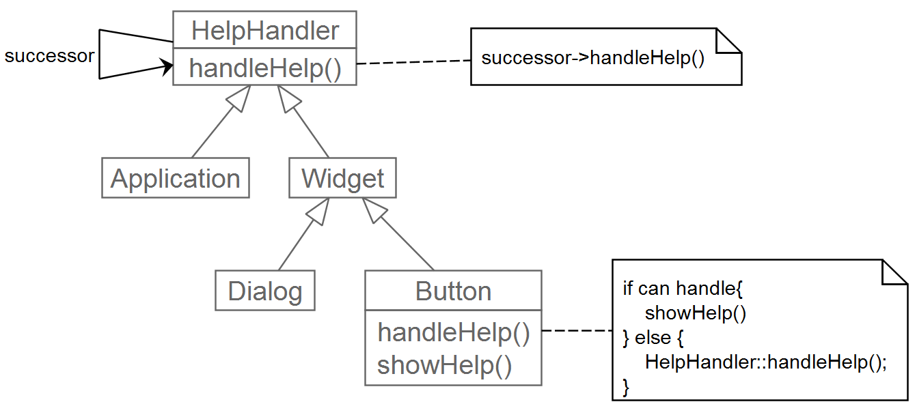
Solution to the example

Slide 9
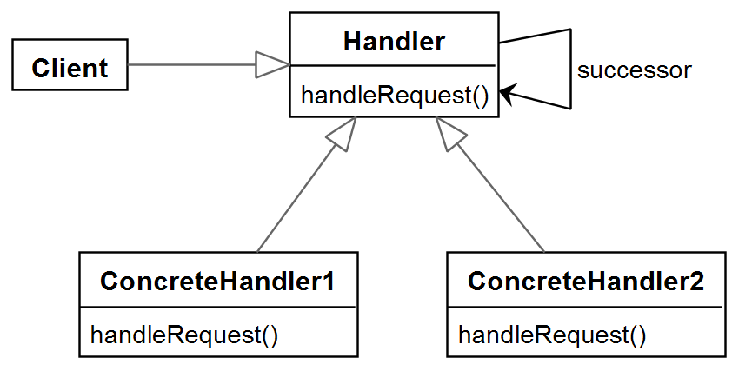
general structure of the chain of responsibility pattern

Slide 10
Consequence
Reduced coupling
  The sender just simply knows its request will be processed appropriately.
Responsibility of the objects can be changed dynamically

Slide 11
Implementation
Implementation of the chain
  Define new links
  Using existing ones
    The parent pointers in the composite pattern.
Representation of the request
  Just one kind of request
  Request code ( an integer or a string )
    Parameters must be packed and unpacked
  Request objects

Slide 12
void Handler::handleRequest (Request * theRequest ) {
switch ( theRequest->getKind( ) ) {
case Help:
// cast argument to appropriate type
handleHelp( (HelpRequest * ) theRequest );
break;
case Keyboard_Message:
handlePrint( (Keyboard_Message *) theRequest );
break;
default:
// ...
break;
}
Code segment to illustrate the use of request objects 1/1
Notes:
For languages that support run-time type resolving, we do not need to declare a separate GetKind method.

Slide 13
typedef int Topic;
const Topic NO_HELP_TOPIC = -1
class HelpHandler {
public:
HelpHandler ( HelpHandler* successor = 0,
Topic= NO_HELP_TOPIC );
virtual bool hasHelp( );
virtual void setHandler( HelpHandler * successor, Topic );
virtual void handleHelp( );
private:
HelpHandler * _successor;
Topic _topic;
};
Sample code for the context sensitive help example 1 / 7
Notes:
在每个类的HandleHelp的函数体中，如果发现TOPIC有效，则会将这个TOPIC值传递到一个独立的类或者应用程序中，用于显示特定的主题的帮助信息。因此，此处的TOPIC相当于一个KEY.

Slide 14
HelpHandler::HelpHandler (HelpHandler *successor , Topic t):
_successor(successor), _topic(t) { }
bool HelpHandler::hasHelp() {
return _topic != NO_HELP_TOPIC;
}
void HelpHandler::handleHelp() {
if ( _successor != 0 ) {
_successor->handleHelp();
}
}
2 / 7
Notes:
HelpHandler has a default implementationi for the HandleHelp() method.

Slide 15
class Widget: public HelpHandler {
protected:
Widget( Widget * parent_, Topic t = NO_HELP_TOPIC );
private:
Widget* parent;
}
Widget::Widget ( Widget * parent_, Topic t)
:HelpHandler( parent_, t )
{
parent = parent_;
}
class Button: public Widget {
public:
Button (Widget* parent_, Topic t= NO_HELP_TOPIC );
virtual void handleHelp();
}
3 / 7
Notes:
All widget classes are subcalss of HelpHandler. Using the Mixin pattern here is a better solution.

Slide 16
Button::Button(Widget * parent_, Topic t)
:Widget (parent_, t ) { }
void Button::handleHelp() {
if ( hasHelp() ) {
// Offer help on the button
} else {
HelpHandler::handleHelp();
}
}
4 / 7

Slide 17
class Dialog: public Widget {
public:
Dialog( HelpHandler * parent_,
Topic t = NO_HELP_TOPIC );
virtual void handleHelp();
}
Dialog::Dialog (HelpHandler* parent_, Topic t)
:Widget(0)
{
setHandler( parent_, t );
}
void Dialog::handleHelp() {
if ( hasHelp() ) {
// offer help on the dialog
} else {
HelpHandler::HandleHelp();
}
}
5 / 7

Slide 18
class Application: public HelpHandler {
public:
Application(Topic t): HelpHandler(0,t) {}
virtual void handleHelp();
}
void Application::handleHelp() {
// application-specific operations, eg.
// show a list of help topics
}
6 / 7

Slide 19
const Topic APPLICATION_TOPIC = 1;
const Topic PRINT_TOPIC =2;
const Topic PAPER_ORIENTATION_TOPIC =3 ;
Application* application =
new Application(APPLICATION_TOPIC);
Dialog * dialog =
new Dialog ( application, PRINT_TOPIC);
Button * button =
new Button( dialog, PAPER_ORIENTATION_TOPIC );
7 / 7

Slide 20
Interpreter: Motivation
The grep command under Linux
  grep my_word * | more
  grep ‘^s.*’ myfile | more
  dir -l | grep ‘[ [:upper] [:digit:] ]’
An example of regular expression
  expression ::= literal | alternation | sequence |
  repetition | '(' expression ')'
  alternation ::= expression '|' expression
  sequence ::= expression '&' expression
  repetition ::= expression '*'
  literal ::= 'a' | 'b' | 'c' | ... { 'a' | 'b' | 'c' ... } *
Notes:
grep ‘^s.*’ mfile: print lines starting with “s”.
* grep ‘[ [:upper] [:digit:] ] print out lines containing an upper letter followed by a digit number.

Slide 21
The Interpreter pattern
Define a grammar for simple languages
Represent sentences in the language
Interpret the sentences
常常会使用composite pattern，但是interpreter pattern更注重的是如何处理被表示的language

Slide 22
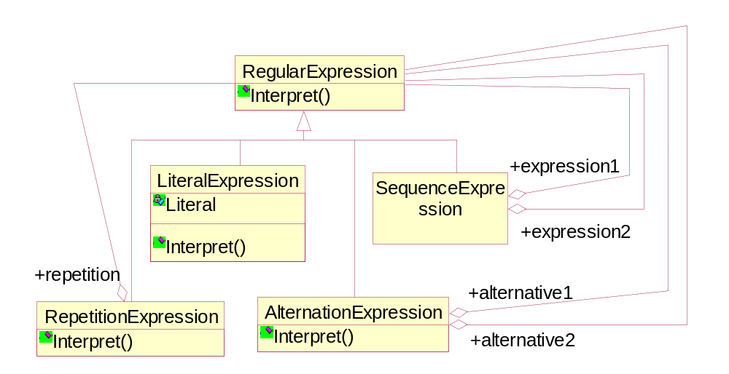

Slide 23
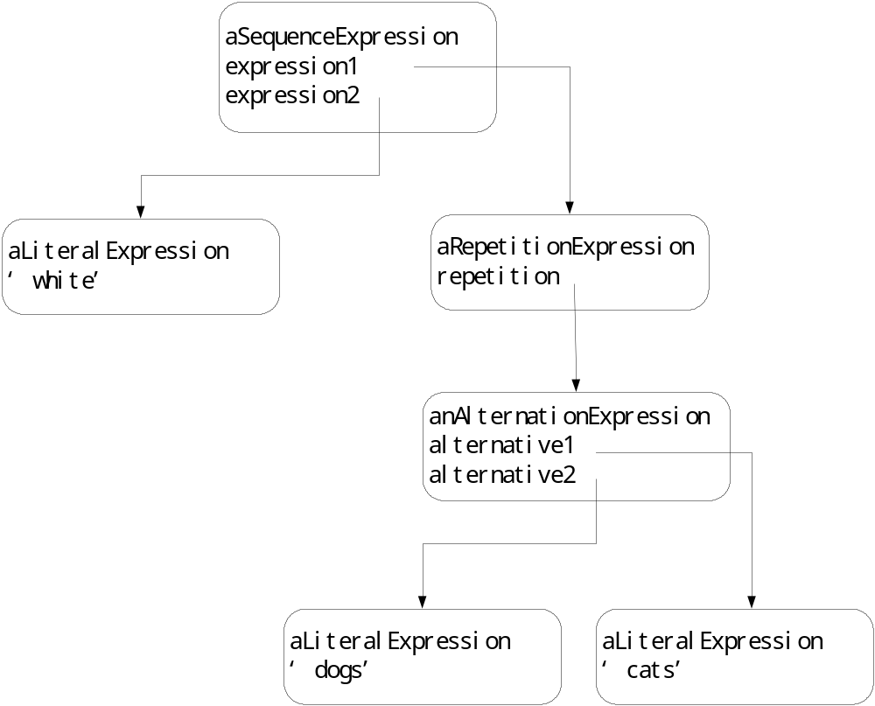
White & (dogs | cats) *

Slide 24
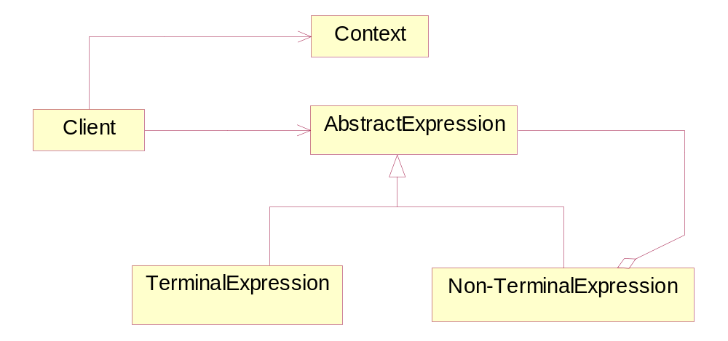
General structure of the Interpreter pattern

Slide 25
An example: boolean expressesion
BooleanExp ::= VariableExp | Constant | OrExp |
AndExp | NotExp | '(' BooleanExp ')'
AndExp ::= BooleanExp 'and' BooleanExp
OrExp ::= BooleanExp 'or' BooleanExp
NotExp ::= 'not' BooleanExp
Constant ::= 'true' | 'false'
VariableExp::= 'A' | 'B' | ... | 'X' | 'Y' | 'Z'

Slide 26
class BooleanExp {
public:
BooleanExp();
virtual ~BooleanExp();
virtual bool Evaluate(Context &) = 0;
virtual BooleanExp * Replace( const char*,
BooleanExp & ) = 0;
virtual BooleanExp * Copy() const = 0;
}
class Context {
public:
bool Lookup(const char*) const;
void Assign(VariableExp *, bool);
}

Slide 27
class VariableExp: public BooleanExp {
public:
VarialeExp( const char * name) { _name = strdup(name); }
virtual ~VariableExp();
virtual bool Evaluate( Context & aContext) {
return aContext.Lookup( _name ); }
virtual BooleanExp * Replace( const char* name,
BooleanExp & exp) {
if (strcmp(name, _name) == 0 )
return exp.Copy();
else
return new VariableExp(_name);
}
virtual BooleanExp * Copy() const {
return new VariableExp(_name); }
private:
char * _name;
}

Slide 28
class AndExp: public BooleanExp {
public:
AndExp(BooleanExp* op1, Boolean* op2) {
_operand1 = op1; _operand2 = op2;
}
virtual ~AndExp();
virtual bool Evaluate( Context & aContext) {
return _operand1->Evaluate(aContext) &&
_operand2->Evaluate(aContext);
}
virtual BooleanExp * Replace( const char* name,
BooleanExp & exp) {
return new AndExp(
_operand1->Replace(name,exp),
_operand2->Replace(name,exp) )
}

Slide 29
virtual BooleanExp * Copy( ) const {
return new AndExp(
_operand1->Copy(),
_operand2->Copy() )
}
}

Slide 30
// The expression is: (true and x ) or (y and (not x) )
BooleanExp * expression;
Context context;
VariableExp* x = new VariableExp(“X”);
VariableExp* y = new VariableExp(“Y”);
Expression = new OrExp(
new AndExp( new Constant ( true), x),
new AndExp( y, new NotExp(x) )
);
context.Assign( x, false);
context.Assign( y, true );
Bool result = expression->Evaluate( context );

Slide 31
// Now we replace the variable y with a new expression and
// re-evaluate the expression
VariableExp* z = new VariableExp(“Z”);
NotExp not_z (z);
BooleanExp*replacement = expression->Replace(“Y”, not_z);
context.Assign(z, true);
result = replacement->Evaluate ( context );

Slide 32
Implementation
Applying the visitor pattern to define the Interpret operation
Dependency analysis
  Examples: if an expression inside a loop does not depend on the local variables of the loop, it can be evaluated only once.
  Often conservative approximations are made
    Overestimation of the read set
  Effect caching
  Parallelism
  Lazy evaluation: compute nothing until it is explicitly asked for.

