Slide 1
Overview of last course
Chapter 6 Class diagram
  Operations
  Associations, association generalization
  Aggregation
  Composite objects
  Association classes

Slide 2
Outline of this course
Class Diagram
  Qualified associations
  Multiple inheritance in UML
  Mixin class
  Discriminators
Implementation of class diagram
  Uni-directional association
  Bi-directional association
  Implementing qualifiers
  Implementation of association classes

Slide 3
Qualified associations
An example: Unix file system
  Each file has a unique internal identifier
  Each file can appear multiple times in different directories, even including in the same directory.
  All names within a directory must be different from each other.

Slide 4
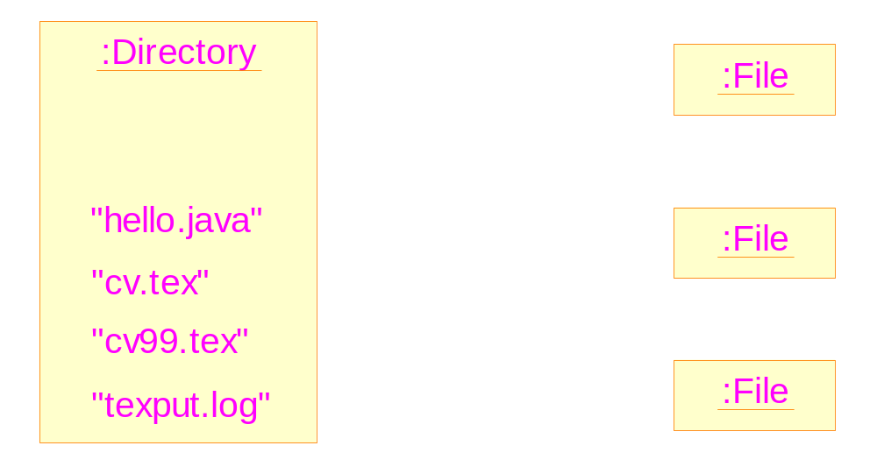
Informal illustration of qualified association

Slide 5
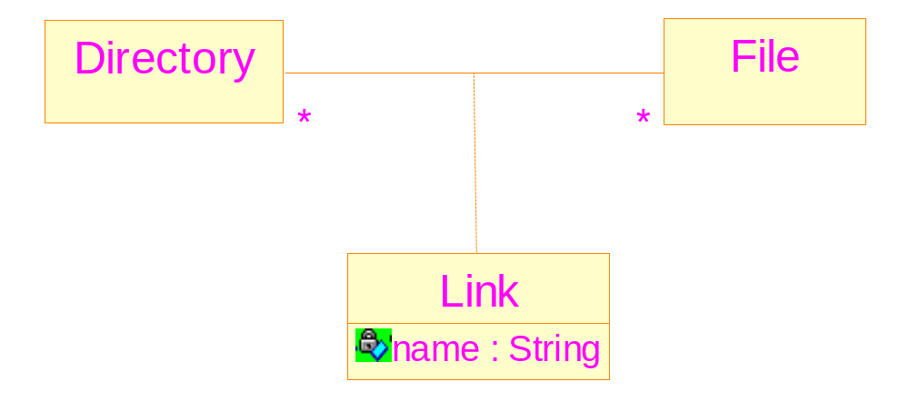
Association class can not describe the relationship
Reasons: It does not allow: a directory may have
different names linked to the same file

Slide 6
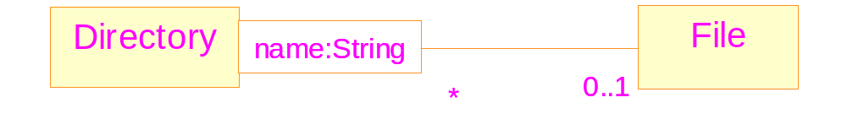
Qualified associations
Definition: an association class which has properties which enable it to act as a key
Mapping from qualifier values to instances of the class at the other end of the association

Slide 7
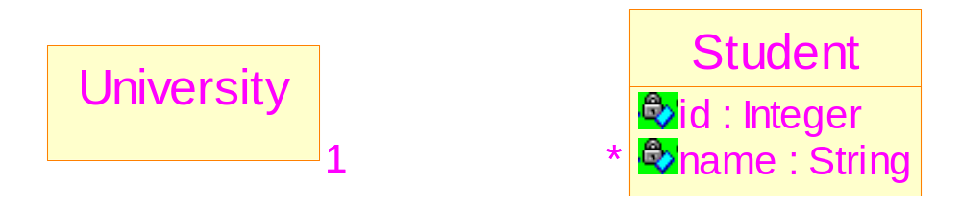
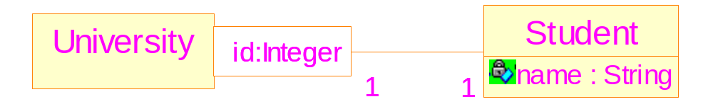
Qualifiers and identifiers
Use of an attribute as an identifier
Better: Use of a qualifier

Slide 8
Multiple inheritance in UML
UML allows multiple inheritance
Attributes and operations of the common ancestor (if any) are inherited only once

Slide 9
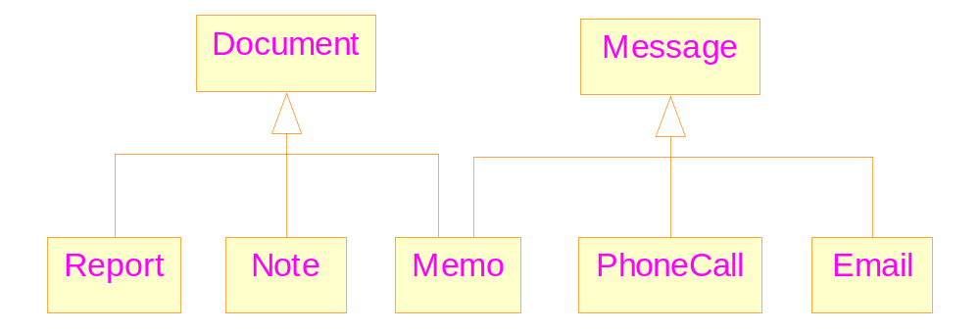
An example of multiple inheritance
Notes:
Possible name clash: “date” of document and message

Slide 10
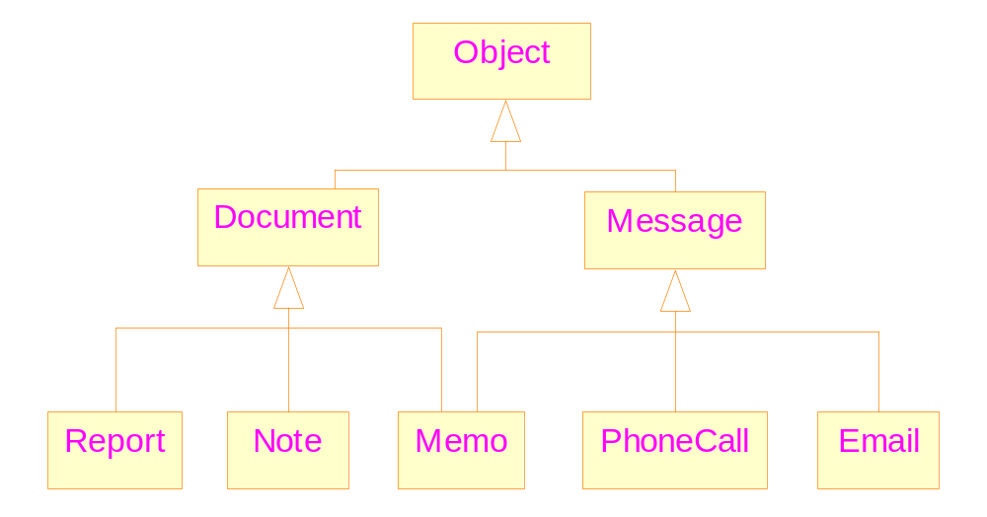
Multiple inheritance with a common ancestor

Slide 11
Mixin class
A mixin class: is intended to provide an optional interface or functionality to other classes.
The functionality should be independent with that of the existing classes.
It is similar to an abstract classes in that it’s not intended to be instantiated.
Mixin classes require multiple inheritance.

Slide 12
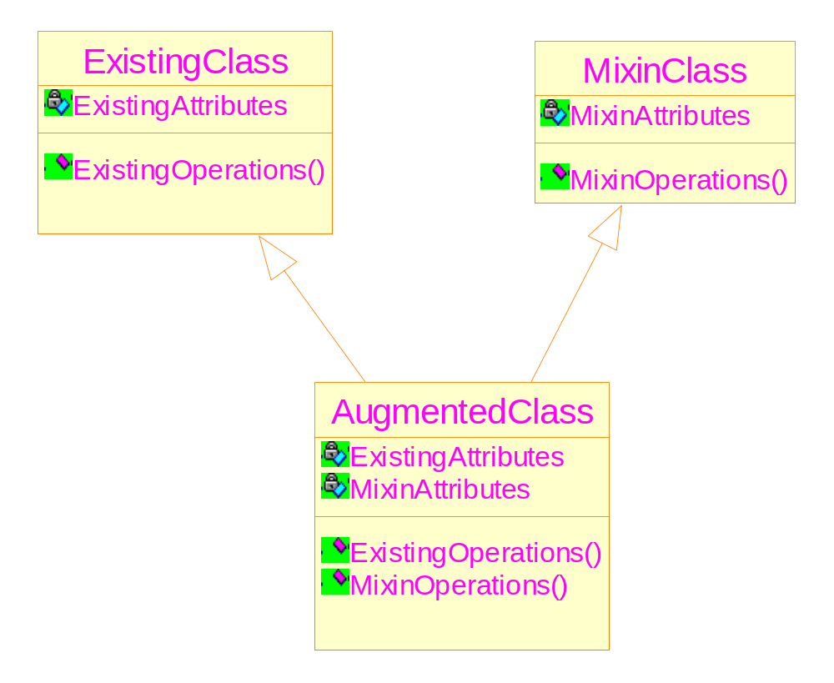
Illustration of mixin classes

Slide 13
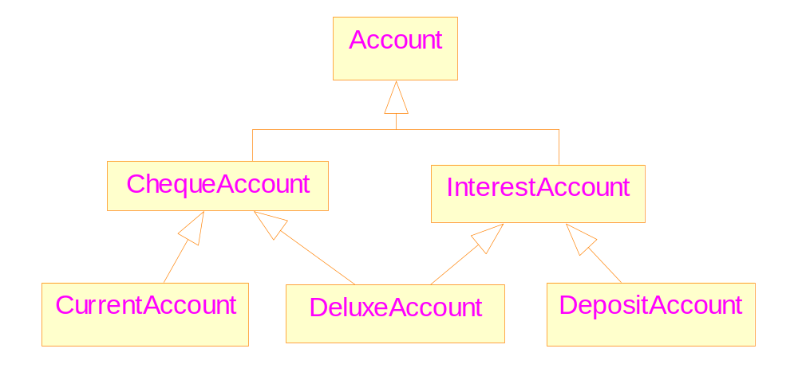
If without mixin class

Slide 14
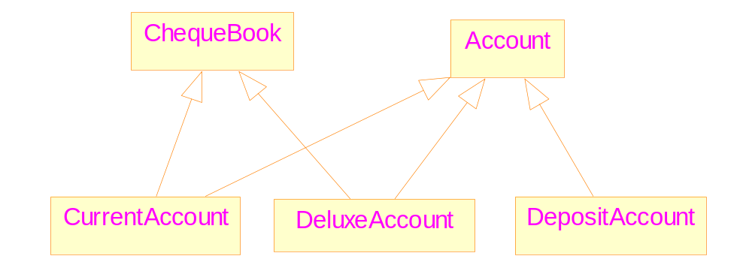
With Mixin class

Slide 15
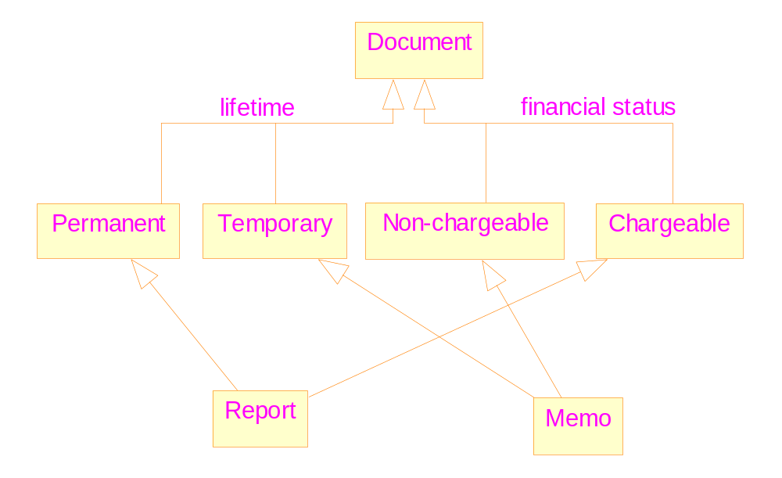
Discriminators

Slide 16
Implementing associations
Uni-directional links
  simple to implement
  Will lead to problems if they are later modified to bi-directional links
Bi-directional links
  Complex to implement ➔ consistency
  With no risk
Both styles of implementation should be hidden from client code

Slide 17
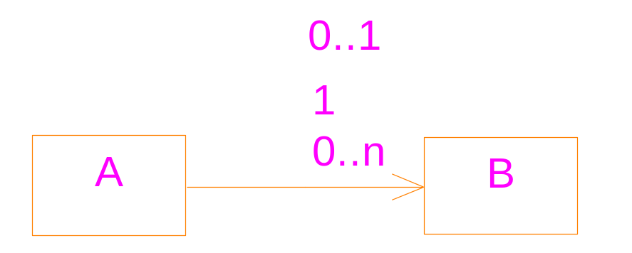
Uni-directional implementations
The multiplicity at the tail of the arrow has no effect on the implementation
Mutable and immutable associations
To implement the semantic correctly, we need:
  Proper declarations of data members, and
  Proper definitions of member functions

Slide 18
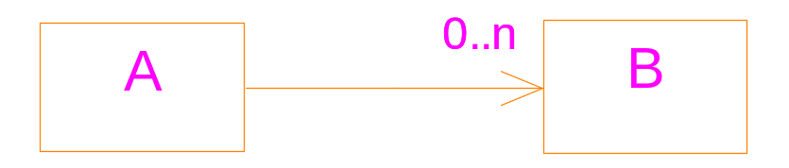
#include <iostream>
#include <vector>
using namespace std;
class B {
//...
public:
operator ==( B & r) {};
};
class A {
vector<B> links;
public:
addLink(B & b) {
links.push_back( b );
};

Slide 19
removeLink(B & b ){
vector<B>::iterator it;
for ( it=links.begin(); it!=links.end();
it++) {
if ( *it == b) break;
}
if ( it != links.end() )
links.erase(it);
};
}
main()
{
}

Slide 20
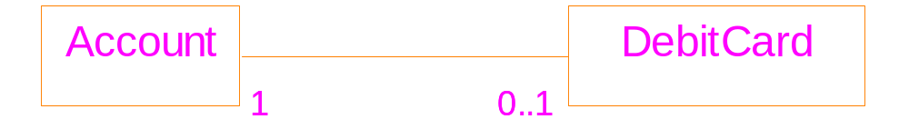
Bidirectional implementation
mutable
immutable

Slide 21
class DebitCard;
class Account {
DebitCard * card;
public:
DebitCard& getCard() {}
void setCard(DebitCard & p_card ) {}
void removeCard() {}
};
class DebitCard{
Account * theAccount;
public:
DebitCard(Account & a) {}
getAccount(){}
}

Slide 22
main()
{
Account a1;
Account a2;
DebitCard card1(a1);
a1.setCard(card1);
//a2.setCard(card1); → cause problem!
}

Slide 23
A better solution
class Account;
class DebitCard{
Account * theAccount;
private:
DebitCard(Account & a) {}
public:
getAccount(){}
friend class Account;
};
class Account {
DebitCard * card;
public:
void addCard() {
card = new DebitCard(*this);
}
Notes:
Give only one of the classes the responsibility of maintaining the association.
The “private” and “friend” of the class DebitCard: ensure that only the Account class can create links pointing to the objects of
Class DebitCard.

Slide 24
DebitCard& getCard() {}
void removeCard() {}
};
main()
{
Account a1;
a1.addCard();
}

Slide 25
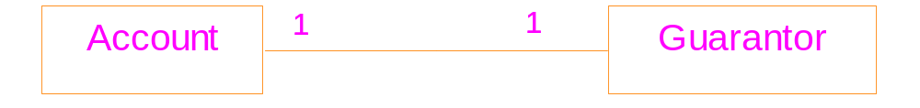
Bidirectional implementation: both directions are immutable
immutable
immutable
A typical mistake: want to create the link
within a single step.

Slide 26
#include <iostream>
using namespace std;
class Guarantor;
class Account {
public:
Guarantor * pGuarantor;
int i;
Account( Guarantor * g) {
pGuarantor = g;
i = 100;
f();
}
virtual f() {cout << "f\n"; }
};

Slide 27
class Guarantor {
public: Account * pAccount;
int j;
Guarantor(Account * a) {
pAccount = a; j = 200;
g();
//a->f();
//cout << a->i;
}
virtual g(){ cout << "g\n"; }
};
main ()
{ Account *a = new Account(new Guarantor(a) );
cout << a->pGuarantor->j;
//cout << a->pGuarantor->pAccount->i;
}
uncertain
Notes:
The order of construction: Guarantor, then Account.
Execution of the lines that are commented out will lead to runt-time errors.
But if A::f is not virtual, the line “a->f()” can be executed correctly.

Slide 28
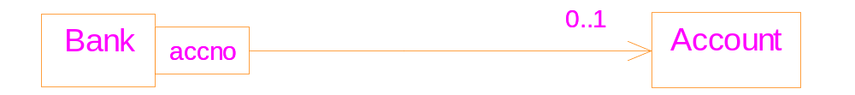
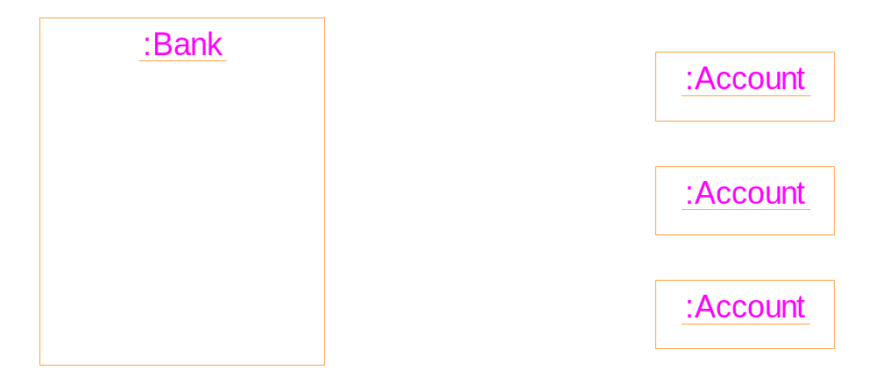
Implementing qualifiers
41
53
99

Slide 29
#include <iostream>
#include <string>
#include <map>
using namespace std;
main( )
{
// a map of expenditure
map<string, double> exp;
string item;
double cost;
while (cin>>item >>cost)
exp[ item ] += cost;
double total=0;
map<string,double>::iterator p;

Slide 30
for (p=exp.begin(); p!=exp.end(); p++){
total += p->second;
cout << p->first << ": "
<< p->second << endl;
}
cout << "total expenditure: " << total;
}
Input:
food 100
book 150
tax 30
book 100
food 180
output:
book: 250
food: 280
tax: 30
total expenditure: 560

Slide 31
Implementation of association classes
Solution: Transform the association class into a simple class linked to the two original classes
The interface of the two original classes should be kept unchanged.
The implementation changed the meaning of the original class diagram. Further constraints should be imposed on the implementation.

Slide 32
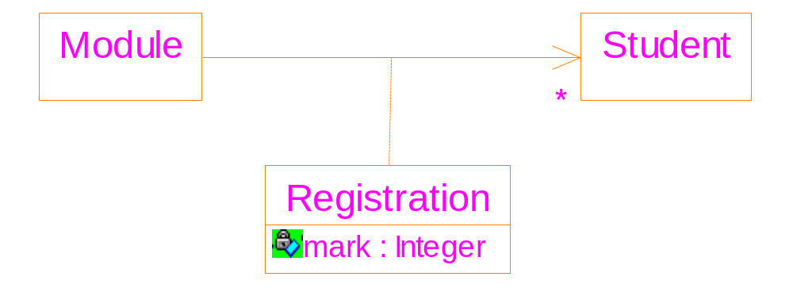
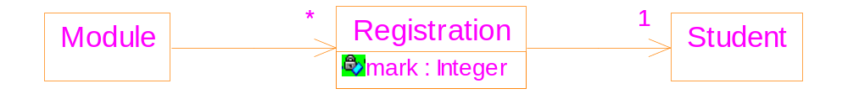

Slide 33
class Registration {
Student * pStudent;
int mark; // the attribute of the link
public:
Registration(Student* st) {
pStudent = st; mark=0; }
};
class Module {
vector<Registration*> registrations;
public:
void enrol(Student* st) { // interface remains
registrations.push_back(new Registration(st));
}
}

