Slide 1
Outline
Use-case Diagram
  Actors
  A use-case should be abstract
  Generalization,Specialization
  Inclusion, Extension
Sequence Diagram
  First step of designing
  An example
  Components of a sequence diagram
  Collaboration diagram
  Conditional/asynchronous message,etc

Slide 2
Introduction to Use-case Diagram
Role played
  Initial statement of the requirements.
  As detailed as you can.
  External visible behavior of the system
Components
  Actors: the roles that users can play
  Use case: the interaction between actors and the system

Slide 3
Actors
Usually: different groups of users
No one-to-one correspondence between a single user and an actor
Not necessarily be human
  Human
  Computer systems
  Some devices

Slide 4
Use case
Should be abstract
  Not every piece of operation can be viewed as a use case
  Exceptions can NOT be viewed as separate use cases.
Definition:a description of a whole class of interactions that have the same overall intention.
Consists of
  A basic course of events
  Alternative courses
  Exceptional courses

Slide 5
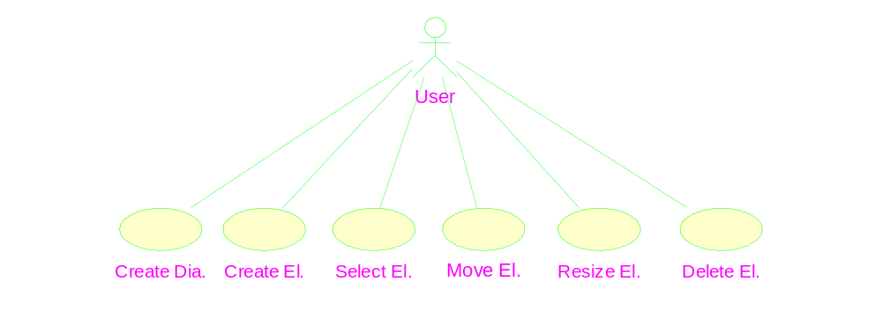
The use case diagram of the diagram editor example
Scenario

Slide 6
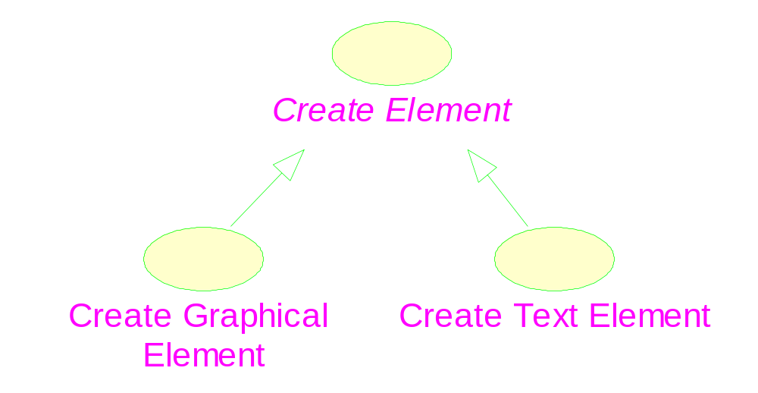
Generalization and Specialization
Abstract use case
Explanation for a use case

Slide 7
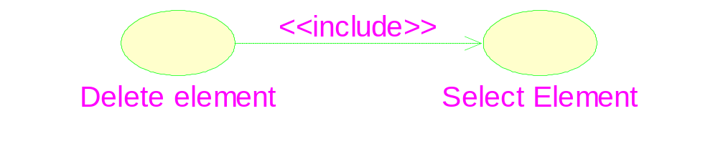
Inclusion of use case
Stereotype: specification of a relationship
The base use case
The inclusion use case

Slide 8
Realization of a use case
Describe how a set of objects can interact with each other to implement the use case.
  For designer: to build up an understanding of the objects, classes and interactions
  The first step of design
  Do not consider the GUI elements
Notation: interaction diagrams
  Sequence diagrams (more informative)
  collaboration diagrams (more concise)

Slide 9
Realization of the “create diagram” use case
Multiple diagrams
➔ We need a “diagram” class
Only one active diagrams
➔ We need a “DiagramEditor” object
The “DiagramEditor” should have a link

Slide 10
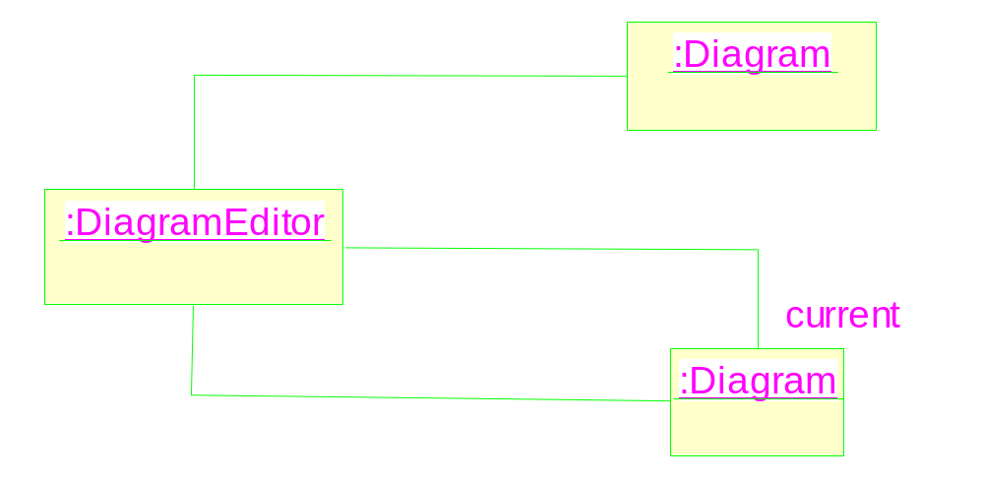

Slide 11

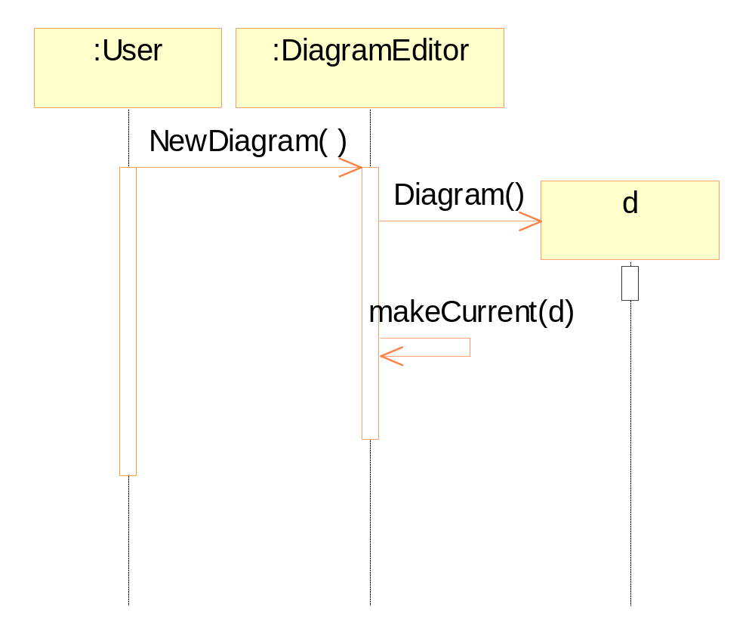
A sequence diagram
Notes:
Rose 2000 can not draw the above figure.
You must use Rose2002 or later.

Slide 12
Elements in a sequence diagram
Objects are shown at the top.
Time flows downward.
Lifeline.
Messages & message to oneself
Activation: processing a message.
Construction of a new object.

Slide 13
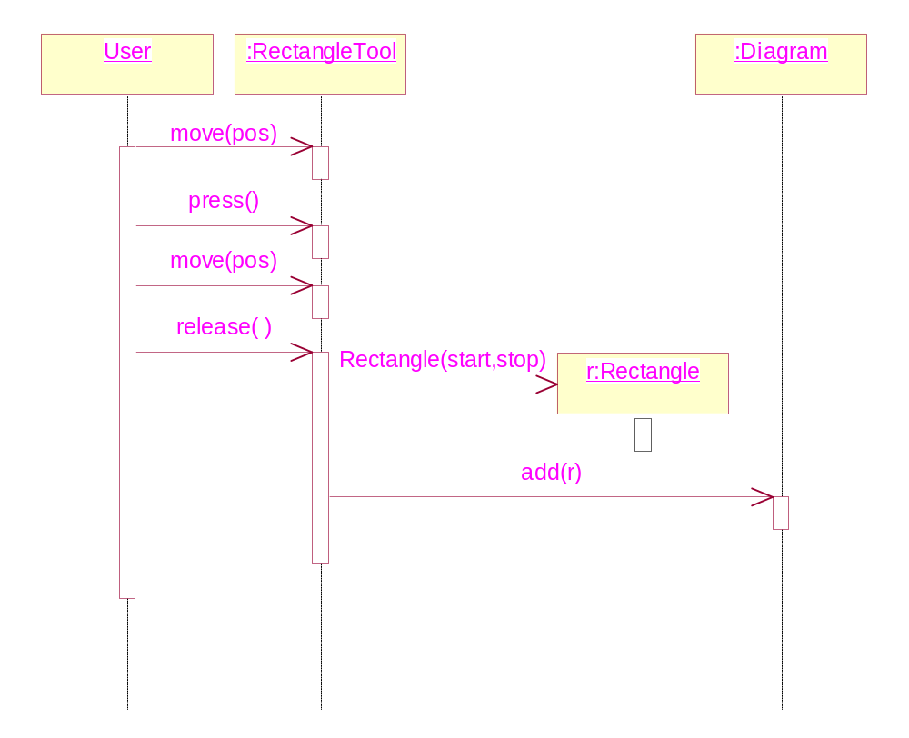
Creating a rectangle element
Notes:
The sequence diagram does not reflect the actual sequences of the demonstrated program. But this is not crucial since our objective is just to compare the difference
between the two types of interaction diagrams.

Slide 14
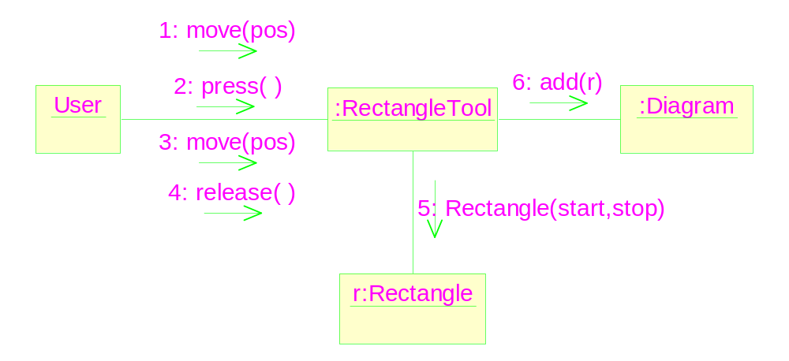
A collaboration diagram
Order of the messages should be explicitly specified.

Slide 15
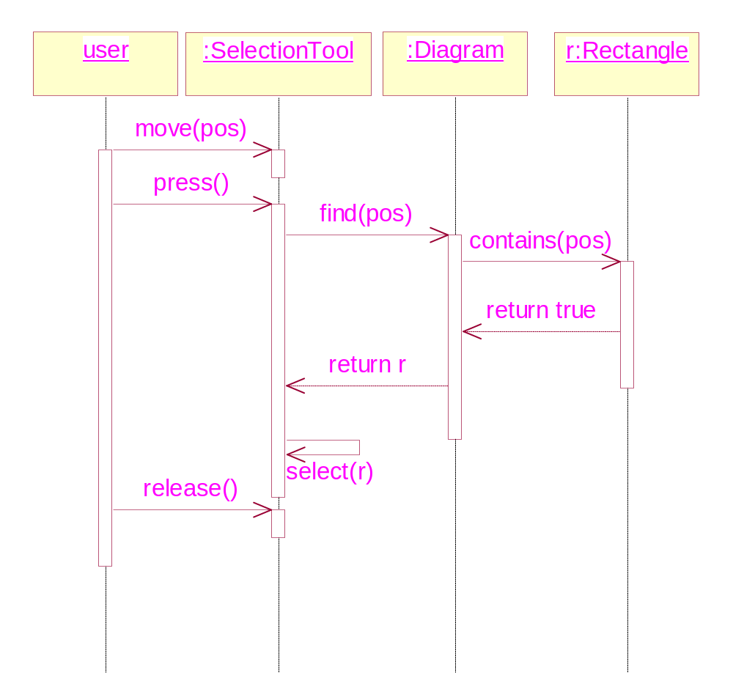
Selecting an element : Return messages
Notes:
This sequence diagram shows the course of selecting an element.

Slide 16
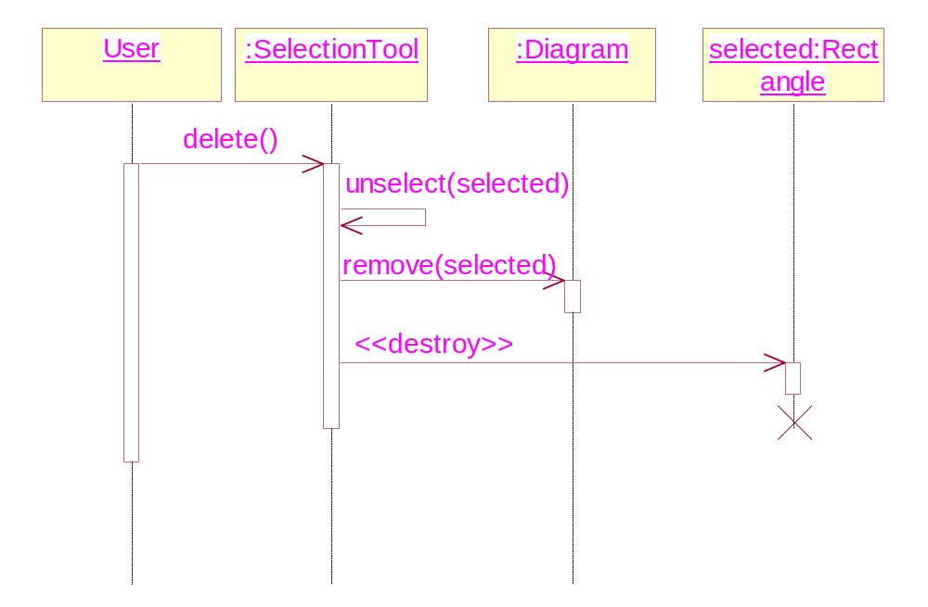
Deleting an element: Termination of objects

Slide 17
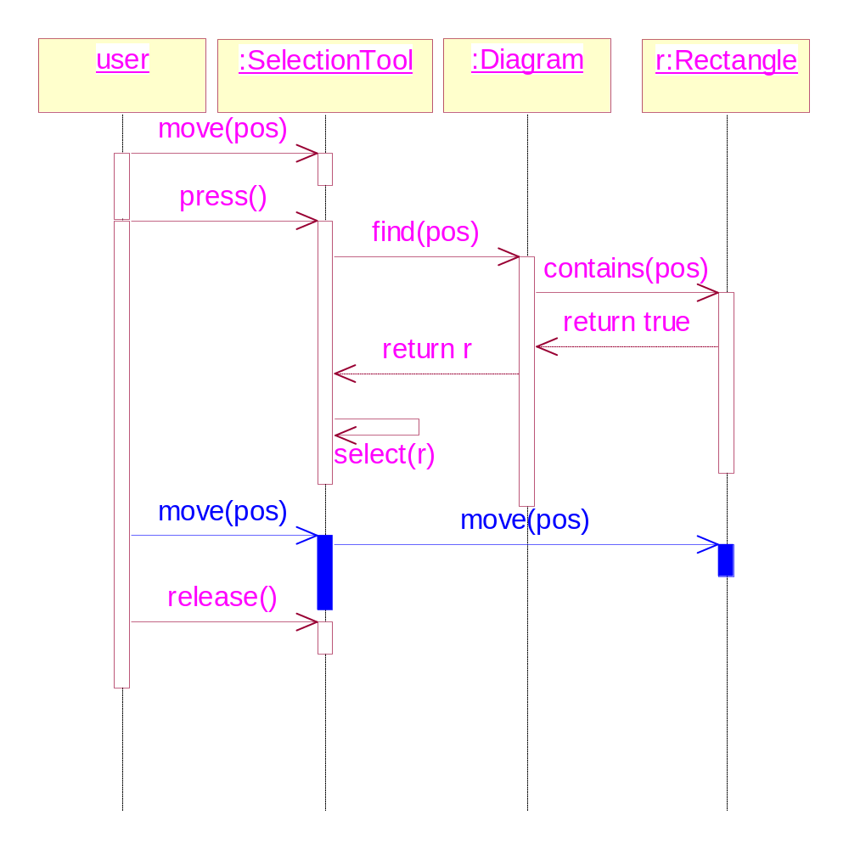
Moving an element: use case extension

Slide 18
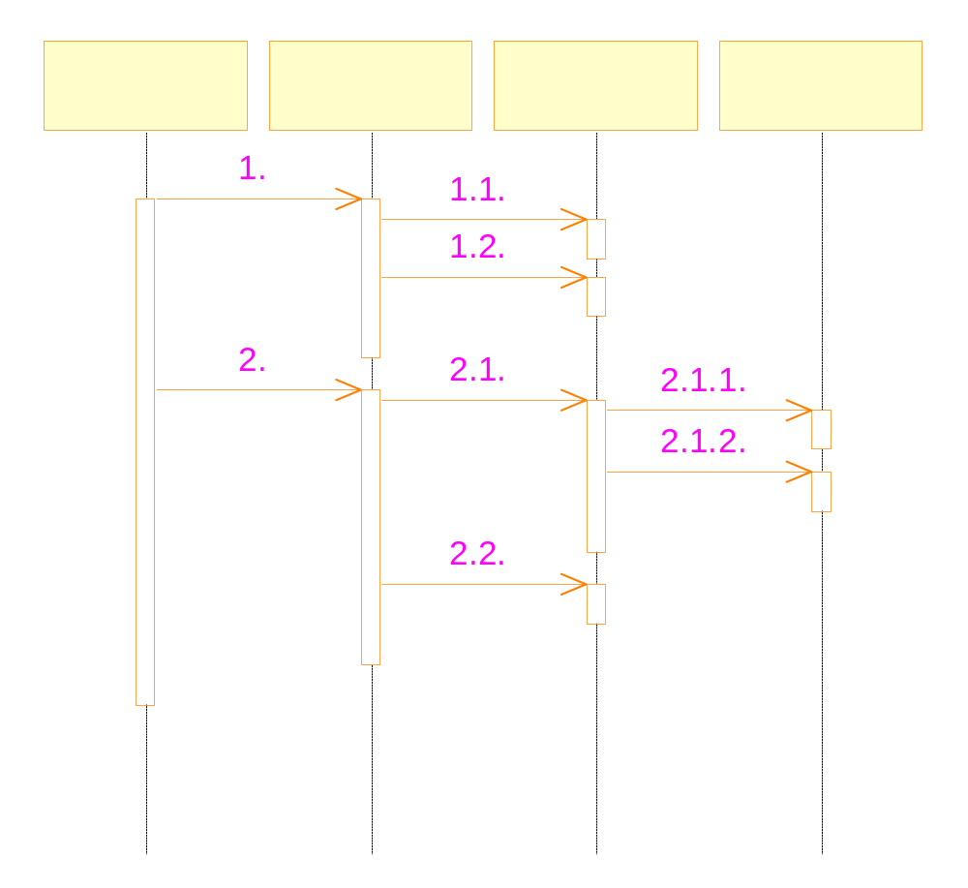
Hierarchical numbering of messages
Can also be used in collaboration diagram
Notes:
Of course, for simple sequence diagram, it is unnecessary for numbering.

Slide 19
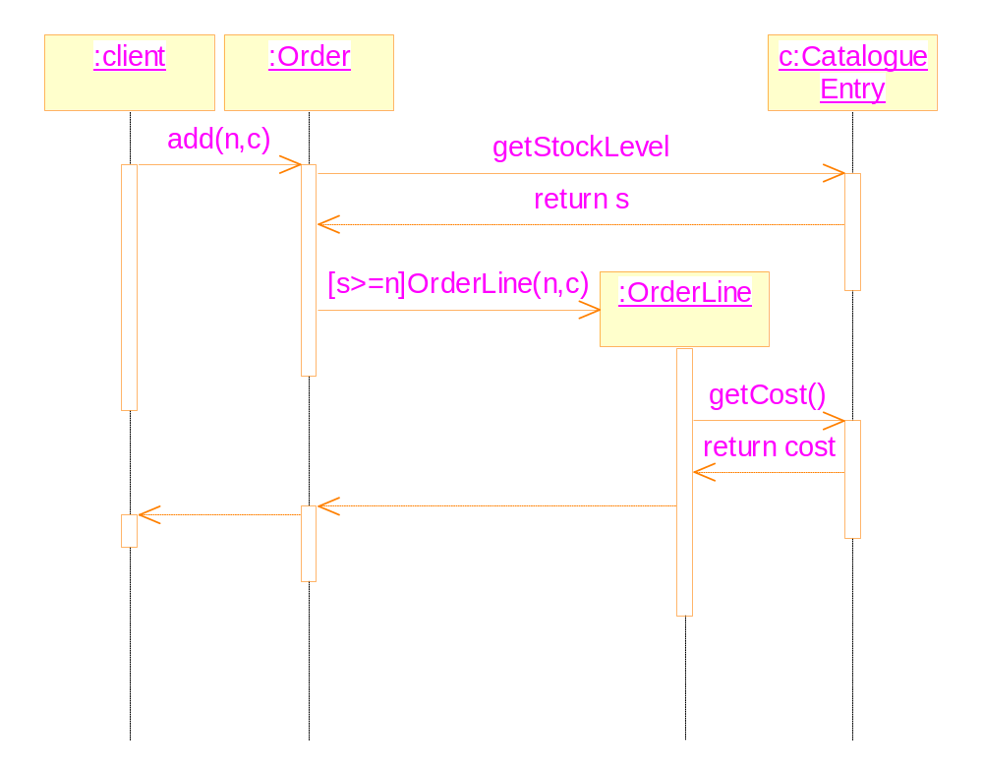
Conditional messages
Notes:
n: the number of parts. c: to specify the catalogue of the part.

Slide 20
Message to oneself
It represents implementation details.
But when the return value of the message is used in the further messages, it should be made explicit.
It causes recursive activity

Slide 21
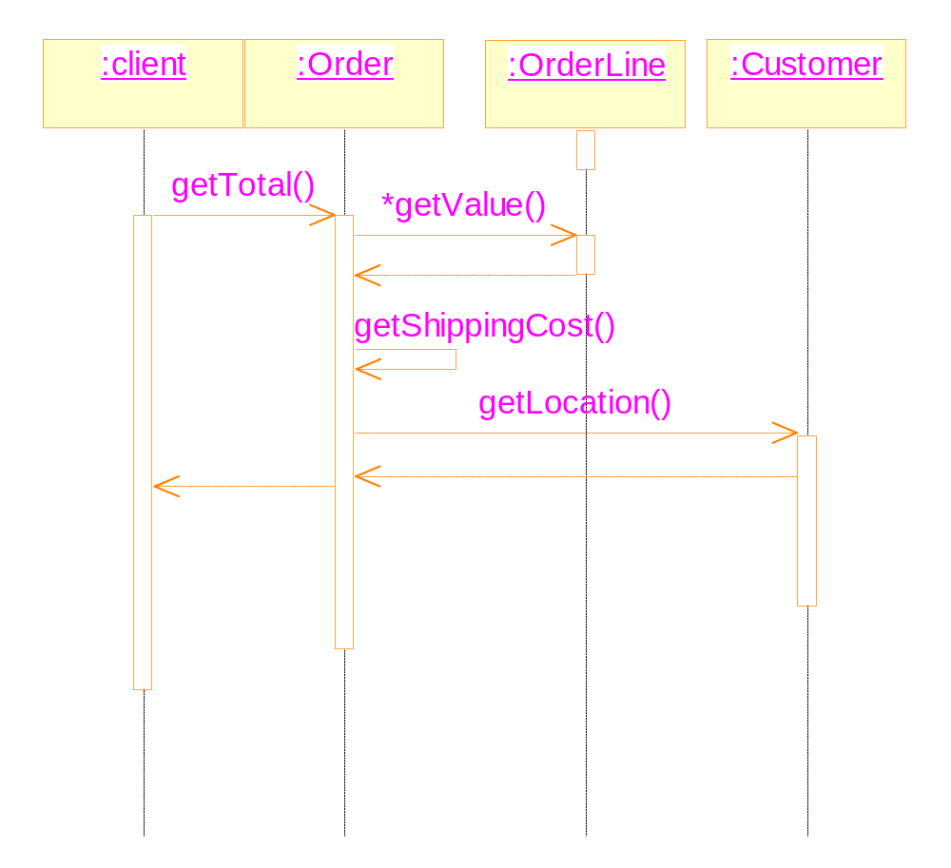

Slide 22
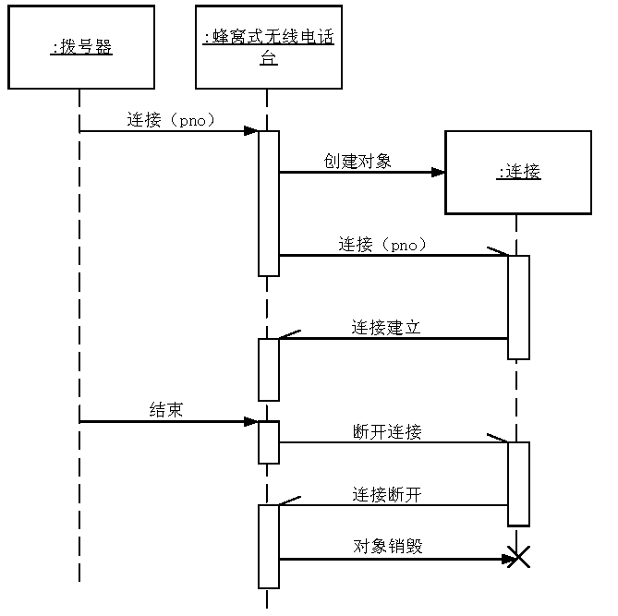
Asynchronous message and multiple threads
Notes:
Taken from http://www.uml.net.cn/OObject.htm

Slide 23
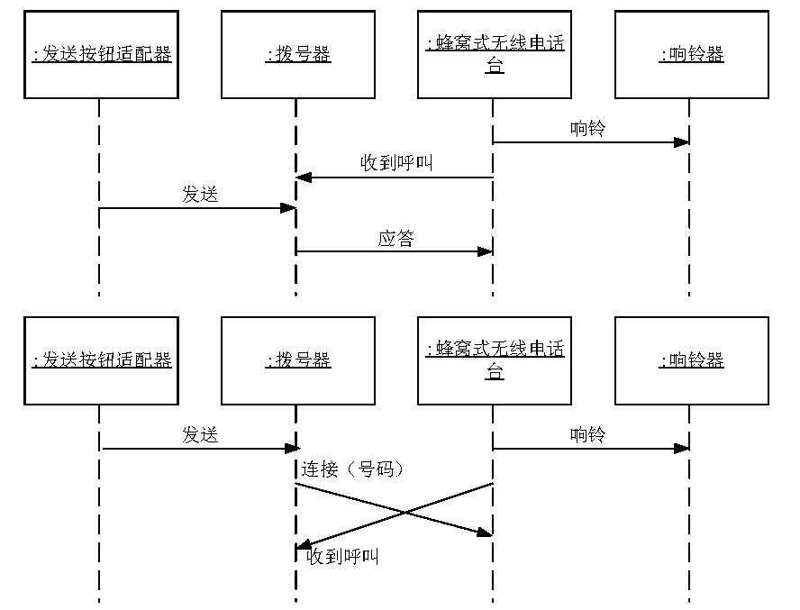
Competition between messages

Slide 24
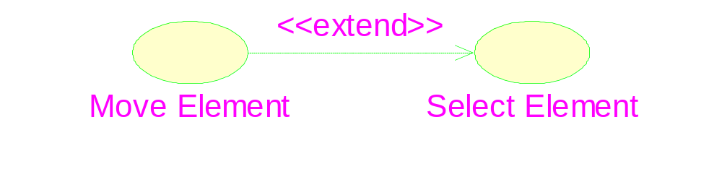
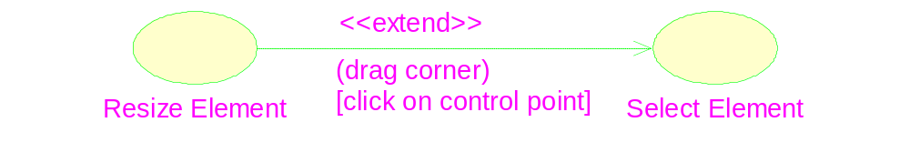
Extension of use case

Slide 25
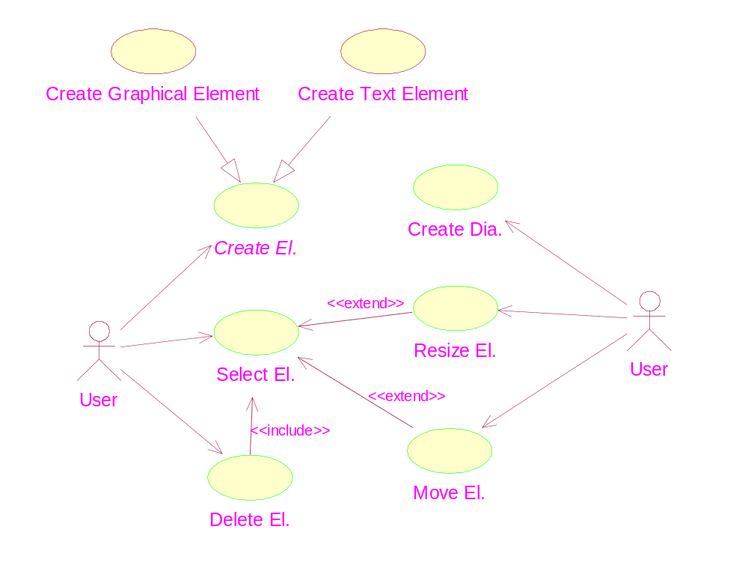
The complete use case diagram

Slide 26
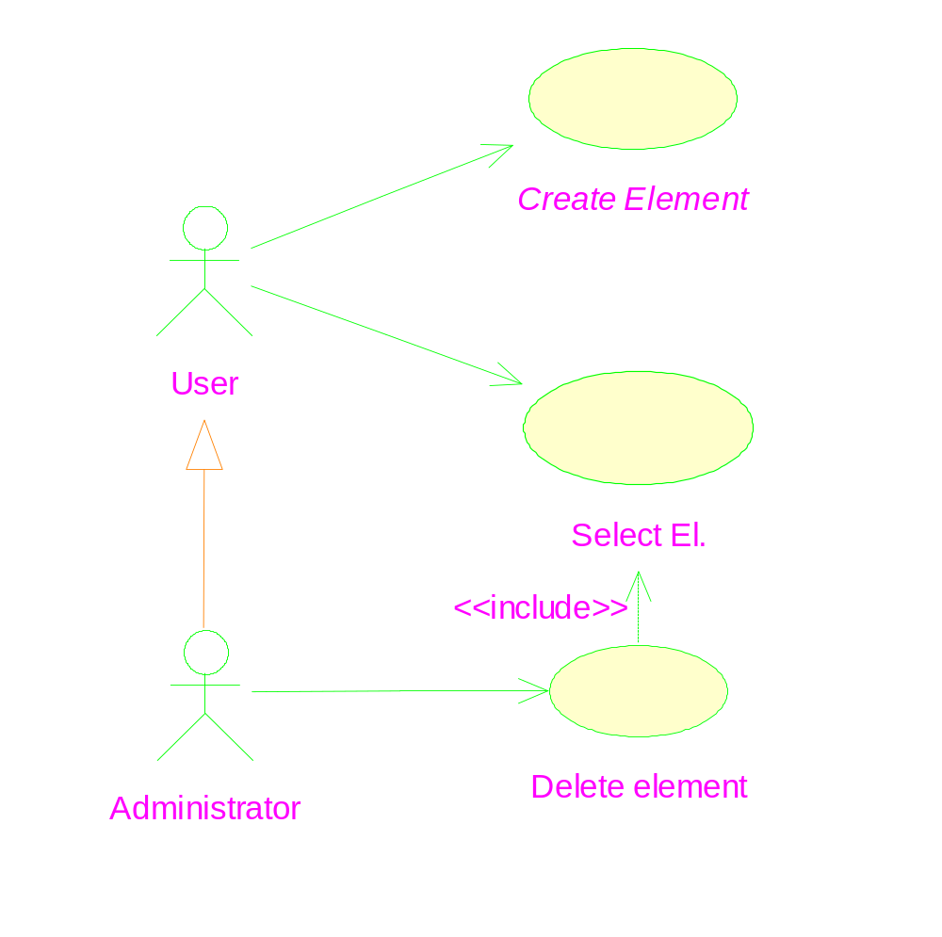
Generalization between actors

