Slide 1
Outline
Why statecharts
State,transition, Initial and final states
Actions, guard conditions
Entry and exit actions
Activities
Composite states
History states
A “real” example
Quiz on the automatic ticket machine
Implementation of statecharts

Slide 2
Why Statecharts
Interaction diagram Vs. statecharts
  The former: a short period, a single user generated transaction, a certain sequence of messages
  The later: an object’s whole life, all possible messages it can accept.
How to construct states
An object in a particular state will respond differently to at least one event from the way in which it responds to that event in other states.
(Active) state, event (triggers) and transitions

Slide 3
An example of statecharts
物流系统简要介绍
向供应商下订单
登记入库
  编辑商品信息
  编辑商品在仓库中的存放信息
要求界面智能
津菱物流管理系统登记入库部分的屏幕截图
状态图
Notes:
1。原来的登记、查询、修改、入库、 标签打印5个界面被集中到了一个界面。用户感觉非常方便、高效。
相关的代码精炼。
2。按钮的状态。
3。在任何时刻用户可以选择一个新的订货单号码，系统不会乱。

Slide 4
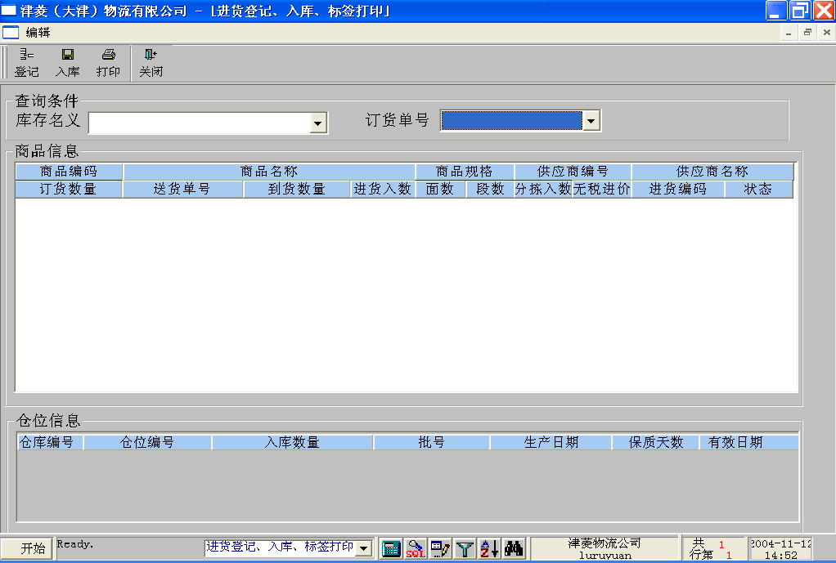

Slide 5
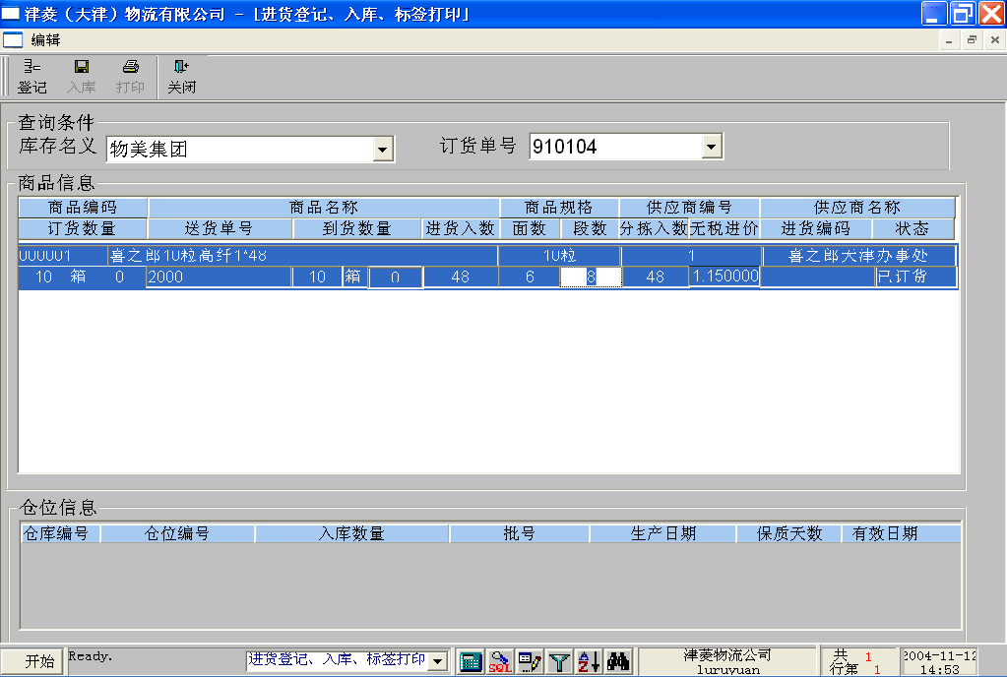

Slide 6
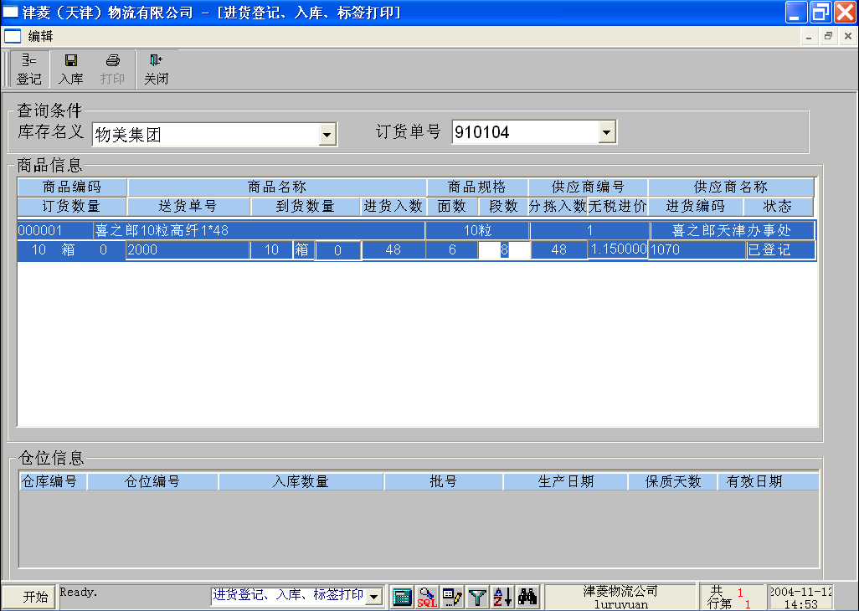

Slide 7
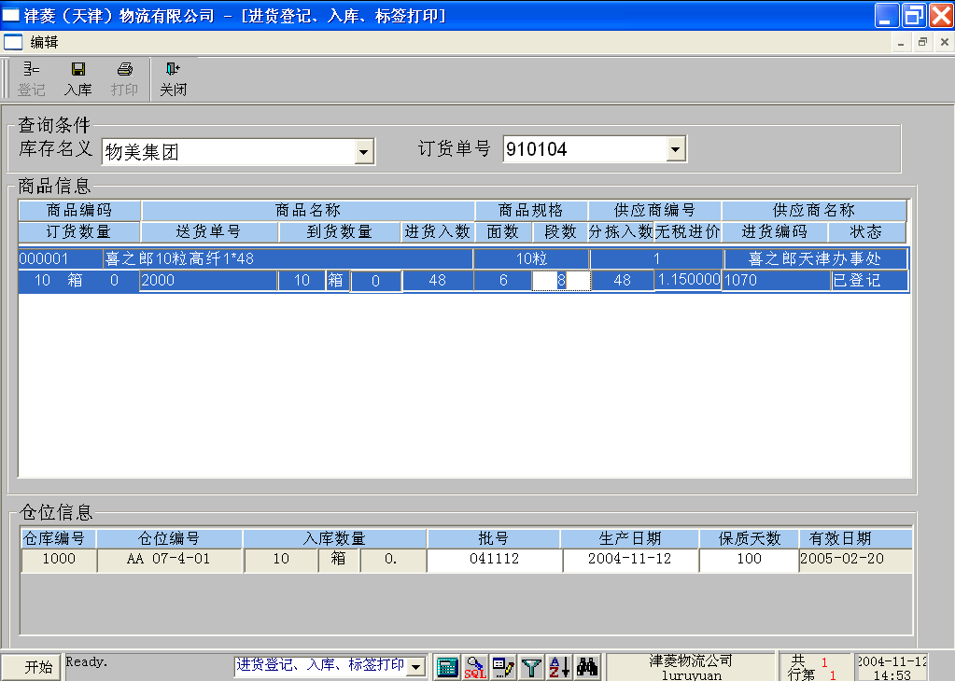


Slide 8
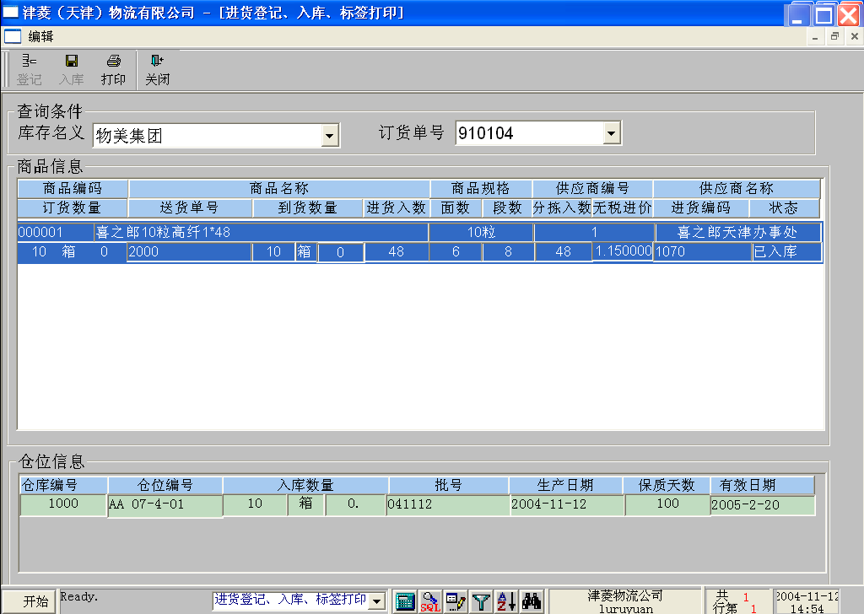

Slide 9
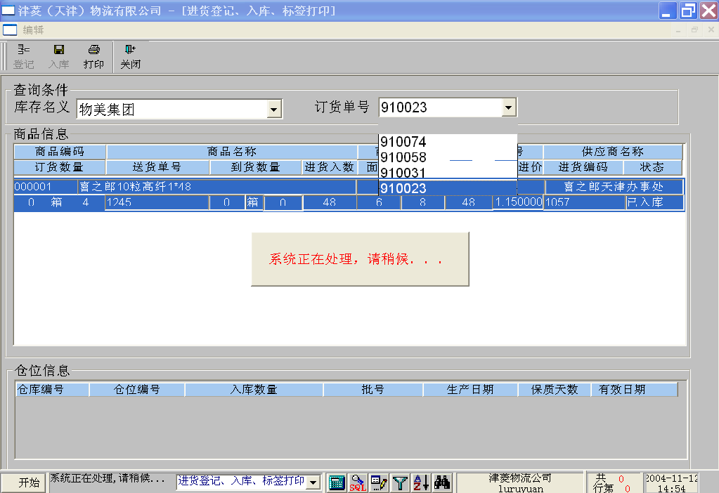

Slide 10
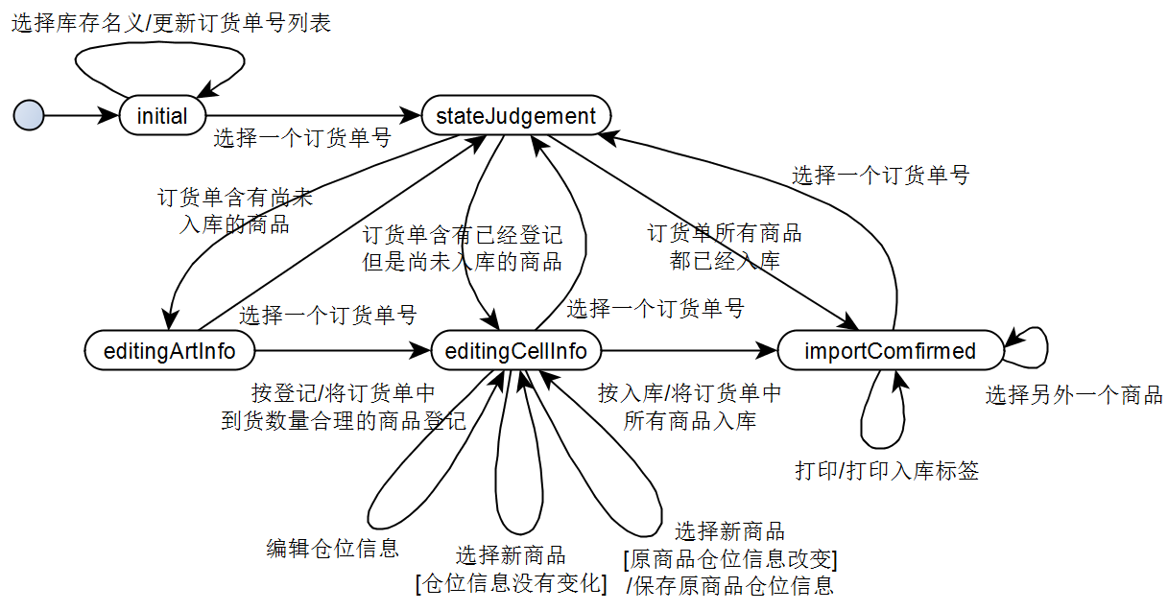

Slide 11
Components of a statechart
State
Event
Transition
Initial and final states
Actions

Slide 12
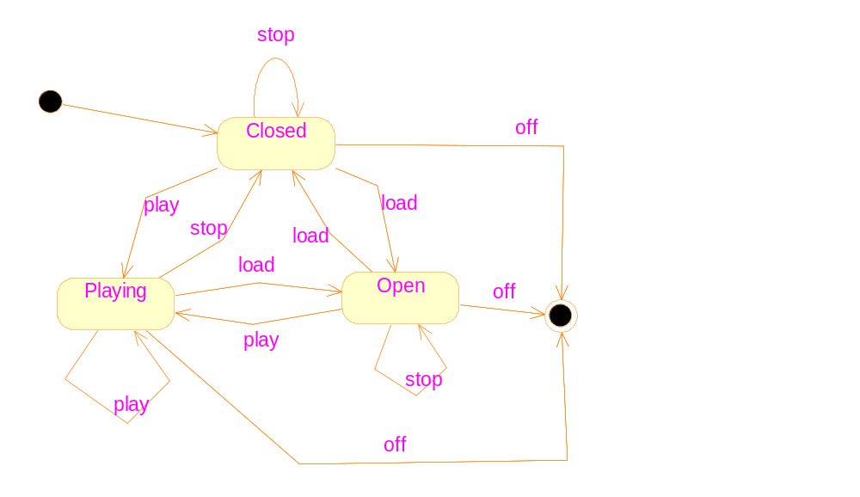
The CD player example

Slide 13
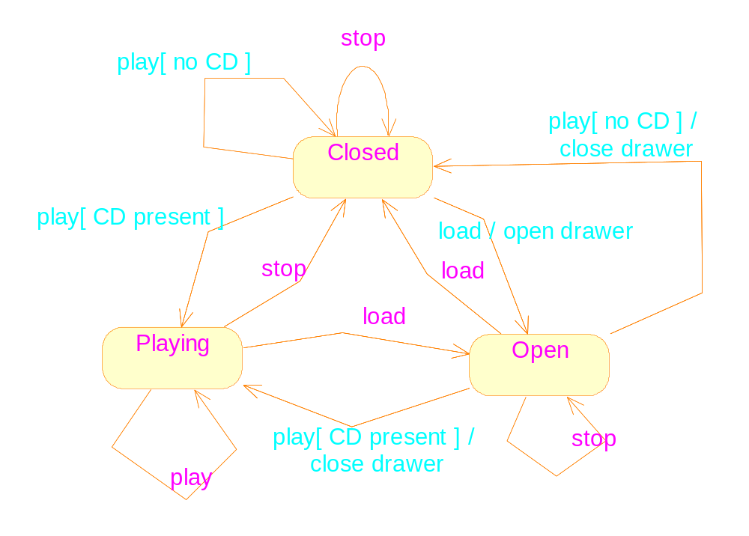
Guard condition and actions

Slide 14
Entry and exit actions
Entry actions are performed every time a state becomes active, immediately after actions on transitions leading to the state have completed.
Exit actions: are performed whenever a transition is fired to leave the state.

Slide 15
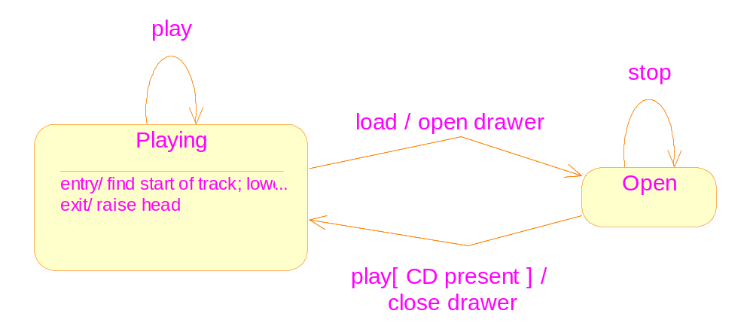
Entry and exit actions
Applicable for self-transitions too.

Slide 16
Activities
Activities
  The operation continues to run throughout the period when the state is active.
  Can be interrupted by other events.
  If no event interrupt it, completion transitions will be issued
Actions
  Can be though of as being instantaneous
  Can not be interrupted by other events.

Slide 17
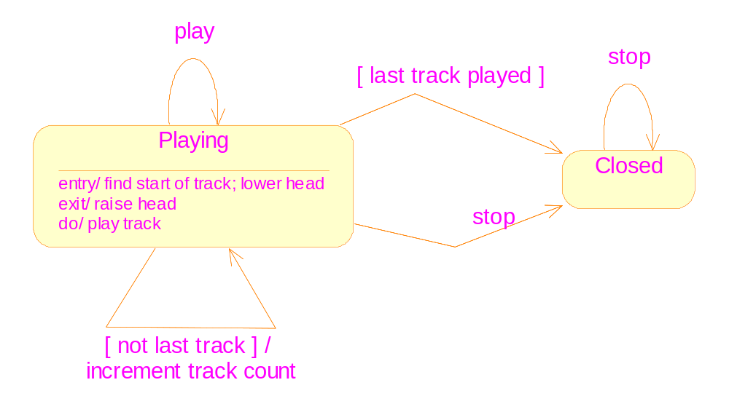
Activities and completion transitions

Slide 18
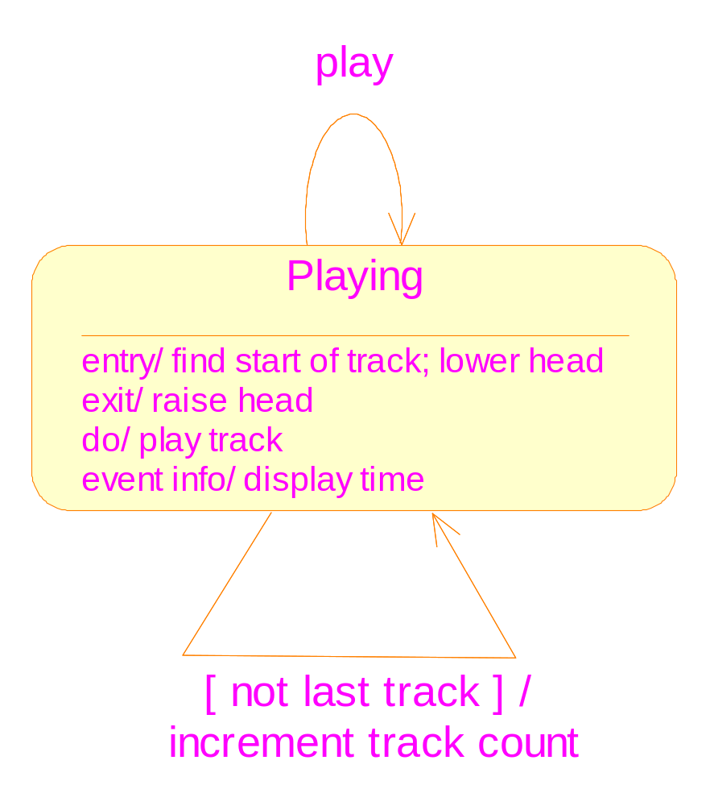
Internal transition: Some events cause transitions to the current state, but without triggering the execution of the entry and exit actions.

Slide 19
Composite states
For complex systems, statecharts are often too complex for producing and understanding.
Composite states are used just for simplifying the statecharts.
Applicability: for states which have the common transitions (outgoing or incoming)
The states above are grouped together to form a composite state; the individual states are called substates.

Slide 20
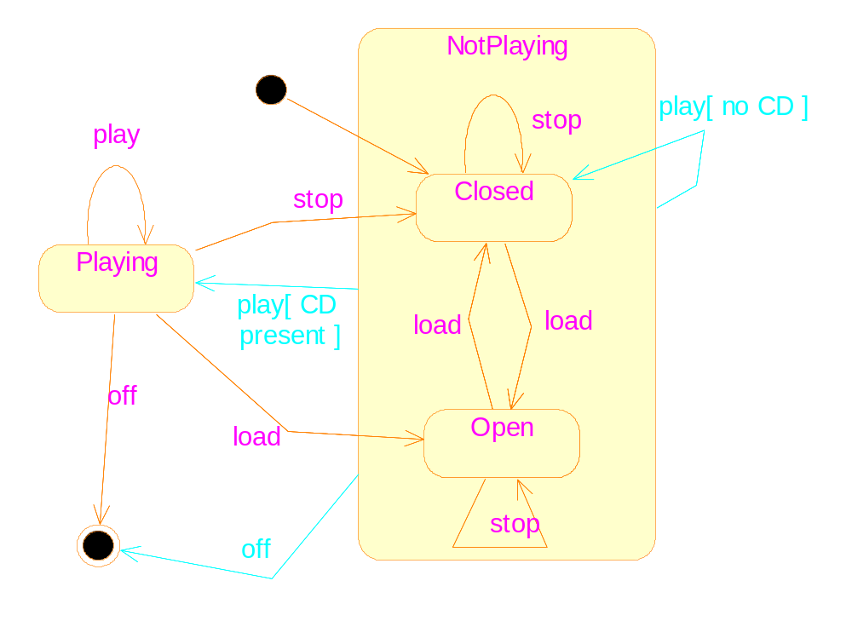

Slide 21
Properties of composite states
If a composite state is active, exactly one of its substate must also be active
Outgoing transition: can flow from the composite state, or from a substate
Incoming transition: can flow to the composite state, or to a substate
Initial state: becomes active when an incoming transition reaches at the boundary
Final state: when ongoing activity has finished; issue completion transitions
Entry/exit actions

Slide 22
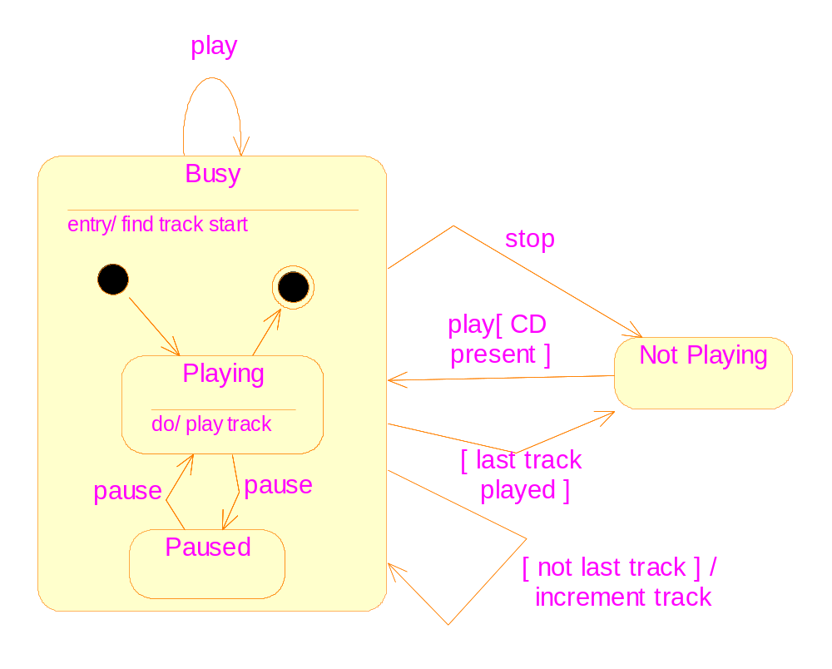

Slide 23
History states
Requirement: if the “play” button is pressed, return to the CD player’s previous state, either “playing” or “paused”
The composite state can remember a history state, denoted by an “H” state.

Slide 24
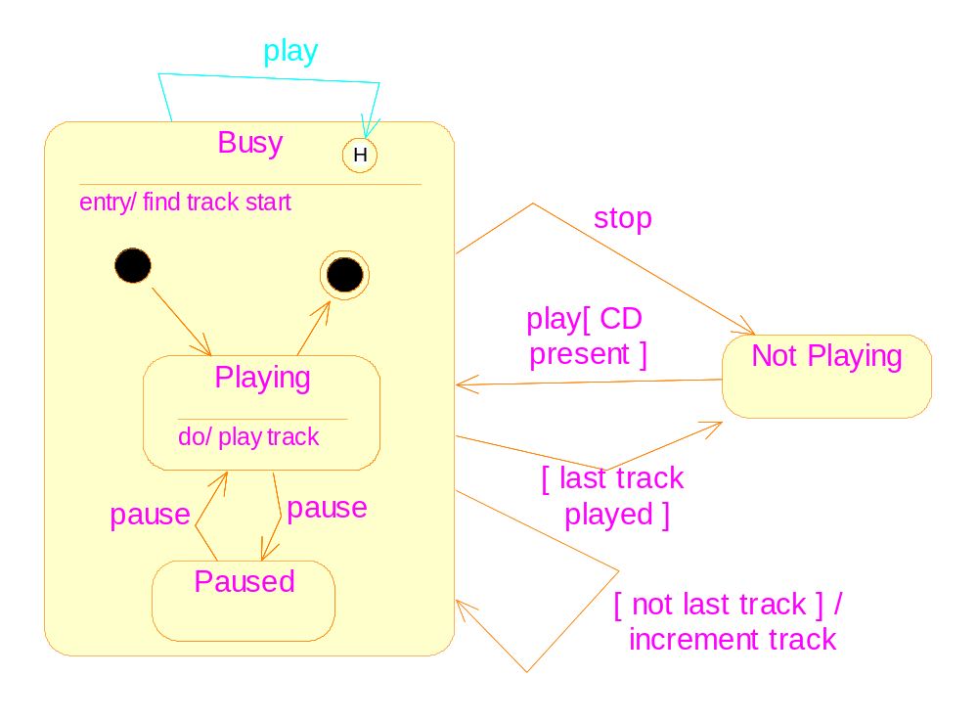
Notes:
The actual behavior of the “play” transition:
If the CD player is playing, it should carry on playing from the start of the track if “play” is pressed, but if it is paused, it should stay paused until the pause button
is pressed again.
To insert the history state, just double click on the “Busy” state.

Slide 25
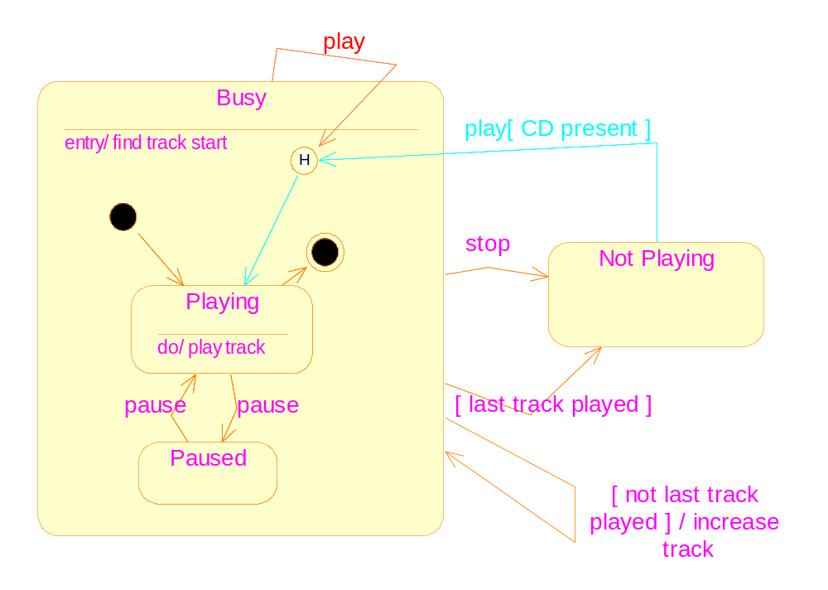
Notes:
If the history state is the first state to be made active, a default state should be specified.

Slide 26
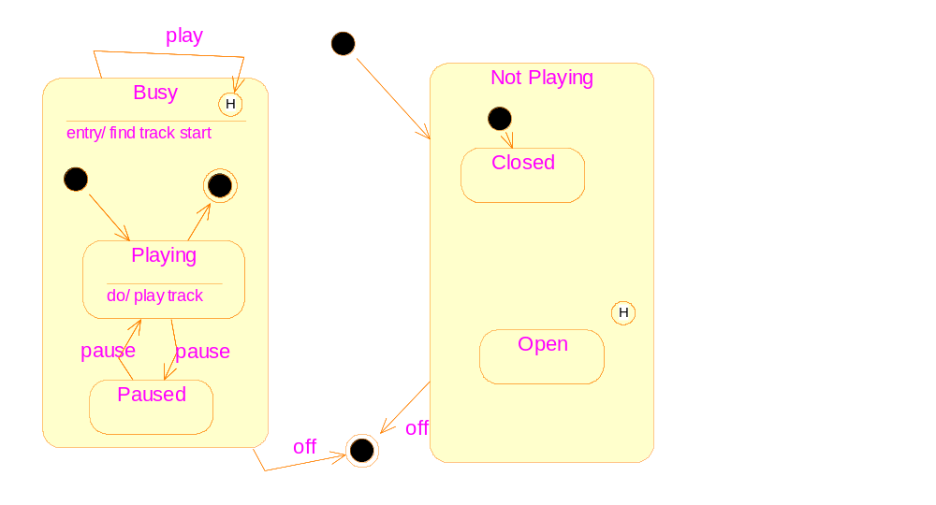
Play
[no CD]
Stop→
←play
[CD present]
[last track played]
stop
[Not last track]
Load →

Slide 27
A “real” example
Description of the automatic ticket machine
  You select a type of ticket
  The machine displays how much money you should continue to pay.
  You insert coins
  Two modes: “Change available” or “Exact money required”
  You have the option of entering money before selecting a ticket type
  Cancel: press the “cancel” button or keep silence for 30 seconds

Slide 28
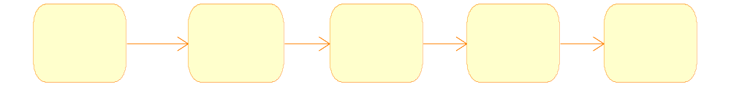
Preliminary statechart
A single (the most common) transaction
Every event leads to a transition between two states
It is unnecessary to name the states
ticket
coin
coin
coin

Slide 29
Analysis of the preliminary statecharts
The process can be divided into three stages:
  The machine waits for the user to select a ticket type;
  The user inserts coins into the machine;
  When the inserted coins is enough, the machine issues the ticket. Return to stage 1.
Most stages correspond to states directly. But for the stages (e.g. stage 3) that only span short periods of duration, we can model them by actions.

Slide 30
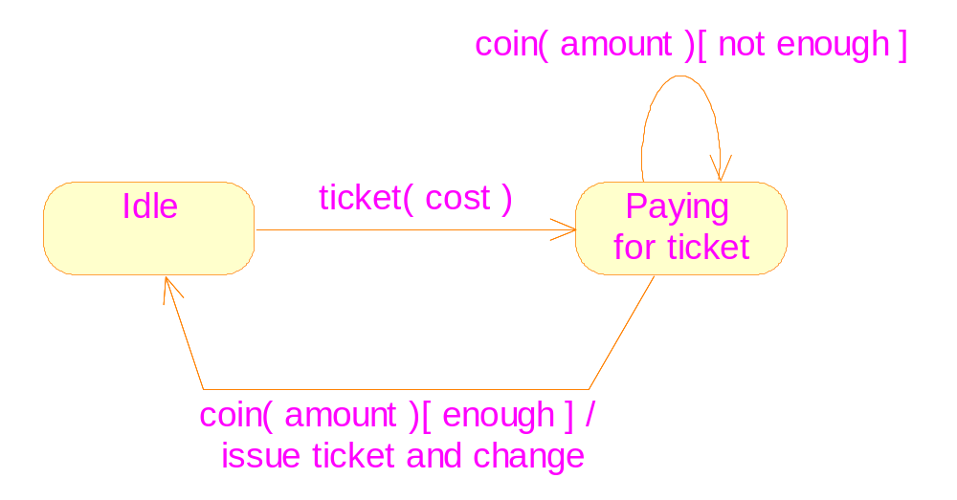

Slide 31
To model the alternative way: entering money before selecting a ticket type
Starting from the “idle” state, there is no transition labeled “coin”.
➔ We need to create a new state

Slide 32

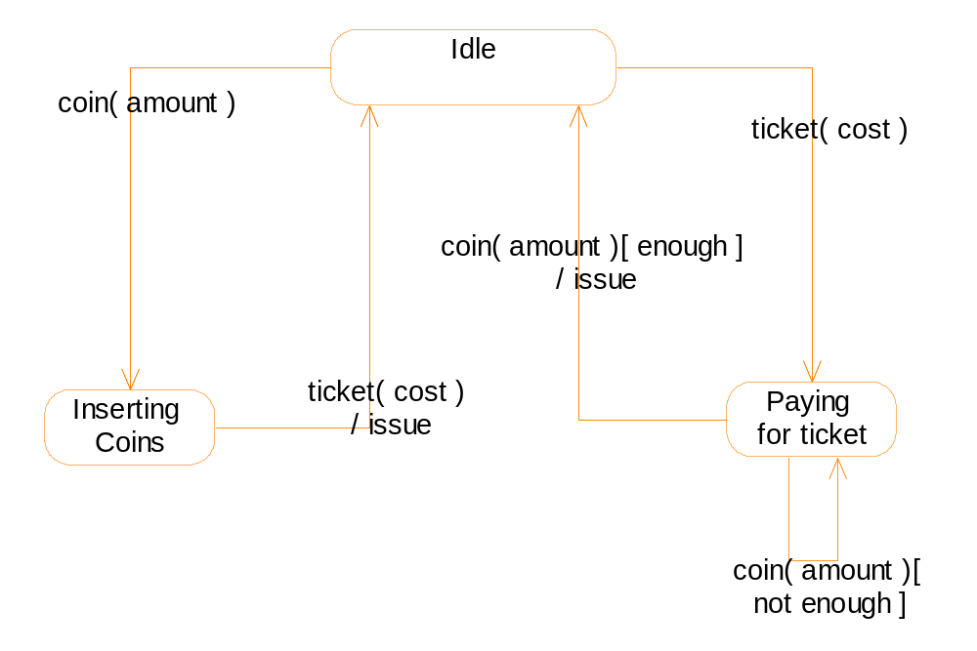

Slide 33
Integrating the transactions
To model the sequence:
  Entering some coins ( but not enough)
  Select a ticket type
  Continue to enter coins
We could create a new state.
But eventually we find the new state is as the same as the existing one

Slide 34
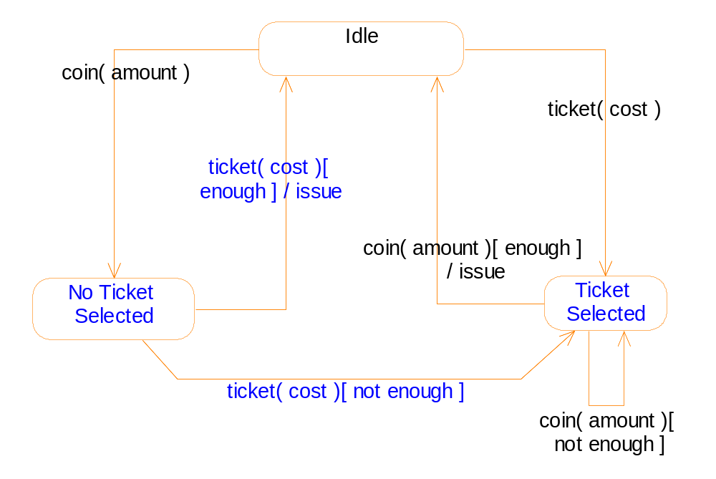

Slide 35
Time events
Each state is supposed to contain an internal timer.
The timer is reset every time the state is entered.
The “after” event
The “when” event

Slide 36
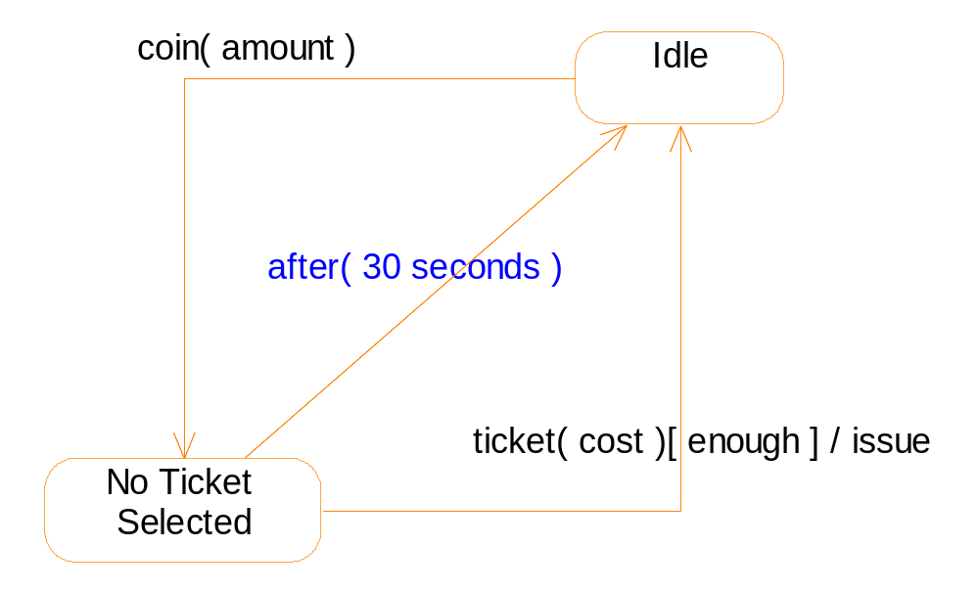

Slide 37
Action states
Purpose of using action states: to avoid repetitions of transitions.
An action state represents a period of time during which an object is performing some internal processing
It only contains an activity
It can not respond to external events.
The transitions leaving an action state can only be completion transitions.
Do not overuse them.
Notes:
The textbook has an error here: it wrongly calls the “Action States” as “Activity states”.
Difference between the two is:
Action state: can not be interrupted by external events.
Activity state: can be interrupted by external events. It has more complex semantics.

Slide 38
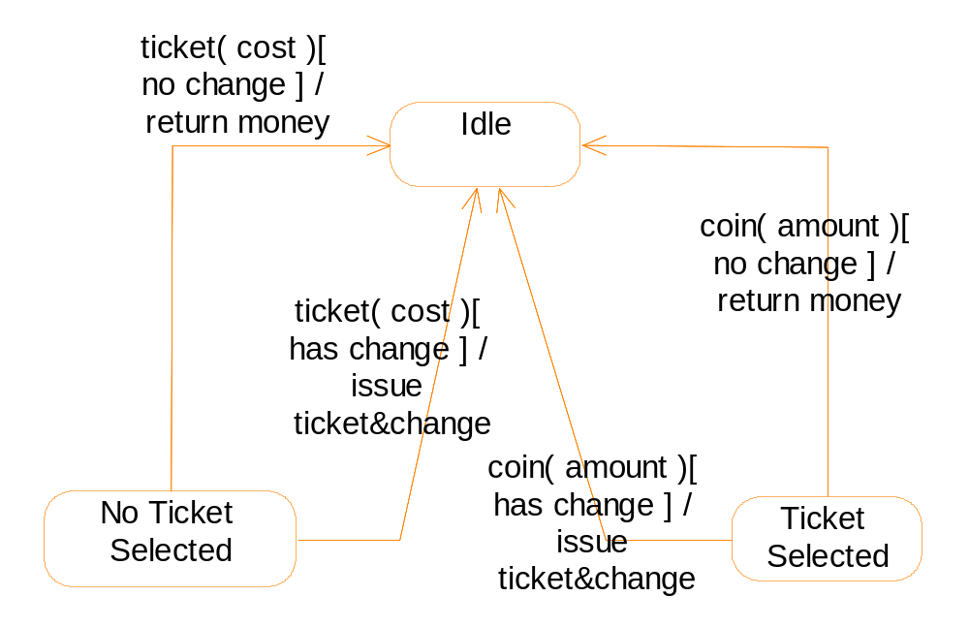
Without action states, some transitions must be repeated.

Slide 39
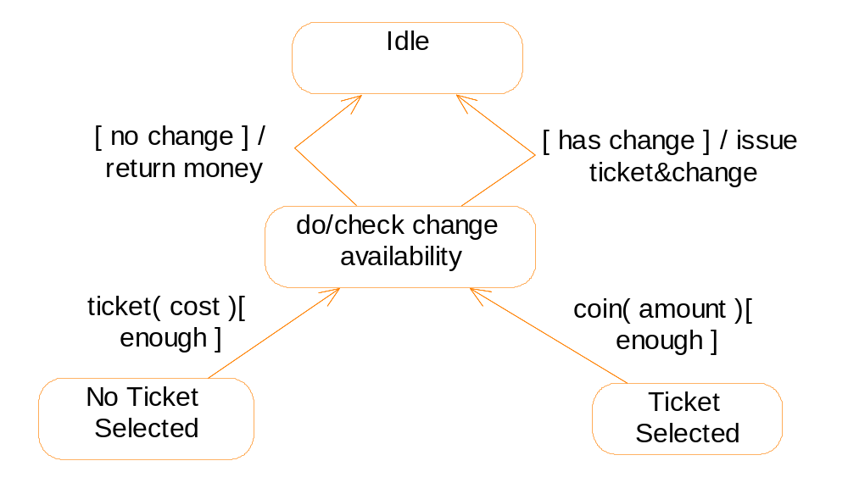
With action states, we get a clearer figure.

Slide 40
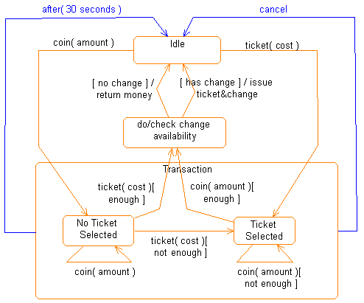
The complete statechart for the ticket machine

Slide 41
Question
Page 203, exercise 8.6.
  Suppose that the ticket selection buttons are deactivated once a ticket type has been selected, and only reactivated at the end of a transaction.
  Suppose that once enough money has been entered to pay for the required ticket, the coin entry slot is closed, and only reopened once any ticket and change has been issued.

Slide 42
Analysis of the requirement #1
In Idle or No ticket selected state, a single press of the ticket type button leads to transitions ending at the ticket selected state. Thus, we need only to study the last state.
Add an entry action to deactivate the buttons
Since all transitions leaving from the ticket selected state end at the Idle state, we can add an exit action into the state to reactivate the buttons.

Slide 43
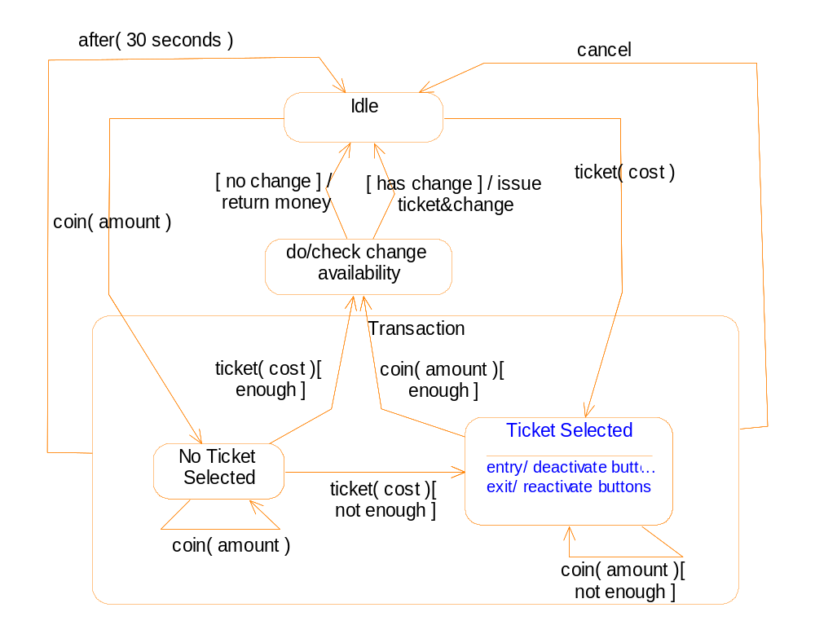

Slide 44
Analysis of the requirement #2
In Idle or No ticket selected state, the machine does not know what type of ticket is required by the user, so it is impossible to judge whether the entered money is enough. Thus, the slot is kept open.
In the ticket selected state, when enough money has been entered, the machine jumps into the action state.
Thus, we add an entry action into the action state to close the slot.
Since the slot is reopened only after the ticket and change is issued, we add an entry action into the idle state.

Slide 45
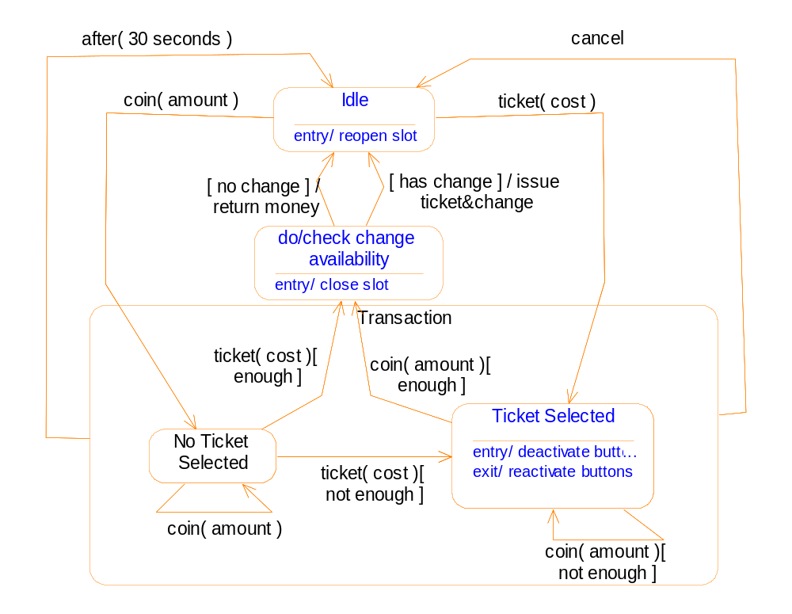

Slide 46
Implementation of statecharts
Solution 1
  The states are modeled by an enumeration variable.
  “Switch” statements are used for the member functions whose behaviors varies with the state.
Drawbacks
  When a new state is added, all functions should be changed.
  Some functions contain many empty cases in the switch statement

Slide 47
Implementation of statecharts
Solution 2:
  Suppose class A has n states. Each state is modeled by a state class.
  All the state classes are generalized to a root class.
  Class A holds a pointer (to the root class).
  For incoming messages, class A simply pass them on to the object representing the current state.

Slide 48
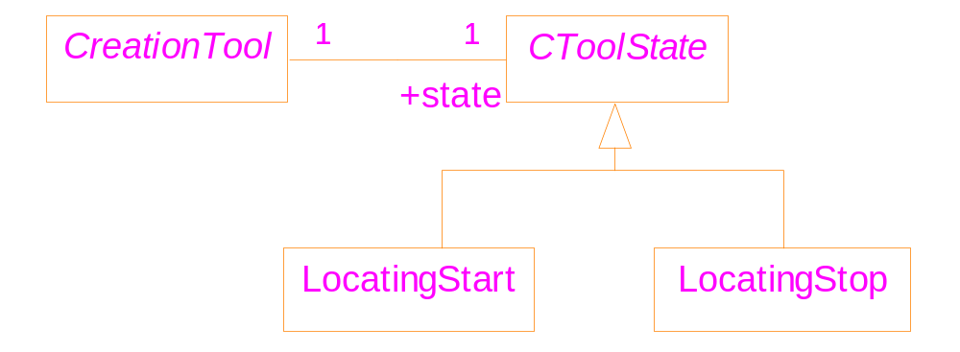
class CToolState {
virtual void Press()=0;
};
class CreationTool{
CToolState* state;
void Press() {state->Press();}
}

Slide 49
Solution 2 (continued)
The root class has an interface to process all messages sent to class A.
Each state class only re-define functions for the messages that interest it.
Each state is capable of destroying itself, creating a new object representing a new state, and setting the current state to the new state.
➔ bidirectional association between class A and the root class is necessary.

Slide 50
class CToolState;
class CreationTool{
CToolState* pCurState; // points to the current state
public:
void Press();
void ChangeState( CToolState * pNewState);
};
class CToolState {
protected:
CreationTool * pCreationTool; // bidirectional
Skeleton of the implementation:1/4
Notes:
Due to the bidirectional link, declarations of the “CreationTool” and the “CToolState”
must be separated from their definitions.

Slide 51
public:
CToolState(CreationTool * p);
void ChangeState(CToolState * s);
virtual void Press();
};
void CreationTool::Press() { pCurState->Press(); }
void CreationTool::ChangeState(CToolState *pNewState)
{ delete pCurState;
pCurState = pNewState;
}
CToolState::CToolState(CreationTool * p)
{ pCreationTool = p;
}
Passing message
Skeleton of the implementation:2/4

Slide 52
void CToolState::ChangeState(CToolState * s)
{ pCreationTool->ChangeState(s);
}
void CToolState::Press() {}
class LocatingStop : public CToolState {
public:
LocatingStop( CreationTool * p): CToolState(p) {}
};
Skeleton of the implementation:3/4

Slide 53
class LocatingStart: public CToolState {
public:
LocatingStart( CreationTool * p): CToolState(p) {}
void Press() {
// set start position
// draw faint image
ChangeState(new LocatingStop(pCreationTool) );
}
}
main() { }
Skeleton of the implementation:4/4

