Slide 1
Overview
Abstract factory pattern
  The pattern
  Implementation(singleton,make)
Iterator & visitor pattern
  Iterator
  Proxy pattern

Slide 2
Outline
Iterator Pattern
  Robust Iterator
  Pre-order traversing
Visitor Pattern
Builder Pattern

Slide 3
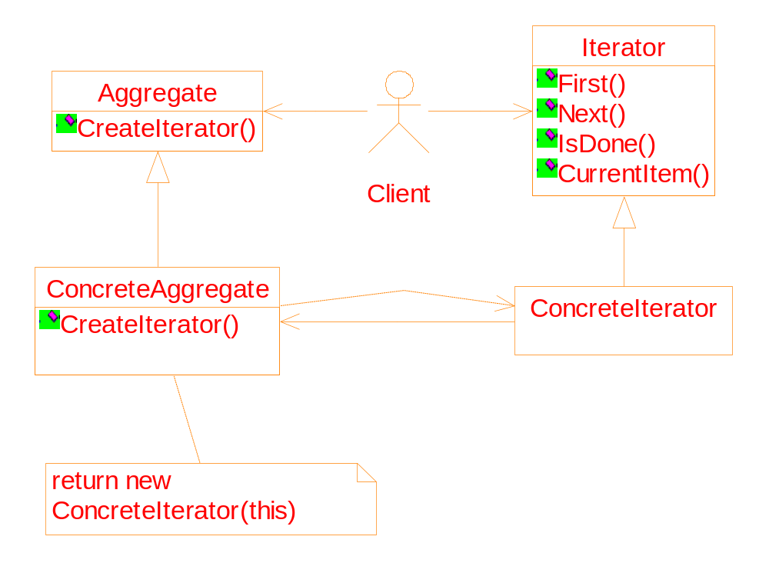
General structure of the iterator pattern

Slide 4
Implementation
Robust iterator
In general, it is dangerous to modify an aggregate object while you are traversing it.
An example:
3
10
19
30
3
3
10
10
19
19
30
30

Slide 5
#include <iostream>
#include <vector>
using namespace std;
main()
{
vector<int> v;
for (int i=0; i<10; i++)
v.push_back(i);
vector<int>::iterator p;
for (p=v.begin(); p!=v.end(); p++)
v.insert(p, *p);
}
Why is the program wrong?
3
10
19
30
3
3
10
10
19
19
30
30

Slide 6
The first problem:before insertion, the
elements after the insertion point are
moved backward.
p
3
10
19
30
p
3
3
10
19
30
As a result, all new elements will be inserted
to the head of the original sequence.

Slide 7
The second problem: the insertion operation
may lead to re-allocation of memory
p
p
3
10
19
30
3
10
19
30
As a result, the iterator(pointer) points to
an invalid memory block.
How to solve the problem?

Slide 8
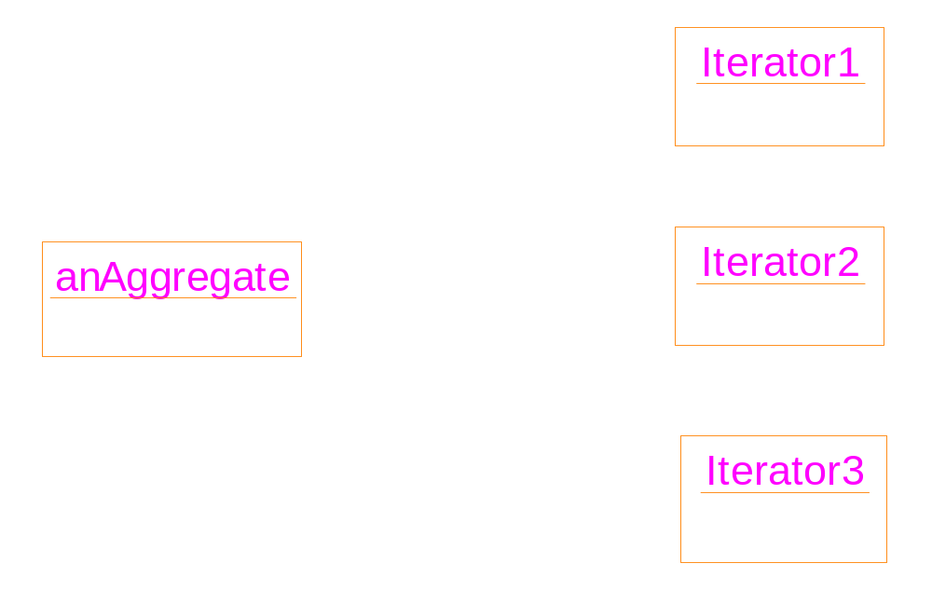
Solution for robust iterator
When create an iterator, register it with the aggregate. On insertion and deletion, the aggregate adjust the internal state of the iterators

Slide 9
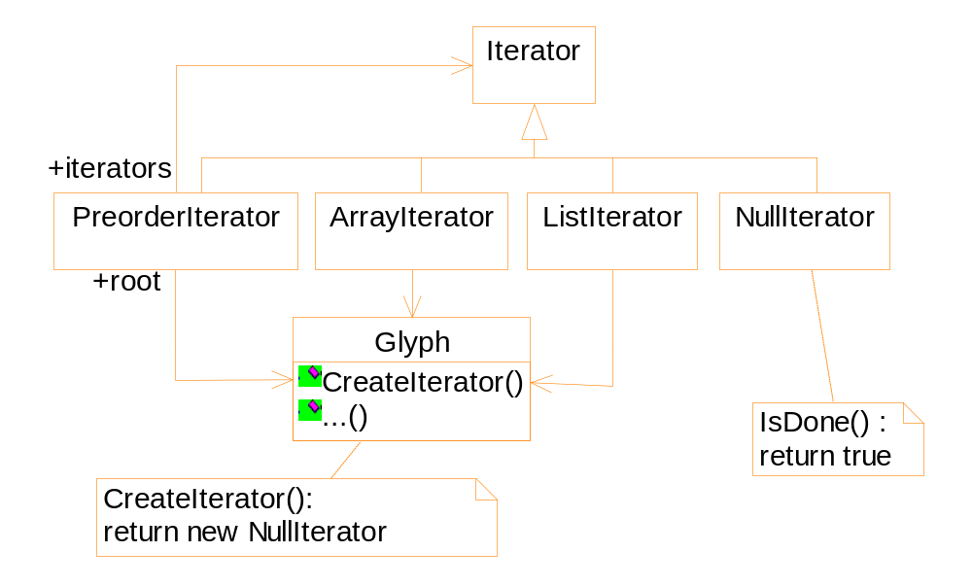
Applying the Iterator pattern in Lexi

Slide 10
Traversing a Glyph element
void func( Glyph * g)
{
Iterator<Glyph*> *it = g->CreateIterator();
// the Proxy pattern can be used here instead.
for (it->First(); ! it->IsDone(); it->Next() ) {
Glyph * child = it->CurrentItem();
// do something with current child
}
delete it;
}

Slide 11
PreorderIterator: Traversing a Glyph hierarchy tree in preorder
What is preorder traversing?
The “first” operation of a preorder iterator
void PreorderIterator::First() {
Iterator<Glyph*> * i = _root->CreateIterator();
if (i) {
i->First();
_iterators.RemoveAll();
_iterators.Push(i);
}
}

Slide 12
A
i
B
C
D
→ B
E
F
G
H
I
CurrentItem: B

Slide 13
The next( ) operation of a pre-order iterator
Use a stack to record the path previously reached: Each element of the stack is an iterator; The CurrentItems pointed by the iterators form the path
If we encounter a leaf node, we call Top()->Next();
If we have searched all children of the top, delete the top, and call Top()->Next().

Slide 14
void PreorderIterator::Next() {
Iterator<Glyph*> * i =
_iterators.Top()->CurrentItem()->
CreateIterator();
i->First();
_iterators.Push(i);
while { _iterators.Size() > 0 &&
_iterators.Top()->IsDone() ) {
delete _iterators.Pop();
_iterators.Top()->Next();
}
}

Slide 15
A
B
C
D
→ B
i
E
F
G
→ E
H
I
CurrentItem: E

Slide 16
A
B
C
D
→ B
E
F
G
→ E
i
H
I
→ H
CurrentItem: H

Slide 17
A
B
C
D
→ B
E
F
G
→ E
H
I
→ H
I:^
I:^

Slide 18
A
B
C
D
→ B
E
F
G
→ E
H
I
→ I
i
CurrentItem: I

Slide 19
A
B
C
D
→ B
E
F
G
→ E
H
I
→ I
I:^
I:^

Slide 20
A
B
C
D
→ B
E
F
G
→ E
H
I
IsDone
i

Slide 21
A
B
C
D
→ B
E
F
G
→ E
H
I

Slide 22
A
B
C
D
→ B
E
F
G
→ F
i
H
I

Slide 23
Traversal versus Traversal actions
Where to put the traversal actions
e.g. spelling check, hyphenation
  Integrate analyzers into the iterator
  ➔ Possibly there are many analyzers!
  Separate the analyzers with the iterator.
Different analyzers are interested with different type of aggregate objects
E.g. spelling checker only processes characters
➔ how to judge the type of the aggregate

Slide 24
First step: encapsulating the analyzer
During the iteration, each time we encounter a new Glyph, we feed it into the analyzer
The analyzer can accumulate information (characters in this case)

Slide 25
Straight solution: using type-casting
SpellingChecker spellingChecker;
Composition *c;
Glyph * g;
PreorderIterator i(c);
for ( i.First(); ! i.IsDone(); i.Next() ) {
g = i.CurrentItem( );
SpellingChecker.Check( g );
}

Slide 26
void SpellingChecker::Check( Glyph * glyph )
{
Character * c;
Row * r;
Image * i;
if (c=dynamic_cast<Character*> (glyph)) {
// analyze the character
}else if (r=dynamic_cast<Row*> (glyph ) {
// prepare to analyze r's children
}else if (i=dynamic_cast<Image*>(glyph ) {
// do nothing
}
}

Slide 27
Safer solution: using special operation
Add the operation
void CheckMe( SpellingChecker & checker)
into the Glyph class
For each subclass of Glyph, define the
operation like:
void Subclass::CheckMe(SpellingChecker&
checker) {
checker.Check(this);
}

Slide 28
class SpellingChecker {
public:
SpellingChecker();
void Check(Character*);
void Check(Row*);
void Check(Image*);
private:
char _currentWord[ MAX_WORD_SIZE ];
}

Slide 29
SpellingChecker spellingChecker;
Composition *c;
Glyph * g;
PreorderIterator i(c);
for ( i.First(); ! i.IsDone(); i.Next() ) {
g = i.CurrentItem( );
g.CheckMe( spellingChecker );
}

Slide 30

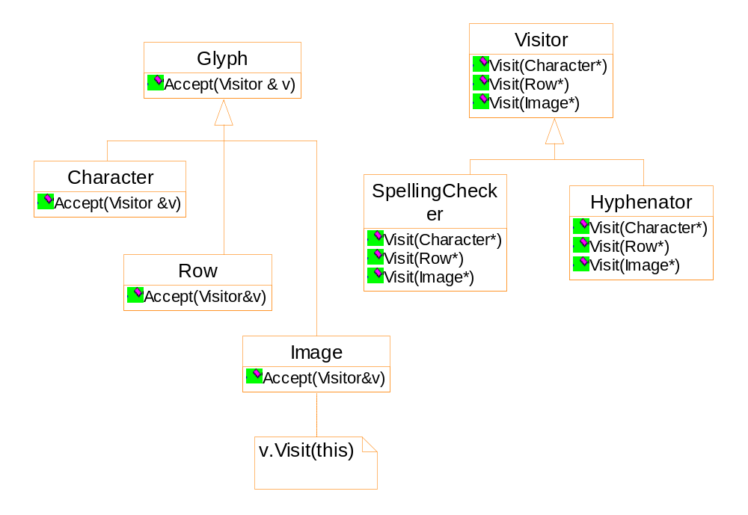
Visitor pattern

