Slide 1

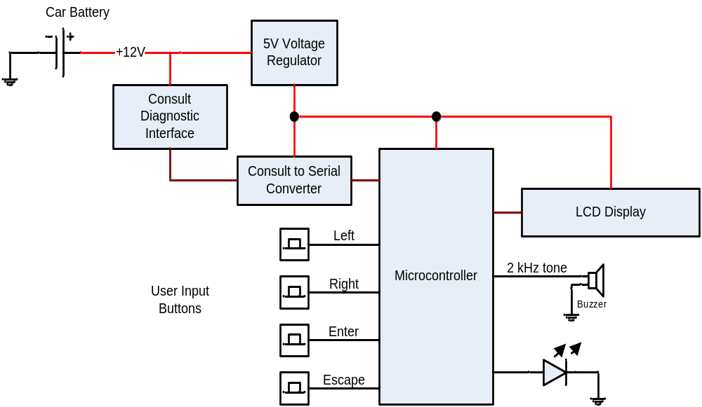
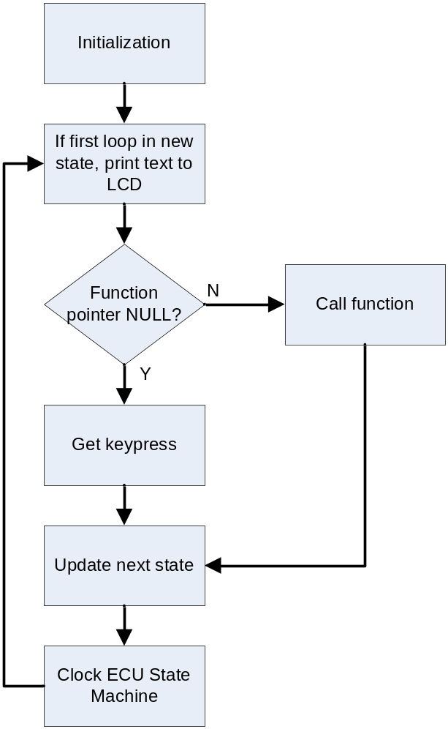
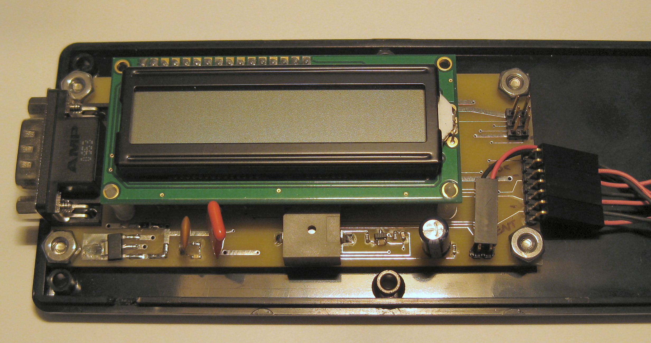
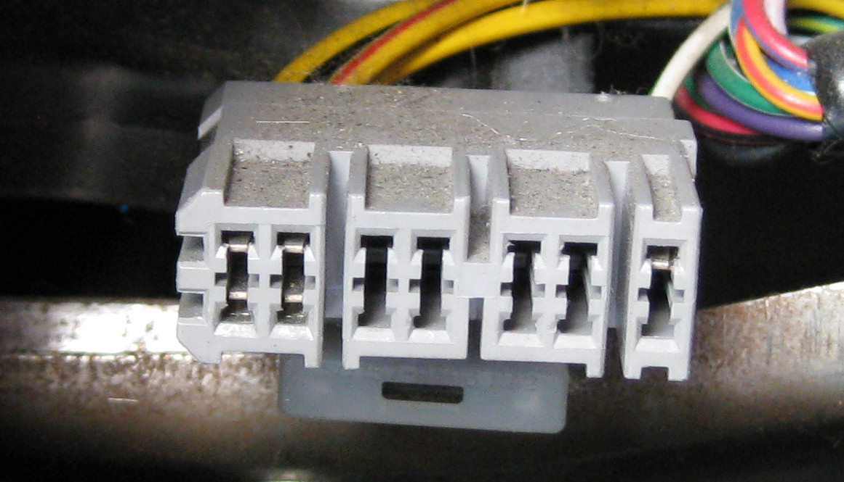

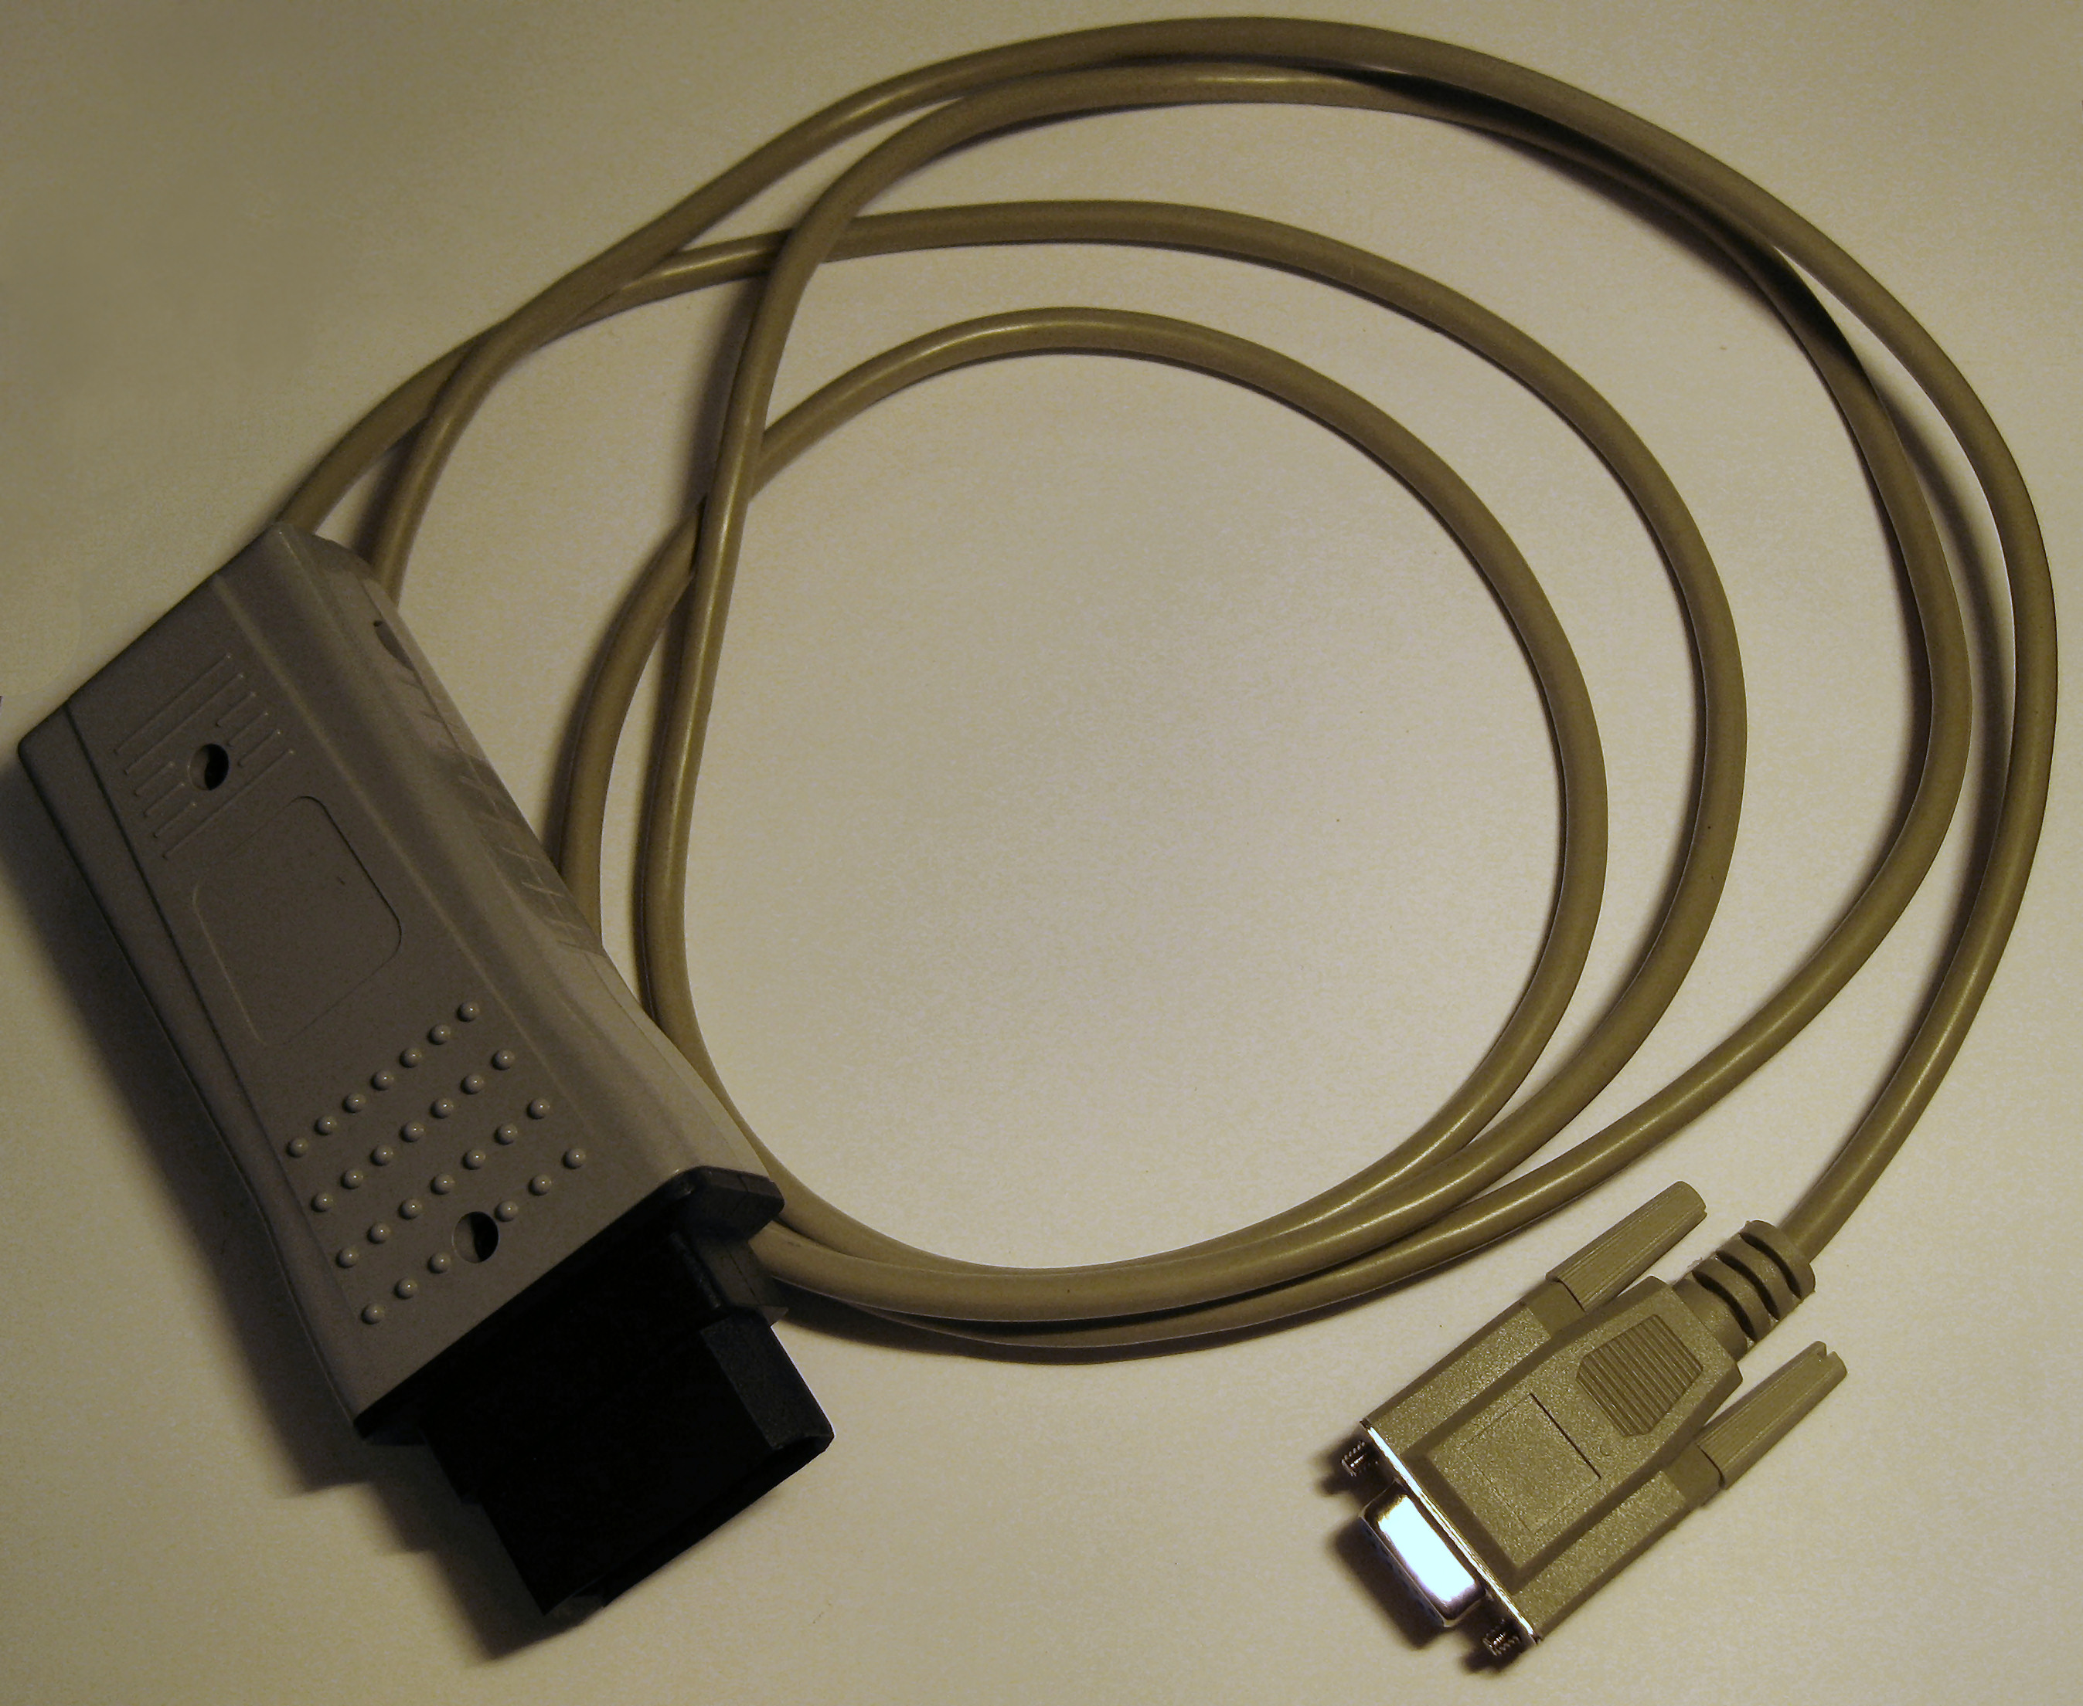
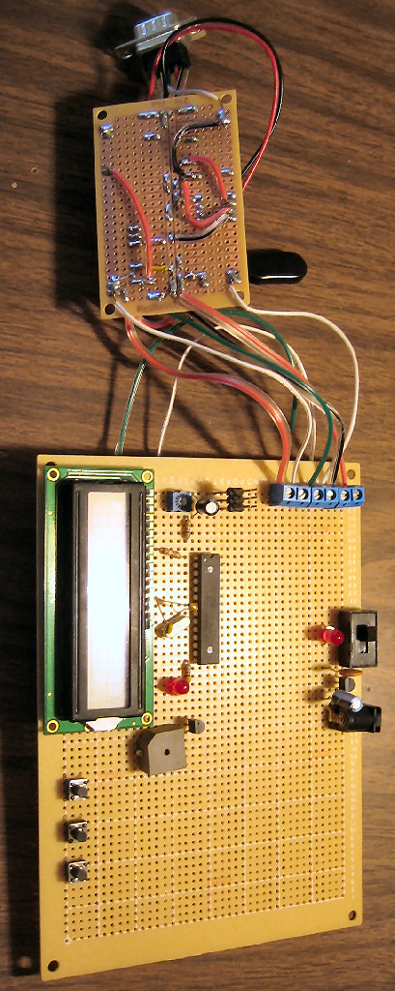
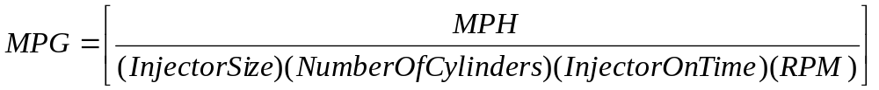
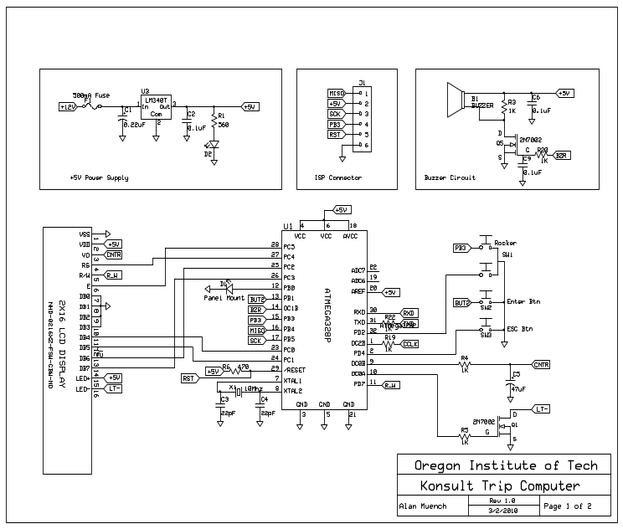
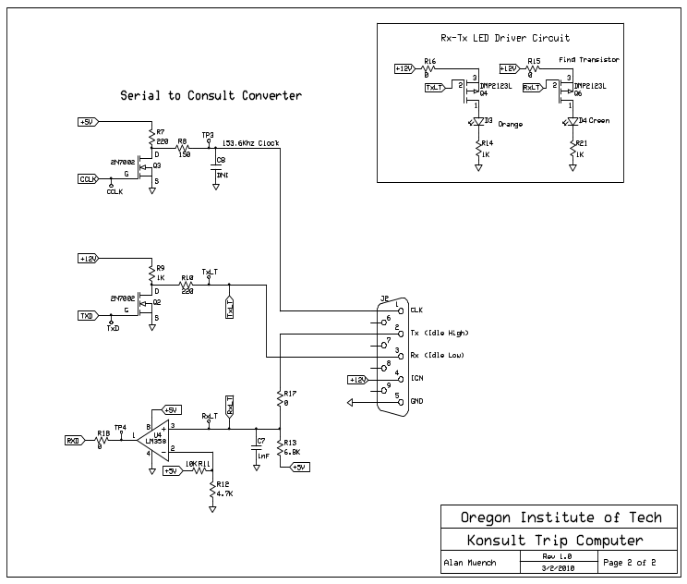
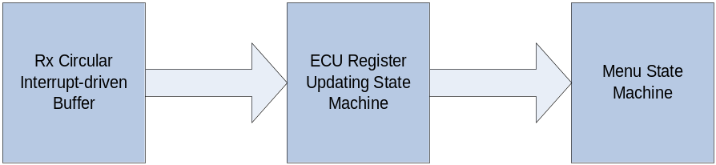
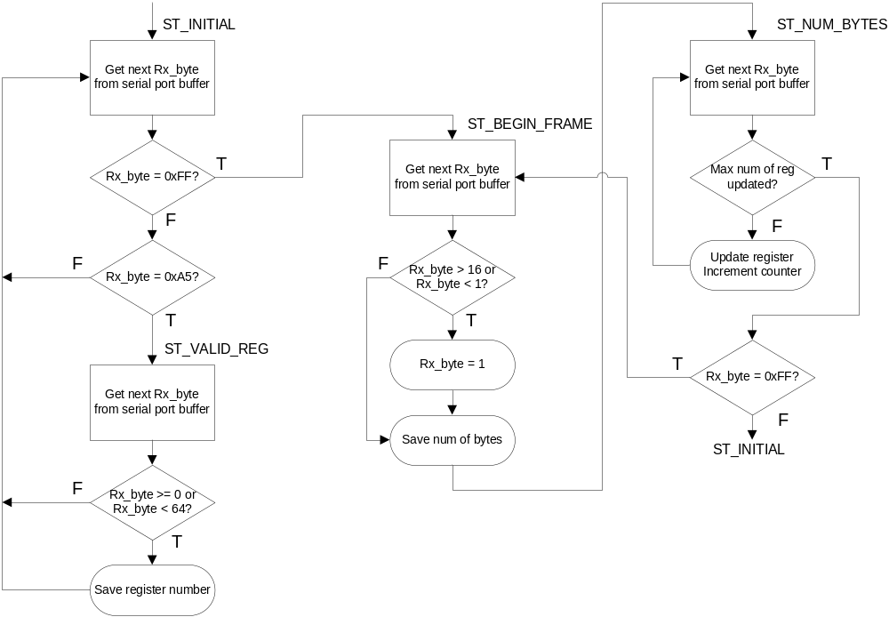
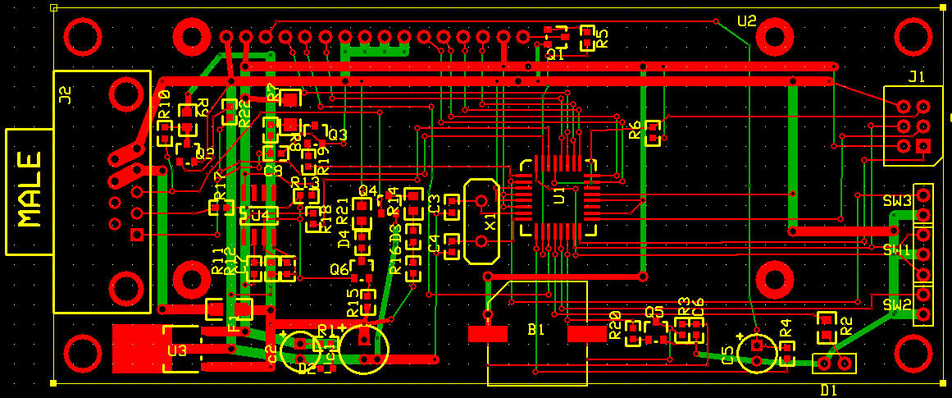
Light Control
An Android App for your Nanoleaf Light Panels
Student Project Symposium
June 2019
Software Engineering Technology
Lydia Doza
Introduction
Method
Results
Conclusions
Write your own text here. Remember to change out all headings, titles, and names for those in your own project
Fig. 1. clear photos with descriptive, yet brief captions
Fig. 6. This amount of information in one graphic is good
Fig. 10. Line up images in an order of progressions, assuming the viewer is going to read each column, top to bottom, starting at the left most column
Tips:
  Break out information into short bursts
  Such as a bulleted list
  Save paragraph text and full explanations for your report
  Use easy to read fonts.
    Comic Sans and handwriting are not easy to read!
  Hyperlinks don’t work in printed matter. Spell out the whole url or use bit.ly or tiny.url to abbreviate a long url
  Get graphics
    High resolution graphics
    Check your graphics by going to view and zoom to 100% to make sure they do not pixilate
    This includes an equations, autocad, visio, etc drawings.
Fig. 2. This amount of information in one graphic is ok
Fig. 11. Some groups have changed the background color, or even to a faded graphic for more visual effect
Fig. 3. High image resolution! Make sure your self taken images do not have glare. Try a simple light box for taking high quality images of smaller projects.
Fig. 7. This equation works
Additional Information/ Next steps
Some projects work well in different formats. This template is provided for your convenience. If you want to use a different style, follow these same general guidelines and keep your final product to the same dimensions. If you want design help ask your Advisor or come by the library to see Dawn.
Objectives
Fig. 8. This amount of information in one graphic is good, if it is enough detail to say what you need it to.
The main objectives a poster are:
  To provide a graphic representation of your project
  To provide quick to read/ skim information
  To give an overview of your project
  To attract attention to your project
Posters will be printed at 40x27in,
Cost to print in the library on your own is $9.00
Fig. 4. This image has far too much detail. Lines will get lost in scaling and printing will be fuzzy
Additional information on poster design can be found at:
Ten Simple Rules for a Good Poster Presentation
Better Posters; a resource for improving poster presentations
Creating Effective Poster Presentations | An Effective Poster
Acknowledgements
I would like to thank the following people:
  my project advisor
  The company or partners I worked with
  Any other constituents who were involved in the project and you want to acknowledge
Fig. 5. Bright colors may attract in a digital format, but do not translate to print well. Go with primary colors on light backgrounds
Fig. 9. This could be broken into 3 parts for better visibility and readability

