Slide 1

Human resources slide 1
LytCtrl
By Lydia Doza
Fall Term 2018 Final Presentation and Demo
Oregon Institute of Technology

Slide 2
Human resources slide 2
AGENDA
Introduction – What is LytCtrl?
Goals for proof of concept.
Accomplishments, issues, and solutions.
A look at Winter term 2019 for LytCtrl.
Proof of Concept Demonstration
Questions

Slide 3
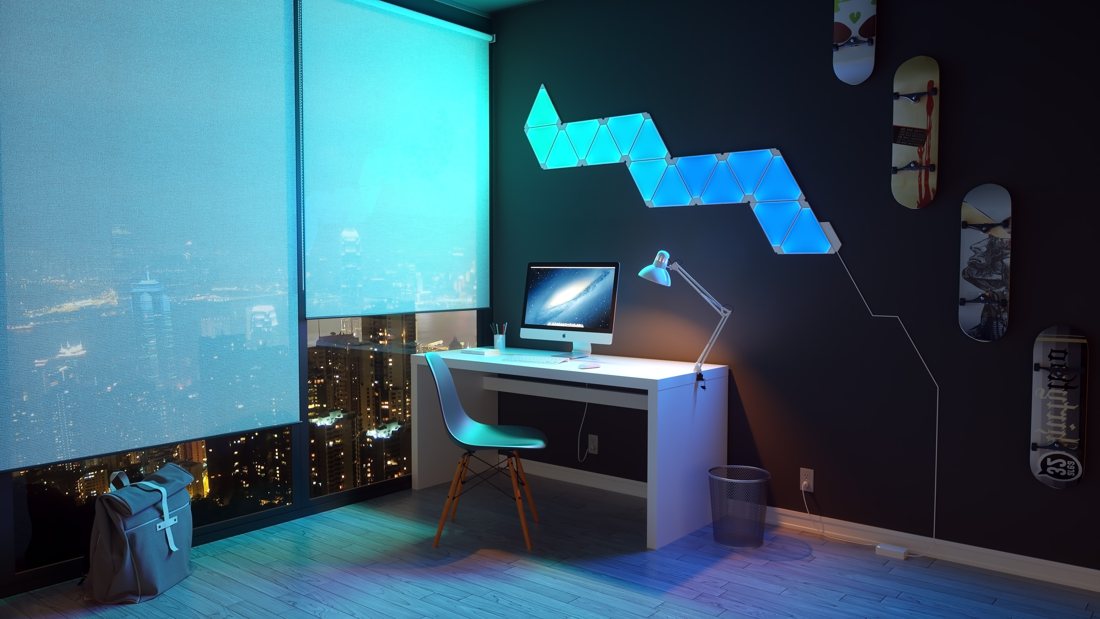



Intro to LytCtrl
The LytCtrl Android app gives the owner of Nanoleaf Light Panels control over their lights.
It uses the OpenAPI provided by Nanoleaf to communicate with the panels over WiFi.
Set schedules for the lights to act as alarms or to ensure they are off at night.

Slide 4





Human resources slide 4
Goals for Proof of Concept:
Figuring out how to put the pieces together
Manually use all API calls:
Create new Android project:
Use PostMan to try all API calls
Use the right tools from the beginning
Learn Android Fundamentals:
Show control with API from app:
Java and Android Framework
For now, hard-coded API call to turn lights on/off

Slide 5

Human resources slide 8
Scrum Stories Selected Why They Were Chosen
Preparing for the demo.
Click here for the list of the stories in the demo sprint
The idea behind choosing the stories was to present a proof of concept of my project:
Learn how to use of the Open API by NanoLeaf by controlling lights with Postman
Complete most hands-on learning about Android development on Udacity
Start making Android project with simple UI

Slide 6
Human resources slide 9
Accomplishments
Made list of all API calls in PostMan using hardcoded Auth tokens
Completed 7 and a half Lessons on Udacity
Create first Android Project
Learn how permissions work and how to connect to the internet
Using a RecylcerView to improve performance in the app
Passing data between different screens
The Lifecycle of an Android App
How to Store Preferences (and other storage types)
Using Content Providers (accessing shared storage from an app)
Android Architecture Components
Created project for demo which includes some UI objects
With a concrete list of what I wanted to demo, making progress towards checking of items on the list was easy

Slide 7
Human resources slide 9
Goals that weren’t completed
Ideally the LytCtrl app would be able to make an api call when the button was selected to toggle the lights on/off.
Originally wanted to have discovery as part of the demo: After learning more about the API and how discovery works, it could not be done.
Timed SSDP NOTIFY calls every 60 seconds
SSDP is a new protocol that requires more research
Unless on a home network, SSDP may be forbidden

Slide 8
Human resources slide 9
Issues and Methods to Resolve Them
Initially I thought the Nanoleaf SDK was required to be able to make calls to the light panels. One night I spent 4 hours trying to get it installed (required Cygwin on Windows and a bunch of dependencies/packages). The following day I was talking with coworkers and realized that is not usually how API calls work and found more documentation on the website.
Going through Udacity has had a few issues as well. One of the lessons is completely absent from the website but the example code is still in the repository. Had to teach myself SQLite.
Unable to make the buttons work on the app. Still working on resolving it.

Slide 9
Human resources slide 9
Planning Winter Term 2019
Stories to be carried over to next term
Finish Udacity course to understand good practices for Android Development
Get HTTP requests working from app to make API calls (turn on light, turn off light)
Stories to focus on
Finish designing UI
Create all of the screens to be seen on the app
Make the features work

Slide 10
Human resources slide 10
Q&A
LytCtrl Android App Fall 2018 Oregon Institute of technology

Slide 11
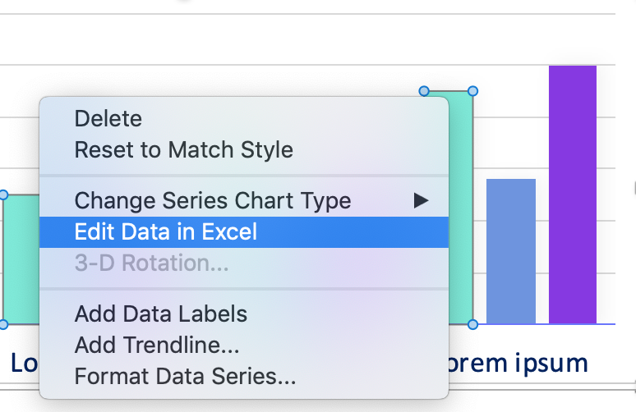
Human resources slide 11
Editing Data
If you would like to edit the data in the graph attached to this template, simply right-click on it and select Edit Data in Excel.

