Slide 1


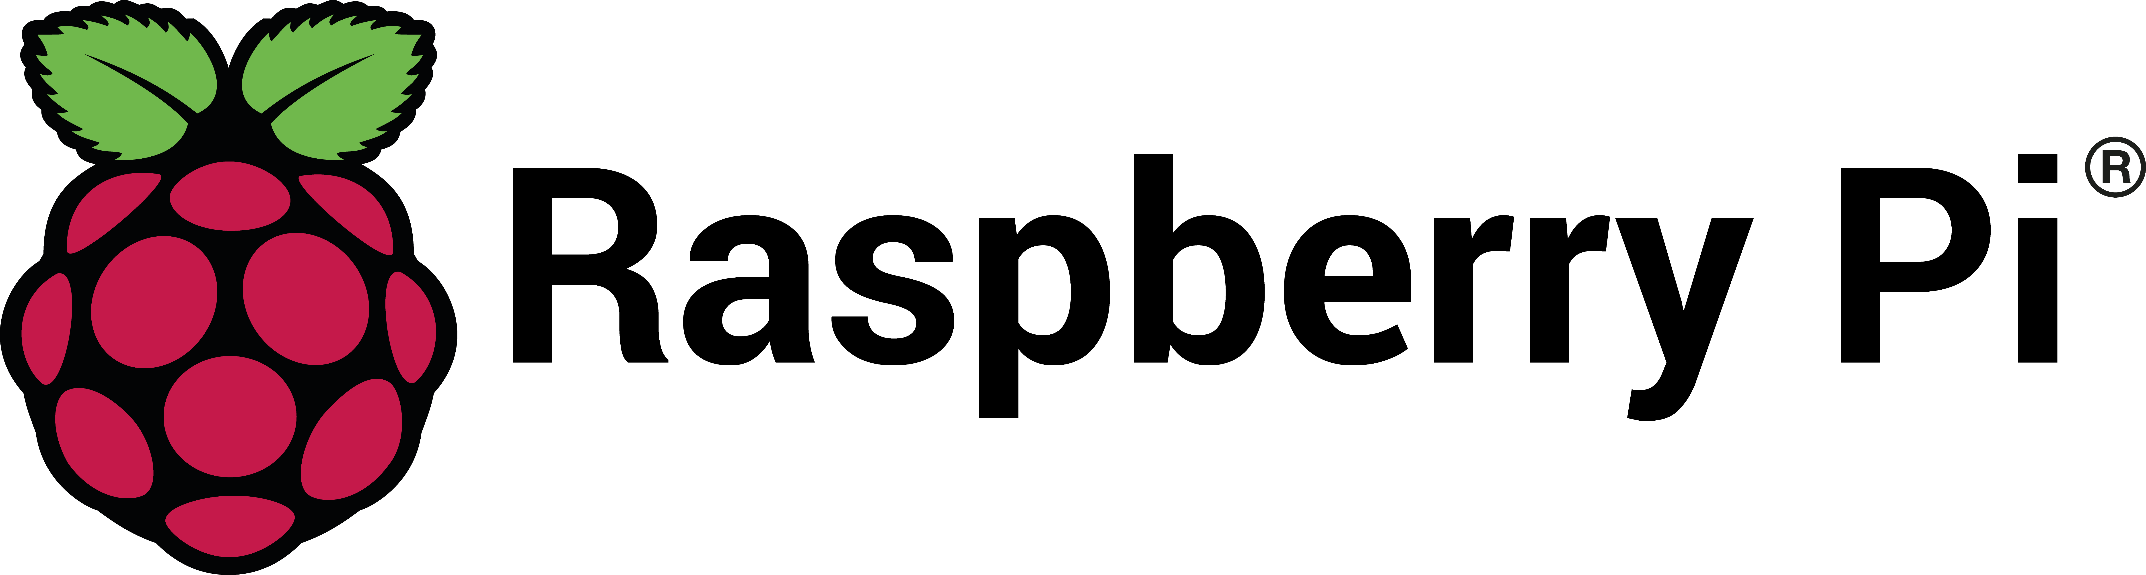
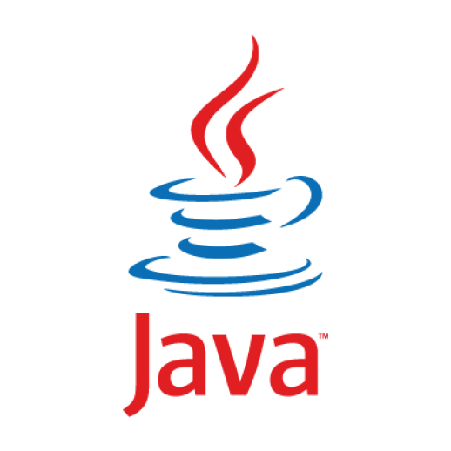


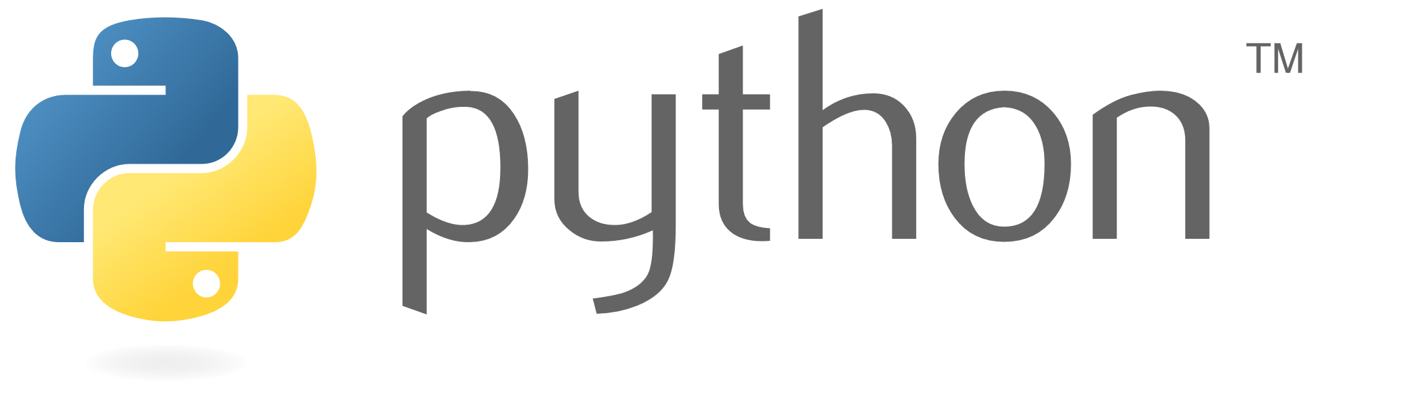


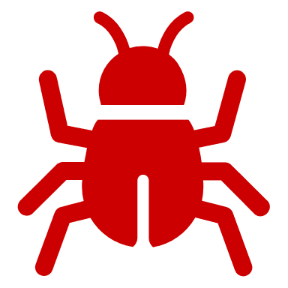







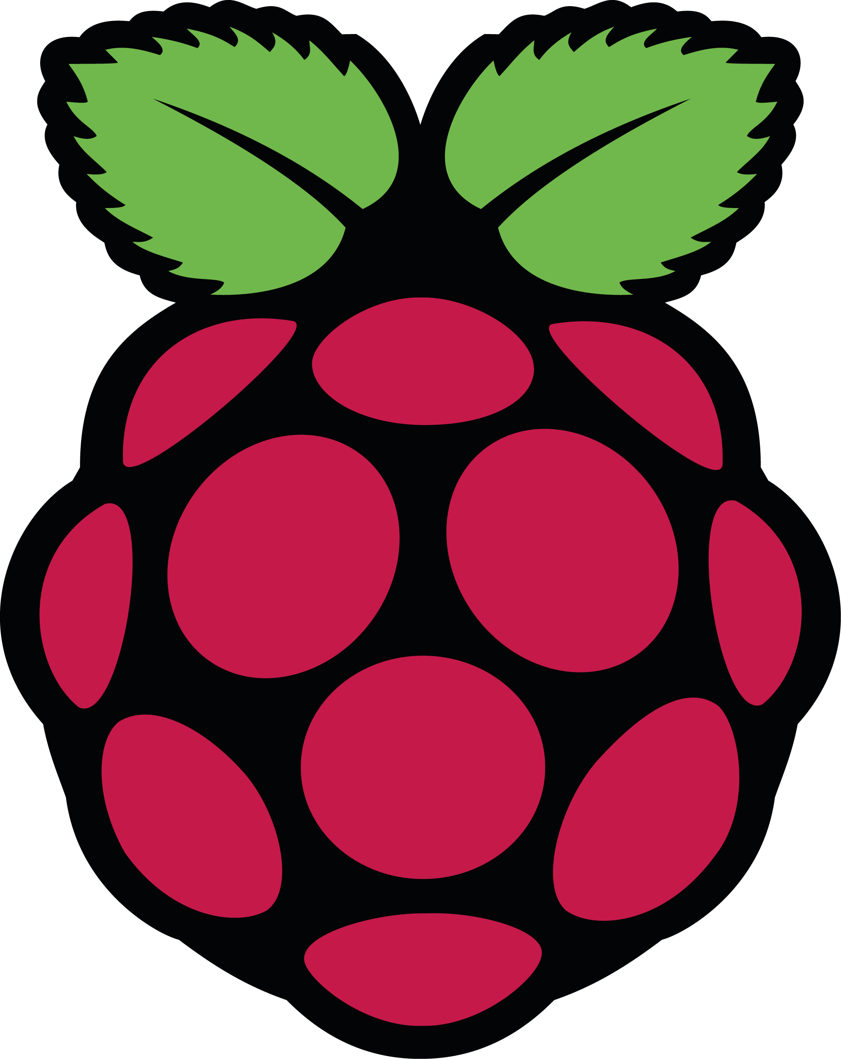
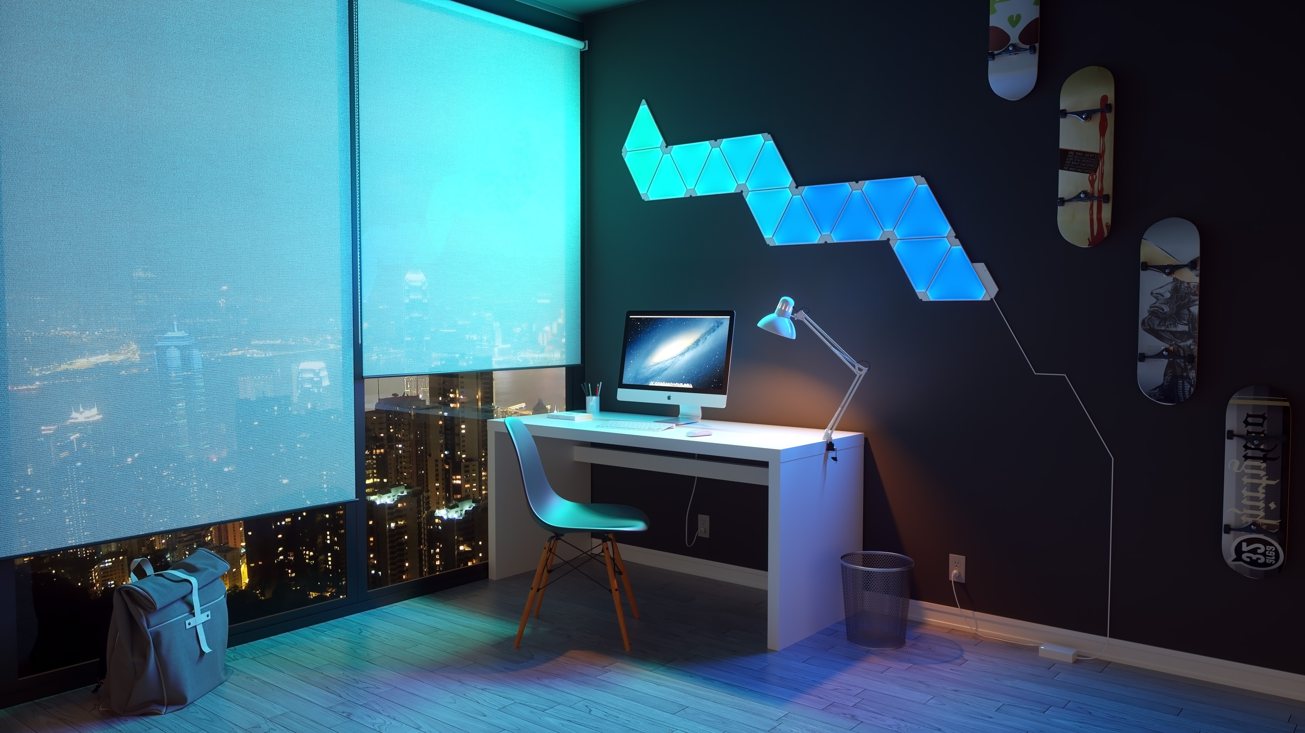


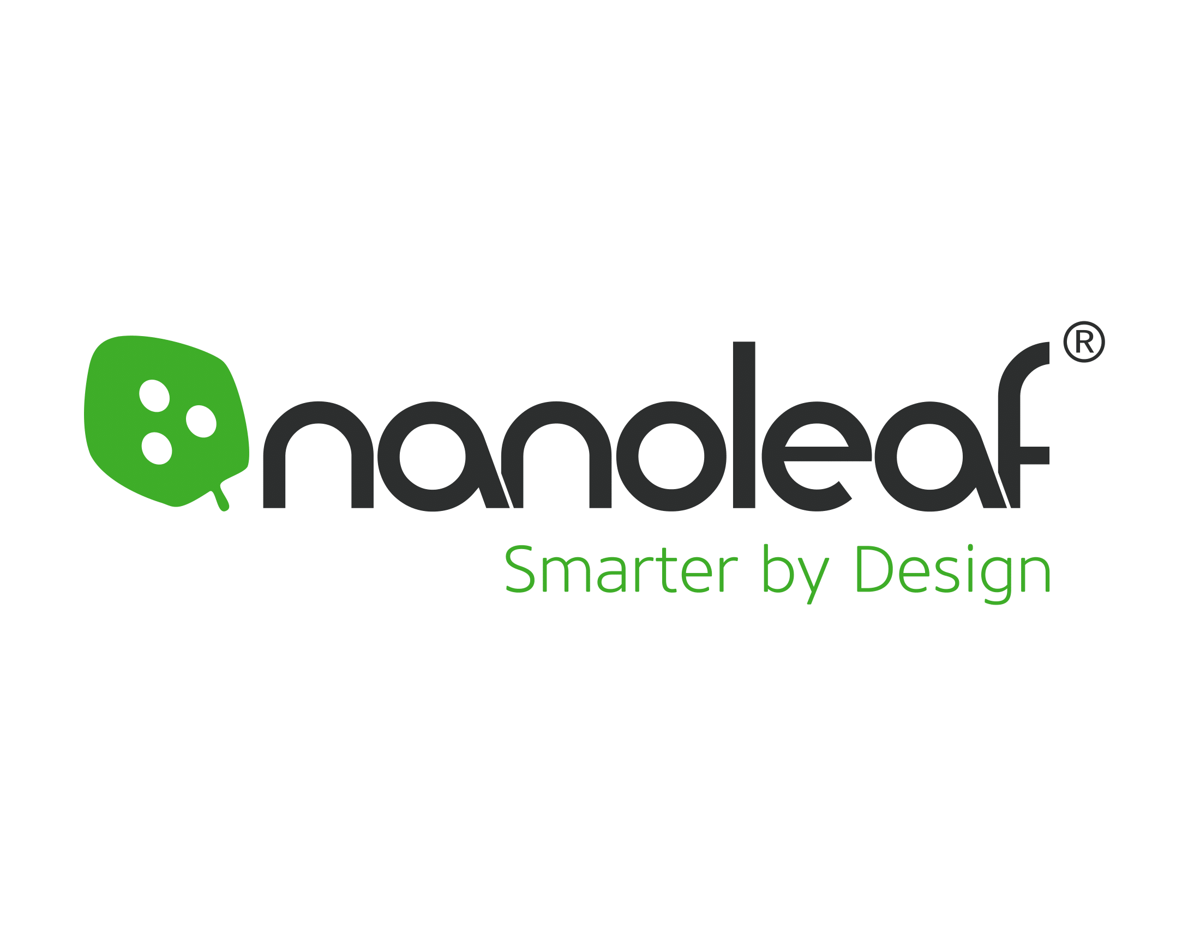
Light Control An Android App for your Nanoleaf Light Panels
Student Project Symposium
June 2019
Software Engineering Technology
Lydia Doza
Introduction
Method
Results
Conclusions
Light Control is an Android app that allows you to control your Nanoleaf smart lights from outside your home.
Light Control works with a Flask server hosted on a Rasperberry Pi 3B that has WiFi and Bluetooth.
Almost every piece of this project had technology that I had never used before, including:
Getting so many different types of technology to work together was a challenge.
The Light Control Android app can
Control the lights away from home
Turn the lights on and off.
Change the colors of the panels.
Schedule turning on/off the lights.
Let you control other users ability to control the lights.
Sometimes it is better not to install Android Studio updates while you’re in the middle of development.
When you can’t fix all the problems you find, it’s important to figure out which ones will help you get to your minimum viable product.
With Light Control Wondering whether you left the lights on at home is a thing of the past.
Light control enables you to check the power state of the Nanoleaf lights from your phone anywhere you have internet connection.
You can turn your lights off from the office.
You can create a schedule to automatically turn your lights on in the mornings.
Manage user profiles to allow others to control the lights when you want them to.
With this app, your lights are in your control.
The Flask server hosts a web service that allows the Android App to connect to your home WiFi.
First, you have to pair your phone to the Flask server for security.
Now the Flask server will recognize your phone running Light Control.
The Flask server takes the web requests from Light Control and sends them to the Nanoleaf Light Panel’s API over WiFi.
And most importantly, I learned how to find, prioritize, and fix bugs
Additional Information/ Next steps
This project may continue onward to be released on the Android market as an open source option to control Nanoleaf light panels.
Tools and parts used:
Nanoleaf – www.nanoleaf.me
Raspberry Pi – www.raspberrypi.org
Android development –
developer.android.com
Flask – flask.pocoo.org
Python – www.python.org
www.github.com/LydiaDoza
Objectives
What’s the point?
To control Nanoleaf Light Panels from anywhere.
To create schedules for the lights to act as alarms or to ensure they are off at night.
To help reduce power consumption by letting you turn your lights off from anywhere
Requests
Replies
Acknowledgements
I would like to thank the following people:
Sherry Yang, my project advisor
Gabriel McDermott, usability tester

