Slide 1

Human resources slide 1
LytCtrl
By Lydia Doza
Winter Term 2018 Final Presentation and Demo
Oregon Institute of Technology

Slide 2
Human resources slide 2
AGENDA
Introduction – What is LytCtrl?
Project Status.
A look at Spring term 2019 for LytCtrl.
Demonstration
Questions

Slide 3
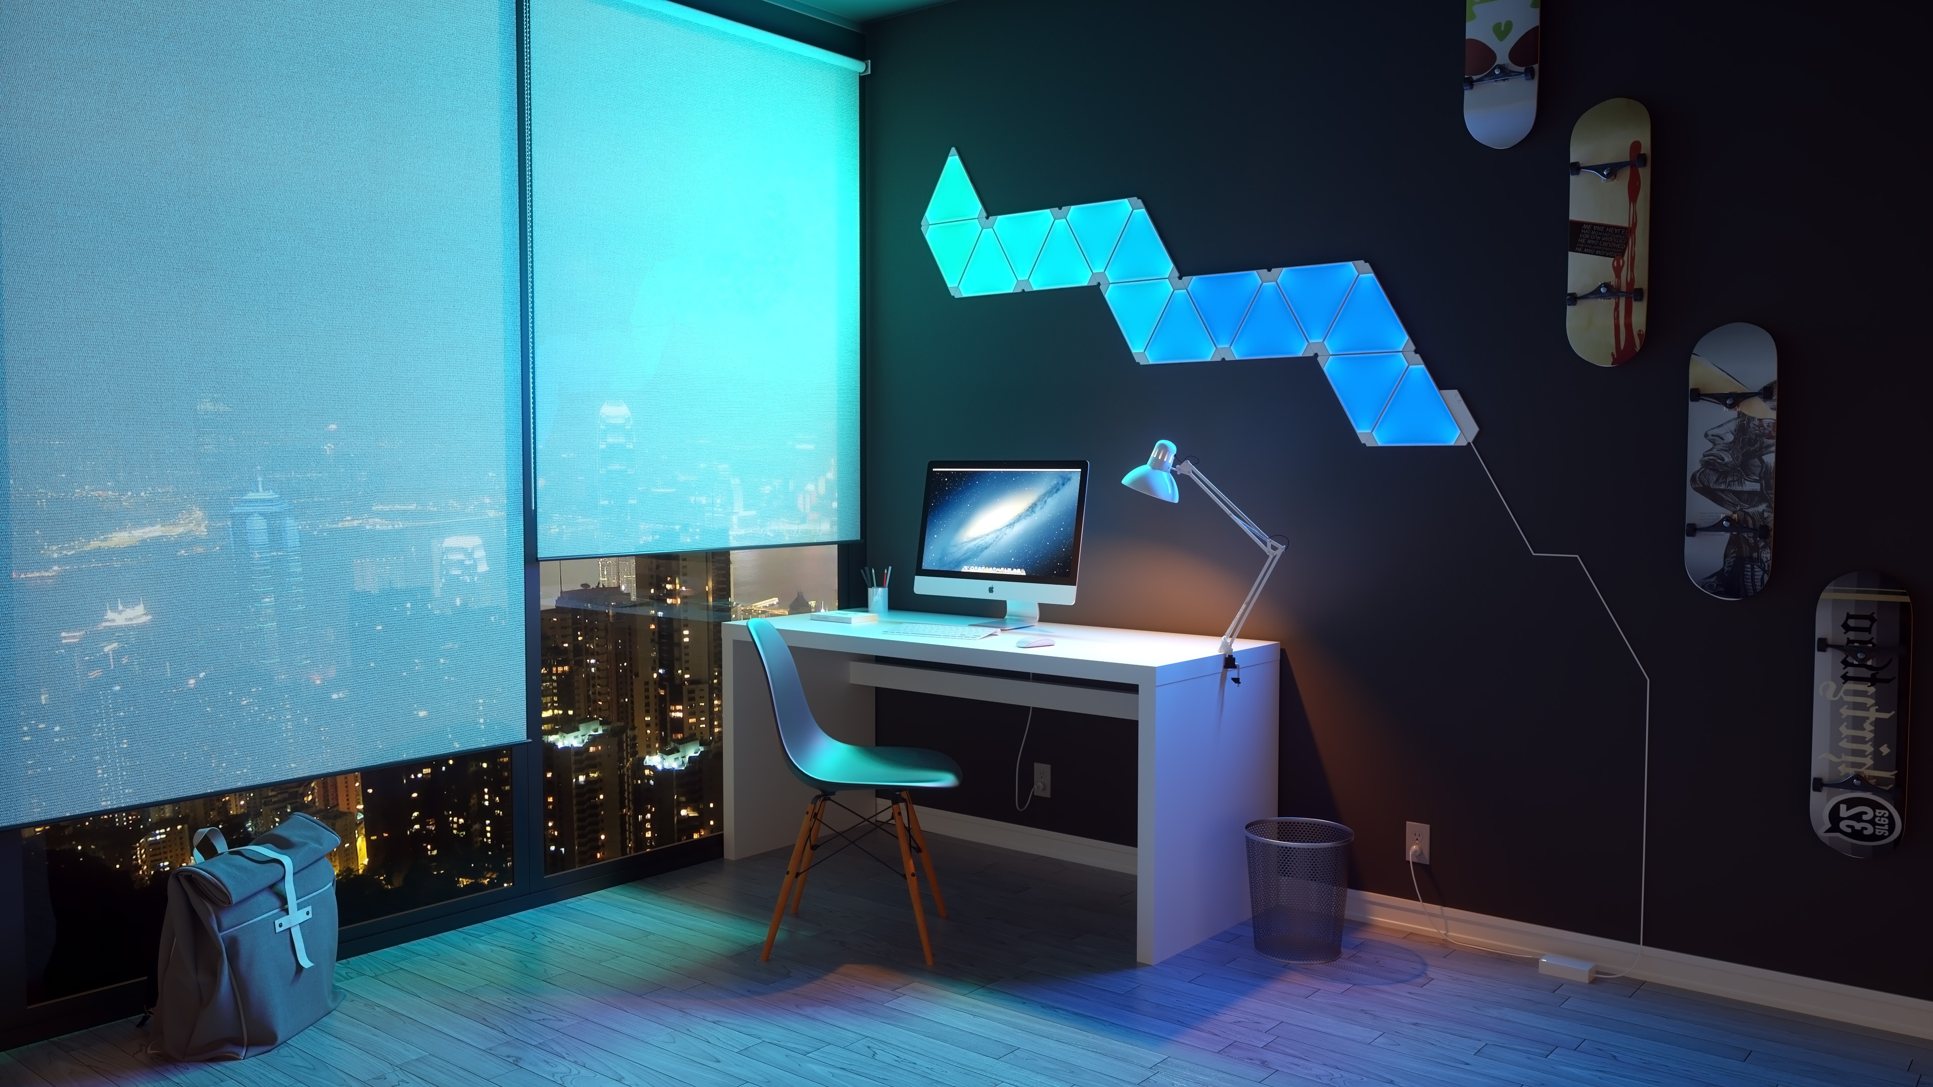



Intro to LytCtrl
The LytCtrl Android app gives the owner of Nanoleaf Light Panels control over their lights.
It uses the Open API provided by Nanoleaf to communicate with the panels over WiFi.
Set schedules for the lights to act as alarms or to ensure they are off at night.

Slide 4




Human resources slide 4
Project Status
Percentage of LytCtrl completed.
Buttons use all API calls:
Build project :
Completed
Use PostMan to try all API calls
Start with nothing, make something
40%
35%
Fragments:
Show control with API from app:
Make fragments to split functionality
For now, hard-coded API call to show power state
To do before Spring

Slide 5
Human resources slide 9
Accomplishments
Created project with navigation
Work on UI Design
Create Icons for different DPI screens
Use Fragments to separate functionality
Wire app to use Fragments and multiple activities
Create buttons that make API Requests

Slide 6
Human resources slide 9
Issues and Methods to Resolve Them
Splitting up functionality into fragments presented issues with member references.
Relating layouts to different fragments’ functionality is not straightforward.
Opening up networking from an app requires special permission
Sick for two weeks + 3 weeks travel
Resolution:
Make call from main activity to instantiated fragment
Include required Internet permission in manifest
Spring break is a great time to get caught up

Slide 7
Human resources slide 9
Planning Spring Term 2019
Stories to be carried over to next term
Many of them:
View available effects
Actual control of the lights
On/off
Select color effect
Server-side control for the lights
Pi with Ubuntu server
Pair with app on local wifi
Public API for app to communicate from outside network
Add scheduling for lights
On/off
Color effect

Slide 8
Human resources slide 10
Demo
LytCtrl Android App Winter 2018 Oregon Institute of technology

Slide 9
Human resources slide 10
Q&A
LytCtrl Android App Winter 2018 Oregon Institute of technology

