Slide 1
TBB Project Architecture

Slide 2
Class groups
Image Boards
Classes for all forms of content (catalogs, posts, threads, etc)
UI
Classes for converting Image Board classes into viewable UI and displaying them
Cachemanager
Class for managing cache and other saved settings
Client
Class for sending requests to other classes

Slide 3
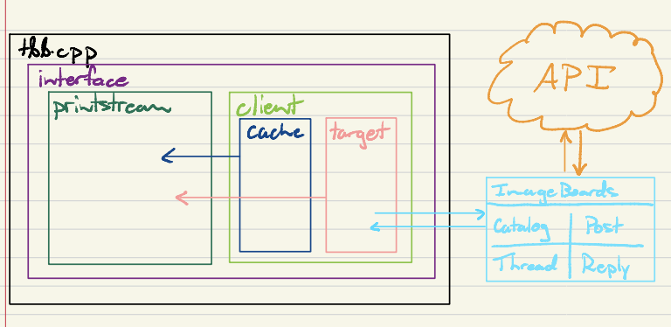
Design Hierarchy

Slide 4
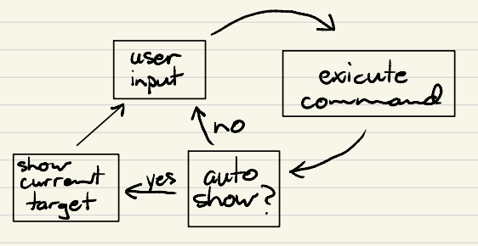
State
Once started, the continuously runs through a loop until quit, as demonstrated by the state machine on the right.

Slide 5
Requirements/Libraries
g++ version 4.8 or greater
curl
jsoncpp
readline

