Slide 1
Pokemon Stay
A Story Try:al and Error
Lydia Peabody
June 24, 2019

Slide 2
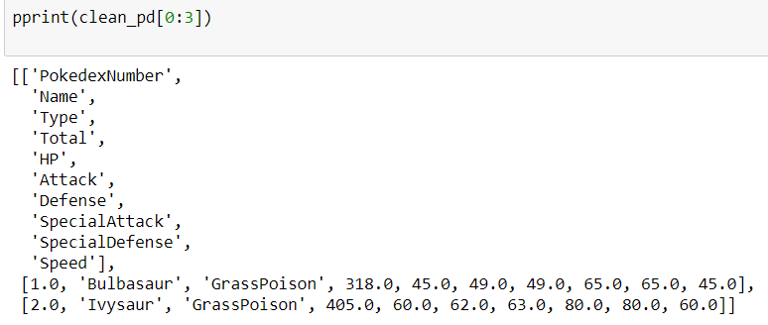
A Happy Moment :-)
Weird csv in …
list()
Try:
item = float(item)
Except:
pass
Magic list of lists out!
Notes:
8.1 Load the file and clean the data
Try; Except - basically my way of approaching the world; try/except is great - just give me what I want and ignore the rest
Sometimes it works well: when you just want to know whether or not something is a float, and ignore everything else, you're good
Import csv + csv.reader() instead of f.read()
Tried for hours to make it work without csv and without try/except because try/except won’t go in list comprehension, so clearly there’s another way that works, but no luck
Potential issue: hiding other errors
But I love the simplicity of it
Big picture: There’s no data science without data. Data quality is important, and cleaning data will be harder than you think. From what people who work in data science tells me, that really never changes. Obtaining the useful data and cleaning it well is often the hard part. Once you have good data, and understand your question, learning what your data has to say may be the easy part.

Slide 3
Python is not my First Language
Try: Writing thoughts straight into code
Except:
Lost in loops in loops in loops in loops
Notes:
Every time I’ve done something with programming, I’ve been told, don’t try to just start writing code. But I still do it.
Habits die hard.
Make sure you know what you're trying to get out to begin with. If you can't write what you want in pictures, your native language, diagrams, or talk it out, it's unlikely to magically appear in python
I start out thinking I know what I need to do more often than I actually know what I need to do

Slide 4



A simple task
Try:
Appending
a slice[2:3] of a list
to an [existing list]
Except:
It creates a
[[nested] list]
Notes:
I want this little piece of this list to go in that other list.
I can’t even figure out where I learned this, but it surprised me enough that I made a note of it.
Pretty sure I just went through each one separately or added them together, instead - keep it simple!
Combining the last two: I still lack an intuitive sense of what objects are and how they interact. I am usually creating loops of thing in something. But at this point I always need to do a print to remember what type of thing that creates (Bonus learning: put a break after the print to only get a sample, and not a pageful of text; In fact, print / break is basically my primary troublshooting technique - if I can see what's happening at that point, I can do something about it

Slide 5
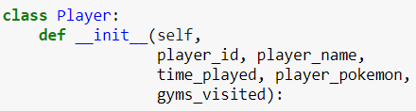
Fun with Complications
Try:
Classes
Except:
When nothing in your program uses their advantages
Notes:
I'm absolutely sure they're useful. And I'm pretty sure if you were really making a Pokemon Stay game, players would be a class.
But without building anything that players are doing, how they function, what options they have to become SuperPlayers, etc, it just makes life more complicated.
Sometimes doing the minimum that will work is the best way to go, unless you know you’re building for something bigger to come.

Slide 6

(Popcorn) Kernels
Try: Just running the cell you edit
?
Except:
Don’t be afraid to restart
Notes:
Try: Just running the cell you're working on. Except: as with most tech, when things start to look a little wonky for not obvious reason, try rebooting (aka restarting your kernel and running all cells). A modified list stays modified unless it gets reset, so remember that re-running earlier code is important when modifying lists.
Aside:
What's a kernel anyway?? It's a program that's reading and running your code. Jupyter says it's "introspecting" your code, but I failed to get a good sense of exactly what that means

