Slide 1
Leadership
Designing your Career

Slide 2
Great Leaders- What are their Characteristics in common?

Slide 3
Intelligence
Characterizing Features:
Hire very smart people to work for you
Reading other people (emotional IQ)

Slide 4
Vision
Characterizing Features:
  Knows where the world is going, can see around corners
  Able to adjust to changes

Slide 5
Communication
Characterizing Features
  Positive bias in communicating
  Listens as well as talks
  See problems as opportunities
  Motivate others by example

Slide 6
Confidence
Characterizing Features
  I can do it and you can do it
  If we execute, we’re going to win
  Overcome objections why it wouldn’t work
  Right decision: make a decision (many decisions are made too late)
  Sometimes you can make a better decision with less information

Slide 7
Competence
Characterizing features
  Can do what they say they are going to do
  Are leaders generalists? Zero odds that you are really good at everything.
  Know what you don’t know and know who is good in your areas of weakness.
  Not afraid to ask a “stupid” question.

Slide 8
Emotional Intelligence (beyond IQ)
Daniel Goleman (HBR November-December 1998)
Outstanding Performance driven by
  Technical skills (e.g. accounting, engineering, etc.)
  Cognitive skills ( analytic reasoning)
  Emotional Intelligence

Slide 9
What is Emotional Intelligence?
Self awareness
  Recognize your own emotions and their effect on others (self-confidence, realistic self-assessment)
Self Regulation
  Control disruptive impulses and moods (comfort with ambiguity, integrity)- doesn’t shoot from the hip
Motivation
  A passion to work that goes beyond money and status (optimism even in the face of failure)

Slide 10
Emotional Intelligence (cont.)
Empathy
  Understanding the emotional drives of others (expertise in building and retaining talent)
Social Skill
  ability to find common ground and build rapport (effectiveness in leading change)

Slide 11
Other considerations
What about Toughness?
  Do you need to be tough to be a Leader?
  How about ruthless?
How about optimism?
How about “energy level”
How about being an introvert (or extrovert)

Slide 12
Jack Welch- an example of leadership
Took over GE in 1980. Retired in 2000
Succeeded a person totally different from himself
Started to make immediate, drastic changes

Slide 13
Jack Welch
GE was not broken when Jack Welch took over
His Mantra:
  Be #1 or #2? Why?
  Three circles of businesses. Why?
  Fix, Sell or Close? Why?
Applications of this for start-ups?
Neutron Jack He eliminating 122,000 positions! Isn’t this the height of cruelty!

Slide 14
His Method of Leading
Candor- See the world the way it is rather than the way you want it to be
Simplicity – Needless complexity obscures the real issues
Self confidence – To be clear and concise about objectives. To hire people “smarter” than you are.To lead, not manage
Two-way communication- To relentlessly communicate the message but to gather unfiltered feedback
Evaluation and Reward – To make sure that people are judged on the basis of these criteria

Slide 15
His Method of Leading
Workout- Town meetings where anyone can question the chief.
“Best Practices”
Developing Leaders
Stretch Goals
Focus on Quality

Slide 16
GE Stock Price
https://www.macrotrends.net/stocks/charts/GE/general-electric/stock-price-history

Slide 17
Nature vs Nurture
Are Leaders made or born?

Slide 18
Nice exercise- what do I do about it?
Break-Out Session
How do you develop these characteristics- if you don’t have them all- or even if you do?
  Let’s begin by everybody rating themselves (1-5 on each, 5 high)
    Do a “360”i.e., ask people around you.
  What are your biggest challenges?
  What are you working on now that an improved behavior could favorably effect?

Slide 19
  Create improvement model
    Take from personal observations of leaders you admire, biographical readings, introspection
    Create some specific goals to move yourself in the right direction for some improvement area e.g.,
      Improve relationship with someone with whom problems now exist
      Achieve a leadership position within a group
      Create and execute an aggressive, candid, repetitious multifaceted communication plan
      Evaluate what turns you on in a job/school- peel the onion to improve motivation

Slide 20
  Create improvement model
    Get feedback from Coach (Could be a friend, mentor, spouse)
    Listen!
    Track progress
    Iterate
    Assess clearly

Slide 21
“Management of Yourself” or
Advice on an Industrial Career in a “Large” Company
Some thoughts on designing a career, beginning as a scientist or engineer, and rising to a position of responsibility as a Manager of Technology
Ken Pickar

Slide 22
Full Disclosure by
Professor Ken Pickar
Caltech’s Renowned Expert
You are welcome to step into my office for advice
But be warned. . .
This advice is of varying quality
?
Thanks, You’ve
ruined my life!
Well, that
was useless
Thank you! Thank you!
I will name my firstborn
after you!

Slide 23
    The Death of Lifetime Employment
    Odds are high you will not work for one company your whole life
    -This is not a bad thing!
    You do not owe the company job loyalty
    - Don’t stick with the company as it goes down
    - If there is a great offer from a competitor- take it
    The company does not owe you loyalty
    - They can get out of the business you are in and they can /no will lay you off
    You can change your job
    - You will change your job
    You can change your life
    - you have more talents to give than are required by any particular business
    - mistakes are recoverable

Slide 24
    The Death of Lifetime Employment
    In fact, you don’t have to be in one line of work your whole time

Slide 25
Central riveting thought
    It is up to you to be sure that you remain employable
    -in your company
    -in your career

Slide 26
Education- Formal and Continuing
For some companies, A PhD is useful
For other an MS or BS will be fine
In some companies a BS will suffice if you are very, very good
but if there are a lot of PhDs around you could be relegated to the
role of a “technician”
An MBA is not necessary but business knowledge is
If you go to Business School, preserve the Caltech brand!

Slide 27
If a company does not have a serious educational program you might want to reconsider joining them
  You need Continuous Skills development through OJT (on-the-job-training) and formal courses. For example:
    Technical Skills development
    Process management
    Quality (TQM, six sigma)
    Program management
    Product engineering
    Business- esp. marketing and financial
    Operations such as factory
    Communication- esp. presentations
    Reading of Engineering books both technical and managerial, journals, etc. Awareness of new technologies which could affect the business.
    General business. Awareness of what is going on in the market that could affect your business
    Networking with others in allied (or even competitive) positions

Slide 28
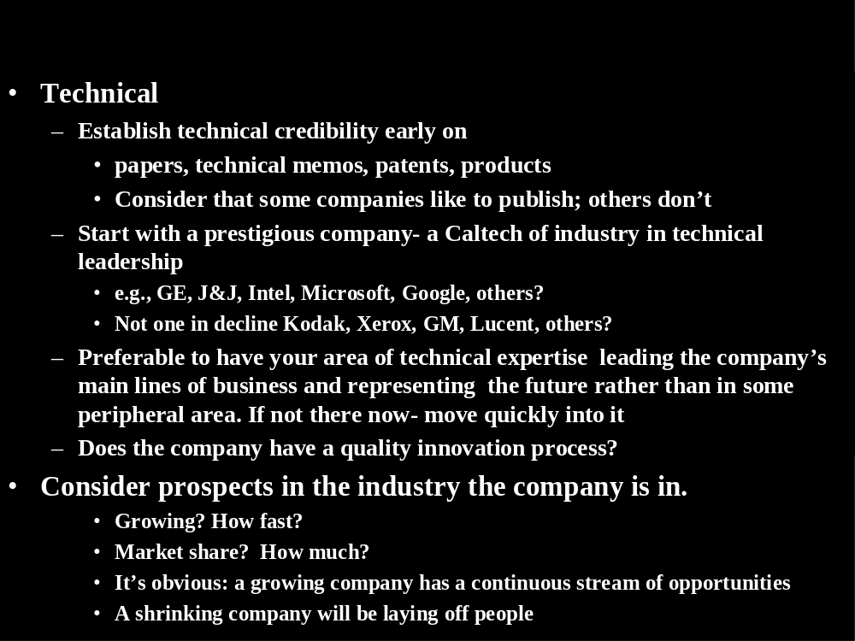

Slide 29
Team
  Engage in projects which require interactions amongst diverse disciplines
    Collaborations to show ability to work with others
    Learn from others
    Leverage your strengths
    Gets you out of the lab and away from your desk

Slide 30
Organizational and Career Path
  Move to project management or product marketing (and succeed!)
    Don’t take on the impossible
      Do risk assessment before jumping
      Know what you are getting into
      Look for programs that the company really cares about - high visibility
      Get on some corporate-wide process improvement team

Slide 31
      Select an appropriate boss
        Person on a success track not person whose career is stalled
        Person with a record of helping the careers of his/her employees
        Makes time to talk to you
        A coach, A leader- not a “manager” or a bureaucrat
        Be sure to insist on at least one serious career discussion each year. Two are better

Slide 32
Other characteristics
Integrity
  Are people treated with fairness?
  What is the relationship with the community?
  Do they pollute
  Do they lie?
  How would you have known at Facebook?
Communication
  Is the boss visible?
  Do you know how the company is doing on a periodic basis or is it “mushroom” management
  Do you know clearly what is expected of you?
  Do you have periodic meetings with your boss to assess your performance (at least 2X/year)
  Big company or small- advantages and disadvantages

Slide 33
Find mentor(s)
Someone you can confide in
Someone you admire
Someone who has your interests at heart
Someone who has “been around the block”
Someone not in HR!
Can be more than one- for different aspects or your life

Slide 34
Why Business Leadership for a Technical Person?

Slide 35


Slide 36
Simplified Career Tracks
Technical
Leadership
Track
Build
Technical
strengths
Build
Technical
strengths
Build
Technical,
Leadership
strengths
Management
of Technology
Track
Build
Technical
strengths
Program,
Process
or
business
Broad
technical
leadership
Business
Leadership
Track
Program Mgmt
or
Marketing
Small
P&L
Large
P&L
Multi
P&Ls

Slide 37
Consider Program Management
Develops various skills
  People assessment
  Communication
  Negotiation
  Financial
  Organizational
  Complexity
  Measurement

Slide 38
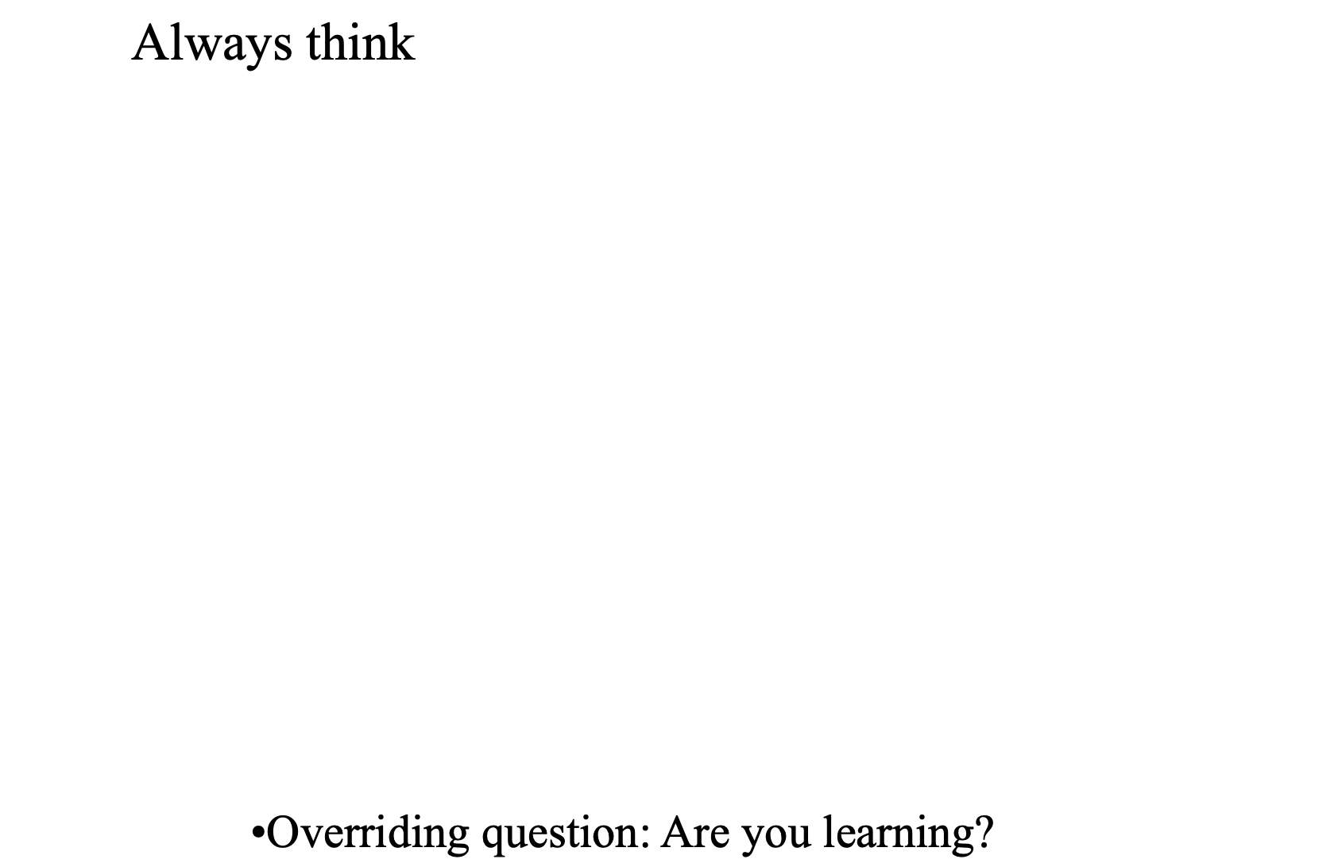

Slide 39
Compensation
Don’t get bludgeoned into making a quick decision after an offer is made
Stock options are back in value but companies may award less of them
No compensation is better than a stock option in a growing public company or one that goes IPO
  Even if the multiple falls, if the company is growing profitably at a rapid clip, you will be rewarded
  There is no downside
Company savings plans, equity portfolios are almost always better managed than those done personally by a busy executive
But diversify- remember companies that go bankrupt!

Slide 40
Compensation
When negotiating, don’t have to accept the first offer- but also don’t get involved in lengthy haggling
As soon as you have accepted the offer, your negotiating power for anything drops off precipitously
If you need some time, ask for it. Don’t be a victim of an HR “bum’s rush”. They took a long time to hire you and they expect an answer back from you in a week!

Slide 41
What about a start-up?
Optimum time is after a few years (~3-5) working for a good company. You will learn more about what the culture of a good company is.
If you wait 10 years plus, it is much harder
  Too comfortable
  Mind set reasons
  Possibly for family reasons
Best to be young
  Less obligations
  Less need for structure
  More time to recover if (as is probable) the company doesn’t work out.

Slide 42
What about a start-up?
Most important characteristics of a good company
  Validated market
  Protected technology
  Experienced CEO
Do you believe in the idea?!
Have you done your homework?!
Remember
  You will have no life! Worse than Caltech!

Slide 43
    Be prepared for setbacks-
    no successful manager I know
    hasn’t fallen on his face at least once

Slide 44
On any of these I am available to advise now or in the future
- but remember my opening caveat!

Slide 45
Questions?
Comments?

