Slide 1

The dbt Semantic Layer
One definition of every metric. Any tool. No more spreadsheet wars.
Presented by Lydia Chinaparaj

Slide 2



What Is a Semantic Layer?
A semantic layer is a business-friendly abstraction on top of your data models — standardizing metric definitions, dimensions, and relationships so every tool speaks the same language.
Data Models
Semantic Layer
Consumers
Raw tables and columns in
the warehouse
Entities, dimensions, and
metrics defined once
BI tools and analysts query
trusted metrics
Why It Exists
Popular Implementations
Translates technical tables into business concepts
Creates one shared definition for metrics like Revenue and Active Customers
Prevents each BI tool from reimplementing metric logic differently
dbt Semantic Layer (MetricFlow) — metrics as code in dbt YAML
LookML (Looker) — governed metrics inside Looker
Cube — headless semantic layer for metrics APIs
AtScale — enterprise layer on cloud data platforms

Slide 3



Why Teams Need a Semantic Layer?
Without shared definitions, metric logic scatters across dashboards, SQL scripts, and notebooks — producing conflicting answers and eroding data trust.
Revenue Mismatch
Active Customer Mismatch
AOV Mismatch
Finance excludes canceled orders. Marketing includes them. Both call it "Revenue."
Product uses a 30-day window. Sales uses 90 days. Same KPI, different answers.
One dashboard uses gross sales, another uses discounted totals. Leadership sees two numbers.

Slide 4










What Is the dbt Semantic Layer?
The dbt Semantic Layer is dbt's metrics governance layer, powered by MetricFlow. Teams define business metrics once in YAML and query them consistently across every tool — no duplicated SQL, no metric drift.
BI Tools
Notebooks
Models
Catalogs
Observability
Core Components
dbt Semantic Layer
(MetricFlow)
Semantic models — map dbt models to entities & dimensions
Metrics — reusable KPI definitions (simple, ratio, derived, cumulative, conversion)
Raw Data
Cloud Data Platform
Saved queries — reusable metric + dimension patterns for consistent reporting
Time spine — enables complete time series and period comparisons
Consumers query one governed layer instead of the warehouse directly.
Metric logic lives in dbt — versioned, code-reviewed, and propagated from one source of truth.

Slide 5

Core Concepts
Every piece of the dbt Semantic Layer maps to a distinct role — from raw model grain to queryable business KPI.
Semantic Model
Entity & Dimension
Business-facing metadata layer on top of a dbt model. Defines entities and dimensions at a known grain. Example: orders model on ref('orders').
Entities are identifiers for joins (e.g. order_id, customer_id). Dimensions slice and filter results — categorical or time-based.
Simple Metric
Saved Query
Aggregatable KPI defined with type: simple using sum, count, or count_distinct. Example: total_revenue with agg: sum.
Reusable query definition for common metric + dimension outputs. Standardizes recurring reporting views. Example: daily revenue by country.

Slide 6



Integrations
One metric definition powers many tools simultaneously — eliminating dashboard-specific SQL and duplicate logic.
Native integrations
Power BI, Tableau, Google Sheets, Excel, and more
Programmatic access
GraphQL, JDBC, ADBC, and Python APIs
Saved queries & exports
For repeated workloads and non-native tools
Adoption tip: Start with high-impact KPIs in one or two tools, then expand coverage incrementally.

Slide 7

Tradeoffs & Limitations
The Semantic Layer is powerful — but it comes with real costs and constraints worth planning for.
Operational Tradeoffs
dbt-Specific Constraints
Foundation Required
Full Semantic Layer APIs require dbt Cloud Starter/Enterprise plans
dbt Core users get MetricFlow locally — not hosted APIs or native integrations
Some tools need exports or custom API usage; not all are natively supported
Supported platforms: Snowflake, BigQuery, Databricks, Redshift, Postgres, Trino
Needs clean marts, consistent grain, and reliable tests before it pays off
Governance Overhead
Metric ownership, review process, and change management add real work
Warehouse Cost
Dynamic query generation can increase compute for broad exploratory slicing
Semantic Layer improves consistency and reuse — but it is not the right fit for every analytics workflow.

Slide 8
When to Use It vs. Something Else
Choose the right tool for the job — the Semantic Layer excels at governed, reusable KPIs shared across teams, but lighter-weight alternatives win for simpler, contained use cases.
Scenario | Recommended Approach
Same KPI used across multiple teams or tools | Use Semantic Layer
Frequent KPI definition drift and low data trust | Use Semantic Layer
Need governed self-service with reusable dimensions | Use Semantic Layer
One team, one dashboard, very stable requirements | Direct SQL or model in BI tool
Fixed recurring report with no slicing needs | Precomputed mart, export, or materialized view
Highly custom one-off analysis or experimentation | Ad hoc SQL or notebook logic
Strict low-latency serving requirements | Pre-aggregated tables + cache (optionally with Semantic Layer)

Slide 9
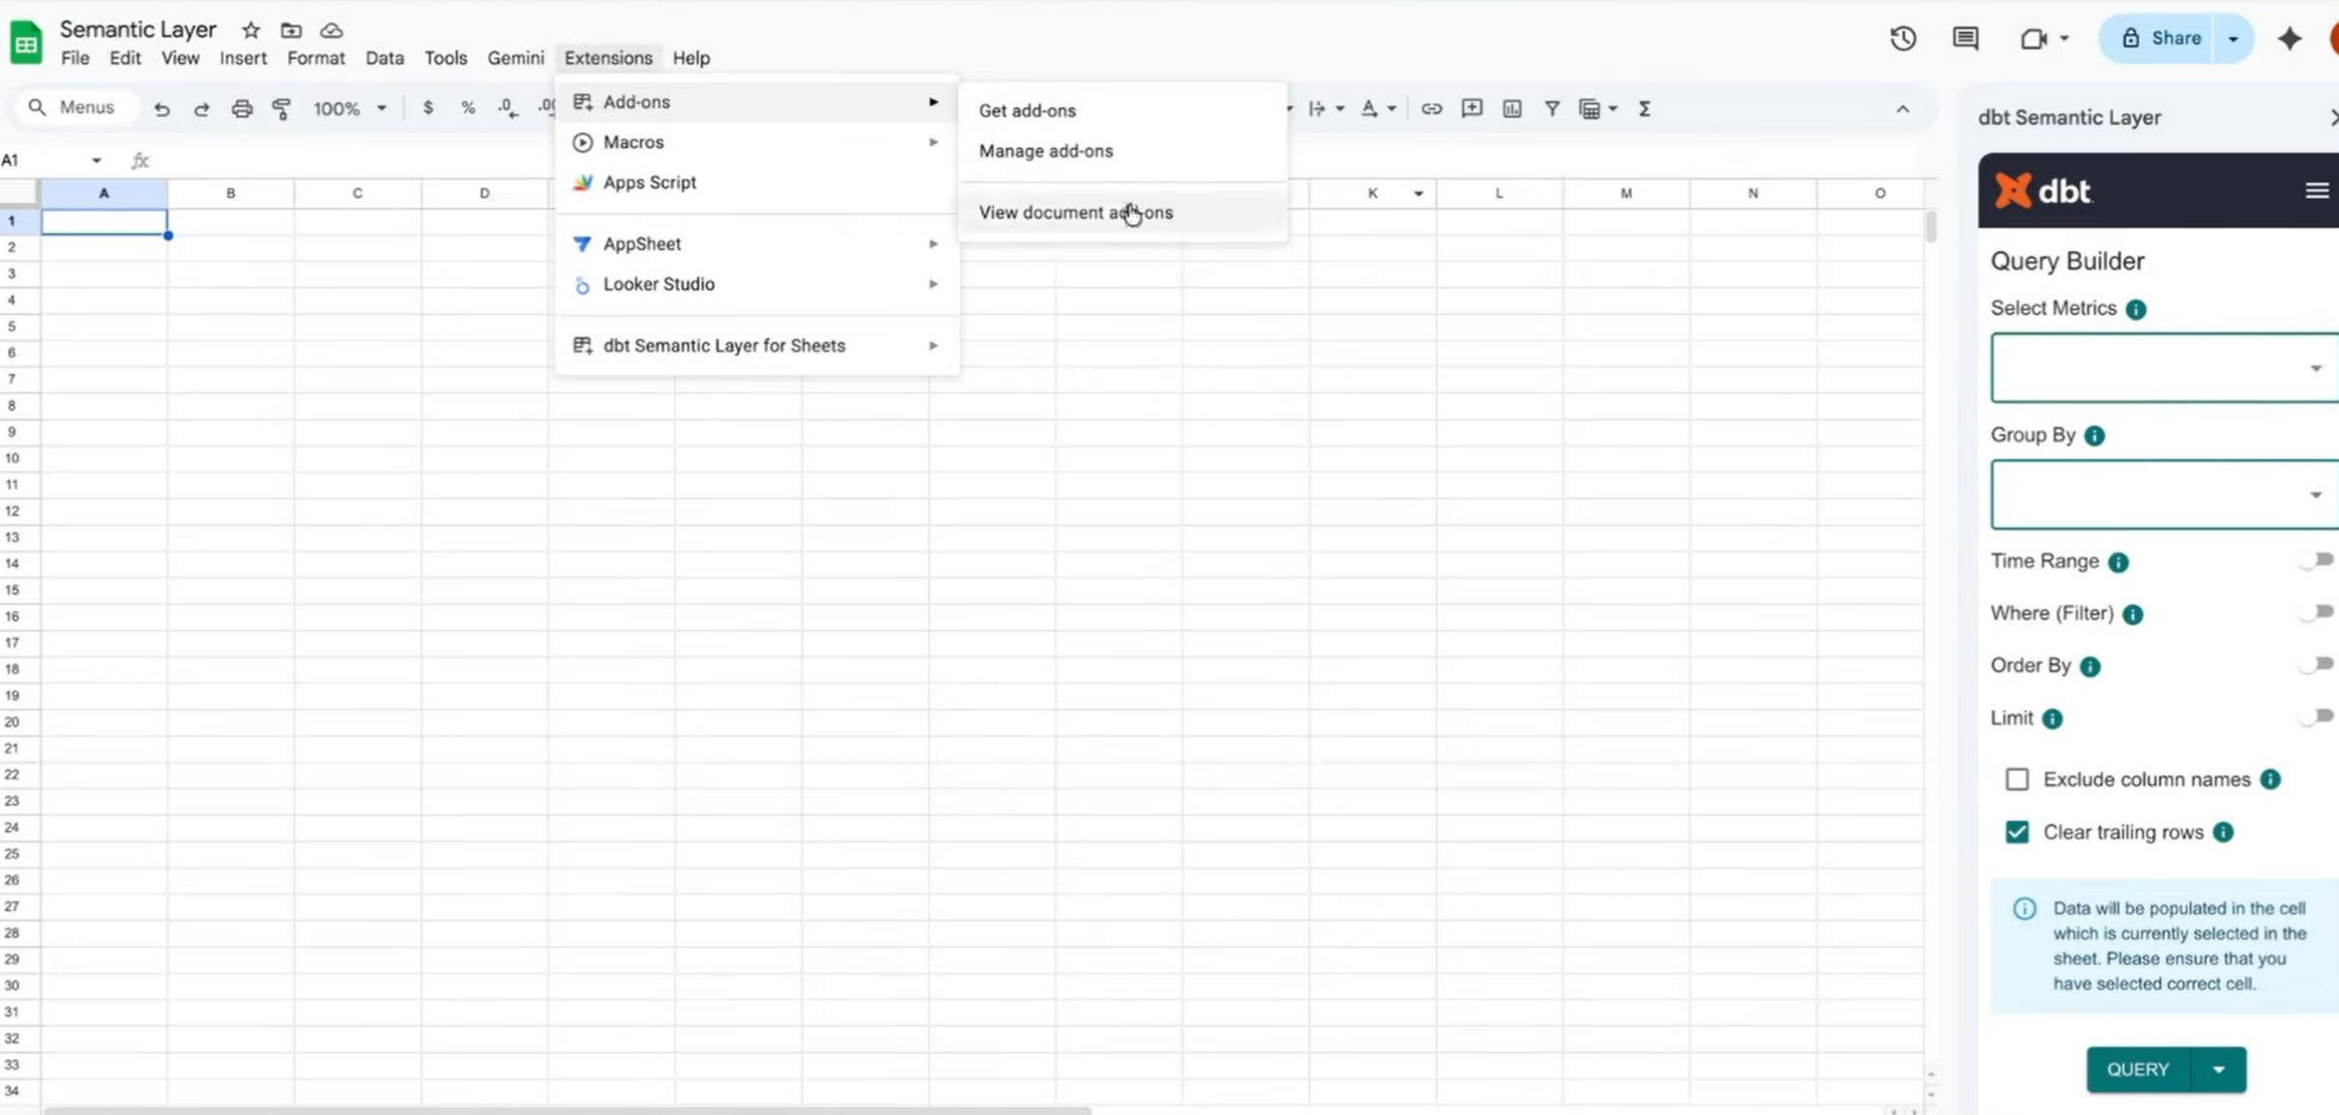
Available Anywhere Analysts Already Work
The dbt Semantic Layer add-on installs directly into Google Sheets, meeting teams in their existing workflow.

Slide 10
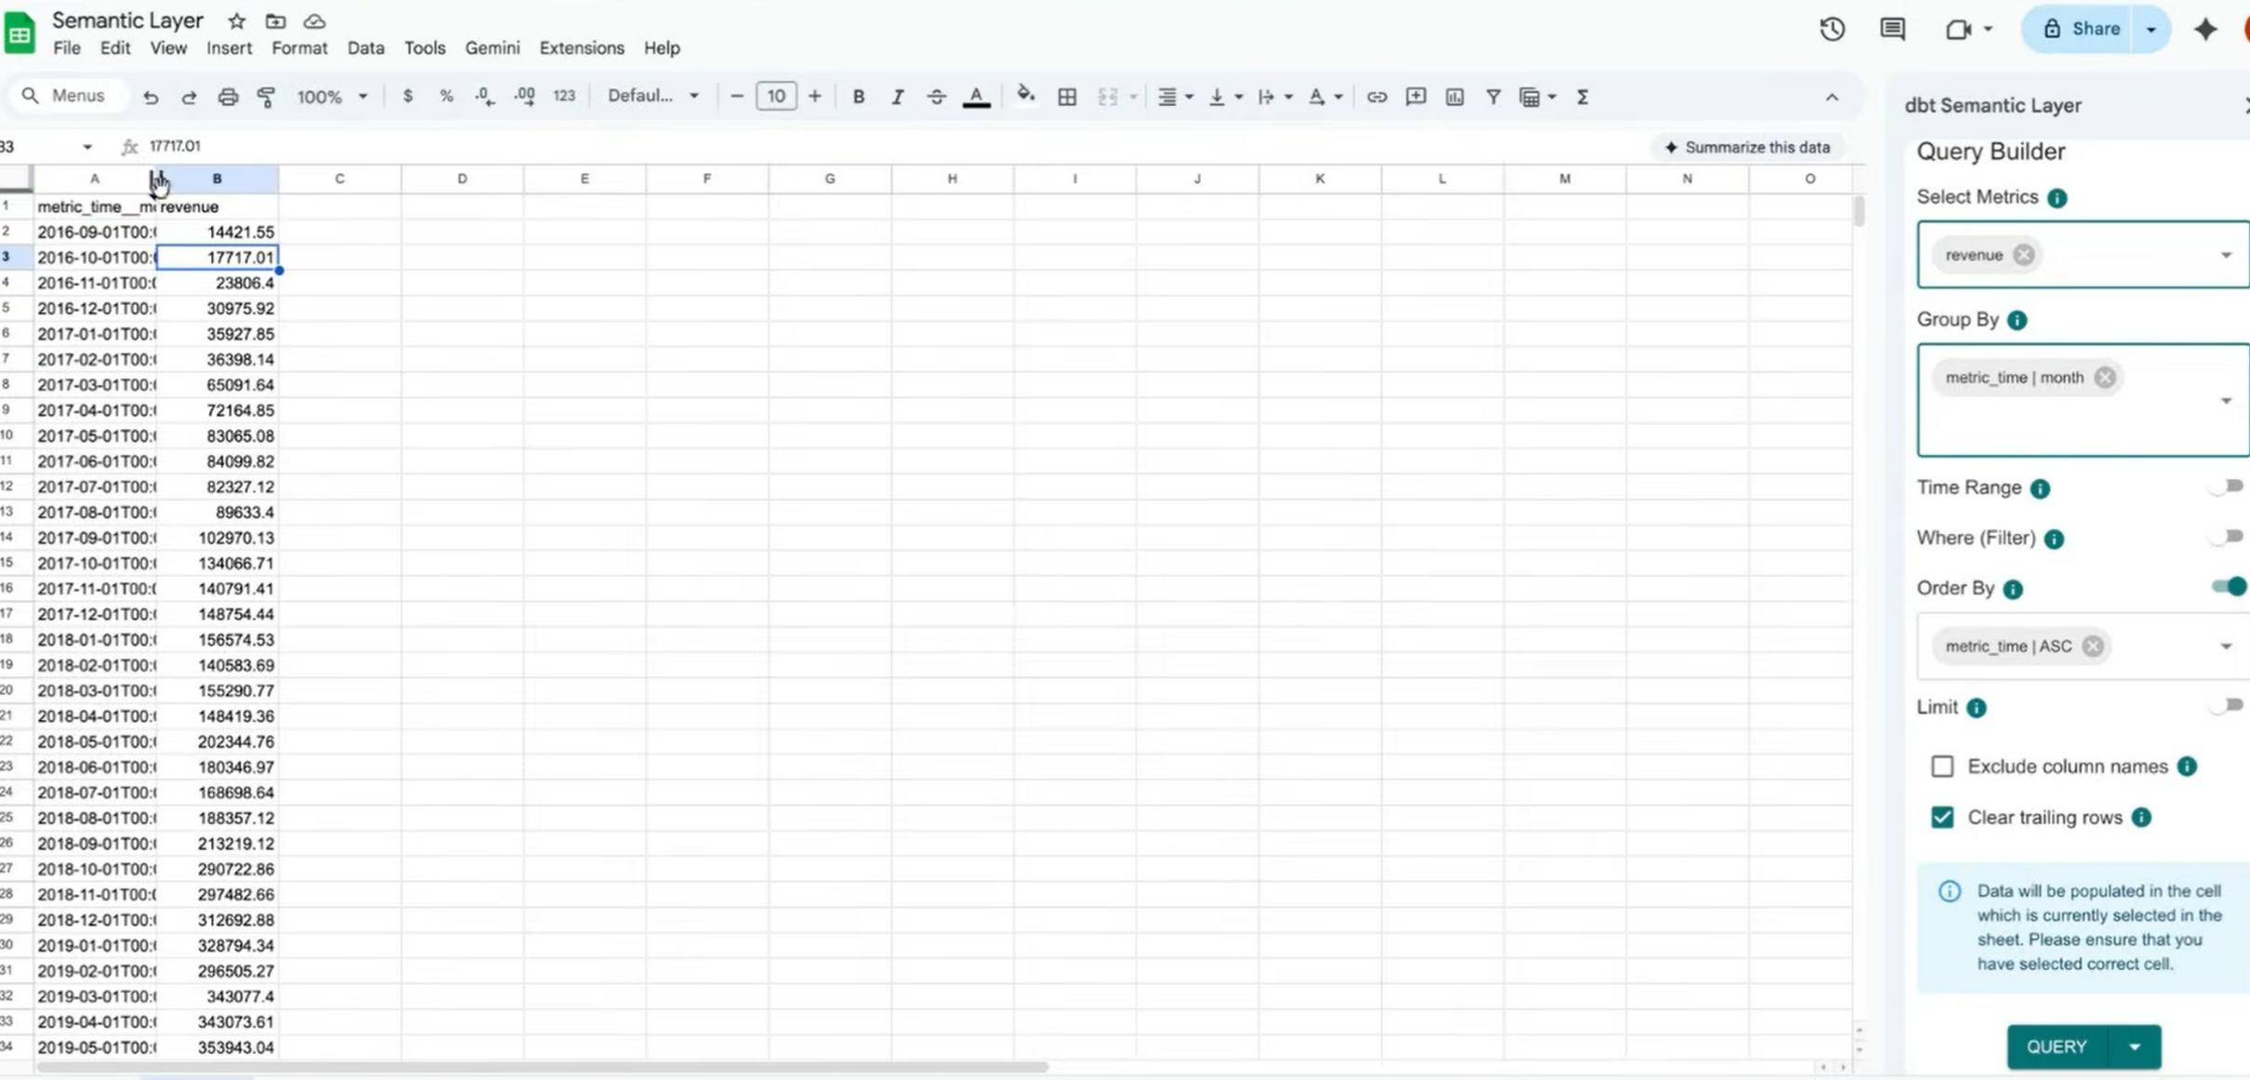
See It In Action: Query Builder in Sheets
Analysts pull governed metrics like revenue directly into Google Sheets — no manual SQL, no duplicated logic.

